Slide 1
AI
Reinforcement Learning
Jay Urbain

Slide 2
Reinforcement Learning
How an agent learns through training without a teacher (unsupervised) in unknown environment.
Reinforcement learning algorithms have been widely used for many applications such as robotics, multi agent system, game, and etc.
Reinforcement learning algorithms: Q-learning, temporal difference learning.

Slide 3
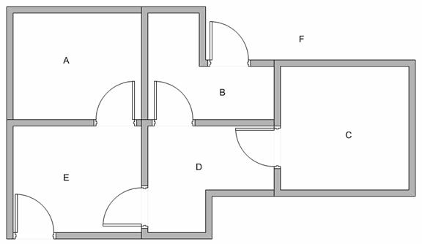
Modeling the environment
Given a building with 5 rooms (A-E), and 2 doors leading to outside F.

Slide 4
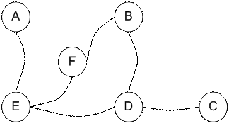
Modeling the environment
We can represent the building as a graph.

Slide 5
Modeling the environment
If we put an agent in any room, we want the agent to “learn” how to go outside of the building, i.e., go to node F, the target room.
To set this kind of goal, we introduce a reward value to each door which is represented as an edge of the graph.
The doors that lead immediately to the goal have an instant reward of 100.
Other doors that do not have direct connection to the target room have zero reward.
Because the doors are two way, we assign two arrows.
Each arrow contains an instant reward value.

Slide 6
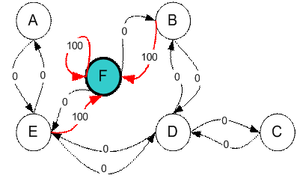
Modeling the environment
Add additional loop with highest reward (100) to goal room (F back to F) so the agent stays.

Slide 7
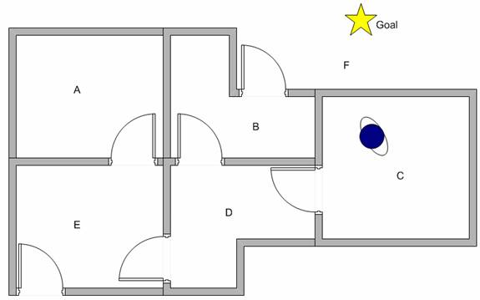
Agent, State and Action Introduction
Agent has no initial knowledge of the environment., i.e., it does not know which sequence of doors to pass through to get outside of the building (F).
Start in Room C, want the agent to learn to reach outside the house (F).
Need to have agent learn through experience, i.e., trial and error.

Slide 8
An NP-Complete Problem:
Hamiltonian Cycles
An example of an NP-Complete problem:
  A hamiltonian cycle of an undirected graph is a simple cycle that contains every vertex
  The hamiltonian-cycle problem: given a graph G, does it have a hamiltonian cycle?
    Draw on board: dodecahedron, odd bipartite graph
  Describe a naïve algorithm for solving the hamiltonian-cycle problem. Running time?

Slide 9
P and NP
As mentioned, P is set of problems that can be solved in polynomial time
NP (nondeterministic polynomial time) is the set of problems that can be solved in polynomial time by a nondeterministic computer
  What the hell is that?

Slide 10
Nondeterminism
Think of a non-deterministic computer as a computer that magically “guesses” a solution, then has to verify that it is correct
  If a solution exists, computer always guesses it
  One way to imagine it: a parallel computer that can freely spawn an infinite number of processes
    Have one processor work on each possible solution
    All processors attempt to verify that their solution works
    If a processor finds it has a working solution
  So: NP = problems verifiable in polynomial time

Slide 11
P and NP
Summary so far:
  P = problems that can be solved in polynomial time
  NP = problems for which a solution can be verified in polynomial time
  Unknown whether P = NP (most suspect not)
Hamiltonian-cycle problem is in NP:
  Cannot solve in polynomial time
  Easy to verify solution in polynomial time (How?)

Slide 12
NP-Complete Problems
We will see that NP-Complete problems are the “hardest” problems in NP:
  If any one NP-Complete problem can be solved in polynomial time…
  …then every NP-Complete problem can be solved in polynomial time…
  …and in fact every problem in NP can be solved in polynomial time (which would show P = NP)
  Thus: solve hamiltonian-cycle in O(n¹⁰⁰) time, you’ve proved that P = NP. Retire rich & famous.

Slide 13
Reduction
The crux of NP-Completeness is reducibility
  Informally, a problem P can be reduced to another problem Q if any instance of P can be “easily rephrased” as an instance of Q, the solution to which provides a solution to the instance of P
    What do you think“easily” means?
    This rephrasing is called transformation
  Intuitively: If P reduces to Q, P is “no harder to solve” than Q

Slide 14
Reducibility
An example:
  P: Given a set of Booleans, is at least one TRUE?
  Q: Given a set of integers, is their sum positive?
  Transformation: (x₁, x₂, …, x_{n}) = (y₁, y₂, …, y_{n}) where y_{i} = 1 if x_{i} = TRUE, y_{i} = 0 if x_{i} = FALSE
Another example:
  Solving linear equations is reducible to solving quadratic equations

Slide 15
Using Reductions
If P is polynomial-time reducible to Q, we denote this P ≤_{p} Q
Definition of NP-Hard and NP-Complete:
  If all problems R ∈ NP are reducible to P, then P is NP-Hard
  We say P is NP-Complete if P is NP-Hard
  and P ∈ NP
If P ≤_{p} Q and P is NP-Complete, Q is also
NP- Complete

Slide 16
NP-Complete Problems
Given one NP-Complete problem, we can prove many interesting problems NP-Complete
  Graph coloring (= register allocation)
  Hamiltonian cycle
  Hamiltonian path
  Knapsack problem
  Traveling salesman
  Job scheduling with penalties
  Many, many more

Slide 17
Terminology
What is the difference between a problem and an instance of that problem?
We can express instances of problems as strings
  How can we express a instance of the hamiltonian cycle problem as a string?
To simplify things, we will worry only about decision problems with a yes/no answer
  Many problems are optimization problems, but we can often re-cast those as decision problems

Slide 18
Why Prove NP-Completeness?
Though nobody has proven that P != NP, if you prove a problem NP-Complete, most people accept that it is probably intractable
Therefore it can be important to prove that a problem is NP-Complete
  Don’t need to come up with an efficient algorithm
  Can instead work on approximation algorithms

Slide 19
Proving NP-Completeness
What steps do we have to take to prove a problem P is NP-Complete?
  Pick a known NP-Complete problem Q
  Reduce Q to P
    Describe a transformation that maps instances of Q to instances of P, such that “yes” for P = “yes” for Q
    Prove the transformation works
    Prove it runs in polynomial time
  Attempt to prove P ∈ NP. How?

Slide 20
Undirected Hamiltonian Cycle ⇒
Directed Hamiltonian Cycle
Reduce the undirected hamiltonian cycle problem to the directed hamiltonian cycle problem
  Which variant am I proving NP-Complete?
Draw a undirected example on the board
  What transformation do I need to effect?

Slide 21
Undirected Hamiltonian Cycle ⇒
Directed Hamiltonian Cycle
Given an undirected graph G = (V, E)
Transform G into G’ = (V, E’) where E’ contains an edge <u’, v’> and an edge <v’, u’> for each edge <u, v> in G. That is, for every undirected edge in G, make two directed edges in G’ so that you can reach v from u and u from v, just as in G.
This transformation will take 2*|E| operations where |E| is the number of edges (which ranges between n-1 and (n-1)² so is Q(n²).
Now, for any graph G, if there is a Hamiltonian cycle, then our solution for the directed graph Hamiltonian cycle will find a Hamiltonian cycle in G’ and output yes, and if there is no Hamiltonian cycle for G, then our solution for the directed Hamiltonian cycle will output no because both graphs share the same edges between all nodes.

Slide 22
Hamiltonian Cycle ⇒ TSP
The well-known traveling salesman problem:
  Optimization variant: a salesman must travel to n cities, visiting each city exactly once and finishing where he begins. How to minimize travel time?
  Model as complete graph with cost c(i,j) to go from city i to city j
How would we turn this into a decision problem?
  A: ask if ∃ a TSP with cost < k

Slide 23
Hamiltonian Cycle ⇒ TSP
The steps to prove TSP is NP-Complete:
  Prove that TSP ∈ NP (Argue this)
  Reduce the undirected hamiltonian cycle problem to the TSP
    So if we had a TSP-solver, we could use it to solve the hamilitonian cycle problem in polynomial time
    How can we transform an instance of the hamiltonian cycle problem to an instance of the TSP?
    Can we do this in polynomial time?

Slide 24
Hamiltonian Cycle ⇒ TSP
Given an undirected graph G = (V, E)
Transform G into a network N = (V, E’) where E’ has edge weights for every edge, and let k = n (the number of nodes in G and N).
In this case, all edge weights will be set to 1. This transformation takes |E| + 1 operations (1 operation per edge to assign an edge weight of 1, and 1 instruction to set k = n).
Now, ask the question “is there a solution to the traveling salesman problem on N with k = n?

Slide 25
Hamiltonian Cycle ⇒ TSP
That is, can we find a path through the n nodes in N that touches every vertex in V and returns to the starting vertex such that the total cost of this cycle is n?
If the answer is yes, then this cycle, by definition, is a Hamiltonian cycle.
If the answer is no, then there is no cycle that can reach every node and return using only n edges, and so no Hamiltonian cycle exists.

Slide 26
The TSP
Random asides:
  TSPs (and variants) have enormous practical importance
    E.g., for shipping and freighting companies
    Lots of research into good approximation algorithms
  Recently made famous as a DNA computing problem

Slide 27
The SAT Problem
One of the first problems to be proved NP-Complete was satisfiability (SAT):
  Given a Boolean expression on n variables, can we assign values such that the expression is TRUE?
  Ex: ((x₁ →x₂) ∨ ¬((¬x₁ ↔ x₃) ∨ x₄)) ∧¬x₂
  Cook’s Theorem: The satisfiability problem is NP-Complete

Slide 28
Conjunctive Normal Form
Even if the form of the Boolean expression is simplified, the problem may be NP-Complete
  Literal: an occurrence of a Boolean or its negation
  A Boolean formula is in conjunctive normal form, or CNF, if it is an AND of clauses, each of which is an OR of literals
    Ex: (x₁ ∨ ¬x₂) ∧ (¬x₁ ∨ x₃ ∨ x₄) ∧ (¬x₅)
  3-CNF: each clause has exactly 3 distinct literals
    Ex: (x₁ ∨ ¬x₂ ∨ ¬x₃) ∧ (¬x₁ ∨ x₃ ∨ x₄) ∧ (¬x₅ ∨ x₃ ∨ x₄)
    Notice: true if at least one literal in each clause is true

Slide 29
The 3-CNF Problem
Thm 36.10: Satisfiability of Boolean formulas in 3-CNF form (the 3-CNF Problem) is NP-Complete
  Proof: Nope
The reason we care about the 3-CNF problem is that it is relatively easy to reduce to others
  Thus by proving 3-CNF NP-Complete we can prove many seemingly unrelated problems NP-Complete

Slide 30
3-CNF → Clique
What is a clique of a graph G?
A: a subset of vertices fully connected to each other, i.e. a complete subgraph of G
The clique problem: how large is the maximum-size clique in a graph?
Can we turn this into a decision problem?
A: Yes, we call this the k-clique problem
Is the k-clique problem within NP?

Slide 31
3-CNF → Clique
What should the reduction do?
A: Transform a 3-CNF formula to a graph, for which a k-clique will exist (for some k) iff the 3-CNF formula is satisfiable

Slide 32
3-CNF → Clique
The reduction:
  Let B = C₁ ∧ C₂ ∧ … ∧ C_{k} be a 3-CNF formula with k clauses, each of which has 3 distinct literals
  For each clause put a triple of vertices in the graph, one for each literal
  Put an edge between two vertices if they are in different triples and their literals are consistent, meaning not each other’s negation
  Run an example:
  B = (x ∨ ¬y ∨ ¬z) ∧ (¬x ∨ y ∨ z ) ∧ (x ∨ y ∨ z )

Slide 33
3-CNF → Clique
Prove the reduction works:
  If B has a satisfying assignment, then each clause has at least one literal (vertex) that evaluates to 1
  Picking one such “true” literal from each clause gives a set V’ of k vertices. V’ is a clique (Why?)
  If G has a clique V’ of size k, it must contain one vertex in each triple (clause) (Why?)
  We can assign 1 to each literal corresponding with a vertex in V’, without fear of contradiction

Slide 34
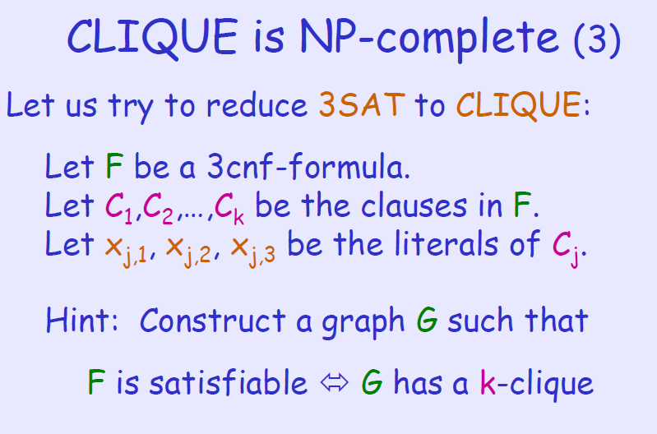


Slide 35
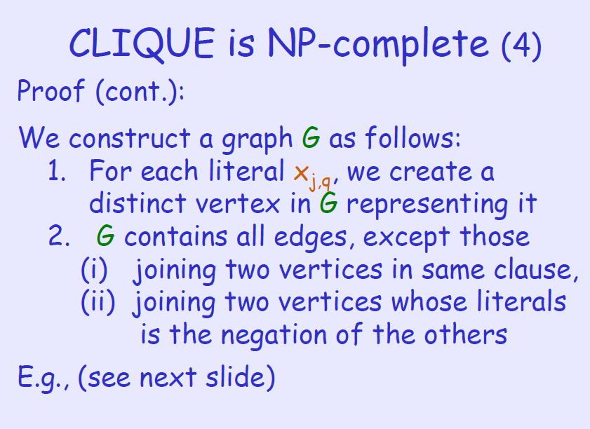

Slide 36
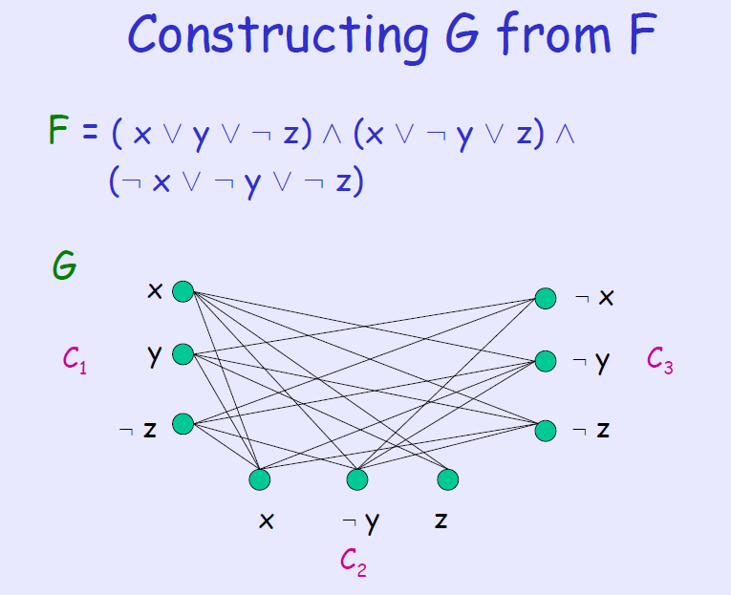

Slide 37
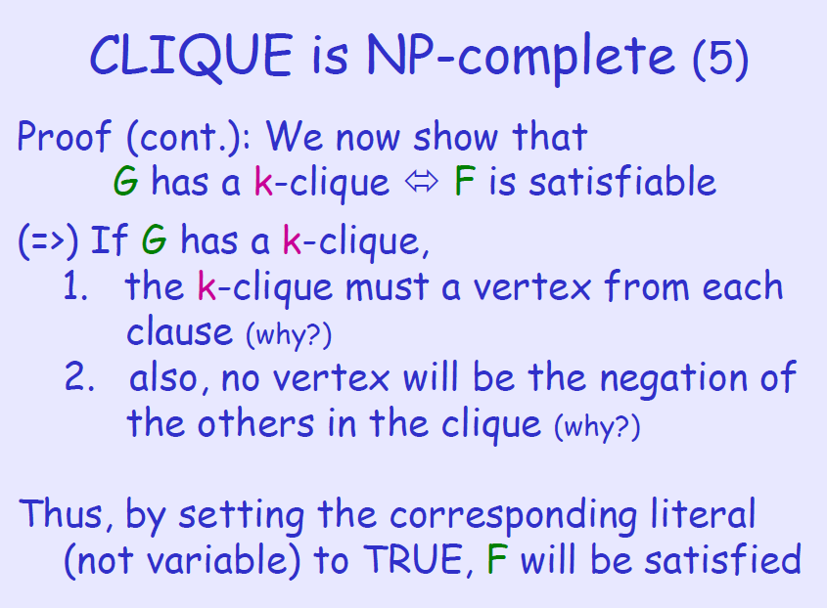

Slide 38
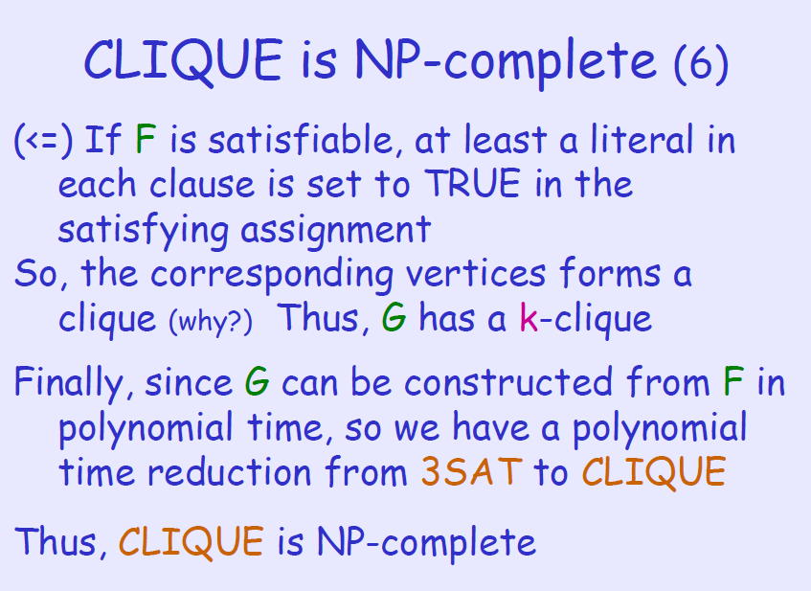

Slide 39
Clique → Vertex Cover
A vertex cover for a graph G is a set of vertices incident to every edge in G
The vertex cover problem: what is the minimum size vertex cover in G?
Restated as a decision problem: does a vertex cover of size k exist in G?
Thm 36.12: vertex cover is NP-Complete

Slide 40
Clique → Vertex Cover
First, show vertex cover in NP (How?)
Next, reduce k-clique to vertex cover
  The complement G_{C} of a graph G contains exactly those edges not in G
  Compute G_{C} in polynomial time
  G has a clique of size k iff G_{C} has a vertex cover of size |V| - k

Slide 41
Clique → Vertex Cover
Claim: If G has a clique of size k, G_{C} has a vertex cover of size |V| - k
  Let V’ be the k-clique
  Then V - V’ is a vertex cover in G_{C}
    Let (u,v) be any edge in G_{C}
    Then u and v cannot both be in V’ (Why?)
    Thus at least one of u or v is in V-V’ (why?), so
    edge (u, v) is covered by V-V’
    Since true for any edge in G_{C}, V-V’ is a vertex cover

Slide 42
Clique → Vertex Cover
Claim: If G_{C} has a vertex cover V’ ⊆ V, with |V’| = |V| - k, then G has a clique of size k
  For all u,v ∈ V, if (u,v) ∈ G_{C} then u ∈ V’ or
  v ∈ V’ or both (Why?)
  Contrapositive: if u ∉ V’ and v ∉ V’, then
  (u,v) ∈ E
  In other words, all vertices in V-V’ are connected by an edge, thus V-V’ is a clique
  Since |V| - |V’| = k, the size of the clique is k

Slide 43
General Comments
Literally hundreds of problems have been shown to be NP-Complete
Some reductions are profound, some are comparatively easy, many are easy once the key insight is given
You can expect a simple NP-Completeness proof on the final

Slide 44
Other NP-Complete Problems
Subset-sum: Given a set of integers, does there exist a subset that adds up to some target T?
0-1 knapsack: when weights not just integers
Hamiltonian path: Obvious
Graph coloring: can a given graph be colored with k colors such that no adjacent vertices are the same color?
Etc…

Slide 45
Notes
Recall: A Hamiltonian cycle in a graph exists if there is a path that reaches every node and returns to the starting point as long as no node (except the first) is reached more than once and no edge is used more than once. Thus, the Hamiltonian Cycle reaches n+1 nodes (the first node twice) and n edges.
Reduction#1: (problem 13.10) show that the Hamiltonian cycle problem for undirected graphs is reducible to the Hamiltonian cycle problem for directed graphs.
Given an undirected graph G = (V, E)
Transform G into G’ = (V, E’) where E’ contains an edge <u’, v’> and an edge <v’, u’> for each edge <u, v> in G. That is, for every undirected edge in G, make two directed edges in G’ so that you can reach v from u and u from v, just as in G. This transformation will take 2*|E| operations where |E| is the number of edges (which ranges between n-1 and (n-1)² so is Q(n²).
Now, for any graph G, if there is a Hamiltonian cycle, then our solution for the directed graph Hamiltonian cycle will find a Hamiltonian cycle in G’ and output yes, and if there is no Hamiltonian cycle for G, then our solution for the directed Hamiltonian cycle will output no because both graphs share the same edges between all nodes.

Slide 46
Notes
Reduction #2: (problem 13.11) show that the Hamiltonian cycle problem is reducible to the traveling salesman problem. We are given the choice of directed or undirected, I will choose undirected.
Given an undirected graph G = (V, E)
Transform G into a network N = (V, E’) where E’ has edge weights for every edge, and let k = n (the number of nodes in G and N). In this case, all edge weights will be set to 1. This transformation takes |E| + 1 operations (1 operation per edge to assign an edge weight of 1, and 1 instruction to set k = n). Now, ask the question “is there a solution to the traveling salesman problem on N with k = n? That is, can we find a path through the n nodes in N that touches every vertex in V and returns to the starting vertex such that the total cost of this cycle is n? If the answer is yes, then this cycle, by definition, is a Hamiltonian cycle. If the answer is no, then there is no cycle that can reach every node and return using only n edges, and so no Hamiltonian cycle exists.

