Slide 1
Notes on Classification
CS4881 Artificial Intelligence
Jay Urbain
Credits:
Nazli Goharian and David Grossman, IIT
Machine Learning, Tom Mitchell
AIMA, Russell and Norvig

Slide 2
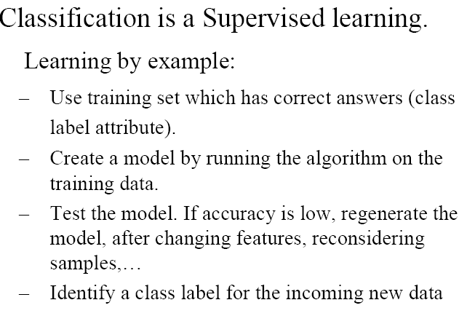
Classification

Slide 3
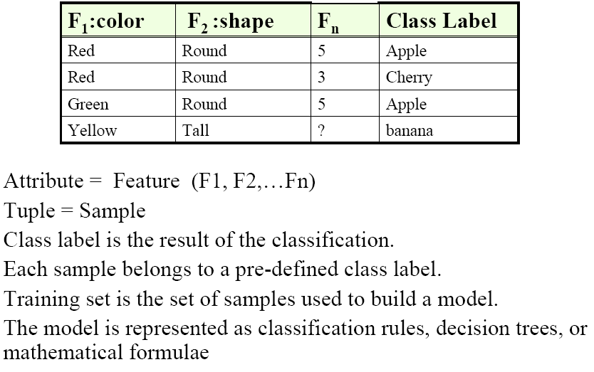
Classification

Slide 4
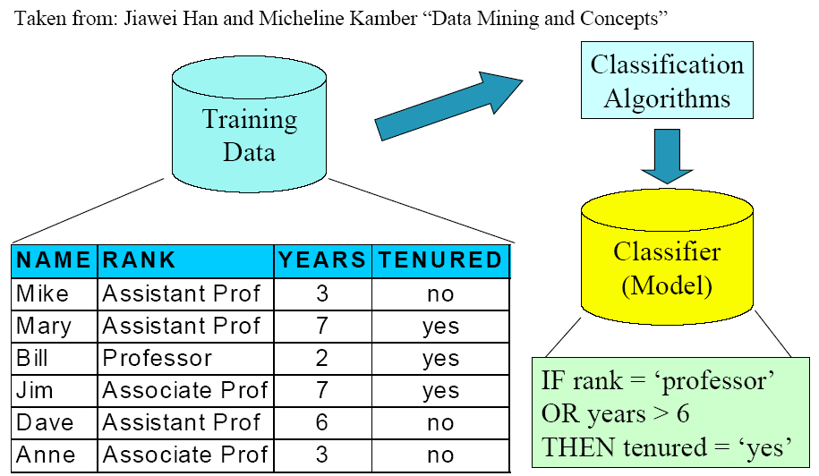
Classification

Slide 5
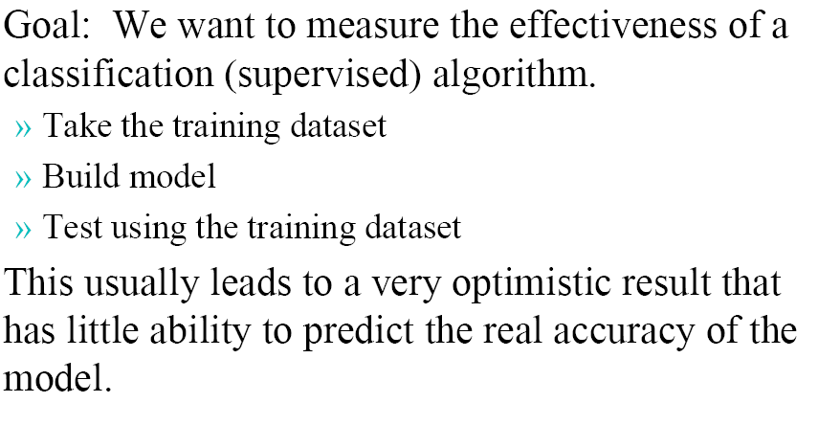
Measuring Accuracy

Slide 6
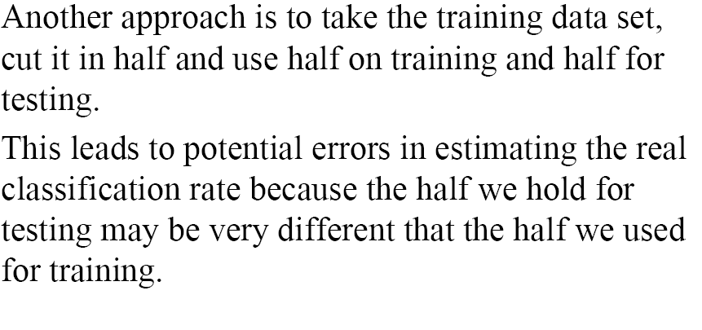
Measuring Accuracy (cont.)

Slide 7
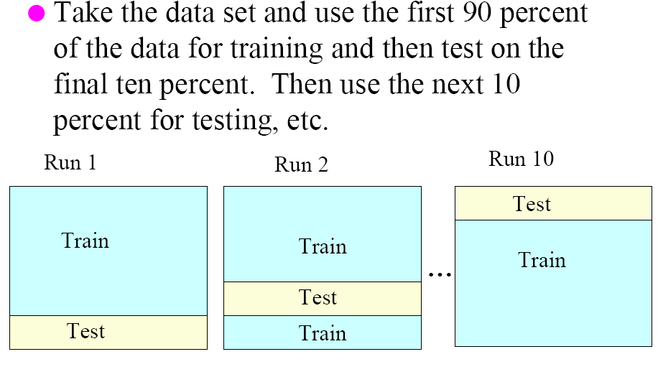
10-fold cross validation

Slide 8
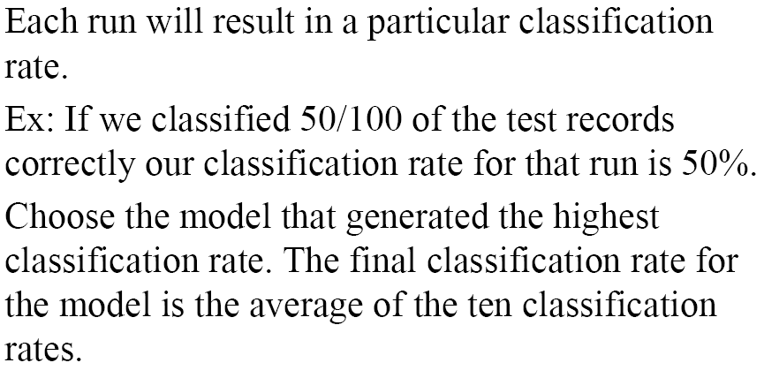
10-fold cross validation

Slide 9
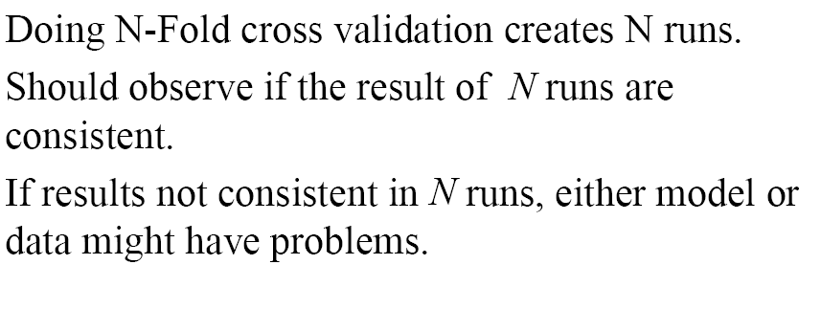
10-fold cross validation

Slide 10
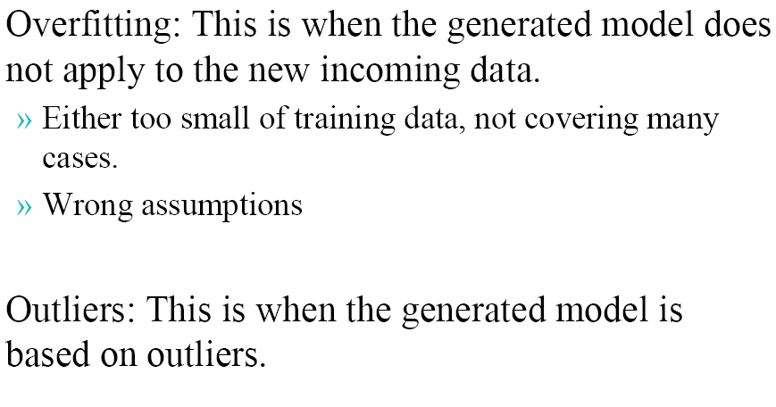
Potential Problems

Slide 11
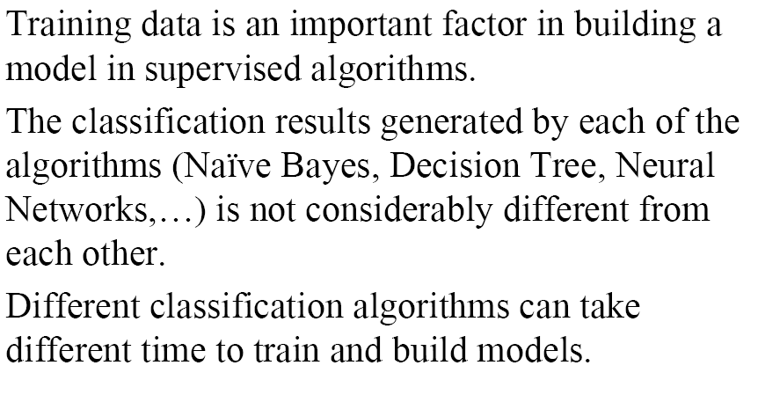
Summary

