Slide 1
Cluster Analysis
CS4881 Aritificial Intelligence
Jay Urbain
Credits:
Tom Mitchell, Machine Learning
Jiawei Han and Micheline Kamber, Data Mining

Slide 2
Cluster Analysis
What is Cluster Analysis?
Types of Data in Cluster Analysis
A Categorization of Major Clustering Methods
Partitioning Methods
Hierarchical Methods
Density-Based Methods
Grid-Based Methods
Model-Based Clustering Methods
Outlier Analysis
Summary

Slide 3
What is Cluster Analysis?
Cluster: a collection of data objects
  Similar to one another within the same cluster
  Dissimilar to the objects in other clusters
Cluster analysis
  Grouping a set of data objects into clusters
Clustering is unsupervised classification: no predefined classes
Typical applications
  As a stand-alone tool to get insight into data distribution
  As a preprocessing step for other algorithms

Slide 4
General Applications of Clustering
Pattern Recognition
Spatial Data Analysis
  create thematic maps in GIS by clustering feature spaces
  detect spatial clusters and explain them in spatial data mining
Image Processing
Economic Science (especially market research)
WWW
  Document/text classification
  Cluster Weblog data to discover groups of similar access patterns

Slide 5
Examples of Clustering Applications
Marketing: Help marketers discover distinct groups in their customer bases, and then use this knowledge to develop targeted marketing programs
Land use: Identification of areas of similar land use in an earth observation database
Insurance: Identifying groups of motor insurance policy holders with a high average claim cost
City-planning: Identifying groups of houses according to their house type, value, and geographical location
Earth-quake studies: Observed earth quake epicenters should be clustered along continent faults

Slide 6
What Is Good Clustering?
A good clustering method will produce high quality clusters with
  high intra-class similarity
  low inter-class similarity
The quality of a clustering result depends on both the similarity measure used by the method and its implementation.
The quality of a clustering method is also measured by its ability to discover some or all of the hidden patterns.

Slide 7
Requirements of Clustering
Scalability
Ability to deal with different types of attributes
Discovery of clusters with arbitrary shape
Minimal requirements for domain knowledge to determine input parameters
Able to deal with noise and outliers
Insensitive to order of input records
High dimensionality
Incorporation of user-specified constraints
Interpretability and usability

Slide 8
Cluster Analysis
What is Cluster Analysis?
Types of Data in Cluster Analysis
A Categorization of Major Clustering Methods
Partitioning Methods
Hierarchical Methods
Density-Based Methods
Grid-Based Methods
Model-Based Clustering Methods
Outlier Analysis
Summary

Slide 9


Data Structures
Data matrix
  (two modes)
Dissimilarity matrix
  (one mode)

Slide 10
Measure the Quality of Clustering
Dissimilarity/Similarity metric: Similarity is expressed in terms of a distance function, which is typically metric: d(i, j)
There is a separate “quality” function that measures the “goodness” of a cluster.
The definitions of distance functions are usually very different for interval-scaled, boolean, categorical, ordinal and ratio variables.
Weights should be associated with different variables based on applications and data semantics.
It is hard to define “similar enough” or “good enough”
  the answer is typically highly subjective.

Slide 11
Type of data in clustering analysis
Interval-scaled variables:
Binary variables:
Nominal, ordinal, and ratio variables:
Variables of mixed types:

Slide 12




Interval-valued variables
Standardize data
  Calculate the mean absolute deviation:
  where
  Calculate the standardized measurement (z-score)
Using mean absolute deviation is more robust than using standard deviation

Slide 13


Similarity and Dissimilarity Between Objects
Distances are normally used to measure the similarity or dissimilarity between two data objects
Some popular ones include: Minkowski distance:
  where i = (x_{i1}, x_{i2}, …, x_{ip}) and j = (x_{j1}, x_{j2}, …, x_{jp}) are two p-dimensional data objects, and q is a positive integer
If q = 1, d is Manhattan distance

Slide 14

Similarity and Dissimilarity Between Objects (Cont.)
If q = 2, d is Euclidean distance:
  Properties
    d(i,j) ≥ 0
    d(i,i) = 0
    d(i,j) = d(j,i)
    d(i,j) ≤ d(i,k) + d(k,j)
Also one can use weighted distance, parametric Pearson product moment correlation, or other disimilarity measures.

Slide 15



Binary Variables
A contingency table for binary data
Simple matching coefficient (invariant, if the binary variable is symmetric):
Jaccard coefficient (noninvariant if the binary variable is asymmetric):
Object j
Object i

Slide 16


Dissimilarity between Binary Variables
Example
  gender is a symmetric attribute
  the remaining attributes are asymmetric binary
  let the values Y and P be set to 1, and the value N be set to 0

Slide 17

Nominal Variables
A generalization of the binary variable in that it can take more than 2 states, e.g., red, yellow, blue, green
Method 1: Simple matching
  m: # of matches, p: total # of variables
Method 2: use a large number of binary variables
  creating a new binary variable for each of the M nominal states

Slide 18


Ordinal Variables
An ordinal variable can be discrete or continuous
order is important, e.g., rank
Can be treated like interval-scaled
  replacing x_{if} by their rank
  map the range of each variable onto [0, 1] by replacing i-th object in the f-th variable by
  compute the dissimilarity using methods for interval-scaled variables

Slide 19
Ratio-Scaled Variables
Ratio-scaled variable: a positive measurement on a nonlinear scale, approximately at exponential scale, such as Ae^{Bt} or Ae^{-Bt}
Methods:
  treat them like interval-scaled variables — not a good choice! (why?)
  apply logarithmic transformation
y_{if} = log(x_{if})
  treat them as continuous ordinal data treat their rank as interval-scaled.

Slide 20


Variables of Mixed Types
A database may contain all the six types of variables
  symmetric binary, asymmetric binary, nominal, ordinal, interval and ratio.
One may use a weighted formula to combine their effects.
  f is binary or nominal:
    d_{ij}^{(f)} = 0 if x_{if} = x_{jf} , or d_{ij}^{(f)} = 1 o.w.
  f is interval-based: use the normalized distance
  f is ordinal or ratio-scaled
    compute ranks r_{if} and
    and treat z_{if} as interval-scaled

Slide 21
Chapter 8. Cluster Analysis
What is Cluster Analysis?
Types of Data in Cluster Analysis
A Categorization of Major Clustering Methods
Partitioning Methods
Hierarchical Methods
Density-Based Methods
Grid-Based Methods
Model-Based Clustering Methods
Outlier Analysis
Summary

Slide 22
Major Clustering Approaches
Partitioning algorithms: Construct various partitions and then evaluate them by some criterion
Hierarchy algorithms: Create a hierarchical decomposition of the set of data (or objects) using some criterion
Density-based: based on connectivity and density functions
Grid-based: based on a multiple-level granularity structure
Model-based: A model is hypothesized for each of the clusters and the idea is to find the best fit of that model to each other

Slide 23
Chapter 8. Cluster Analysis
What is Cluster Analysis?
Types of Data in Cluster Analysis
A Categorization of Major Clustering Methods
Partitioning Methods
Hierarchical Methods
Density-Based Methods
Grid-Based Methods
Model-Based Clustering Methods
Outlier Analysis
Summary

Slide 24
Partitioning Algorithms: Basic Concept
Partitioning method: Construct a partition of a database D of n objects into a set of k clusters
Given a k, find a partition of k clusters that optimizes the chosen partitioning criterion
  Global optimal: exhaustively enumerate all partitions
  Heuristic methods: k-means and k-medoids algorithms
  k-means (MacQueen’67): Each cluster is represented by the center of the cluster
  k-medoids or PAM (Partition around medoids) (Kaufman & Rousseeuw’87): Each cluster is represented by one of the objects in the cluster

Slide 25
The K-Means Clustering Method
Given k, the k-means algorithm is implemented in 4 steps:
  Partition objects into k nonempty subsets
  Compute seed points as the centroids of the clusters of the current partition. The centroid is the center (mean point) of the cluster.
  Assign each object to the cluster with the nearest seed point.
  Go back to Step 2, stop when no more new assignment.

Slide 26

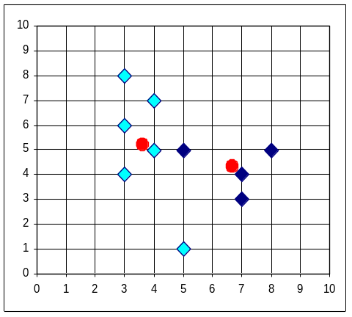


The K-Means Clustering Method
Example

Slide 27
Comments on the K-Means Method
Strength
  Relatively efficient: O(tkn), where n is # objects, k is # clusters, and t is # iterations. Normally, k, t << n.
  Often terminates at a local optimum. The global optimum may be found using techniques such as: deterministic annealing and genetic algorithms
Weakness
  Applicable only when mean is defined, then what about categorical data?
  Need to specify k, the number of clusters, in advance
  Unable to handle noisy data and outliers
  Not suitable to discover clusters with non-convex shapes

Slide 28
Variations of the K-Means Method
A few variants of the k-means which differ in
  Selection of the initial k means
  Dissimilarity calculations
  Strategies to calculate cluster means
Handling categorical data: k-modes (Huang’98)
  Replacing means of clusters with modes
  Using new dissimilarity measures to deal with categorical objects
  Using a frequency-based method to update modes of clusters
  A mixture of categorical and numerical data: k-prototype method

Slide 29
The K-Medoids Clustering Method
Find representative objects, called medoids, in clusters
PAM (Partitioning Around Medoids, 1987)
  starts from an initial set of medoids and iteratively replaces one of the medoids by one of the non-medoids if it improves the total distance of the resulting clustering
  PAM works effectively for small data sets, but does not scale well for large data sets
CLARA (Kaufmann & Rousseeuw, 1990)
CLARANS (Ng & Han, 1994): Randomized sampling
Focusing + spatial data structure (Ester et al., 1995)

Slide 30
Cluster Analysis
What is Cluster Analysis?
Types of Data in Cluster Analysis
A Categorization of Major Clustering Methods
Partitioning Methods
Hierarchical Methods
Density-Based Methods
Grid-Based Methods
Model-Based Clustering Methods
Outlier Analysis
Summary

Slide 31
Hierarchical Clustering
Use distance matrix as clustering criteria. This method does not require the number of clusters k as an input, but needs a termination condition
Step 0
Step 1
Step 2
Step 3
Step 4
agglomerative
(AGNES)
a
a b
b
a b c d e
c
c d e
d
d e
e
divisive
(DIANA)
Step 4
Step 3
Step 2
Step 1
Step 0

Slide 32

AGNES (Agglomerative Nesting)
Introduced in Kaufmann and Rousseeuw (1990)
Implemented in statistical analysis packages, e.g., Splus
Use the Single-Link method and the dissimilarity matrix.
Merge nodes that have the least dissimilarity
Go on in a non-descending fashion
Eventually all nodes belong to the same cluster

Slide 33
A Dendrogram Shows How the Clusters are Merged Hierarchically
  Decompose data objects into a several levels of nested partitioning (tree of clusters), called a dendrogram.
  A clustering of the data objects is obtained by cutting the dendrogram at the desired level, then each connected component forms a cluster.

Slide 34
DIANA (Divisive Analysis)
Introduced in Kaufmann and Rousseeuw (1990)
Implemented in statistical analysis packages, e.g., Splus
Inverse order of AGNES
Eventually each node forms a cluster on its own

Slide 35
More on Hierarchical Clustering Methods
Major weakness of agglomerative clustering methods
  do not scale well: time complexity of at least O(n²), where n is the number of total objects
  can never undo what was done previously
Integration of hierarchical with distance-based clustering
  BIRCH (1996): uses CF-tree and incrementally adjusts the quality of sub-clusters
  CURE (1998): selects well-scattered points from the cluster and then shrinks them towards the center of the cluster by a specified fraction
  CHAMELEON (1999): hierarchical clustering using dynamic modeling

Slide 36
Clustering Feature Vector
Clustering Feature: CF = (N, LS, SS)
N: Number of data points
LS: ∑^{N}_{i=1}=X_{i}
SS: ∑^{N}_{i=1}=X_{i}²
CF = (5, (16,30),(54,190))
(3,4)
(2,6)
(4,5)
(4,7)
(3,8)

Slide 37
Overall Framework of CHAMELEON
Construct
Sparse Graph
Partition the Graph
Data Set
Merge Partition
Final Clusters

Slide 38
Chapter 8. Cluster Analysis
What is Cluster Analysis?
Types of Data in Cluster Analysis
A Categorization of Major Clustering Methods
Partitioning Methods
Hierarchical Methods
Density-Based Methods
Grid-Based Methods
Model-Based Clustering Methods
Outlier Analysis
Summary

Slide 39
Density-Based Clustering Methods
Clustering based on density (local cluster criterion), such as density-connected points
Major features:
  Discover clusters of arbitrary shape
  Handle noise
  One scan
  Need density parameters as termination condition
Several interesting studies:
  DBSCAN: Ester, et al. (KDD’96)
  OPTICS: Ankerst, et al (SIGMOD’99).
  DENCLUE: Hinneburg & D. Keim (KDD’98)
  CLIQUE: Agrawal, et al. (SIGMOD’98)

Slide 40
Density-Based Clustering: Background
Two parameters:
  Eps: Maximum radius of the neighbourhood
  MinPts: Minimum number of points in an Eps-neighbourhood of that point
N_{Eps}(p): {q belongs to D | dist(p,q) <= Eps}
Directly density-reachable: A point p is directly density-reachable from a point q wrt. Eps, MinPts if
  1) p belongs to N_{Eps}(q)
  2) core point condition:
  |N_{Eps} (q)| >= MinPts
p
MinPts = 5
Eps = 1 cm
q

Slide 41
Density-Based Clustering: Background (II)
Density-reachable:
  A point p is density-reachable from a point q wrt. Eps, MinPts if there is a chain of points p₁, …, p_{n}, p₁ = q, p_{n} = p such that p_{i+1} is directly density-reachable from p_{i}
Density-connected
  A point p is density-connected to a point q wrt. Eps, MinPts if there is a point o such that both, p and q are density-reachable from o wrt. Eps and MinPts.
p
p₁
q
p
q
o

Slide 42
DBSCAN: Density Based Spatial Clustering of Applications with Noise
Relies on a density-based notion of cluster: A cluster is defined as a maximal set of density-connected points
Discovers clusters of arbitrary shape in spatial databases with noise
Outlier
Border
Eps = 1cm
MinPts = 5
Core

Slide 43
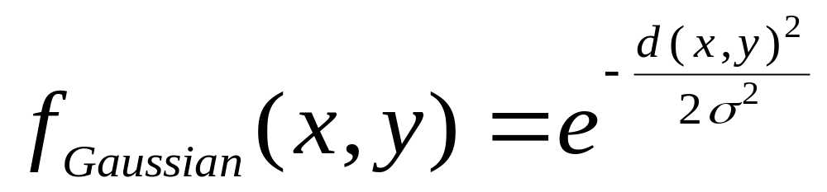
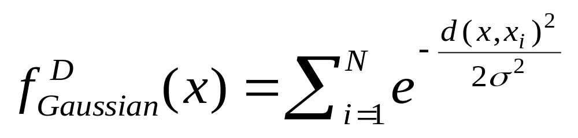

Gradient: The steepness of a slope
Example

Slide 44



Density Attractor

Slide 45

Center-Defined and Arbitrary

Slide 46
Chapter 8. Cluster Analysis
What is Cluster Analysis?
Types of Data in Cluster Analysis
A Categorization of Major Clustering Methods
Partitioning Methods
Hierarchical Methods
Density-Based Methods
Grid-Based Methods
Model-Based Clustering Methods
Outlier Analysis
Summary

Slide 47
Grid-Based Clustering Method
Using multi-resolution grid data structure
Several interesting methods
  STING (a STatistical INformation Grid approach) by Wang, Yang and Muntz (1997)
  WaveCluster by Sheikholeslami, Chatterjee, and Zhang (VLDB’98)
    A multi-resolution clustering approach using wavelet method
  CLIQUE: Agrawal, et al. (SIGMOD’98)

Slide 48
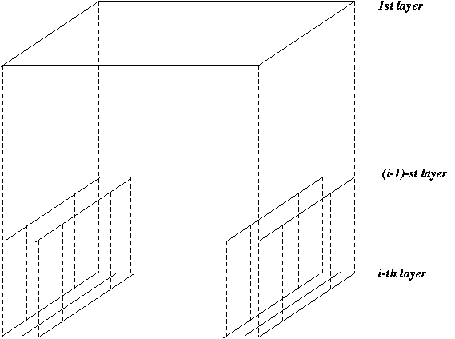
STING: A Statistical Information Grid Approach
Wang, Yang and Muntz (VLDB’97)
The spatial area area is divided into rectangular cells
There are several levels of cells corresponding to different levels of resolution

Slide 49
STING: A Statistical Information Grid Approach (2)
  Each cell at a high level is partitioned into a number of smaller cells in the next lower level
  Statistical info of each cell is calculated and stored beforehand and is used to answer queries
  Parameters of higher level cells can be easily calculated from parameters of lower level cell
    count, mean, s, min, max
    type of distribution—normal, uniform, etc.
  Use a top-down approach to answer spatial data queries
  Start from a pre-selected layer—typically with a small number of cells
  For each cell in the current level compute the confidence interval

Slide 50
STING: A Statistical Information Grid Approach (3)
  Remove the irrelevant cells from further consideration
  When finish examining the current layer, proceed to the next lower level
  Repeat this process until the bottom layer is reached
  Advantages:
    Query-independent, easy to parallelize, incremental update
    O(K), where K is the number of grid cells at the lowest level
  Disadvantages:
    All the cluster boundaries are either horizontal or vertical, and no diagonal boundary is detected

Slide 51
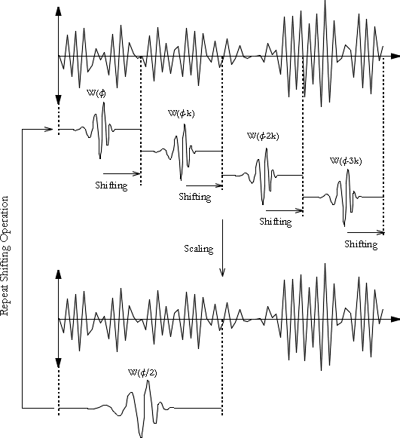
What is Wavelet (1)?

Slide 52
WaveCluster (1998)
How to apply wavelet transform to find clusters
  Summaries the data by imposing a multidimensional grid structure onto data space
  These multidimensional spatial data objects are represented in a n-dimensional feature space
  Apply wavelet transform on feature space to find the dense regions in the feature space
  Apply wavelet transform multiple times which result in clusters at different scales from fine to coarse

Slide 53


What Is Wavelet (2)?

Slide 54

Quantization

Slide 55

Transformation

Slide 56
WaveCluster (1998)
Why is wavelet transformation useful for clustering
  Unsupervised clustering
  It uses hat-shape filters to emphasize region where points cluster, but simultaneously to suppress weaker information in their boundary
  Effective removal of outliers
  Multi-resolution
  Cost efficiency
Major features:
  Complexity O(N)
  Detect arbitrary shaped clusters at different scales
  Not sensitive to noise, not sensitive to input order
  Only applicable to low dimensional data

Slide 57
CLIQUE (Clustering In QUEst)
Agrawal, Gehrke, Gunopulos, Raghavan (SIGMOD’98).
Automatically identifying subspaces of a high dimensional data space that allow better clustering than original space
CLIQUE can be considered as both density-based and grid-based
  It partitions each dimension into the same number of equal length interval
  It partitions an m-dimensional data space into non-overlapping rectangular units
  A unit is dense if the fraction of total data points contained in the unit exceeds the input model parameter
  A cluster is a maximal set of connected dense units within a subspace

Slide 58
CLIQUE: The Major Steps
Partition the data space and find the number of points that lie inside each cell of the partition.
Identify the subspaces that contain clusters using the Apriori principle
Identify clusters:
  Determine dense units in all subspaces of interests
  Determine connected dense units in all subspaces of interests.
Generate minimal description for the clusters
  Determine maximal regions that cover a cluster of connected dense units for each cluster
  Determination of minimal cover for each cluster

Slide 59
Salary (10,000)
Vacation(week)
7
7
6
6
5
5
4
4
3
3
2
2
1
1
0
age
0
age
20
30
40
50
60
20
30
40
50
60
τ = 3
Vacation
Salary
30
50
age

Slide 60
Strength and Weakness of CLIQUE
Strength
  It automatically finds subspaces of the highest dimensionality such that high density clusters exist in those subspaces
  It is insensitive to the order of records in input and does not presume some canonical data distribution
  It scales linearly with the size of input and has good scalability as the number of dimensions in the data increases
Weakness
  The accuracy of the clustering result may be degraded at the expense of simplicity of the method

Slide 61
Chapter 8. Cluster Analysis
What is Cluster Analysis?
Types of Data in Cluster Analysis
A Categorization of Major Clustering Methods
Partitioning Methods
Hierarchical Methods
Density-Based Methods
Grid-Based Methods
Model-Based Clustering Methods
Outlier Analysis
Summary

Slide 62
Model-Based Clustering Methods
Attempt to optimize the fit between the data and some mathematical model
Statistical and AI approach
  Conceptual clustering
    A form of clustering in machine learning
    Produces a classification scheme for a set of unlabeled objects
    Finds characteristic description for each concept (class)
  COBWEB (Fisher’87)
    A popular a simple method of incremental conceptual learning
    Creates a hierarchical clustering in the form of a classification tree
    Each node refers to a concept and contains a probabilistic description of that concept

Slide 63

COBWEB Clustering Method
A classification tree

Slide 64
More on Statistical-Based Clustering
Limitations of COBWEB
  The assumption that the attributes are independent of each other is often too strong because correlation may exist
  Not suitable for clustering large database data – skewed tree and expensive probability distributions
CLASSIT
  an extension of COBWEB for incremental clustering of continuous data
  suffers similar problems as COBWEB
AutoClass (Cheeseman and Stutz, 1996)
  Uses Bayesian statistical analysis to estimate the number of clusters
  Popular in industry

Slide 65
Other Model-Based Clustering Methods
Neural network approaches
  Represent each cluster as an exemplar, acting as a “prototype” of the cluster
  New objects are distributed to the cluster whose exemplar is the most similar according to some dostance measure
Competitive learning
  Involves a hierarchical architecture of several units (neurons)
  Neurons compete in a “winner-takes-all” fashion for the object currently being presented

Slide 66
Chapter 8. Cluster Analysis
What is Cluster Analysis?
Types of Data in Cluster Analysis
A Categorization of Major Clustering Methods
Partitioning Methods
Hierarchical Methods
Density-Based Methods
Grid-Based Methods
Model-Based Clustering Methods
Outlier Analysis
Summary

Slide 67
What Is Outlier Discovery?
What are outliers?
  The set of objects are considerably dissimilar from the remainder of the data
  Example: Sports: Michael Jordon, Wayne Gretzky, ...
Problem
  Find top n outlier points
Applications:
  Credit card fraud detection
  Telecom fraud detection
  Customer segmentation
  Medical analysis

Slide 68

Outlier Discovery: Statistical Approaches
Assume a model underlying distribution that generates data set (e.g. normal distribution)
Use discordancy tests depending on
  data distribution
  distribution parameter (e.g., mean, variance)
  number of expected outliers
Drawbacks
  most tests are for single attribute
  In many cases, data distribution may not be known

Slide 69
Chapter 8. Cluster Analysis
What is Cluster Analysis?
Types of Data in Cluster Analysis
A Categorization of Major Clustering Methods
Partitioning Methods
Hierarchical Methods
Density-Based Methods
Grid-Based Methods
Model-Based Clustering Methods
Outlier Analysis
Summary

Slide 70
Problems and Challenges
Considerable progress has been made in scalable clustering methods
  Partitioning: k-means, k-medoids, CLARANS
  Hierarchical: BIRCH, CURE
  Density-based: DBSCAN, CLIQUE, OPTICS
  Grid-based: STING, WaveCluster
  Model-based: Autoclass, Denclue, Cobweb
Current clustering techniques do not address all the requirements adequately
Constraint-based clustering analysis: Constraints exist in data space (bridges and highways) or in user queries

Slide 71
Constraint-Based Clustering Analysis
Clustering analysis: less parameters but more user-desired constraints, e.g., an ATM allocation problem

Slide 72
Summary
Cluster analysis groups objects based on their similarity and has wide applications
Measure of similarity can be computed for various types of data
Clustering algorithms can be categorized into partitioning methods, hierarchical methods, density-based methods, grid-based methods, and model-based methods
Outlier detection and analysis are very useful for fraud detection, etc. and can be performed by statistical, distance-based or deviation-based approaches
There are still lots of research issues on cluster analysis, such as constraint-based clustering

Slide 73
References (1)
R. Agrawal, J. Gehrke, D. Gunopulos, and P. Raghavan. Automatic subspace clustering of high dimensional data for data mining applications. SIGMOD'98
M. R. Anderberg. Cluster Analysis for Applications. Academic Press, 1973.
M. Ankerst, M. Breunig, H.-P. Kriegel, and J. Sander. Optics: Ordering points to identify the clustering structure, SIGMOD’99.
P. Arabie, L. J. Hubert, and G. De Soete. Clustering and Classification. World Scietific, 1996
M. Ester, H.-P. Kriegel, J. Sander, and X. Xu. A density-based algorithm for discovering clusters in large spatial databases. KDD'96.
M. Ester, H.-P. Kriegel, and X. Xu. Knowledge discovery in large spatial databases: Focusing techniques for efficient class identification. SSD'95.
D. Fisher. Knowledge acquisition via incremental conceptual clustering. Machine Learning, 2:139-172, 1987.
D. Gibson, J. Kleinberg, and P. Raghavan. Clustering categorical data: An approach based on dynamic systems. In Proc. VLDB’98.
S. Guha, R. Rastogi, and K. Shim. Cure: An efficient clustering algorithm for large databases. SIGMOD'98.
A. K. Jain and R. C. Dubes. Algorithms for Clustering Data. Printice Hall, 1988.

Slide 74
References (2)
L. Kaufman and P. J. Rousseeuw. Finding Groups in Data: an Introduction to Cluster Analysis. John Wiley & Sons, 1990.
E. Knorr and R. Ng. Algorithms for mining distance-based outliers in large datasets. VLDB’98.
G. J. McLachlan and K.E. Bkasford. Mixture Models: Inference and Applications to Clustering. John Wiley and Sons, 1988.
P. Michaud. Clustering techniques. Future Generation Computer systems, 13, 1997.
R. Ng and J. Han. Efficient and effective clustering method for spatial data mining. VLDB'94.
E. Schikuta. Grid clustering: An efficient hierarchical clustering method for very large data sets. Proc. 1996 Int. Conf. on Pattern Recognition, 101-105.
G. Sheikholeslami, S. Chatterjee, and A. Zhang. WaveCluster: A multi-resolution clustering approach for very large spatial databases. VLDB’98.
W. Wang, Yang, R. Muntz, STING: A Statistical Information grid Approach to Spatial Data Mining, VLDB’97.
T. Zhang, R. Ramakrishnan, and M. Livny. BIRCH : an efficient data clustering method for very large databases. SIGMOD'96.

