Slide 1
Cluster Analysis - Abridged
CS4881 Aritificial Intelligence
Jay Urbain, PhD
Credits:
Tom Mitchell, Machine Learning
Jiawei Han and Micheline Kamber, Data Mining

Slide 2
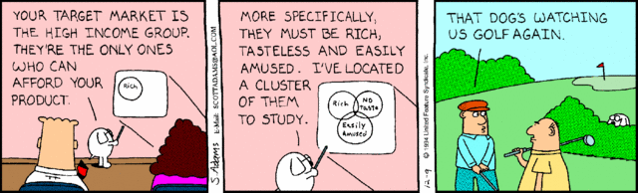
Cluster Analysis
What is Cluster Analysis?
Types of Data in Cluster Analysis
A Categorization of Major Clustering Methods
Partitioning Methods
Hierarchical Methods
Summary

Slide 3
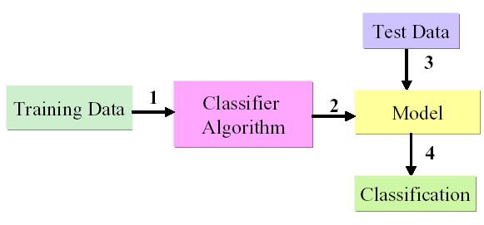
Supervised Learning
Supervised Learning
Learn by example from training data with a class label
Create model by running algorithm on training data
Identify a class label for the incoming new data

Slide 4
Supervised Learning Algorithms
Supervised Learning Algorithms
  Naive Bayes
  Neural Networks
  Decision Trees
  Support Vector Machine
  Bayes Nets

Slide 5
Unsupervised Learning Algorithms
There are many machine learning situations in which class labels are not available, so unsupervised methods are needed.
Unsupervised Learning Algorithms
  Clustering – many
  Topic Models
  Collaborative Filtering
  Association Rules - Apriori

Slide 6
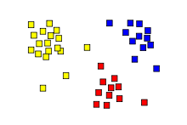
Clustering
Clustering: assigning a set of objects into groups (clusters) so that the objects in the same cluster are more similar (with respect to some features) to each other than to those in other clusters.
Cluster analysis itself is not one specific algorithm (there are many), but the general task to be solved.

Slide 7
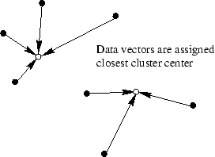
Clustering
Objects are clustered into groups that reflect distinct regions of the decision (feature) space.
Data vectors are assigned
to the closest cluster center
(centroid).

Slide 8
One of the first clustering applications?
During a cholera outbreak in London in 1854, John Snow used a special map to plot the cases of the disease that were reported.
A key observation, after the creation of the map, was the close association between the density of disease cases and a single well located at a central street.
After this, the well pump was removed putting an end to the epidemic.

Slide 9
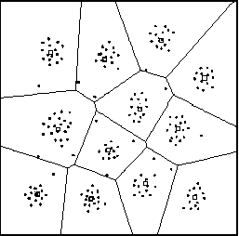
Cluster Analysis Defined
Cluster: a collection of data objects
  Similar to one another within the same cluster
  Dissimilar to the objects in other clusters
Cluster analysis
  Grouping a set of data objects into clusters
Clustering is unsupervised classification: no predefined classes
Exploratory data mining technique

Slide 10
General Applications
Typical applications
  As a stand-alone tool to get insight into data distribution
  As a preprocessing step for other algorithms
General Applications
  Co-expressed genes
  NLP Semantics
  Document clustering for IR
  Pattern Recognition
  Spatial Data Analysis
  Image Processing
  Market research
  Cluster Weblog data discover search groups

Slide 11
Specific Applications
Social Networking: Collaborative filtering.
Marketing: Discover distinct groups for targeted marketing programs.
Land use: Identification of areas of similar land use.
Insurance: Identifying groups with a high claim cost.
City-planning: Identifying groups of houses according to their house type, value, and geographical location.
Earth-quake studies: Epicenters should be clustered along continent faults.
Text mining: Identify frequently co-occuring terms for concept identification.

Slide 12
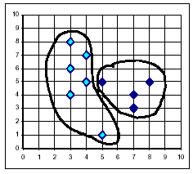
What Is Good Clustering?
A good clustering method will produce high quality clusters with:
  high intra-class similarity
  low inter-class similarity
Dependent on method used, data/domain, and implementation.
Quality measured by its ability to discover some or all of the hidden patterns.

Slide 13
Measuring Distance for Object Assignment
Similarity is expressed in terms of a distance function, which is typically a metric: d(i, j).
There is a separate “quality” function that measures the “goodness” of a cluster.
Distance functions are different for interval-scaled, boolean, nominal/categorical, ordinal, and ratio variables.
Hard to define “similar enough” or “good enough” – its subjective.

Slide 14
Data types must be normalized
Nominal
  Categorical data. Use labels/categories. E.g., rocks as igneous, sedimentary and metamorphic; eye color, zip codes.
Ordinal
  Rankings, ordered data. E.g., movie rating on a 1-4 star scale, grades, height in {tall, medium, short}, places in a race.
Interval
  Measurable on interval scales. E.g., temperature, dates.
  Data that is divided into ranges and in which the distance between the intervals is meaningful. Arbitrary zero.
Ratio
  Measurement is the estimation of the ratio between a magnitude of a continuous quantity and a unit magnitude of the same kind.
  Absolute zero. E.g., height, weight,

Slide 15
Data examples…
Nominal Data: Categories
  Male, Female, Race, Political Party (categorical data that cannot be ranked)
Ordinal Data: Ordered data
  Degree of Satisfaction at Restaurant (data that can be ranked)
Interval Data: Meaningful intervals
  Temperature, Dates (data that has an arbitrary zero)
Ratio Data:
  Height, Weight, Age, Length (data that has an absolute zero)

Slide 16

Similarity/Dissimilarity Between Objects
Distances are normally used to measure the similarity or dissimilarity between two data objects
Some popular ones include: Manhattan distance

Slide 17

Similarity and Dissimilarity Between Objects (Cont.)
Euclidean distance:
  Properties
    d(i,j) ≥ 0
    d(i,i) = 0
    d(i,j) = d(j,i)
    d(i,j) ≤ d(i,k) + d(k,j)
Also one can use weighted distance, Pearson product correlation, or other dissimilarity measures.

Slide 18
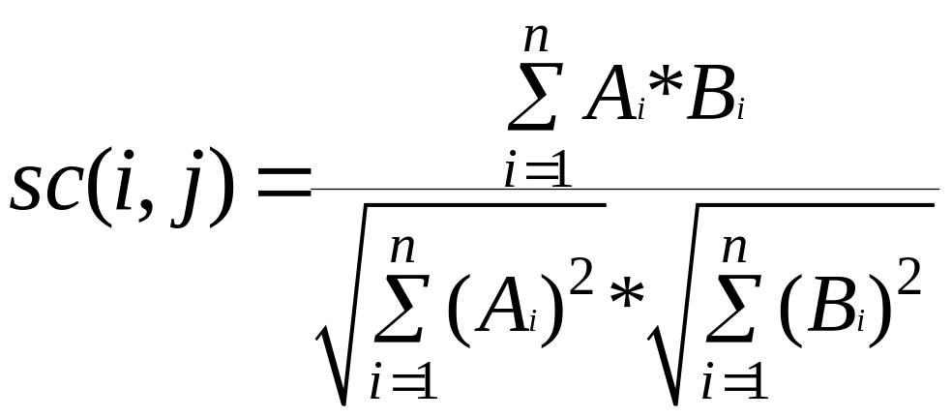
Similarity Between Objects - Cosine
Cosine distance
Normalized cross-product of 2 vectors.
Popular in information retrieval.

Slide 19



Normalizing Interval Data
Standardize data
  Calculate the mean absolute deviation:
  where
  Calculate the standardized measurement (z-score)
Note: Using mean absolute deviation is more robust than using standard deviation:

Slide 20

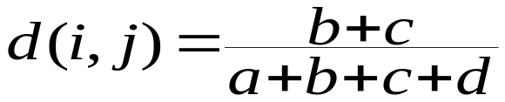

Binary Variables
A contingency table for binary data
Simple matching coefficient (invariant, if the binary variable is symmetric):
Jaccard coefficient (noninvariant if the binary variable is asymmetric) disregard negative matches, i.e., positive and negative matches do not contain symmetric information:
Object j
Object i

Slide 21
Binary Variables - Jaccard Index
Common situation is that objects, p and q, have only binary attributes
Compute similarities using the following quantities
  M01 = the number of attributes where p was 0 and q was 1
  M10 = the number of attributes where p was 1 and q was 0
  M00 = the number of attributes where p was 0 and q was 0
  M11 = the number of attributes where p was 1 and q was 1
Simple Matching and Jaccard Coefficients
  SMC = number of matches / number of attributes
  = (M11 + M00) / (M01 + M10 + M11 + M00)
Jaccard = number of 11 matches / number of not-both-zero attributes values = (M11) / (M01 + M10 + M11)

Slide 22
SMC vs. Jaccard Index
p = 1 0 0 0 0 0 0 0 0 0
q = 0 0 0 0 0 0 1 0 0 1
M01 = 2 (number of attributes where p was 0 and q was 1)
M10 = 1 (number of attributes where p was 1 and q was 0)
M00 = 7 (number of attributes where p was 0 and q was 0)
M11 = 0 (number of attributes where p was 1 and q was 1)
SMC = (M11 + M00)/(M01 + M10 + M11 + M00)
= (0+7) / (2+1+0+7) = 0.7
J = (M11) / (M01 + M10 + M11)
= 0 / (2 + 1 + 0) = 0

Slide 23

Nominal (Categorical) Variables
A generalization of the binary variable in that it can take more than 2 states, e.g., red, yellow, blue, green
Method 1: Simple matching (typical)
  m: # of matches, p: total # of variables
Method 2: use a large number of binary variables
  creating a new binary variable for each of the M nominal states

Slide 24

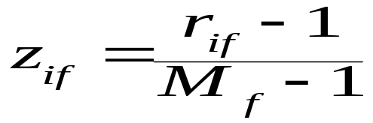
Ordinal Variables
An ordinal variable can be discrete or continuous
Order is important, e.g., rank
Can be treated like interval-scaled
  replacing x_{if} by their rank
  map the range of each variable onto [0, 1] by replacing i-th object in the f-th variable by
  compute the dissimilarity using methods for interval-scaled variables

Slide 25
Ratio-Scaled Variables
Ratio-scaled variable:
Methods:
  treat them like interval-scaled variables (linear data)
  apply logarithmic transformation (exponential data: Ae^{Bt} or Ae^{-Bt} )
  treat them as continuous ordinal data, treat their rank as interval-scaled.

Slide 26


Variables of Mixed Types
A database may contain all the six types of variables
  symmetric binary, asymmetric binary, nominal, ordinal, interval and ratio.
One may use a weighted formula to combine their effects.
  f is binary or nominal:
    d_{ij}^{(f)} = 0 if x_{if} = x_{jf} , or d_{ij}^{(f)} = 1
  f is interval-based: use the normalized distance
  f is ordinal or ratio-scaled
    compute ranks r_{if} and
    and treat z_{if} as interval-scaled

Slide 27
Major Clustering Approaches
Partitioning algorithms: Construct various partitions and then evaluate them by some criterion
Hierarchy algorithms: Create a hierarchical decomposition of the set of data (or objects) using some criterion
Statistical/Model Based: A model is hypothesized for each of the clusters. The idea is to find the best fit of that model to each other. E.g., Expectation Maximum, Topic Model
Density-based: based on connectivity and density functions
Grid-based: based on a multiple-level granularity structure

Slide 28
Partitioning Algorithms: Basic Concept
Partitioning method: Construct a partition of a database D of n objects into a set of k clusters
Given a k, find a partition of k clusters that optimizes the chosen partitioning criterion
  Global optimal: exhaustively enumerate all partitions
  Heuristic methods: k-means and k-medoids algorithms
    k-means (MacQueen’67): Each cluster is represented by the center of the cluster (centroid)
    k-medoids or PAM (Partition around medoids) (Kaufman & Rousseeuw’87): Each cluster is represented by one of the objects in the cluster (most representative)

Slide 29
The K-Means Clustering Method
Given k, the k-means algorithm is implemented in 4 steps:
  Partition objects (records) into k nonempty subsets
  Compute seed points as the centroids of the clusters of the current partition. The centroid is the center (mean point) of the cluster.
  Assign each object to the cluster with the nearest seed point.
  Go back to Step 2, stop when no more new assignment or convergence.

Slide 30
K-Means Psuedo Code
Randomly assign samples to each cluster
for each Cj // for each cluster
Cj.sum <=Sum(Vi in j'th cluster)
Cj.count <= Sum(1 if Vi in j'th cluster)
Cj.centroid <= Cj.sum/Cj.count
Do
for each Vi // object
for each Cj // for each cluster
Dij <= Euclidian (Vi,Cj) // distance between object and cluster centroid
if( Dij < Vi.d )
Vi.d = Dij
Vi.centroid = Cj
Assign Vi to centroid Cx with smallest distance
for each Cj // for each cluster
Cj.sum <=Sum(Vi in j'th cluster)
Cj.count <= Sum(1 if Vi in j'th cluster)
Cj.centroid <= Cj.sum/Cj.count
While (Diff <THRESHOLD)

Slide 31
Comments on the K-Means Method
Strength
  Relatively efficient: O(tkn), where n is # objects, k is # clusters, and t is # iterations. Normally, k, t << n.
  Often terminates at a local optimum. The global optimum may be found using techniques such as: annealing and genetic algorithms.
Weakness
  Applicable only when mean is defined. Not well suited for categorical data.
  Need to specify k, the number of clusters, in advance.
  Unable to handle noisy data and outliers.
  Not suitable to discover clusters with non-convex shapes.

Slide 32
Variations of the K-Means Method
A few variants of the k-means which differ in
  Selection of the initial k
  Distance calculations
    single-linkage clustering (the minimum of object distances)
    complete linkage clustering (the maximum of object distances)
    UPGMA("Unweighted Pair Group Method with Arithmetic Mean", also known as average linkage clustering).
  Strategies to calculate cluster means

Slide 33
K-Modes Method
Handling categorical data: k-modes (Huang’98)
  Replacing means of clusters with modes
  Using new dissimilarity measures to deal with categorical objects
  Using a frequency-based method to update modes of clusters
  A mixture of categorical and numerical data: k-prototype method

Slide 34
The K-Medoids Clustering Method
Find representative objects, called medoids, in clusters
PAM (Partitioning Around Medoids, 1987)
  starts from an initial set of medoids and iteratively replaces one of the medoids by one of the non-medoids if it improves the total distance of the resulting clustering,
  PAM works effectively for small data sets, but does not scale well for large data sets,
CLARA (Kaufmann & Rousseeuw, 1990)
CLARANS (Ng & Han, 1994): Randomized sampling
Focusing + spatial data structure (Ester et al., 1995)

Slide 35
Hierarchical Clustering
Use distance matrix as clustering criteria. This method does not require the number of clusters k as an input, but needs a termination condition
Step 0
Step 1
Step 2
Step 3
Step 4
agglomerative
(AGNES)
a
a b
b
a b c d e
c
c d e
d
d e
e
divisive
(DIANA)
Step 4
Step 3
Step 2
Step 1
Step 0

Slide 36
A Dendrogram Shows How the Clusters are Merged Hierarchically

Slide 37

DIANA (Divisive Analysis)
Introduced in Kaufmann and Rousseeuw (1990)
Implemented in statistical analysis packages, e.g., Splus
Inverse order of AGNES
Eventually each node forms a cluster on its own

Slide 38
More on Hierarchical Clustering Methods
Major weakness of agglomerative clustering methods
  does not scale well: time complexity of at least O(n²), where n is the number of total objects
  can never undo what was done previously
Demo clustering of search results!

Slide 39
Summary
Cluster analysis groups objects based on their similarity and has wide applications.
Measure of similarity can be computed for various types of data.
Clustering algorithms can be categorized into partitioning methods, hierarchical methods, density-based methods, grid-based methods, and model-based methods.
Outlier detection and analysis are very useful for fraud detection, etc. and can be performed by statistical, distance-based or deviation-based approaches.
There are still lots of research issues on cluster analysis, such as constraint-based clustering, statistical methods.
Note: Demo Topic Models if time!

Slide 40
References (1)
R. Agrawal, J. Gehrke, D. Gunopulos, and P. Raghavan. Automatic subspace clustering of high dimensional data for data mining applications. SIGMOD'98
M. R. Anderberg. Cluster Analysis for Applications. Academic Press, 1973.
M. Ankerst, M. Breunig, H.-P. Kriegel, and J. Sander. Optics: Ordering points to identify the clustering structure, SIGMOD’99.
P. Arabie, L. J. Hubert, and G. De Soete. Clustering and Classification. World Scietific, 1996
M. Ester, H.-P. Kriegel, J. Sander, and X. Xu. A density-based algorithm for discovering clusters in large spatial databases. KDD'96.
M. Ester, H.-P. Kriegel, and X. Xu. Knowledge discovery in large spatial databases: Focusing techniques for efficient class identification. SSD'95.
D. Fisher. Knowledge acquisition via incremental conceptual clustering. Machine Learning, 2:139-172, 1987.
D. Gibson, J. Kleinberg, and P. Raghavan. Clustering categorical data: An approach based on dynamic systems. In Proc. VLDB’98.
S. Guha, R. Rastogi, and K. Shim. Cure: An efficient clustering algorithm for large databases. SIGMOD'98.
A. K. Jain and R. C. Dubes. Algorithms for Clustering Data. Printice Hall, 1988.

Slide 41
References (2)
L. Kaufman and P. J. Rousseeuw. Finding Groups in Data: an Introduction to Cluster Analysis. John Wiley & Sons, 1990.
E. Knorr and R. Ng. Algorithms for mining distance-based outliers in large datasets. VLDB’98.
G. J. McLachlan and K.E. Bkasford. Mixture Models: Inference and Applications to Clustering. John Wiley and Sons, 1988.
P. Michaud. Clustering techniques. Future Generation Computer systems, 13, 1997.
R. Ng and J. Han. Efficient and effective clustering method for spatial data mining. VLDB'94.
E. Schikuta. Grid clustering: An efficient hierarchical clustering method for very large data sets. Proc. 1996 Int. Conf. on Pattern Recognition, 101-105.
G. Sheikholeslami, S. Chatterjee, and A. Zhang. WaveCluster: A multi-resolution clustering approach for very large spatial databases. VLDB’98.
W. Wang, Yang, R. Muntz, STING: A Statistical Information grid Approach to Spatial Data Mining, VLDB’97.
T. Zhang, R. Ramakrishnan, and M. Livny. BIRCH : an efficient data clustering method for very large databases. SIGMOD'96.

Slide 42


Data Structures
Data matrix
  (two modes)
Dissimilarity matrix
  (one mode)

Slide 43
Data (Stevens, Science 1946) (skip)
Scale Type | Permissible Statistics | Admissible Scale Transformation | Mathematical structure
nominal (also denoted as categorical) | mode, chi square | One to One (equality (=)) | standard set structure (unordered)
ordinal | median, percentile | Monotonic increasing (order (<)) | totally ordered set
interval | mean, standard deviation, correlation, regression, analysis of variance | Positive linear (affine) | affine line
ratio | All statistics permitted for interval scales plus the following: geometric mean, harmonic mean, coefficient of variation, logarithms | Positive similarities (multiplication) | field
Nominal
  Categories, ID numbers, eye color, zip codes
Ordinal
  Rankings (e.g., taste of potato chips on a scale from 1-10), grades, height in {tall, medium, short}
Interval
  Calendar dates, temperatures in Celsius or Fahrenheit
Ratio
  Temperature in Kelvin, length, time, counts

Slide 44
AGNES (Agglomerative Nesting)
Introduced in Kaufmann and Rousseeuw (1990)
Merge nodes that have the least dissimilarity
Go on in a non-descending fashion
Eventually all nodes belong to the same cluster

Slide 45


Binary Variables (skip)
Jaccard index is a statistic used for comparing the similarity and diversity of sample sets. Jaccard similarity coefficient:
Jaccard distance coefficient:

Slide 46

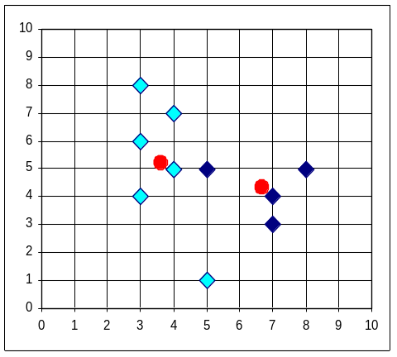


The K-Means Clustering Method
Example

