Slide 1
Concept Learning
CS4881 Artificial Intelligence
Jay Urbain
Credits:
Machine Learning, Tom Mitchell

Slide 2
Concept Learning
Learning from examples
General-to-specific ordering over hypotheses
Version spaces and candidate elimination algorithm
Picking new examples
The need for inductive bias
Note: Fundamental approach towards machine learning assuming no noise to illustrate key concepts.

Slide 3

Training Examples for EnjoySport
What is the general concept?

Slide 4
Representing Hypothesis
Many possible representations
  Decision Tree, Neural Net, conditional probabilities
Here, h is the conjunction of constraints on attributes
Each constraint can be
  A specific value, e.g. Water=Warm
  Don’t care, e.g. Water=?
  No value allowed, e.g., Water=0
Example:
Sky, AirTemp, Humid, Wind, Water, Forecast
<Sunny, ?, ?, Strong , ?, Same>

Slide 5
Prototypical Concept Learning Task
Given:
Instances X: Possible days, each described by the feature attributes Sky, AirTemp, Humidity, Wind, Water, Forecast.
Target function c: EnjoySport: X -> {0, 1}
Hypothesis H: Conjunctions of literals. E.g.
  <?, Cold, High, ?, ?, ?>
Training examples D: Positive and negative examples of the target function.
Determine: A hypothesis h in H such that h(x) = c(x) for all x in D.

Slide 6
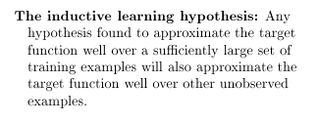
Inductive learning hypothesis

Slide 7
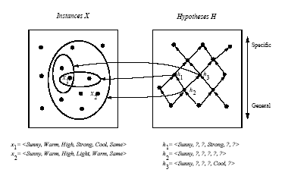
Instance, Hypotheses, and More-General-Than

Slide 8
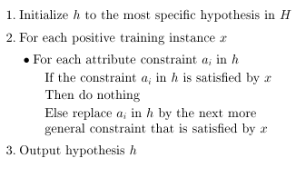
Find-S Algorithm

Slide 9
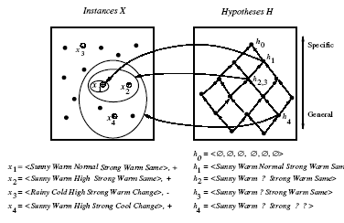
Hypothesis Space Search by Find-S

Slide 10
Complaints about Find-S
Can’t tell whether it has learned the concept
Can’t tell when training data is inconsistent
Picks a maximally specific h (why?)
  What about algorithm’s ability to generalize over unseen examples?
  Depending on H, there might be several!

Slide 11
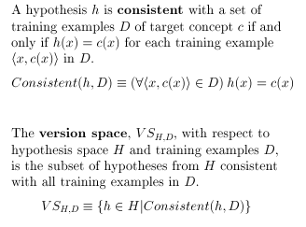
Version Spaces

Slide 12
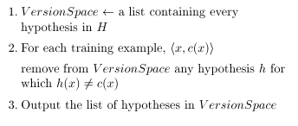
List-then-Eliminate Algorithm

Slide 13
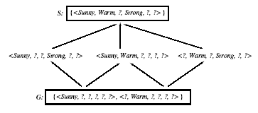
Example: Version Space

Slide 14
Representing Version Spaces
The General boundary G, of version space VS_{H,D} is the set of its maximally general members.
The Specific boundary S, of version space VS_{H,D} is the set of its maximally specific members.
Every member of the version space lies between these boundaries.

Slide 15
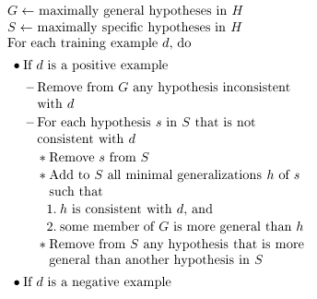
Candidate Elimination Algorithm

Slide 16
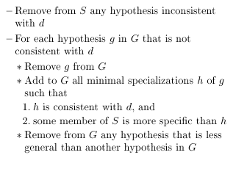
Candidate Elimination Algorithm (cont.)

Slide 17
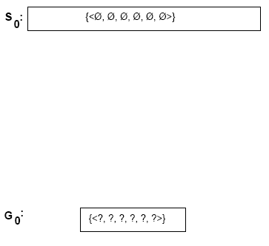
Example trace of candidate elimination

Slide 18
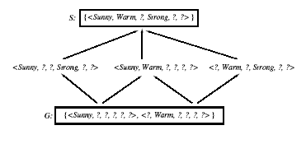
Example trace of candidate elimination

Slide 19
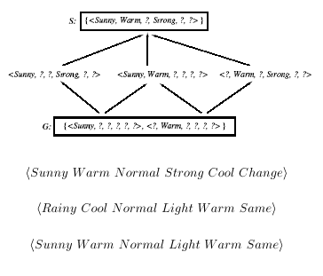
How should this these be classified?

Slide 20
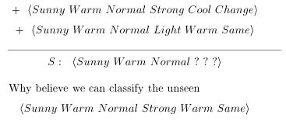
What justifies this inductive leap?

Slide 21
Inductive Bias
CANDIDATE-ELIMINATION algorithm will converge toward the true target concept.
  Provided it is given accurate training examples
  Provided its initial hypothesis space contains the target concept.

Slide 22
Biased Learner
Assume we want to make sure the hypothesis space contains the unknown target concept.
Consider a hypothesis space that only allows conjunction of attribute values.
Because of this restriction we will not be able to represent disjunctive target concepts:
  <sky=cloudy OR sky=sunny>
  We have biased the learner to only consider conjunctive hypotheses.

Slide 23
UnBiased Learner
Obvious solution is to provide a hypothesis space with every teachable concept.
For EnjoySport the instance space is 96.
How many possible concepts can be defined over these instances?
  The power set 2⁹⁶! (2^{s} set of all subsets s)

Slide 24
UnBiased Learner
Assuming we can enumerate this hypothesis space of every teachable concept.
We can represent this as arbitraty disjunctions, conjunctions and negations reflected from shown examples:
  {Sunny,?,?,?,?,?} V {Cloudy,?,?,?,?,?}
We now have another problem: our concept learning algorithm can no longer generalize!
We would end up with:
  S:{x1vX2vX3) G:{not(X4vX5}

Slide 25
The futility of bias-free learning
A learner that makes no apriori assumptions regarding the identity of the target concept has no rational basis for classifying any unseen instances.

Slide 26
The futility of bias-free learning
CANDIDATE-ELIMINATION algo. was able to generalize beyond the observed training examples because it was biased by the implicit assumption that the target concept could be represented by a conjunction of attribute values.
What is the bias of a route learner?
Decision tree?
Neural Net?

Slide 27
Inductive bias
The minimal set of assertions a concept learning algorithm makes concerning the hypothesis space containing the target concept.
I.e., an assumption about how the hypothesis space is structured, and that it can represent the target concept.

Slide 28
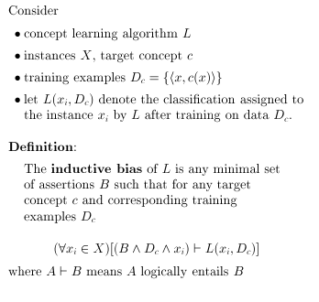
Inductive bias

Slide 29
The Futility of Bias-Free Learning
Fundamental Property of Inductive Learning
  A learner that makes no apriori assumptions regarding the identity of the target concept has no rational basis for classifying any unseen instances.
We constantly have recourse to inductive biases
  Example: we all know that the sun will rise tomorrow. Although we cannot deduce that it will do so based on the fact that it rose today, yesterday, the day before, etc., we do take this leap of faith or use this inductive bias, naturally!

Slide 30
Three Learners with Different Biases
Rote learner: Store examples, Classify x iff it matches previously observed example.
  This system simply memorizes the training data and their classification - No generalization is involved.
Version space candidate elimination algorithm
  New instances are classified only if all the hypotheses in the version space agree on the classification.
Find-S
  New instances are classified using the most specific hypothesis consistent with the training data.

Slide 31
Three Learners with Different Biases
Remebmer!
  An unbiased learner is not able to generalize beyond the observed examples!!!!

Slide 32
Summary
Concept learning as search through H
General-to-specific ordering over H
Version space candidate elimination algorithm
S and G boundaries characterize learner’s uncertainty
Learner can generate useful queries
Inductive leaps possible only if learner is biased
Inductive learners can be modeled by equivalent deductive systems.

