Slide 1
Decision Trees
CS4881 Aritificial Intelligence
Jay Urbain
Credits: Tom Mitchell, Machine Learning

Slide 2
Outline
Widely used, practical method for inductive inference.
Method for approximating discrete valued functions.
Exhaustively search hypothesis space.
Can be used for representing if-then-else rules.

Slide 3
DT Representation
Classify instances by sorting them down a tree from the root to some leaf node.
Leaf node provides classification instance.
Each node in tree specifies a test of some attribute of the instance.
Each branch descending from that node represents one of the possible values for this attribute.

Slide 4
DT Classification
Given a DT an “instance” is classified by:
  starting at the root node of the tree
  testing the attribute specified by this node
  Moving down the tree branch corresponding to the value of the attribute in the given example.
  Repeate process for each subtree rooted at the new node.
  Each leaf represents classification of instance.

Slide 5
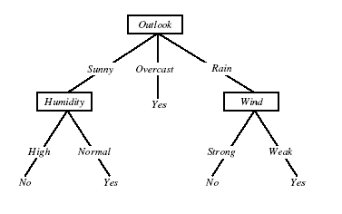
DT for Play Tennis

Slide 6
Play Tennis Example
How to classify?:
  {outlook=sunny, temperature=hot, humidity=high, wind=strong}
Decision trees represent a disjunction of conjunctions of the attribute values of instances.
For positive classification, the previous decision tree corresponds to:
  (outlook=sunny ^ humidity=high) v (outlook=overcast) v
  (outlook=rain ^ wind=weak)

Slide 7
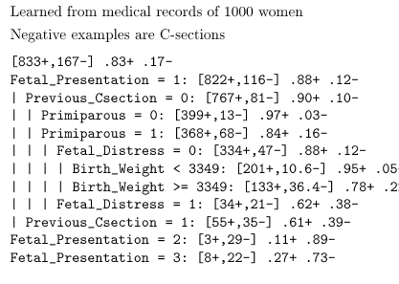
Predict C-Section Risk Example

Slide 8
Appropriate problems DT’s
Instances describable by attribute-value pairs
Target function is discrete values
Disjunctive hypothesis may be required
Possibly noisy training data
Examples:
  Equipment, or medical diagnosis
  Credit risk analysis
  Modeling calendar scheduling preferences

Slide 9
Top-down induction of DTs
Main loop:
A <- select the “best” decision attribute for next node
Assign A as decision attribute for node
For each value of A, create new descendant of node
Sort training examples to leaf nodes
If training examples perfectly classified, then STOP
Else iterate over new leaf nodes

Slide 10
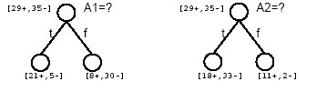
Which attribute is best?

Slide 11
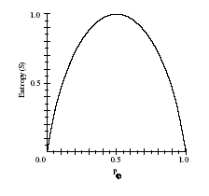

Entropy
Given, S, a set of training examples.
Entropy measures the impurity of S
p+ is proportion of positive examples of S
p- is proportion of negative examples of S

Slide 12

Entropy
Entropy(S) = expected number of bits needed to encode class(+/-) of randomly drawn member of S (under the optimal, shortest-length code)
  MDL – minimum description length
Why?
Information theory (Claude Shanon): optimal length code assigns
-log₂p bits to message having probability p.
So, expected number of bits to encode + or – examples of random member of S:

Slide 13
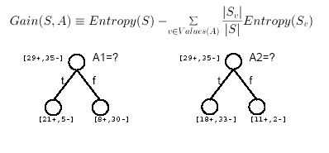
Information Gain
Gain(S,A) = expected reduction in entropy due to sorting of A

Slide 14
Calculating Info Gain
entropy(s) |  |  |  | 0.940286 |  | // 9/14*(-LOG(9/14,2))+5/14*(-LOG(5/14,2))
entropy (s, humidity for high) |  |  |  | 0.985228 |  | // 3/7*(-LOG(3/7,2))+4/7*(-LOG(4/7,2))
entropy (s, humidity for normal) |  |  |  | 0.591673 |  | // 6/7*(-LOG(6/7,2))+1/7*(-LOG(1/7,2))
Gain(S, Humidity) = entropy(s) - 7/14*entropy (s, humidity for high) - 7/14*entropy (s, humidity for normal)
Gain(S, Humidity) = |  |  |  | 0.151836 |  | // D2- 7/14*D4 - 7/14*D6

Slide 15
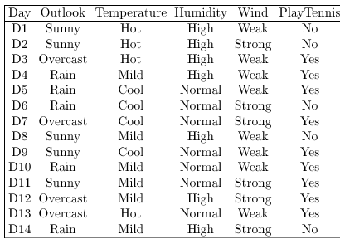
Training Examples

Slide 16
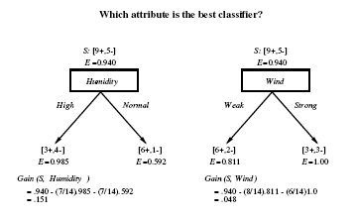
Selecting the Next Attribute

Slide 17
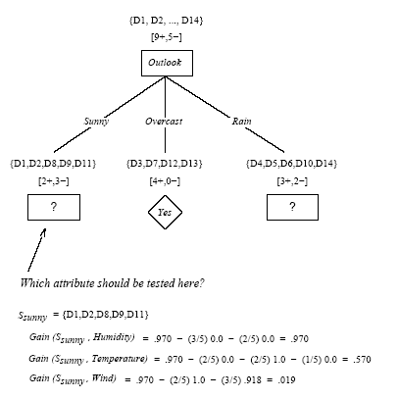

Slide 18
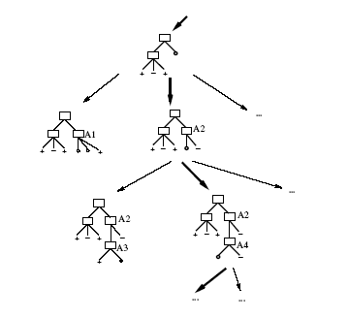
Hypothesis Space Search by ID3

Slide 19
Hypothesis Space Search by ID3
Hypothesis space is complete!
  Target function is surely in there…
Outputs a single hypothesis
No backtracing
  Local minima
Statiscally=based search choices
  Robust to noisy data
Inductive bias: approx “prefer shortest tree”

Slide 20
Inductive Bias of ID3
Note H is the power set of instances X
Unbiased?
Note really…
Prefer short trees, and for those with high info gain attributes near the root
Bias is a preference for some hypothesis, rather than a restriction of hypothesis space H
Occam’s razor: prefer the shortest hypothesis that fits the data.

Slide 21
Occam’s Razor
Why prefer short hypotheses?
Argument in favor:
Fewer short hypo’s than long hypo’s
A short hypo that fits data unlikely to be coincidence
A long hypo that fits data might be coincidence
Argument opposed:
There are many ways to define small sets of hypo’s
e.g., all trees with a prime number of nodes use attributes with “Z”
What’s so special about small sets based on size of hypothesis?

Slide 22
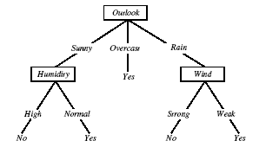
Overfitting in Decision Trees
Consider adding noisy traing example D15:
Sunny, Hot, Normal, Strong, Playtennis=No

Slide 23

Overfitting
Consider error of hypothesis h over:
  Training data: error_{train}(h)
  Entire distribution D of data: error_{D}(h)
Hypothesis h ε H overfits training data if there is an alternative hypothesis h’ ε H such that:

Slide 24
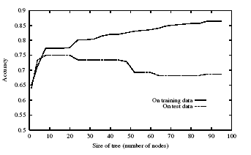
Overfitting

Slide 25
Avoiding Overfitting
Stop growing when data split not statistically significant
Grow full tree, then post-prune
How to select best tree:
  Measure performance over training data
  Measure performance over separate validation set
MDL: minimize size(tree)+size(missclassification)

Slide 26
Reduced-Error Pruning
Split data into training and validation set
Do until further pruning is harmful:
  Evaluate impact on validation set of pruning each possible node (plus those below it)
  Greedily remove the one that most improves validation set accuracy
Produces smallest version of most accurate subtree

Slide 27
Rule Post-Pruning
Convert tree to equivalent rules
Prune each rule independently of others
Sort final rule into desired sequence of use.
Most frequently used method, e.g., C4.5

Slide 28
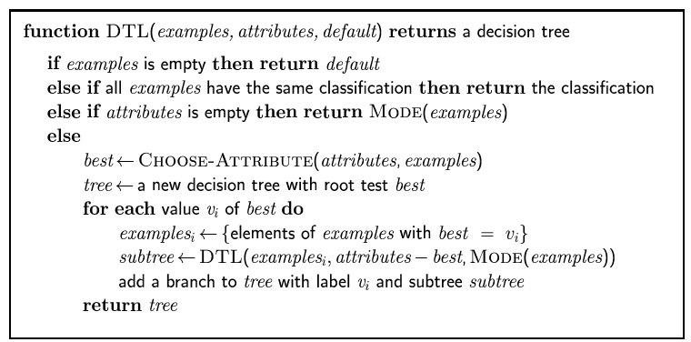
Decision tree learning
Aim: find a small tree consistent with the training examples
Idea: (recursively) choose "most significant" attribute as root of (sub)tree

