Slide 1
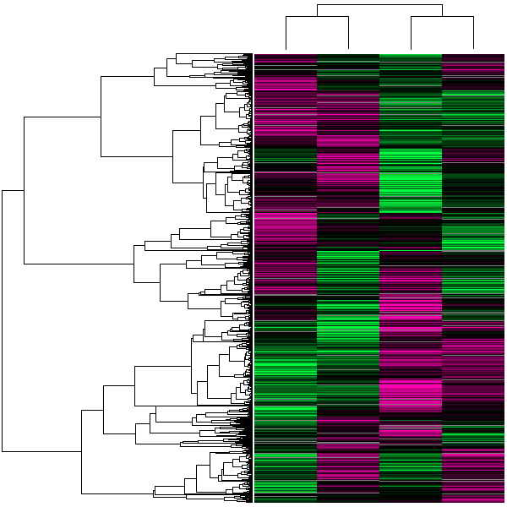
Data Mining & Knowledge Discovery in Databases
September, 2008
Jay Urbain
Ophir Frieder
Notes:
Background (no slide)
Very interested in the fields of data mining and knowledge extraction to aid decision making.
Working in the medical field for many years.
Led design and development for 3 generations of patient monitoring systems for OR and ICU.
Was part of a start-up called ThinkMed with a couple of physicians that developed a decision support system to identify patients at risk by mining medical and drug claims.
E.g., ID someone < 13 years of age, has asthma, has been in the ER > 3 times in last 6 months. Use information to contact child’s pediatrician and get them on a bronchial dilator steroid medication.
I became fascinated with data mining technology while at ThinkMed, though my in depth knowledge at the time was limited.
Became depressed analyzing data of patient’s physiological condition worsening over time in large part due to lack of appropriate medical intervention.
Patients would start with diabetes, and then develop cardiovascular, glaucoma, and renal disease over a course of many years and often a million dollars in expended health care dollars.
Many examples of physicians making major health care decisions and not being aware of the latest research and standards of care. This is especially true for more rare conditions that go undiagnosed.
Feel there is significant potential benefit in helping not only physicians but health consumers identify the most current and most relevant standards, and also help in the knowledge discovery process.
Our ability to identify and harvest knowledge from medical data can have a significant impact on the quality of patient’s lives.
In looking for a test collection to start my research, I was naturally drawn to the MEDLINE database.
Several physician friends have expressed frustration with their inability to identify the most relevant documents.
The problem is that it probably did find what they were looking for, it just found too much other stuff.
At the same time, I’ve been impressed with stories of mothers of children with rate disorders finding research in MEDLINE that was able to help a friend or family member.
My brother-in-law recently died of brain cancer. His persistence in pursing new types of medical treatment, much through his and my sister’s research extended his life for years.
The trends in health care dictate that individuals are going to have to take increasing responsibility for their own health care and the knowledge from MEDLINE literature and other sources will need to also become available to non-clinicians.

Slide 2
Overview
Introduction
Datawarehousing
Supervised learning algorithms
  Naïve Bayes
  Decision Tree
  Neural Networks
Unsupervised learning
  Clustering
  Association Rules
Bioinformatics applications
Notes:
MEDLINE provides semantic information through a hierarchy of document Medical Subject Headings.
Evaluated pseudo relevance feedback (RF) of document MeSH terms to improve MEDLINE query retrieval precision.

Slide 3
Introduction
Knowledge Discovery in Databases (KDD)
  Process of identifying knowledge from useful patterns in data.
Data Mining (DM)
  The use of machine learning algorithms to find useful information in the KDD process.

Slide 4
Data Mining versus Database
In a DB, the user knows what they are looking for. The meaning of the data is defined in the schema.
  In DM, the user might or might not know (exploratory data mining, e.g., clustering).
In DB’s the answer to the query is correct 100% of the time, provided the data is correct.
  In DM you attempt to get the answer as accurate as possible.
In DB, results are a subset of the data.
  In DM, the results are the analysis of the data.

Slide 5
Knowledge Discovery Process
Knowledge Interpretation
  Data mining: the core of knowledge discovery process.
Visualization
Data Mining
Task-relevant Data
Data transformations
Data Warehousing
Selection
Preprocessed Data
Data Cleaning
Data Integration
Databases

Slide 6
Traditional Data Mining Applications
Fraud Detection and Risk Analysis
Retail
Stock market analysis
Identifying and profiling criminals
Medical Diagnosis & Treatment
Web Mining
  What are associations among different pages?
  What are web page characteristics?
  What is the distribution of information on web?
Text mining

Slide 7
Biological Applications Requiring Innovative KDD & DM Perspectives
Interpretation of large-scale gene expression data
Protein structure prediction
Evolution and phylogenic analysis
Molecular sequence management and alignment
Recognition of genes and regulatory elements
Whole genome comparative analysis and synthesis
Modeling of biological pathways
Biomedical text mining
Drug design and combinatorial libraries

Slide 8
DM Technology Needed for Biology
Data mining and warehousing as applied to models of biology – models keep changing
Data types and algorithms needed for biological analysis
Interactive exploration and visualization for biology
New indexing and search structures with applications to biology

Slide 9
Sources of data
Entrez gene ontology
Gene expression data
Protein sequences (SWISS-PROT)
Clinical data
UMLS Metathesaurus ontology
Pubmed literature
Journal literature
Formats
  Unstructured text
  Delimited flat files
  Relational databases
  XML

Slide 10
Datawarehousing
Consolidate data from disparate data repositories into one common data source.
Organize data into a data structure to facilitate high-performance analysis across heterogeneous data sources.
Gives multidimensional view of data. Example:
  Gene
  N experimental cohorts of gene expression levels
  Gene annotation
  Gene-protein correlation
Use specialized OLAP data structures:
  Star-schema, Snow-Flakes, Galaxy.

Slide 11
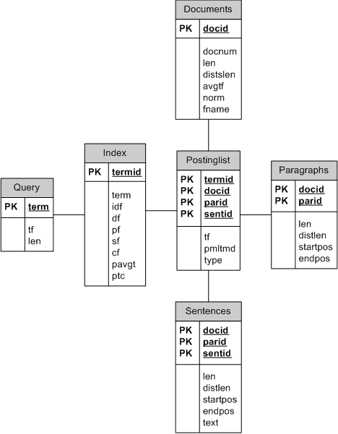
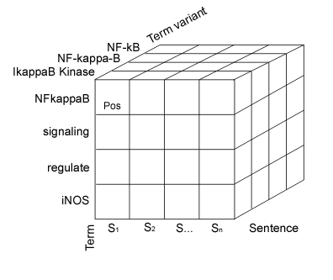
Star schema data structures

Slide 12
OLAP Style Query
  select p.docid, max(d.docnum) docnum,
  sum( ln((s.ndocs-i.df+0.5)/(i.df+0.5))*
  (((k1+1)*p.tf)/(k1*((1-b)+b*(d.len/s.avgdoclen))+p.tf))* ((k3+1)*q.tf/(k3+q.tf)) ) as sc
  from index i, documents d, query q, indexstats s,
  (
  select p2.docid, p2.termid, sum(p2.tf) tf
  from postinglist p2, invertedindex i2, query q2
  where i2.termid=p2.termid
  and i2.term=q2.term
  group by p2.docid, p2.termid ) p
  where p.docid=d.docid
  and i.termid=p.termid
  and i.term=q.term
  group by p.docid

Slide 13
Data Mining
Supervised learning algorithms
  Naïve Bayes
  Decision Tree
  Neural Networks
Unsupervised learning
  Association Rules
  Clustering

Slide 14
Machine Learning Algorithms
Supervised algorithms - learn by example.
  Use training data which has correct answers (class label).
  Create a classification model by running the algorithm on the training data.
  Test the model. If accuracy is low, regenerate model after changing features, training samples, etc.
  Use model to predict class label for new incoming data.
Unsupervised algorithms – find hidden relationships in data
  Do not use training data.
  Classes may not be known in advance.
Reinforcement learning –
  How an agent ought to take actions in an environment so as to maximize some notion of long-term reward.

Slide 15
Microarray analysis
class discovery (unsupervised classification)
class comparison (differential gene expression)
class prediction (supervised classification)

Slide 16
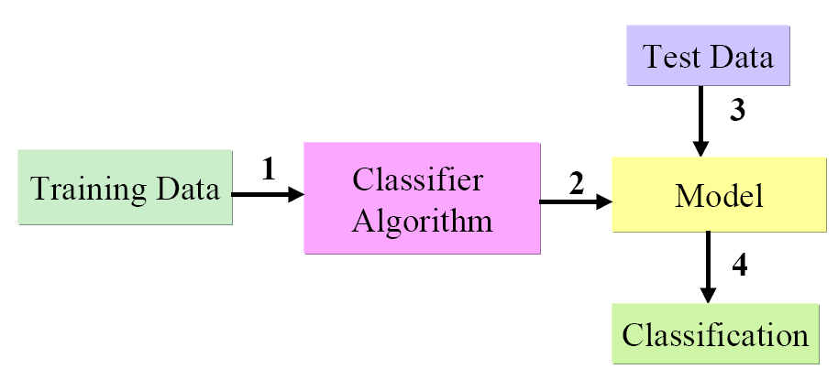
Supervised Learning

Slide 17
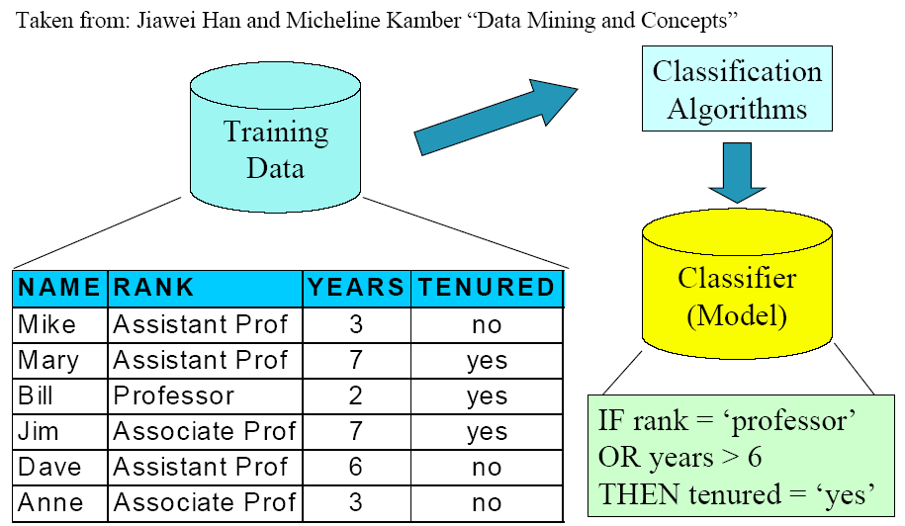
Classification

Slide 18
Evaluation
Measuring accuracy of DM results
  Use of Cross-Validation in Supervised algorithms
    Information Retrieval measures of Precision & recall.
    Various accuracy measures based on each algorithm.
  Qualitative – especially for unsupervised techniques.

Slide 19
Measuring Accuracy
Goal: Measure effectiveness of classification algorithm (supervised learning).
Take training dataset
Build model
Test using the training dataset
  Leads to overly optimistic result
  Has little ability to predict accuracy on new unseen data.

Slide 20
Measuring Accuracy
A better approach… cross validation
  Take training data set, cut it in half and use half on training, and half on testing.
  Leads to potential errors on estimating the real classification rate because the half we hold for testing may be very different than the half we used for training.

Slide 21
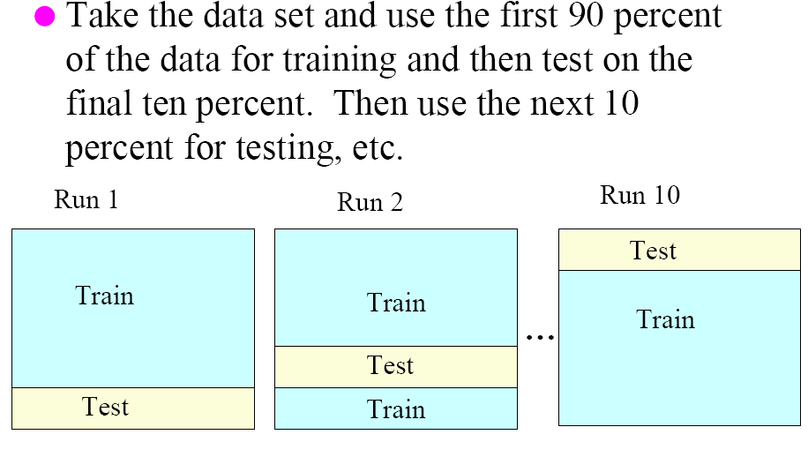
10-fold cross validation

Slide 22
10-fold cross validation
Observe the results of the N-runs of cross validation to see if the results are consistent.
If the results are not consider, either the classification model or data may have problems.
What kind of problems?

Slide 23
Potential Problems
What kind of problems?
  Data could be inherently random – there is no statistical pattern that can be learned.
    Hypothesis incorrect.
  Overfitting – the classification algorithm learns a model that is too specific to the training data, and is then unable to generalize to new data.
  The data set could be too small to learn a statistically significant classification model.
  Outliers in the data could skew results.
  Feature attributes selected for classification are not effective.
    No statistical significance.

Slide 24
Classification Notes
Training data and selection of feature attributes are important factors in building a supervised learning model.
Classification results generated by different algorithms (Naïve Bayes, Decision Trees, Neural Networks, Support Vector Machines, etc.) typically not statistically significant.
Different classification algorithms can take different time to train and build.
Some algorithms produce models that are easy to interpret (Naïve Bayes, Decision Trees).
Other algorithms are more like a black box (Neural Networks, and to a lesser extent SVM).

Slide 25
Naïve Bayes Classification
CS4881 Artificial Intelligence
Jay Urbain
Credits:
Machine Learning, Tom Mitchell
AIMA, Russell and Norvig

Slide 26
Naïve Bayes Classifier
Bayes theorem
Combines probability of each feature with respect to class label.
Example:
  Makes strong independence assumption between features.
  Classify email as spam based on sender, and text
  Diagnose meningitis based on chest-xray, symptom

Slide 27
Uncertainty in Bioinformatics
  Uncertainty often affects molecular biology experiments and data for different reasons.
    Heterogeneity of gene or protein expression within the same tumor tissue.

Slide 28
Review conditional probability
Can factor joint probability using chain rule:
  P(a, b) = P(a | b) P(b) = P(b | a) P(a)
This is amazing, we can express joint probability by conditioning on a or b:
  P(a | b) P(b) = P(b | a) P(a)
… and derive Bayes Theorem:
  P(a | b) = P(b | a) P(a)/ P(b)
  P(b | a) = P(a | b) P(b)/ P(a)

Slide 29
Naïve Bayes Classifier
Lets say we have a hypothesis, & we want to calculate the probability of the hypothesis being correct.
Hypothesis:
  given a set of features (gene expression levels) what is the probability that a set of genes are co-expressed for cancer?
  Where X={x₁, x_{2,…,}x_{n}} is the set of gene expression levels.
Classification probabilities:
  P(C=genes co-expressed | X)
  P(not C=genes not co-expressed | X)

Slide 30
Bayes Theorem - Learning
From training data calculate P(X|C), P(X), and P(C).
P(X|C) Likelihood of X conditioned on class C
  Shows the confidence/probability of X given C from training data.
  Given C is true, calculate probability that feature set X, where X= {x₁, x₂} has the following feature values:
  x₁= gene 1 expressed
  x₂= gene 2 expressed.
P(X) Prior probability of X (normalization constant).
  Represents the prior probability that x₁ and x₂ are expressed independent of us knowing anything else.
P(C_{i}) is the ratio of total samples with class C_{i} = cancer to all samples.

Slide 31

Bayes Theorem - Learning
Hypothesis that the 2 genes are co-expressed for cancer is the class C_{i.} = cancer
  Note: P (X) can be ignored as it is constant for all classes. For proper probabilities include in denominator.
Assuming the independence assumption, P(X|C_{i}) is:

Slide 32
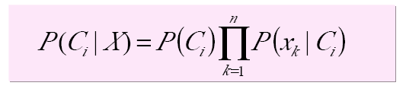
Naïve Bayes Classification
P(C|X) Posterior probability of hypothesis class C
  X: {x₁, x_{2…,} x_{n}}
  Shows the confidence/probability of C given X
  x₁: gene 1 expression level, x₂: gene 2 expression level
  C: cancer

Slide 33
Naïve Bayes Classification
For categorical attribute:
  P(x_{k}|C_{i}) is the frequency of samples having value x_{k} in class C_{i}.
For continuous (numeric) attribute:
  P(x_{k}|C_{i}) is calculated via a Gaussian density function.

Slide 34
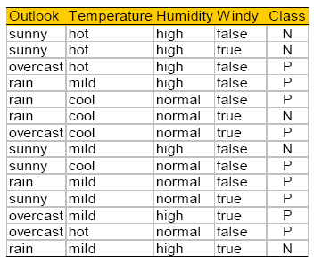
Play Tennis? (Tom Mitchell)

Slide 35
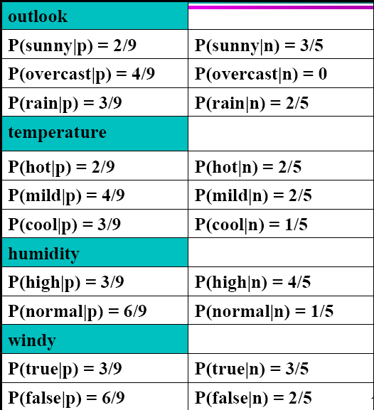
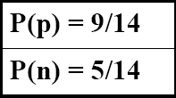
Play Tennis Example: estimating P(x_{i}|C)

Slide 36
Play Tennis Example: estimating P(C_{i}|x_{i})
An incoming sample: X = <sunny, cool, high, true>
P(play|X) = P(X|p)*P(p) =
  P(p)*P(sunny|p)*P(cool|p)*P(high|p)*p(true|p)
  9/14 * 2/9 * 3/9 * 3/9 * 3/9= 0.0053
P(no play|X) = P(X|p)*P(n) =
  P(n)*P(sunny|n)*P(cool|n)*P(high|n)*p(true|n)
  5/14 * 3/5 * 1/5 * 4/5 * 3/5 = 0.0206
  Class n (no play) has higher probability than class p (play) for example X.

Slide 37
Decision Trees
CS4881 Artificial Intelligence
Jay Urbain
Credits: Tom Mitchell, Machine Learning

Slide 38
Outline
Widely used, practical method for inductive inference.
Method for approximating discrete valued functions.
Exhaustively search hypothesis space.
Can be used for representing if-then-else rules.

Slide 39
DT Representation
Classify instances by sorting them down a tree from the root to some leaf node.
Leaf node provides classification instance.
Each node in tree specifies a test of some attribute of the instance.
Each branch descending from that node represents one of the possible values for this attribute.

Slide 40
DT Classification
Given a DT an “instance” is classified by:
  starting at the root node of the tree
  testing the attribute specified by this node
  Moving down the tree branch corresponding to the value of the attribute in the given example.
  Repeat process for each subtree rooted at the new node.
  Each leaf represents classification of instance.

Slide 41
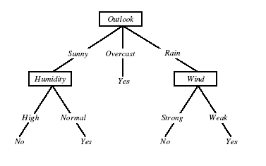
DT for Play Tennis

Slide 42
Play Tennis Example
How to classify?:
  {outlook=sunny, temperature=hot, humidity=high, wind=strong}
Decision trees represent a disjunction of conjunctions of the attribute values of instances.
For positive classification, the previous decision tree corresponds to:
  (outlook=sunny ^ humidity=high) v (outlook=overcast) v
  (outlook=rain ^ wind=weak)

Slide 43
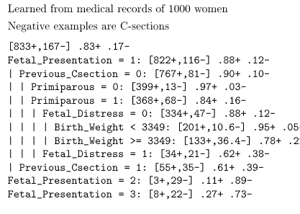
Predict C-Section Risk Example

Slide 44
Appropriate problems DT’s
Instances describable by attribute-value pairs
Target function is discrete values
Disjunctive hypothesis may be required
Possibly noisy training data
Examples:
  Gene expression
  Equipment, or medical diagnosis
  Credit risk analysis
  Modeling calendar scheduling preferences

Slide 45
Top-down induction of DTs
Main loop:
A <- select the “best” decision attribute for next node
Assign A as decision attribute for node
For each value of A, create new descendant of node
Sort training examples to leaf nodes
If training examples perfectly classified, then STOP
Else iterate over new leaf nodes

Slide 46
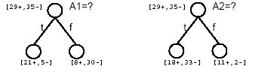
Which attribute is best?

Slide 47
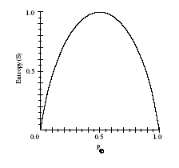

Entropy
Given, S, a set of training examples.
Entropy measures the impurity of S
p+ is proportion of positive examples of S
p- is proportion of negative examples of S

Slide 48
STOP for Bioinformatics
Entropy calculation included in following slides.

Slide 49

Entropy
Entropy(S) = expected number of bits needed to encode class(+/-) of randomly drawn member of S (under the optimal, shortest-length code)
  MDL – minimum description length
Why?
Information theory (Claude Shanon): optimal length code assigns
-log₂p bits to message having probability p.
So, expected number of bits to encode + or – examples of random member of S:

Slide 50
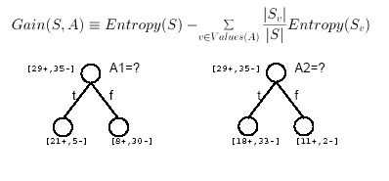
Information Gain
Gain(S,A) = expected reduction in entropy due to sorting of A

Slide 51
Calculating Info Gain
entropy(s) |  |  |  | 0.940286 |  | // 9/14*(-LOG(9/14,2))+5/14*(-LOG(5/14,2))
entropy (s, humidity for high) |  |  |  | 0.985228 |  | // 3/7*(-LOG(3/7,2))+4/7*(-LOG(4/7,2))
entropy (s, humidity for normal) |  |  |  | 0.591673 |  | // 6/7*(-LOG(6/7,2))+1/7*(-LOG(1/7,2))
Gain(S, Humidity) = entropy(s) - 7/14*entropy (s, humidity for high) - 7/14*entropy (s, humidity for normal)
Gain(S, Humidity) = |  |  |  | 0.151836 |  | // D2- 7/14*D4 - 7/14*D6

Slide 52
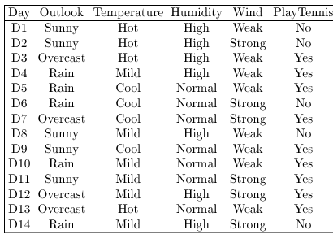
Training Examples

Slide 53
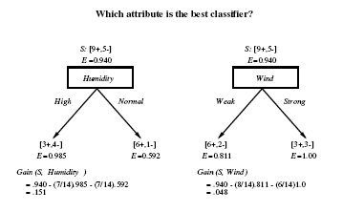
Selecting the Next Attribute

Slide 54
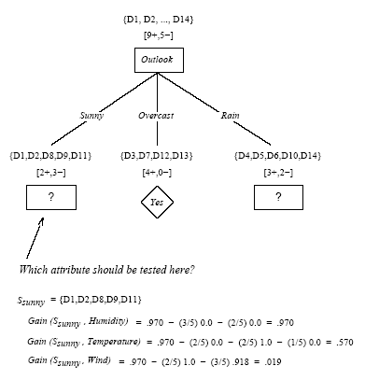

Slide 55
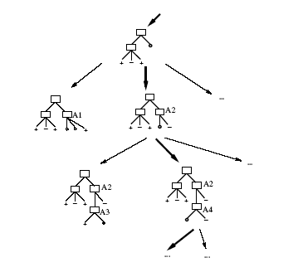
Hypothesis Space Search by ID3

Slide 56
Hypothesis Space Search by ID3
Hypothesis space is complete!
  Target function is surely in there…
Outputs a single hypothesis
No backtracing
  Local minima
Statiscally=based search choices
  Robust to noisy data
Inductive bias: approx “prefer shortest tree”

Slide 57
Inductive Bias of ID3
Note H is the power set of instances X
Unbiased?
Note really…
Prefer short trees, and for those with high info gain attributes near the root
Bias is a preference for some hypothesis, rather than a restriction of hypothesis space H
Occam’s razor: prefer the shortest hypothesis that fits the data.

Slide 58
Occam’s Razor
Why prefer short hypotheses?
Argument in favor:
Fewer short hypo’s than long hypo’s
A short hypo that fits data unlikely to be coincidence
A long hypo that fits data might be coincidence
Argument opposed:
There are many ways to define small sets of hypo’s
e.g., all trees with a prime number of nodes use attributes with “Z”
What’s so special about small sets based on size of hypothesis?

Slide 59
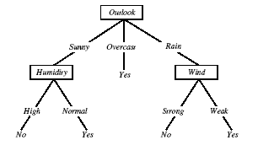
Overfitting in Decision Trees
Consider adding noisy traing example D15:
Sunny, Hot, Normal, Strong, Playtennis=No

Slide 60

Overfitting
Consider error of hypothesis h over:
  Training data: error_{train}(h)
  Entire distribution D of data: error_{D}(h)
Hypothesis h ε H overfits training data if there is an alternative hypothesis h’ ε H such that:

Slide 61
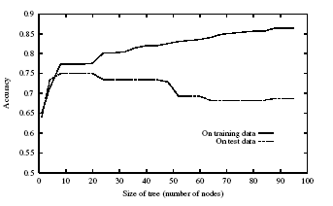
Overfitting

Slide 62
Avoiding Overfitting
Stop growing when data split not statistically significant
Grow full tree, then post-prune
How to select best tree:
  Measure performance over training data
  Measure performance over separate validation set
MDL: minimize size(tree)+size(missclassification)

Slide 63
Reduced-Error Pruning
Split data into training and validation set
Do until further pruning is harmful:
  Evaluate impact on validation set of pruning each possible node (plus those below it)
  Greedily remove the one that most improves validation set accuracy
Produces smallest version of most accurate subtree

Slide 64
Rule Post-Pruning
Convert tree to equivalent rules
Prune each rule independently of others
Sort final rule into desired sequence of use.
Most frequently used method, e.g., C4.5

Slide 65
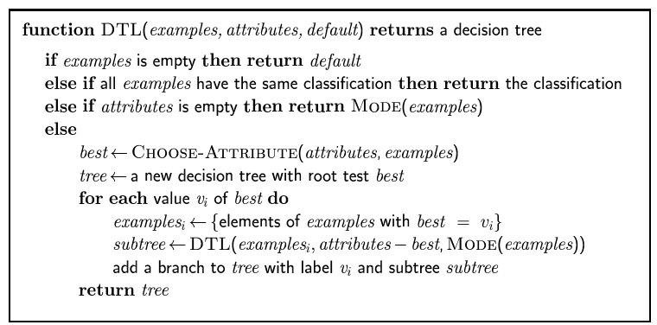
Decision tree learning
Aim: find a small tree consistent with the training examples
Idea: (recursively) choose "most significant" attribute as root of (sub)tree

Slide 66
Cluster Analysis
CS4881 Aritificial Intelligence
Jay Urbain
Credits:
Tom Mitchell, Machine Learning
Jiawei Han and Micheline Kamber, Data Mining

Slide 67
Cluster Analysis
What is Cluster Analysis?
Types of Data in Cluster Analysis
A Categorization of Major Clustering Methods
Partitioning Methods
Hierarchical Methods
Summary

Slide 68
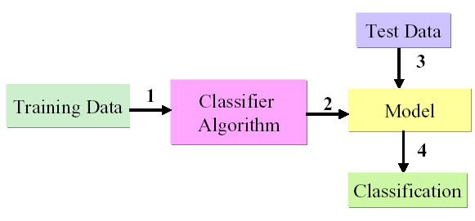
Supervised Learning
Supervised Learning
Learn by example from training data with a class label
Create classification model by running algorithm on training data
Identify a class label for the incoming new data

Slide 69
Unsupervised Learning Algorithms
There are many machine learning situations in which class labels are not available, so unsupervised methods are needed.
Unsupervised Learning Algorithms
  Clustering
  Markov Chain Monte Carlo
  Association Rules - Apriori

Slide 70
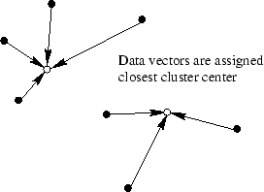
Clustering
Clustering is a widespread technique that clusters data into groups that reflect distinct regions of the decision space.

Slide 71
One of the first clustering applications?
During a cholera outbreak in London in 1854, John Snow used a special map to plot the cases of the disease that were reported.
A key observation, after the creation of the map, was the close association between the density of disease cases and a single well located at a central street.
After this, the well pump was removed putting an end to the epidemic.[4,5]

Slide 72
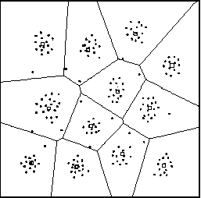
What is Cluster Analysis?
Cluster: a collection of data objects
  Similar to one another within the same cluster
  Dissimilar to the objects in other clusters
Cluster analysis
  Grouping a set of data objects into clusters
Clustering is unsupervised classification: no predefined classes

Slide 73
General Applications
Typical applications
  As a stand-alone tool to get insight into data distribution
  As a preprocessing step for other algorithms
General Applications
  Molecular biology
  Pattern Recognition
  Spatial Data Analysis
  Image Processing
  Market research
  Document/text classification
  Cluster Web log data discover search groups

Slide 74
Specific Applications
Molecular Biology: Gene expression
Text mining: Identify frequently co-occurring terms for concept identification.
Marketing: Discover distinct groups for targeted marketing programs
Land use: Identification of areas of similar land use
Insurance: Identifying groups with a high claim cost
City-planning: Identifying groups of houses according to their house type, value, and geographical location
Earth-quake studies: Epicenters should be clustered along continent faults.

Slide 75
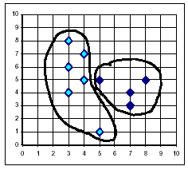
What Is Good Clustering?
A good clustering method will produce high quality clusters with
  high intra-class similarity
  low inter-class similarity
Dependent on method used, data/domain, and implementation.
Quality measured by its ability to discover some or all of the hidden patterns.

Slide 76


Data Structures
Data matrix
  (two modes)
Dissimilarity matrix
  (one mode)

Slide 77
Measure the Quality of Clustering
Dissimilarity/Similarity metric: Similarity is expressed in terms of a distance function, which is typically metric: d(i, j)
There is a separate “quality” function that measures the “goodness” of a cluster.
Distance functions are different for interval-scaled, Boolean, categorical, ordinal and ratio variables.
Hard to define “similar enough” or “good enough” - subjective

Slide 78
Type of data in clustering analysis
Interval-scaled variables
  Continuous measurements of roughly linear scale
Binary variables
  Symmetric e.g. M/F, Asymmetric e.g. Income category
Nominal (categorical), ordinal (ordered), and ratio variables (positive non-linear/exponential
Variables of mixed types

Slide 79



Interval-valued variables
Standardize data
  Calculate the mean absolute deviation:
  where
  Calculate the standardized measurement (z-score)
Using mean absolute deviation is more robust than using standard deviation

Slide 80

Similarity and Dissimilarity Between Objects
Distances are normally used to measure the similarity or dissimilarity between two data objects
Some popular ones include: Manhattan distance (block distance).

Slide 81

Similarity and Dissimilarity Between Objects (Cont.)
If q = 2, d is Euclidean distance:
  Properties
    d(i,j) ≥ 0
    d(i,i) = 0
    d(i,j) = d(j,i)
    d(i,j) ≤ d(i,k) + d(k,j)
Also one can use weighted distance, parametric Pearson product moment correlation, or other dissimilarity measures.

Slide 82



Binary Variables
A contingency table for binary data
Simple matching coefficient (invariant, if the binary variable is symmetric):
Jaccard coefficient (non-invariant if the binary variable is asymmetric) disregard negative matches:
Object j
Object i

Slide 83


Dissimilarity between Binary Variables
Example
  gender is a symmetric attribute
  the remaining attributes are asymmetric binary
  let the values Y and P be set to 1, and the value N be set to 0

Slide 84

Nominal Variables
A generalization of the binary variable in that it can take more than 2 states, e.g., red, yellow, blue, green
Method 1: Simple matching
  m: # of matches, p: total # of variables
Method 2: use a large number of binary variables
  creating a new binary variable for each of the M nominal states

Slide 85


Ordinal Variables
An ordinal variable can be discrete or continuous
order is important, e.g., rank
Can be treated like interval-scaled
  replacing x_{if} by their rank
  map the range of each variable onto [0, 1] by replacing i-th object in the f-th variable by
  compute the dissimilarity using methods for interval-scaled variables

Slide 86
Ratio-Scaled Variables
Ratio-scaled variable: a positive measurement on a nonlinear scale, approximately at exponential scale, such as Ae^{Bt} or Ae^{-Bt}
Methods:
  treat them like interval-scaled variables — not a good choice! (why?)
  apply logarithmic transformation
y_{if} = log(x_{if})
  treat them as continuous ordinal data treat their rank as interval-scaled.

Slide 87


Variables of Mixed Types
A database may contain all the six types of variables
  symmetric binary, asymmetric binary, nominal, ordinal, interval and ratio.
One may use a weighted formula to combine their effects.
  f is binary or nominal:
    d_{ij}^{(f)} = 0 if x_{if} = x_{jf} , or d_{ij}^{(f)} = 1 o.w.
  f is interval-based: use the normalized distance
  f is ordinal or ratio-scaled
    compute ranks r_{if} and
    and treat z_{if} as interval-scaled

Slide 88
Major Clustering Approaches
Partitioning algorithms: Construct various partitions and then evaluate them by some criterion
Hierarchy algorithms: Create a hierarchical decomposition of the set of data (or objects) using some criterion
Density-based: based on connectivity and density functions
Grid-based: based on a multiple-level granularity structure
Model-based: A model is hypothesized for each of the clusters and the idea is to find the best fit of that model to each other

Slide 89
Partitioning Algorithms: Basic Concept
Partitioning method: Construct a partition of a database D of n objects into a set of k clusters
Given a k, find a partition of k clusters that optimizes the chosen partitioning criterion
  Global optimal: exhaustively enumerate all partitions
  Heuristic methods: k-means and k-mediods algorithms
  k-means (MacQueen’67): Each cluster is represented by the center of the cluster
  k-mediods or PAM (Partition around mediods) (Kaufman & Rousseeuw’87): Each cluster is represented by one of the objects in the cluster .

Slide 90
The K-Means Clustering Method
Given k, the k-means algorithm is implemented in 4 steps:
  Partition objects into k nonempty subsets
  Compute seed points as the centroids of the clusters of the current partition. The centroid is the center (mean point) of the cluster.
  Assign each object to the cluster with the nearest seed point.
  Go back to Step 2, stop when no more new assignment.

Slide 91

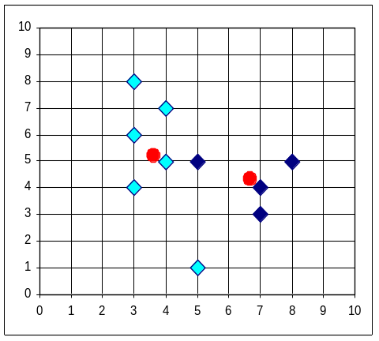


The K-Means Clustering Method
Example

Slide 92
Comments on the K-Means Method
Strength
  Relatively efficient: O(tkn), where n is # objects, k is # clusters, and t is # iterations. Normally, k, t << n.
  Often terminates at a local optimum. The global optimum may be found using techniques such as: deterministic annealing and genetic algorithms
Weakness
  Applicable only when mean is defined, then what about categorical data?
  Need to specify k, the number of clusters, in advance
  Unable to handle noisy data and outliers
  Not suitable to discover clusters with non-convex shapes

Slide 93
Variations of the K-Means Method
A few variants of the k-means which differ in
  Selection of the initial k means
  Dissimilarity calculations
  Strategies to calculate cluster means
Handling categorical data: k-modes (Huang’98)
  Replacing means of clusters with modes
  Using new dissimilarity measures to deal with categorical objects
  Using a frequency-based method to update modes of clusters
  A mixture of categorical and numerical data: k-prototype method

Slide 94
The K-Medoids Clustering Method
Find representative objects, called medoids, in clusters
PAM (Partitioning Around Medoids, 1987)
  starts from an initial set of medoids and iteratively replaces one of the medoids by one of the non-medoids if it improves the total distance of the resulting clustering
  PAM works effectively for small data sets, but does not scale well for large data sets
CLARA (Kaufmann & Rousseeuw, 1990)
CLARANS (Ng & Han, 1994): Randomized sampling
Focusing + spatial data structure (Ester et al., 1995)

Slide 95
Hierarchical Clustering
Use distance matrix as clustering criteria. This method does not require the number of clusters k as an input, but needs a termination condition
Step 0
Step 1
Step 2
Step 3
Step 4
agglomerative
a
a b
b
a b c d e
c
c d e
d
d e
e
divisive
Step 4
Step 3
Step 2
Step 1
Step 0

Slide 96

Agglomerative Nesting
Introduced in Kaufmann and Rousseeuw (1990)
Use the Single-Link method and the dissimilarity matrix.
Merge nodes that have the least dissimilarity
Go on in a non-descending fashion
Eventually all nodes belong to the same cluster

Slide 97
A Dendrogram Shows How the Clusters are Merged Hierarchically
  Decompose data objects into a several levels of nested partitioning (tree of clusters), called a dendrogram.
  A clustering of the data objects is obtained by cutting the dendrogram at the desired level, then each connected component forms a cluster.

Slide 98
Divisive Analysis
Introduced in Kaufmann and Rousseeuw (1990)
Inverse order
Eventually each node forms a cluster on its own

Slide 99
More on Hierarchical Clustering Methods
Major weakness of agglomerative clustering methods
  do not scale well: time complexity of at least O(n²), where n is the number of total objects
  can never undo what was done previously
Integration of hierarchical with distance-based clustering
  BIRCH (1996): uses CF-tree and incrementally adjusts the quality of sub-clusters
  CURE (1998): selects well-scattered points from the cluster and then shrinks them towards the center of the cluster by a specified fraction
  CHAMELEON (1999): hierarchical clustering using dynamic modeling

Slide 100
Summary
Cluster analysis groups objects based on their similarity and has wide applications
Measure of similarity can be computed for various types of data
Clustering algorithms can be categorized into partitioning methods, hierarchical methods, density-based methods, grid-based methods, and model-based methods
Outlier detection and analysis are very useful for fraud detection, etc. and can be performed by statistical, distance-based or deviation-based approaches
There are still lots of research issues on cluster analysis, such as constraint-based clustering

Slide 101
Reference
R. Agrawal, J. Gehrke, D. Gunopulos, and P. Raghavan. Automatic subspace clustering of high dimensional data for data mining applications. SIGMOD'98
M. R. Anderberg. Cluster Analysis for Applications. Academic Press, 1973.
M. Ankerst, M. Breunig, H.-P. Kriegel, and J. Sander. Optics: Ordering points to identify the clustering structure, SIGMOD’99.
P. Arabie, L. J. Hubert, and G. De Soete. Clustering and Classification. World Scietific, 1996
M. Ester, H.-P. Kriegel, J. Sander, and X. Xu. A density-based algorithm for discovering clusters in large spatial databases. KDD'96.
M. Ester, H.-P. Kriegel, and X. Xu. Knowledge discovery in large spatial databases: Focusing techniques for efficient class identification. SSD'95.
D. Fisher. Knowledge acquisition via incremental conceptual clustering. Machine Learning, 2:139-172, 1987.
D. Gibson, J. Kleinberg, and P. Raghavan. Clustering categorical data: An approach based on dynamic systems. In Proc. VLDB’98.
S. Guha, R. Rastogi, and K. Shim. Cure: An efficient clustering algorithm for large databases. SIGMOD'98.
A. K. Jain and R. C. Dubes. Algorithms for Clustering Data. Printice Hall, 1988.

Slide 102
References
L. Kaufman and P. J. Rousseeuw. Finding Groups in Data: an Introduction to Cluster Analysis. John Wiley & Sons, 1990.
E. Knorr and R. Ng. Algorithms for mining distance-based outliers in large datasets. VLDB’98.
G. J. McLachlan and K.E. Bkasford. Mixture Models: Inference and Applications to Clustering. John Wiley and Sons, 1988.
P. Michaud. Clustering techniques. Future Generation Computer systems, 13, 1997.
R. Ng and J. Han. Efficient and effective clustering method for spatial data mining. VLDB'94.
E. Schikuta. Grid clustering: An efficient hierarchical clustering method for very large data sets. Proc. 1996 Int. Conf. on Pattern Recognition, 101-105.
G. Sheikholeslami, S. Chatterjee, and A. Zhang. WaveCluster: A multi-resolution clustering approach for very large spatial databases. VLDB’98.
W. Wang, Yang, R. Muntz, STING: A Statistical Information grid Approach to Spatial Data Mining, VLDB’97.
T. Zhang, R. Ramakrishnan, and M. Livny. BIRCH : an efficient data clustering method for very large databases. SIGMOD'96.

Slide 103
Bioinformatics
Computational branch of bioinformatics.
  Computational solutions to the analysis of biological data.
Computational Biology
Computational solutions to models of biological phenomena.
Notes:
MEDLINE provides semantic information through a hierarchy of document Medical Subject Headings.
Evaluated pseudo relevance feedback (RF) of document MeSH terms to improve MEDLINE query retrieval precision.

