Slide 1
Bayesian networks
CS4881 Artificial Intelligence
Jay Urbain, PhD
Credits:
Judea Pearl, “Causality: Models, Reasoning, and Inference”
Russell and Norvig, AIMA

Slide 2
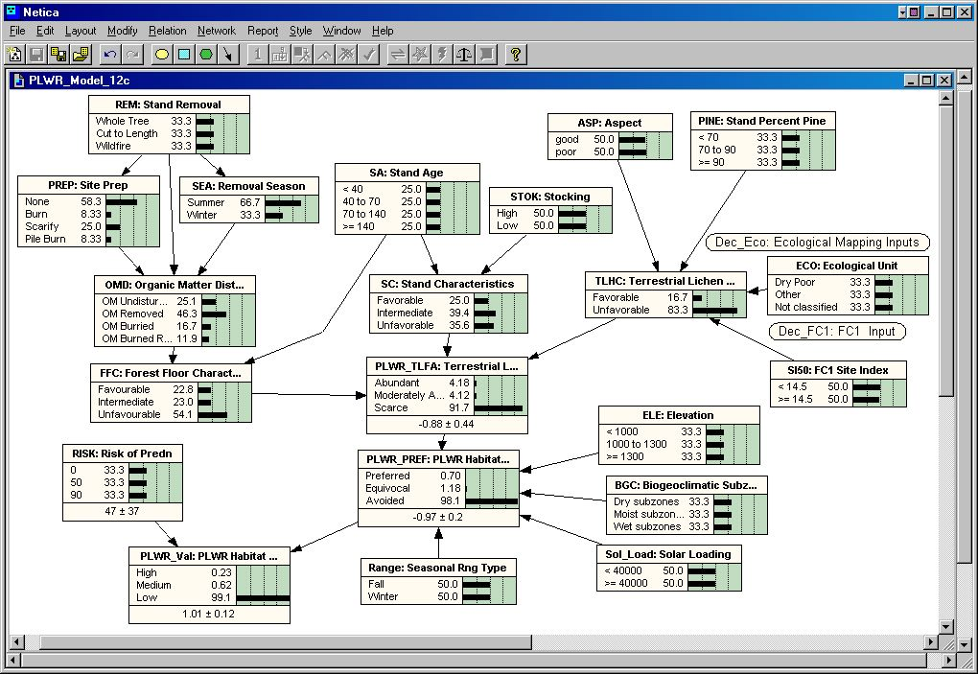
Outline
Introduction to Bayesian Networks
Syntax
Semantics

Slide 3
Bayesian networks
Graphical notation for conditional independence assertions of full joint distributions.
Syntax:
  a set of nodes, one per random variable
  a directed, acyclic graph (Semantics: link ≈ "directly influences“ or “causes”)
  a conditional distribution for each node given its parents:
    P (X_{i} | Parents (X_{i}))
In the simplest case, conditional distributions are represented as a conditional probability table (CPT) giving the distribution over each random variable X_{i} for each combination of parent values.

Slide 4

Example
Topology of network encodes conditional independence assertions:
Weather is independent of the other variables.
Toothache and Catch are conditionally independent given Cavity.

Slide 5
Example
I'm at work, neighbor John calls to say my alarm is ringing, but neighbor Mary doesn't call. Sometimes it's set off by minor earthquakes. Is there a burglar?
Variables: Burglary, Earthquake, Alarm, JohnCalls, MaryCalls
Network topology reflects "causal" knowledge:
  A burglar can set the alarm off
  An earthquake can set the alarm off
  The alarm can cause Mary to call
  The alarm can cause John to call

Slide 6
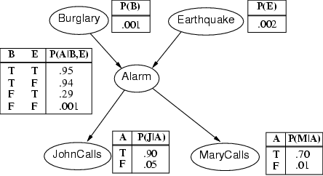
Example cont’d.

Slide 7
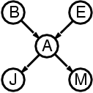
Compactness
A CPT for Boolean random variable X_{i} with k Boolean parents has 2^{k} rows for the combinations of parent values, i.e., 2 parents => 4 rows
Each row requires one number p for X_{i} = true
(the number for X_{i} = false is just 1-p)
If each variable has no more than k parents, the complete network of n variables requires O(n · 2^{k}) numbers
I.e., the network grows linearly in n, vs. O(2^{n}) for the full joint distribution
For burglary net, 1 + 1 + 4 + 2 + 2 = 10 numbers (vs. 2⁵-1 = 31)
Note: Show factorization!

Slide 8
Semantics
The full joint distribution is defined as the product of the local conditional distributions:
P (X₁, … ,X_{n}) = π_{i = 1} P (X_{i} | Parents(X_{i}))
e.g., P(j ∧ m ∧ a ∧ ¬b ∧ ¬e)
= P (j | a) P (m | a) P (a | ¬b, ¬e) P (¬b) P (¬e)
= 0.90 * 0.70 * 0.001 * 0.999 * 0.998
n

Slide 9
Constructing Bayesian networks
1. Choose an ordering of variables X₁, … ,X_{n}
2. For i = 1 to n
  add X_{i} to the network
  select parents from X₁, … ,X_{i-1}
  P (X_{i} | Parents(X_{i})) = P (X_{i} | X₁, ... X_{i-1})
This choice of parents guarantees (conditional indepedance):
P (X₁, … ,X_{n}) = π_{i =1} P (X_{i} | X₁, … , X_{i-1}) (chain rule)
= π_{i =1}P (X_{i} | Parents(X_{i})) (by construction)
n
n

Slide 10
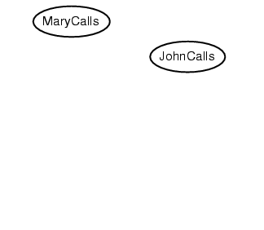
Example
Suppose we choose the ordering M, J, A, B, E
P(J | M) = P(J)?

Slide 11
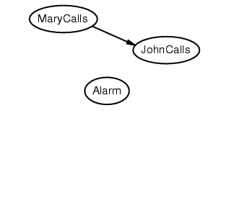
Example
Suppose we choose the ordering M, J, A, B, E
P(J | M) = P(J)? No
P(A | J, M) = P(A | J)?, P(A | J, M) = P(A)?

Slide 12
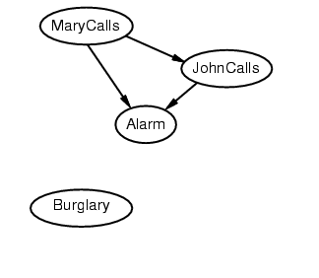
Example
Suppose we choose the ordering M, J, A, B, E
P(J | M) = P(J)? No
P(A | J, M) = P(A | J)? P(A | J, M) = P(A)? No
P(B | A, J, M) = P(B | A)?
P(B | A, J, M) = P(B)?

Slide 13
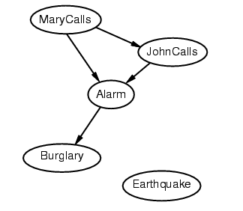
Example
Suppose we choose the ordering M, J, A, B, E
P(J | M) = P(J)? No
P(A | J, M) = P(A | J)? P(A | J, M) = P(A)? No
P(B | A, J, M) = P(B | A)? Yes
P(B | A, J, M) = P(B)? No
P(E | B, A ,J, M) = P(E | A)?
P(E | B, A, J, M) = P(E | A, B)?

Slide 14
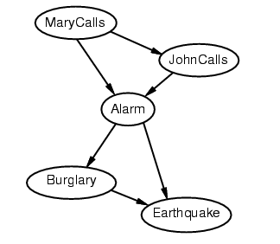
Example
Suppose we choose the ordering M, J, A, B, E
P(J | M) = P(J)? No
P(A | J, M) = P(A | J)? P(A | J, M) = P(A)? No
P(B | A, J, M) = P(B | A)? Yes
P(B | A, J, M) = P(B)? No
P(E | B, A ,J, M) = P(E | A)? No/Yes?
P(E | B, A, J, M) = P(E | A, B)? Yes

Slide 15
Example contd.
Deciding conditional independence is hard in non-causal directions
Causal models and conditional independence seem hardwired for humans!
Network is less compact: 1 + 2 + 4 + 2 + 4 = 13 numbers needed

Slide 16
Summary
Bayesian networks provide a natural representation for (causally induced) conditional independence
Topology + CPTs = compact representation of joint distribution
Generally easy for domain experts to construct
Very powerful real world systems
Note: Example…

