Slide 1
Learning from Observations
CS4881 Artificial Intelligence
Jay Urbain, PhD

Slide 2
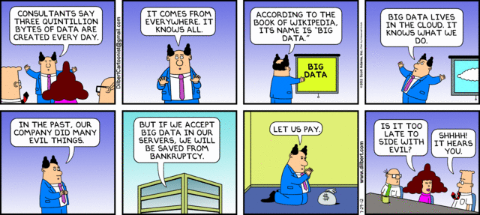
Outline
Learning agents
Inductive learning
Decision tree learning

Slide 3
Learning
Learning is essential for unknown environments,
  i.e., when designer lacks omniscience.
Learning is useful as a system construction method,
  i.e., expose the agent to reality rather than trying to write it down.
Learning modifies the agent's decision mechanism to improve performance.

Slide 4
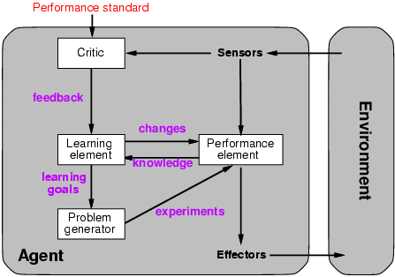
Learning agents

Slide 5
Learning element
Design of a learning element is affected by
  Which components of the performance element are to be learned
  What feedback is available to learn for these components
  What representation is used for the components
Type of feedback:
  Supervised learning: correct answers for each example
  Semi-supervised learning: correct answers for some examples
  Unsupervised learning: correct answers not given
  Reinforcement learning: occasional rewards

Slide 6
Machine Learning
Supervised learning algorithms
  Naïve Bayes
  Decision Tree
  Neural Networks
  Support Vector Machines
Unsupervised learning
  Association Rules
  Clustering
  Markov Chain Monte Carlo
Reinforcement learning (later)
  Q-learning, Temporal Difference learning
Semi-Supervised learning
  Use limited set of labeled examples to bootstrap learning
Active learning

Slide 7
Machine Learning Algorithms
Supervised algorithms - learn by example.
  Use training data which has correct answers (class label).
  Create a classification model (performance element) by running the algorithm on the training data.
  Test the model. If accuracy is low, regenerate model after changing features, training samples, etc.
  Use model to predict class label for new incoming data.
Unsupervised algorithms – find hidden relationships in data
  Do not use training data.
  Classes may not be known in advance.
Reinforcement learning –
  How an agent ought to take actions in an environment so as to maximize some notion of long-term reward.

Slide 8
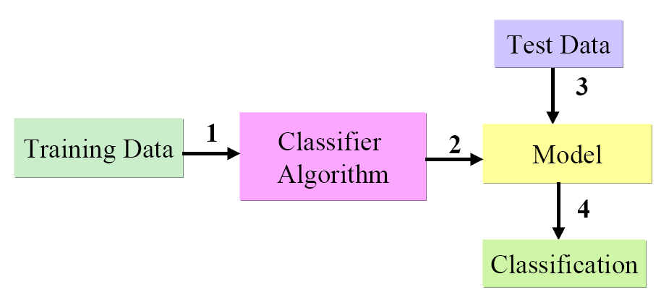
Supervised Learning

Slide 9
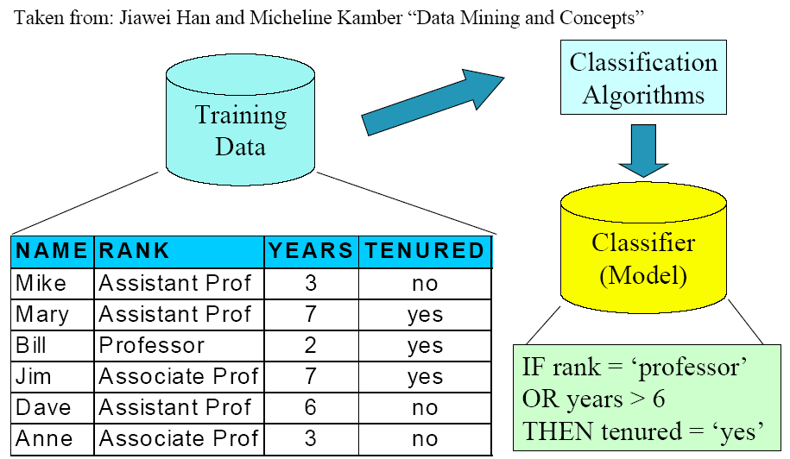
Classification

Slide 10
Inductive learning
Simplest form: learn a function from examples
Type of reasoning that involves moving from a set of specific facts to a general conclusion.
f is the target function
An example is a pair (x, f(x))
Problem: find a hypothesis h
  such that h ≈ f
  given a training set of examples
This is a highly simplified model of real learning:
  Ignores prior knowledge
  Assumes examples are given

Slide 11
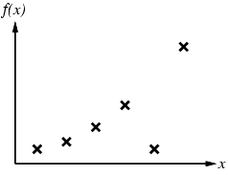
Inductive learning method
Construct/adjust h to agree with f on training set
(h is consistent if it agrees with f on all examples)
E.g., curve fitting:

Slide 12
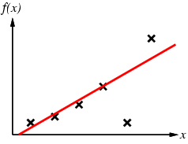
Inductive learning method
Construct/adjust h to agree with f on training set
(h is consistent if it agrees with f on all examples)
E.g., curve fitting:

Slide 13
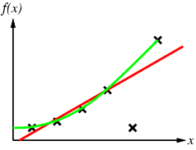
Inductive learning method
Construct/adjust h to agree with f on training set
(h is consistent if it agrees with f on all examples)
E.g., curve fitting:

Slide 14
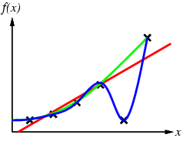
Inductive learning method
Construct/adjust h to agree with f on training set
(h is consistent if it agrees with f on all examples)
E.g., curve fitting:

Slide 15
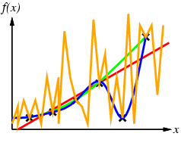
Inductive learning method
Construct/adjust h to agree with f on training set
(h is consistent if it agrees with f on all examples)
E.g., curve fitting:

Slide 16
Inductive learning method
Construct/adjust h to agree with f on training set
(h is consistent if it agrees with f on all examples)
E.g., curve fitting:
Ockham’s razor: prefer the simplest hypothesis consistent with the data

Slide 17
Review conditional probability (skip)
Can factor joint probability using chain rule:
  P(a, b) = P(a | b) P(b) = P(b | a) P(a)
This is amazing, we can express joint probability by conditioning on a or b:
  P(a | b) P(b) = P(b | a) P(a)
… and derive Bayes Theorem:
  P(a | b) = P(b | a) P(a)/ P(b)
  P(b | a) = P(a | b) P(b)/ P(a)

Slide 18
Naïve Bayes Classifier
Lets say we have a hypothesis, & we want to calculate the probability of the hypothesis being correct.
Hypothesis:
  given a set of features (gene expression levels) what is the probability that a set of genes are co-expressed for cancer?
  Where X={x₁, x_{2,…,}x_{n}} is the set of gene expression levels.
Classification probabilities:
  P(C=genes co-expressed | X)
  P(not C=genes not co-expressed | X)

Slide 19
Bayes Theorem - Learning
From training data calculate P(X|C), P(X), and P(C).
P(X|C) Likelihood of X conditioned on class C
  Shows the confidence/probability of X given C from training data.
  Given C is true, calculate probability that feature set X, where X= {x₁, x₂} has the following feature values:
  x₁= gene 1 expressed
  x₂= gene 2 expressed.
P(X) Prior probability of X (normalization constant).
  Represents the prior probability that x₁ and x₂ are expressed independent of us knowing anything else.
P(C_{i}) is the ratio of total samples with class C_{i} = cancer to all samples.

Slide 20

Bayes Theorem - Learning
Hypothesis that the 2 genes are co-expressed for cancer is the class C_{i.} = cancer
  Note: P (X) can be ignored as it is constant for all classes. For proper probabilities include in denominator.
Assuming the independence assumption, P(X|C_{i}) is:

Slide 21
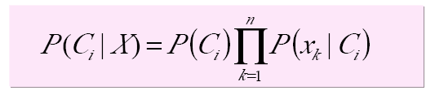
Naïve Bayes Classification
P(C|X) Posterior probability of hypothesis class C
  X: {x₁, x_{2…,} x_{n}}
  Shows the confidence/probability of C given X
  x₁: gene 1 expression level, x₂: gene 2 expression level
  C: cancer

Slide 22
Naïve Bayes Classification (skip)
For categorical attribute:
  P(x_{k}|C_{i}) is the frequency of samples having value x_{k} in class C_{i}.
For continuous (numeric) attribute:
  P(x_{k}|C_{i}) is calculated via a Gaussian density function.

Slide 23
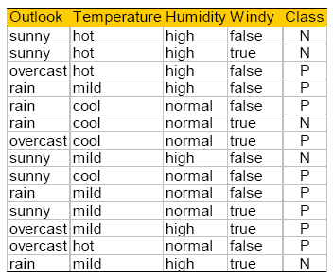
Play Tennis? (Tom Mitchell)
(skip)

Slide 24
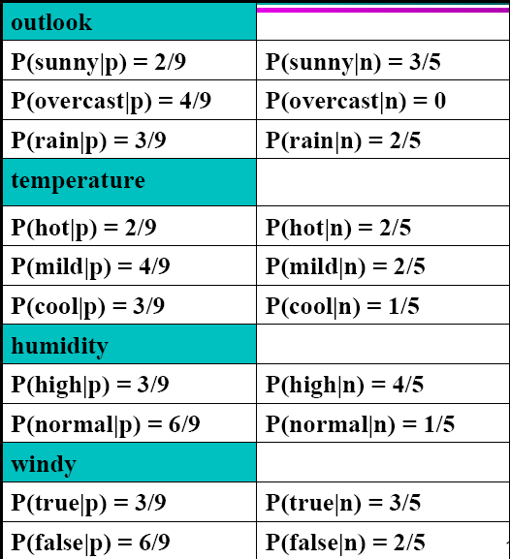
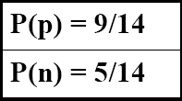
Play Tennis Example: estimating P(x_{i}|C) (skip)

Slide 25
Play Tennis Example: estimating P(C_{i}|x_{i}) (skip)
An incoming sample: X = <sunny, cool, high, true>
P(play|X) = P(X|p)*P(p) =
  P(p)*P(sunny|p)*P(cool|p)*P(high|p)*p(true|p)
  9/14 * 2/9 * 3/9 * 3/9 * 3/9= 0.0053
  0.0053/0.0259 = 0.204633
P(no play|X) = P(X|p)*P(n) =
  P(n)*P(sunny|n)*P(cool|n)*P(high|n)*p(true|n)
  5/14 * 3/5 * 1/5 * 4/5 * 3/5 = 0.0206
  0.795367/0.0259 = 0.795367
  Class n (no play) has higher probability than class p (play) for example X.

Slide 26
Decision Trees (DT)
Widely used, practical method for inductive inference.
Method for approximating discrete valued functions.
Exhaustively search hypothesis space.
Can be used for representing if-then-else rules.

Slide 27
DT Representation
Classify instances by sorting them down a tree from the root to some leaf node.
Leaf node provides classification instance.
Each node in tree specifies a test of some attribute (feature) of the instance.
Each branch descending from that node represents one of the possible values for this attribute.

Slide 28
DT Classification
Classifying a sample using a decision tree:
  Starting at the root node of the tree
  Test the attribute specified by this node.
  Moving down the tree branch corresponding to the value of the attribute in the given example.
  Repeat process for each subtree rooted at the new node.
  Each leaf represents classification of instance.

Slide 29
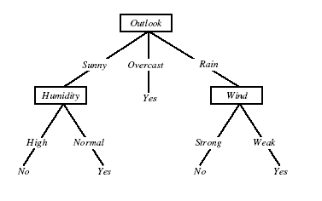
DT for Play Tennis

Slide 30
Play Tennis Example
How to classify?:
  {outlook=sunny, temperature=hot, humidity=high, wind=strong}
Decision trees represent a disjunction of conjunctions of the attribute values of instances.
For positive classification, the previous decision tree corresponds to:
  (outlook=sunny ^ humidity=high) v (outlook=overcast) v
  (outlook=rain ^ wind=weak)

Slide 31
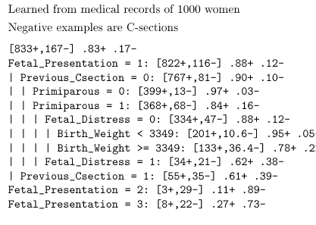
Predict C-Section Risk Example

Slide 32
Appropriate problems DT’s
Instances describable by attribute-value pairs
Target function is discrete values
  Note DT's can be modified to handle real valued parameters.
Disjunctive hypothesis may be required
Possibly noisy training data
Examples:
  Gene expression
  Equipment, or medical diagnosis
  Credit risk analysis
  Modeling calendar scheduling preferences

Slide 33
Top-down induction (creation) of DTs
Main loop:
A <- select the “best” decision attribute for next node
Assign A as decision attribute for node
For each value of A, create new descendant of node
Sort training examples to current leaf nodes
If training examples perfectly classified, then STOP
Else iterate over new leaf nodes

Slide 34
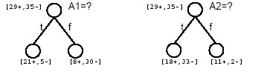
Which attribute is best?

Slide 35
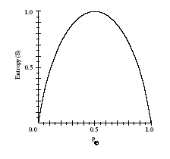

Entropy
Given S, a set of training examples:
Entropy measures the impurity of S
p+ is proportion of positive examples of S
p- is proportion of negative examples of S

Slide 36
STOP for Bioinformatics, continue to inflict pain for AI
Entropy calculation included in the following slides.

Slide 37

Entropy
Entropy(S) = expected number of bits needed to encode class(+/-) of randomly drawn member of S (under the optimal, shortest-length code)
  MDL – minimum description length
Why?
Information theory (Claude Shanon): optimal length code assigns
-log₂p bits to message having probability p.
So, expected number of bits to encode + or – examples of random member of S:

Slide 38
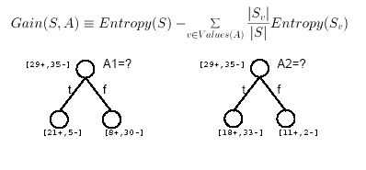
Information Gain
Gain(S,A) = expected reduction in entropy due to sorting of A

Slide 39
Calculating Info Gain
entropy(s) |  |  |  | 0.940286 |  | // 9/14*(-LOG(9/14,2))+5/14*(LOG(5/14,2))
entropy (s, humidity for high) |  |  |  | 0.985228 |  | // 3/7*(-LOG(3/7,2))+4/7*(-LOG(4/7,2))
entropy (s, humidity for normal) |  |  |  | 0.591673 |  | // 6/7*(-LOG(6/7,2))+1/7*(-LOG(1/7,2))
Gain(S, Humidity) = entropy(s) - 7/14*entropy (s, humidity for high) - 7/14*entropy (s, humidity for normal)
Gain(S, Humidity) = |  |  |  | 0.151836 |  | // D2- 7/14*D4 - 7/14*D6

Slide 40
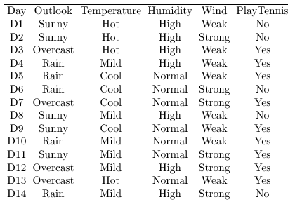
Training Examples

Slide 41
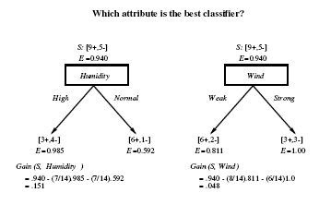
Selecting the Next Attribute

Slide 42
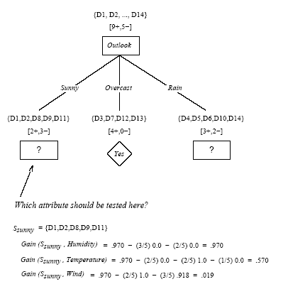

Slide 43
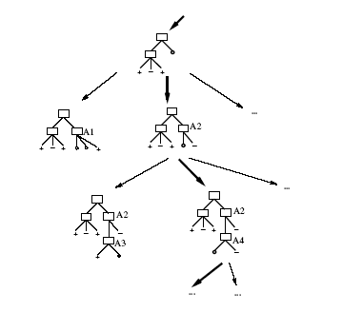
Hypothesis Space Search by ID3

Slide 44
Hypothesis Space Search by ID3
Hypothesis space is complete!
  Target function is surely in there…
Outputs a single hypothesis
No backtracing
  Local minima
Statiscally based search choices
  Robust to noisy data
Inductive bias: approx “prefer shortest tree”

Slide 45
Inductive Bias of ID3
Note H is the power set of instances X
Unbiased?
Not really…
Prefer short trees, and for those with high info gain attributes near the root
Bias is a preference for some hypothesis, rather than a restriction of hypothesis space H
Occam’s razor: prefer the shortest hypothesis that fits the data.

Slide 46
Occam’s Razor
Why prefer short hypotheses?
Argument in favor:
Fewer short hypo’s than long hypo’s
A short hypo that fits data unlikely to be coincidence
A long hypo that fits data might be coincidence
Argument opposed:
There are many ways to define small sets of hypo’s
  e.g., all trees with a prime number of nodes use attributes with “Z”
What’s so special about small sets based on size of hypothesis?

Slide 47
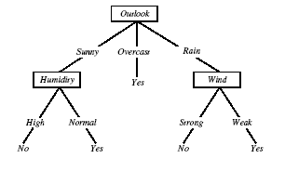
Overfitting in Decision Trees
Consider adding noisy training example D15:
Sunny, Hot, Normal, Strong, Play tennis=No

Slide 48

Overfitting
Consider error of hypothesis h over:
  Training data: error_{train}(h)
  Entire distribution D of data: error_{D}(h)
Hypothesis h ϵ H overfits training data if there is an alternative hypothesis h’ ϵ H such that:

Slide 49
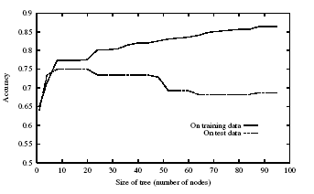
Overfitting

Slide 50
Avoiding Overfitting
Avoid Overfitting
Stop growing when data split is not statistically significant
Grow full tree, then prune
How to select best tree:
Measure performance over training data
Measure performance over separate validation set
Minimum Description Length
MDL: minimize (size(tree)+size(missclassification))

Slide 51
Reduced-Error Pruning
Start with completed tree
Split data into training and validation set
Do until further pruning is harmful:
  Evaluate impact on validation set of pruning each possible node (plus those below it)
  Greedily remove the one that most improves validation set accuracy
Produces smallest version of most accurate subtree

Slide 52
Rule Post-Pruning
Convert tree to equivalent rules
Prune each rule independently of others
Evaluate impact on validation set
Sort final rule into desired sequence of use.
Most frequently used method, e.g., C4.5

Slide 53
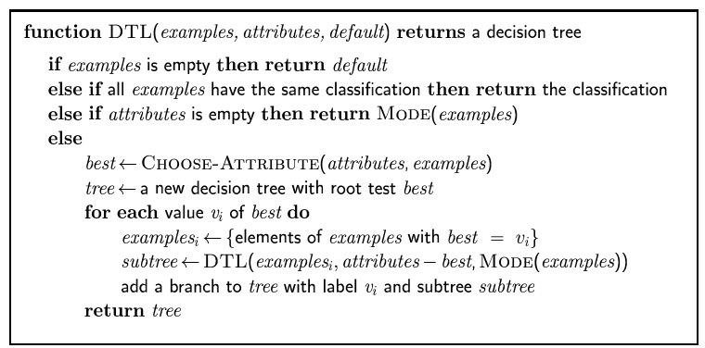
Decision tree learning
Aim: find a small tree consistent with the training examples
Idea: (recursively) choose "most significant" attribute as root of (sub)tree

Slide 54
Summary
Learning needed for unknown environments, lazy designers
Learning agent = performance element + learning element + critic
For supervised learning, the aim is to find a simple hypothesis approximately consistent with training examples
Decision tree learning using information gain
Learning performance = prediction accuracy measured on test set
Overfitting hampers a machine learners ability to generalize to unseen examples

