Slide 1
Online search algorithms
CS4881 Artificial Intelligence
Jay Urbain

Slide 2
Outline
Online search
Exploratory search
Sample applications
Online search problems
Online-DFS-Agent
Online local search
Random walk
LTRA*

Slide 3
Online search
We have concentrated on agents that use offline search algorithms.
  They compute a complete solution before setting foot in the real world.
  Then execute the solution without recourse of their percepts.
  Talk about analysis paralysis!
In contrast, an online search agent operates by interleaving computation and action.
  First it takes an action
  Then it observes the environment and computes the next action.
In what types of environments is online search required?

Slide 4
Online search
Online search is a good idea in dynamic or semidynamic domains –
  Domains where there is a penalty for sitting around and computing too long.
Online search is an even better idea for stochastic domains – think taxi cab agent!
In general, offline search would need to come up with an exponentially large contingency plan that considers all possible happenings.
Online search need only consider what actually does happen. Example:
  A chess playing agent is well advised to make its first move long before it has figured out the complete course of the game. Why?

Slide 5
Exploratory Search
Online search is necessary for any exploration problem.
States and actions are unknown to the agent.
An agent in this state of ignorance must use its actions as experiments to determine what to do next.
Requires agent to interleave computation and action.
Discovery of how the world works, is in part, an online search process.

Slide 6
Sample Problems
Examples:
Robot that is placed in a new building and must explore it to build a map that it can use for getting from A to B.
Methods for escaping from labyrinths!
Web search agent builds knowledge and structure of the problem as it explores environment to achieve desired goal, receives feedback from user (relevance feedback).
Newborn exploring their environment:
  Has many actions, does not know outcomes of actions, and has experience in only a few of the possible states it can reach.
Model for human language acquisition.

Slide 7
Online Search Problems
Online search problem can be solved only by an agent executing actions, rather than by a purely computational process.
Assume agent knows the following:
  ACTIONS(s), which returns a list of actions allowed in state s.
  The step-cost function c(s, a, s’).
    Note: can not be used until agent knows s’.
  GOAL-TEST(s).

Slide 8
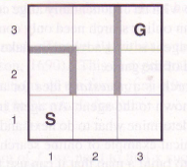
Online Search Problems
Agent cannot access the successors of a state except by actually trying all the actions in the state.
In maze problem, agent does not know that going Up from (1,1) leads to (1,2).
Ignorance can be reduced – robot explorer might know how its movement actions work, but may be ignorant of the location of obstacles.

Slide 9
Online Search Problems
Assumptions:
Agent can recognize state it has visited before.
Actions are deterministic.
Agent may have access to admissible heuristic h(s).
Agent’s objective is to reach goal state while minimizing cost.
Cost is the total path cost agent travels.

Slide 10
Online Search Problems
Common to compare online path cost with the cost of the path the agent would take if it knew the search space in advance.
  Just plug in an informed search algorithm.
  Known as “competitive ratio”
In a worst-case scenario what is the best competitive ratio you can achieve?
In what circumstances would this occur?

Slide 11
Online Search Problems
Worst case competitive ratio can be infinite.
  Some actions can be irreversible – can reach dead-end state from which goal state is unreachable.
Claim:
  No algorithm can avoid dead ends in all state spaces.
Adversary argument:
  Imagine an adversary that constructs the state space while the agent explores it and can put the goals and dead ends wherever it likes.
  Major research problem in natural terrain robotics – staircases, cliffs, ramps.
For now we assume state space is safely explorable and reversible.

Slide 12
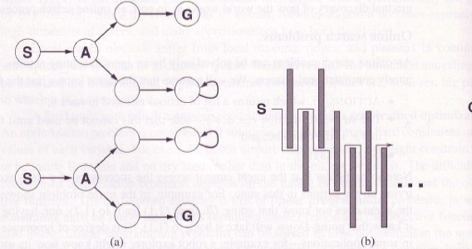
Online Search Problems
State space that can lead to dead end
Adversary blocks route to goal with wall in 2D environment.

Slide 13
Online search agent
After each action, agent receives percept (feedback) defining state reached.
Agent augments it’s map of the environment with this information.
Current map is used to decide where to go next.
Online agent can only expand a node it occupies –
  Can’t just jump around a search tree like A* informed search.
  Better to expand nodes in local order – depth-first search.

Slide 14
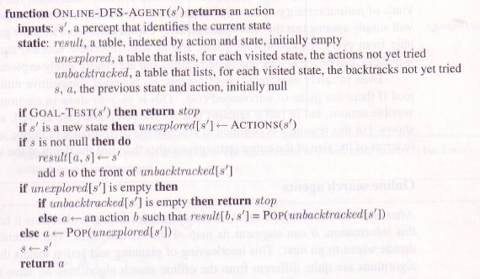
Online Search Problems

Slide 15
LRTA*-AGENT selects an action according to the value of neighboring states, which are updated as the agent moves about the state space.
function ONLINE-DFS-AGENT(s') returns an action
inputs: s', a percept that identifies the current state
persistent: result, a table, indexed by state and action, initially empty
untried, a table that lists, for each state, the actions not yet tried
unbacktracked, a table that lists, for each state, the backtracks not yet tried
s, a, the previous state and action, initially null
if GOAL-TEST(s') then return stop
if s' is a new state (not in untried) then untried[s'] <- ACTIONS(s')
if s is not null then
result[s, a] <- s'
add s to the front of the unbacktracked[s']
if untried[s'] is empty then
if unbacktracked[s'] is empty then return stop
else a <- an action b such that result[s', b] = POP(unbacktracked[s'])
else a <- POP(untried[s'])
s <- s'
return a

Slide 16
Online-DFS-Agent
Trace through maze problem with Online-DFS-Agent.
  How many links in state-space will Online-DFS-Agent visit for worst case scenario in reaching it’s goal?
  Will Online-DFS-Agent work in environments where actions are irreversible?
  Do any such agents have a bounded competitive ratio?

Slide 17
Online-Local Search
Like depth-first search, local hill-climbing search has the property of locality in its node expansions.
  Unfortunately, it can easily leave agent at local maxima.
  Random restart does not work, since agent can’t teleport itself to remote node in search space.

Slide 18
Random Walk
Random walk randomly selects one of the available actions from the current state.
Preferences can be given to actions that have not yet been tried.
Random walk will eventually find a goal or complete its exploration if state-space is finite*.
Can be very slow, can be surprisingly fast.
*Infinite case is tricky: Complete in 1D & 2D, chance of 0.3405 in 3D – see Hughes 1995.

Slide 19

Random Walk
Environment where random walk will take exponential many states to the goal. Why?

Slide 20
Random Walk
Environment where random walk will take exponential many states to the goal. Why?
At each step, backward progress twice as likely as forward progress.

Slide 21
Learning realtime A*
Augmenting hill climbing with memory rather than randomness is more effective.
Idea: store current best estimate h(s) of the cost to reach goal.
Heuristic estimate h(s) updated as agent gains experience in the state-space.
Cost to reach goal through a neighbor s’ is cost to get to s’ + estimated cost to goal – c(s, a, s’) + H(s’).
Called learning realtime A* (LTRA*)

Slide 22
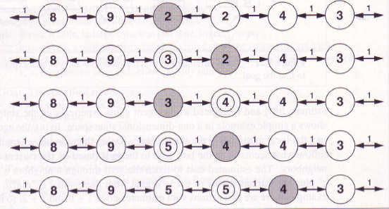
Learning realtime A*
LRTA*-AGENT selects an action according to the value of neighboring states, which are updated as the agent moves about the state space.

Slide 23
LRTA*-AGENT selects an action according to the value of neighboring states, which are updated as the agent moves about the state space.
function LRTA*-AGENT(s') returns an action
inputs: s', a percept that identifies the current state
persistent: result, a table, indexed by state and action, initially empty
H, a table of cost estimates indexed by state, initially empty
s, a, the previous state and action, initially null
if GOAL-TEST(s') then return stop
if s' is a new state (not in H) then H[s'] <- h(s')
if s is not null
result[s, a] <- s'
H[s] <- min LRTA*-COST(s, b, result[s, b], H)
b (element of) ACTIONS(s)
a <- an action b in ACTIONS(s') that minimizes LRTA*-COST(s', b, result[s', b], H)
s <- s'
return a
function LRTA*-COST(s, a, s', H) returns a cost estimate
if s' is undefined then return h(s)
else return c(s, a, s') + H[s']

Slide 24
Summary
Exploration problems arise when the agent has no idea about the states and actions of its environments.
For safely explorable environments, online search agents can build a map and find a goal if it exists.
Updating heuristic estimates from experience provides an effective method to escape from local minima.

Slide 25
Summary
Many opportunities for learning:
  Agent learns map of environment
  Learn more accurate estimates of the value of a state.
  Would be nice if agent could develop general rules it learned from exploring one state space to a similar state space, e.g., what does up mean?
  More fun ahead!

