Slide 1
Constraint Satisfaction Problems
CS4881 Artificial Intelligence
Jay Urbain, Ph.D.

Slide 2
Outline
Constraint Satisfaction Problems (CSP)
Backtracking search for CSPs
Local search for CSPs

Slide 3
Constraint satisfaction problems (CSPs)
Standard search problem:
  From the point of view of standard search algorithm, each state is atomic (indivisible).
  Treated as a "black box” with no internal structure.
CSP:
  Take advantage of the structure of states, and use general-purpose rather than problem-specific heuristics.
  Use a factored representation of states defined by variables X_{i} with values from domain D_{i}
  Eliminate large portions of the search space all at once by identifying variable/value combinations that violate constraints.
  CSP: Goal test is a set of constraints specifying allowable combinations of values for subsets of variables.

Slide 4
Constraint satisfaction problems (CSPs)
CSP Problem {X,D,C}:
  X is set of variables, {X₁, X₂, …, X_{n}}
  D is a set of domains, {D₁, D₂, …, D_{n}}, one for each variable.
  C is a set of constraints that specify allowable combinations of values.
To solve a CSP, we need to define a state space and allowable solutions.
  Consistent assignment: assignment (of values to variables) that does not violate any constraint.
  Complete assignment: Every variable is assigned.
  Solution: Consistent and complete assignment.
  Partial assignment: assign values to only some of the variables.

Slide 5

Example: Map-Coloring
Variables WA, NT, Q, NSW, V, SA, T
Domain (of each variable) D_{i} = {red,green,blue}
Constraints: adjacent regions must have different colors
  e.g., WA ≠ NT, or (WA,NT) in {(red,green),(red,blue),(green,red), (green,blue),(blue,red),(blue,green)}
  Set of constraints define a simple formal language

Slide 6

Example: Map-Coloring
Solutions are complete and consistent assignments, e.g., WA = red, NT = green, Q = red, NSW = green, V = red, SA = blue, T = green

Slide 7
CSP
Many problems are naturally represented by constraints: scheduling, assignment, etc.
By using constraints, search space can be significantly reduced.
By casting a problem as a CSP, can use existing CSP solver.

Slide 8

Constraint graph
Binary CSP: each constraint relates two variables.
Constraint graph: nodes are variables, arcs are constraints.

Slide 9
Varieties of CSPs
Discrete variables
  finite domains:
    n variables, domain size d → O(d^{n}) complete assignments
    e.g., Boolean CSPs, incl. Boolean satisfiability (NP-complete)
  infinite domains:
    integers, strings, etc.
    e.g., job scheduling, variables are start/end days for each job
    need a constraint language, e.g., StartJob₁ + 5 ≤ StartJob₃
Continuous variables
  e.g., start/end times for Hubble Space Telescope observations
  linear constraints solvable in polynomial time by linear programming

Slide 10
Varieties of constraints
Unary constraints involve a single variable,
  e.g., SA ≠ green
Binary constraints involve pairs of variables,
  e.g., SA ≠ WA
Higher-order constraints involve 3 or more variables,
  e.g., cryptarithmetic column constraints, sudoku, rubics cube, etc.

Slide 11

Example: Cryptarithmetic Puzzle
Each letter stands for a distinct digit.
Aim: find submission of digits for letters such that resulting sum is arithmetically correct!
No leading zeros allowed.
Constraint Hypergraph – middle squares are add const’s, X₁ X₂ X₃ caries
Variables:
  F T U W R O X₁ X₂ X₃
Domains: {0,1,2,3,4,5,6,7,8,9}
Constraints: Alldiff (F,T,U,W,R,O)
  O + O = R + 10 · X₁
  X₁ + W + W = U + 10 · X₂
  X₂ + T + T = O + 10 · X₃
  X₃ = F, T ≠ 0, F ≠ 0

Slide 12
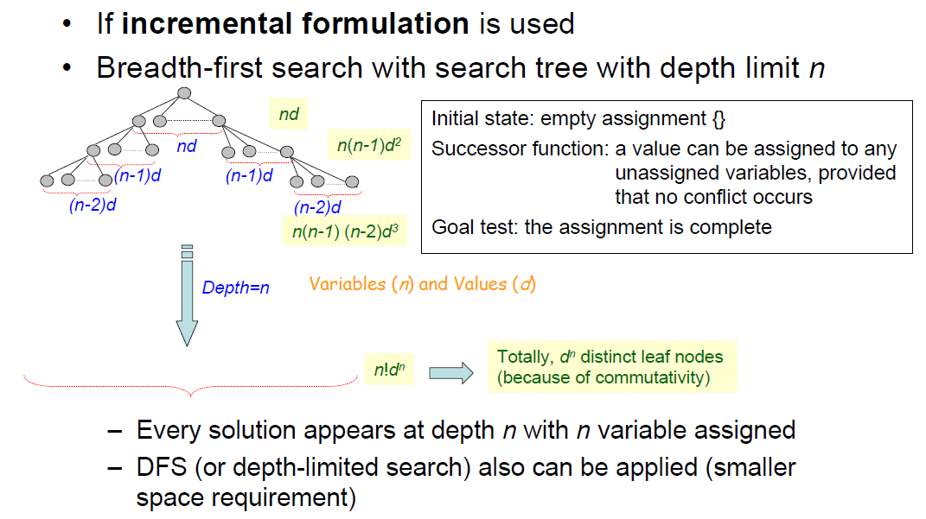
Standard Search Approach
  Can formulate as standard search problem – but order not important!

Slide 13
Real-world CSPs
Assignment problems
  e.g., games: Sudoku, who teaches what class, verification problems
Timetabling problems
  e.g., which class is offered when and where?
Transportation scheduling
Factory scheduling
Notice that many real-world problems involve real-valued variables

Slide 14
Backtracking search
Variable assignments are commutative}, i.e.,
[ WA = red then NT = green ] same as [ NT = green then WA = red ]
Only need to consider assignments to a single variable at each node
Depth-first search for CSPs with single-variable assignments is called backtracking search
Backtracking search is the basic uninformed algorithm for CSPs
Can solve n-queens for n ≈ 25

Slide 15

Backtracking search

Slide 16

Backtracking example

Slide 17

Backtracking example

Slide 18

Backtracking example

Slide 19

Backtracking example

Slide 20
Improving backtracking efficiency
General-purpose methods can give huge gains in speed:
  Which variable should be assigned next?
  In what order should its values be tried?
  Can we detect inevitable failure early?

Slide 21

Most constrained variable
Most constrained variable:
  choose the variable with the fewest legal values
Also known as minimum remaining values (MRV) heuristic

Slide 22

Least constraining value
Tie-breaker among most constrained variables
  Assign value to variable that places the least constraints on remaining variables.

Slide 23

Least constraining value
Given a variable, choose the least constraining value:
  the one that rules out the fewest values in the remaining variables – reserve the right for other variables to play.
Combining these heuristics makes 1000 queens feasible

Slide 24

Forward checking
Idea:
  Keep track of remaining legal values for unassigned variables
  Terminate search when any variable has no legal values

Slide 25

Forward checking
Idea:
  Keep track of remaining legal values for unassigned variables
  Terminate search when any variable has no legal values

Slide 26

Forward checking
Idea:
  Keep track of remaining legal values for unassigned variables
  Terminate search when any variable has no legal values

Slide 27

Forward checking
Idea:
  Keep track of remaining legal values for unassigned variables
  Terminate search when any variable has no legal values

Slide 28
Constraint propagation
Forward checking propagates information from assigned to unassigned variables, but doesn't provide early detection for all failures:
NT and SA cannot both be blue!
Constraint propagation repeatedly enforces constraints locally.

Slide 29
Node consistency
A single variable is node-consistent if all the values in the variable’s domain satisfy the variables’ unary constraints.
E.g.:
  SA starts with domain {red, green, blue}, but Australian’s don’t like green.
  We can make it node consistent by eliminating green {red, blue}.

Slide 30

Arc consistency
A variable is arc-consistent if every value in its domain satisfies the variable’s binary constraints.
Simplest form of propagation makes each arc consistent
X →Y is consistent iff
  for every value x of X there is some allowed y

Slide 31

Arc consistency
Simplest form of propagation makes each arc consistent
X →Y is consistent iff
  for every value x of X there is some allowed y

Slide 32

Arc consistency
Simplest form of propagation makes each arc consistent
X →Y is consistent iff
  for every value x of X there is some allowed y
If X loses a value, neighbors of X need to be rechecked

Slide 33

Arc consistency
Simplest form of propagation makes each arc consistent
X →Y is consistent iff
  for every value x of X there is some allowed y
If X loses a value, neighbors of X need to be rechecked
Arc consistency detects failure earlier than forward checking
Can be run as a preprocessor or after each assignment

Slide 34

Arc consistency algorithm AC-3
Time complexity: O(n²d³)

Slide 35
Local search for CSPs
Hill-climbing, simulated annealing typically work with "complete" states, i.e., all variables assigned.
To apply to CSPs:
  allow states with unsatisfied constraints
  operators reassign variable values
Variable selection: randomly select any conflicted variable.
Value selection by min-conflicts heuristic:
  choose value that violates the fewest constraints
  i.e., hill-climb with h(n) = total number of violated constraints

Slide 36

Example: 4-Queens
States: 4 queens in 4 columns (4⁴ = 256 states)
Actions: move queen in column
Goal test: no attacks
Evaluation: h(n) = number of attacks
Given random initial state, can solve n-queens in almost constant time for arbitrary n with high probability (e.g., n = 10,000,000)

Slide 37
Summary
CSPs are a special kind of problem:
  states defined by values of a fixed set of variables
  goal test defined by constraints on variable values
Backtracking = depth-first search with one variable assigned per node
Variable ordering and value selection heuristics help significantly
Forward checking prevents assignments that guarantee later failure
Constraint propagation (e.g., arc consistency) does additional work to constrain values and detect inconsistencies
Iterative min-conflicts is usually effective in practice

