Slide 1
Logical Agents - Review
CS4881 Aritificial Intelligence
Jay Urbain

Slide 2

Knowledge bases
Knowledge base = set of sentences in a formal language
Declarative approach to building an agent (or other system):
  Tell it what it needs to know
Then it can Ask itself what to do - answers should follow from the KB

Slide 3

A simple knowledge-based agent
The agent must be able to:
  Represent states, actions, etc.
  Incorporate new percepts
  Update internal representations of the world
  Deduce hidden properties of the world
  Deduce appropriate actions

Slide 4
Logic in general
Logics are formal languages for representing information such that conclusions can be drawn
Syntax defines the sentences in the language
Semantics define the "meaning" of sentences;
  i.e., define truth of a sentence in a world

Slide 5
Entailment
Entailment means that one thing follows from another:
KB ╞ α
Knowledge base KB entails sentence α if and only if α is true in all worlds where KB is true
  E.g., the KB containing “the Bulls won” and “the Bucks won” entails “Either the Bulls won or the Bucks won”

Slide 6

Models
Logicians typically think in terms of models, which are formally structured worlds with respect to which truth can be evaluated
We say m is a model of a sentence α if α is true in m
M(α) is the set of all models of α
Then KB ╞ α iff M(KB) ⊆ M(α)
  E.g. α = x + y = 4
  KB1 : x=2, y=2 -> α entailed
  KB2 : x=-2, y=6 -> α entailed
  KB3 : x=1, y=2 -> α not entailed

Slide 7
Inference
KB ├_{i} α = sentence α can be derived from KB by inference procedure i
Soundness: i is sound if whenever KB ├_{i} α, it is also true that KB╞ α (only derives entailed sentences)
Completeness: i is complete if whenever KB╞ α, it is also true that KB ├_{i} α (can derive any entailed sentence)
That is, the procedure will answer any question whose answer follows from what is known by the KB.

Slide 8
Propositional logic: Syntax
Propositional (boolean) logic is the simplest logic – illustrates basic ideas
The proposition symbols P₁, P₂ etc are sentences
  If S is a sentence, ¬S is a sentence (negation)
  If S₁ and S₂ are sentences, S₁ ∧ S₂ is a sentence (conjunction)
  If S₁ and S₂ are sentences, S₁ ∨ S₂ is a sentence (disjunction)
  If S₁ and S₂ are sentences, S₁ ⇒ S₂ is a sentence (implication)
  If S₁ and S₂ are sentences, S₁ ⇔ S₂ is a sentence (biconditional)

Slide 9
Propositional logic: Semantics
Each model specifies true/false for each proposition symbol
  E.g. P_{1,2} P_{2,2} P_{3,1}
  false true false
With these symbols, 8 possible models, can be enumerated automatically.
Rules for evaluating truth with respect to a model m:
¬S is true iff S is false
S₁ ∧ S₂ is true iff S₁ is true and S₂ is true
S₁ ∨ S₂ is true iff S₁is true or S₂ is true
S₁ ⇒ S₂ is true iff S₁ is false or S₂ is true
i.e., is false iff S₁ is true and S₂ is false
S₁ ⇔ S₂ is true iff S₁⇒S₂ is true andS₂⇒S₁ is true
Simple recursive process evaluates an arbitrary sentence, e.g.,
¬P_{1,2} ∧ (P_{2,2} ∨ P_{3,1}) = true ∧ (true ∨ false) = true ∧ true = true

Slide 10

Truth tables for connectives

Slide 11
Wumpus world sentences
Let P_{i,j} be true if there is a pit in [i, j].
Let B_{i,j} be true if there is a breeze in [i, j].
  ¬ P_{1,1}
  ¬B_{1,1}
  B_{2,1}
"Pits cause breezes in adjacent squares"
  B_{1,1} ⇔ (P_{1,2} ∨ P_{2,1})
  B_{2,1} ⇔ (P_{1,1} ∨ P_{2,2} ∨ P_{3,1})

Slide 12

Truth tables for inference

Slide 13

Inference by enumeration
Depth-first enumeration of all models is sound and complete
For n symbols, time complexity is O(2^{n}), space complexity is O(n)

Slide 14

Logical equivalence
Two sentences are logically equivalent} iff true in same models: α ≡ ß iff α╞ β and β╞ α

Slide 15
Validity and satisfiability
A sentence is valid if it is true in all models,
  e.g., True, A ∨¬A, A ⇒ A, (A ∧ (A ⇒ B)) ⇒ B
Validity is connected to inference via the Deduction Theorem:
  KB ╞ α if and only if (KB ⇒ α) is valid
A sentence is satisfiable if it is true in some model
  e.g., A∨ B, C
A sentence is unsatisfiable if it is true in no models
  e.g., A∧¬A
Satisfiability is connected to inference via the following:
  KB ╞ α if and only if (KB ∧¬α) is unsatisfiable

Slide 16
Proof methods
Proof methods divide into (roughly) two kinds:
  Application of inference rules
    Legitimate (sound) generation of new sentences from old
    Proof = a sequence of inference rule applications
    Can use inference rules as operators in a standard search algorithm
    Typically require transformation of sentences into a normal form
  Model checking
    truth table enumeration (always exponential in n)
    improved backtracking, e.g., Davis--Putnam-Logemann-Loveland (DPLL)
    heuristic search in model space (sound but incomplete)
    e.g., min-conflicts-like algorithms

Slide 17

Resolution
Conjunctive Normal Form (CNF)
  conjunction of disjunctions of literals
  clauses
  E.g., (A ∨ ¬B) ∧ (B ∨ ¬C ∨ ¬D)
Resolution inference rule (for CNF):
l_{i} ∨… ∨ l_{k}, m₁ ∨ … ∨ m_{n}
l_{i} ∨ … ∨ l_{i-1} ∨ l_{i+1} ∨ … ∨ l_{k} ∨ m₁ ∨ … ∨ m_{j-1} ∨ m_{j+1} ∨... ∨ m_{n}
where l_{i} and m_{j} are complementary literals.
E.g., P_{1,3} ∨ P_{2,2}, ¬P_{2,2}
P_{1,3}
Resolution is sound and complete
for propositional logic

Slide 18
Conversion to CNF
B_{1,1} ⇔ (P_{1,2} ∨ P_{2,1})
Eliminate ⇔, replacing α ⇔ β with (α ⇒ β)∧(β ⇒ α).
  (B_{1,1} ⇒ (P_{1,2} ∨ P_{2,1})) ∧ ((P_{1,2} ∨ P_{2,1}) ⇒ B_{1,1})
2. Eliminate ⇒, replacing α ⇒ β with ¬α∨ β.
  (¬B_{1,1} ∨ P_{1,2} ∨ P_{2,1}) ∧ (¬(P_{1,2} ∨ P_{2,1}) ∨ B_{1,1})
3. Move ¬ inwards using de Morgan's rules and double-negation:
  (¬B_{1,1} ∨ P_{1,2} ∨ P_{2,1}) ∧ ((¬P_{1,2} ∨ ¬P_{2,1}) ∨ B_{1,1})
4. Apply distributivity law (∧ over ∨) and flatten:
  (¬B_{1,1} ∨ P_{1,2} ∨ P_{2,1}) ∧ (¬P_{1,2} ∨ B_{1,1}) ∧ (¬P_{2,1} ∨ B_{1,1})

Slide 19

Resolution example
KB = (B_{1,1} ⇔ (P_{1,2}∨ P_{2,1})) ∧¬ B_{1,1} α = ¬P_{1,2}

Slide 20
Forward and backward chaining
Horn Form (restricted)
  KB = conjunction of Horn clauses
  Horn clause =
    proposition symbol; or (conjunction of symbols) ⇒ symbol
  E.g., C ∧ (B ⇒ A) ∧ (C ∧ D ⇒ B)
Modus Ponens (for Horn Form): complete for Horn KBs
α₁ ∧ … ∧ α_{n} ⇒ β α₁, … ,α_{n},
β
Can be used with forward chaining or backward chaining.
These algorithms are very natural and run in linear time

Slide 21
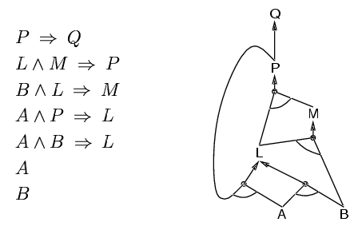
Forward chaining
Idea: fire any rule whose premises are satisfied in the KB,
  add its conclusion to the KB, until query is found

Slide 22
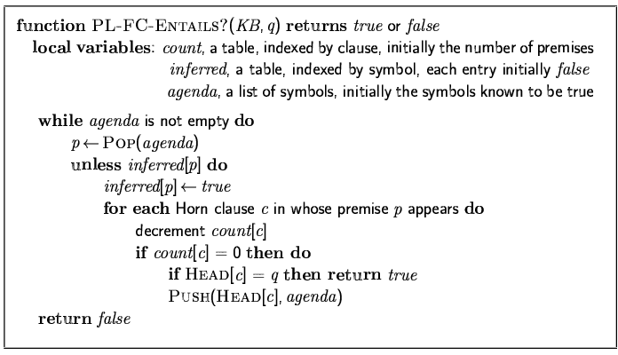
Forward chaining algorithm
Forward chaining is sound and complete for Horn KB

Slide 23
Proof of completeness
FC derives every atomic sentence that is entailed by KB
  FC reaches a fixed point where no new atomic sentences are derived
  Consider the final state as a model m, assigning true/false to symbols
  Every clause in the original KB is true in m
    a₁ ∧ … ∧ a_{k ⇒} b
  Hence m is a model of KB
  If KB╞ q, q is true in every model of KB, including m

Slide 24
Backward chaining
Idea: work backwards from the query q:
  to prove q by BC,
    check if q is known already, or
    prove by BC all premises of some rule concluding q
Avoid loops: check if new sub-goal is already on the goal stack
Avoid repeated work: check if new sub-goal
  has already been proved true, or
  has already failed

Slide 25
Forward vs. backward chaining
FC is data-driven, automatic, unconscious processing,
  e.g., object recognition, routine decisions
May do lots of work that is irrelevant to the goal
BC is goal-driven, appropriate for problem-solving,
  e.g., Where are my keys? How do I get into a PhD program?
Complexity of BC can be much less than linear in size of KB

Slide 26
Efficient propositional inference
Two families of efficient algorithms for propositional inference:
Complete backtracking search algorithms
DPLL algorithm (Davis, Putnam, Logemann, Loveland)
Incomplete local search algorithms
  WalkSAT algorithm

Slide 27
The DPLL algorithm
Determine if an input propositional logic sentence (in CNF) is satisfiable.
Improvements over truth table enumeration:
  Early termination
    A clause is true if any literal is true.
    A sentence is false if any clause is false.
  Pure symbol heuristic
    Pure symbol: always appears with the same "sign" in all clauses.
    e.g., In the three clauses (A ∨ ¬B), (¬B ∨ ¬C), (C ∨ A), A and B are pure, C is impure.
    Make a pure symbol literal true.
  Unit clause heuristic
    Unit clause: only one literal in the clause
    The only literal in a unit clause must be true.

Slide 28
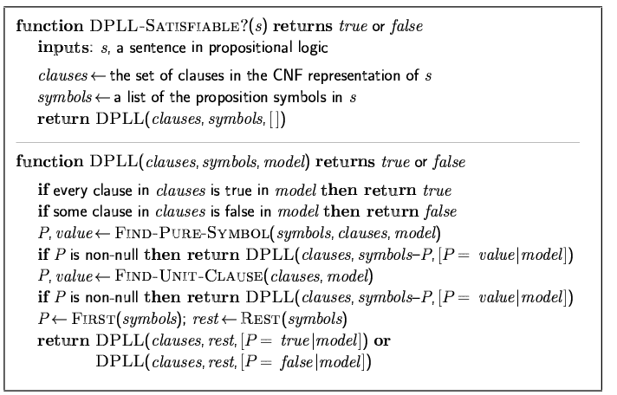
The DPLL algorithm

Slide 29
The WalkSAT algorithm
Incomplete, local search algorithm
Evaluation function: The min-conflict heuristic of minimizing the number of unsatisfied clauses
Balance between greediness and randomness

Slide 30
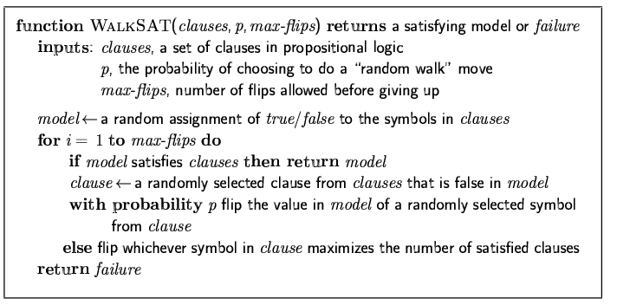
The WalkSAT algorithm

Slide 31
Inference-based agents in the wumpus world
A wumpus-world agent using propositional logic:
  ¬P_{1,1}
  ¬W_{1,1}
  B_{x,y} ⇔ (P_{x,y+1} ∨ P_{x,y-1} ∨ P_{x+1,y} ∨ P_{x-1,y})
  S_{x,y} ⇔ (W_{x,y+1} ∨ W_{x,y-1} ∨ W_{x+1,y} ∨ W_{x-1,y})
  W_{1,1} ∨ W_{1,2} ∨ … ∨ W_{4,4}
  ¬W_{1,1} ∨ ¬W_{1,2}
  ¬W_{1,1} ∨ ¬W_{1,3}
  …
⇒ 64 distinct proposition symbols, 155 sentences

Slide 32
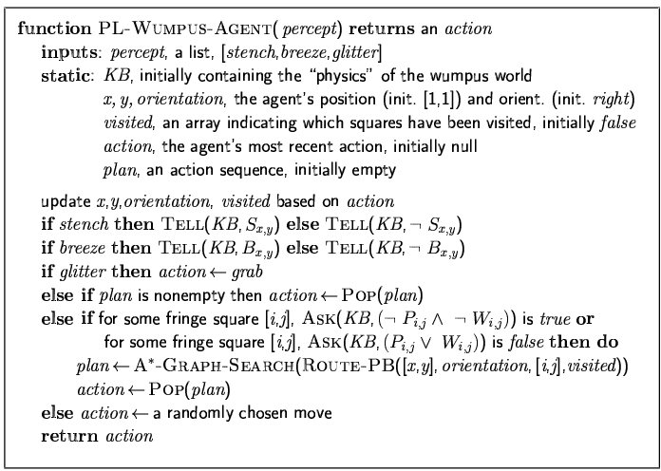

Slide 33
Expressiveness limitation of propositional logic
KB contains "physics" sentences for every single square
For every time t and every location [x,y],
L_{x,y} ∧ FacingRight^{t} ∧ Forward^{t} ⇒ L_{x+1,y}
Rapid proliferation of clauses
t
t

Slide 34
Summary
Logical agents apply inference to a knowledge base to derive new information and make decisions
Basic concepts of logic:
  syntax: formal structure of sentences
  semantics: truth of sentences with respect to models
  entailment: necessary truth of one sentence given another
  inference: deriving sentences from other sentences
  soundness: derivations produce only entailed sentences
  completeness: derivations can produce all entailed sentences
Wumpus world requires the ability to represent partial and negated information, reason by cases, etc.
Resolution is complete for propositional logic
Forward, backward chaining are linear-time, complete for Horn clauses
Propositional logic lacks expressive power

