Slide 1
Inference in first-order logic
CS4881 Artificial Intelligence
Jay Urbain, Ph.D.

Slide 2
Outline
Review
Translating English to FOL
Reducing first-order inference to propositional inference
Unification
Generalized Modus Ponens
Forward chaining
Backward chaining
Resolution

Slide 3
Review: First-Order Logic
(FOL or FOPC) Syntax
User defines these primitives:
  Constant symbols (i.e., the “entities“ in the world) E.g., Mary, 3
  Function symbols (mapping entities to entities) E.g., father-of(Mary) = John, color-of(Sky) = Blue
  Predicate symbols (mapping from entities to truth values) E.g., greater(5,3), green(Grass), color(Grass, Green). Establishes relations.

Slide 4
Review: FOL Primitives
Variable symbols. E.g., x, y
Logical connectives. Same as in PL: not (~), and (^), or (v), implies (=>), if and only if (<=>)
Quantifiers: Universal (A) and Existential (E)
  Universal quantification corresponds to conjunction ("and") in that (Ax)P(x) means that P holds for all values of x in the domain associated with that variable.
  E.g., (Ax) dolphin(x) => mammal(x)
  Existential quantification corresponds to disjunction ("or") in that (Ex)P(x) means that P holds for some value of x in the domain associated with that variable.
  E.g., (Ex) mammal(x) ^ lays-eggs(x)

Slide 5
Review: Universal Quantification
  Universal quantifiers usually used with "implies" to form "if-then rules."
  E.g., (Ax) cs4881_student(x) => smart(x) means "All cs4881students are smart."
  You rarely use universal quantification to make blanket statements about every individual in the world:
  (Ax)cs4881_student(x) ^ smart(x) means “everyone in the world is a cs4881 student and is smart.”

Slide 6
Review: Existential Quantification
  Existential quantification corresponds to disjunction ("or") in that (Ex)P(x) means that P holds for some value of x in the domain associated with that variable.
  E.g., (Ex) mammal(x) ^ lays-eggs(x)
  Rarely use implication with existential quantification:
  (Ex)cs4881_student(x) => smart(x) is true if there is anyone who is not in cs4881or they are smart!

Slide 7
FOL Sentences
Sentences are built up from terms and atoms:
A term (denoting a real-world entity) is a constant symbol, a variable symbol, or an n-place function of n terms.
For example, x and f(x1, ..., xn) are terms, where each xi is a term.
An atom (which has value true or false) is either an n-place predicate of n terms, or, if P and Q are atoms, then ~P, P V Q, P ^ Q, P => Q, P <=> Q are atoms.
A sentence is an atom, or, if P is a sentence and x is a variable, then (Ax)P and (Ex)P are sentences
A well-formed formula (wff) is a sentence containing no "free" variables. I.e., all variables are "bound" by universal or existential quantifiers.
E.g., (Ax)P(x,y) has x bound as a universally quantified variable, but y is free.

Slide 8
Translating English to FOL
Every gardener likes the sun.
(Ax) gardener(x) => likes(x,Sun)
You can fool some of the people all of the time.
(Ex) (person(x) ^ (At)(time(t) => can-fool(x,t)))
You can fool all of the people some of the time.
(Ax) (person(x) => (Et) (time(t) ^ can-fool(x,t)))
All purple mushrooms are poisonous.
(Ax) (mushroom(x) ^ purple(x)) => poisonous(x)
No purple mushroom is poisonous.
~(Ex) purple(x) ^ mushroom(x) ^ poisonous(x)
or,
(Ax) (mushroom(x) ^ purple(x)) => ~poisonous(x)

Slide 9
Difficulty of FOL Inference
Inference in propositional logic (PL) is relatively easy
  Enumerate all possibilities (truth tables)
  Apply sound inference rules on facts (forward chaining)
But in FOL we have concepts and variables, relations, and quantification
  This complicates things - a lot
First, let’s see how we can convert FOL into propositional logic, then use PL inference.

Slide 10
Convert FOL into PL
Get rid of quantifiers
Universal instantiation (UI) (Universal Elimination)
Every instantiation of a universally quantified sentence is entailed by it:
∀v α
Subst({v/g}, α)
Variable v substituted with ground term g in sentence α from KB
E.g., ∀x Eats(Bob, x) infer Eats(Bob, pizza), Eats(Bob, doughnuts), Eats(Bob, books), …
E.g., ∀x King(x) ∧ Greedy(x) ⇒ Evil(x) yields:
  King(John) ∧ Greedy(John) ⇒ Evil(John)
  King(Richard) ∧ Greedy(Richard) ⇒ Evil(Richard)
  King(Father(John)) ∧ Greedy(Father(John)) ⇒ Evil(Father(John))

Slide 11
Convert FOL into PL
Existential instantiation (EI) (Existential Elimination)
  Variable substituted for new term (Skolem constant).
∃v α
Subst({v/k}, α)
For any sentence α, variable v, and constant symbol k that does not appear elsewhere in the knowledge base:
E.g., ∃ x Eats(Bob, x) infer Eats(Bob, NewFood)
Why do we need a new term?
  Bob eats something and Tyler eats something, but they don’t eat the same thing, i.e.,
  ∃ x Eats(Bob, x) ^ ∃ x Eats(Tyler, x)
E.g., ∃x Crown(x) ∧ OnHead(x,John) yields: Crown(C₁) ∧ OnHead(C₁,John)
provided C₁ is a new constant symbol, called a Skolem constant

Slide 12
Reduction to propositional inference
Suppose the KB contains just the following:
  ∀x King(x) ∧ Greedy(x) ⇒ Evil(x)
  King(John), King(Richard)
  Greedy(John), Greedy(Richard)
  Brother(Richard,John)
Instantiating the universal sentence in all possible ways, we have:
  King(John) ∧ Greedy(John) ⇒ Evil(John)
  King(Richard) ∧ Greedy(Richard) ⇒ Evil(Richard)
  King(John), King(Richard)
  Greedy(John), Greedy(Richard)
  Brother(Richard,John)
The new KB is propositionalized: proposition symbols are
  King(John), Greedy(John), Evil(John), King(Richard), etc.

Slide 13
Reduction cont'd.
Every FOL KB can be propositionalized so as to preserve entailment.
A ground sentence is entailed by new KB iff it is entailed by original sentence in KB.
Idea: propositionalize KB and query, apply resolution, return result.
Problem: with function symbols, there are infinitely many ground terms,
  e.g., Father(Father(Father(John))).

Slide 14
Reduction cont’d. (skip)
Theorem: Herbrand (1930). If a sentence α is entailed by an FOL KB, it is entailed by a finite subset of the propositionalized KB.
Idea: For n = 0 to ∞ do
  create a propositional KB by instantiating with depth-n terms
  see if α is entailed by this KB.
Problem: works if α is entailed, loops if α is not entailed
Theorem: Turing (1936), Church (1936) Entailment for FOL is semidecidable
Algorithms exist that say yes to every entailed sentence, but no algorithm exists that also says no to every nonentailed sentence.

Slide 15
Problems with propositionalization
Propositionalization seems to generate lots of irrelevant sentences.
E.g., from:
  ∀x King(x) ∧ Greedy(x) ⇒ Evil(x)
  King(John)
  ∀y Greedy(y)
  Greedy(Richard)
  Brother(Richard,John)
Evil(John) seems obvious, but propositionalization produces lots of facts such as Greedy(Richard) that are irrelevant.
With p k-ary predicates and n constants, there are p·n^{k} instantiations – exponential in number of predicates.

Slide 16
Better Idea: Unification
Rather than propositionalizing an entire KB and generating lots of irrelevant sentences, unify the sentences that we are interested in.
Unification is a "pattern matching" procedure that takes two atomic sentences, called literals, as input, and returns "failure" if they do not match and a substitution list, Theta, if they do match.
That is, unify(p,q) = Theta means subst(Theta, p) = subst(Theta, q) for two atomic sentences p and q.
Theta is called the most general unifier.
All variables in the given two literals are implicitly universally quantified.
To make literals match, replace (universally-quantified) variables by terms.

Slide 17
Unification
We can get the inference immediately if we can find a substitution θ such that King(x) and Greedy(y) match King(John) and Greedy(John)
θ = {x/John,y/John} works
Unify(α,β) = θ if αθ = βθ
p q θ
Knows(John,x) Knows(John,Jane)
Knows(John,x) Knows(y,OJ)
Knows(John,x) Knows(y,Mother(y))
Knows(John,x) Knows(x,OJ)
Standardizing apart eliminates overlap of variables, e.g., Knows(z₁₇,OJ)

Slide 18
Unification
We can get the inference immediately if we can find a substitution θ such that King(x) and Greedy(x) match King(John) and Greedy(y)
θ = {x/John,y/John} works
Unify(α,β) = θ if αθ = βθ
p q θ
Knows(John,x) Knows(John,Jane) {x/Jane}}
Knows(John,x) Knows(y,OJ)
Knows(John,x) Knows(y,Mother(y))
Knows(John,x) Knows(x,OJ)
Standardizing apart eliminates overlap of variables, e.g., Knows(z₁₇,OJ)

Slide 19
Unification
We can get the inference immediately if we can find a substitution θ such that King(x) and Greedy(x) match King(John) and Greedy(y)
θ = {x/John,y/John} works
Unify(α,β) = θ if αθ = βθ
p q θ
Knows(John,x) Knows(John,Jane) {x/Jane}}
Knows(John,x) Knows(y,OJ) {x/OJ,y/John}}
Knows(John,x) Knows(y,Mother(y))
Knows(John,x) Knows(x,OJ)
Standardizing apart eliminates overlap of variables, e.g., Knows(z₁₇,OJ)

Slide 20
Unification
We can get the inference immediately if we can find a substitution θ such that King(x) and Greedy(x) match King(John) and Greedy(y)
θ = {x/John,y/John} works
Unify(α,β) = θ if αθ = βθ
p q θ
Knows(John,x) Knows(John,Jane) {x/Jane}}
Knows(John,x) Knows(y,OJ) {x/OJ,y/John}}
Knows(John,x) Knows(y,Mother(y)) {y/John,x/Mother(John)}}
Knows(John,x) Knows(x,OJ)
Standardizing apart eliminates overlap of variables, e.g., Knows(z₁₇,OJ)

Slide 21
Unification
We can get the inference immediately if we can find a substitution θ such that King(x) and Greedy(x) match King(John) and Greedy(y)
θ = {x/John,y/John} works
Unify(α,β) = θ if αθ = βθ
p q θ
Knows(John,x) Knows(John,Jane) {x/Jane}}
Knows(John,x) Knows(y,OJ) {x/OJ,y/John}}
Knows(John,x) Knows(y,Mother(y)) {y/John,x/Mother(John)}}
Knows(John,x) Knows(x,OJ) {fail}
Standardizing apart eliminates overlap of variables, e.g., Knows(z₁₇,OJ)

Slide 22
Unification
To unify Knows(John,x) and Knows(y,z),
θ = {y/John, x/z } or θ = {y/John, x/John, z/John}
The first unifier is more general than the second.
There is a single most general unifier (MGU) that is unique up to renaming of variables.
  MGU = { y/John, x/z }

Slide 23
Unification Algorithm
procedure unify(p, q, theta)
  Scan p and q left-to-right and find the first corresponding terms where p and q "disagree" ; where p and q not equal
  If there is no disagreement, return theta ; success
  Let r and s be the terms in p and q, respectively, where disagreement first occurs
  If variable(r) then
  theta = union(theta, {r/s})
  unify(subst(theta, p), subst(theta, q), theta)
  else if variable(s) then
  theta = union(theta, {s/r})
  unify(subst(theta, p), subst(theta, q), theta)
  else return "failure"
end

Slide 24
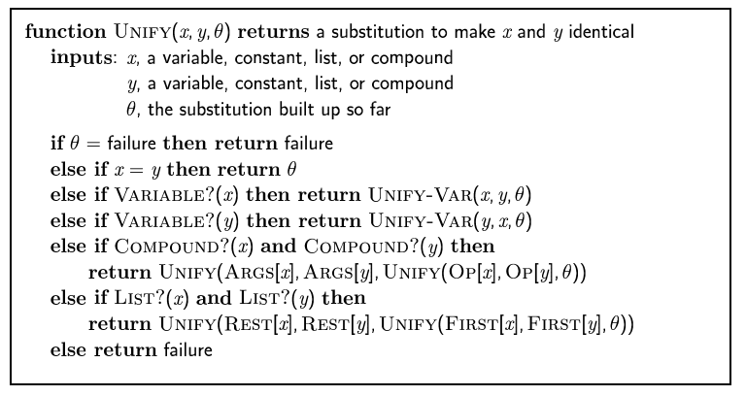
SKIP: The unification algorithm

Slide 25
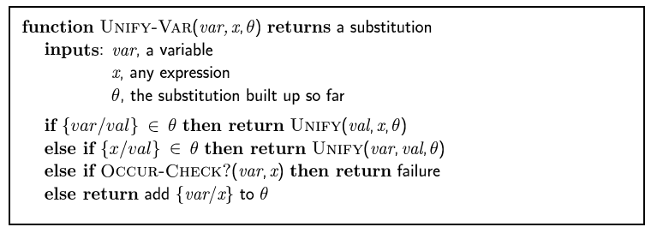
SKIP: The unification algorithm

Slide 26
Generalized Modus Ponens (GMP)
Combines And-Introduction, Universal-Elimination, and Modus Ponens
Example:
  from P(c), Q(c); and (Ax)(P(x) ^ Q(x)) => R(x); derive R(c)
In general, given atomic sentences P1, P2, ..., PN, and implication sentence (Q1 ^ Q2 ^ ... ^ QN) => R, where Q1, ..., QN and R are atomic sentences, and subst(Theta, Pi) = subst(Theta, Qi) for i=1,...,N, derive new sentence: subst(Theta, R).
Example:
subst({x/IceCream, y/Ziggy}, eats(y,x)) = eats(Ziggy, IceCream)

Slide 27
Generalized Modus Ponens (GMP)
If we can find substitutions for p₁', p₂', … , p_{n}', for p₁ ∧ p₂ ∧ … ∧ p_{n} we can infer q.
p₁', p₂', … , p_{n}', ( p₁ ∧ p₂ ∧ … ∧ p_{n} ⇒q)
qθ
p₁' is King(John) p₁ is King(x)
p₂' is Greedy(y) p₂ is Greedy(x)
θ is {x/John,y/John} q is Evil(x)
q θ is Evil(John)
GMP used with KB of definite clauses (exactly one positive literal)
All variables assumed universally quantified
where p_{i}'θ = p_{i} θ for all i

Slide 28
Soundness of GMP
Automated inference using FOL is harder than using PL because variables can take on potentially an infinite number of possible values.
Hence there are potentially an infinite number of ways to apply Universal-Elimination rule of inference.
Godel's Completeness Theorem says that FOL entailment is only semidecidable.
That is, if a sentence is true given a set of axioms, there is a procedure that will determine this. However, if the sentence is false, then there is no guarantee that a procedure will ever determine this.
In other words, the procedure may never halt in this case.

Slide 29
Soundness of GMP
The Truth Table method of inference is not complete for FOL because the truth table size may be infinite.
Natural Deduction is complete for FOL, but is not practical for automated inference because the "branching factor" in a search that is too large.
Caused by the fact that we would have to potentially try every inference rule in every possible way using the set of known sentences.
Generalized Modus Ponens is not complete for FOL
Generalized Modus Ponens is complete for KBs containing only Horn clauses.

Slide 30
Soundness of GMP
A Horn clause is a sentence of the form:
(Ax) (P1(x) ^ P2(x) ^ ... ^ Pn(x)) => Q(x)
where there are 0 or more Pi's, and the Pi's and Q are positive (i.e., un-negated) literals.
Natural deduction using GMP is complete for KBs containing only Horn clauses.
Proofs start with the given axioms/premises in KB, deriving new sentences using GMP until the goal/query sentence is derived.
This defines a forward chaining inference procedure because it moves "forward" from the KB to the goal.

Slide 31
Forward Chaining Using GMP
Natural deduction using GMP is complete for KBs containing only Horn clauses.
Proofs start with the given axioms/premises in KB, deriving new sentences using GMP until the goal/query sentence is derived.
This defines a forward chaining inference procedure because it moves "forward" from the KB to the goal.

Slide 32
Forward Chaining Using GMP
Example: KB = All cats like fish, cats eat everything they like, and Ziggy is a cat. In FOL, KB =
  (Ax) cat(x) => likes(x, Fish)
  (Ax)(Ay) (cat(x) ^ likes(x,y)) => eats(x,y)
  cat(Ziggy)
Goal query: Does Ziggy eat fish?
Proof:
  Use GMP with (1) and (3) to derive: 4. likes(Ziggy, Fish)
  Use GMP with (3), (4) and (2) to derive eats(Ziggy, Fish)
  So, Yes, Ziggy eats fish.

Slide 33
Backward-chaining
Backward-chaining deduction using GMP is complete for KBs containing only Horn clauses.
Proofs start with the goal query, find implications that would allow you to prove it, and then prove each of the antecedents in the implication, continuing to work "backwards" until we get to the axioms, which we know are true.

Slide 34
Backward Chaining Using GMP
Example: Does Ziggy eat fish? Q = eats(Ziggy, Fish)
In FOL, KB =
  (Ax) cat(x) => likes(x, Fish)
  (Ax)(Ay) (cat(x) ^ likes(x,y)) => eats(x,y)
  cat(Ziggy)
To prove eats(Ziggy, Fish), first see if this is known from one of the axioms directly.
Here it is not known, so see if there is a Horn clause that has the consequent (i.e., right-hand side) of the implication matching the goal.

Slide 35
Backward Chaining Using GMP
Example: Does Ziggy eat fish? Q = eats(Ziggy, Fish)
In FOL, KB =
  (Ax) cat(x) => likes(x, Fish)
  (Ax)(Ay) (cat(x) ^ likes(x,y)) => eats(x,y)
  cat(Ziggy)
Proof:
  Q matches RHS of Horn clause (2), so try and prove new sub-goals cat(Ziggy) and likes(Ziggy, Fish) that correspond to the LHS of (2).
  cat(Ziggy) matches axiom (3), so we've "solved" that sub-goal
  likes(Ziggy, Fish) matches the RHS of (1), so try and prove cat(Ziggy)
  cat(Ziggy) matches (as it did earlier) axiom (3), so we've solved this sub-goal
  There are no unsolved sub-goals, so we're done. Yes, Ziggy eats fish.

Slide 36
Example knowledge base
The law says that it is a crime for an American to sell weapons to hostile nations. The country Nono, an enemy of America, has some missiles, and all of its missiles were sold to it by Colonel West, who is American.
Prove that Col. West is a criminal

Slide 37
Example knowledge base contd.
... it is a crime for an American to sell weapons to hostile nations:
  American(x) ∧ Weapon(y) ∧ Sells(x,y,z) ∧ Hostile(z) ⇒ Criminal(x)
Nono … has some missiles, i.e., ∃x Owns(Nono,x) ∧ Missile(x):
  Owns(Nono,M₁) and Missile(M₁)
… all of its missiles were sold to it by Colonel West
  Missile(x) ∧ Owns(Nono,x) ⇒ Sells(West,x,Nono)
Missiles are weapons:
  Missile(x) ⇒ Weapon(x)
An enemy of America counts as "hostile“:
  Enemy(x,America) ⇒ Hostile(x)
West, who is American …
  American(West)
The country Nono, an enemy of America …
  Enemy(Nono,America)

Slide 38
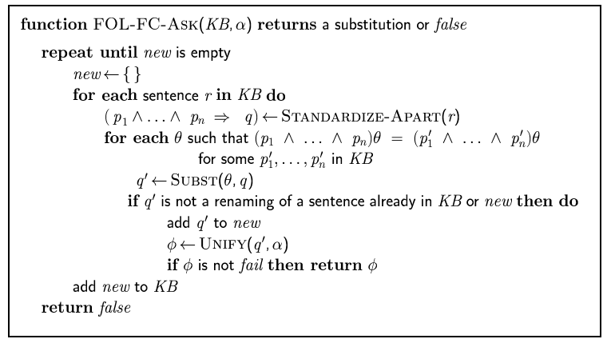
Forward chaining algorithm

Slide 39
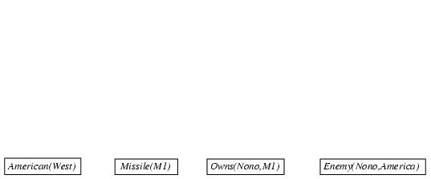
Forward chaining proof

Slide 40
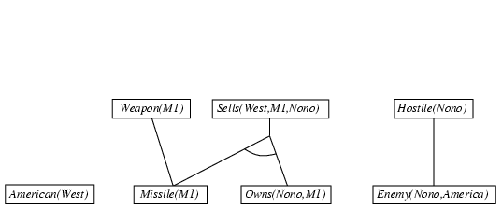
Forward chaining proof

Slide 41
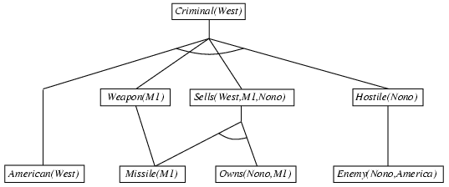
Forward chaining proof

Slide 42
Properties of forward chaining
Sound and complete for first-order definite clauses
Datalog = first-order definite clauses + no functions
FC terminates for Datalog in finite number of iterations
May not terminate in general if α is not entailed
This is unavoidable: entailment with definite clauses is semidecidable

Slide 43
Efficiency of forward chaining
Incremental forward chaining: no need to match a rule on iteration k if a premise wasn't added on iteration k-1
  ⇒ match each rule whose premise contains a newly added positive literal
Matching itself can be expensive:
Database indexing allows O(1) retrieval of known facts
  e.g., query Missile(x) retrieves Missile(M₁)
Forward chaining is widely used in deductive databases

Slide 44

STOP: Hard matching example
Diff(wa,nt) ∧ Diff(wa,sa) ∧ Diff(nt,q) ∧ Diff(nt,sa) ∧ Diff(q,nsw) ∧ Diff(q,sa) ∧ Diff(nsw,v) ∧ Diff(nsw,sa) ∧ Diff(v,sa) ⇒ Colorable()
Diff(Red,Blue) Diff (Red,Green) Diff(Green,Red) Diff(Green,Blue) Diff(Blue,Red) Diff(Blue,Green)
Colorable() is inferred iff the CSP has a solution
CSPs include 3SAT as a special case, hence matching is NP-hard

Slide 45
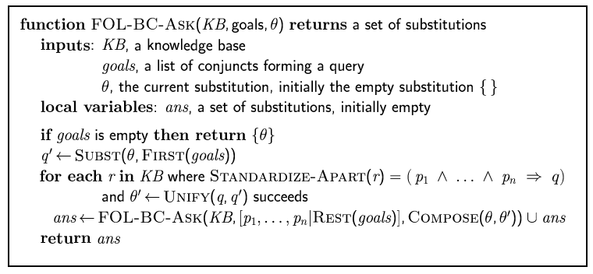
Backward chaining algorithm
SUBST(COMPOSE(θ₁, θ₂), p) = SUBST(θ₂, SUBST(θ₁, p))

Slide 46

Backward chaining example

Slide 47
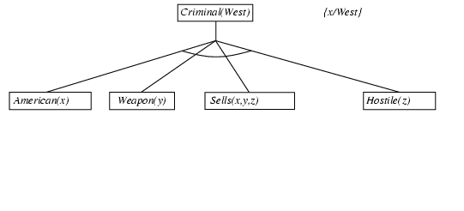
Backward chaining example

Slide 48
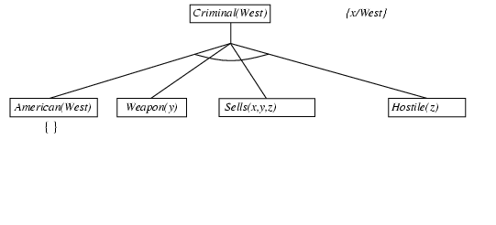
Backward chaining example

Slide 49
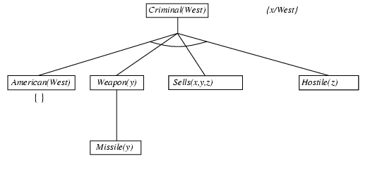
Backward chaining example

Slide 50
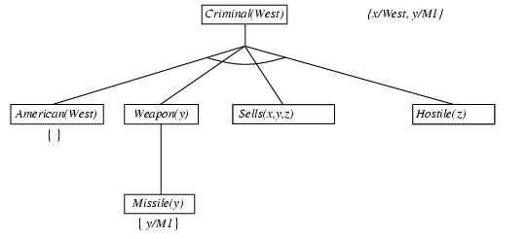
Backward chaining example

Slide 51
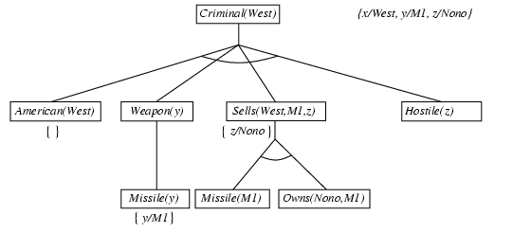
Backward chaining example

Slide 52
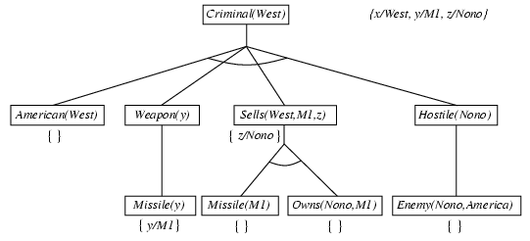
Backward chaining example

Slide 53
Backward chaining example

Slide 54
Properties of backward chaining
Depth-first recursive proof search: space is linear in size of proof
Incomplete due to infinite loops
  ⇒ fix by checking current goal against every goal on stack
Inefficient due to repeated subgoals (both success and failure)
  ⇒ fix using caching of previous results (extra space)
Widely used for logic programming

Slide 55
Logic programming: Prolog
Algorithm = Logic + Control
Basis: backward chaining with Horn clauses + bells & whistles
Widely used in Europe, Japan (basis of 5th Generation project)
Compilation techniques ⇒ 60 million LIPS
Program = set of clauses = head :- literal₁, … literal_{n}.
criminal(X) :- american(X), weapon(Y), sells(X,Y,Z), hostile(Z).
Depth-first, left-to-right backward chaining
Built-in predicates for arithmetic etc., e.g., X is Y*Z+3
Built-in predicates that have side effects (e.g., input and output predicates, assert/retract predicates)
Closed-world assumption ("negation as failure")
  e.g., given alive(X) :- not dead(X).
  alive(joe) succeeds if dead(joe) fails

Slide 56
Prolog
Appending two lists to produce a third:
append([],Y,Y).
append([X|L],Y,[X|Z]) :- append(L,Y,Z).
query: append(A,B,[1,2]) ?
answers: A=[] B=[1,2]
A=[1] B=[2]
A=[1,2] B=[]

Slide 57
Resolution: brief summary
Full first-order version:
l₁ ∨ ··· ∨ l_{k}, m₁ ∨ ··· ∨ m_{n}
(l₁ ∨ ··· ∨ l_{i-1} ∨ l_{i+1} ∨ ··· ∨ l_{k} ∨ m₁ ∨ ··· ∨ m_{j-1} ∨ m_{j+1} ∨ ··· ∨ m_{n})θ
where Unify(l_{i}, ¬m_{j}) = θ.
The two clauses are assumed to be standardized apart so that they share no variables.
For example,
¬Rich(x) ∨ Unhappy(x)
Rich(Ken)
Unhappy(Ken)
with θ = {x/Ken}
Apply resolution steps to CNF(KB ∧ ¬α); complete for FOL

Slide 58
Conversion to CNF
Everyone who loves all animals is loved by someone:
  ∀x [∀y Animal(y) ⇒ Loves(x,y)] ⇒ [∃y Loves(y,x)]
1. Eliminate biconditionals and implications
  ∀x [¬∀y ¬Animal(y) ∨ Loves(x,y)] ∨ [∃y Loves(y,x)]
2. Move ¬ inwards: ¬∀x p ≡ ∃x ¬p, ¬ ∃x p ≡ ∀x ¬p
  ∀x [∃y ¬(¬Animal(y) ∨ Loves(x,y))] ∨ [∃y Loves(y,x)]
  ∀x [∃y ¬¬Animal(y) ∧ ¬Loves(x,y)] ∨ [∃y Loves(y,x)]
  ∀x [∃y Animal(y) ∧ ¬Loves(x,y)] ∨ [∃y Loves(y,x)]

Slide 59
Conversion to CNF contd.
Standardize variables: each quantifier should use a different one
  ∀x [∃y Animal(y) ∧ ¬Loves(x,y)] ∨ [∃z Loves(z,x)]
Skolemize: a more general form of existential instantiation.
  Each existential variable is replaced by a Skolem function of the enclosing universally quantified variables:
  ∀x [Animal(F(x)) ∧ ¬Loves(x,F(x))] ∨ Loves(G(x),x)
Drop universal quantifiers:
  [Animal(F(x)) ∧ ¬Loves(x,F(x))] ∨ Loves(G(x),x)
Distribute ∨ over ∧ :
  [Animal(F(x)) ∨ Loves(G(x),x)] ∧ [¬Loves(x,F(x)) ∨ Loves(G(x),x)]

Slide 60
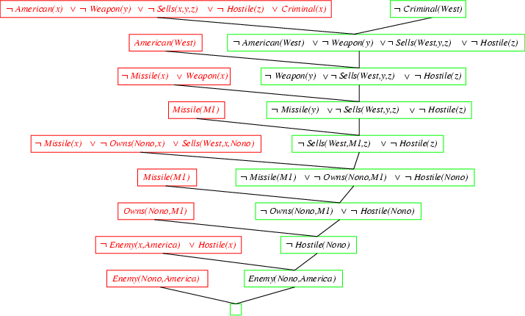
Resolution proof: definite clauses

