Slide 1
Inference in first-order logic
CS4881 Aritificial Intelligence
Jay Urbain

Slide 2
Outline
Reducing first-order inference to propositional inference
Unification
Generalized Modus Ponens
Forward chaining
Backward chaining
Resolution

Slide 3
Difficulty of FOL Inference
Inference in propositional logic (PL) is relatively easy
  Enumerate all possibilities (truth tables)
  Apply sound inference rules on facts
But in FOL we have concepts and variables, relations, and quantification
  This complicates things - a lot
First, let’s see how we can convert FOL into propositional logic, then use PL inference.
  And see why this is valid

Slide 4
Convert (Reduce) FOL into PL
Get rid of quantifiers
Universal instantiation (UI) (Universal Elimination)
Every instantiation of a universally quantified sentence is entailed by it:
∀v α
Subst({v/g}, α)
Variable v substituted with ground term g from KB
E.g., ∀x Eats(Bob, x) infer Eats(Bob, pizza), Eats(Bob, donughts), Eats(Bob, books), …
E.g., ∀x King(x) ∧ Greedy(x) ⇒ Evil(x) yields:
  King(John) ∧ Greedy(John) ⇒ Evil(John)
  King(Richard) ∧ Greedy(Richard) ⇒ Evil(Richard)
  King(Father(John)) ∧ Greedy(Father(John)) ⇒ Evil(Father(John))

Slide 5
Convert FOL into PL
Existential instantiation (EI) (Existential Elimination)
  Variable substituted for new term (Skolem constant).
∃v α
Subst({v/k}, α)
For any sentence α, variable v, and constant symbol k that does not appear elsewhere in the knowledge base:
E.g., ∃ x Eats(Bob, x) infer Eats(Bob, NewFood)
Why do we need a new term?
  Bob eats something and Tyler eats something, but they don’t eat the same thing, i.e.,
  ∃ x Eats(Bob, x) ^ ∃ x Eats(Tyler, x)
E.g., ∃x Crown(x) ∧ OnHead(x,John) yields: Crown(C₁) ∧ OnHead(C₁,John)
provided C₁ is a new constant symbol, called a Skolem constant

Slide 6
Convert FOL into PL
Basic idea: use substitution, treat ground terms like propositional symbols.
Translate English to FOL
Tom is a turtle
  turtle(Tom)
Rob is a rabbit
  rabbit(Rob)
Turtles outlast rabbits
  ∀x,y turtle(x) ^ rabbit(y) ⇒ outlasts(x,y)
Now proove Tom outlasts Rob!

Slide 7
Convert FOL into PL
Proof: Tom outlasts Rob
Logical and introduction:
  turtle(Tom) ^ rabbit(Rob)
Universal elimination {x/Tom, y/Rob}, among millions of other things in KB
  turtle(Tom) ^ rabbit(Rob) ⇒ outlasts(Tom,Rob)
Modus Ponens
  outlasts(Tom,Rob)
Does not seem very efficient
  Need more powerful inference rules for FOL
  Why bother with the million things?

Slide 8
Generalized Modus Ponens (GMP)
Unify rule premise with known facts and apply unifier to conclusion
  I.e., Find a substitution that makes the rule premise match known facts.
Rule: ∀x,y turtle(x) ^ rabbit(y) ⇒ outlasts(x,y)
  Known facts: turtle(Tom) ^ rabbit(Rob)
  Unifier: {x/Tom, y/Rob}
Apply unifier to conclusion:
  outlasts(Tom, Rob)

Slide 9
Generalized Modus Ponens (GMP)
Unify rule premise with known facts
  I.e., Find a substitution that makes the rule premise match known facts.
p₁', p₂', … , p_{n}', ( p₁ ∧ p₂ ∧ … ∧ p_{n} ⇒q)
SUBST(θ,q)
Where SUBST(θ, p_{i}') = SUBST(θ, p_{i}) for all i
SUBST(θ,α) just means apply the substitutions contained witin θ to sentence α.
Substitution list θ = {v₁/t₁, v₂/t₂, …, v_{n}/t_{n}} means
  Replace all occurrences of variable vi with term ti
  Substitutions are made in left to right order
All variables assumed to be universally quantified
Used with a KB in Horn normal form, i.e., KB of definite clauses (exactly one positive literal)

Slide 10
Generalized Modus Ponens (GMP)
Unify rule premise with known facts
  I.e., Find a substitution that makes the rule premise match known facts.
p₁', p₂', … , p_{n}', ( p₁ ∧ p₂ ∧ … ∧ p_{n} ⇒q)
SUBST(θ,q)
Where SUBST(θ, p_{i}') = SUBST(θ, p_{i}) for all I
Example:
p1' = taller(Larry,Curly)
p2' = taller(Curly,Moe)
p1 ^ p2 ⇒ q = taller(x,y) ^ taller(y,z) ⇒ taller(x,z)
θ = {x/Larry, y/Curly, z/Moe}
SUBST(θ,q) = taller(Larry,Moe)

Slide 11
Reduction to propositional inference
Suppose the KB contains just the following:
  ∀x King(x) ∧ Greedy(x) ⇒ Evil(x)
  King(John), King(Richard)
  Greedy(John), Greedy(Richard)
  Brother(Richard,John)
Instantiating the universal sentence in all possible ways, we have:
  King(John) ∧ Greedy(John) ⇒ Evil(John)
  King(Richard) ∧ Greedy(Richard) ⇒ Evil(Richard)
  King(John), King(Richard)
  Greedy(John), Greedy(Richard)
  Brother(Richard,John)
The new KB is propositionalized: proposition symbols are
  King(John), Greedy(John), Evil(John), King(Richard), etc.

Slide 12
Reduction contd.
Every FOL KB can be propositionalized so as to preserve entailment.
(A ground sentence is entailed by new KB iff entailed by original KB).
Idea: propositionalize KB and query, apply resolution, return result.
Problem: with function symbols, there are infinitely many ground terms,
  e.g., Father(Father(Father(John))).

Slide 13
Reduction cont’d.
Theorem: Herbrand (1930). If a sentence α is entailed by an FOL KB, it is entailed by a finite subset of the propositionalized KB.
Idea: For n = 0 to ∞ do
  create a propositional KB by instantiating with depth-$n$ terms
  see if α is entailed by this KB.
Problem: works if α is entailed, loops if α is not entailed
Theorem: Turing (1936), Church (1936) Entailment for FOL is semidecidable (algorithms exist that say yes to every entailed sentence, but no algorithm exists that also says no to every nonentailed sentence.)

Slide 14
Problems with propositionalization
Propositionalization seems to generate lots of irrelevant sentences.
E.g., from:
  ∀x King(x) ∧ Greedy(x) ⇒ Evil(x)
  King(John)
  ∀y Greedy(y)
  Brother(Richard,John)
It seems obvious that Evil(John), but propositionalization produces lots of facts such as Greedy(Richard) that are irrelevant
With p k-ary predicates and n constants, there are p·n^{k} instantiations – exponential in number of predicates.

Slide 15
Unification
We can get the inference immediately if we can find a substitution θ such that King(x) and Greedy(x) match King(John) and Greedy(y)
θ = {x/John,y/John} works
Unify(α,β) = θ if αθ = βθ
p q θ
Knows(John,x) Knows(John,Jane)
Knows(John,x) Knows(y,OJ)
Knows(John,x) Knows(y,Mother(y))
Knows(John,x) Knows(x,OJ)
Standardizing apart eliminates overlap of variables, e.g., Knows(z₁₇,OJ)

Slide 16
Unification
We can get the inference immediately if we can find a substitution θ such that King(x) and Greedy(x) match King(John) and Greedy(y)
θ = {x/John,y/John} works
Unify(α,β) = θ if αθ = βθ
p q θ
Knows(John,x) Knows(John,Jane) {x/Jane}}
Knows(John,x) Knows(y,OJ)
Knows(John,x) Knows(y,Mother(y))
Knows(John,x) Knows(x,OJ)
Standardizing apart eliminates overlap of variables, e.g., Knows(z₁₇,OJ)

Slide 17
Unification
We can get the inference immediately if we can find a substitution θ such that King(x) and Greedy(x) match King(John) and Greedy(y)
θ = {x/John,y/John} works
Unify(α,β) = θ if αθ = βθ
p q θ
Knows(John,x) Knows(John,Jane) {x/Jane}}
Knows(John,x) Knows(y,OJ) {x/OJ,y/John}}
Knows(John,x) Knows(y,Mother(y))
Knows(John,x) Knows(x,OJ)
Standardizing apart eliminates overlap of variables, e.g., Knows(z₁₇,OJ)

Slide 18
Unification
We can get the inference immediately if we can find a substitution θ such that King(x) and Greedy(x) match King(John) and Greedy(y)
θ = {x/John,y/John} works
Unify(α,β) = θ if αθ = βθ
p q θ
Knows(John,x) Knows(John,Jane) {x/Jane}}
Knows(John,x) Knows(y,OJ) {x/OJ,y/John}}
Knows(John,x) Knows(y,Mother(y)) {y/John,x/Mother(John)}}
Knows(John,x) Knows(x,OJ)
Standardizing apart eliminates overlap of variables, e.g., Knows(z₁₇,OJ)

Slide 19
Unification
We can get the inference immediately if we can find a substitution θ such that King(x) and Greedy(x) match King(John) and Greedy(y)
θ = {x/John,y/John} works
Unify(α,β) = θ if αθ = βθ
p q θ
Knows(John,x) Knows(John,Jane) {x/Jane}}
Knows(John,x) Knows(y,OJ) {x/OJ,y/John}}
Knows(John,x) Knows(y,Mother(y)) {y/John,x/Mother(John)}}
Knows(John,x) Knows(x,OJ) {fail}
Standardizing apart eliminates overlap of variables, e.g., Knows(z₁₇,OJ)

Slide 20
Unification
To unify Knows(John,x) and Knows(y,z),
θ = {y/John, x/z } or θ = {y/John, x/John, z/John}
The first unifier is more general than the second.
There is a single most general unifier (MGU) that is unique up to renaming of variables.
  MGU = { y/John, x/z }

Slide 21
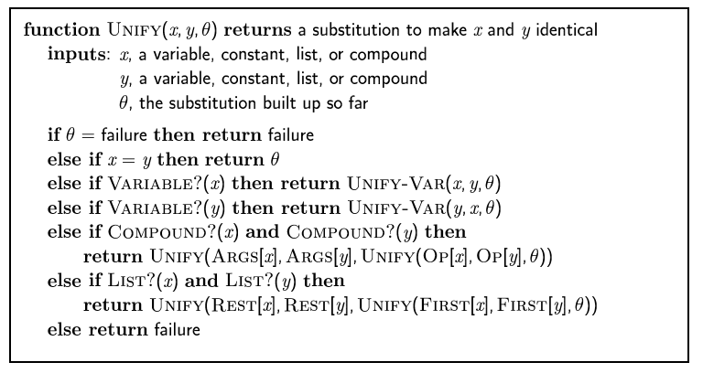
The unification algorithm

Slide 22
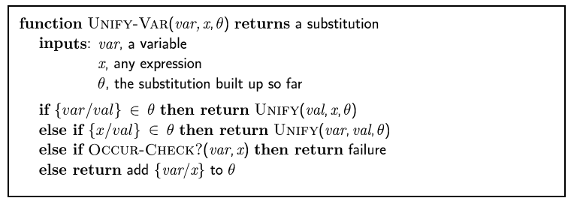
The unification algorithm

Slide 23
Generalized Modus Ponens (GMP)
p₁', p₂', … , p_{n}', ( p₁ ∧ p₂ ∧ … ∧ p_{n} ⇒q)
qθ
p₁' is King(John) p₁ is King(x)
p₂' is Greedy(y) p₂ is Greedy(x)
θ is {x/John,y/John} q is Evil(x)
q θ is Evil(John)
GMP used with KB of definite clauses (exactly one positive literal)
All variables assumed universally quantified
where p_{i}'θ = p_{i} θ for all i

Slide 24
Soundness of GMP
Need to show that
p₁', …, p_{n}', (p₁ ∧ … ∧ p_{n} ⇒ q) ╞ qθ
provided that p_{i}'θ = p_{i}θ for all I
Lemma: For any sentence p, we have p ╞ pθ by UI
  (p₁ ∧ … ∧ p_{n} ⇒ q) ╞ (p₁ ∧ … ∧ p_{n} ⇒ q)θ = (p₁θ ∧ … ∧ p_{n}θ ⇒ qθ)
  p₁', \; …, \;p_{n}' ╞ p₁' ∧ … ∧ p_{n}' ╞ p₁'θ ∧ … ∧ p_{n}'θ
  From 1 and 2, qθ follows by ordinary Modus Ponens

Slide 25
Example knowledge base
The law says that it is a crime for an American to sell weapons to hostile nations. The country Nono, an enemy of America, has some missiles, and all of its missiles were sold to it by Colonel West, who is American.
Prove that Col. West is a criminal

Slide 26
Example knowledge base contd.
... it is a crime for an American to sell weapons to hostile nations:
  American(x) ∧ Weapon(y) ∧ Sells(x,y,z) ∧ Hostile(z) ⇒ Criminal(x)
Nono … has some missiles, i.e., ∃x Owns(Nono,x) ∧ Missile(x):
  Owns(Nono,M₁) and Missile(M₁)
… all of its missiles were sold to it by Colonel West
  Missile(x) ∧ Owns(Nono,x) ⇒ Sells(West,x,Nono)
Missiles are weapons:
  Missile(x) ⇒ Weapon(x)
An enemy of America counts as "hostile“:
  Enemy(x,America) ⇒ Hostile(x)
West, who is American …
  American(West)
The country Nono, an enemy of America …
  Enemy(Nono,America)

Slide 27
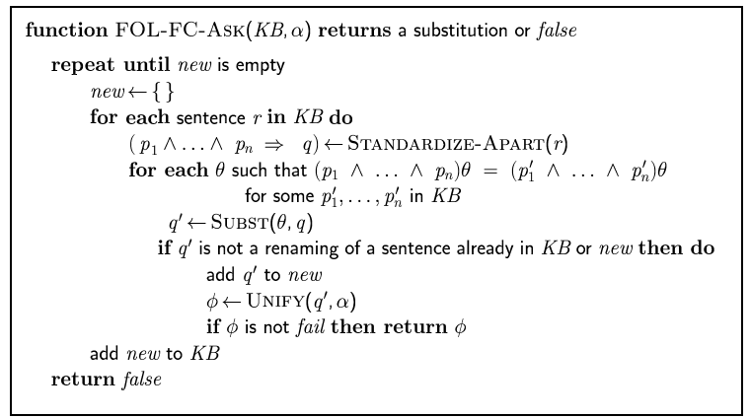
Forward chaining algorithm

Slide 28
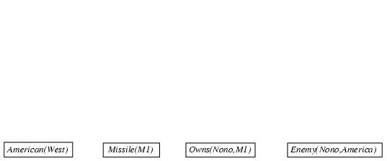
Forward chaining proof

Slide 29
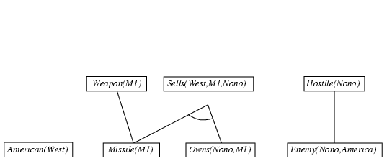
Forward chaining proof

Slide 30
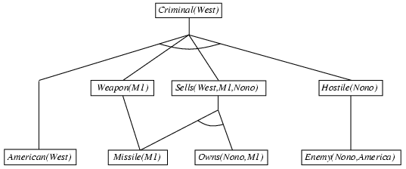
Forward chaining proof

Slide 31
Properties of forward chaining
Sound and complete for first-order definite clauses
Datalog = first-order definite clauses + no functions
FC terminates for Datalog in finite number of iterations
May not terminate in general if α is not entailed
This is unavoidable: entailment with definite clauses is semidecidable

Slide 32
Efficiency of forward chaining
Incremental forward chaining: no need to match a rule on iteration k if a premise wasn't added on iteration k-1
  ⇒ match each rule whose premise contains a newly added positive literal
Matching itself can be expensive:
Database indexing allows O(1) retrieval of known facts
  e.g., query Missile(x) retrieves Missile(M₁)
Forward chaining is widely used in deductive databases

Slide 33

Hard matching example
Diff(wa,nt) ∧ Diff(wa,sa) ∧ Diff(nt,q) ∧ Diff(nt,sa) ∧ Diff(q,nsw) ∧ Diff(q,sa) ∧ Diff(nsw,v) ∧ Diff(nsw,sa) ∧ Diff(v,sa) ⇒ Colorable()
Diff(Red,Blue) Diff (Red,Green) Diff(Green,Red) Diff(Green,Blue) Diff(Blue,Red) Diff(Blue,Green)
Colorable() is inferred iff the CSP has a solution
CSPs include 3SAT as a special case, hence matching is NP-hard

Slide 34
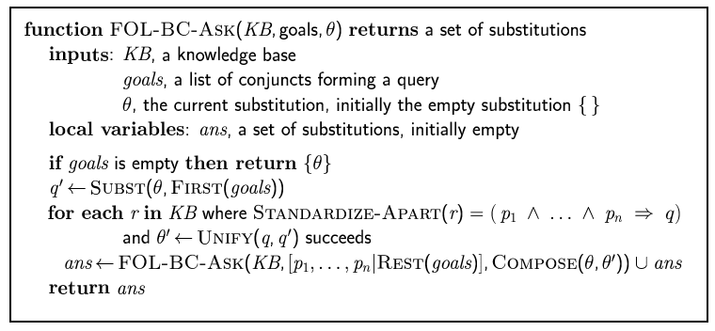
Backward chaining algorithm
SUBST(COMPOSE(θ₁, θ₂), p) = SUBST(θ₂, SUBST(θ₁, p))

Slide 35

Backward chaining example

Slide 36
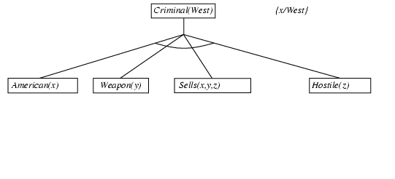
Backward chaining example

Slide 37
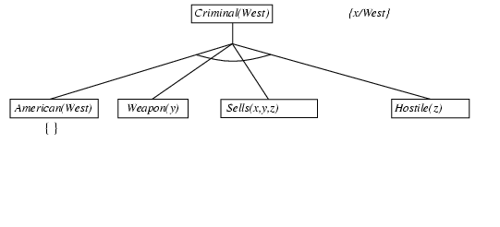
Backward chaining example

Slide 38
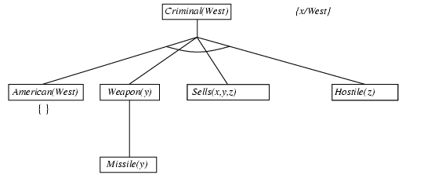
Backward chaining example

Slide 39
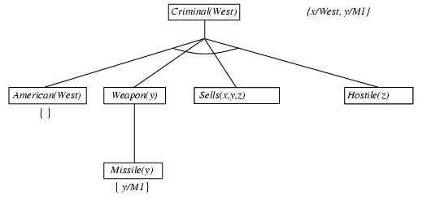
Backward chaining example

Slide 40
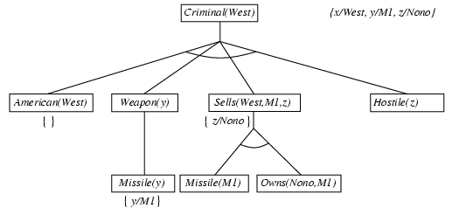
Backward chaining example

Slide 41
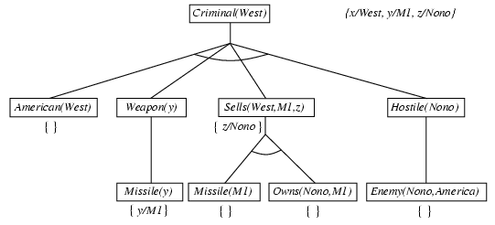
Backward chaining example

Slide 42
Backward chaining example

Slide 43
Properties of backward chaining
Depth-first recursive proof search: space is linear in size of proof
Incomplete due to infinite loops
  ⇒ fix by checking current goal against every goal on stack
Inefficient due to repeated subgoals (both success and failure)
  ⇒ fix using caching of previous results (extra space)
Widely used for logic programming

Slide 44
Logic programming: Prolog
Algorithm = Logic + Control
Basis: backward chaining with Horn clauses + bells & whistles
Widely used in Europe, Japan (basis of 5th Generation project)
Compilation techniques ⇒ 60 million LIPS
Program = set of clauses = head :- literal₁, … literal_{n}.
criminal(X) :- american(X), weapon(Y), sells(X,Y,Z), hostile(Z).
Depth-first, left-to-right backward chaining
Built-in predicates for arithmetic etc., e.g., X is Y*Z+3
Built-in predicates that have side effects (e.g., input and output predicates, assert/retract predicates)
Closed-world assumption ("negation as failure")
  e.g., given alive(X) :- not dead(X).
  alive(joe) succeeds if dead(joe) fails

Slide 45
Prolog
Appending two lists to produce a third:
append([],Y,Y).
append([X|L],Y,[X|Z]) :- append(L,Y,Z).
query: append(A,B,[1,2]) ?
answers: A=[] B=[1,2]
A=[1] B=[2]
A=[1,2] B=[]

Slide 46
Resolution: brief summary
Full first-order version:
l₁ ∨ ··· ∨ l_{k}, m₁ ∨ ··· ∨ m_{n}
(l₁ ∨ ··· ∨ l_{i-1} ∨ l_{i+1} ∨ ··· ∨ l_{k} ∨ m₁ ∨ ··· ∨ m_{j-1} ∨ m_{j+1} ∨ ··· ∨ m_{n})θ
where Unify(l_{i}, ¬m_{j}) = θ.
The two clauses are assumed to be standardized apart so that they share no variables.
For example,
¬Rich(x) ∨ Unhappy(x)
Rich(Ken)
Unhappy(Ken)
with θ = {x/Ken}
Apply resolution steps to CNF(KB ∧ ¬α); complete for FOL

Slide 47
Conversion to CNF
Everyone who loves all animals is loved by someone:
  ∀x [∀y Animal(y) ⇒ Loves(x,y)] ⇒ [∃y Loves(y,x)]
1. Eliminate biconditionals and implications
  ∀x [¬∀y ¬Animal(y) ∨ Loves(x,y)] ∨ [∃y Loves(y,x)]
2. Move ¬ inwards: ¬∀x p ≡ ∃x ¬p, ¬ ∃x p ≡ ∀x ¬p
  ∀x [∃y ¬(¬Animal(y) ∨ Loves(x,y))] ∨ [∃y Loves(y,x)]
  ∀x [∃y ¬¬Animal(y) ∧ ¬Loves(x,y)] ∨ [∃y Loves(y,x)]
  ∀x [∃y Animal(y) ∧ ¬Loves(x,y)] ∨ [∃y Loves(y,x)]

Slide 48
Conversion to CNF contd.
Standardize variables: each quantifier should use a different one
  ∀x [∃y Animal(y) ∧ ¬Loves(x,y)] ∨ [∃z Loves(z,x)]
Skolemize: a more general form of existential instantiation.
  Each existential variable is replaced by a Skolem function of the enclosing universally quantified variables:
  ∀x [Animal(F(x)) ∧ ¬Loves(x,F(x))] ∨ Loves(G(x),x)
Drop universal quantifiers:
  [Animal(F(x)) ∧ ¬Loves(x,F(x))] ∨ Loves(G(x),x)
Distribute ∨ over ∧ :
  [Animal(F(x)) ∨ Loves(G(x),x)] ∧ [¬Loves(x,F(x)) ∨ Loves(G(x),x)]

Slide 49
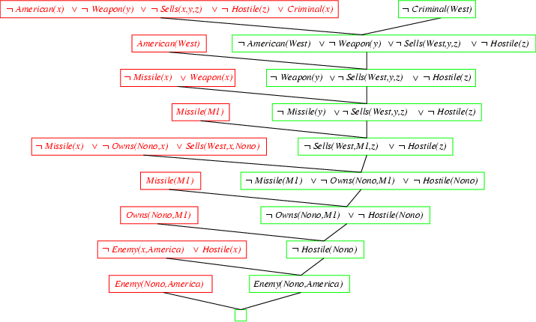
Resolution proof: definite clauses

