Slide 1
Inference in first-order logic
CS4881 Aritificial Intelligence
Jay Urbain

Slide 2
Outline
Review
Translating English to FOL
Reducing first-order inference to propositional inference
Unification
Generalized Modus Ponens
Forward chaining
Backward chaining
Resolution

Slide 3
Review: First-Order Logic
(FOL or FOPC) Syntax
User defines these primitives:
  Constant symbols (i.e., the “entities“ in the world) E.g., Mary, 3
  Function symbols (mapping entities to entities) E.g., father-of(Mary) = John, color-of(Sky) = Blue
  Predicate symbols (mapping from entities to truth values) E.g., greater(5,3), green(Grass), color(Grass, Green). Establishes relations.

Slide 4
Review: FOL Primitives
Variable symbols. E.g., x, y
Logical connectives. Same as in PL: not (~), and (^), or (v), implies (=>), if and only if (<=>)
Quantifiers: Universal (A) and Existential (E)
  Universal quantification corresponds to conjunction ("and") in that (Ax)P(x) means that P holds for all values of x in the domain associated with that variable.
  E.g., (Ax) dolphin(x) => mammal(x)
  Existential quantification corresponds to disjunction ("or") in that (Ex)P(x) means that P holds for some value of x in the domain associated with that variable.
  E.g., (Ex) mammal(x) ^ lays-eggs(x)

Slide 5
Review: Universal Quantification
  Universal quantifiers usually used with "implies" to form "if-then rules."
  E.g., (Ax) cs4881_student(x) => smart(x) means "All cs4881students are smart."
  You rarely use universal quantification to make blanket statements about every individual in the world:
  (Ax)cs4881_student(x) ^ smart(x) means “everyone in the world is a cs4881 student and is smart.”

Slide 6
Review: Existential Quantification
  Existential quantification corresponds to disjunction ("or") in that (Ex)P(x) means that P holds for some value of x in the domain associated with that variable. E.g., (Ex) mammal(x) ^ lays-eggs(x)
  Rarely use implication with existential quantification:
  (Ex)cs4881_student(x) => smart(x) is true if there is anyone who is not in cs4881or they are smart!

Slide 7
FOL Sentences
Sentences are built up from terms and atoms:
A term (denoting a real-world individual) is a constant symbol, a variable symbol, or an n-place function of n terms.
For example, x and f(x1, ..., xn) are terms, where each xi is a term.
An atom (which has value true or false) is either an n-place predicate of n terms, or, if P and Q are atoms, then ~P, P V Q, P ^ Q, P => Q, P <=> Q are atoms.
A sentence is an atom, or, if P is a sentence and x is a variable, then (Ax)P and (Ex)P are sentences
A well-formed formula (wff) is a sentence containing no "free" variables. I.e., all variables are "bound" by universal or existential quantifiers.
E.g., (Ax)P(x,y) has x bound as a universally quantified variable, but y is free.

Slide 8
Translating English to FOL
Every gardener likes the sun.
(Ax) gardener(x) => likes(x,Sun)
You can fool some of the people all of the time.
(Ex) (person(x) ^ (At)(time(t) => can-fool(x,t)))
You can fool all of the people some of the time.
(Ax) (person(x) => (Et) (time(t) ^ can-fool(x,t)))
All purple mushrooms are poisonous.
(Ax) (mushroom(x) ^ purple(x)) => poisonous(x)
No purple mushroom is poisonous.
~(Ex) purple(x) ^ mushroom(x) ^ poisonous(x)
or,
(Ax) (mushroom(x) ^ purple(x)) => ~poisonous(x)

Slide 9
Difficulty of FOL Inference
Inference in propositional logic (PL) is relatively easy
  Enumerate all possibilities (truth tables)
  Apply sound inference rules on facts
But in FOL we have concepts and variables, relations, and quantification
  This complicates things - a lot
First, let’s see how we can convert FOL into propositional logic, then use PL inference.
  And see why this is valid

Slide 10
Convert (Reduce) FOL into PL
Get rid of quantifiers
Universal instantiation (UI) (Universal Elimination)
Every instantiation of a universally quantified sentence is entailed by it:
∀v α
Subst({v/g}, α)
Variable v substituted with ground term g from KB
E.g., ∀x Eats(Bob, x) infer Eats(Bob, pizza), Eats(Bob, donughts), Eats(Bob, books), …
E.g., ∀x King(x) ∧ Greedy(x) ⇒ Evil(x) yields:
  King(John) ∧ Greedy(John) ⇒ Evil(John)
  King(Richard) ∧ Greedy(Richard) ⇒ Evil(Richard)
  King(Father(John)) ∧ Greedy(Father(John)) ⇒ Evil(Father(John))

Slide 11
Convert FOL into PL
Existential instantiation (EI) (Existential Elimination)
  Variable substituted for new term (Skolem constant).
∃v α
Subst({v/k}, α)
For any sentence α, variable v, and constant symbol k that does not appear elsewhere in the knowledge base:
E.g., ∃ x Eats(Bob, x) infer Eats(Bob, NewFood)
Why do we need a new term?
  Bob eats something and Tyler eats something, but they don’t eat the same thing, i.e.,
  ∃ x Eats(Bob, x) ^ ∃ x Eats(Tyler, x)
E.g., ∃x Crown(x) ∧ OnHead(x,John) yields: Crown(C₁) ∧ OnHead(C₁,John)
provided C₁ is a new constant symbol, called a Skolem constant

Slide 12
Convert FOL into PL
Basic idea: use substitution, treat ground terms like propositional symbols.
Translate English to FOL
Tom is a turtle
  turtle(Tom)
Rob is a rabbit
  rabbit(Rob)
Turtles outlast rabbits
  ∀x,y turtle(x) ^ rabbit(y) ⇒ outlasts(x,y)
Now proove Tom outlasts Rob!

Slide 13
Convert FOL into PL
Proof: Tom outlasts Rob
Logical AND introduction:
  turtle(x) ^ rabbit(y)
Universal elimination {x/Tom, y/Rob}, among millions of other things in KB
  turtle(Tom) ^ rabbit(Rob) ⇒ outlasts(Tom,Rob)
Modus Ponens
  outlasts(Tom,Rob)
Does not seem very efficient
  Need more powerful inference rules for FOL
  Why bother with the million things?

Slide 14
Generalized Modus Ponens (GMP)
Unify the rule premise with known facts and apply unifier to conclusion
  I.e., Find a substitution that makes the rule premise match known facts.
Rule: ∀x,y turtle(x) ^ rabbit(y) ⇒ outlasts(x,y)
  Known facts: turtle(Tom) ^ rabbit(Rob)
  Unifier: {x/Tom, y/Rob}
Apply unifier to conclusion:
  outlasts(Tom, Rob)

Slide 15
Generalized Modus Ponens (GMP)
Unify rule premise with known facts
p₁', p₂', … , p_{n}', ( p₁ ∧ p₂ ∧ … ∧ p_{n} ⇒q)
SUBST(θ,q)
Where SUBST(θ, p_{i}') = SUBST(θ, p_{i}) for all i
SUBST(θ,α) just means apply the substitutions contained witin θ to sentence α.
Substitution list θ = {v₁/t₁, v₂/t₂, …, v_{n}/t_{n}} means
  Replace all occurrences of variable v_{i} with term t_{i}
  Substitutions are made in left to right order
All variables are assumed to be universally quantified
Used with a KB in Horn normal form, i.e., KB of definite clauses (exactly one positive literal)

Slide 16
Generalized Modus Ponens (GMP)
Unify rule premise with known facts
  I.e., Find a substitution that makes the rule premise match known facts.
p₁', p₂', … , p_{n}', ( p₁ ∧ p₂ ∧ … ∧ p_{n} ⇒q)
SUBST(θ,q)
Where SUBST(θ, p_{i}') = SUBST(θ, p_{i}) for all I
Example:
p1' = taller(Larry,Curly)
p2' = taller(Curly,Moe)
p1 ^ p2 ⇒ q = taller(x,y) ^ taller(y,z) ⇒ taller(x,z)
θ = {x/Larry, y/Curly, z/Moe}
SUBST(θ,q) = taller(Larry,Moe)

Slide 17
Reduction to propositional inference
Suppose the KB contains just the following:
  ∀x King(x) ∧ Greedy(x) ⇒ Evil(x)
  King(John), King(Richard)
  Greedy(John), Greedy(Richard)
  Brother(Richard,John)
Instantiating the universal sentence in all possible ways, we have:
  King(John) ∧ Greedy(John) ⇒ Evil(John)
  King(Richard) ∧ Greedy(Richard) ⇒ Evil(Richard)
  King(John), King(Richard)
  Greedy(John), Greedy(Richard)
  Brother(Richard,John)
The new KB is propositionalized: proposition symbols are
  King(John), Greedy(John), Evil(John), King(Richard), etc.

Slide 18
Reduction contd.
Every FOL KB can be propositionalized so as to preserve entailment.
(A ground sentence is entailed by new KB iff entailed by original KB).
Idea: propositionalize KB and query, apply resolution, return result.
Problem: with function symbols, there are infinitely many ground terms,
  e.g., Father(Father(Father(John))).

Slide 19
Reduction cont’d.
Theorem: Herbrand (1930). If a sentence α is entailed by an FOL KB, it is entailed by a finite subset of the propositionalized KB.
Idea: For n = 0 to ∞ do
  create a propositional KB by instantiating with depth-$n$ terms
  see if α is entailed by this KB.
Problem: works if α is entailed, loops if α is not entailed
Theorem: Turing (1936), Church (1936) Entailment for FOL is semidecidable (algorithms exist that say yes to every entailed sentence, but no algorithm exists that also says no to every nonentailed sentence.)

Slide 20
Unification
Substitution θ is said to unify p and q if SUBST(θ, p) = SUBST(θ, q)
e.g., θ = {x/John,y/John} works
Unify(α,β) = θ, if αθ = βθ
p q θ
Knows(John,x) Knows(John,Jane)
Knows(John,x) Knows(y,OJ)
Knows(John,x) Knows(y,Mother(y))
Knows(John,x) Knows(x,OJ)
Standardizing apart eliminates overlap of variables, e.g., Knows(z₁₇,OJ)

Slide 21
Unification
Substitution θ is said to unify p and q if SUBST(θ, p) = SUBST(θ, q)
e.g., θ = {x/John,y/John} works
Unify(α,β) = θ, if αθ = βθ
p q θ
Knows(John,x) Knows(John,Jane) {x/Jane}}
Knows(John,x) Knows(y,OJ)
Knows(John,x) Knows(y,Mother(y))
Knows(John,x) Knows(x,OJ)
Standardizing apart eliminates overlap of variables, e.g., Knows(z₁₇,OJ)

Slide 22
Unification
Substitution θ is said to unify p and q if SUBST(θ, p) = SUBST(θ, q)
e.g., θ = {x/John,y/John} works
Unify(α,β) = θ, if αθ = βθ
p q θ
Knows(John,x) Knows(John,Jane) {x/Jane}}
Knows(John,x) Knows(y,OJ) {x/OJ,y/John}}
Knows(John,x) Knows(y,Mother(y))
Knows(John,x) Knows(x,OJ)
Standardizing apart eliminates overlap of variables, e.g., Knows(z₁₇,OJ)

Slide 23
Unification
Substitution θ is said to unify p and q if SUBST(θ, p) = SUBST(θ, q)
e.g., θ = {x/John,y/John} works
Unify(α,β) = θ, if αθ = βθ
p q θ
Knows(John,x) Knows(John,Jane) {x/Jane}}
Knows(John,x) Knows(y,OJ) {x/OJ,y/John}}
Knows(John,x) Knows(y,Mother(y)) {y/John,x/Mother(John)}}
Knows(John,x) Knows(x,OJ)
Standardizing apart eliminates overlap of variables, e.g., Knows(z₁₇,OJ)

Slide 24
Unification
Substitution θ is said to unify p and q if SUBST(θ, p) = SUBST(θ, q)
e.g., θ = {x/John,y/John} works
Unify(α,β) = θ, if αθ = βθ
p q θ
Knows(John,x) Knows(John,Jane) {x/Jane}}
Knows(John,x) Knows(y,OJ) {x/OJ,y/John}}
Knows(John,x) Knows(y,Mother(y)) {y/John,x/Mother(John)}}
Knows(John,x) Knows(x,OJ) {fail}
Standardizing apart eliminates overlap of variables, e.g., Knows(z₁₇,OJ)

Slide 25
Unification
To unify Knows(John,x) and Knows(y,z),
θ = {y/John, x/z } or θ = {y/John, x/John, z/John}
The first unifier is more general than the second.
There is a single most general unifier (MGU) that is unique up to renaming of variables.
  MGU = { y/John, x/z }
MGU is unique up to renaming of variables
Cannot unify if a variable itself occurs in the other term: UNIFY(x, f(x)) = FAIL
Cannot unify different ground terms: UNIFY(Nik, Ryan)

Slide 26
Completeness of FOL inference
Truth table enumeration is incomplete for FOL
  Table may be of infinite size
Natural deduction complete for FOL
  Impractical: branching factor too large
GMP is sound
GMP is incomplete for FOL
Not all sentences can be converted to Horn clauses
GMP is complete for FOL kB in HNF
  Forward chaining
  Bakcward chaining

Slide 27
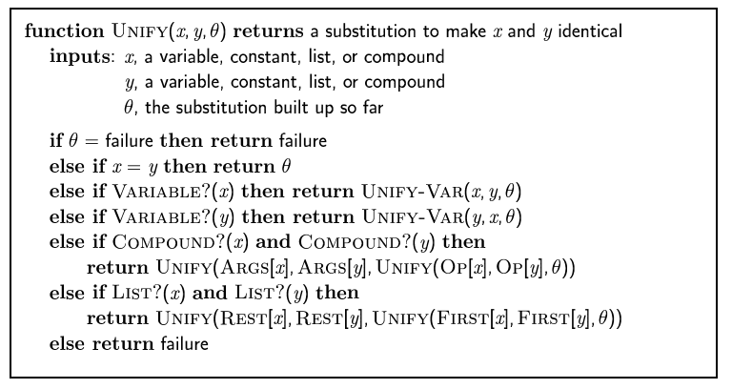
The unification algorithm

Slide 28
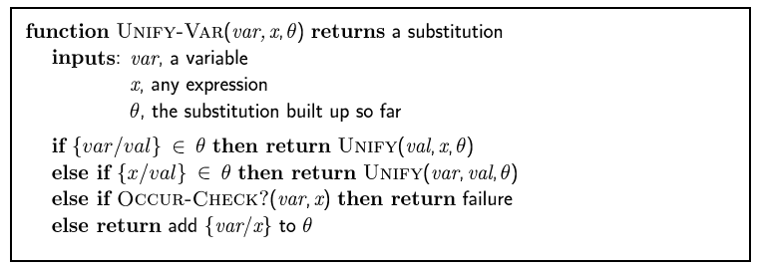
The unification algorithm

Slide 29
Example knowledge base
The law says that it is a crime for an American to sell weapons to hostile nations. The country Nono, an enemy of America, has some missiles, and all of its missiles were sold to it by Colonel West, who is American.
Prove that Col. West is a criminal

Slide 30
Example knowledge base contd.
... it is a crime for an American to sell weapons to hostile nations:
  American(x) ∧ Weapon(y) ∧ Sells(x,y,z) ∧ Hostile(z) ⇒ Criminal(x)
Nono … has some missiles, i.e., ∃x Owns(Nono,x) ∧ Missile(x):
  Owns(Nono,M₁) and Missile(M₁)
… all of its missiles were sold to it by Colonel West
  Missile(x) ∧ Owns(Nono,x) ⇒ Sells(West,x,Nono)
Missiles are weapons:
  Missile(x) ⇒ Weapon(x)
An enemy of America counts as "hostile“:
  Enemy(x,America) ⇒ Hostile(x)
West, who is American …
  American(West)
The country Nono, an enemy of America …
  Enemy(Nono,America)

Slide 31
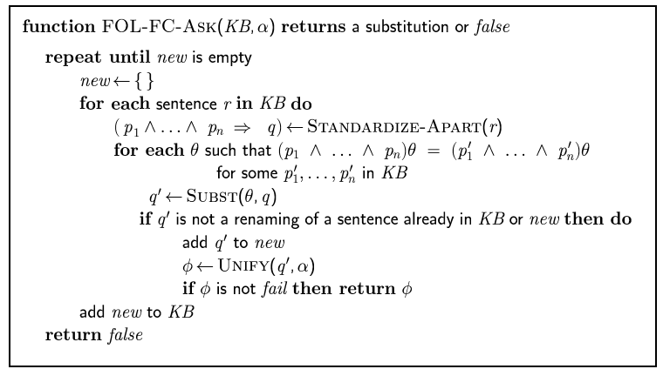
Forward chaining algorithm

Slide 32
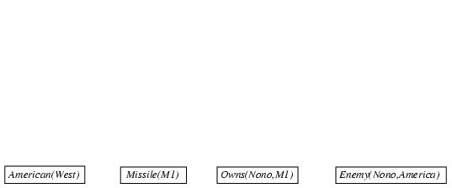
Forward chaining proof

Slide 33
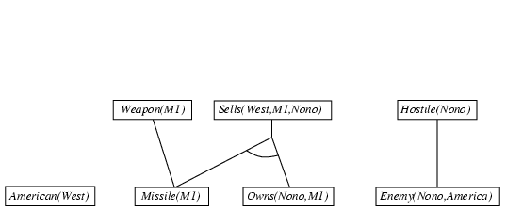
Forward chaining proof

Slide 34
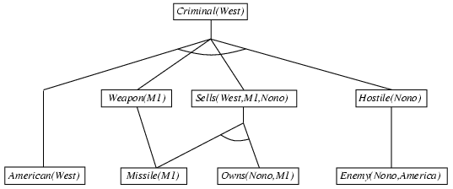
Forward chaining proof

Slide 35
Properties of forward chaining
Sound and complete for first-order definite clauses
Datalog = first-order definite clauses + no functions
FC terminates for Datalog in finite number of iterations
May not terminate in general if α is not entailed
  This is unavoidable: entailment with definite clauses is semidecidable

Slide 36
Efficiency of forward chaining
Incremental forward chaining: no need to match a rule on iteration k if a premise wasn't added on iteration k-1
  ⇒ match each rule whose premise contains a newly added positive literal
Matching itself can be expensive:
Database indexing allows O(1) retrieval of known facts
  e.g., query Missile(x) retrieves Missile(M₁)
Forward chaining is widely used in deductive databases

Slide 37
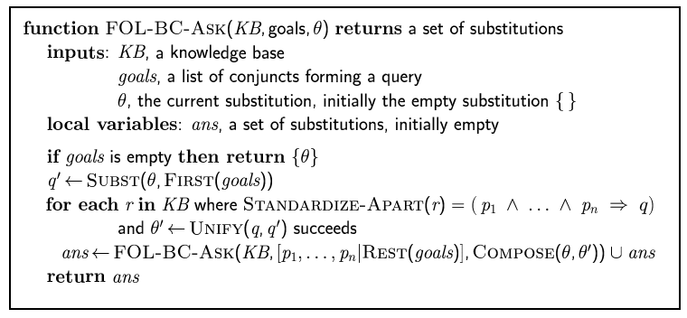
Backward chaining algorithm
SUBST(COMPOSE(θ₁, θ₂), p) = SUBST(θ₂, SUBST(θ₁, p))

Slide 38

Backward chaining example

Slide 39
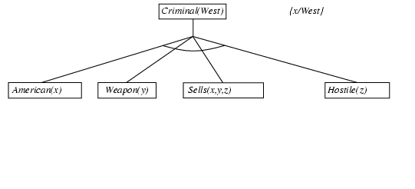
Backward chaining example

Slide 40
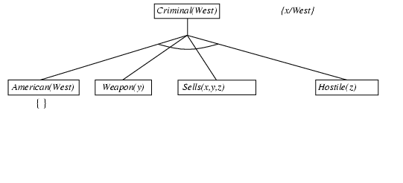
Backward chaining example

Slide 41
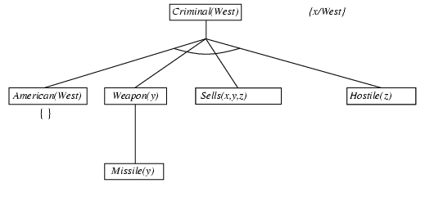
Backward chaining example

Slide 42
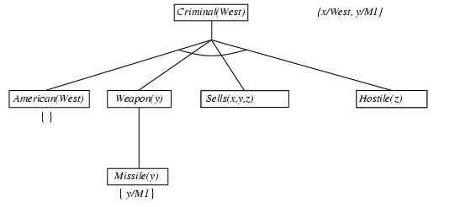
Backward chaining example

Slide 43
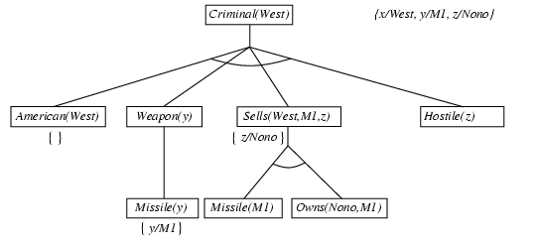
Backward chaining example

Slide 44
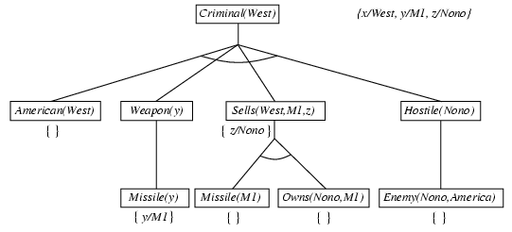
Backward chaining example

Slide 45
Backward chaining example

Slide 46
Properties of backward chaining
Depth-first recursive proof search: space is linear in size of proof
Incomplete due to infinite loops
  ⇒ fix by checking current goal against every goal on stack
Inefficient due to repeated subgoals (both success and failure)
  ⇒ fix using caching of previous results (extra space)
Widely used for logic programming

Slide 47
Resolution in FOL
FC and BC are not complete for FOL
Resolution is. (refutation-complete) But slower.
To prove KB╞ α, show that KB ^ ¬α is unsatisfiable
  KB and ¬ α need to be in CNF: conjunction of clauses that are disjunction of literals. Any FOL KB can be converted into CNF
  Repeatedly combines two clauses to make a new one until an empty clause is derived: a contradiction

Slide 48
Resolution: brief summary
Full first-order version:
l₁ ∨ ··· ∨ l_{k}, m₁ ∨ ··· ∨ m_{n}
(l₁ ∨ ··· ∨ l_{i-1} ∨ l_{i+1} ∨ ··· ∨ l_{k} ∨ m₁ ∨ ··· ∨ m_{j-1} ∨ m_{j+1} ∨ ··· ∨ m_{n})θ
where Unify(l_{i}, ¬m_{j}) = θ.
The two clauses are assumed to be standardized apart so that they share no variables.
For example,
¬Rich(x) ∨ Unhappy(x)
Rich(Ken)
Unhappy(Ken)
with θ = {x/Ken}
Apply resolution steps to CNF(KB ∧ ¬α); complete for FOL

Slide 49
Conversion to CNF
Everyone who loves all animals is loved by someone:
  ∀x [∀y Animal(y) ⇒ Loves(x,y)] ⇒ [∃y Loves(y,x)]
1. Eliminate biconditionals and implications
  ∀x [¬∀y ¬Animal(y) ∨ Loves(x,y)] ∨ [∃y Loves(y,x)]
2. Move ¬ inwards: ¬∀x p ≡ ∃x ¬p, ¬ ∃x p ≡ ∀x ¬p
  ∀x [∃y ¬(¬Animal(y) ∨ Loves(x,y))] ∨ [∃y Loves(y,x)]
  ∀x [∃y ¬¬Animal(y) ∧ ¬Loves(x,y)] ∨ [∃y Loves(y,x)]
  ∀x [∃y Animal(y) ∧ ¬Loves(x,y)] ∨ [∃y Loves(y,x)]

Slide 50
Conversion to CNF contd.
Standardize variables: each quantifier should use a different one
  ∀x [∃y Animal(y) ∧ ¬Loves(x,y)] ∨ [∃z Loves(z,x)]
Skolemize: a more general form of existential instantiation.
  Each existential variable is replaced by a Skolem function of the enclosing universally quantified variables:
  ∀x [Animal(F(x)) ∧ ¬Loves(x,F(x))] ∨ Loves(G(x),x)
Drop universal quantifiers:
  [Animal(F(x)) ∧ ¬Loves(x,F(x))] ∨ Loves(G(x),x)
Distribute ∨ over ∧ :
  [Animal(F(x)) ∨ Loves(G(x),x)] ∧ [¬Loves(x,F(x)) ∨ Loves(G(x),x)]

Slide 51
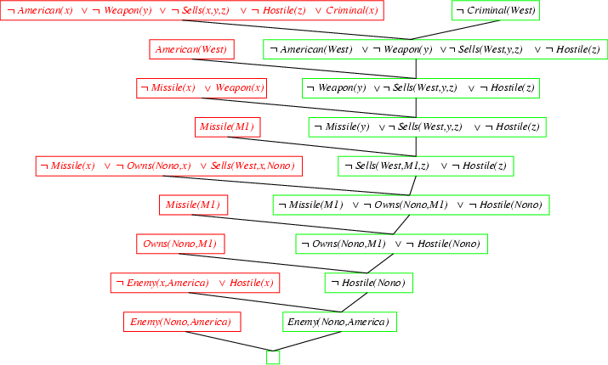
Resolution proof: definite clauses

Slide 52
Logic programming: Prolog
Algorithm = Logic + Control
Basis: backward chaining with Horn clauses + bells & whistles
Widely used in Europe, Japan (basis of 5th Generation project)
Compilation techniques ⇒ 60 million LIPS
Program = set of clauses = head :- literal₁, … literal_{n}.
criminal(X) :- american(X), weapon(Y), sells(X,Y,Z), hostile(Z).
Depth-first, left-to-right backward chaining
Built-in predicates for arithmetic etc., e.g., X is Y*Z+3
Built-in predicates that have side effects (e.g., input and output predicates, assert/retract predicates)
Closed-world assumption ("negation as failure")
  e.g., given alive(X) :- not dead(X).
  alive(joe) succeeds if dead(joe) fails

Slide 53
Summary
FOL is a very expressive language, but difficult to perform inference with.
  One inference method is removing all variables / quantifiers (propositionalizing), which is slow.
  We can also use unification to identify appropriate substitutions with generalized Modus Ponens, which is complete for HNF but not general FOL.
  The forward chaining and backward chaining algorithms use GMP to KBs in HNF.
  Generalized resolution inference is complete for all of FOL. KB must be in CNF. Use refutation.

