Slide 1
Naïve Bayes Classification
CS4881 Artificial Intelligence
Jay Urbain
Credits:
Nazli Goharian, Georgetown; and David Grossman, IIT
Machine Learning, Tom Mitchell
AIMA, Russell and Norvig

Slide 2
Naïve Bayes Classifier
Bayes theorem
Combines probability of each feature with class label.
Makes strong independence assumption between features, i.e., features are independent.
Examples:
  Determine type of fruit from shape and color
  Determine credit risk by age, income, and education
  Determine life style from education and salary
  Is education and salary really independent?

Slide 3
Naïve Bayes Classifier
Given a hypothesis, calculate the probability the hypothesis is correct.
Hypothesis: given x₁, x₂ => object is a Peach
Calculate probability that x₁, x₂ is a Peach
  P(H: x₁, x₂ is a Peach)
  P(H: x₁, x₂ is an Apricot)
  …
Calculate each of the probabilities
Choose the highest probability

Slide 4
Naïve Bayes Classifier
P(H|X) Posterior probability of hypothesis H
  X: {x₁, x_{2…,} x_{n}} // feature vector
  Shows the confidence/probability of H given X
  x₁: shape=round, x₂: color=orange
  H: x₁, x₂ is a peach
P(H) Prior probability of hypothesis H
  Represents the probability of H just happening, regardless of evidential data.
  E.g. What is the probability of picking a peach from a fruit bin without knowledge of shape and color.

Slide 5
Bayes Theorem - Learning
P(X|H) Likelihood: probability of X conditioned on hypothesis H
  Shows the confidence/probability of H given X
  Given H is true (X is a peach) calculate probability that X is round and orange, i.e., x₁=round, x₂=orange.
P(X) Prior probability of X
  Represents the probability that sample is round and orange.
  Use for normalization.

Slide 6
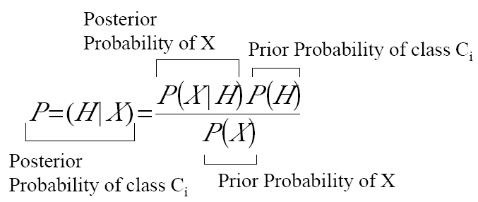
Bayes Theorem - Classification

Slide 7

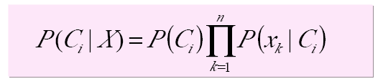
Naïve Bayes Classification
Hypothesis H is the class C_{i.}
  Note: P (X) is ignored below as it is constant for all classes.
Assuming the independence assumption, P(X|C_{i}) is:
Therefore:
P(C_{i}) is the ratio of total samples in class C_{i} to all samples.
Divide by P(X) to get correct probabilities – does not affect classification.

Slide 8
Naïve Bayes Classification
For categorical attribute:
  P(x_{k}|C_{i}) is the frequency of samples having value x_{k} in class C_{i}.
For continuous (numeric) attribute:
  P(x_{k}|C_{i}) is calculated via a Gaussian density function.

Slide 9
Naïve Bayes Classification
Having pre-calculated allP(x_{k}|C_{i}), an unknown example X is classified as follows:
  For all possible classes calculate P(C_{i}|X)
  Assign X to the class with the highest P(C_{i}|X)

Slide 10
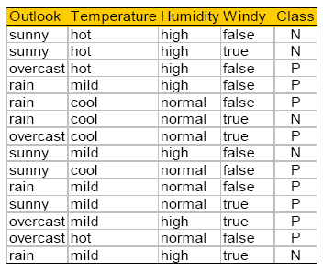
Play Tennis?

Slide 11
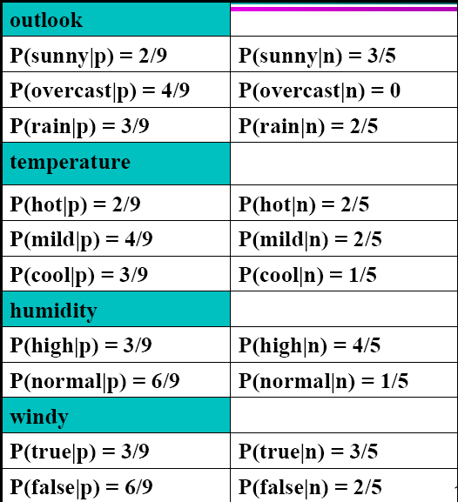
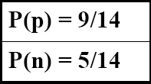
Play Tennis Example: estimating P(x_{i}|C)

Slide 12
Play Tennis Example: estimating P(C_{i}|x_{i})
New incoming sample: X = <sunny, cool, high, true>
P(play|X) = P(X|p)*P(p) =
  P(p)*P(sunny|p)*P(cool|p)*P(high|p)*p(true|p)
  9/14 * 2/9 * 3/9 * 3/9 * 3/9= 0.0053
P(no play|X) = P(X|p)*P(n) =
  P(n)*P(sunny|n)*P(cool|n)*P(high|n)*p(true|n)
  5/14 * 3/5 * 1/5 * 4/5 * 3/5 = 0.0206
Class n (no play) has higher probability than class p (play) for example X.
Note:
  P(X) = P(X|no play) + P(X|play)

