Slide 1
Naïve Bayes Classification
CS4881 Artificial Intelligence
Jay Urbain, PhD
Credits:
Machine Learning, Tom Mitchell
Nazli Goharian, Georgetown; David Grossman, IIT

Slide 2
Bayesian Classification: Why?
A statistical classifier: performs probabilistic prediction, i.e., predicts class membership probabilities
Foundation: Based on Bayes’ Theorem.
Performance: A simple Bayesian classifier, naïve Bayes, makes strong independence assumptions, but can perform well.
Comparable performance with basic decision trees and selected neural network classifiers
Incremental: Each training example can incrementally increase/decrease the probability that a hypothesis is correct (online learning) — prior knowledge can be combined with observed data
Standard: Provides a theoretically sound standard of optimal decision for which other methods can be measured

Slide 3
Naïve Bayes Classifier
Bayes theorem
Combines probability of each feature with respect to a class label.
Makes strong independence assumption between features, i.e., independence between features
Sample applications:
  Classify email as spam based on sender, and text
  Diagnose meningitis based on chest-xray, symptom
  Classify fruit from shape and color
  Determine life style from education and salary

Slide 4
Review conditional probability
Can factor joint probability using the chain rule:
  P(a ^ b) = P(a | b) P(b) = P(b | a) P(a)
And express the joint probability by conditioning on a or b:
  P(a | b) P(b) = P(b | a) P(a)
… and derive Bayes Theorem:
  P(a | b) = P(b | a) P(a)/ P(b)
  P(b | a) = P(a | b) P(b)/ P(a)

Slide 5
Naïve Bayes Classifier
Lets say we have a hypothesis H, & we want to calculate the probability of the hypothesis being correct.
Hypothesis: given feature x₁, x₂ => object is a Peach
Calculate probability that x₁, x₂ is a Peach
  P(H: x₁, x₂ is a Peach)
  P(H: x₁, x₂ is an Apricot)
Calculate each of these probabilities
Choose the highest probability

Slide 6
Naïve Bayes Classifier
P(H|X) Posterior probability of hypothesis H
  X: {x₁, x_{2…,} x_{n}}
  Shows the confidence/probability of H given X
  x₁: shape=round, x₂: color=orange
  H: x₁, x₂ is a peach
P(H) Prior probability of hypothesis H
  Represents the probability of H just happening, regardless of data.
  E.g. What is the probability of picking a peach from a fruit bin without knowledge of shape and color.

Slide 7
Bayes Theorem - Learning
P(X|H) Likelihood - the evidence X conditioned on hypothesis H
  Shows the confidence (probability) of X given H
  Given H is true (X is a peach) calculate probability that X is round and orange, i.e., x₁=round, x₂=orange.
P(X) Prior probability of X
  Represents the probability that sample is round and orange.

Slide 8
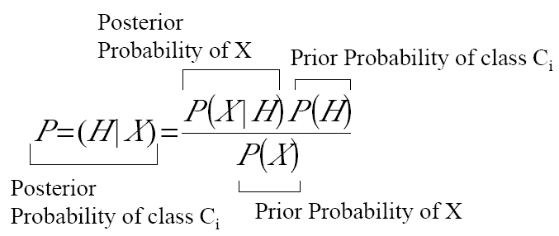
Bayes Theorem - Classification
Likelihood

Slide 9

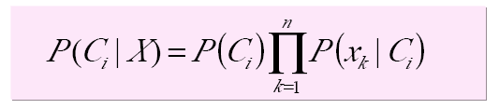
Naïve Bayes Classification
Hypothesis H is the class C_{i.}
  Note: P (X) can be ignored (for classification) as it is constant for all classes.
Assuming the independence assumption, P(X|C_{i}) is:
Therefore:
P(C_{i}) is the ratio of total samples in class C_{i} to all samples.

Slide 10


Naïve Bayes Classification
For categorical attribute:
  P(x_{k}|C_{i}) is the frequency of samples having value x_{k} in class C_{i}
For continuous (numeric) attribute:
  P(x_{k}|C_{i}) is calculated via a Gaussian density function. with a mean μ and standard deviation σ

Slide 11
Naïve Bayes Classification
Having pre-calculated allP(x_{k}|C_{i}), an unknown example X is classified as follows:
  For all classes calculate P(C_{i}|X)
  Assign X to the class with the highest P(C_{i}|X)

Slide 12
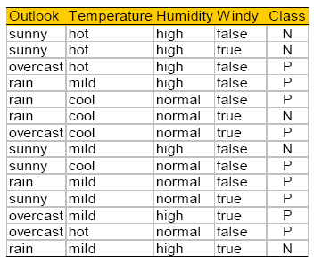
Play Tennis?
An incoming sample: X = <sunny, cool, high, true>

Slide 13
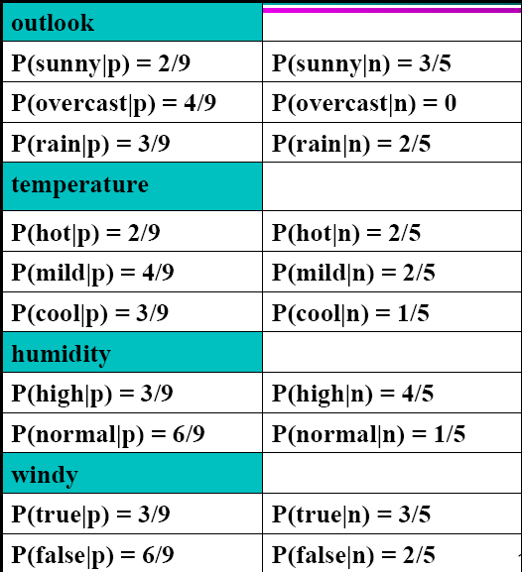
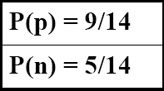
Play Tennis Example: estimating P(x_{i}|C)

Slide 14
Play Tennis Example: estimating P(C_{i}|x_{i})
An incoming sample: X = <sunny, cool, high, true>
P(play|X) = P(X|p)*P(p) =
  P(p)*P(sunny|p)*P(cool|p)*P(high|p)*p(true|p)
  9/14 * 2/9 * 3/9 * 3/9 * 3/9= 0.0053
P(no play|X) = P(X|p)*P(n) =
  P(n)*P(sunny|n)*P(cool|n)*P(high|n)*p(true|n)
  5/14 * 3/5 * 1/5 * 4/5 * 3/5 = 0.0206
  Class n (no play) has higher probability than class p (play) for example X.

Slide 15

Avoiding the Zero-Probability Problem
Naïve Bayesian prediction requires each conditional prob. be non-zero. Otherwise, the predicted prob. will be zero
Ex. Suppose a dataset with 1000 tuples, income=low (0), income= medium (990), and income = high (10)
Use Laplacian correction (or Laplacian smoothing)
  Adding 1 to each case
    Prob(income = low) = (0+1)/(1000+3) = 1/1003
    Prob(income = medium) = 991/1003
    Prob(income = high) = 11/1003
  The “corrected” prob. estimates are close to their “uncorrected” counterparts

Slide 16
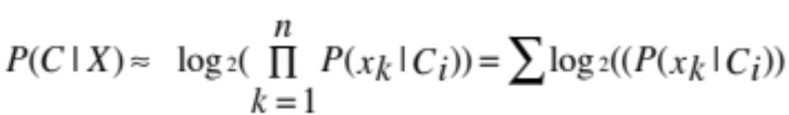
Avoiding the Zero-Probability Problem
Standard approach: use logarithms
Log of products is sum of logs

Slide 17
Naïve Bayes Classifier: Comments
Advantages
  Easy to implement
  Good results obtained in most of the cases
Disadvantages
  Assumption: class conditional independence, therefore loss of accuracy
  Practically, dependencies exist among variables
    E.g., hospitals: patients: Profile: age, family history, etc.
      Symptoms: fever, cough etc., Disease: lung cancer, diabetes, etc.
    Dependencies among these cannot be modeled by Naïve Bayes Classifier
How to deal with these dependencies? Bayesian Belief Networks

