Slide 1
Reinforcement Learning
CS4881 Artificial Intelligence,
Jay Urbain
Credits: Machine Learning, Tom Mitchell
AIMA, Russell and Norvig
Kardi Teknomo, Q-Learning Using Matlab

Slide 2
Reinforcement Learning
Concerned with how an agent ought to take actions in an environment so as to maximize some notion of cumulative reward.
Learning by interacting with your environment is a foundational idea underlying nearly all theories of learning and intelligence.

Slide 3
Reinforcement Learning
How can an agent can learn from success and failure, or reward and punishment to achieve a goal?
An agent can learn to play chess by supervised learning – given examples of game situations along with the best moves for those situations.
What if there is no friendly teacher providing examples for us to learn from, what can a poor agent do?
How can an agent learn from it’s own experiences?

Slide 4
Reinforcement Learning
Basic Idea:
  By trying random moves and observing the outcomes of its actions, an agent can eventually build a predictive model of its environment.
  For example, given enough experience playing a game, an agent will know what the board will look like after it makes a given move and even how the opponent is likely to reply in a give situation.

Slide 5
Reinforcement Learning
Consider learning to choose actions:
Robot learning to dock on battery charger
Learning to choose actions to optimize factory output
Learning to play Tic-tac-toe, Chess, or Wumpus World!
Note several problem characteristics:
Delayed reward (no instant gratification!)
Opportunity for active exploration
Possibility that the state is only partially observable
Possible need to learn multiple tasks with same sensors/effectors

Slide 6
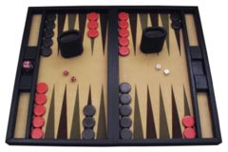
Example Backgammon, Tesauro 1995
Learn to play Backgammon
Immediate reward
+100 win
-100 lose
0 for all other states
Trained by playing 1.5M games against itself
Now ~equal to best human player
Backgammon is a board game for two players in which pieces are moved according to the roll of dice. The winner is the first to remove all of his/her own pieces from the board.

Slide 7
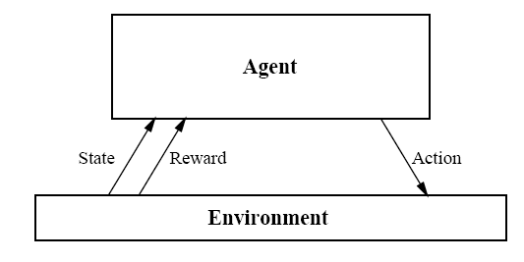


Reinforcement Learning Problem
Goal: Learn to choose actions that maximize reward

Slide 8
Markov Decision Process Defined
A discrete time stochastic control process.
At each time step, the process is in some state s, and the decision maker may choose any action a that is available in state s.
The process responds at the next time step by randomly moving into a new state s', and giving the decision maker a corresponding reward R_{a}(s,s').

Slide 9
Markov Decision Process
Assume
Finite set of states S
Set of actions A
At each discrete time t, agent observes state s_{t} Є S and chooses action a_{t} Є A
Then receives reward r_{t} and state changes to s_{t+1}
Markov assumption: s_{t+1} = δ(s_{t}, a_{t})
r_{t and} s_{t+1} depend only on current state s_{t} & action a_{t}.
The value of all future rewards are subsumed by r_{t}
Functions δ and r can be nondeterministic functions, that are not known by the agent.

Slide 10

Agent’s Learning Task
Execute actions in the environment, observe results and learn action policy π : S -> A that maximizes the discounted value of future rewards:
Where is the discount factor (from economics) for future rewards.
Problem:
Target function is the action policy, but we have no training examples of form <s,a>.
Training examples are of the form of taking action a from a given state s and observing rewards:<<s,a>,r>.

Slide 11


Value Function
For each possible policy, π: (S->A), the agent might adopt, we can define an evaluation function V^{π} over states:
Where the rewards r_{t}, r_{t+1},… are generated by following policy π starting at state s.
The task is to learn (search for) the optimal policy π *

Slide 12



What to Learn
Might try to have agent learning the optimal evaluation function V*.
Could then do look-ahead search to choose best action from any state s:
Problem:
This works if the agent knows the set of states and resulting set of actions:
But when it doesn’t, it can’t select actions this way.

Slide 13
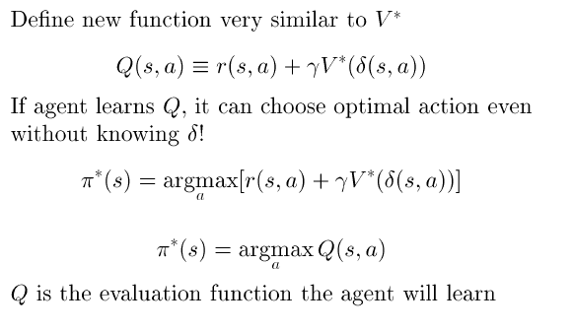
Q Function

Slide 14
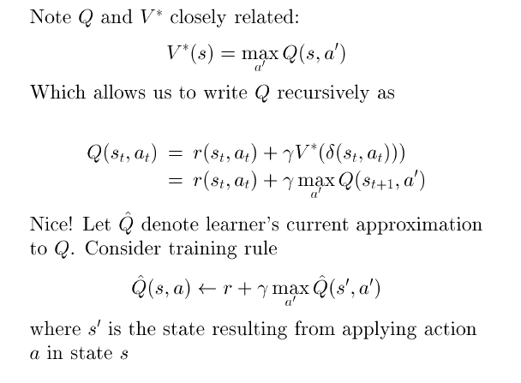
Training Rule to Learn Q

Slide 15
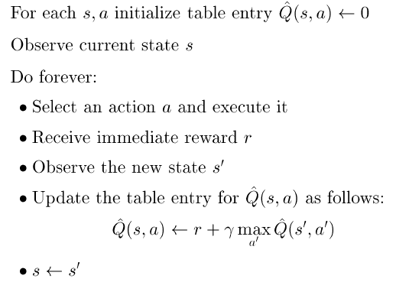
Q Learning from Deterministic Worlds

Slide 16
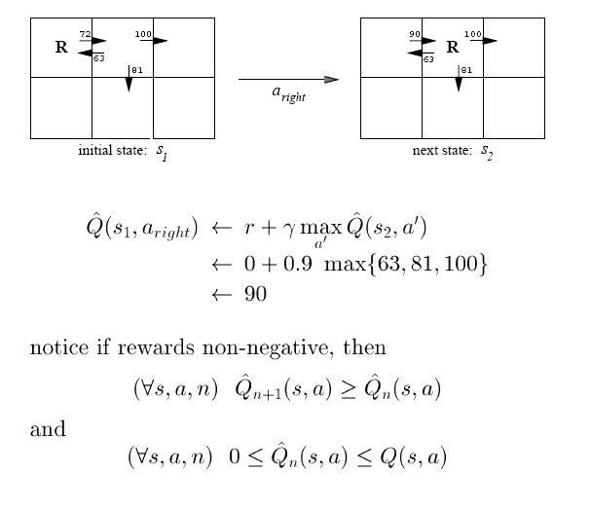
Updating Q approximation

Slide 17
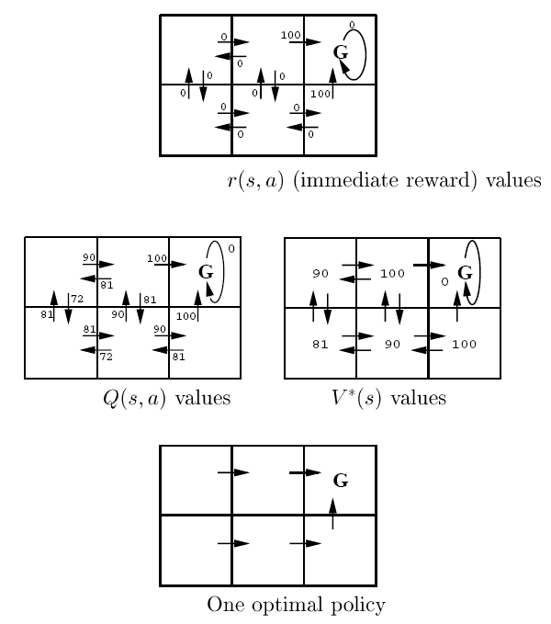

Slide 18
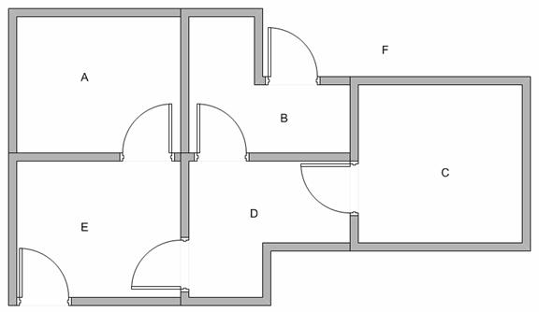
Modeling the environment
5 rooms in a building connected by doors. Goal state is F (leave building).

Slide 19
Set goal state
Represent the rooms by a graph, each room as a vertex and each door as an edge.
Set the target room to reinforce “good” behavior.
If we put an agent in any room, we want the agent to go outside the building, i.e., the goal room is the node F.
A
0
B
0
0
100
0
F
100
100
100
100
0
0
0
0
E
0
D
0
0
0
C

Slide 20
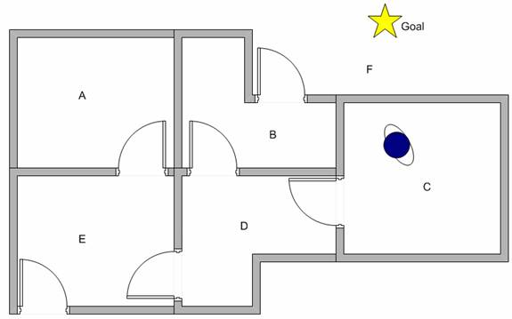
Learn through experience
Robot can learn through experience.
It does not know which sequence of doors the agent must pass to go outside the building.

Slide 21
Q Learning
We can put the state diagram and the instant reward values into the following reward table, or matrix R .
Q=R(state,action) + gama*MAX(next state, all actions)
Reward | Action
State | A | B | C | D | E | F
A | - | - | - | - | 0 | -
B | - | - | - | 0 | - | 100
C | - | - | - | 0 | - | -
D | - | 0 | 0 | - | 0 | -
E | 0 | - | - | 0 | - | 100
F | - | 0 | - | - | 0 | 100

Slide 22
Q Learning
Set the value of learning parameter gamma=0.8 and initial state as room B.
From the second row (state B) of matrix R. There are two possible actions for the current state B, go to state D, or go to state F. By random selection, we select to go to F as our action.
Reward | Action
State | A | B | C | D | E | F
A | - | - | - | - | 0 | -
B | - | - | - | 0 | - | 100
C | - | - | - | 0 | - | -
D | - | 0 | 0 | - | 0 | -
E | 0 | - | - | 0 | - | 100
F | - | 0 | - | - | 0 | 100

Slide 23
Q Learning
Now that we are in state F. Look at the sixth row of reward matrix R, i.e. state F. It has 3 possible actions to go to state B, E or F.
Q(B,F) =R(B,F) + 0.8*MAX[Q(F,B), Q(F,E), Q(F,F)]
=100 + 0.8*MAX[0,0,0]=100

Slide 24
Q Learning
We update the goal state F with 100 (which is the current value) and stop since this is a goal state.
This completes an episode.
Q (1) | Action
State | A | B | C | D | E | F
A | - | - | - | - | 0 | -
B | - | - | - | 0 | - | 100
C | - | - | - | 0 | - | -
D | - | 0 | 0 | - | 0 | -
E | 0 | - | - | 0 | - | 100
F | - | 0 | - | - | 0 | 100

Slide 25
Q Learning - another episode
For the next episode, start with a random initial state. This time our initial state is D.
Look at the fourth row of matrix R; it has 3 possible actions, that is to go to state B, C and E. By random selection, we select to go to state B as our action.
Reward | Action
State | A | B | C | D | E | F
A | - | - | - | - | 0 | -
B | - | - | - | 0 | - | 100
C | - | - | - | 0 | - | -
D | - | 0 | 0 | - | 0 | -
E | 0 | - | - | 0 | - | 100
F | - | 0 | - | - | 0 | 100

Slide 26
Q Learning - another episode
Now we are in state B. Look at the second row of reward matrix R (i.e. state B). It has 2 possible actions to go to state D or state F. Then, we compute the Q value.
Q(D,B) =R(D,B) + 0.8*MAX[Q(B,D), Q(B,F)]
=0 + 0.8*MAX[0,100]=80
Q (2) | Action
State | A | B | C | D | E | F
A | - | - | - | - | 0 | -
B | - | - | - | 0 | - | 100
C | - | - | - | 0 | - | -
D | - | 80 | 0 | - | 0 | -
E | 0 | - | - | 0 | - | 100
F | - | 0 | - | - | 0 | 100

Slide 27
Q Learning - another episode
The next state is B, which now becomes the current state.
Repeat the inner loop in the Q learning algorithm because state B is not the goal state.
There are two possible actions from the current state B, that is to go to state D, or go to state F. By lucky draw, our action selected is state F.
Now we think of state F that has 3 possible actions to go to state B, E or F. We compute the Q value using the maximum value of these possible actions.
Q(B,F) =R(B,F) + 0.8*MAX[Q(F,B), Q(F,E), Q(F,F)]
=100 + 0.8*MAX[0,0,0]=100

Slide 28
Q Learning - another episode
This result does not change the Q matrix.
Because F is the goal state, we finish this episode.
Our agent's brain now contains an updated matrix Q:
Q (2) | Action
State | A | B | C | D | E | F | max
A | - | - | - | - | 0 | - | 0
B | - | - | - | 0 | - | 100 | 100
C | - | - | - | 0 | - | - | 0
D | - | 80 | 0 | - | 0 | - | 80
E | 0 | - | - | 0 | - | 100 | 100
F | - | 0 | - | - | 0 | 100 | 100

Slide 29
Q Learning - more episodes
As our agent learns more episodes, it will evolve towards convergence for values of the Q (reward) matrix:
Q (1) | Action
State | A | B | C | D | E | F | max
A | - | - | - | - | 80 | - | 80
B | - | - | - | 0 | - | 180 | 180
C | - | - | - | 0 | - | - | 0
D | - | 80 | 0 | - | 80 | - | 80
E | 0 | - | - | 0 | - | 180 | 180
F | - | 80 | - | - | 80 | 180 | 180

Slide 30
Q Learning - many episodes
If our agent learns more and more experience through many episodes, it will finally reach convergence values of Q matrix as:
Q (n) | Action
State | A | B | C | D | E | F
A | - | - | - | - | 144 | -
B | - | - | - | 64 | - | 244
C | - | - | - | 64 | - | -
D | - | 144 | 0 | - | 144 | -
E | 64 | - | - | 64 | - | 244
F | - | 144 | - | - | 144 | 244

Slide 31
Q Learning - many episodes
This Q matrix, then can be normalized into a percentage by dividing all valid entries with the highest number.
We can now read optimal policy from max state.
Q (n) | Action
State | A | B | C | D | E | F | max | Max State
A | - | - | - | - | 59% | - | 59% | E
B | - | - | - | 26% | - | 100% | 100% | F
C | - | - | - | 26% | - | - | 26% | D
D | - | 59% | 0% | - | 59% | - | 59% | B
E | 26% | - | - | 26% | - | 100% | 100% | F
F | - | 59% | - | - | 59% | 100% | 100% | F

Slide 32
Q Learning Algorithm
Set parameter , and environment reward matrix R
Initialize matrix Q as zero matrix
For each episode:
  Select random initial state
  Do while not reach goal state
    Select one among all possible actions for the current state
    Using this possible action, consider to go to the next state
    Get maximum Q value of this next state based on all possible actions
    Compute
    Set the next state as the current state
End Do
End For

Slide 33
Algorithm to utilize the Q matrix
Input: Q matrix, initial state
Set current state = initial state
From current state, find action that produce maximum Q value
Set current state = next state
Go to 2 until current state = goal state

Slide 34
Q_{hat} convergence
Q_{hat} (Q approximation) converges to Q in a deterministic world where each <s,a> is visited infinitely often.
Proof: Define a full interval to be an interval during which each <s,a> is visited. During each full interval the largest error in Q_{hat} table is reduced by a factor of

Slide 35
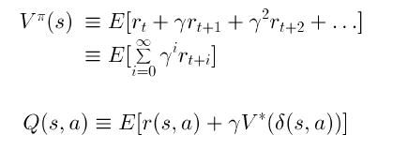
Non-deterministic case
What if reward and next state are non-deterministic?
Redefine V and Q by taking expected values:
Note: Bayesian RL is an active research field

Slide 36
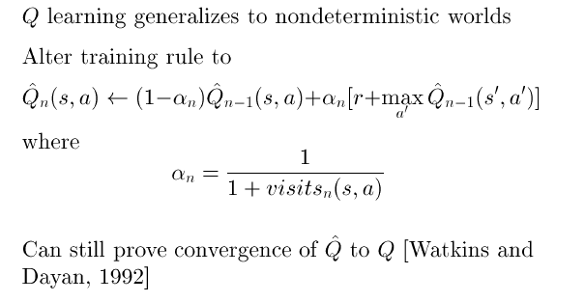
Non-deterministic case

Slide 37
Temporal difference learning
The number of training iterations necessary to sufficiently represent the optimal Q-function scales poorly with respect to the size of the time interval between states.
The greater the number of actions per unit time, the greater the number of training iterations required to adequately represent the optimal Q-function.
TD uses the concept of discounting the cumulative reinforcement versus the reinforcement from a single state transition.

Slide 38

Temporal difference learning
Given the MDP with 1000 states.
State 0 is initial state & state 999 is an absorbing state.
Each state transition returns a cost (reinforcement) of 1, and the value for 999 is defined to be 1.
Q-learning, value interaction can solve this problem.
However TD(lambda) can solve it faster.
TD(lambda) updates the value of the current state based on a weighted combination of the values of all future states versus only the value of the immediate successor state. Basic Bellman eqn:

Slide 39
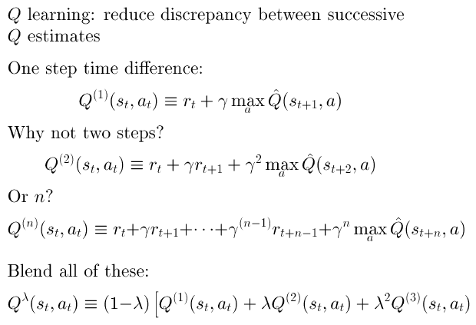
Temporal difference learning –
Update rule uses difference in utilities between successive states

Slide 40
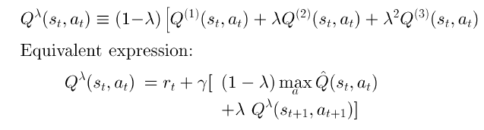
Temporal difference learning – the reinforcement is the difference between the ideal prediction and the current prediction

Slide 41
Ongoing research
Replace Q approximation table with Neural Net, Bayes Net or other generalized classifier
Handle case where state only partially observable
Design optimal exploration strategies
Extend to continuous action, state
Learn and use delta function: S x A->S
Relationship to dynamic programming
Applications to dynamic markets (Stock, auctions, etc.)

Slide 42
Applications of Reinforcement Learning
Intelligent Trading Agents for Massively Multi-player Game Economies, John Reeder, Gita Sukthankar, M. Georgiopoulos, G. Anagnostopoulos
Learning to be a Bot: Reinforcement Learning in Shooter Games, Michelle McPartland, Marcus Gallagher
Agent Learning using Action-Dependent Learning Rates in Computer Role-Playing Games, Maria Cutumisu, Duane Szafron, Michael Bowling, Richard S. Sutton
Combining Model-Based Meta-Reasoning and Reinforcement Learning for Adapting Game-Playing Agents, Patrick Ulam, Joshua Jones, Ashok Goel

Slide 43
Demos
Demo - Control of an octopus arm using GPTD
http://videolectures.net/icml07_engel_demo/
Reinforcement Learning Repository at UMass, Amherst
http://www-all.cs.umass.edu/rlr/domains.html
Robot arm
http://iridia.ulb.ac.be/~fvandenb/qlearning/qlearning.html
Cat-Mouse applet
http://www.cse.unsw.edu.au/~cs9417ml/RL1/applet.html

