Slide 1
Towards Adaptive Online Content Personalisation
Jonathan Wasson
wassonjonathan@gmail.com
Supervisor: Doctor Benjamin Rosman

Slide 2
Why have adaptive content?
Increase user performance
Increase user enjoyment
Diversify content
Present unique content
Notes:
Computer games
Left 4 dead 2
Dark souls
Other systems
ATMs, Operating Systems etc.
Goldilocks effect

Slide 3
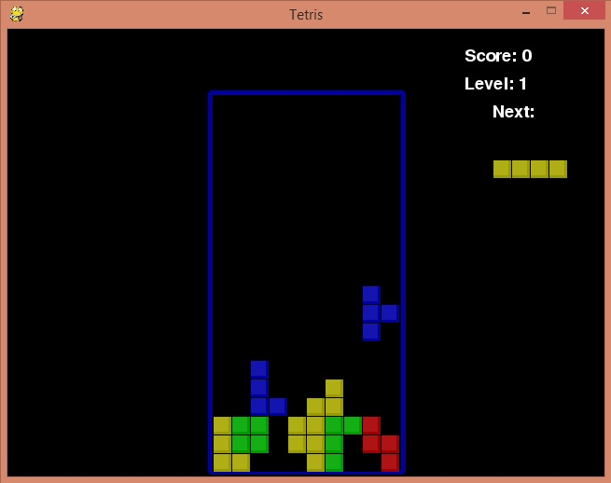
Implementation:
Notes:
Talk about pygame.

Slide 4
Method:
Training:
Observe different users play styles
Makes stacks, goes for lowest placement etc.
Store data in the form <s,a,s’>
Actions in Tetris: Left, Right, Up, Down, Space, None
State in Tetris: Heights, Block position, Block shape, Block orientation. Can create unique state number using modulo arithmetic
Make MDP out of this for each play style

Slide 5
Markov Decision Process:
A directed graph where nodes represent states and connections represent probabilities
Can be represented as a linked list in the form <state, action, state’>

Slide 6
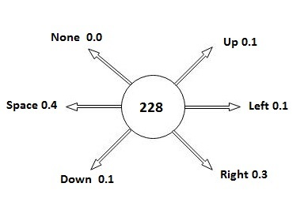
Example:
Notes:
State: heights, block shape, block position, block orientation

Slide 7
Adaptive algorithm
Observe user play style
Match play style to MDP to identify user type
Update probabilities
Change content appropriately
Change distribution of blocks
Change block fall speed

Slide 8
Experiment:
3 Agents
Each with a unique behaviour
Corresponding to a skill level
Skilled, Moderate, Unskilled
Unskilled: goes for lowest placement
Moderate: matches block to reduce gaps
Skilled: human that implements both
Check viability of adaptive content

Slide 9
Viablitity:
Accuracy:
Collect data regarding whether or not the estimation was correct
Run time:
Find the average time taken to make an estimation
Performance:
Check score
Change block speed and block distribution
Notes:
1000 games of Moderate
1000 games of Unskilled
100 games of Skilled
Make change if guess is above 99%

Slide 10
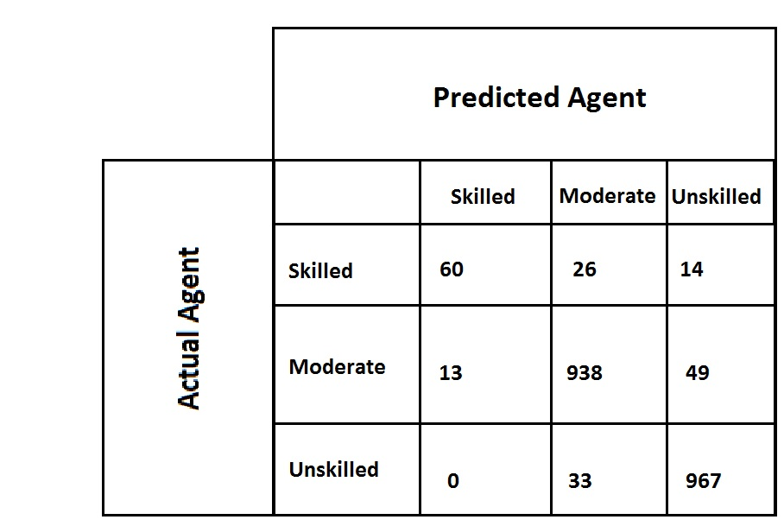
Accuracy:
Notes:
Skilled: 60%

Slide 11
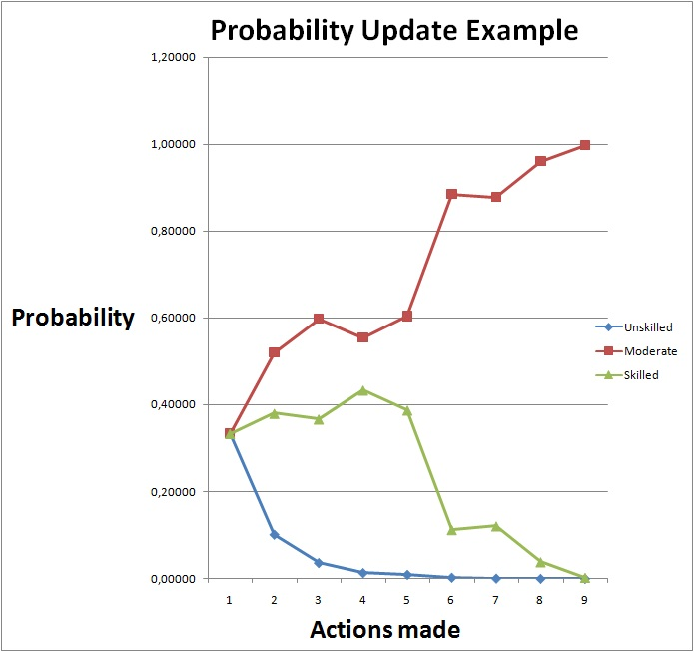
Run time:
Notes:
38 actions on average

Slide 12
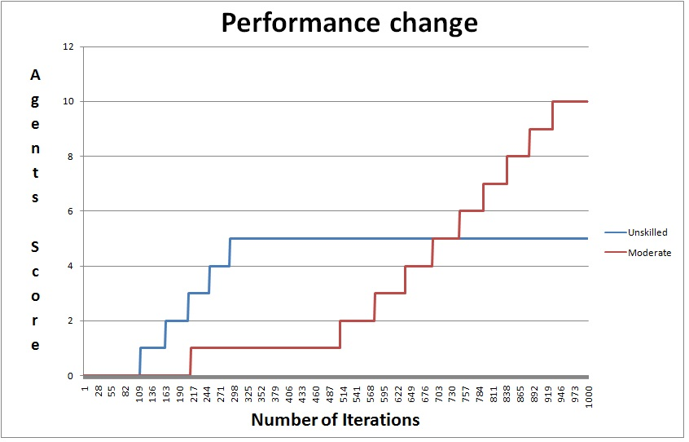
Performance:
Notes:
Skilled: 26
Unskilled: 0
Moderate: 2

Slide 13
Overview:
Accuracy was good for distinct behaviours
Accuracy was bad for indistinct behaviours
Performance can be varied at programmers discretion

Slide 14
Conclusion:
Expand to larger systems
Differentiate between almost identical behaviours
Implement in different scenarios:
Web development
Adaptive interface

