Slide 1
Anonymity and Severity Analysis for Data Leakage Detection
Jay Velasco
3/11/2017

Slide 2
Introduction
29% increase in total cost of a data breach
$158 average per record
$355 per record in healthcare
$4 million per breach
Structural changes
CISO
Permanent costs
Dependency on the ability to detect and respond

Slide 3
A Severity-based Quantification of Data Leakages in Database Systems
M-Score
Provides a measurement of misuse
Request sensitivity to be defined by domain experts
Sensitive attributes
L-Severity
Severity score is needed
Research was based off of M-Score
Practice
Data model within the healthcare domain

Slide 4

M-Score
Notes:
X – predefined emphasis on # of rows
R^L # of leaked rows
RS – final record score

Slide 5
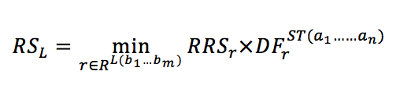
Final Record Score
Notes:
For each record in the set of leaked records
Multiply the raw record score by the distinguishing factor
Distinguishing factor focuses on privacy and anonymity – will emphasize on this more later

Slide 6
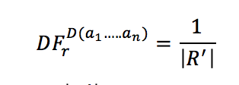
Distinguishing Factor
Notes:
Distinguishing factor is 1 / # of quasi identifier attributes
Quasi identifier attributes are attributes that can be used to infer the identify of a subject from another data source

Slide 7
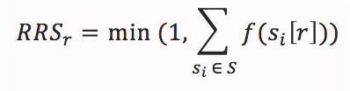
Raw Record Score
Notes:
Sum of the sensitivity score of each sensitive attribute
Ceiling of 1

Slide 8
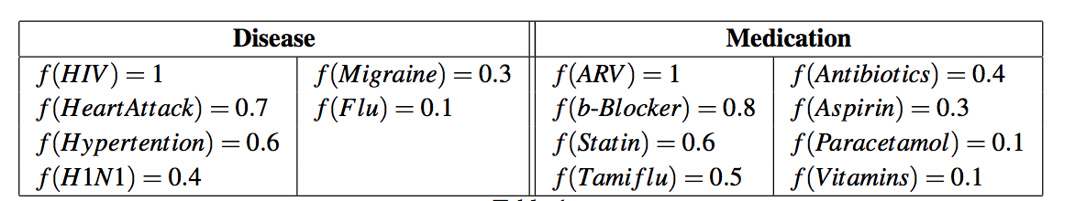
Sensitivity Scores

Slide 9
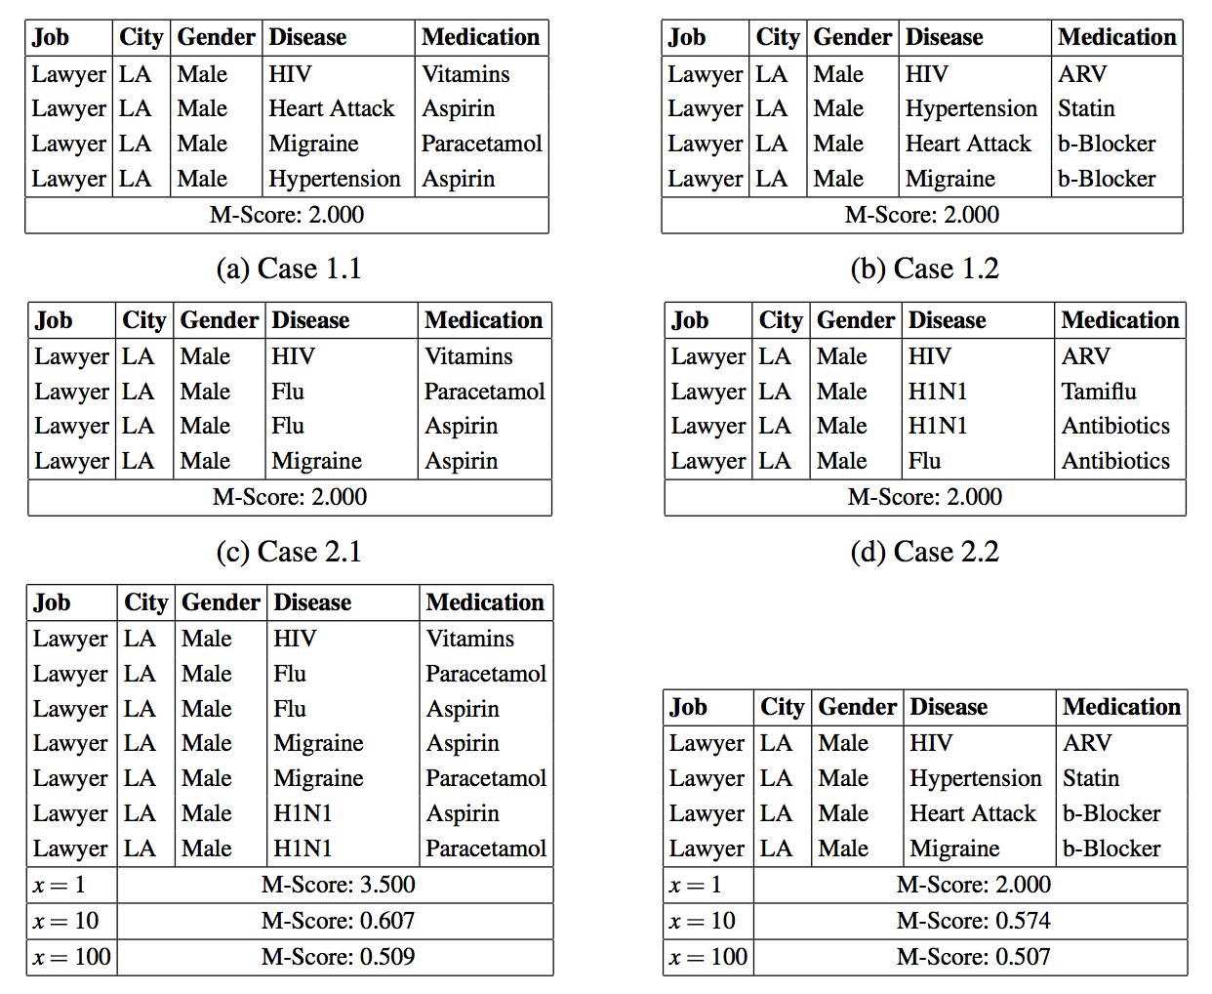
Sample of Leakages

Slide 10
Limitations
Min
Ceiling of 1
Max
Only the max final record score is used in the M-Score calculation

Slide 11

L-Severity
Notes:
Sum of the record sensitivity

Slide 12

Record Sensitivity
Notes:
Node Sensitivity – defined by data model – will go over this later

Slide 13
Motivation
Lack of emphasis on anonymity
Valvilis et al. suggestion
Contribution is to the severity based metric
Many metrics to use
Many factors
Insider attack/knowledge
Many Types of privacy metrics

Slide 14
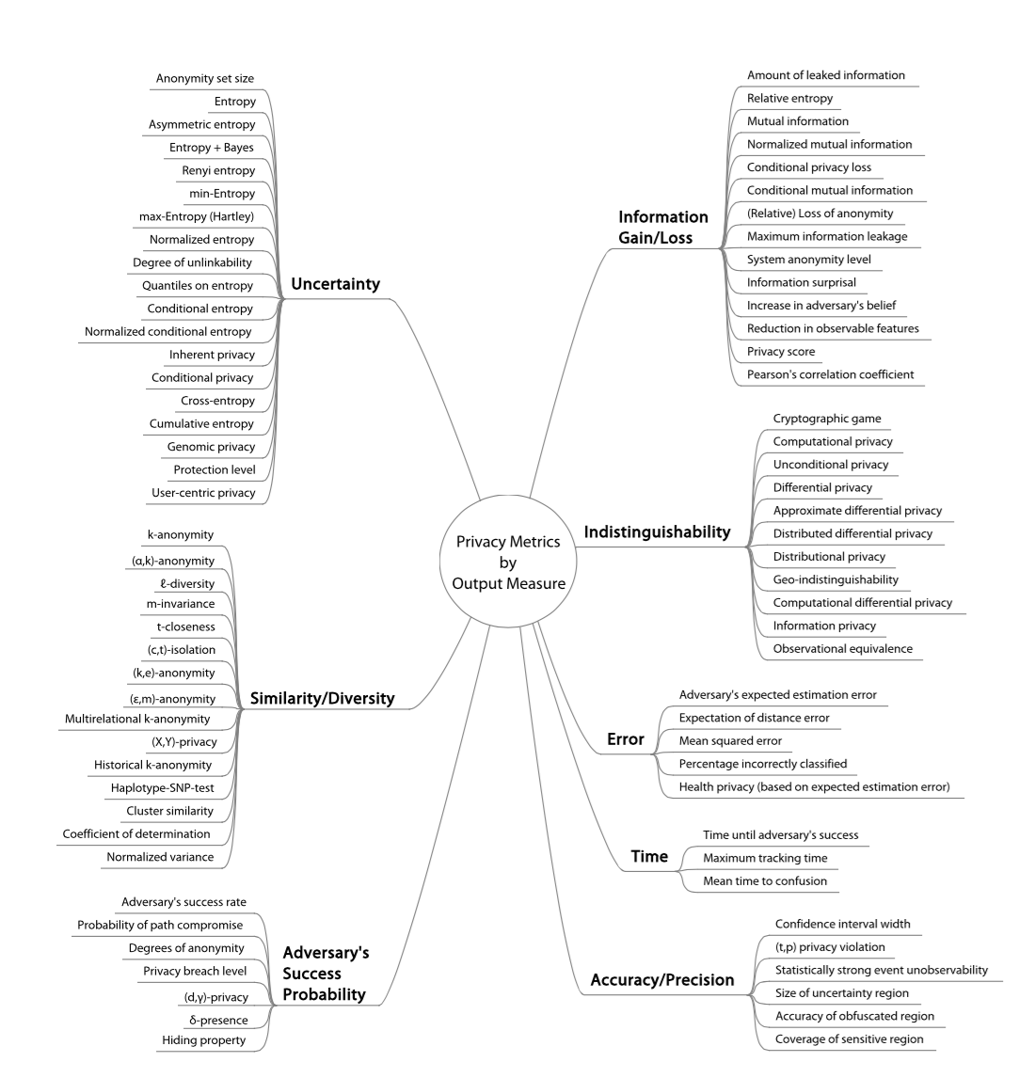
Technical Privacy Metrics: a Systematic Survey

Slide 15
Examples
Information Gain
Entropy
Decision Trees
Similarity or Diversity
K-anonymity
L-diversity
T-closeness
M-Score

Slide 16
Practice
Applied on a single database
Internal
Database Links
ETL
Multiple data containers
3rd party vendors
Aggregation
Legacy Systems

Slide 17
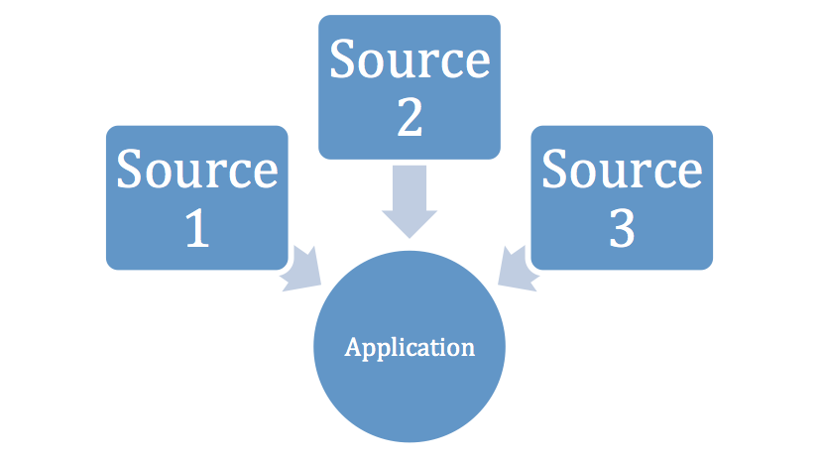
Scenario

Slide 18
Timeline
Lecture 1
Topic Selection
Lecture 2
Proposal Paper and Presentation
Lecture 3
Finalize privacy metrics of choice
Design Application
Lecture 4
Create proof of concept
Stronger emphasis on writing

Slide 19
Timeline
Lecture 5
Proof of conception continuation
Write up technical specifications
Lecture 6
Finish writing
Lecture 7
Finalize, cleanup and review

Slide 20
Conclusion
Introduction
Previous Work
Motivation
Timeline

Slide 21
References
S. Vavilis, M. Petkovic, and N. Zannone, “A severity-based quantifica-tion of data leakages in database systems,”Journal of Computer Security,vol. 24, no. 3, pp. 321–345, 2016.
Ponemon Institute. (2016). 2016 Cost of Data Breach Study: Global Analysis. The Ponemon Institute.
Wagner, Isabel, and David Eckhoff. "Technical privacy metrics: a systematic survey." arXiv preprint arXiv:1512.00327 (2015).
Harel, Amir, et al. "M-score: A misuseability weight measure." IEEE Transactions on Dependable and Secure Computing 9.3 (2012): 414-428.

Slide 22
Proposals
New Metric
L-Severity
Data model to reason severity within the application’s domain

Slide 23
Leaked records and values are mapped to the data model
Discrimination Factor (DF)
The extent that data can identify an individual

Slide 24
Data Model
– T is a set of data types.
– I is a set of data instances.
– HR⊂T×T∪I is a hierarchy relation representing a specialization relationship.
– IR ⊂ I × I represents an inference relation on I.
– SL : T ∪ I → R+0 is a labeling function that assigns a sensitivity value to data types and instances.
– PL : I × I → [0, 1] is a labeling function that defines the degree of inference, that is to what extent knowledge about a data instance can be inferred based on the knowledge about another data instance.

Slide 25
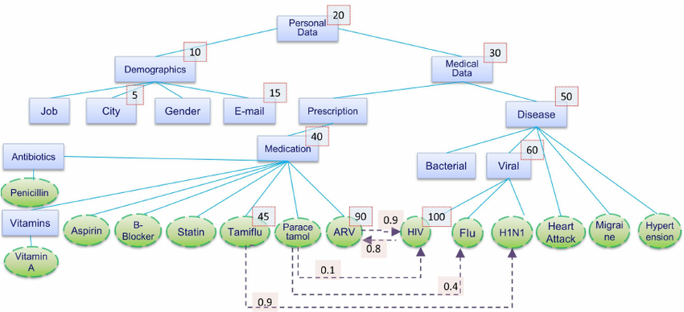
Healthcare Data Model
Notes:
Types are rectangular T
Instances are ovals I
PL Propagation label, 0.9 Tamiflu to H1n1
Inference relations by dashed lines IR
Solid lines are hierarchical relations HR

Slide 26
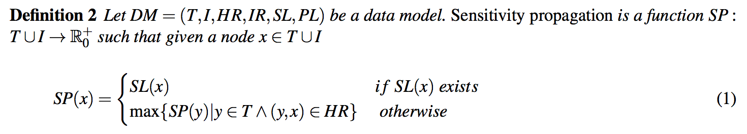
Notes:
SL – HIV 100
Statin – 40

Slide 27
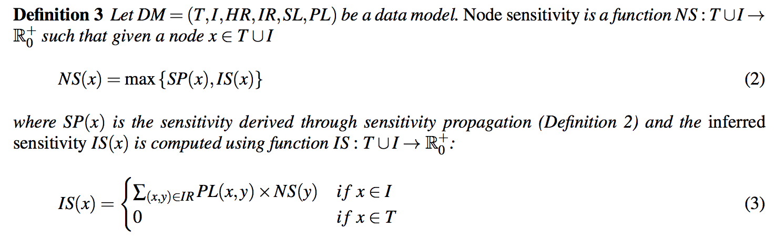
Notes:
IS = inferred sensitivity
Paracetamol
Node Sensitivity is 40
Inferred sensitivity is 34
100 * .1 = 10
60 * .4 = 24
SUM = 34

Slide 28
Rule | Description
Let A be a set of attributes.
A database table D(a1,...,an) is a set of records over a set of attributes {a1,...,an} ⊆ A | D(Job, City, Gender, Disease, Medication)
Sensitive attributes S = {s1,...,sm} ⊆ A | Disease and Medication are sensitive attributes
a ∈ S | Each sensitive attribute takes values from a pre-specified domain
Quasi-identifiers Q = {q1 , . . . , qk } ⊆ A | Attributes Job and City are quasi-identifiers
a ∈ Q | can be used to reveal the identity of an individual

Slide 29
Rule | Description
a ∈ S ∩ Q | Attribute Gender belongs to both sets
We denote the records in D(a1,...,an) as RD(a1,...,an) | records
r ∈ RD(a1,...,an) | record
ai[r] represents the value of attribute ai in r | value
a ∈ A, Ca denotes the domain of a | {HIV, Heart Attack, Hypertension, Migraine, H1N1, Flu}
{Ca}a∈A ⊆ T ∪ I | Domain can be made up of types and instances

Slide 30
Definition 4
Let A be a set of attributes and Ca the domain of an attribute a ∈ A. The sensitivity score function f : Ca → [0, 1] assigns a sensitivity value to each value in Ca .
f(ai[r])
Notes:
Set of attributes within a certain domain assigned a specific sensitivity score

Slide 31
Definition 5
Let D(a1,...,an) be a table, S = {sl,...,sm} ⊆ A the set of sensitive attributes in D(a1,...,an), and f the sensitivity score function. Given a record r ∈ RD(a1,...,an), the raw record score of r is
RRSr =min(1,∑ f(si[r]))
Notes:
Raw record score of a row
Minimum (1, sum of the sensitivity score of records

Slide 32
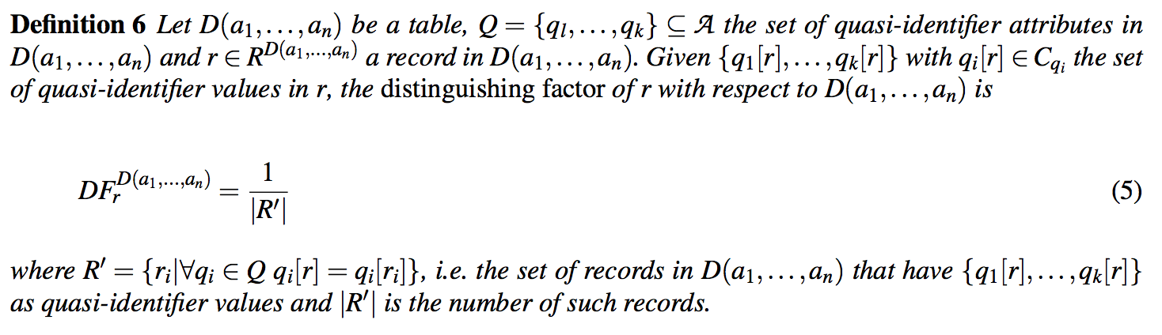
Definition 6
Notes:
Identify the quasi attributes
# of those that match

Slide 33
M-Score example

Slide 34
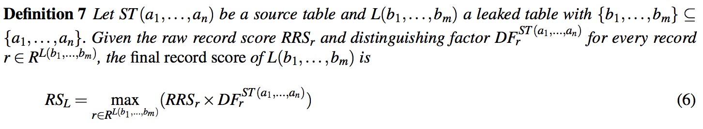

Slide 35
M-Score Example

Slide 36
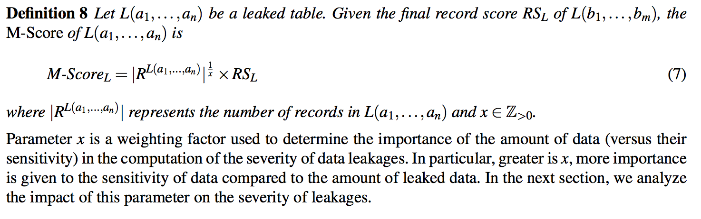

Slide 37
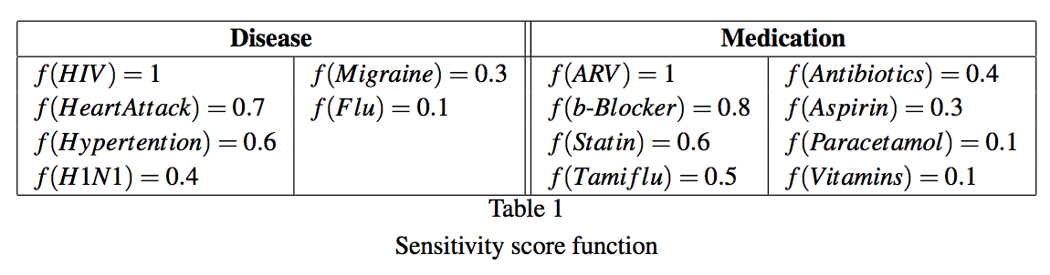

Slide 38
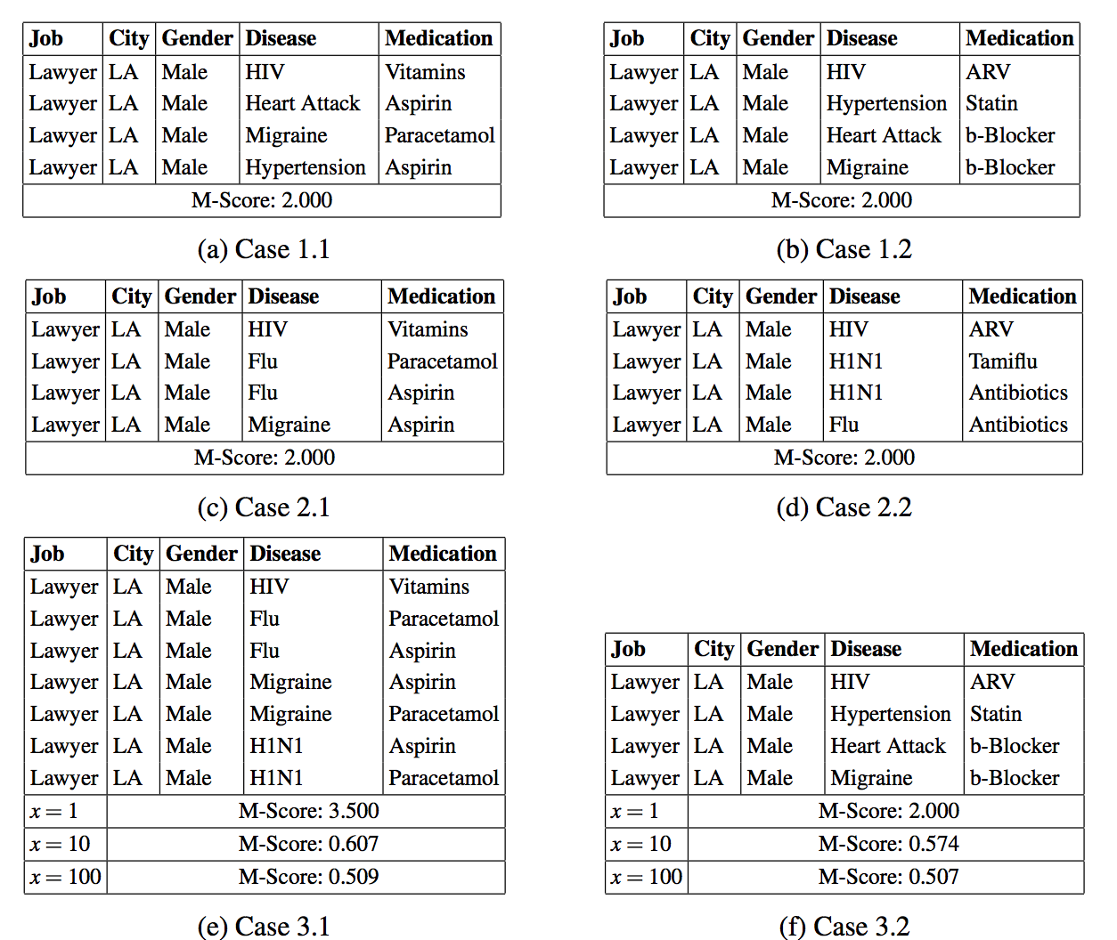
Notes:
.5 DF
MIN
Table 2 more sever
RS only takes account of record with highest sensitivity
3. Influenced by number of rows, but less sever

Slide 39
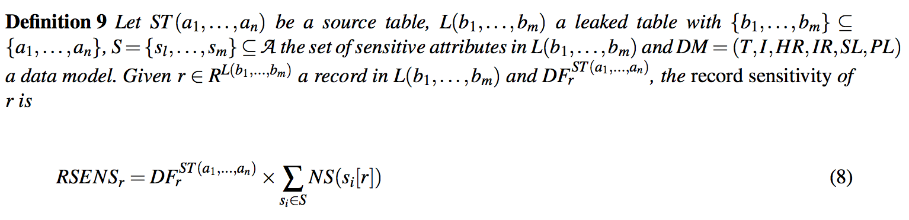
Notes:
Node Sensitivty
Per record
Dependency factor x sum of node sensitivity (sensitive attribute)
Contradiction, used senstivity score on table, not data model

Slide 40
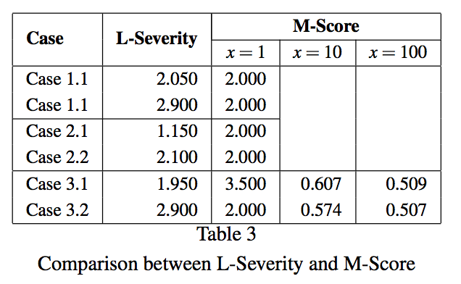
Notes:
Case 1.1 is incorrect

Slide 41
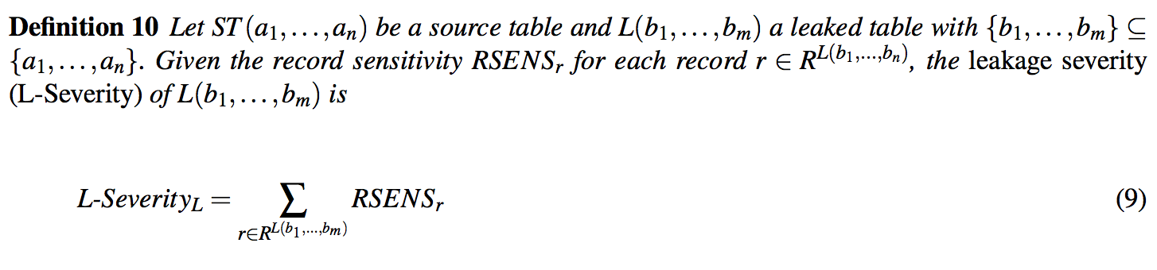

Slide 42
Case 1.1
Disease | Medication | Disease SF | Medication SF | Sum of SF
HIV | Vitamins | 100 | 10 | 55
Heart Attack | Aspirin | 70 | 30 | 50
Migraine | Parcetamol | 30 | 10 | 20
Hypertension | Aspirin | 60 | 30 | 45
 |  |  |  | 170
 |  |  |  | 1.7

