Slide 1
Anonymity and Severity Analysis for Data Leakage Detection
Jay Velasco
3/11/2017

Slide 2
Introduction
29% increase in total cost of a data breach
$158 average per record
$355 per record in healthcare
$4 million per breach
Structural changes
CISO
Permanent costs
Dependency on the ability to detect and respond

Slide 3
A Severity-based Quantification of Data Leakages in Database Systems
M-Score
Provides a measurement of misuse
Request sensitivity to be defined by domain experts
Sensitive attributes
L-Severity
Severity score is needed
Research was based off of M-Score
Practice
Data model within the healthcare domain

Slide 4

M-Score
Notes:
X – predefined emphasis on # of rows
R^L # of leaked rows
RS – final record score

Slide 5
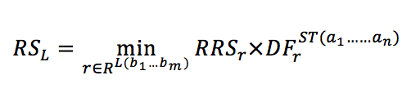
Final Record Score
Notes:
For each record in the set of leaked records
Multiply the raw record score by the distinguishing factor
Distinguishing factor focuses on privacy and anonymity – will emphasize on this more later

Slide 6
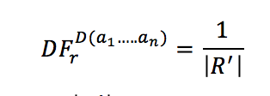
Distinguishing Factor
Notes:
Distinguishing factor is 1 / # of quasi identifier attributes
Quasi identifier attributes are attributes that can be used to infer the identify of a subject from another data source

Slide 7
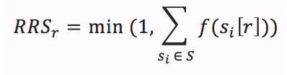
Raw Record Score
Notes:
Sum of the sensitivity score of each sensitive attribute
Ceiling of 1

Slide 8
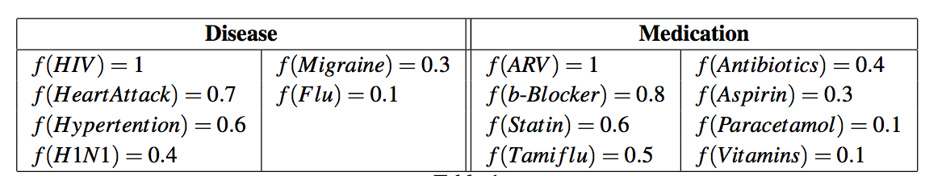
Sensitivity Scores

Slide 9
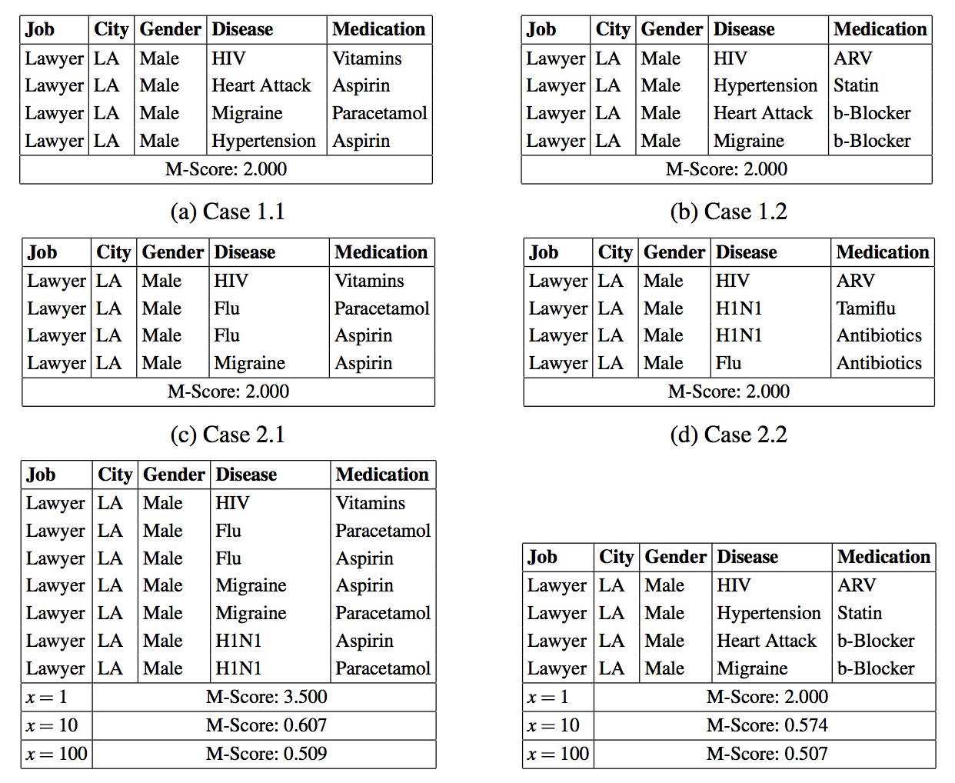
Sample of Leakages

Slide 10
Limitations
Min
Ceiling of 1
Max
Only the max final record score is used in the M-Score calculation

Slide 11

L-Severity
Notes:
Sum of the record sensitivity

Slide 12

Record Sensitivity
Notes:
Node Sensitivity – defined by data model – will go over this later

Slide 13
Motivation
Lack of emphasis on anonymity
Valvilis et al. suggestion
Contribution is to the severity based metric
Many metrics to use
Many factors
Insider attack/knowledge
Many Types of privacy metrics

Slide 14
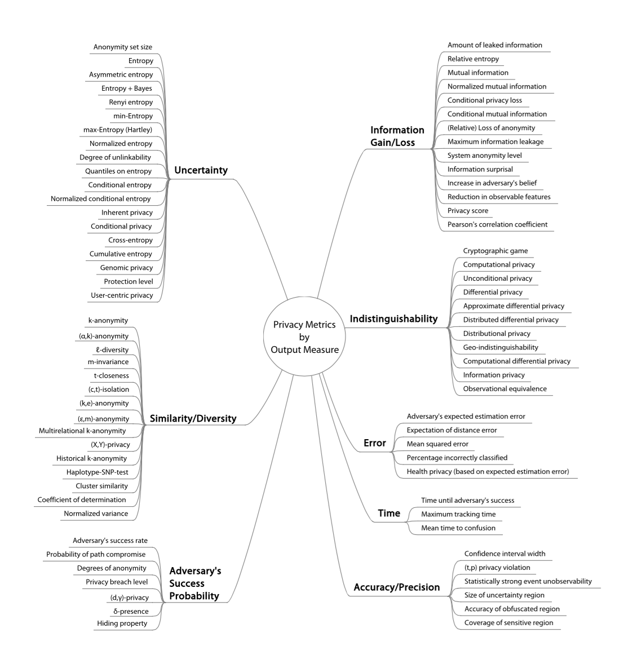
Technical Privacy Metrics: a Systematic Survey

Slide 15
Examples
Information Gain
Entropy
Decision Trees
Similarity or Diversity
K-anonymity
L-diversity
T-closeness
M-Score

Slide 16
Example
Constant Distinguishing Factor of .5
Case 3.1: 7 records
1.950
Case 3.2: 4 records
2.900
Dynamic Distinguishing Factor
Case 3.1: 7 records
2.150
Case 3.2: 4 records
1.450

Slide 17
Example
Changed the quasi-identifier values
Assumed the same constant value in research
Severity was higher in the smaller table
Altering the number of quasi-identifier values can impact the overall result of the severity score
Can impact the number of false positives

Slide 18
Practice
Applied on a single database
Internal
Database Links
ETL
Multiple data containers
3rd party vendors
Aggregation
Legacy Systems

Slide 19
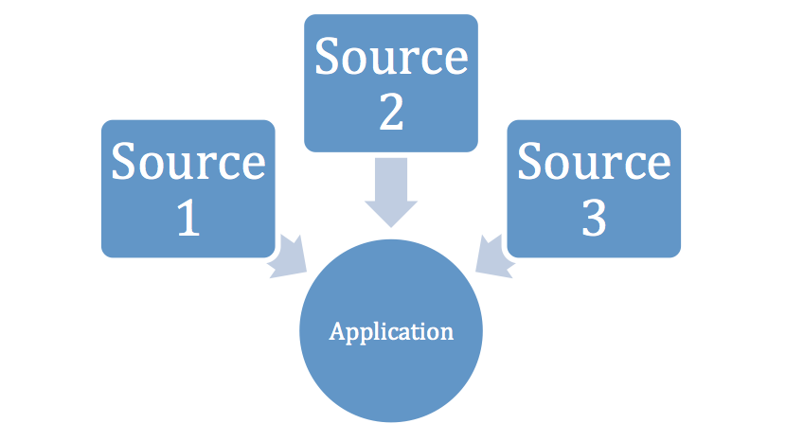
Scenario

Slide 20
Timeline
Lecture 1
Topic Selection
Lecture 2
Proposal Paper and Presentation
Lecture 3
Finalize privacy metrics of choice
Design Application
Lecture 4
Create proof of concept
Stronger emphasis on writing

Slide 21
Timeline
Lecture 5
Proof of conception continuation
Write up technical specifications
Lecture 6
Finish writing
Lecture 7
Finalize, cleanup and review

Slide 22
Obstacles
Replicating work
Incorrect calculations
Missing information
Interpreting Calculations
Contribution
Time Constraints

Slide 23
Conclusion
Goals
More specific metric for combining severity and anonymity
Robust application layer for DLD and PET
Future Work
Experimental Phase
Create Architecture
Severity measurement of modifications
Inserts
Update
Deletes

Slide 24
Conclusion
Introduction
Previous Work
Motivation
Timeline

Slide 25
References
S. Vavilis, M. Petkovic, and N. Zannone, “A severity-based quantifica-tion of data leakages in database systems,”Journal of Computer Security,vol. 24, no. 3, pp. 321–345, 2016.
Ponemon Institute. (2016). 2016 Cost of Data Breach Study: Global Analysis. The Ponemon Institute.
Wagner, Isabel, and David Eckhoff. "Technical privacy metrics: a systematic survey." arXiv preprint arXiv:1512.00327 (2015).
Harel, Amir, et al. "M-score: A misuseability weight measure." IEEE Transactions on Dependable and Secure Computing 9.3 (2012): 414-428.

