Slide 2
A Severity-based Quantification of Data Leakages in Database Systems
Quantify data leakage based on severity
Focus on most severe cases
Data model based on domain knowledge
Applied on healthcare information
In 2012 94% of US Hospitals suffered from a serious breach
Cost of a breach is $3.5 million

Slide 3
M-Score

Slide 4
Proposals
New Metric
L-Severity
Data model to reason severity within the application’s domain

Slide 5
Leaked records and values are mapped to the data model
Discrimination Factor (DF)
The extent that data can identify an individual

Slide 6
Data Model
– T is a set of data types.
– I is a set of data instances.
– HR⊂T×T∪I is a hierarchy relation representing a specialization relationship.
– IR ⊂ I × I represents an inference relation on I.
– SL : T ∪ I → R+0 is a labeling function that assigns a sensitivity value to data types and instances.
– PL : I × I → [0, 1] is a labeling function that defines the degree of inference, that is to what extent knowledge about a data instance can be inferred based on the knowledge about another data instance.

Slide 7
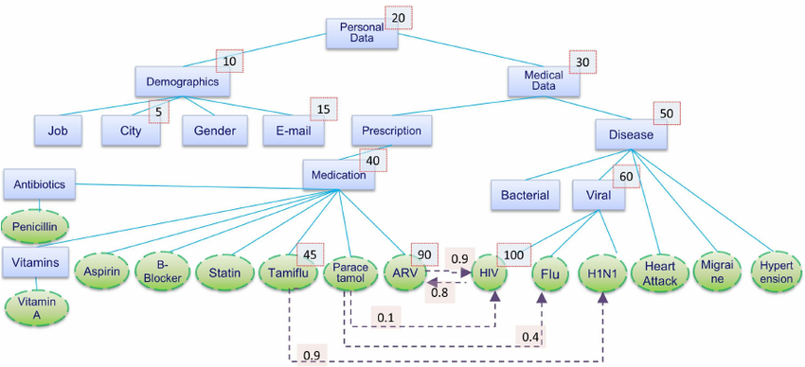
Healthcare Data Model
Notes:
Types are rectangular T
Instances are ovals I
PL Propagation label, 0.9 Tamiflu to H1n1
Inference relations by dashed lines IR
Solid lines are hierarchical relations HR

Slide 8
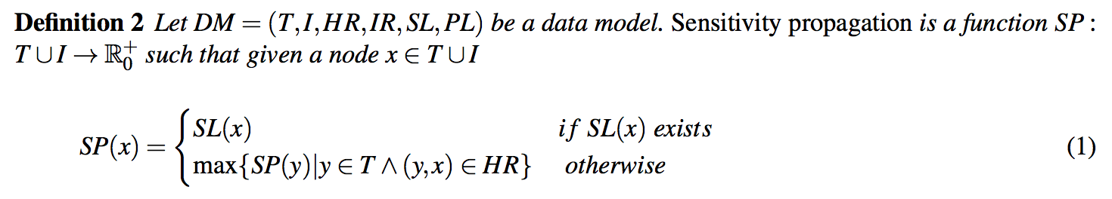
Notes:
SL – HIV 100
Statin – 40

Slide 9
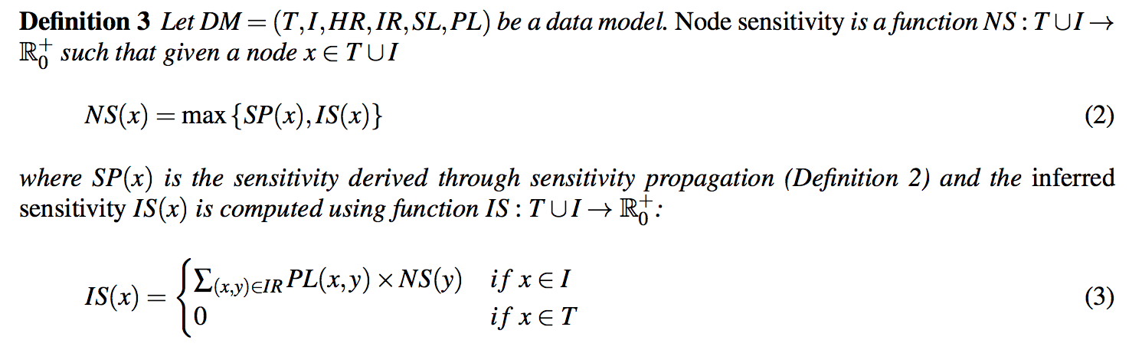
Notes:
IS = inferred sensitivity
Paracetamol
Node Sensitivity is 40
Inferred sensitivity is 34
100 * .1 = 10
60 * .4 = 24
SUM = 34

Slide 10
Rule | Description
Let A be a set of attributes.
A database table D(a1,...,an) is a set of records over a set of attributes {a1,...,an} ⊆ A | D(Job, City, Gender, Disease, Medication)
Sensitive attributes S = {s1,...,sm} ⊆ A | Disease and Medication are sensitive attributes
a ∈ S | Each sensitive attribute takes values from a pre-specified domain
Quasi-identifiers Q = {q1 , . . . , qk } ⊆ A | Attributes Job and City are quasi-identifiers
a ∈ Q | can be used to reveal the identity of an individual

Slide 11
Rule | Description
a ∈ S ∩ Q | Attribute Gender belongs to both sets
We denote the records in D(a1,...,an) as RD(a1,...,an) | records
r ∈ RD(a1,...,an) | record
ai[r] represents the value of attribute ai in r | value
a ∈ A, Ca denotes the domain of a | {HIV, Heart Attack, Hypertension, Migraine, H1N1, Flu}
{Ca}a∈A ⊆ T ∪ I | Domain can be made up of types and instances

Slide 12
Definition 4
Let A be a set of attributes and Ca the domain of an attribute a ∈ A. The sensitivity score function f : Ca → [0, 1] assigns a sensitivity value to each value in Ca .
f(ai[r])
Notes:
Set of attributes within a certain domain assigned a specific sensitivity score

Slide 13
Definition 5
Let D(a1,...,an) be a table, S = {sl,...,sm} ⊆ A the set of sensitive attributes in D(a1,...,an), and f the sensitivity score function. Given a record r ∈ RD(a1,...,an), the raw record score of r is
RRSr =min(1,∑ f(si[r]))
Notes:
Raw record score of a row
Minimum (1, sum of the sensitivity score of records

Slide 14
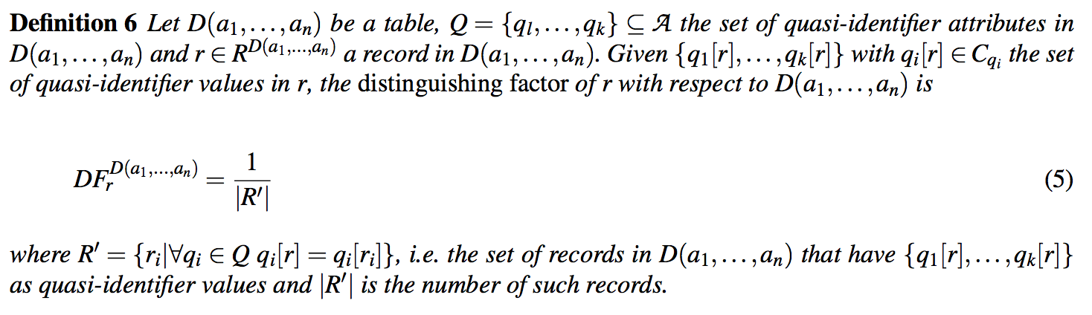
Definition 6
Notes:
Identify the quasi attributes
# of those that match

Slide 15
M-Score example

Slide 16
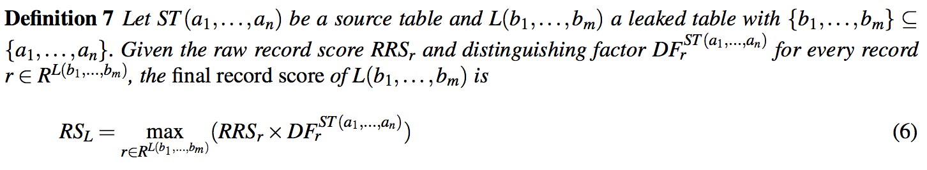

Slide 17
M-Score Example

Slide 18
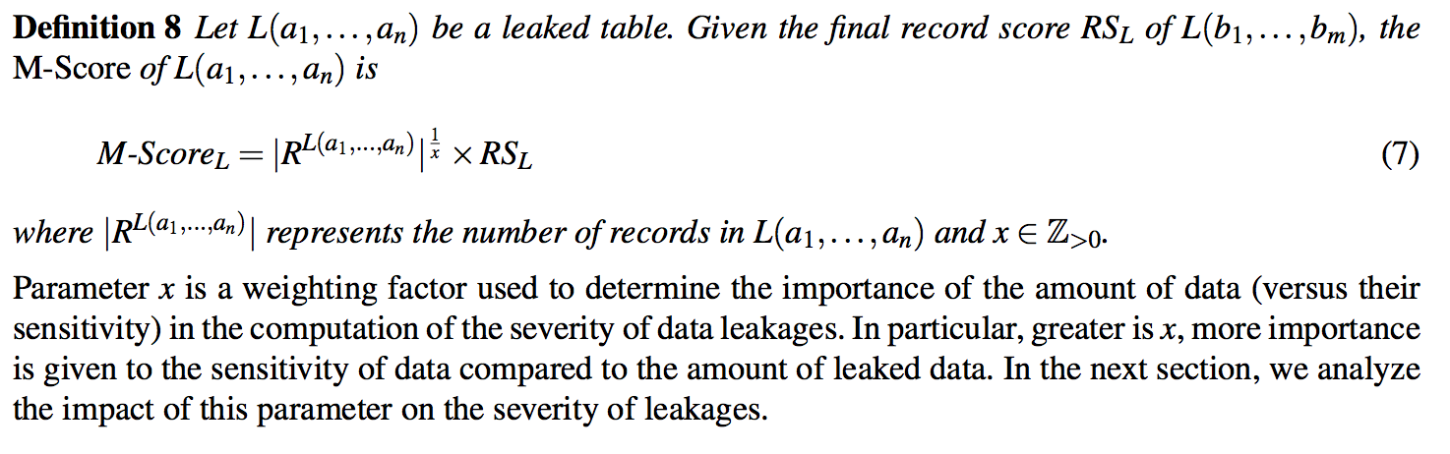

Slide 19
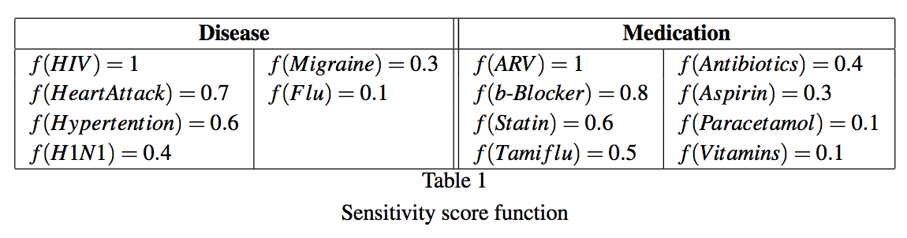

Slide 20
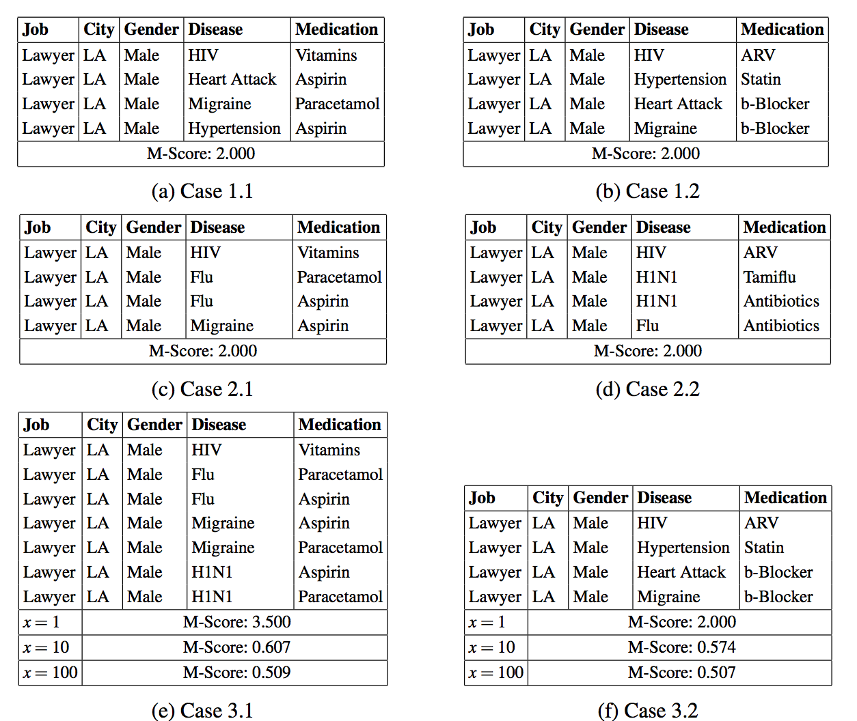
Notes:
.5 DF
MIN
Table 2 more sever
RS only takes account of record with highest sensitivity
3. Influenced by number of rows, but less sever

Slide 21
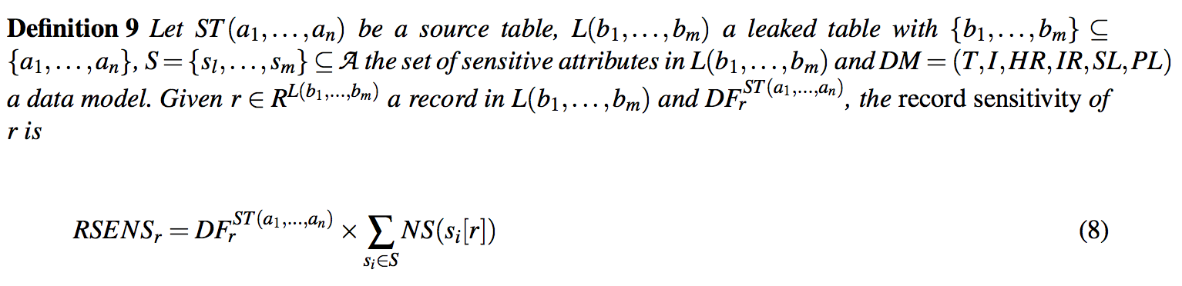
Notes:
Node Sensitivty
Per record
Dependency factor x sum of node sensitivity (sensitive attribute)
Contradiction, used senstivity score on table, not data model

Slide 22
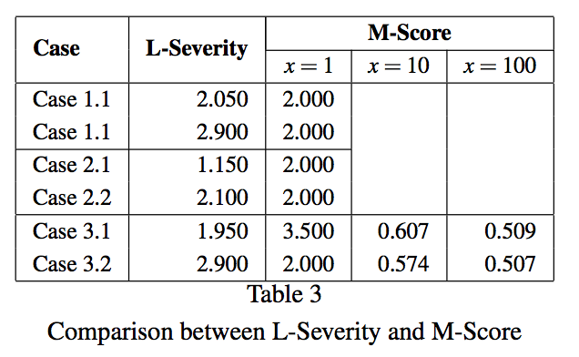
Notes:
Case 1.1 is incorrect

Slide 23
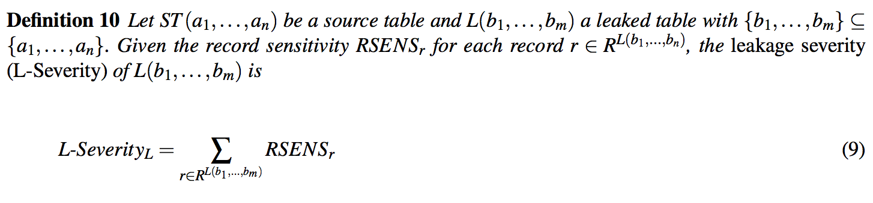

Slide 24
Case 1.1
Disease | Medication | Disease SF | Medication SF | Sum of SF
HIV | Vitamins | 100 | 10 | 55
Heart Attack | Aspirin | 70 | 30 | 50
Migraine | Parcetamol | 30 | 10 | 20
Hypertension | Aspirin | 60 | 30 | 45
 |  |  |  | 170
 |  |  |  | 1.7

