Slide 1
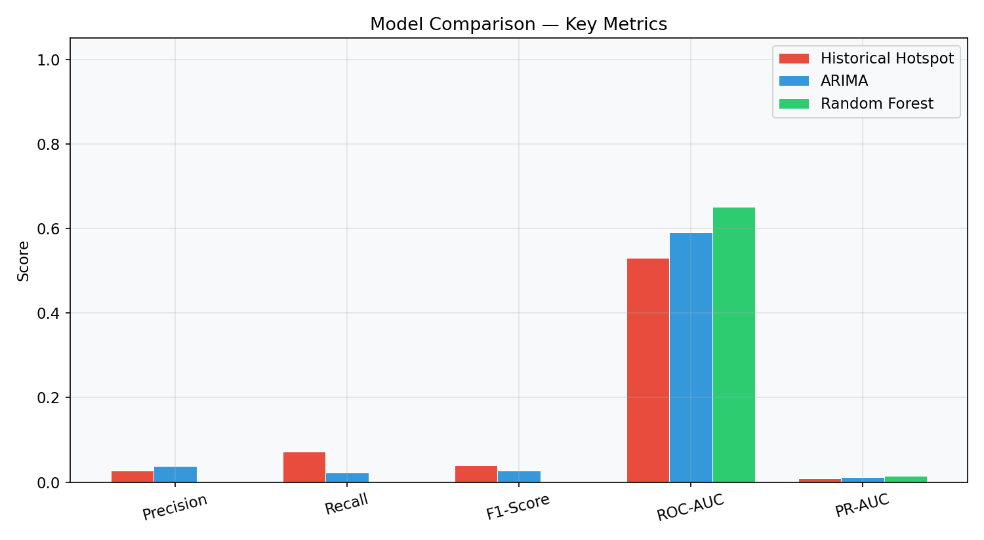
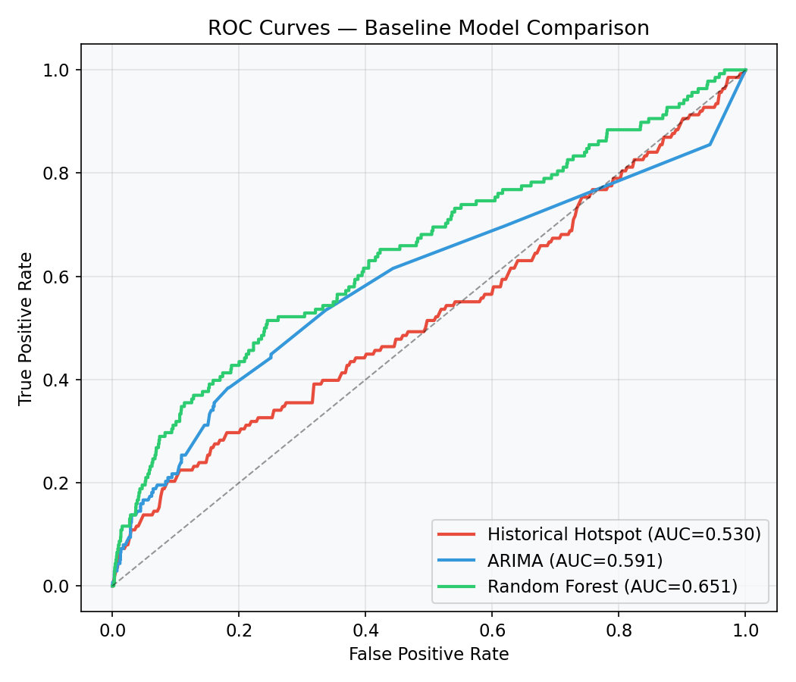
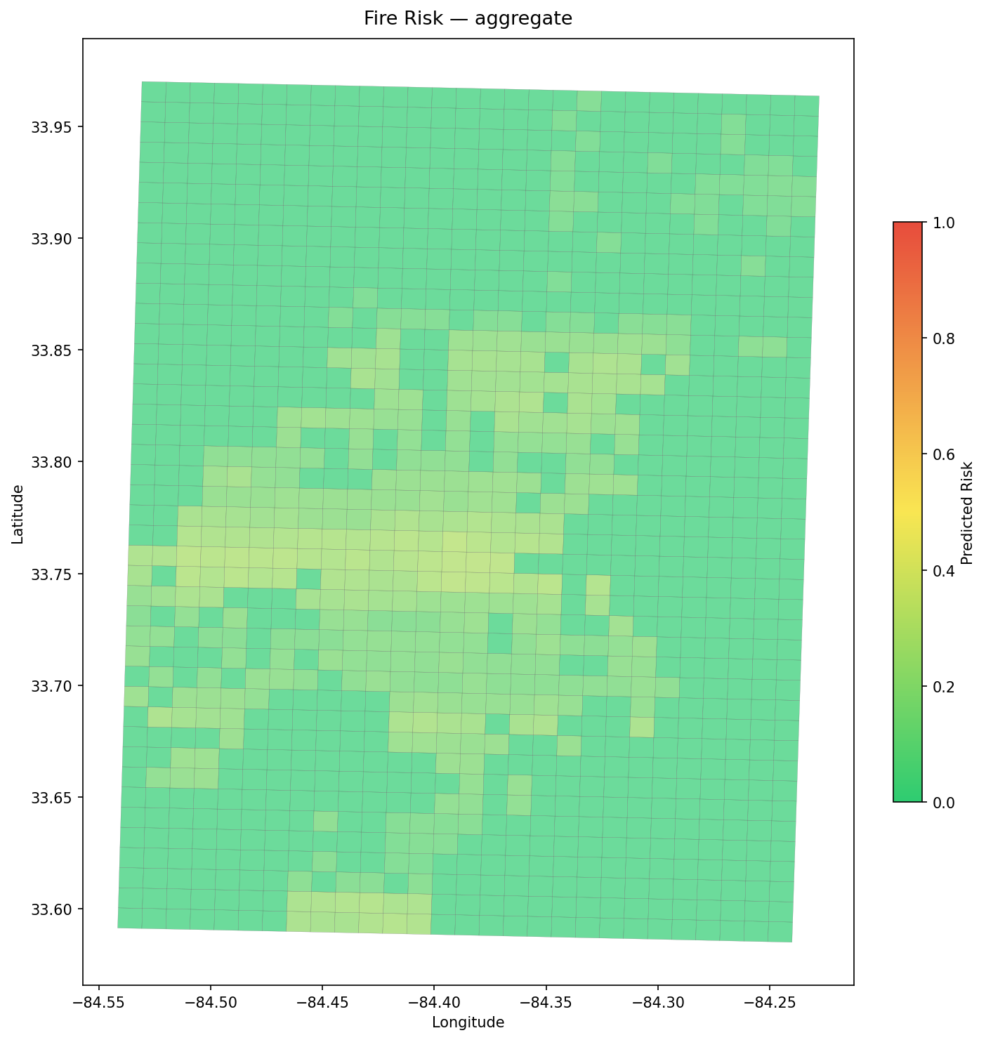
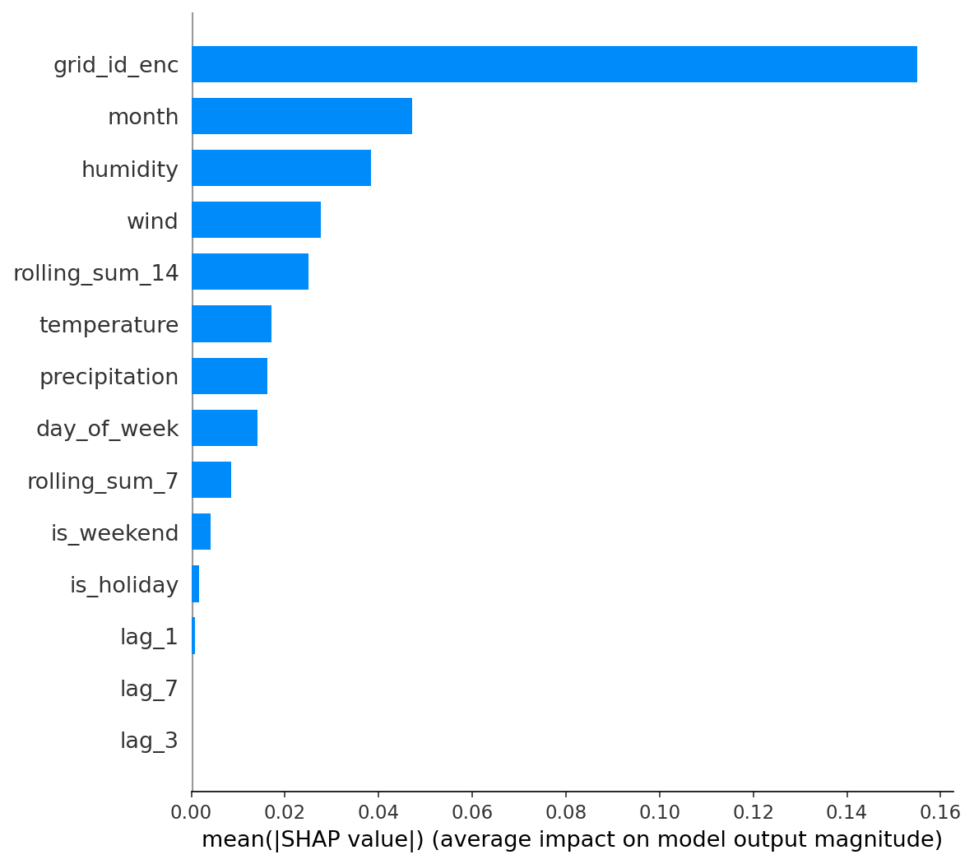
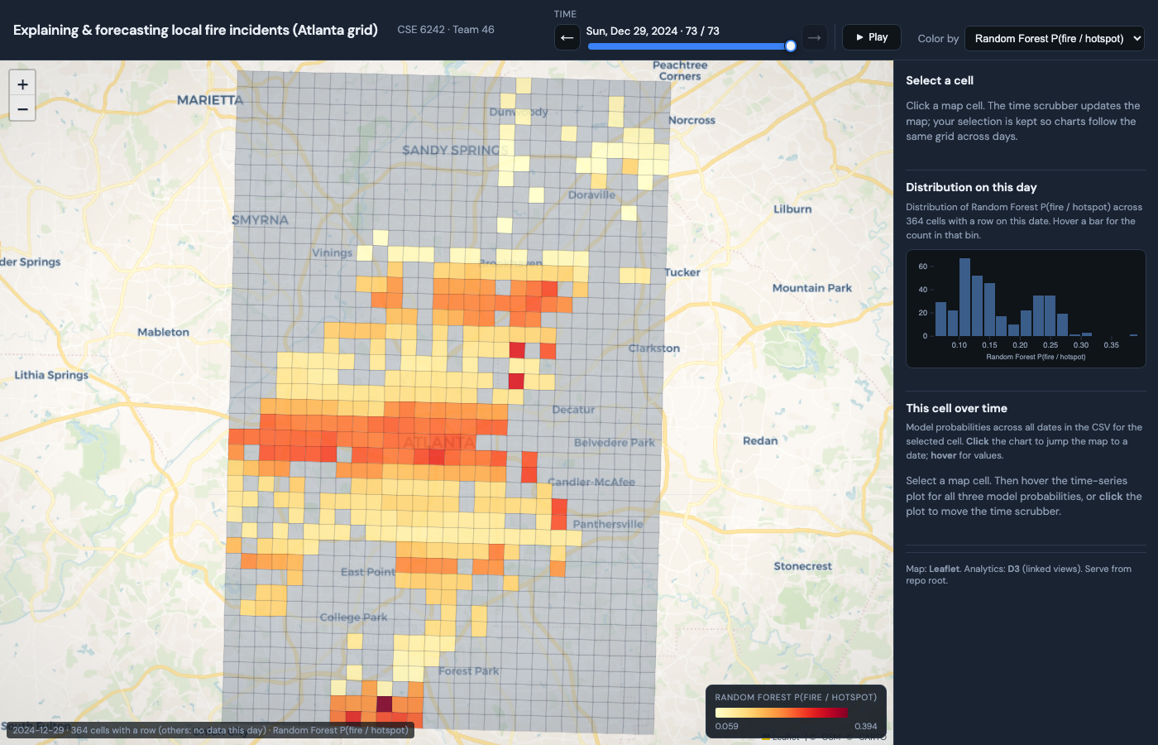
Ignition Insights
Explaining and Forecasting Urban Fire Risk
Vishruth Anand · Vineeth Nareddy · Rian Rahman · James Reilly · Jayanth Vennamreddy
Georgia Institute of Technology | CSE 6242 Data and Visual Analytics | Team 46
INTRODUCTION
RESULTS
• Problem: Fire departments make staffing and inspection decisions under uncertainty, yet fire incidents cluster unevenly across neighborhoods and time periods.
• Current tools show what happened, but not where risk is concentrated, how it shifts over time, or why a model flags a particular area.
• Why it matters: Better risk awareness helps departments pre-position resources, prioritize inspections, and potentially reduce response times.
• Our system forecasts next-day fire risk on a 1 km Atlanta grid and explains each prediction through an interactive Leaflet/D3 dashboard.
• Evaluation: temporal hold-out (last 20% of dates). Metrics: Accuracy, Precision, Recall, F1, ROC-AUC, PR-AUC.
• Test set: 26,572 cell-days, only 138 positive (0.52%). Extreme imbalance makes accuracy misleading (all > 98%).
• Model comparison: RF outranks both baselines. ROC-AUC: RF 0.65 > ARIMA 0.59 > Hotspot 0.53. PR-AUC: RF 0.014 > ARIMA 0.011 > Hotspot 0.009.
• RF threshold yields 0 true positives, but the continuous probability surface is more useful as a ranked risk map.
DATA
• 1,473 geocoded fire incidents from 2024 NFIRS PDR Light (Atlanta, fire codes 100-199, deduplicated).
• Daily weather from Open-Meteo: temperature, humidity, precipitation, wind speed (citywide, one row per day).
• 1,176 grid cells at 1 km resolution; 132,860 cell-day rows with 18 features (weather, calendar, lags, rolling sums).
METHODS
• Hotspot baseline: Gaussian KDE over training centroids weighted by count. Tests if static spatial density alone can identify future risk.
• ARIMA baseline: per-cell time-series for top 50 cells. Grid search (p,d,q) by AIC. Tests whether a cell's own history predicts its future activity.
• Random Forest (main model): 300 trees, max depth 15, balanced weights, 14 features + encoded grid_id. Intuition: combining weather, calendar, recent history, and location should outperform single-signal baselines.
• Temporal 80/20 split: train Jan-Oct 18, test Oct 19-Dec 30. No row shuffling to prevent future-data leakage.
• Novelty: most prior systems offer forecasting or explanation, not both. Ours integrates prediction, SHAP explanation, and linked exploration in one tool.
Fig. 3: Model comparison across key evaluation metrics
Fig. 4: ROC curves for all three baseline models
INTERPRETABILITY
• SHAP TreeExplainer on the RF model: per-feature contributions for every cell-date prediction.
• Top drivers: rolling_sum_14, rolling_sum_7 (recent activity), then month, wind, and grid location.
Fig. 1: Aggregate RF risk across all test dates (Atlanta 1 km grid)
INTERACTIVE DASHBOARD
• Leaflet map + D3 analytics. Metric selector, date slider with play/pause, linked histogram and time-series views.
• Click any cell: feature snapshot, SHAP explanation panel with driver bar chart and narrative sentence.
Fig. 5: SHAP feature importance (mean |SHAP value|)
CONCLUSIONS
• Binary metrics are insufficient at 0.5% positive rate; ranked risk surfaces are more practical than alarms.
• Linked views (map + timeline + histogram + explanation) make model outputs easier to understand and critique.
• Future: census/land-use features, calibrated thresholds, gradient boosting, and a formal user study.
REFERENCES
• [1] Wang et al., CityGuard, IMWUT 2019
• [2] Coffield et al., Fire size ML, IJWF 2019
• [3] Lattimer et al., ML fire simulation, FSJ 2020
• [4] Asgary et al., Toronto fire clustering, 2010
• [5] Yuan & Wylie, ARIMA vs RF, Austin 2024
• [6] Madaio et al., Firebird Atlanta, 2016
• [7] Jin et al., Deep sequence fire, ASC 2020
• [8] Ahn et al., Stacking ensemble, Fire 2024
• [9-15] Zhang, Ku, Cui, Liao, Kang, Xiao, Jennings
Fig. 2: Dashboard with choropleth, time control, and explanation panel

