Slide 1
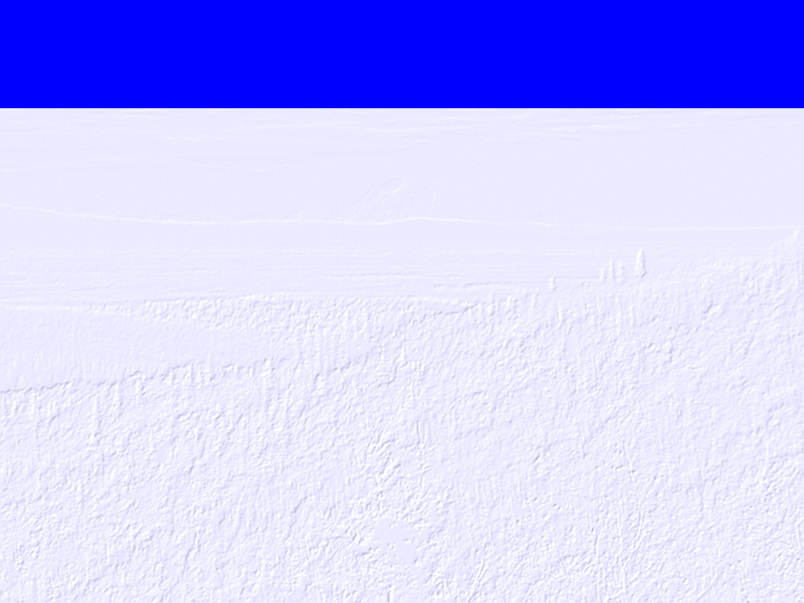
Some New Spatial Statistical Models for Stream Networks
By
Jay M. Ver Hoef
National Marine Mammal Lab
7600 Sand Point Way, NE
Seattle, WA 98115
jay.verhoef@noaa.gov

Slide 2
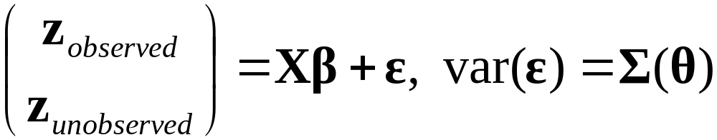
General Linear Model
Prediction
Estimation

Slide 3
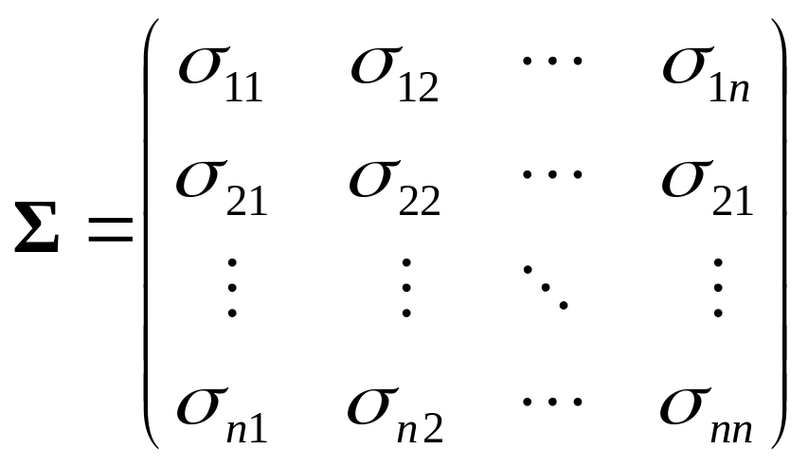
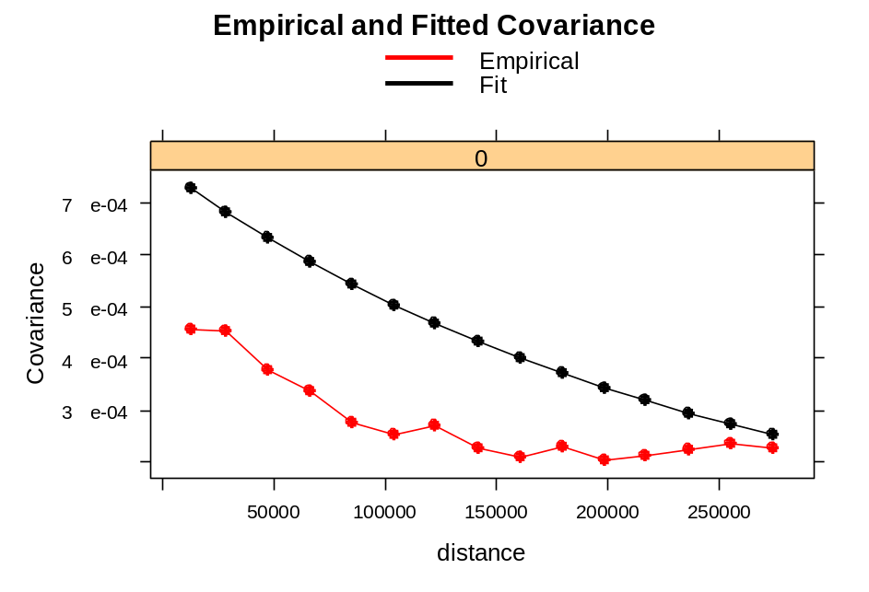
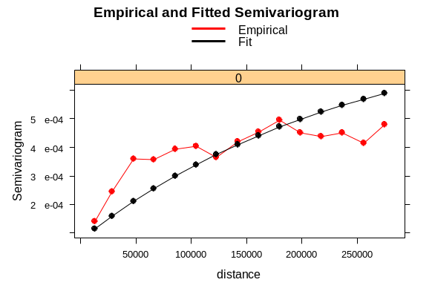
Spatial Linear Models

Slide 4
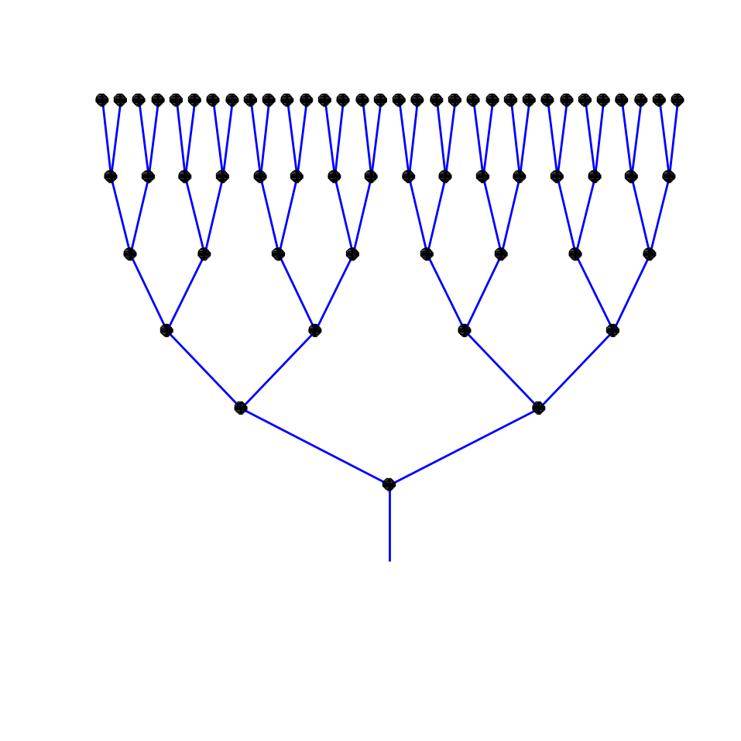
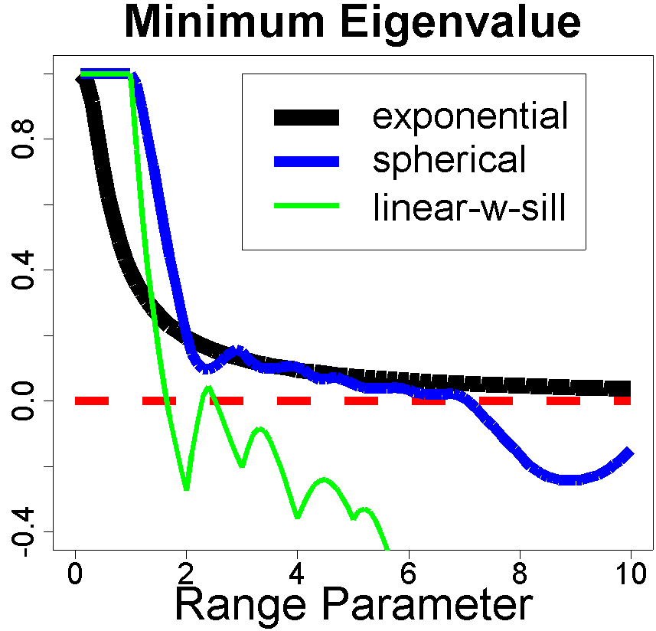
Pitfalls: Valid Models for Stream Networks
Not to scale. All lengths = 1

Slide 5
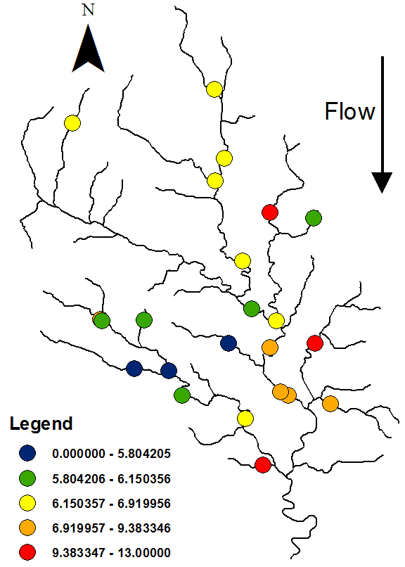
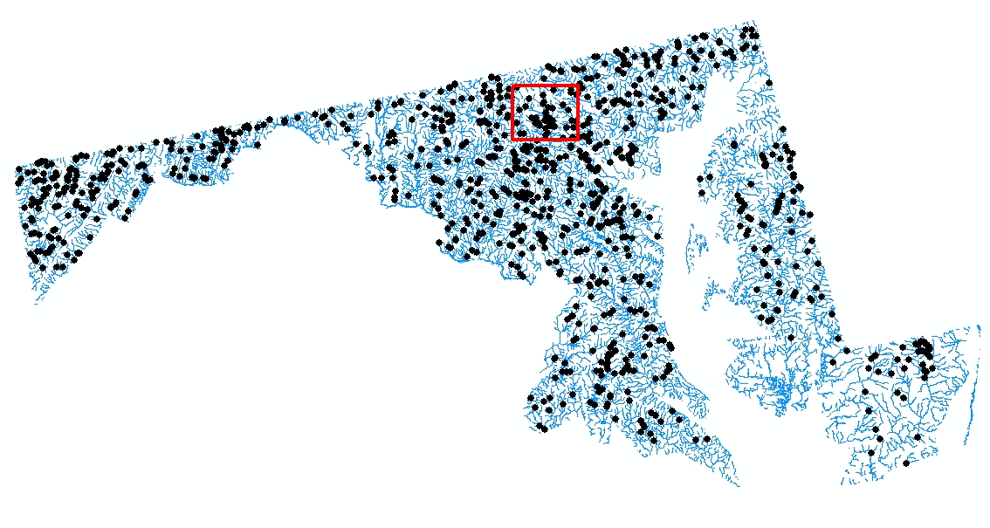
Stream Network Models
SO₄ Concentration

Slide 6
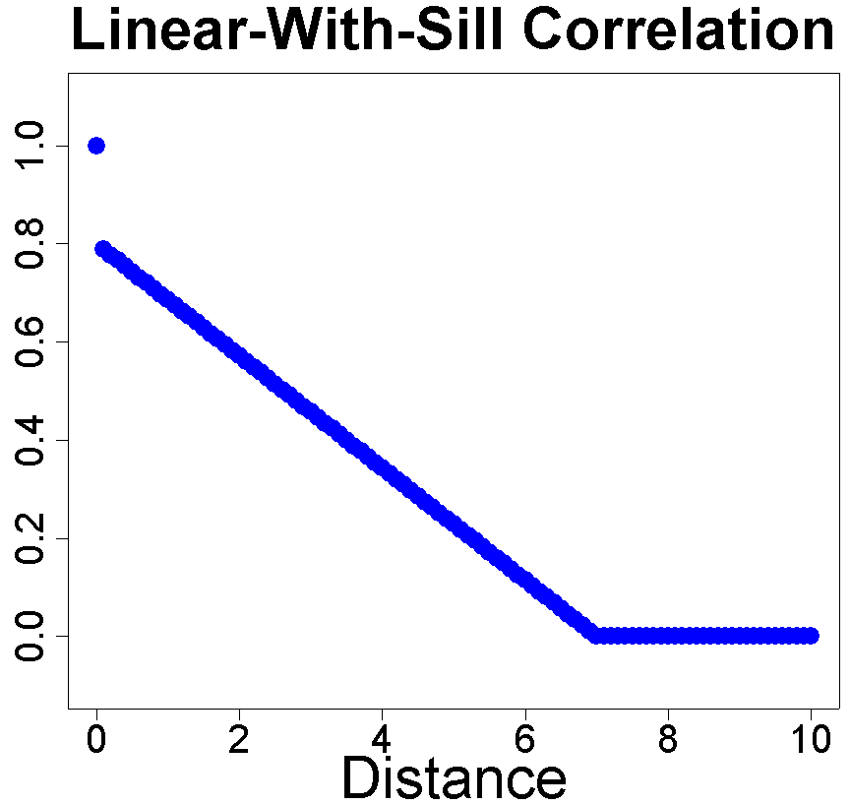
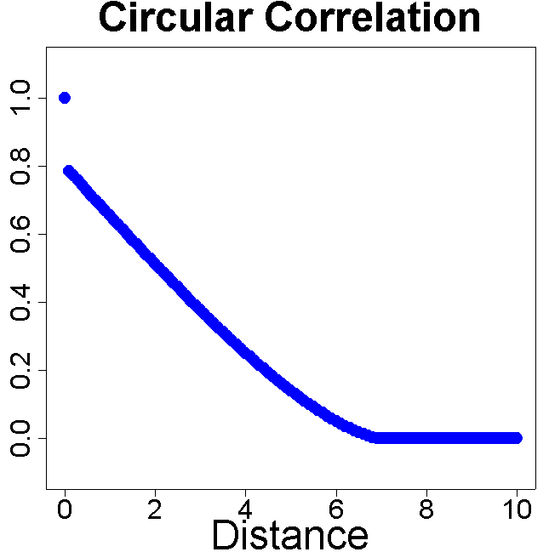
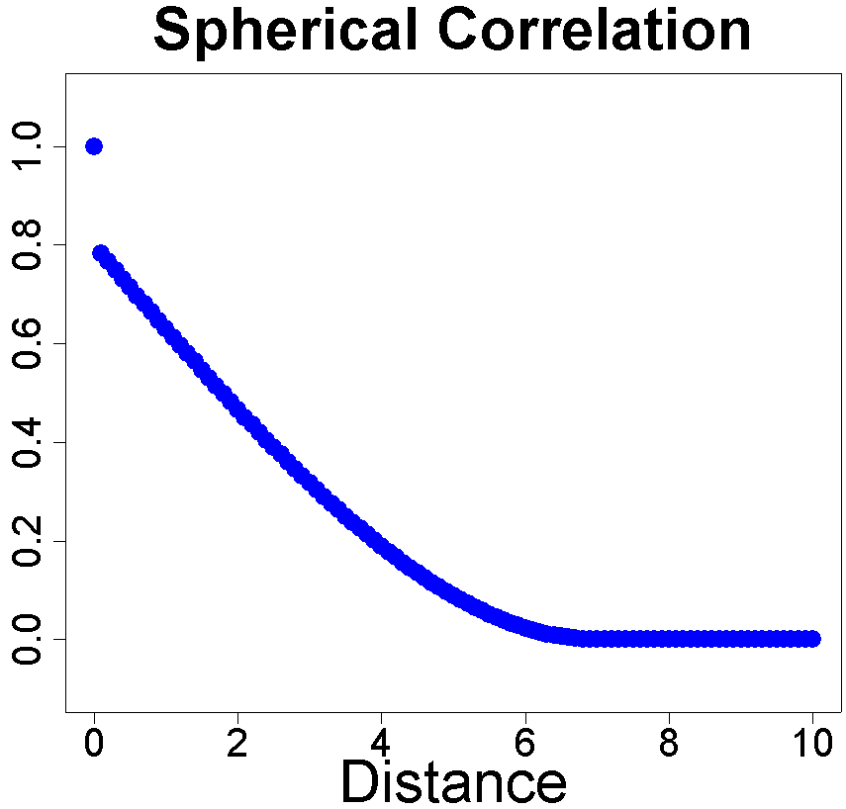
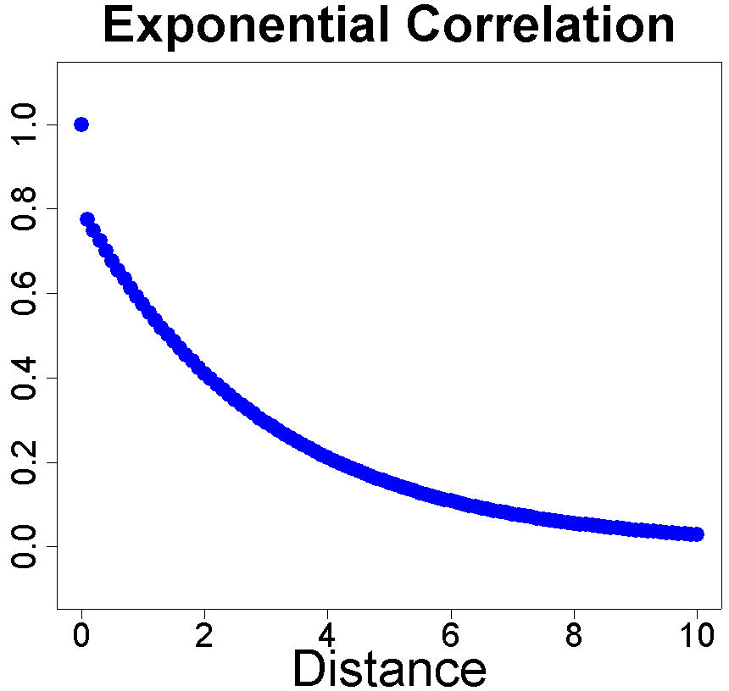
Valid Models in 1-D

Slide 7
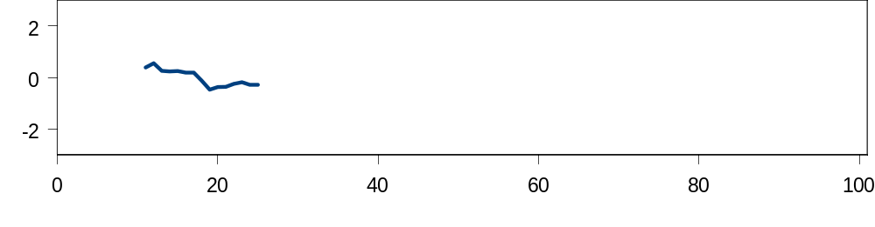
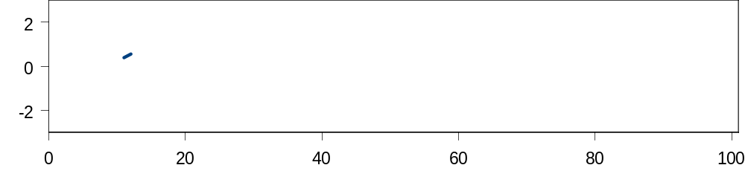
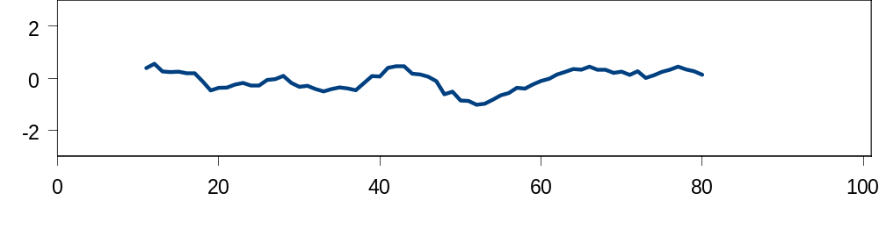
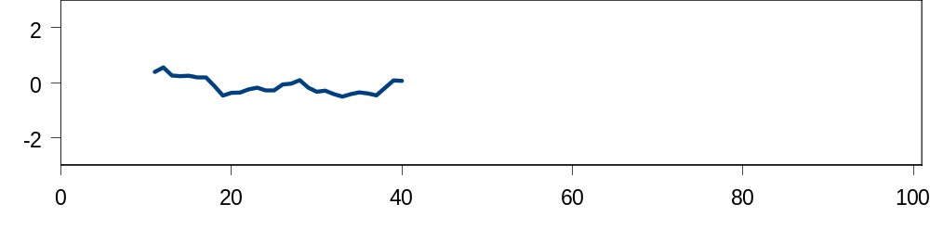
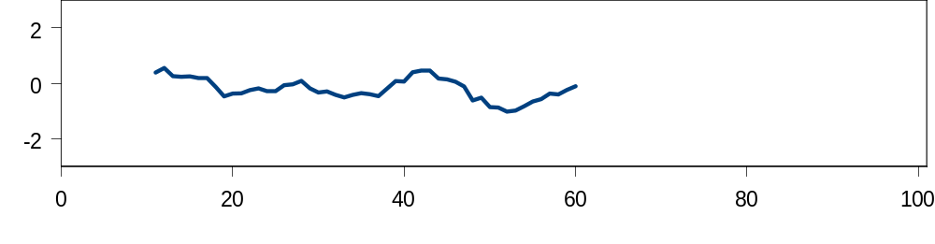
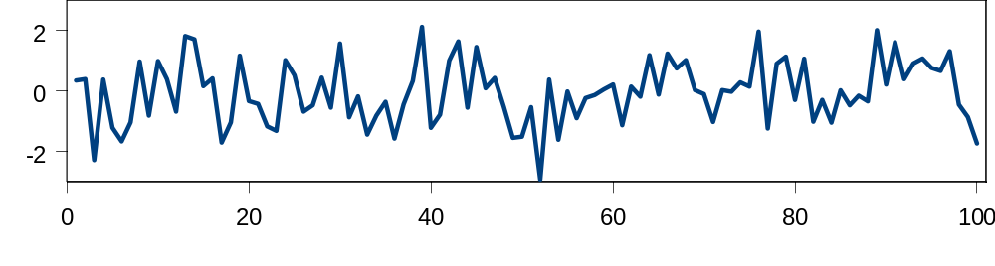
Moving Average Construction

Slide 8
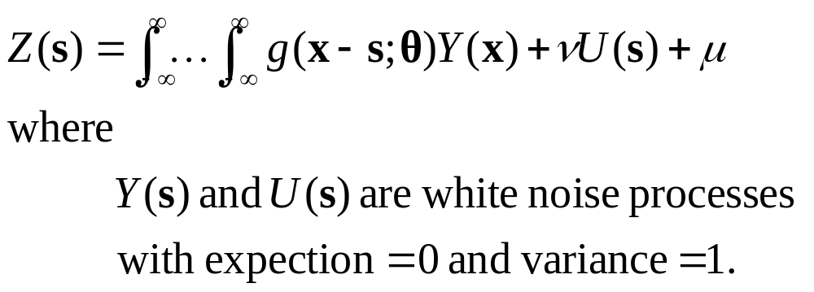
Moving Average Construction

Slide 9
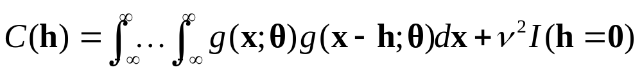
Valid Covariance

Slide 10
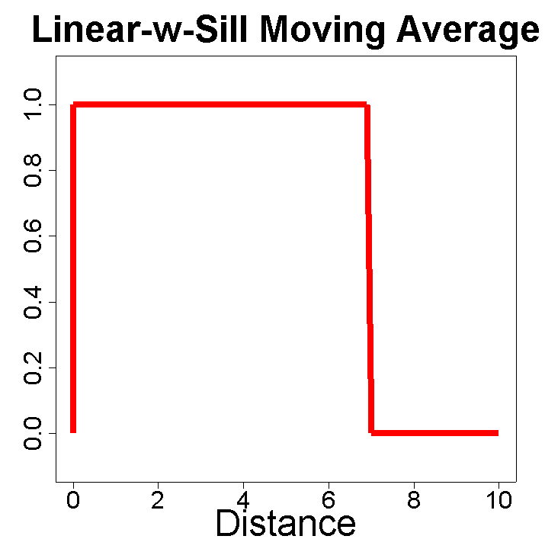
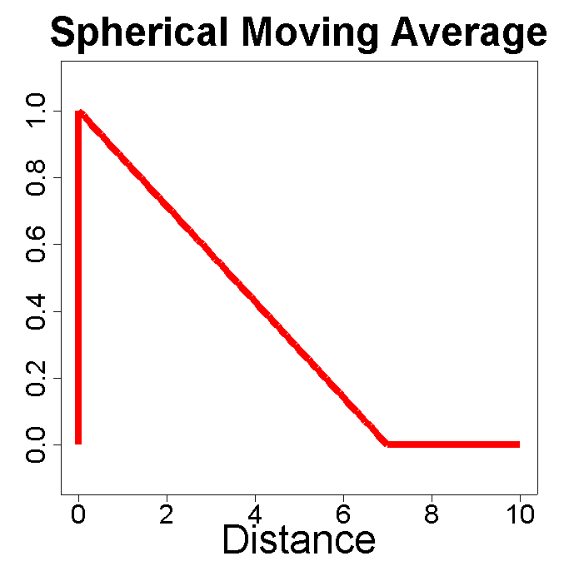
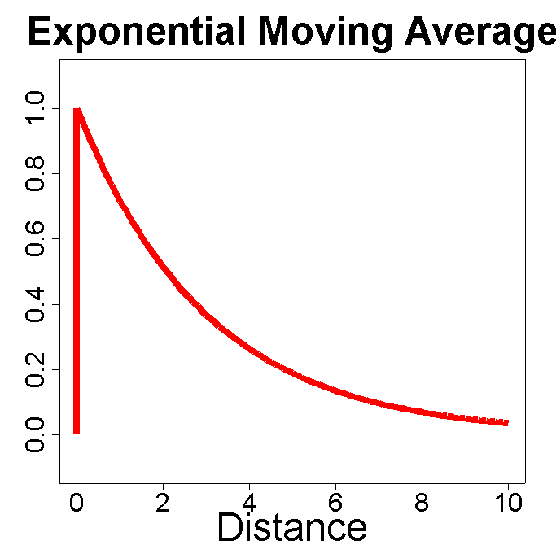
Moving Averages in 1-D

Slide 11
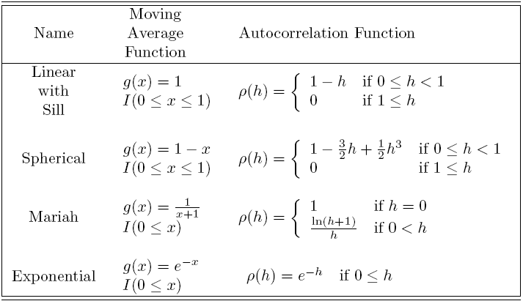
Moving Averages in 1-D

Slide 12
Tail-Up Models
Flow

Slide 13
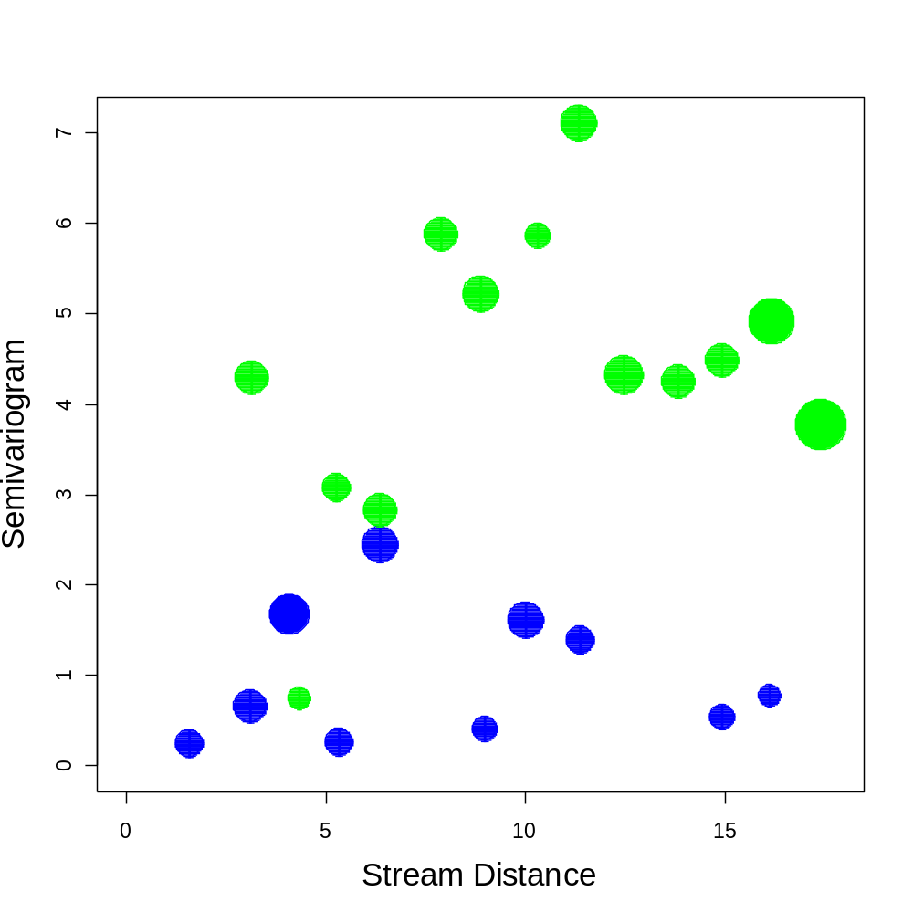


Why Tail-Up Models?
Flow Unconnected
Flow Connected

Slide 14
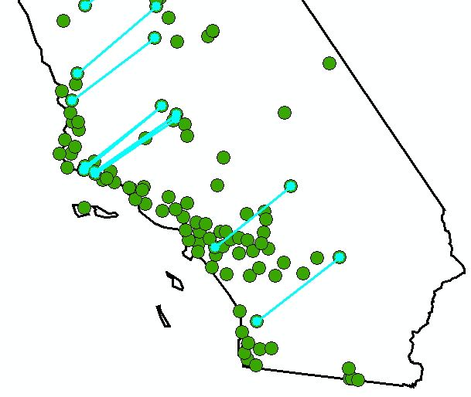
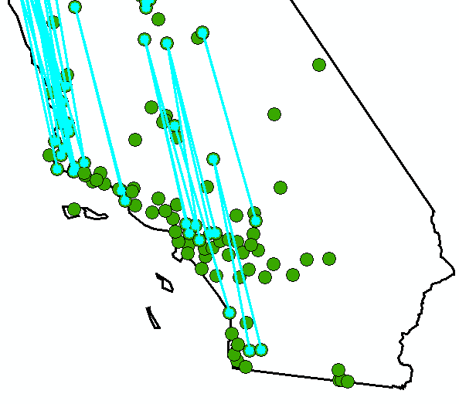
Empiricial Semivariogram
Semivariogram(distance h) =
½ average[(value at location i – value at location j)²]
for all pairs of locations i and j separated by distance h.

Slide 15
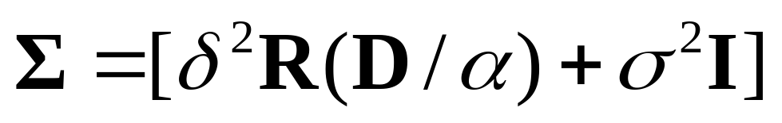
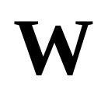
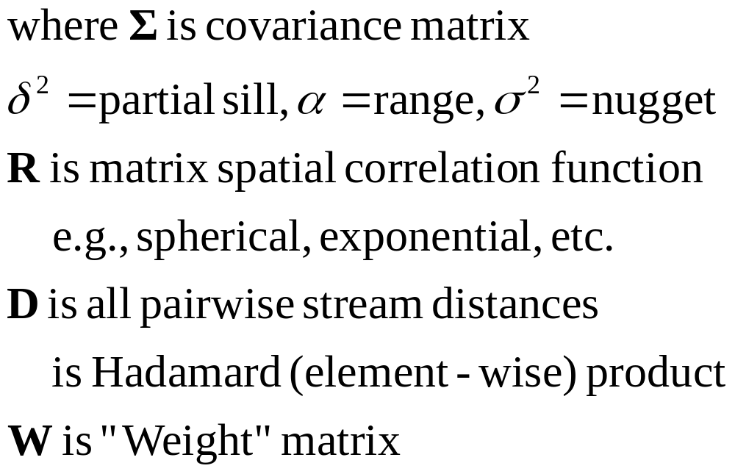
Constructing a Valid Covariance Matrix for Tail-Up Models
◉
◉

Slide 16
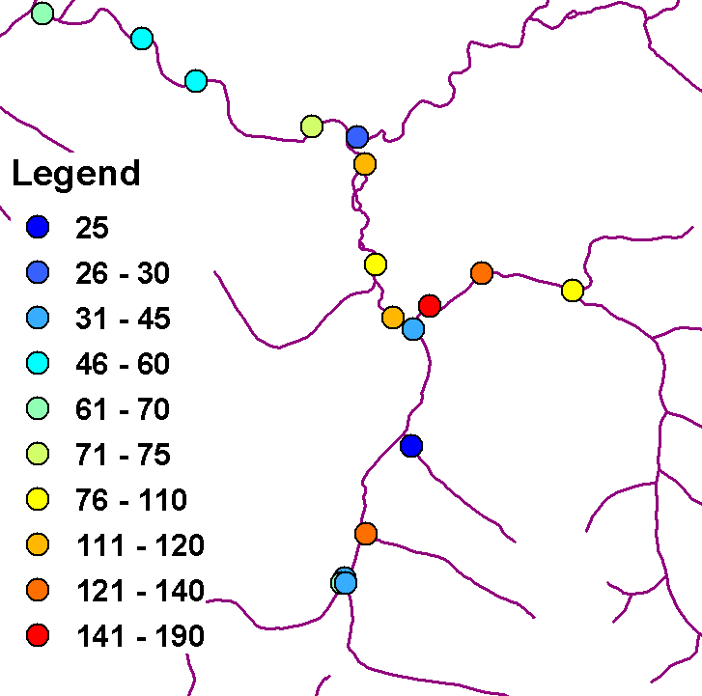
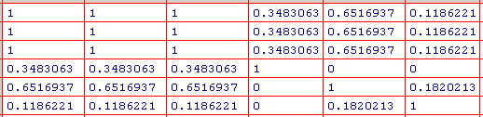
Flow Matrix Example
1
Flow
F
2
3
4
5
6
Flow
Flow

Slide 17
Tail-Down Models
Flow

Slide 18
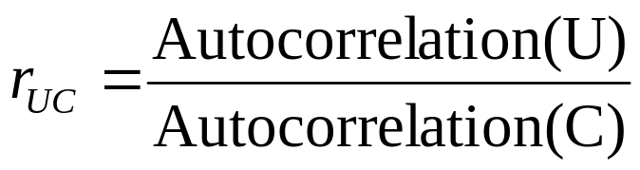

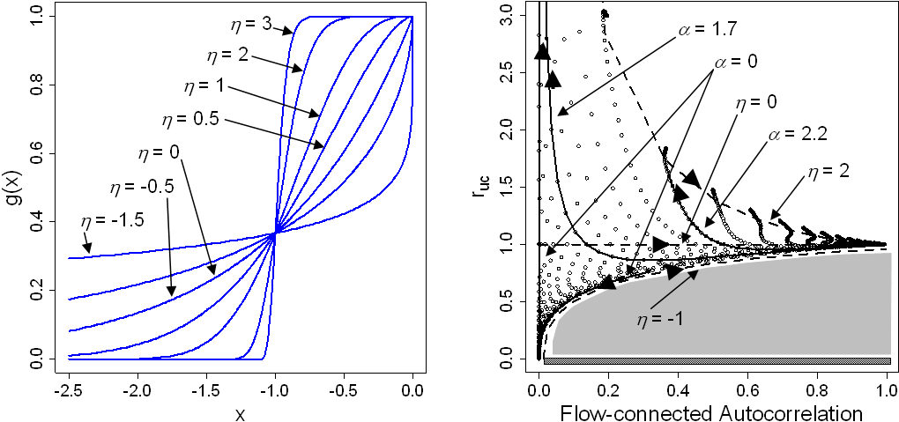
Autocorrelation Ratios
U
U=C
C

Slide 19
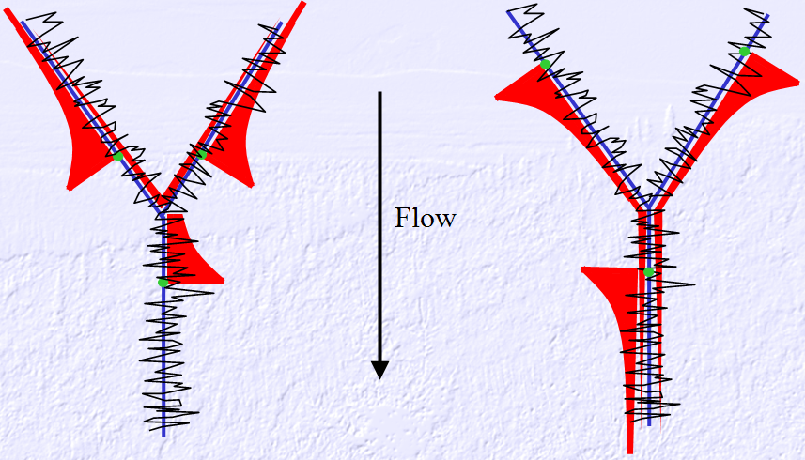
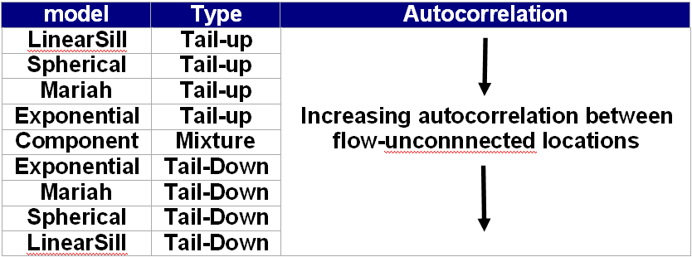
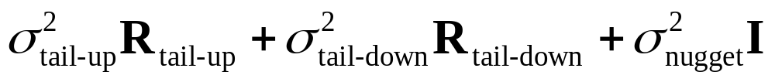
A Classification of Models
Component Models

Slide 20
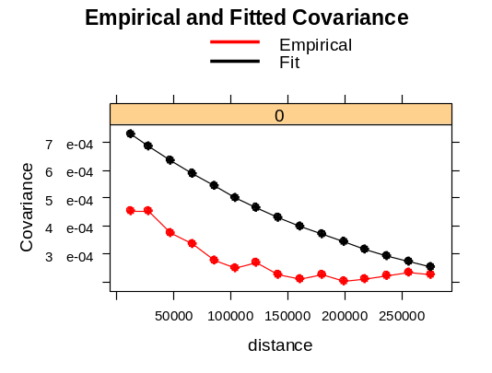
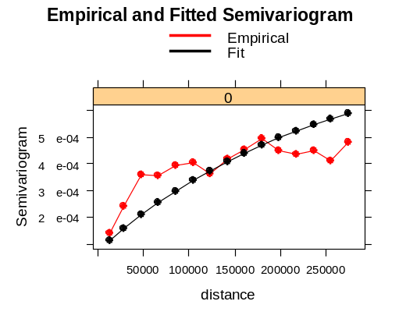
Covariance Parameter Estimation
Weighted Least Squares
Generalized Least Squares
Maximum Likelihood
Restricted Maximum Likelihood
Bayes (Markov Chain Monte Carlo MCMC)

Slide 21
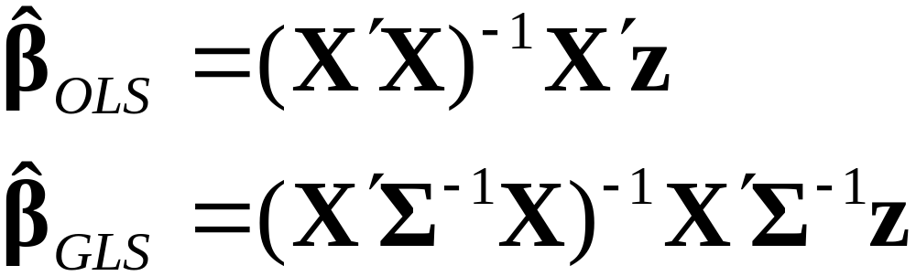
Generalized Least Squares
Estimating regression parameters

Slide 22
Maryland Stream Example
Estimation
SO₄ Data
Diagnostics
Prediction

Slide 23
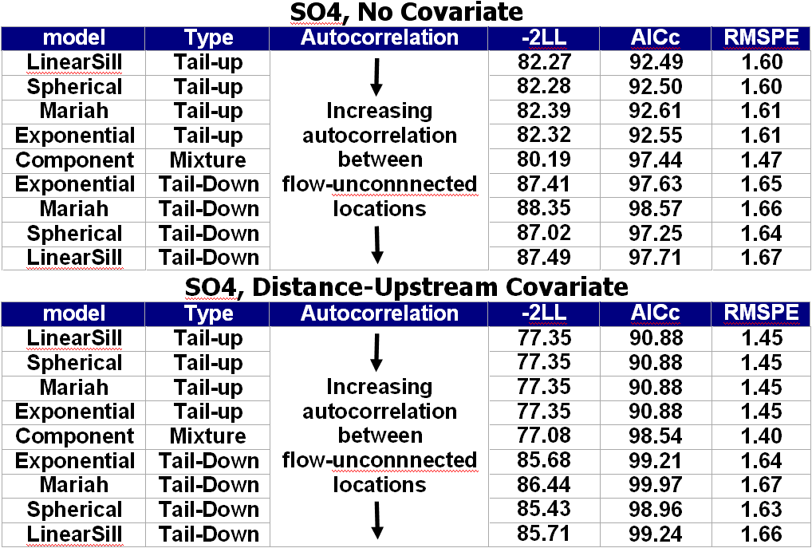
Choosing a Model

Slide 24
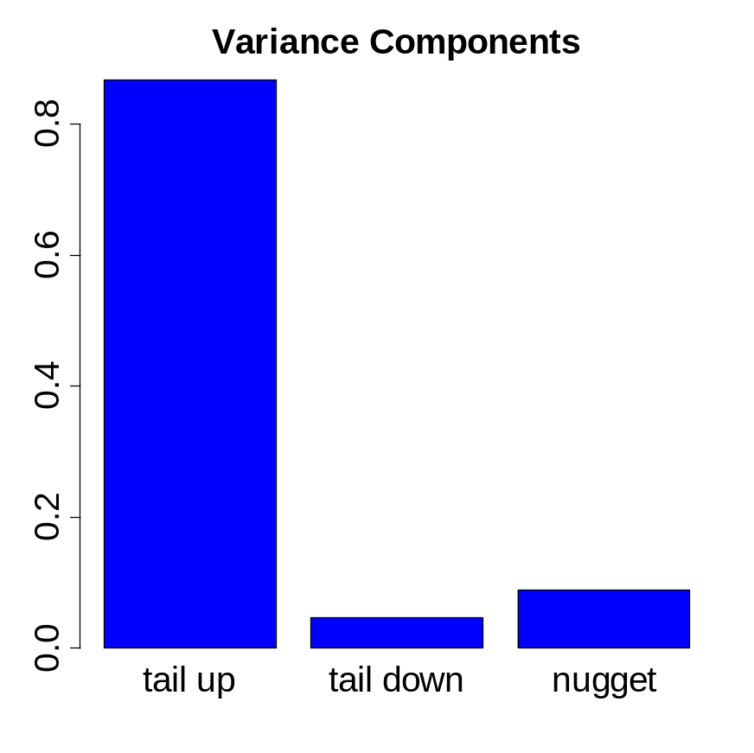
Variance Components
Estimation
SO₄ Data

Slide 25
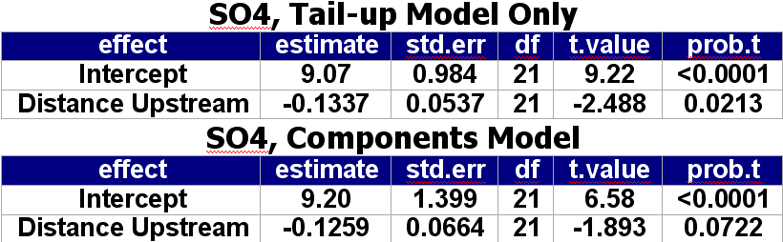
Estimating Fixed Effects
SO₄ Data
Estimation

Slide 26
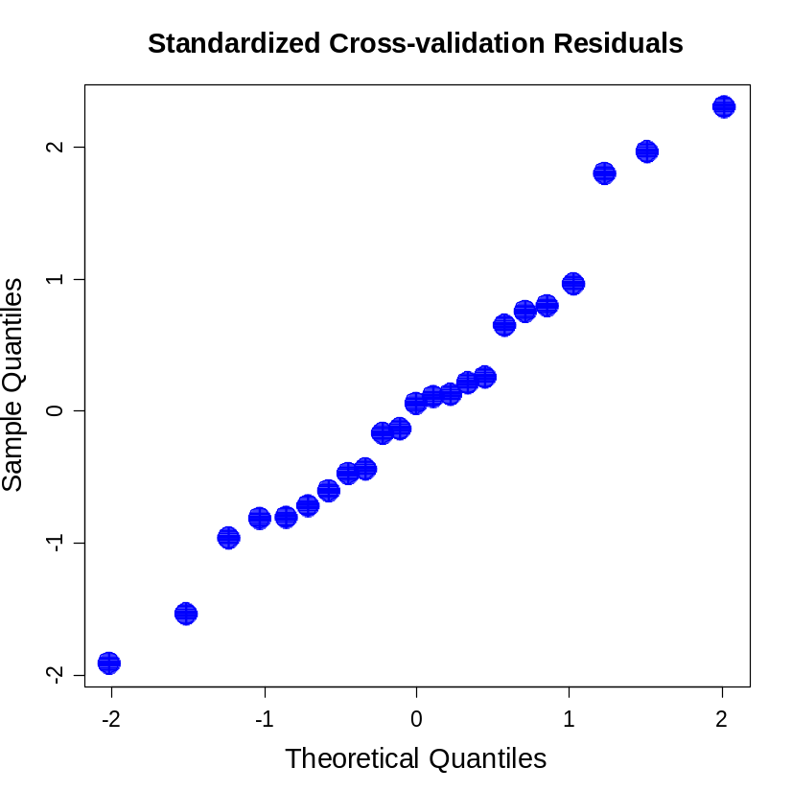
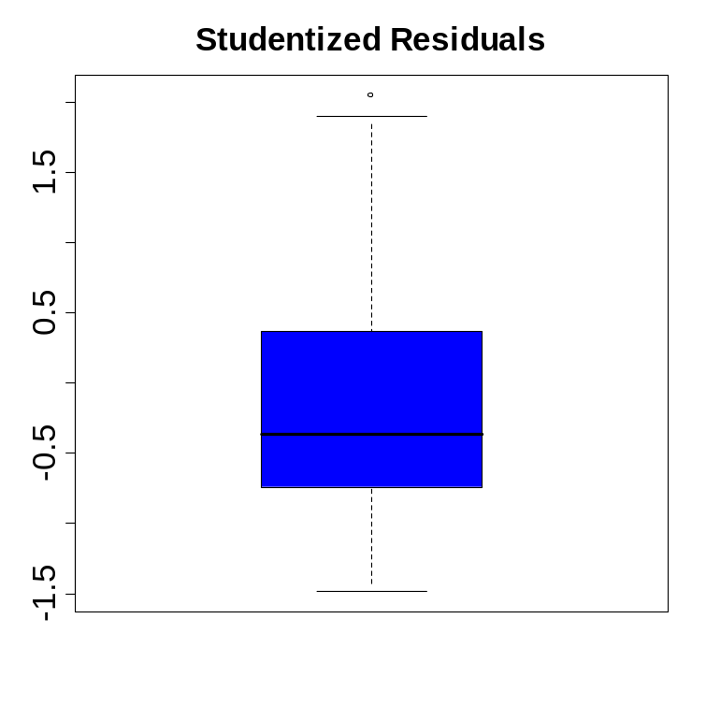
Residual Diagnostics
Diagnostics

Slide 27
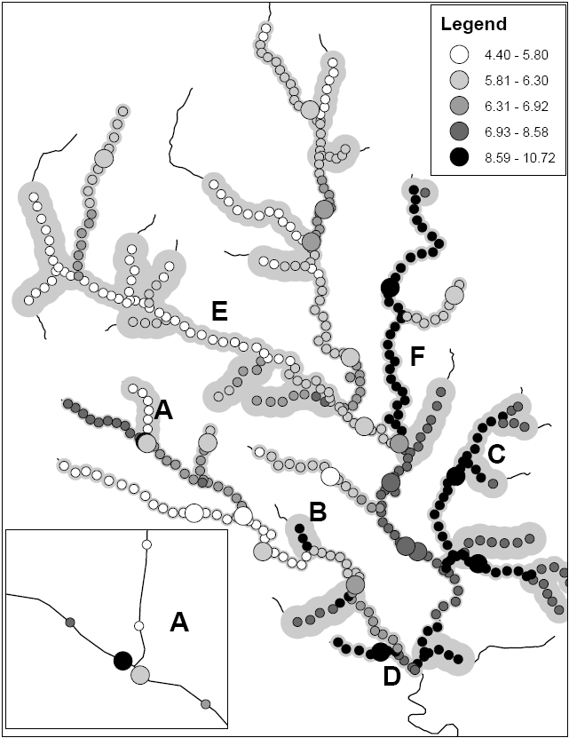
Prediction
Prediction
A
Block Kriging
E = 5.82 se =1.13
F = 9.67 se = 0.67

Slide 28
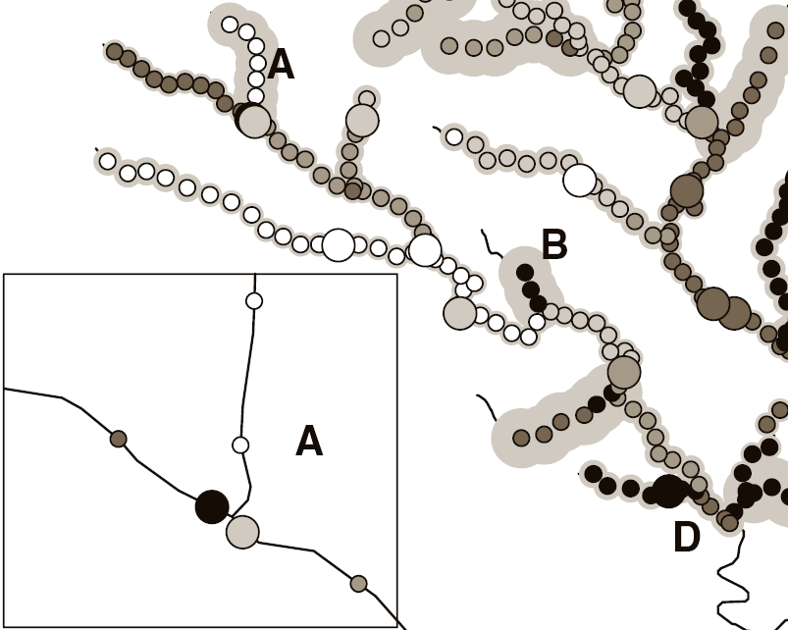
Discontinuity at Nodes
Flow
Flow
Flow

Slide 29
New Work
More models. Can look beyond moving averages.
Add Euclidean Distance Models as a Component
Generalized linear models for stream networks.
Multivariate extensions.
Optimal designs

