Slide 1
Calculating Spatial Data Using GIS
Erin E. Peterson
CSIRO Mathematical and Information Sciences Division
August 5, 2007

Slide 2
Overview
Software requirements
Data requirements
FLoWS version 1.0 toolset
Landscape Networks (LSN)
Flowchart for Creating Spatial Data

Slide 3
Software Requirements
ArcGIS v9.1
ArcInfo license
The Spatial Analyst Extension
The Functional Linkage of Watersheds and Streams (FLoWS) geoprocessing toolbox (Theobald et al., 2006)
The Spatial Modeling in River Networks geoprocessing toolbox

Slide 4
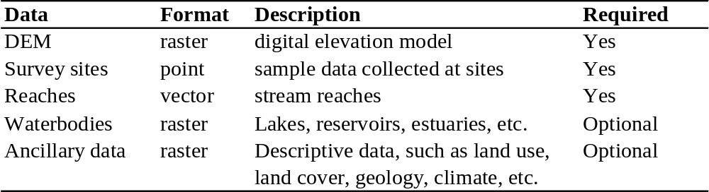
Data Requirements

Slide 5
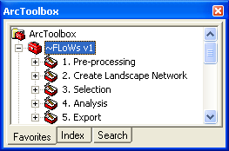
FLoWS Version 1.0 Toolset
Functional Linkage of Watersheds and Streams (FLoWS)
  ArcGIS Geoprocessing Toolbox written in Python v2.1 for ArcGIS v9.1
  Developed by Dr. Dave Theobald and John Norman at Colorado State University
  Website: http://www.nrel.colostate.edu/projects/starmap/flows_index.htm
What are the FLoWS tools?
  Graph theoretic-based analysis tools
  Functionally link aquatic and terrestrial components of a landscape based on hydrologic processes
  Hydrologic modeling framework
  Represents spatial context and relationships using geographic information

Slide 6
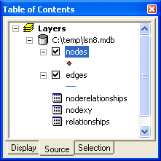
Landscape Network (LSN)
Data structure utilized by the FLoWS tools
  Contained in a personal geodatabase
5 Essential elements of a LSN
  Nodes
  Edges
  Node xy table
  Node relationship table
  Relationship table
Additional elements that can be incorporated
  Reach Catchment Areas (RCAs)
  Survey sites

Slide 7
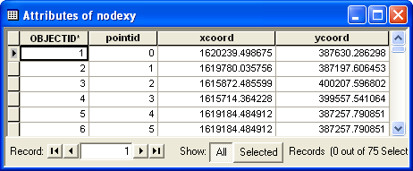
Landscape Network (LSN)
Nodes: topologic breaks in the GIS dataset
  Sources, outlets, confluences, or pseudo nodes
  Each node is assigned a point ID
Edges: flow paths from node to node
  RID = Reach Identifier: assigned to edges when a LSN is created
Nodes
Source
Outlet
Confluence
Pseudo node
Edges
Node x,y table
  Provides x,y coordinates for each node

Slide 8
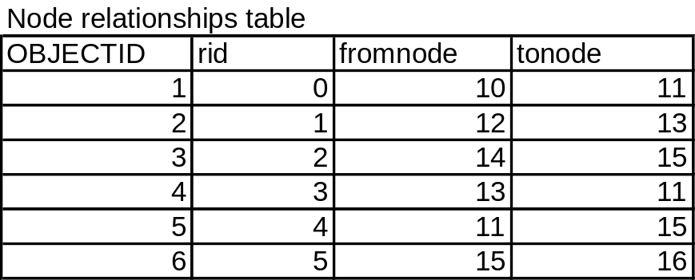
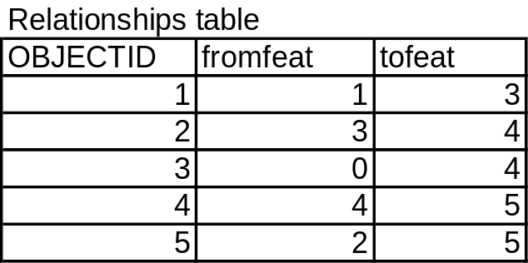
Landscape Network (LSN)
10
12
Node relationships table:
  Links nodes to their associated edges
  Based on the edge rid field and node point ID
  Maintains direction
0
1
13
3
11
14
4
2
15
5
16
point ID
rid
Relationship table:
  Links edges to one another in a downstream order
  Based on the edge rid

Slide 9
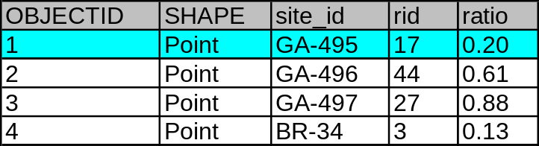
Landscape Network (LSN)
Incorporating sites into the LSN
Each site associated to an edge using dynamic segmentation
  Site moved to closest edge segment and rid assigned
  Distance ratio from end of an edge calculated and assigned
Allows point to point distances to be calculated along a network
  No need to alter or split edges
20m/100m = 0.2
100 m
20 m

Slide 10
Landscape Network (LSN)
Reach Catchment Areas (RCAs)
Non-overlapping, contiguous tessellation of RCAs
RCAs are networked up & downstream based on stream network topology
Conceptually similar to HUCs
  Represent hydrologic connectivity
  Finer set of analytical units
1 to 1 relationship
  Reaches are linked to the landscape
  For each RCA, attributes such as:
    Area
    Topography
    Land use, soils, geology, vegetation, etc.
Efficient method for calculating watershed attributes
  Flexible: can be used for multiple datasets

Slide 11
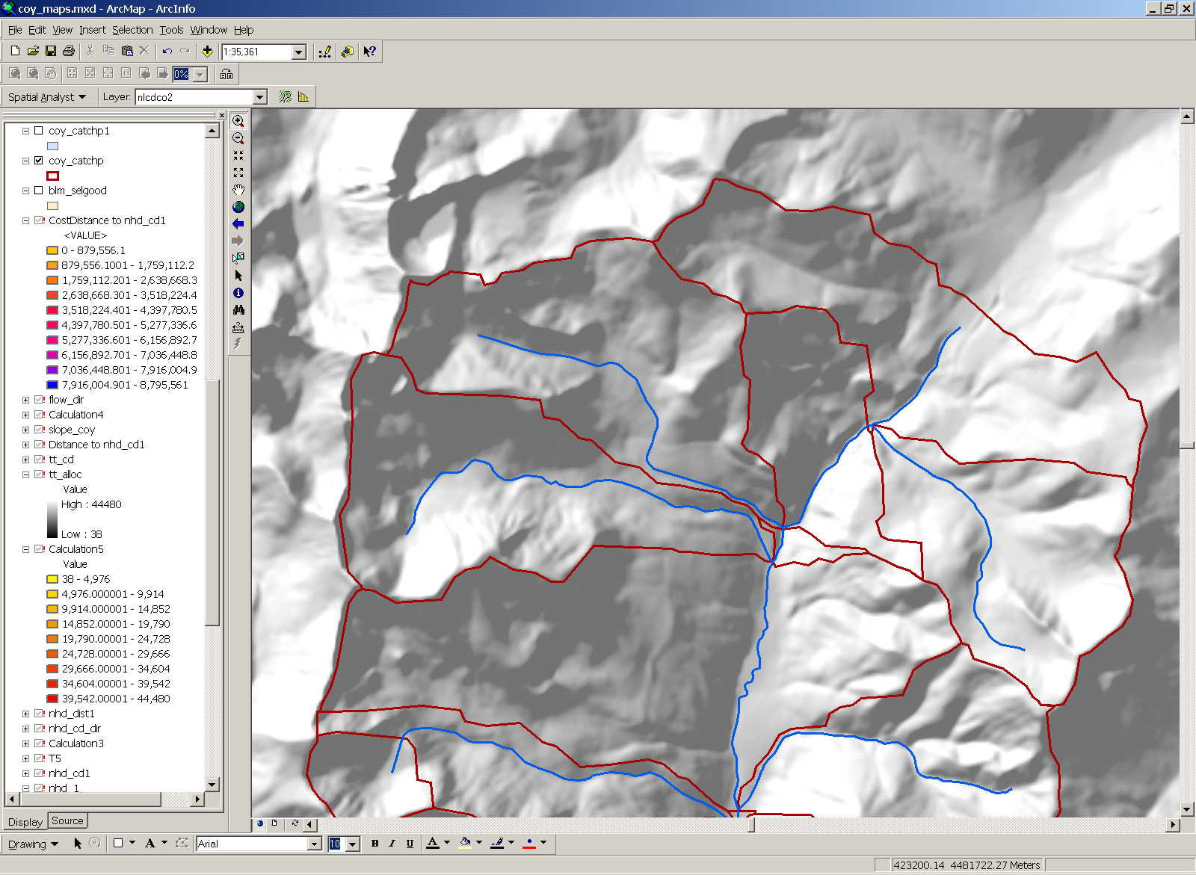
RCAs
Edges
RCA boundaries

Slide 12
Calculating Watershed Attributes From RCAs

Slide 13
Watershed attribute = Local RCA attribute +
Sum of upstream RCA attributes

Slide 14
Calculating Watershed Attributes From RCAs

Slide 15
Watershed attribute = Local RCA attribute +
Sum of upstream RCA attributes

Slide 16
Watershed attribute = % Local RCA attribute +
Sum of upstream RCA attributes

Slide 17
Watershed attribute = % Local RCA attribute +
Sum of upstream RCA attributes

Slide 18
Landscape Network (LSN)
RCAs
Watershed
Edges
Sites
RCA
RCAs
Sites
RCA
Nodes
Watershed
Edges
Edges

Slide 19
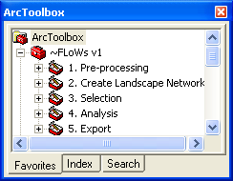

FLoWS Tools
The FLoWS toolbox consists of five toolsets
  Pre-processing
  Create Landscape Network
  Selection
  Analysis
  Export
Spatial Modeling in River Networks Tools
  Calculates the spatial weights matrix
  Calculates the hydrologic distance matrix
  Calculates watershed explanatory variables for sites

Slide 20
General Flowchart
FLoWS Tools
Pre-processing
Create LSN
Analysis
Spatial Modeling
In River Networks Tools
Calculate & Export Spatial Modeling Data

Slide 21
General Flowchart
FLoWS Toolsets
Pre-processing
Create LSN
Analysis
Spatial Modeling
In River Networks Tools
Export Data

Slide 22
Pre-processing Steps (1)
Check Digitized Direction & Create LSN
Manually
edit if necessary
streams
Visually inspect for errors in digitized direction
streams
Polyline to Landscape Network
Edges
Nodes
Reverse
Flow
(digitized)
Direction
Legend
shapefile
n x n
Matrix
raster
GP
Tool
table
LSN

Slide 23
Pre-processing Steps (2)
Legend
shapefile
n x n
Matrix
raster
GP
Tool
Check LSN for Topological Errors
table
LSN
Edges
Check
Network
Topology
Node
Errors
Nodes
Use node errors to ID
topology errors and
manually edit
streams
streams
This is an iterative process. The LSN MUST
be topologically corrected before continuing
streams
Topologically Correct LSN
Nodes
Edges
Edges
Polyline to Landscape Network
Nodes

Slide 24
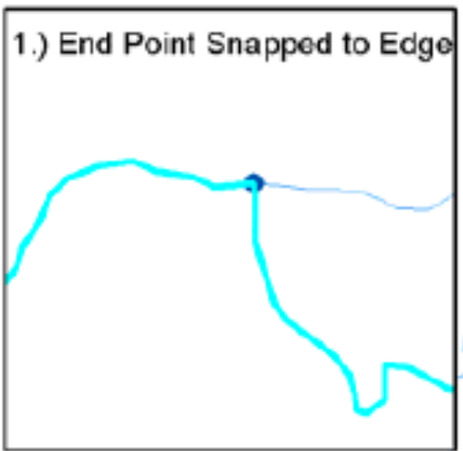
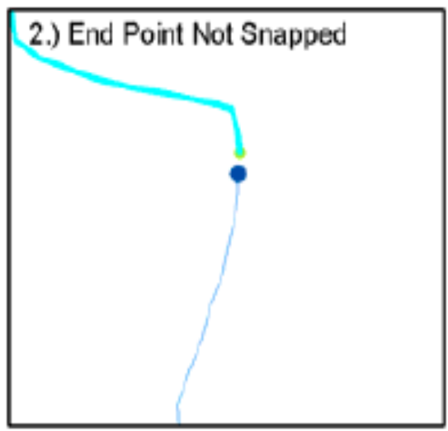
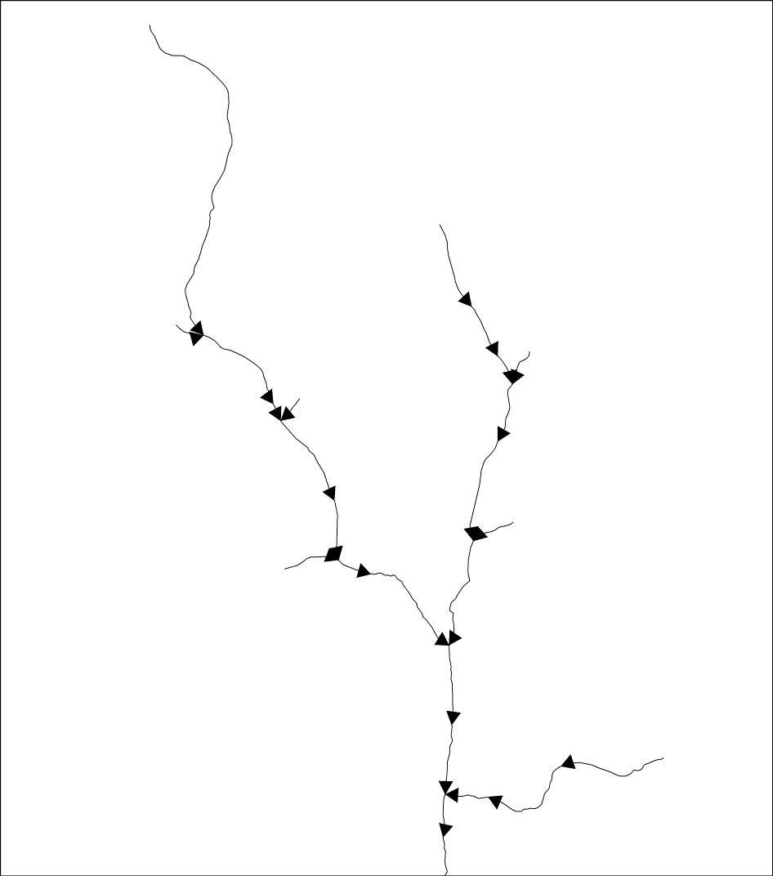
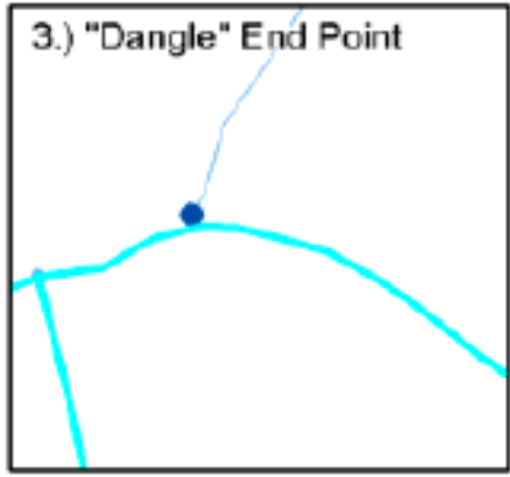
Network Errors
Repair Topological Errors
Check Digitized Direction

Slide 25
Pre-processing Steps (3)
Incorporate Sites into LSN
Edges
Nodes
Edges
Snap Points to LSN Edges
Sites
Sites
Nodes
Legend
shapefile
n x n
Matrix
raster
GP
Tool
table
LSN

Slide 26
Pre-processing Steps (4)
Create RCAs
DEM
Flowdir
Create
RCAs
RCAs
wbgrid
Edges
edgegrid
Sites
Nodes
Legend
shapefile
n x n
Matrix
raster
GP
Tool
table
LSN

Slide 27
General Flowchart
FLoWS Toolsets
Pre-processing
Create LSN
Analysis
Spatial Modeling
In River Networks Tools
Export Data

Slide 28
Analysis Steps (1)
Legend
shapefile
n x n
Matrix
raster
GP
Tool
table
LSN
Calculate RCA Attributes
RCA
Zonal
Statistics
Land Use
Join
Link RCAs with Reaches 1:1 Relationship
Edges
Add Field
Sites
Store RCA
Attributes in Edges Attribute Table
Nodes

Slide 29
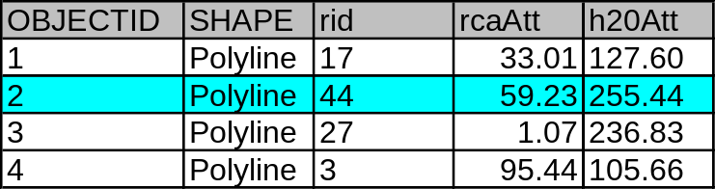
Analysis Steps (2)
Legend
shapefile
n x n
Matrix
raster
GP
Tool
table
LSN
Calculate Watershed Attributes
Edges
Add Field
Sites
Accumulate
Attributes
Downstream
Store Watershed
Attributes in Edges Attribute Table
Nodes
Accumulate
RCA Attributes

Slide 30
General Flowchart
FLoWS Toolsets
Pre-processing
Create LSN
Analysis
Spatial Modeling
In River Networks Tools
Export Data

Slide 31
Export Data (1)
Calculate Downstream Portion of Hydrologic Distance
Edges
Calculate
Downstream
Portion of
Instream Distance
hydrodist.txt
Sites
Nodes
Legend
Records downstream distance only
Contains information for:
Downstream, upstream, and total distance between sites
shapefile
n x n
Matrix
raster
GP
Tool
table
LSN

Slide 32
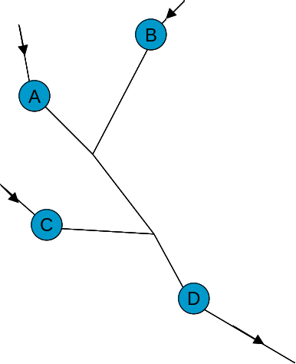
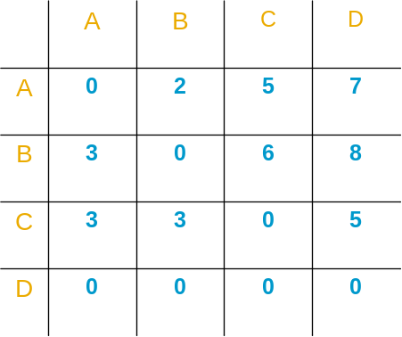
Downstream Portion of Instream Distance
Total distance A → B
=
Downstream A → B
+
Downstream B→ A = 5
Upstream distance A → B
=
Downstream distance B → A = 3
Downstream distance A → B = 2

Slide 33
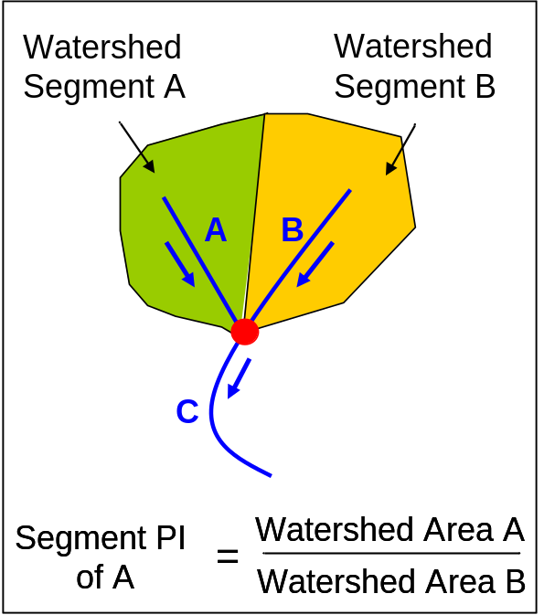
Export Data (2)
Legend
shapefile
n x n
Matrix
raster
GP
Tool
table
LSN
Calculate Segment Proportional Influence (PI) & Add to Edges Attribute Table
Edges
Sites
Nodes
Calculate
Segment
PI
Add Field
Store Segment PI in Edges Attribute Table

Slide 34
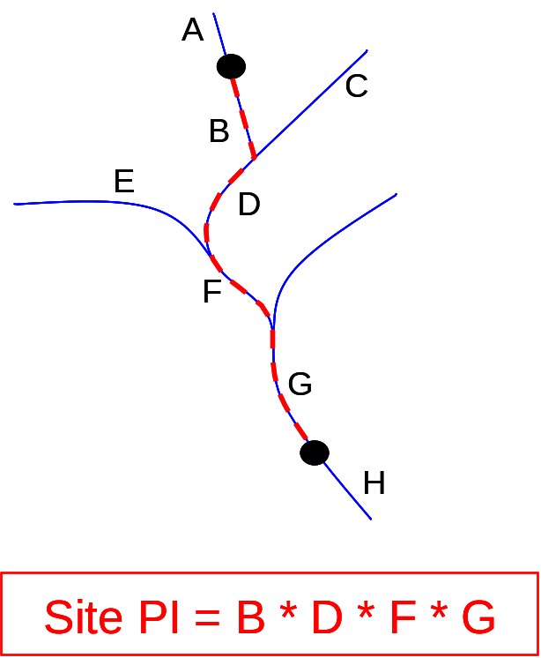
Export Data (3)
Legend
shapefile
n x n
Matrix
raster
GP
Tool
table
LSN
Calculate Spatial Weights Between Sites
Edges
Sites
Nodes
Calculate
Site
PI
pimatrix.txt

Slide 35
Export Data (3)
Get Watershed Attributes for Sites
Edges
Add Field
Get
Watershed
Attributes
Store Watershed
Attributes in Sites Attribute Table
Site
Data
Export Data
Table
Sites
Nodes
Legend
shapefile
n x n
Matrix
raster
GP
Tool
table
LSN

Slide 36
Spatial Data for Spatial Modeling
Observed values for each site
Explanatory variables for observed and predicted sites
Downstream portion of hydrologic distance between sites
Spatial Weights between sites
sitedata.csv
hydrodist.txt
pimatrix.txt

Slide 37


Thank you
Erin E. Peterson
CSIRO Mathematical and Information Sciences Division
Water Resources Modelling and Monitoring
Indooroopilly, Queensland, Australia 4068
Email: Erin.Peterson@csiro.au
Web: www.csiro.au

