Slide 1
Process and Pattern in Streams
Dr. Erin E. Peterson
CSIRO Mathematical and Information Sciences Division
Indooroopilly, Queensland, Australia
August 5, 2007

Slide 2
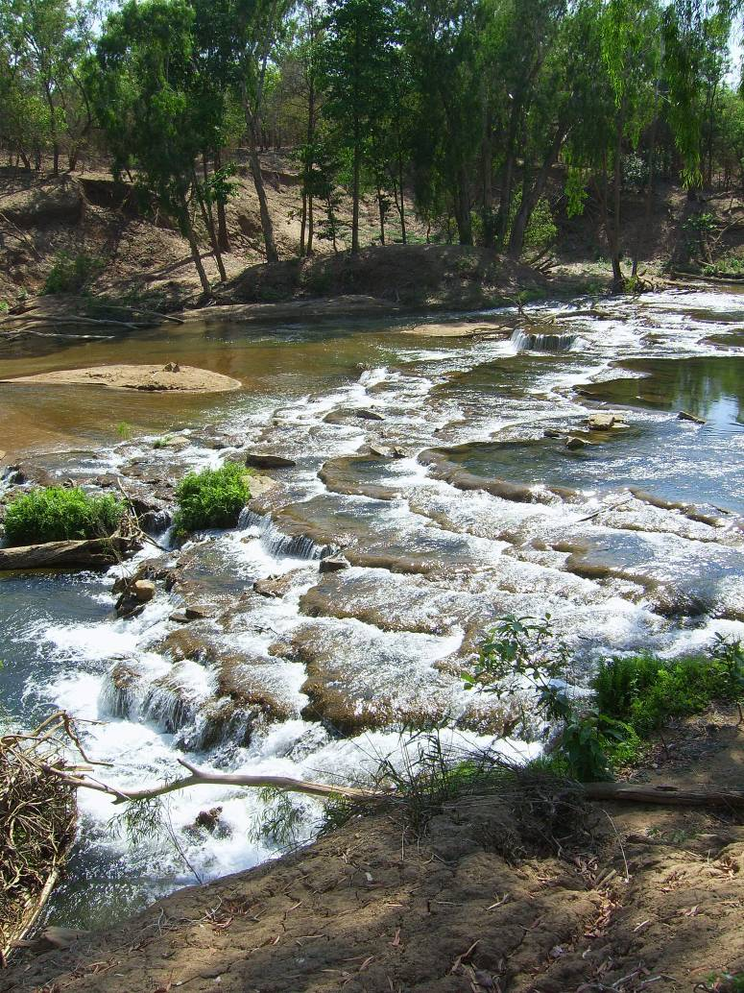
Overview
Stream processes
Multi-scale processes
Spatial characteristics
Conceptual frameworks
The big picture
Douglas River, Northern Territory, Australia. Photo courtesy of Mark Kennard.

Slide 3
Jargon
Stream condition
  Any variable that can be measured within a stream
    Biological: fish, benthic macroinvertebrates, algae
    Physical: substrate size, channel width, depth
    Chemical: pH, nitrate, heavy metals
Watershed condition
  Summarize the characteristics of a watershed
    Land-use, landcover, presence of mining activities, level of urban development, industrial point sources, etc.

Slide 4
Some relevant stream processes
Flow
  Inputs: gaining vs. losing
  Lateral, longitudinal, and vertical connectivity
  Velocity
Flood
  Frequency, duration, intensity, and timing
Transport of material
  Sediment, organisms, organic matter
Hydrologic

Slide 5
Some relevant stream processes
Hydrologic
Erosion versus deposition
Temperature
Light attenuation
Hydraulic geometry
  Width, depth, velocity, slope, roughness, and discharge
Sinuosity
Constrained versus unconstrained streams
Physical

Slide 6
Some relevant stream processes
Chemical
Hydrologic
Weathering of rock
  Major solutes
  Major ions
  Trace metals
Nutrient cycling
Dissolved O₂ & CO₂ balance
Ionic concentration
Salinization
Acidification
Physical

Slide 7
Some relevant stream processes
Chemical
Hydrologic
Primary production
Decomposition
Herbivory
Predator prey relationships
Competition for resources
Dispersal
Drift
Biological
Physical

Slide 8
Complex process interactions
Processes are not independent
Temperature example
  A large storm event occurs after a fire and sediment is transported from the watershed downstream
  Sediment deposits cause the stream to become wider & shallower, which raises the temperature of the water
  The amount of oxygen that can be dissolved in the water decreases with increased temperature
  Metabolic rates of organisms increase with temperature and DO demands also increase
Chemical
Hydrologic
Biological
Physical

Slide 9
Multi-scale Processes
Stream processes are scale-dependent
  Change with the grain or extent of the measurement
  Strength of relationships change at different scales
Influences the conclusions of the observer
“There is no single correct scale or level at which to describe a system…” (Levin, 1992)

Slide 10
Multi-scale Processes
Example: Arkansas Darter Population & Habitat Dynamics
Labbe & Fausch, 2000
Watershed
Predation by non-native northern pike
  Reduced distribution and abundance
  Isolated populations
Catastrophic floods 5-10yr interval altered habitat mosaic (pools) throughout network
Inter & intra-annual flow variation
  Connectivity, dispersal & reproduction
  Shaped the distribution & age composition of populations
Thermal regime of pool
Connectivity between habitat patches
Pool drying or freezing
Segment
Reach
Pool

Slide 11
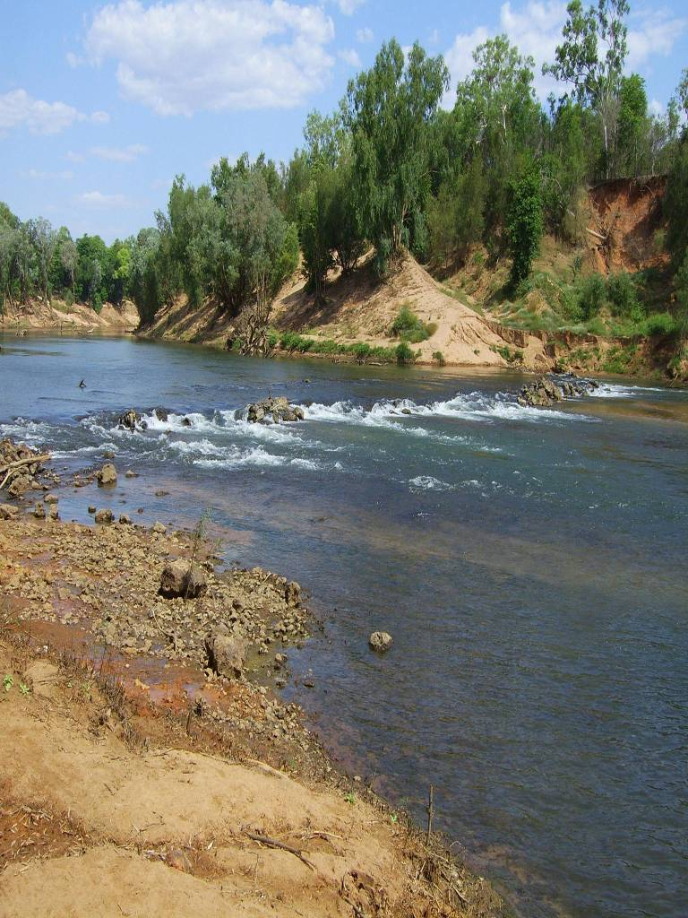
Spatial Characteristics of Stream Networks
Geographic location of the study area
The watershed boundary
Configuration of stream network
Connectivity within stream network
Flow direction and volume
Daly River, Northern Territory, Australia. Photo courtesy of Mark Kennard.

Slide 12
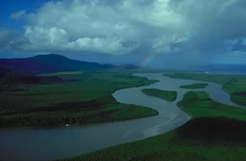
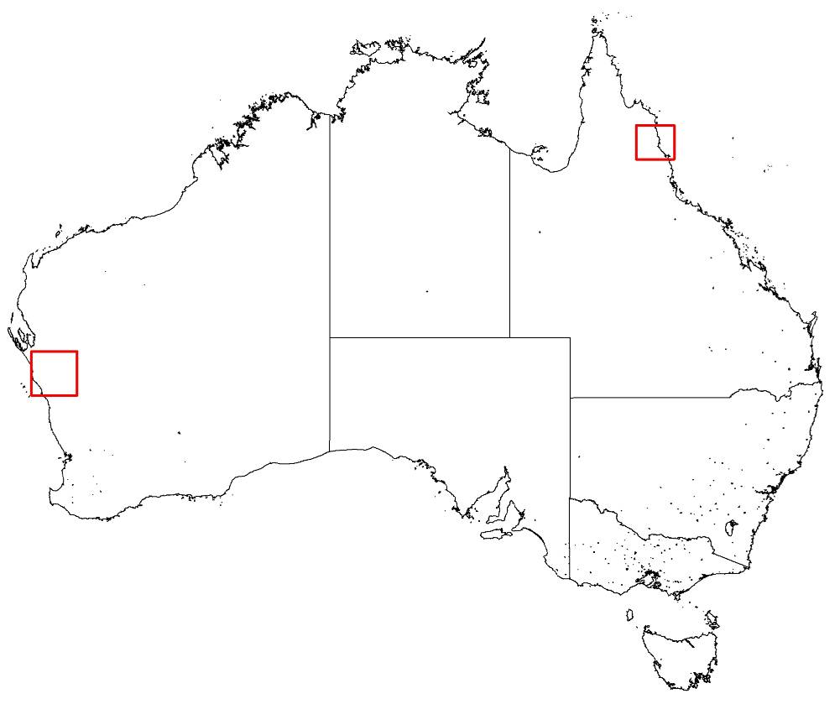
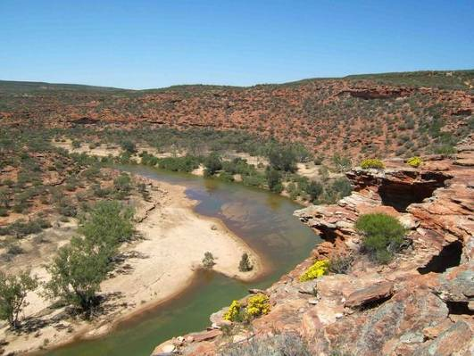
Spatial Characteristics of Stream Networks
Geographic location
Daintree River
Murchison River

Slide 13






Spatial Characteristics of Stream Networks
Watersheds have boundaries

Slide 14
Spatial Characteristics of Stream Networks
Network configuration and shape
Linear
Branched

Slide 15
Spatial Characteristics of Stream Networks
Network connectivity
Hydrologic connectivity
Nested watersheds

Slide 16
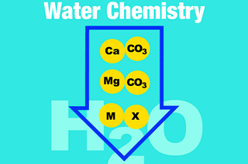
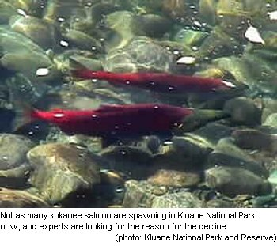
Spatial Characteristics of Stream Networks
Flow direction
Passive transport
Active transport

Slide 17
Spatial patterns in the environment
What are landscape patterns?
  Composition and spatial arrangement of the elements
    Species abundance
    Nutrient concentrations
    Intermittent versus perennial streams
  Represent heterogeneity or variability
Produced by
  Biotic and abiotic conditions
  Unique spatial characteristics of the stream
  Ecological processes: hydrologic, physical, chemical and biotic
  Past conditions
  Disturbance
Streams exhibit multiple patterns at multiple scales

Slide 18
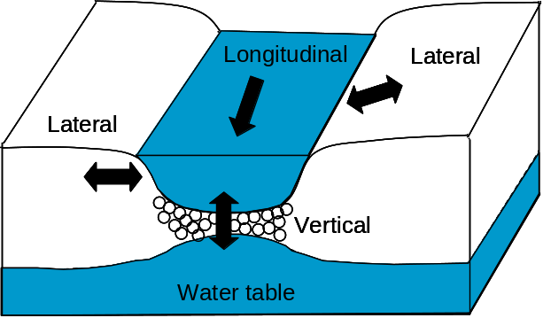
Conceptual Frameworks
Longitudinal, lateral, and vertical connectivity
  River Continuum Concept (RCC) (Vannote et al., 1980)
  Flood Pulse Concept
  (Junk et al., 1989; Tockner et al., 2000)
  Hyporheic Corridor Concept
  (Stanford and Ward, 1993)
Ward, 1989
Hierarchical Frameworks
  Hierarchical framework for stream habitat classification (Frissell et al.,1986)
  Hierarchical frameworks that include both terrestrial and aquatic filter scales (Poff, 1997; Richards et al., 1997; Fausch et al., 2002)
Disturbance
  Serial Discontinuity Concept (Ward and Stanford, 1983 & 1995)
  Network Dynamics Hypothesis (Benda et al., 2004)

Slide 19
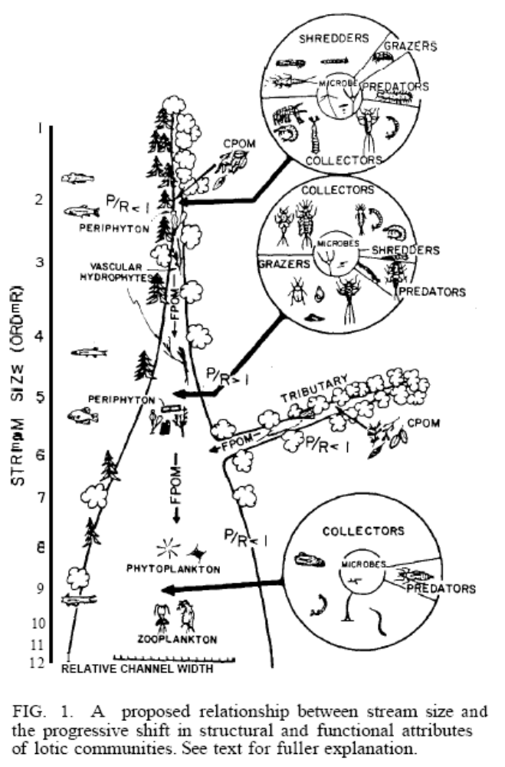
Conceptual Frameworks
River continuum concept (RCC)
Vannote et al., 1980
  Biotic communities & ecological processes change predictably downstream along a continuous gradient of physical conditions
Figure taken directly from Vannote et al., 1980.

Slide 20
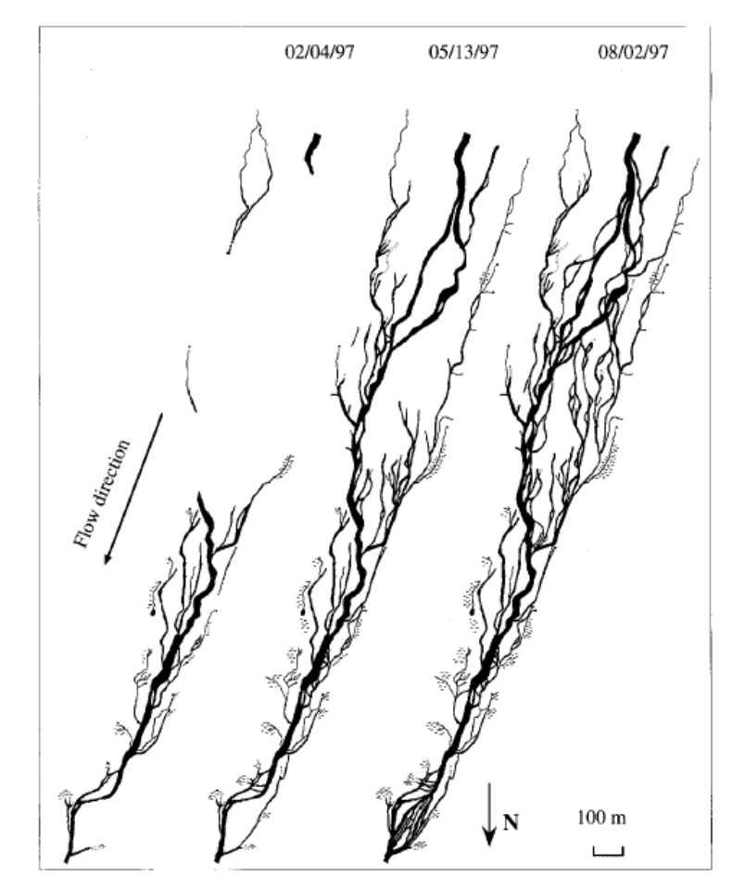
Conceptual Frameworks
The flood pulse concept
Junk et al., 1989; Tockner et al., 2000
  Flood pulses and flow pulses alter longitudinal & lateral connectivity
  Fluvial dynamics affect physical and biological heterogeneity
Figure taken directly from Tockner et al., 2000, which was modified from Malard et al., 1999.

Slide 21
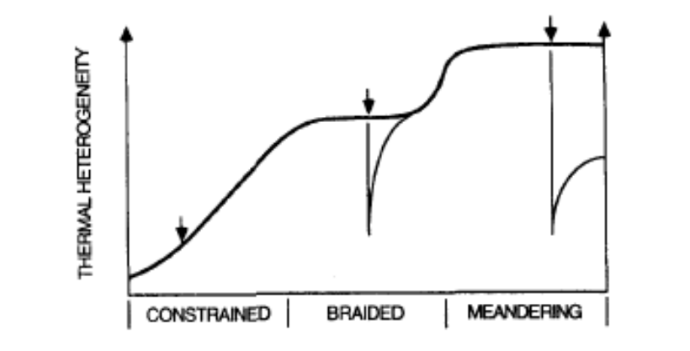
Conceptual Frameworks
The serial discontinuity concept
Ward and Stanford, 1995
  Similar to RCC
  Baseline condition based on longitudinal and lateral gradients
  Impoundments cause disruptions or discontinuities along the gradient
Dam
Dam
Dam
Figure taken and modified from Ward & Stanford, 1995.

Slide 22
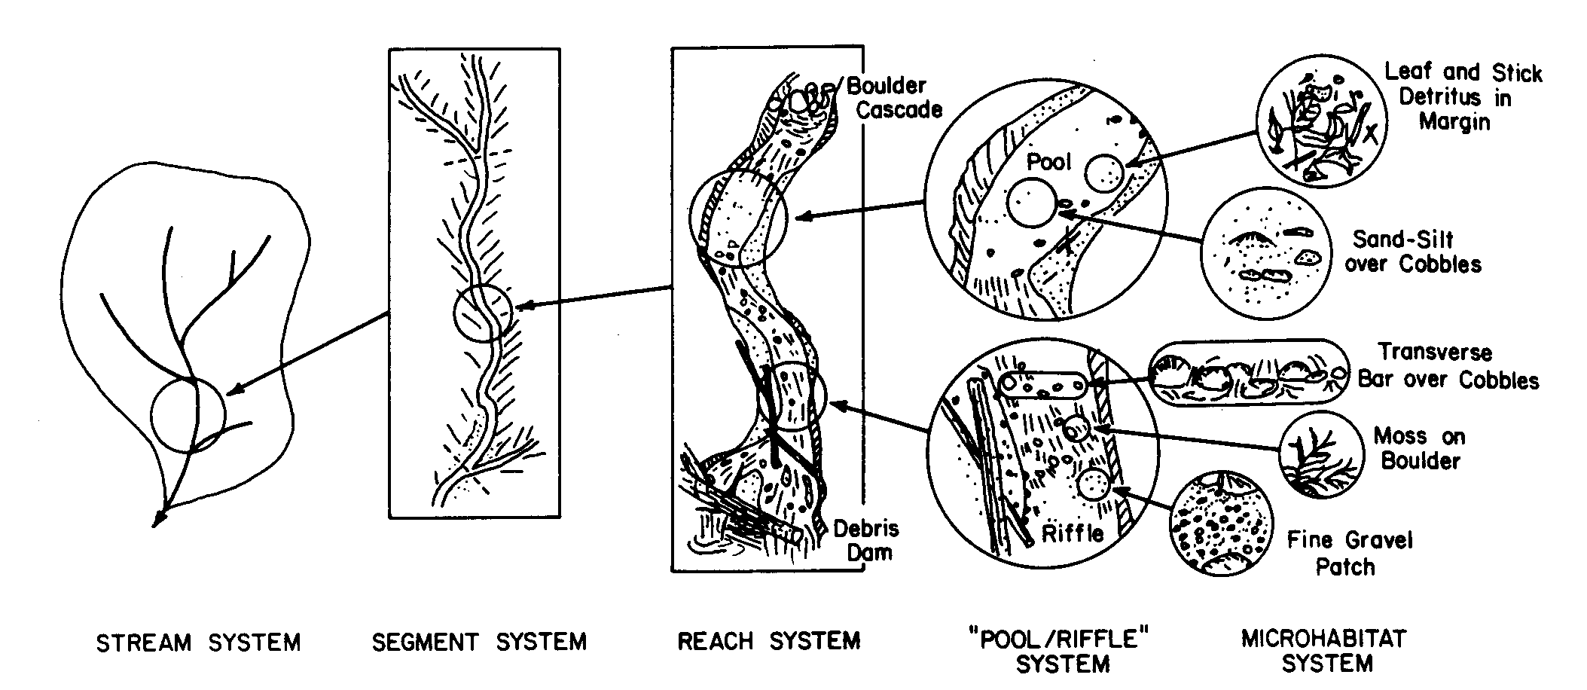
Conceptual Frameworks
Hierarchical stream habitat classification
  Physical classification (Frissell et al., 1986)
Figure taken directly from Frissell and others (1986).

Slide 23
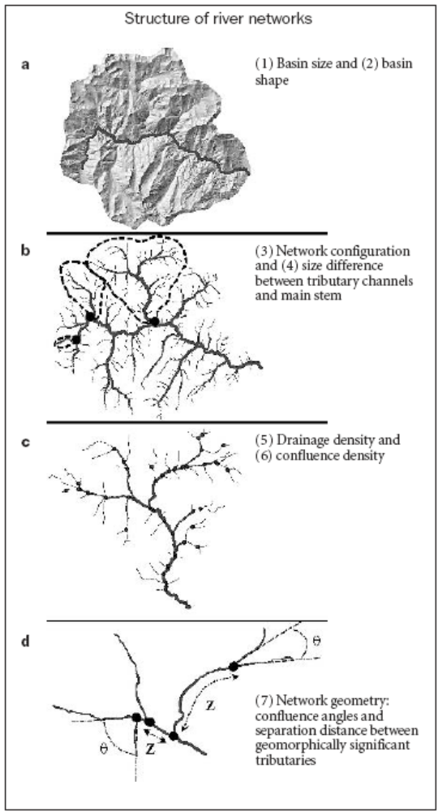
Conceptual Frameworks
Networks Dynamics Hypothesis
  Benda et al., 2004
  Physical template: spatial configuration of network
    Organizes transport & deposition of material through the watershed
    7 structural indexes of river networks
    Morphological heterogeneity at confluences controlled by size ratios of confluent tributaries
  Stochastic watershed processes
    Climatic events cause supply and transport to vary temporally
  Together influence spatio-temporal patterns of heterogeneity
Figure taken directly from Benda and others (2004).

Slide 24
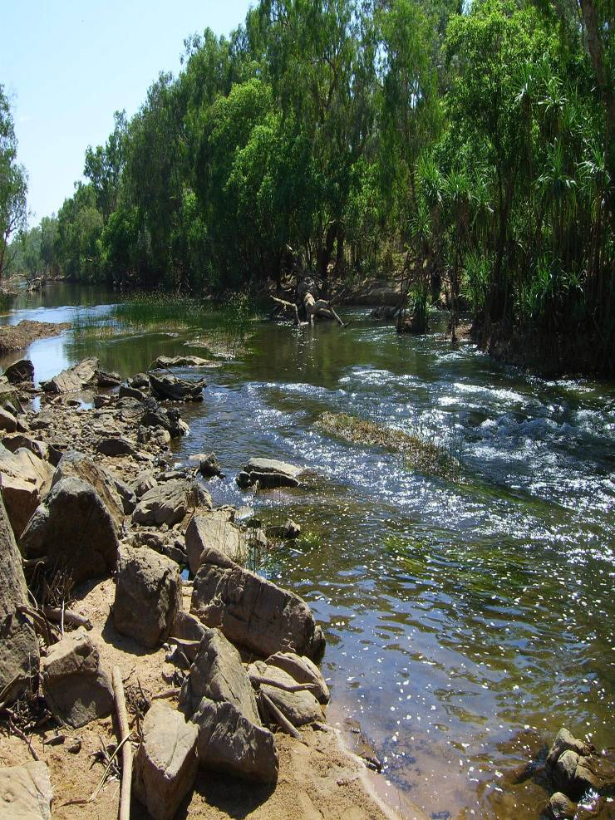
Limitations
Each conceptual framework explains some variability in streams
Complex interactions make it difficult to account for all variability
Can never mechanistically explain all of the variability associated with stream condition
Katherine River, Northern Territory, Australia. Photo courtesy of Mark Kennard.

Slide 25
How does all this relate to spatial models for river networks?
“Applied ecological research… generally seeks to predict ecological patterns, often for the purposes of resource management” (Poff, 1997)
The spatial models for stream networks were developed in an attempt to capture and statistically describe
  Multiple spatial patterns
  At multiple scales
  In order to make predictions with estimates of uncertainty

Slide 26
References
Benda, L., et al. (2004). "The Network Dynamics Hypothesis: How Channel Networks Structure Riverine Habitats." BioScience 54(5): 413-427.
Fausch, K. D., et al. (2002). "Landscapes to Riverscapes: Bridging the Gap between Research and Conservation of Stream Reaches." BioScience 52(6): 483-498.
Frissell, C. A., et al. (1986). "A Hierarchical Framework for Stream Habitat Classification: Viewing Streams in a Watershed Context." Environmental Management 10(2): 199-214.
Junk, W. J., et al. (1989). The flood pulse concept in river-floodplain systems. Proceedings of the International Large River Symposium. Canadian Special Publication of Fisheries and Aquatic Sciences. D. P. Dodge. 106: 110-127.
Labbe, T. R. and K. D. Fausch (2000). "Dynamics of intermittent stream habitat regulate persistence of a threatened fish at multiple scales." Ecological Applications 10(6): 1774-1791.
Levin, S. A. (1992). "The Problem of Pattern and Scale in Ecology." Ecology 73(6): 1943-1967.
Malard, F., et al. (1999). "Shifting dominance of subcatchment water sources and flow paths in a glacial floodplain, Val Roseg, Switzerland." Arctic, Antarctic, and Alpine Research 31(2): 16.
Poff, N. L. (1997). "Landscape filters and species traits: towards mechanistic understanding and prediction in stream ecology." Journal of the North American Benthological Society 16(2): 391-409.
Richards, C., et al. (1997). "Catchment and reach-scale properties as indicatiors of macroinvertebrate species traits." Freshwater Biology 37: 219-230.
Tockner, K., et al. (2000). "An extension of hte flood pulse concept." Hydrological Processes 14: 2861-2883.
Vannote, R. L., et al. (1980). "The River Continuum Concept." Canadian Journal of Fisheries and Aquatic Sciences 37: 130-137.
Ward, J. V. (1989). "The four-dimensional nature of lotic ecosystems." Journal of the North American Benthological Society 8(1): 2-8.
Ward, J. V. and J. A. Stanford (1983). The serial discontinuity concept of lotic ecosystems. Dynamics of Lotic Ecosystems. T. D. Fontaine and S. M. Bartell. Ann Arbor, MI, USA, Ann Arbor Science: 29-42.
Ward, J. V. and J. A. Stanford (1995). "The serial discontinuity concept: Extending the model to floodplain rivers." Regulated Rivers: Research and Management 10: 159-168.

Slide 27


Thank you
Dr. Erin Peterson
CSIRO Mathematical and Information Sciences Division
Indooroopilly, Queensland, Australia 4068
Email: Erin.Peterson@csiro.au
Web: www.csiro.au

