Slide 1
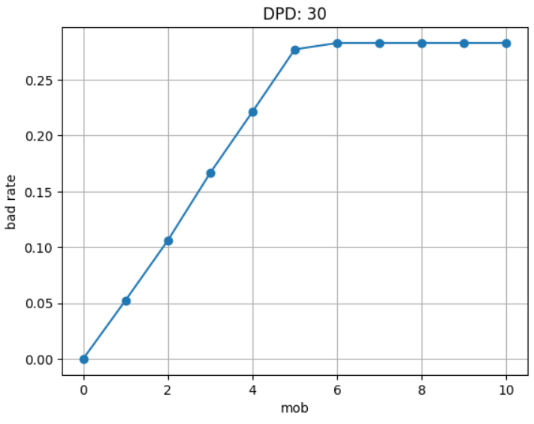
Justification for DPD30_4MOB:
Based on the bad rate analysis, the bad rate seems to taper off and plateau from MOB 5 onwards, suggesting that MOB 5 or 6 could be the most ideal choice for us to confidently model default.
However a long MOB period comes with several drawbacks:
Reduces the amount of data available for training due to more months required for labels to materialize
Similarly creates a larger “gap” between the first monitoring report and inference
Based on further EDA, MOB 5 in fact fully captures the entire population of customers who would eventually default. However we have chosen MOB 4 as this captures 97.03% of all customers who had any overdue_amt over the entire loan.
This more effectively balances the trade-off between label integrity and operational requirements
MOB Period | Capture Rate
5 | 100%
4 | 97.03%
3 | 82.18%

Slide 2
Accounting for time lag in labels:
feature_store and label_store nomenclature captures ‘snapshot_date’ based on the date when airflow executes the ETL, i.e. label_store/2023-04-01.parquet contains labels pertaining to loans with loan_start_date of 2023-01-01 due to the 30DPD_4MOB label definition
Loading logic during training designed to handle correct alignment
Model training pipeline skips retraining gracefully if insufficient data
feature_store date | Label_store date
2023-04-01 | 2023-08-01
2023-05-01 | 2023-09-01
… | …
2023-12-01 | 2024-04-01
Artefacts saved from model training:
model.pkl
metadata.json
cat_imputer.pkl
num_imputer.pkl
ohe_encoder.pkl
training_columns.json

Slide 3
Orchestration considerations:
Monthly re-training
Feature selection not part of the training pipeline because:
Stable schema required for monthly retain
Selected model (XGBoost) has embedded feature selection
Feature importance based on gain is extracted and saved as metadata
This drives the PSI monitoring subsequently
Component | Responsibility | Rationale
DAG (dag.py) | Controls whether model training happens (if there is sufficient data), picks best model for deployment | Keep orchestration logic separate from model training
model_train.py | Data loading, preprocessing, training, evaluation, and saving of model artefacts | Modular, reusable locally or as a task on Airflow
Config/ML_config.yaml | Defines the variables and preprocessing applied, metrics to compute, hyperparameter search space | Keeps preprocessing consistent across training and inference

Slide 4
Priority | Metric | Rationale
P0 | AUC | Measure of model’s ranking power (as business requires ranked list of probabilities)
P0 | Gini | Function of AUC but rescaled between 0 to 1, conventionally easier to interpret for business users
P1 | KS | Measure of model’s discriminatory ability
P2 | F1 | Harmonic mean of Precision and Recall. Optimizing for both Precision and Recall more equally
P3 | Precision | Optimizing for Precision minimizes false positives, identifying only more obvious defaulters, trading off default loss for more business
P3 | Recall | Optimizing for Recall means lowering threshold for “risk” to find as many real defaulters as possible to minimize direct loss trading off lost business
P4 | Accuracy | General gauge for model performance but often biased by class imbalance

Slide 5
Monitoring thresholds
Priority | Metric | Threshold | Actions if breached
P0 | AUC | 0.70 | Best candidate model (OOT_AUC) from auto-ML triggered for redeployment; DS team alerted to review
P0 | Gini | 0.50
P1 | KS | 0.4 | Two consecutive breaches triggers redeployment of best candidate models (OOT_AUC) from auto-ML; DS team alerted to review
P2 | F1 | No defined thresholds for monitoring | Metrics provided as supplementary information
P3 | Precision
P3 | Recall
P4 | Accuracy

Slide 6
Model Deployment
promote_best_model.py
On deployment date, the candidate model with the best OOT_AUC will be “promoted” as the deployed model to be used for inference
While candidate models will continue to be trained each month as long as there is sufficient data, no redeployment happens unless:
Monitoring report highlights that a breach was detected
Monitoring report (JSON) serves as handshake between monitoring pipeline and model deployment function
promote_best_model.py always searches for latest monitoring report and will trigger redeployment of best model within candidate models if a breach was detected

Slide 7
