Slide 1

Data Processing Pipelines
CS611 – Machine Learning Engineering
Assignment 1
Yue Jun Yuan

Slide 2




Proposed Pipeline – Medallion Architecture
Bronze:
Partitioned by month and saved as parquet
Raw data dump
No processing
Raw Data:
Ingested as .csv
Silver:
Partitioned by month and saved as parquet
Data Type enforcement
Data Quality Handling
Synthesize additional columns where relevant
Gold:
Separate feature and label store
Each store subdivided into train / val / test / OOT
Identifiers retained (to be dropped during ML pipeline)
Missing value handling and encoding rules derived from train and applied to other splits
Single python script orchestrates entire preprocessing pipeline
Logic transforming from each stage captured in individual python scripts
Configuration and parameter details managed on separate YAML files
Pipeline fully containerized to ensure reproducibility and facilitate production deployment
Logs are created with each run to detail results of data validation and dataset shape details

Slide 3


Overall Pipelining Considerations
Storing Configuration / Parameters in YAML
Separation of concerns – separation of core pipeline logic from config and parameters
Update of parameters follows different (simpler) approval process as compared to code change
Cleaner and easier to read code logic
Scalability – different YAML files can be used for development / production
Easy switching of file paths, or API end points without modifying code
Version control – changes to parameters can be archived and versioned
Avoids multiple versions of scripts or commented code
User friendly – allows non-programmers to easily understand and edit
Business users or new project members can easily make simple changes
Reduced hardcoding which results in more maintainable and less error-prone codes
Pipeline logging system
Pipeline logging captures script execution, completions and errors in dedicated log files
New time-stamped log file created with each run of pipeline, enabling traceability and easier debugging

Slide 4
Silver Tables Processing
Silver Tables Processing Steps:
Handle Data Quality issues (detailed missing and invalid handling available in following slides – treatment to be agreed with business)
Create or transform additional columns to improve data usability
Create integer based “Credit_History_Age_Months” by transforming text description in “Credit_History_Age”
Create “Type_of_Loan_list” of Array(String) type by parsing “Type_of_Loan”
Full list available in following slides
Data type enforcement – full list of variables with expected data types defined in silver_config.yaml and enforced during processing
Parquet format preserves data type through defined schema
Objective:
Silver tables (separate for each dataset) is processed only minimally to allow for general view and analytics consumption. Use case specific transformation are done in gold layer.

Slide 5
Silver Tables Processing – Data Quality Handling
Dataset | Data Quality Issue | Handling
features_attributes.csv | “SSN” contain values “#F%$D@*&8” not following convention | Replace with np.nan
features_attributes.csv | “Occupation” column contain invalid “_______” values | Replace with np.nan
features_attributes.csv | “Age” containing numeric values suffixed with ‘_’ “Age” column contains large invalid values “Age” column containing negative values | Remove ‘_’ suffix Age<0 or Age>120 replace with np.nan; set “Age_valid’ binary flag to 0 else 1
features_financials.csv | “Annual_Income” containing numeric values suffixed with ‘_’ “Annual_Income” contain inconsistent rounding | Remove ‘_’ suffix Standardize rounding to 2d.p.
features_financials.csv | “Num_Bank_Accounts” containing invalid negative values “Num_Bank_Accounts” containing large invalid values | Replace with np.nan Cap values at 11*
features_financials.csv | “Num_Credit_Card” containing invalid large values | Cap values at 11*
features_financials.csv | “Interest_Rate” containing invalid large values | Cap values at 34*
features_financials.csv | “Type_of_Loan” contains multiple categorical values, including “Not Specified”, and missing values | Create “Type_of_Loan_list” as array of string representation
features_financials.csv | “Num_of_Loan” contain invalid numeric values suffixed with ‘_’ “Num_of_Loan” contain negative values “Num_of_Loan” contain invalid large values | Derive values for “Num_of_Loan” using “Type_of_Loan_list”
* Invalid values handling derived based on data exploration, business to confirm correct maximum values

Slide 6
Silver Tables Processing – Data Quality Handling
Dataset | Data Quality Issue | Handling
features_financials.csv | “Num_of_Delayed_Payment” contain numeric suffixed with ‘_’ “Num_of_Delayed_Payment” contain invalid large values “Num_of_Delayed_Payment” contain negative values | Remove ‘_’ suffix Cap values at 28* No handling business to advice
features_financials.csv | “Changed_Credit_Limit” contain invalid values ‘_’ “Changed_Credit_Limit” contain inconsistent rounding “Changed_Credit_Limit” contain negative values | Replace with np.nan Standardize rounding to 2d.p. No handling business to advice
features_financials.csv | “Outstanding_Debt” containing numeric values suffixed with ‘_’ | Remove ‘_’ suffix
features_financials.csv | “Credit_History_Age” in format of “X Years and Y Months” | Convert to int no. of months
features_financials.csv | “Payment_of_Min_Amount” contains {Yes, No, NM} | Business to advice ‘NM’ validity
features_financials.csv | “Amount_invested_monthly” containing invalid ‘__10000__’ values | Remove both prefix and suffix
features_financials.csv | “Payment_Behaviour” containing invalid ‘!@9#%8’ values | Replace with np.nan
features_financials.csv | “Monthly_Balance” contain invalid ‘__-333333333333333333333333333__’ value | Replace with np.nan
features_financials.csv | “Delay_from_due_date” contains negative values | No handling business to advice
features_financials.csv | “Credit_Mix” contain invalid “_” values | Replace with np.nan
* Invalid values handling derived based on data exploration, business to confirm correct maximum values

Slide 7
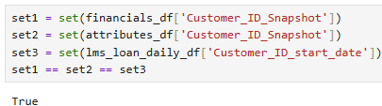
Gold Tables Processing – Pipelining Considerations
The set of concatenated values (Customer_ID + snapshot_date) is equivalent between feature_financials and features_attributes and also equivalent with (Customer_ID + loan_start_date) on lms_loan_daily
Align feature store (financials / attributes) to label store (lms_loan_daily) using above join keys
Clickstream data is missing 3,526 (approximately 28% of) customers
Option 1: Drop records from feature and label stores where Customer_ID are not found in the set of Customer_ID in clickstream data
Impact: Lose more than 1 quarter of dataset, significant reduction in training data impact model ability to generalize ✖
Option 2: Attempt to extrapolate clickstream data for missing customers
Impact: Introduce noise and bias, limited information on nature of features (fe1-fe20) preventing accurate extrapolation ✖
Option 3: Assume clickstream data to reflect some form of digital activity (to verify with business) – therefore lack of data reflects absence of digital activity → impute 0
Impact: Absence of activity is a valid parameter for model learning, avoid injecting false assumptions, simple to implement ✓
Backward looking aggregation of temporal data (features_clickstream) results in misalignment of datapoints available – lack of datapoints to compute LM / L3M aggregates for loans incepted in earlier months of dataset (2023-01-01to 2023-03-01)
Option 1: Introduce “months_available” flag while truncating aggregated data for loans incepted on or before 2023-03-01
Impact: Retains full dataset but may introduces more complexities than value, model may require even more datapoints to learn nuanced differences between how such a flag interacts differently with SUM and AVG aggregates ✖
Option 2: Drop records pertaining to loans incepted on or before 2023-03-01
Impact: Lose 1,537 (12.3%) of customers available, prevents increase of feature space, more practical approach considering ‘missing’ datapoints are more likely due to data sourcing limitations rather than data quality issues ✓

Slide 8
Gold Tables Processing
Gold Tables Processing Steps:
Filter away loans on or before 2023-03-1 (prevent truncation of aggregated features)
Create Label Store – Label definition: default_flag=1 if customer has any overdue_amt > 0 over the life of the loan
No label leakage as every Customer_ID only has 1 loan, and any overdue_amt relates to future outcome relative to loan_start_date
Create aggregated features (AVG_L3M / SUM_L3M / LM) from temporal clickstream data
Aggregation done for each customer using snapshot_date immediately before loan_start_date.
Create Feature Store – “Customer_ID” and “loan_start_date” from Label store used as anchor keys
Left join static features (attributes and financials) followed by aggregated clickstream features
Ensures no data leakage – static features joined on static_feats.snapshot_date, temporal features joined on click_aggs.loan_start_date (already aggregated per logic above)
Perform date-based splits on both feature and label stores using – gold_config.yaml defines split windows
Model specific handling – apply missing value treatment and encoding based on train set data or gold_config.yaml
Details on encoding strategy and missing value handling can be found in following slides
Objective:
Gold tables are split into Feature and Label Stores, each store further split into train / val / test / OOT sets. Gold layer built to be ML ready (identifiers to be dropped during ML pipeline) and designed based on requirements for a tree based model – (no scaling applied). Encoding format is designed to be compatible with most scikit-learn models rather than SparkML models.
Loan_start_date | LM | L3M
2025-01-01 | 2024-12-01 | 2024-10-01 to 2024-12-01

Slide 9
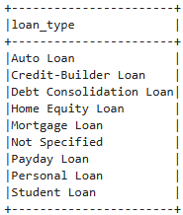
Gold Tables Processing – Pipelining Considerations
Encoding Decisioning
Create and maintain a gold_config.yaml file for features which are expected to contain only business approved values
Processing pipeline verifies that columns like “Types_of_Loan” contain only approved list of values
Adopt lenient policy – log warning and ignore unapproved values
Ensures stability of gold table schema (after multi-hot-encoding)
Early detection of data drift or data quality issues if unexpected values appear
Multi-hot encoding relies on expected set of values from gold_config.yaml to apply encoding to all splits (train / validation / test / OOT)
Encoding pipeline for other categorical variables fits only on train dataset and transforms other splits (test / validation / OOT) using the train fitted pipeline
Guarantees no data leakage from unseen datasets into training
All splits result in the same number of columns

Slide 10
Gold Tables Processing – ML specific handling
Feature | Data Type | Missing - Reason | Fill / Impute Strategy | Missing Frequency
 |  |  |  | Number | (%)
Age | Integer | Unrealistic values (negative or values above reasonable cap 120) replaced with NaN on silver tables | Median | 104 | 0.83%
Occupation | String | “______” values were replace with NaN on silver tables | “Unknown” Flag | 880 | 7.04%
Num_Bank_Accounts | Integer | Negative values treated as invalid and replace with NaN on silver tables | Median | 4 | 0.03%
Type_of_Loan_list | Array( String) | Missing values indicate no loans (Num_of_Loans == 0) | “No_Loan” flag | 1,426 | 11.41%
Changed_Credit_Limit | Float | Invalid “_” values were replaced with NaN on silver tables | Impute 0 | 254 | 2.03%
Credit_Mix | String | Invalid “_” values were replaced with NaN on silver tables | “Unknown” flag | 2,611 | 20.89%
Payment_Behvaiour | String | Invalid ‘!@9#%8’ values were replaced with NaN on silver tables | “Unknown” flag | 998 | 7.98%
Monthly_Balance | Float | Invalid ‘__-333333333333333333333333333__’ values were replaced with NaN on silver tables | Impute 0 | 1 | 0.01%
fe_1 – fe_20 | Float | Absence of digital activity / profile – to confirm with business | Impute 0 | 3,526 | 28.21%
Split | Period | Duration | Purpose
Train | 2023-04 → 2024-06 | 15 months | Used to fit models and transformations (StringIndexer, OneHotEncoder, etc.)
Validation | 2024-07 → 2024-09 | 3 months | Used for hyperparameter tuning / early stopping
Test | 2024-10 → 2024-12 | 3 months | Final performance evaluation before deployment
OOT (Out of Time) | 2025-01 | 1 month | Simulates unseen future data for production generalization check

Slide 11
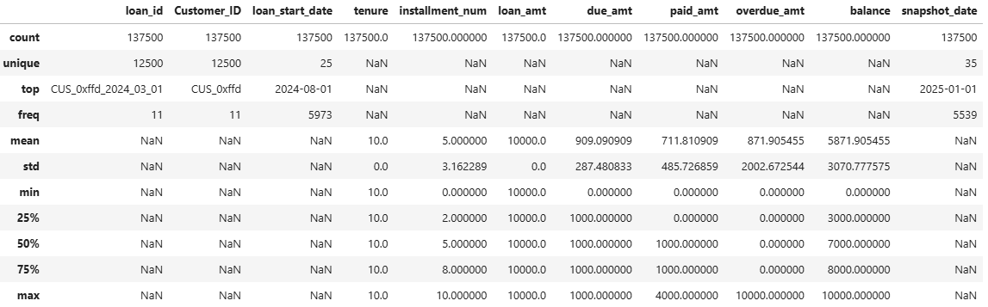
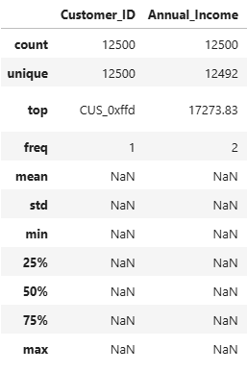
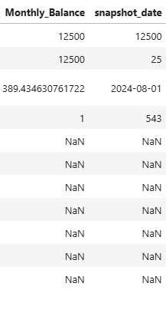
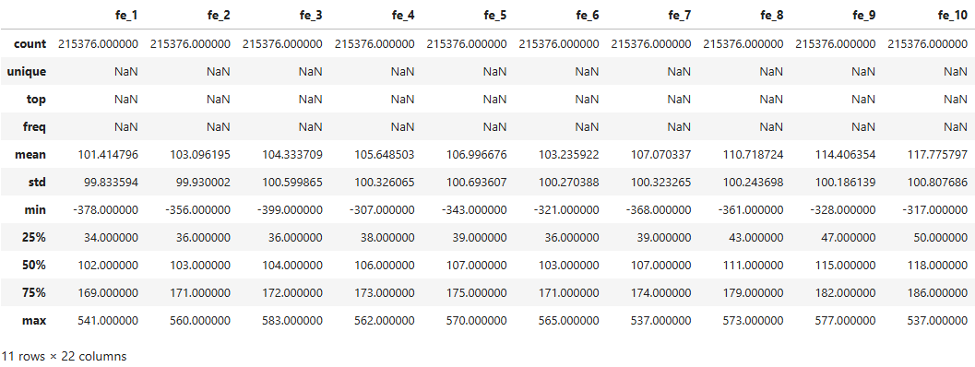
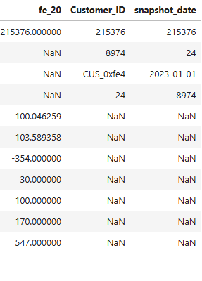
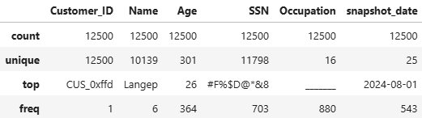
Gold Tables Processing – Feature & Label Stores
Descriptive statistics displayed are based on exploration of raw data and not reflective of final label and feature stores
Label Store
Feature Store
features_financials
features_clickstream
lms_loan_daily
Static financial profile information, snapshot dates range between 2023-01-01 to 2025-01-01 aligns with features_attributes and lms_loan_daily
Temporal customer attributes varies with each snapshot, snapshot dates range between 2023-01-01 to 2024-12-01.
Temporal features are to be aggregated relative to the loan_start_date.
i.e. AVG_fe1_L3M / fe1_LM, etc
Snapshot date aligns with other feature and label datasets post aggregation.
Loan Schedule – each record representing either i) Loan inception or ii) 1 of 10 loan repayment checkpoints.
loan_id is a concatenation of Customer_ID and loan_start_date, therefore each customer only has one loan.
Range of loan_start_dates between 2023-01-01 to 2025-01-01 aligns with snapshot_dates in features_financials and features_attributes (static data).
Temporal data (features_clickstream) relating to time periods immediately before loan_start_date to be aggregated
features_attributes
Static demographic profile information, snapshot dates range between 2023-01-01 to 2025-01-01 aligns with features_financials and lms_loan_daily

Slide 12

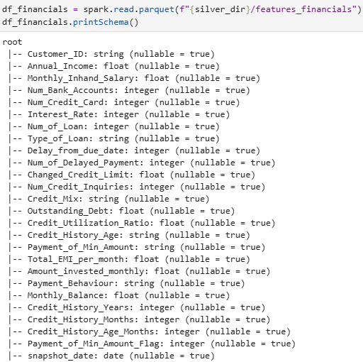
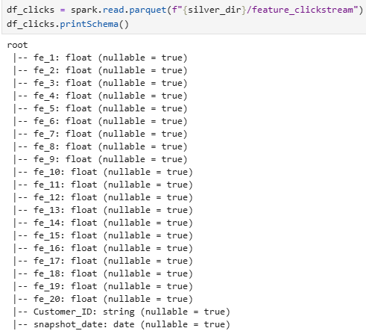
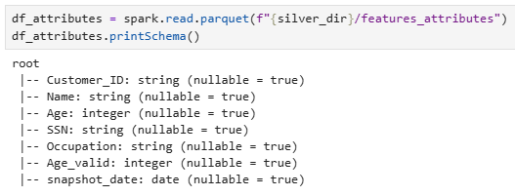
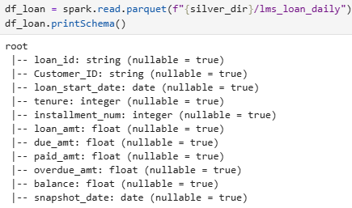
Silver Tables Processing – Data Type Enforcement
Post data quality handling, data type for each and every column is enforced before saving to parquet format
reason

