Slide 1

Building an end-to-end ML pipeline
Yue Jun Yuan

Slide 2





End-to-end Model Lifecycle
Process Gold Tables
Temporal aggregation of clickstream data
Label design and definition
Build feature and label store
Process Bronze Tables
Ingest raw csv monthly
Saved as parquet
Partitioned by month
Airflow Scheduler
Orchestrates all tasks
Docker Containerization
Controlled and reproducible environment
Process Silver Tables
Cleaning and augmenting data
Data type enforcement
Suitable for general use
Monitoring Report
Monitors performance metrics for deployed model and candidate models
Monitors PSI / CSI for key variables
Stored in gold tables
Model Training
Automatic monthly retraining
Model Store
Candidate Models
  Registry of candidate models
  Maintained as .pkl and metadata.json
Deployed Model
  Best model on deployment date
  Triger based automatic redeployment
Model Registry
Model Inference
Generates prediction using deployed model
Stored in gold tables
Breach of thresholds triggers redeployment

Slide 3
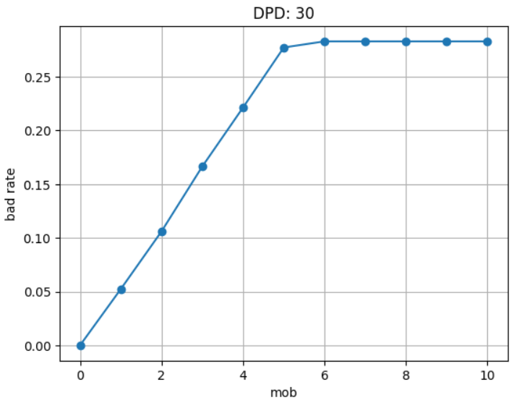
Main ETL Considerations
Data Quality handling and data type enforcement handled on Silver layer → Fit for general analytics use
Temporal aggregation of clickstream data (AVG / SUM L3M, LM)
  Implication: No gold layer (feature / label stores) generated for first two months
Multi-hot encode “Type of Loan” variable – gold_config.yaml defines list of expected values
  Implication: Ensures consistent schema enforced across splits
Label Definition Considerations
  Observation: Bad rate tapers off on the 5th – 6th month → 30DPD_6MOB ✘
  Implication: More months required for labels to materialize – reduced amount of data available for training, creates long gap between inference and monitoring
  Observation: 97.03% of customers having any overdue amount over the loan tenor has an overdue amount within first 4 months → 30DPD_4MOB ✔
  Implication: Increasing from 4 MOB to 5 MOB yields very marginal improvement in capture rate. 4 MOB balances trade-off between operational requirements (timely monitoring) and label integrity
MOB Period | Capture Rate
5 | 100%
4 | 97.03%
3 | 82.18%
5. Feature and Label store nomenclature captures “snapshot_date” based on when airflow executes the ETL
Lag month = 4 logic applied when aligning for training / monitoring
feature_store date | label_store date
2023-04-01 | 2023-08-01
2023-05-01 | 2023-09-01
… | …
2023-12-01 | 2024-04-01

Slide 5
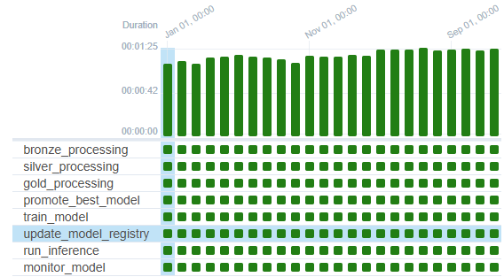
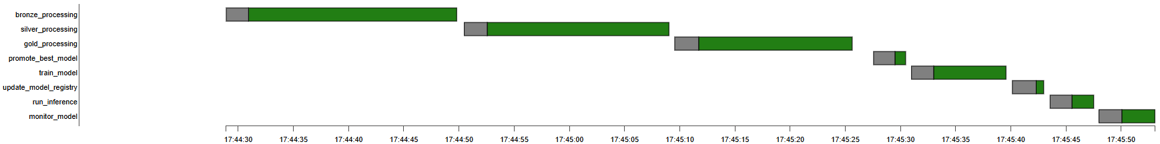

Slide 6
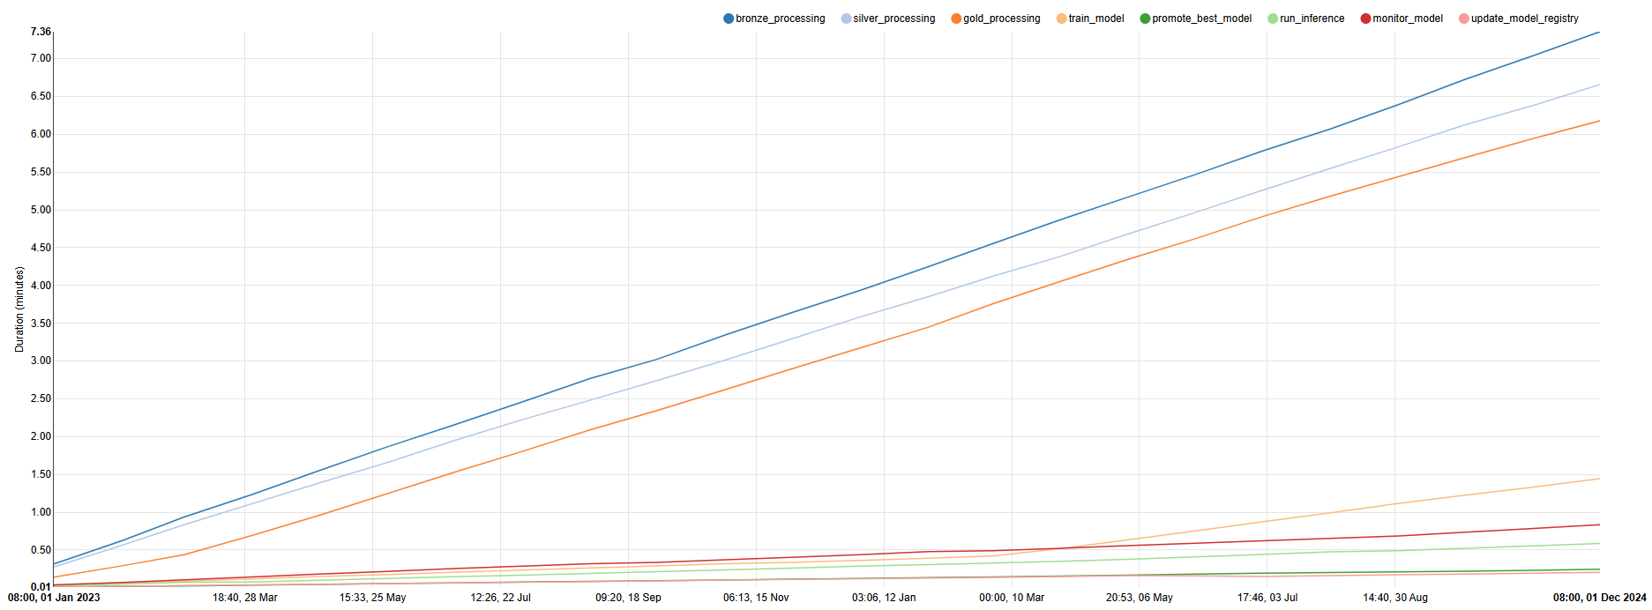

Slide 7
Use our editable graphic resources...
You can easily resize these resources without losing quality. To change the color, just ungroup the resource and click on the object you want to change. Then, click on the paint bucket and select the color you want. Group the resource again when you’re done. You can also look for more infographics on Slidesgo.

Slide 10
JANUARY
FEBRUARY
MARCH
APRIL
MAY
JUNE
PHASE 1
Task 1
Task 2
PHASE 2
Task 1
Task 2
JANUARY
FEBRUARY
MARCH
APRIL
PHASE 1
Task 1
Task 2

Slide 13
...and our sets of editable icons
You can resize these icons without losing quality.
You can change the stroke and fill color; just select the icon and click on the paint bucket/pen.
In Google Slides, you can also use Flaticon’s extension, allowing you to customize and add even more icons.

Slide 14
Educational Icons
Medical Icons

Slide 15
Business Icons
Teamwork Icons

Slide 16
Help & Support Icons
Avatar Icons

Slide 17
Creative Process Icons
Performing Arts Icons

Slide 18
Nature Icons

Slide 19
SEO & Marketing Icons

