Slide 1
Holiday_events:
Aggregated count of one hot vectors for ‘type’ and ‘locale’, drop ‘locale_name’ and ‘description’ due to sparsity – may introduce too much noise / unstable
Features capturing the holidays happening in the month before prediction (in snapshot_date)
num_of_holiday_<type>, num_of_holiday_<locale>
Features capturing the holidays happening on the month of prediction (future from snapshot_date)
num_of_holiday_<type>_NM, num_of_holiday_<locale>_NM
how do we achieve this? Problem: if holidays_events.csv is consumed as part of ETL process running in sequence monthly, when building feature store on gold layer, we would not have access to the future dated holidays.
Solution: Separate ingestion of holidays_events.csv as a single run task at the start of the DAG – build holiday_events dataset as reference tables
Same store_nbr can have multiple transactions when grouped by month. i.e. (number of) “transactions” per store_nbr follows a daily granularity → aggregate by sum per month on gold layer
Same treatment for ‘sales’

Slide 2
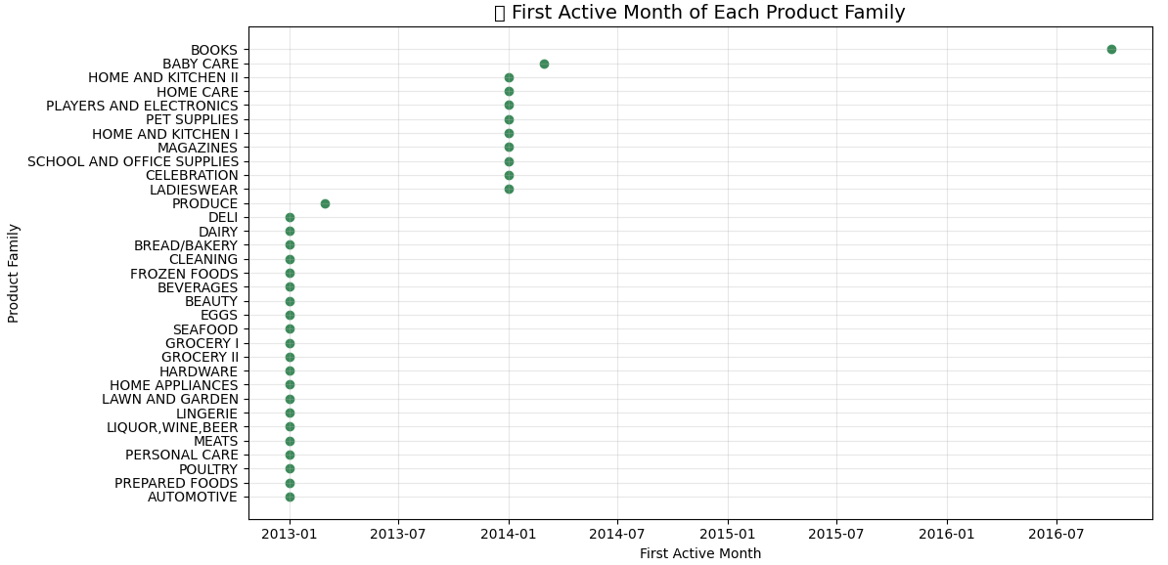
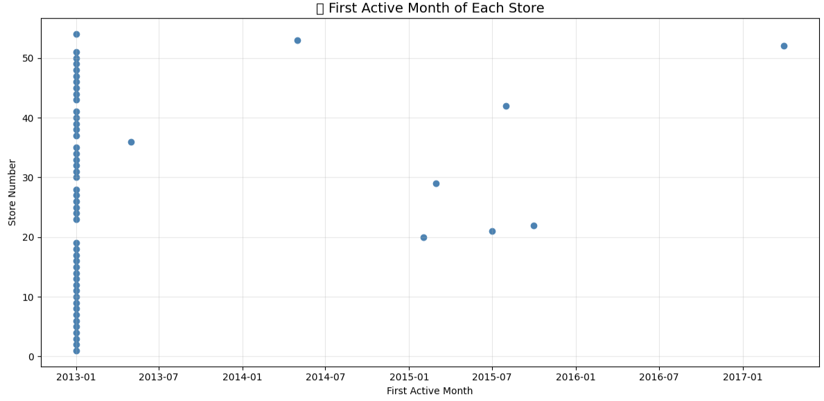
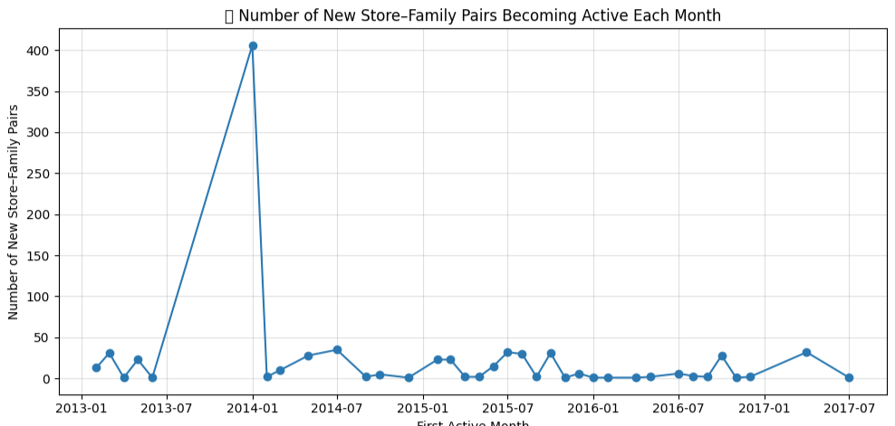
There are three kinds of sparsity:
Store-level sparsity: (store opening lag) Entire store_nbr doesn’t exist before some date (brand-new store opening).
Family-level sparsity: (product introduction lag) entire product family did not exist until later (e.g. “Books” only begins 2016-10-01).
Store × Family sparsity: (Product roll-out lag) both store and product family exist, but certain stores only started selling the product at some future date.
When running prediction → model receives feature vectors that it’s never seen
However, since we are using a single global model (with store_nbr and family as features rather than identifiers), the model can still rely on global learned patterns (i.e. oil prices, holidays, macro trends etc) → while predictions will be less reliable due to missing key contextual history, it will not be completely off

Slide 3
Reference tables built at the start of the DAG:
datamart/silver_reference/holiday_features.parquet
Used for feature engineering for feature store
datamart/silver_reference/store_start_dates.parquet
datamart/silver_reference/family_start_dates.parquet
datamart/silver_reference/store_family_start_dates.parquet
Used during monitoring (flag cold start predictions) / provide explainability for underperformance

