Slide 1

C# Workshops – Step03
Spring 2021 – 24 Feb 2021
Jay W.

Slide 2

Operator Overloading
Overload +, -, *, / etc.
Use where it makes sense
Complex, Fractions, Matrix, Vector

Slide 3
Design Guidelines for Op Overload https://docs.microsoft.com/en-us/dotnet/standard/design-guidelines/operator-overloads
✔️ CONSIDER defining operator overloads in a type that should feel like a primitive type.
✔️ DO overload operators in a symmetric fashion.
✔️ DO define operator overloads in structs that represent numbers (such as System.Decimal).
❌ AVOID defining operator overloads, except in types that should feel like primitive (built-in) types.
❌ DO NOT be cute when defining operator overloads.

Slide 4
Operator Precedence
Remember operator precedence
* > +
System maintains this when you overload * and +

Slide 5
Operator Overloading & Extension methods
Both are not available yet.
Can’t write an extension method that overloads an operator

Slide 6
Overloading ==
Equality is complex
https://accu.org/conf-docs/PDFs_2011/Steve-Love-Roger-Orr-equals.pdf
Be careful when overloading ==

Slide 7
BigInteger
When you don’t want to worry about pesky overflow
Does do operator overloading
System.Numerics
https://visualstudiomagazine.com/articles/2011/01/25/biginteger.aspx

Slide 8
System.Numerics
Matrix, Vectors, Complex etc.
BitOperations

Slide 9
Complex class : operator overloading https://github.com/microsoft/referencesource/blob/master/System.Numerics/System/Numerics/Complex.cs
public static Complex operator +(Complex left, Complex right)
{
return (
new Complex(
(left.m_real + right.m_real),
(left.m_imaginary + right.m_imaginary)));
}

Slide 10
Need for Generics: code reuse
Params ( list of parameters )
Add ints
Add doubles
Add Complex

Slide 11
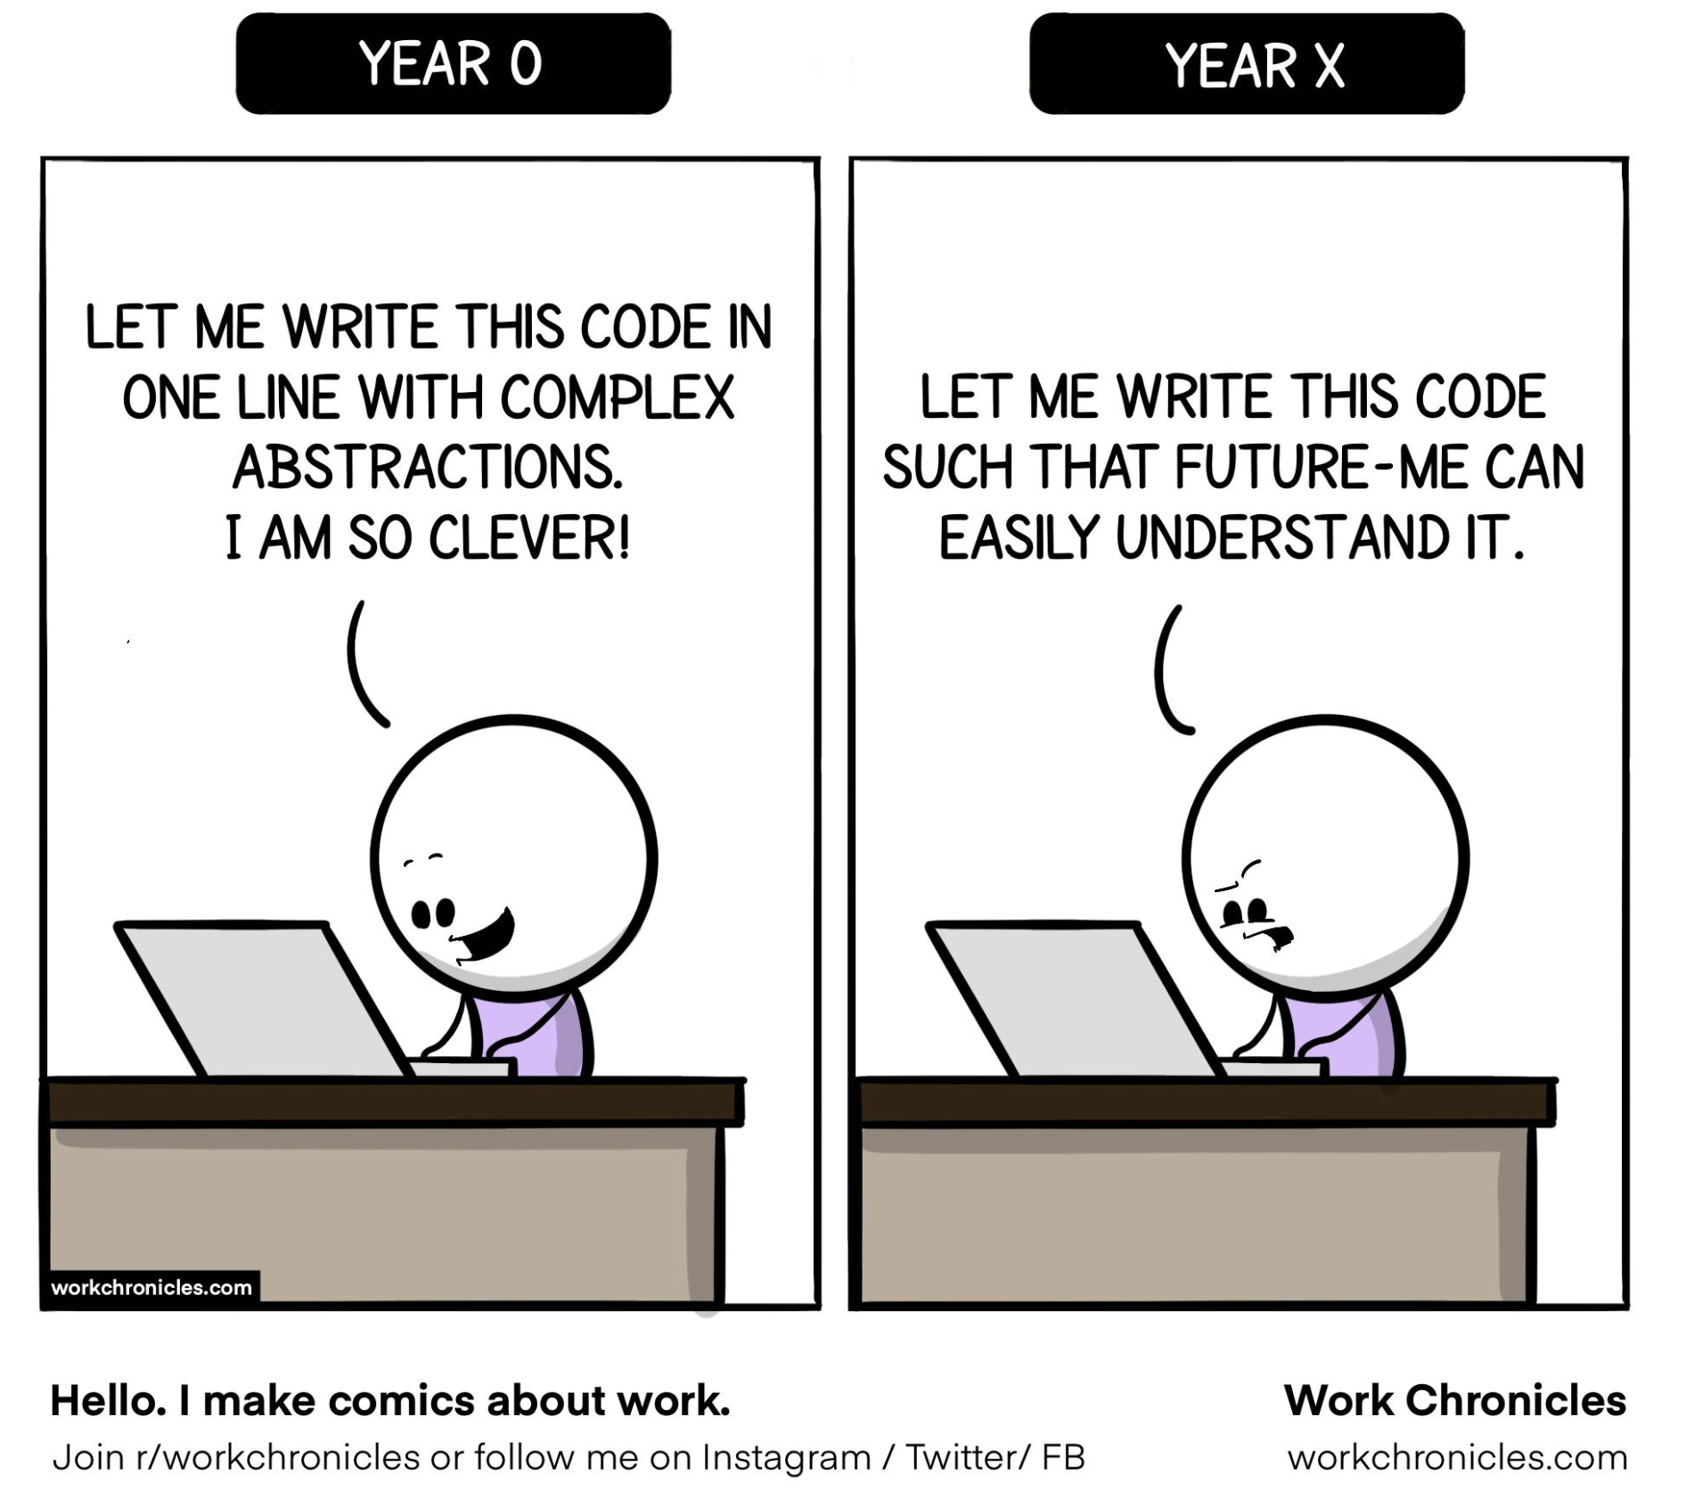
Programmer Humor https://i.redd.it/d35x0skhu0j61.jpg

