Slide 1
IMAGE-BASED
VIRTUAL TRY-ON NETWORK
WITH STRUCTURAL COHERENCE
Instructor
Andrew Owens
reporter
Chia-Ming Wang

Slide 2
Introduction

Slide 3
What is try-on?
Put new clothes on a person.

Slide 4
Why it's important?
There are no source code on Github.
ICIP conferece paper.
The rising of online shopping.

Slide 5
Method

Slide 6
Overview
Human Parsing Module
Geometric Matching Module
Try-on Module
Use same clothes and model when training

Slide 7
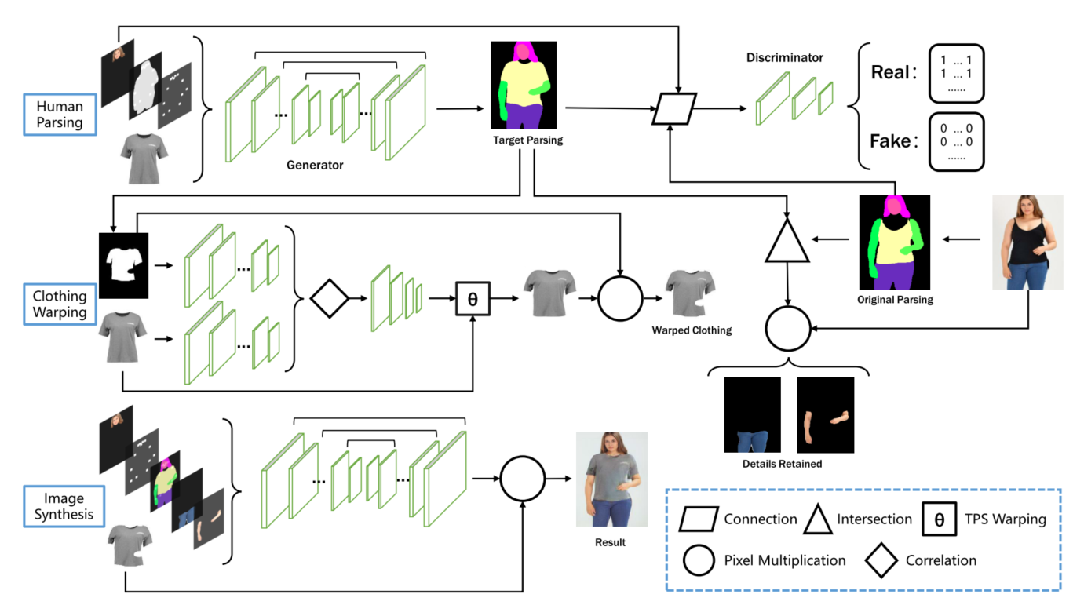

Slide 8
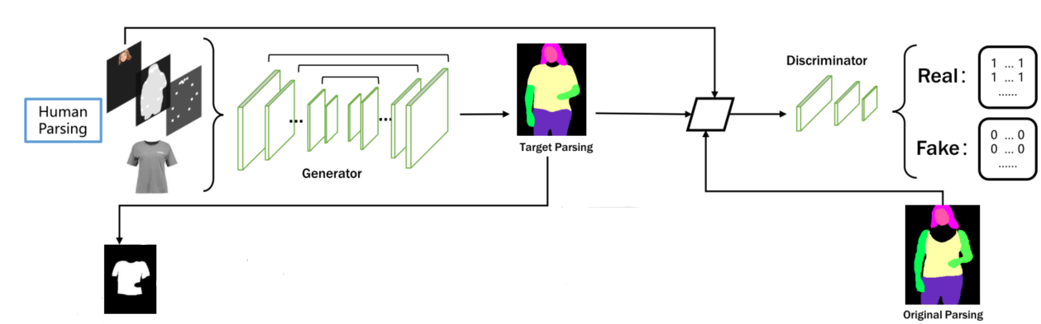
Human Parsing Module
Get parsing with new clothes
= Unet + GAN

Slide 9
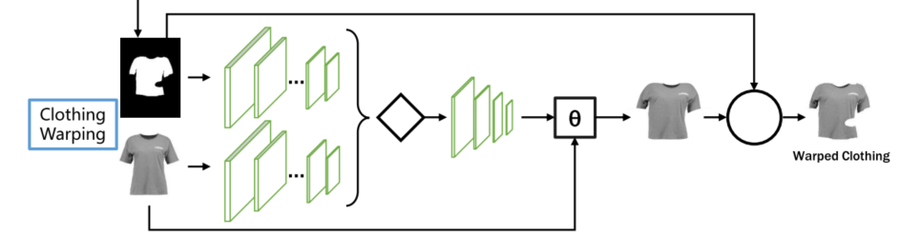
Geometric Matching Module
This is inherite from CP-VTON
Warp the clothes to the shape of parsing

Slide 10
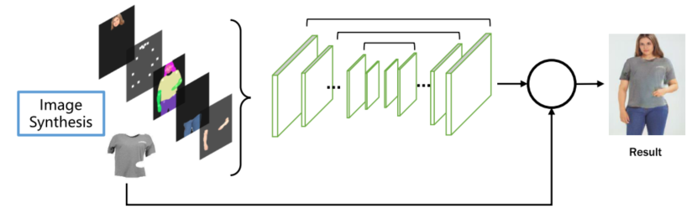
Try-on Module
= Unet

Slide 11
学校名称：OfficePLUS大学
Experiment

