Slide 1
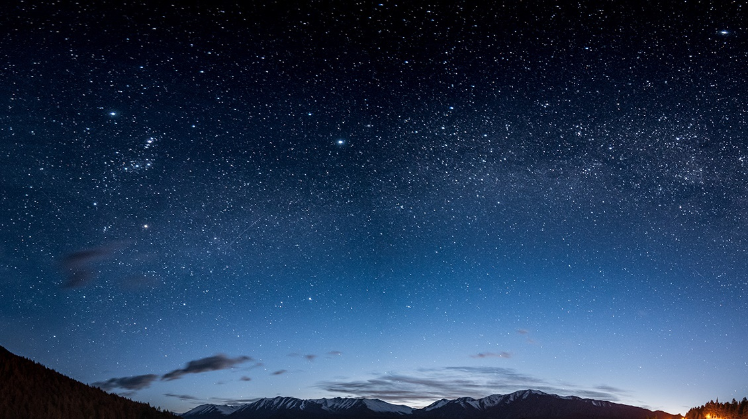
WEB Technologies (UE19CS204)
Project Title : Lenswork Exhibitory site(Using Mern stack)
Team Members:
NAME | SRN | Section
Jaywanth J | PES2UG19CS165 | C
Hemanth Hegde | PES2UG19CS148 | C
Jaaswin D Kotian | PES2UG19CS156 | C

Slide 2

Abstract:
Using eyewear sites like lenskart , Oakley and more as example , we seek to reproduce such websites on a smaller scale.
We aim to implement a simpler model but just as appealing as a good E-Commerce Site.
We wish to represent the functionalities of interacting with user through contact form and showcasing our companies’ products.
We seek to showcase a seamless design with dynamic animations in order to ensure a quick about means to actually ensure the customer’s time to find what they want is minimized as much as possible.
We finally expect to implement good principles of web design such as Responsive sites, efficient data handling and such to implement a light but stable site.

Slide 3
PROJECT ELEMENTS AND MODULES:
The project seeks to have the following pages and modules:
Home Page: Overview of the Site showcasing designs with animations and a Contact Form at the bottom to process queries or large orders.
About Us Page: To describe the company and its features.
Products Page : To showcase the actual designs similar to an E-Commerce Site.
Contact Us Page:
Navbar and Footer modules

Slide 4
Technologies Used:
React
MongoDB
Express
Axios
Cors
Node

Slide 5
Member Contribution
Jaaswin – Base Styling for all the pages , React Routing for Components , Express Routing.
Hemanth – Responsive Design, Card Design, Footer Design, Database integration.
Jaywanth – Contact – Us Page , Frontend and Backend Integration ,Information Retrieval, React Navbar development.

Slide 6

Thank You!

