Slide 1

SynthMed
Enterprise Design Thinking
AI Agent for Medical Research Synthesis powered by IBM watsonx Orchestrate

Slide 3
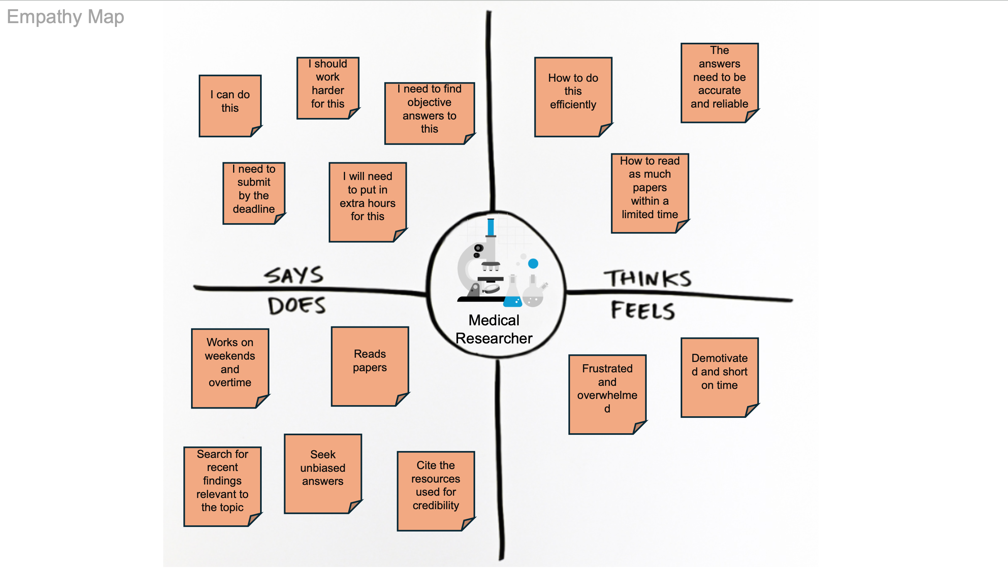

Slide 4
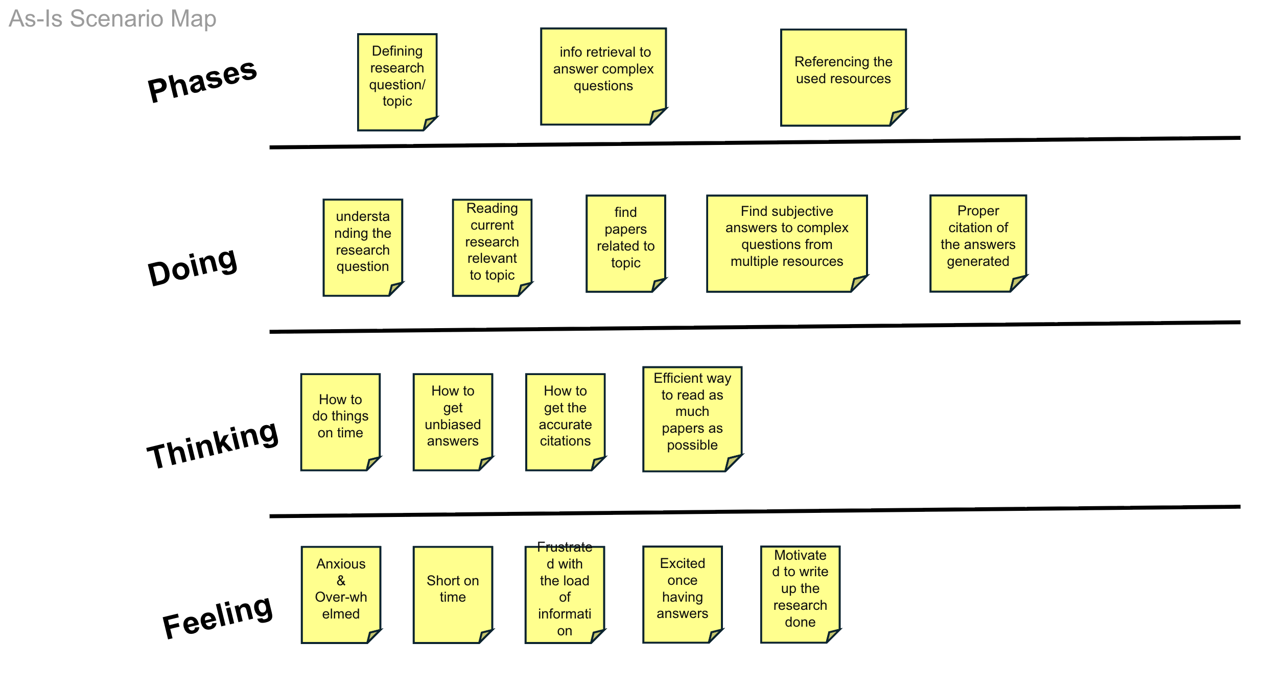

Slide 5
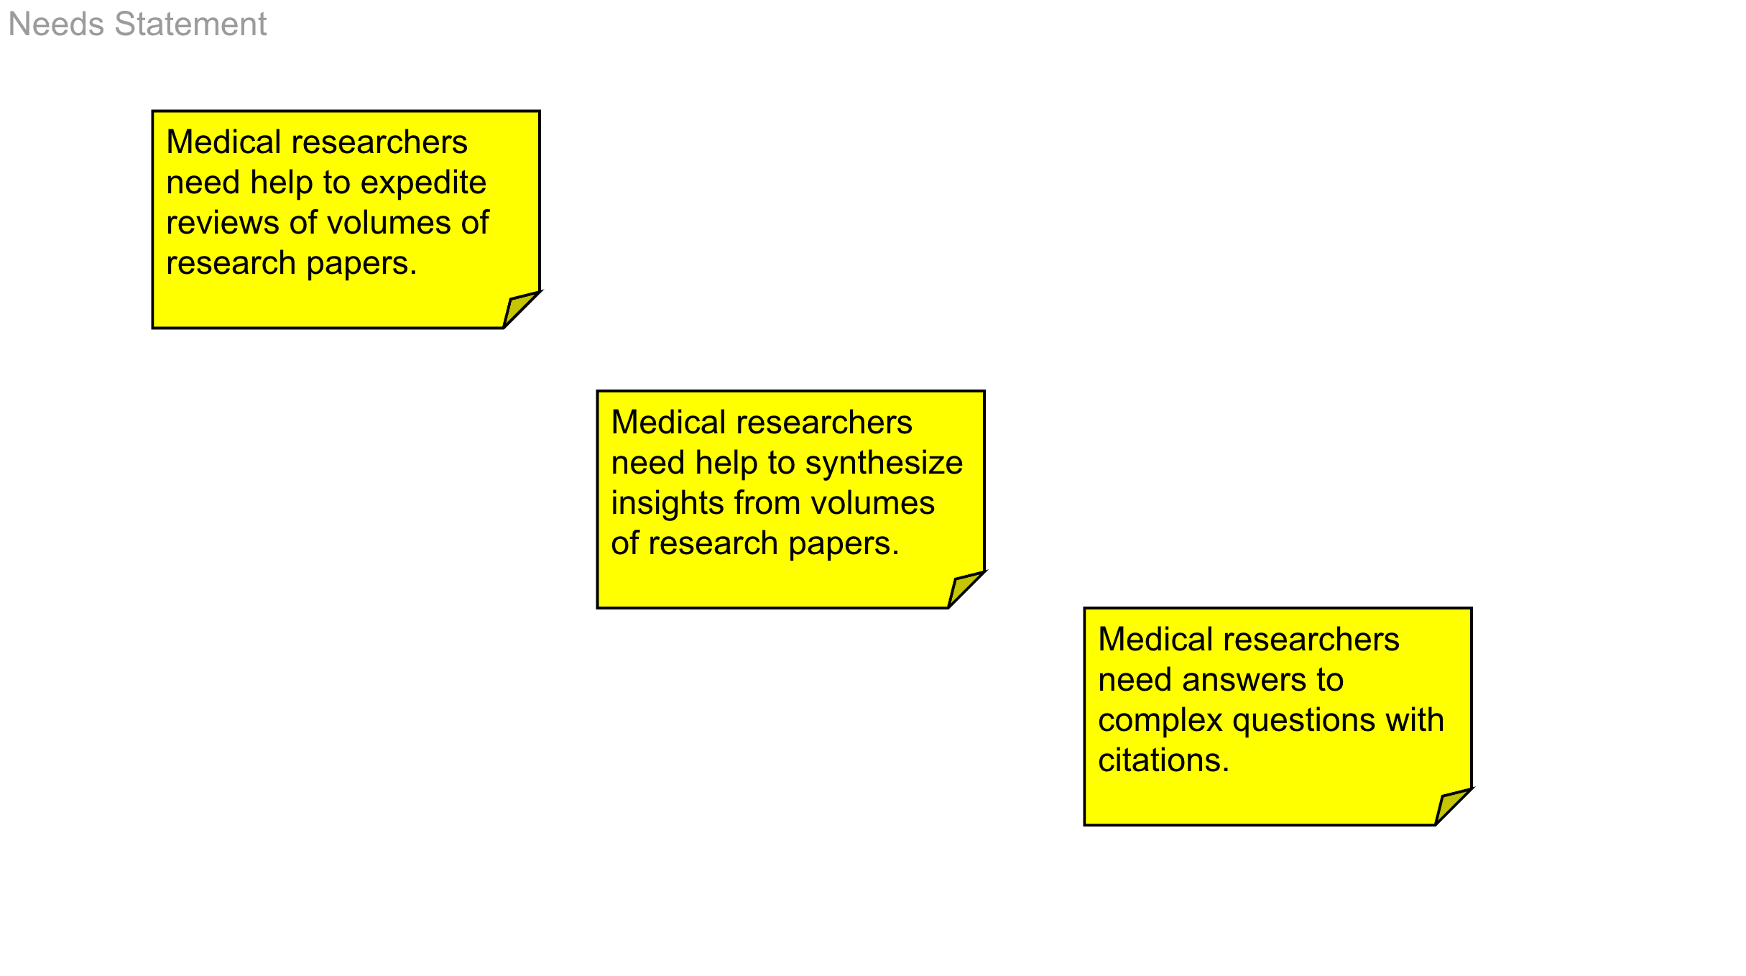

Slide 6
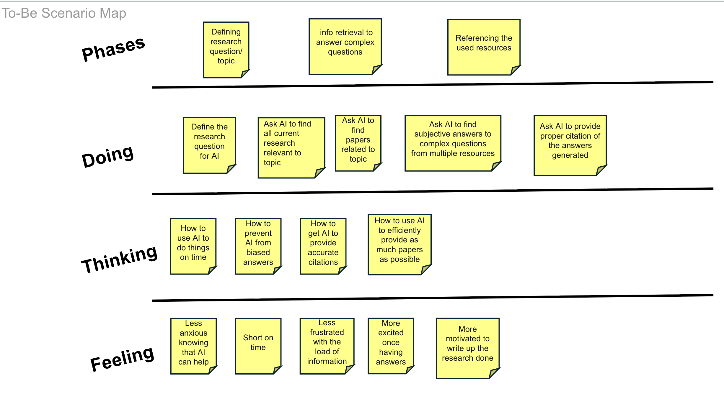

Slide 7
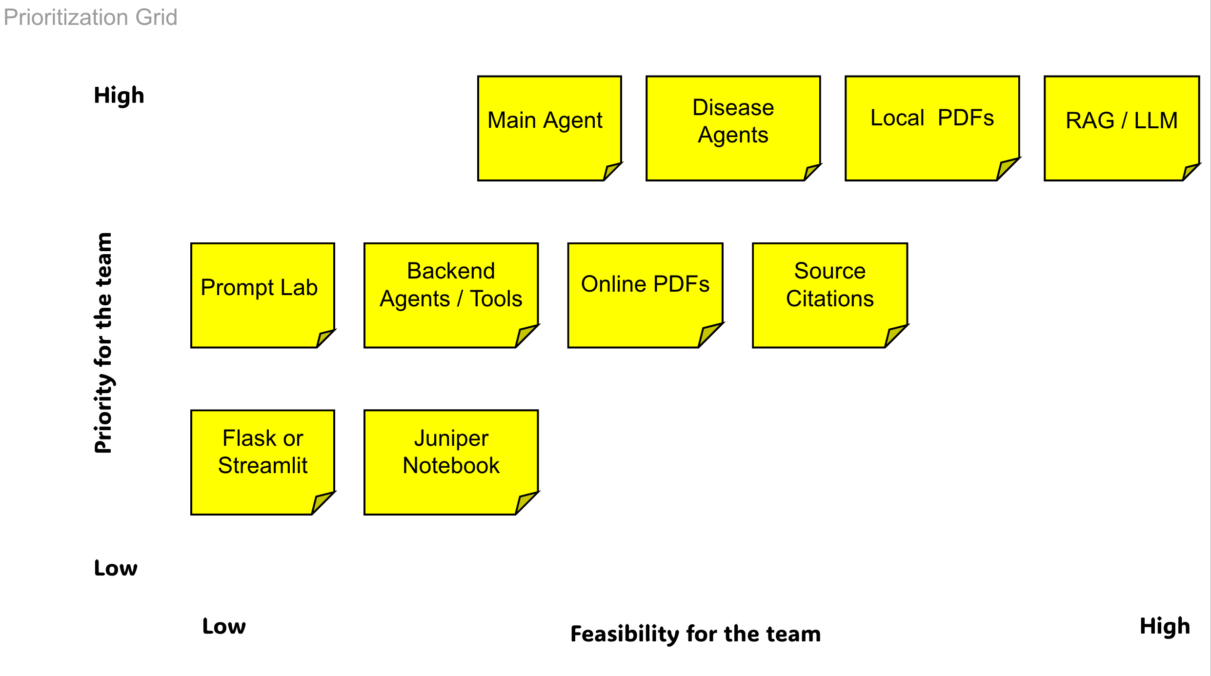

Slide 8


Slide 9
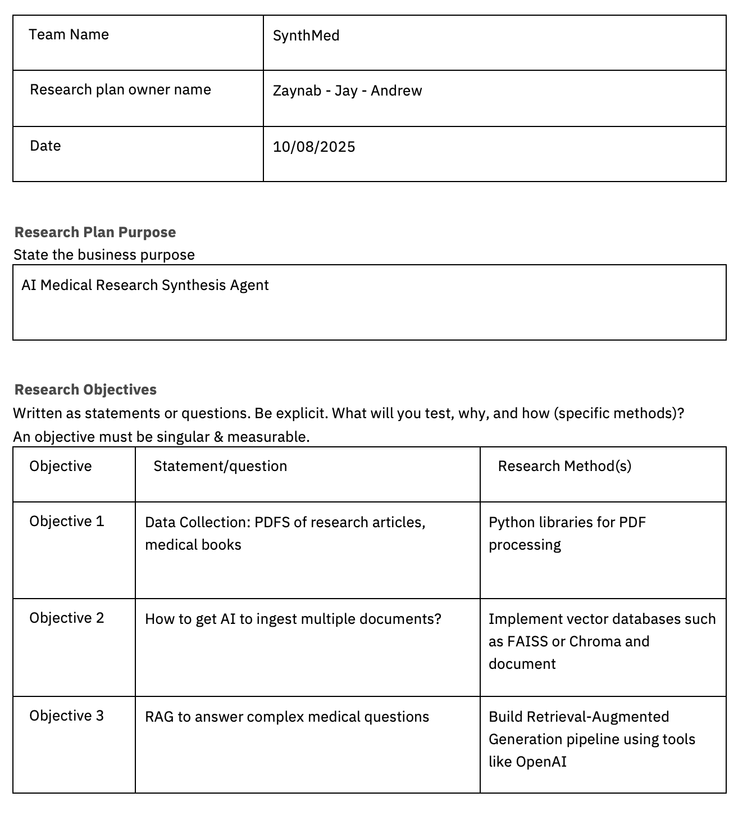
SynthMed Research Plan

Slide 10
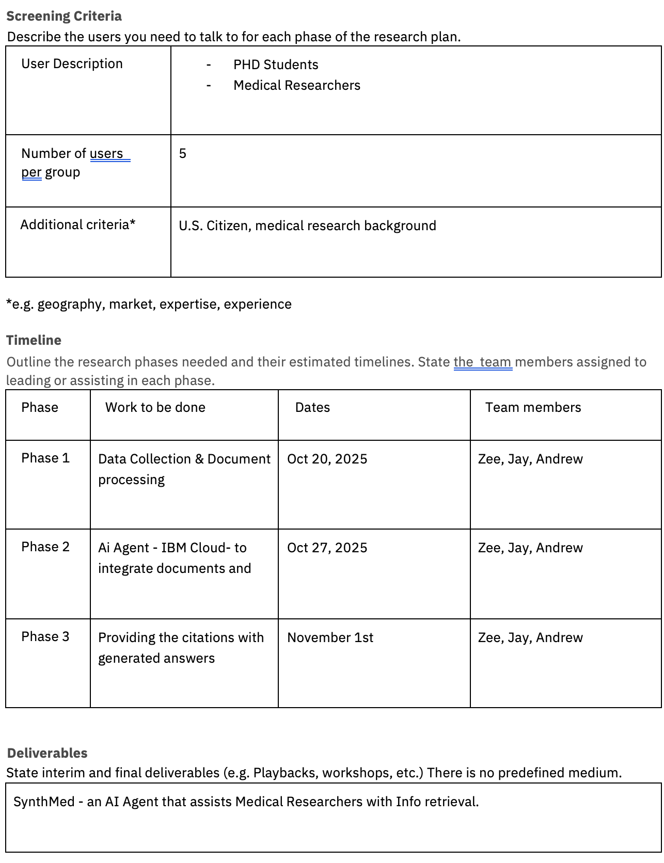
SynthMed Research Plan (continued)

