Slide 1

CSC1103 Programming Methodology
Mini-Project
Tic-Tac-Toe
Session 1 Group 08

Slide 2
Team Members
Elroy Lee (2300950)
Jiang Weimin (2301083)
Felix Chang (2301105)
Lim Jing Chuan Jonathan (2300923)
Ryan Oh Tian Guan (2300916)
Agenda
Overview of individual parts
Brief run through of individual parts
Demo Video

Slide 3
Elroy Lee (2300950)
Contributions Overview:
Basic Tic-tac-toe functions
Perfect Minimax AI to win the game
Naive Bayes Machine Learning Algorithm

Slide 4
Elroy Lee (2300950)
Basic Tic-tac-toe functions:
Board Representation
Utilized array to represent game board
Win Conditions
Identifying patterns or combinations of moves that result in win.
Board Completion
Ensures game recognizes where board is full

Slide 5
Elroy Lee (2300950)
Perfect Minimax AI to win the game
Minimax Algorithm
Recursive Algorithm used for decision-making
Analyzes all possible outcomes to make the best decision.
Game Tree Exploration
Constructs game tree representing all possible moves and outcomes
Searches through the tree recursively to determine best possible move
Benefits:
Optimal Strategy Assured
No training data required

Slide 6
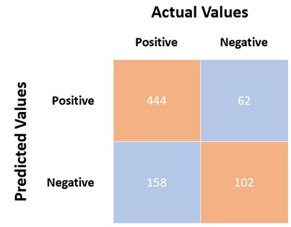
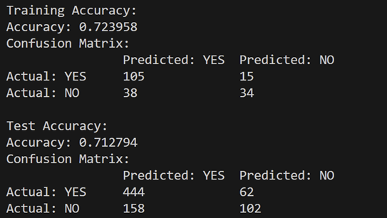
Elroy Lee (2300950)
Machine Learning Algorithm (Naive Bayes)
Calculating Accuracy
Ensured the effectiveness of Naive Bayes classifier
Developed confusion matrix for detailed breakdown of predictions
Sample dataset from testing set: 87.7% accuracy

Slide 7
Jiang Weimin (2301083)
Slide 1 - Contributions Overview:
One Player Mode:
Minimax AI (Imperfect)
Easy & Medium Mode.
GUI with RayLib:
Included menus, scoreboard.
Navigation controls (home, back, restart, exit).
Mode selection
Background music
Structures and Pointers:
Transformed the entire codebase
Employing structures & pointers.

Slide 8
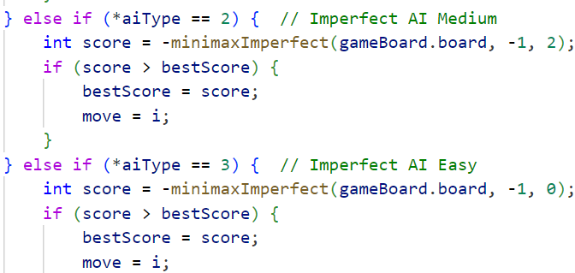
Jiang Weimin (2301083)
Slide 2 - Minimax Imperfect AI for Engaging Challenges
Objective:
Develop balanced AI for a positive gaming experience.
Approach:
Implemented an imperfect minimax algorithm for single-player mode.
Adaptive Depth:
Introduced dynamic depth adjustments for different AI difficulty levels.
Easy Mode: Shallow depth for quicker and less challenging moves.
Medium Mode: Moderate depth for a balanced gaming experience.
Benefits:
Prevents frustration,
ensure player wins are achievable.

Slide 9
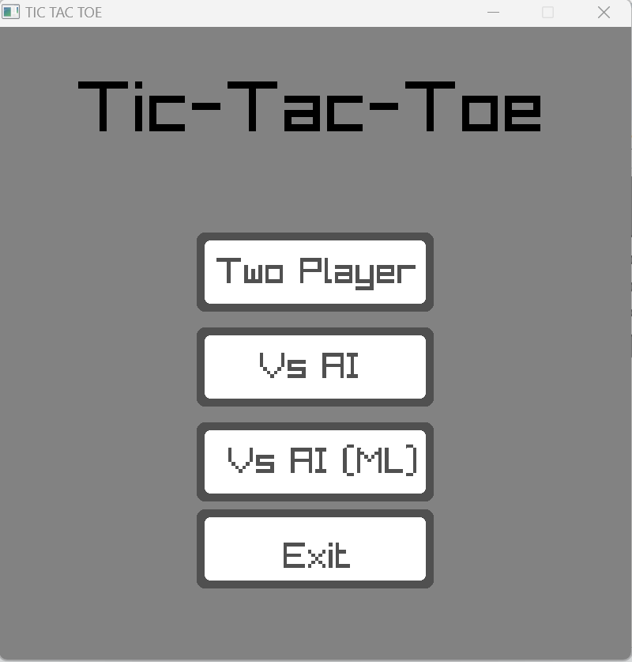
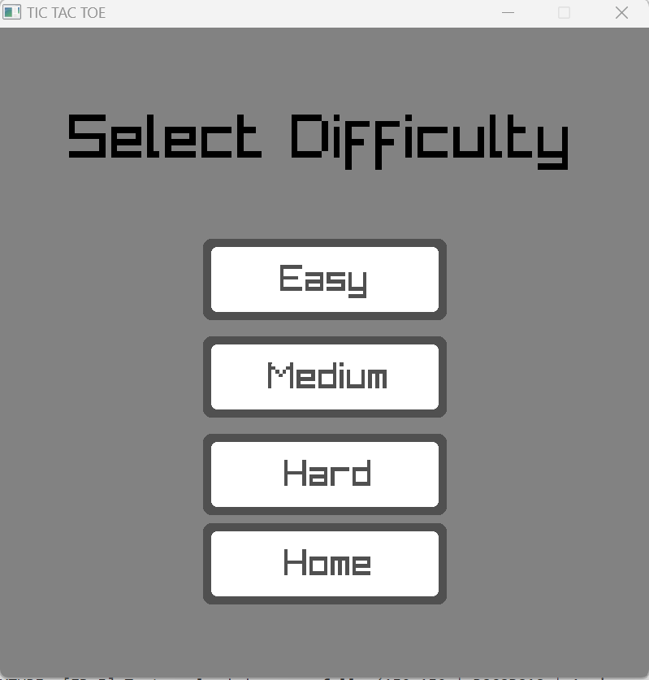
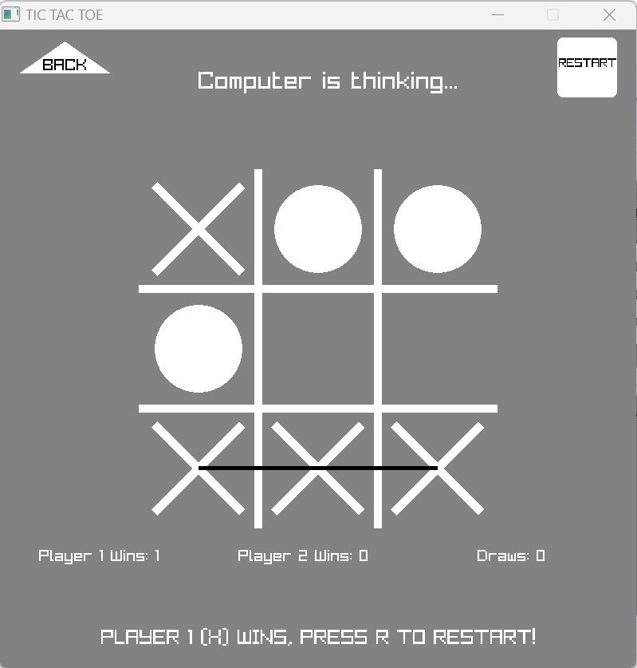
Jiang Weimin (2301083)
Slide 3 - GUI with Menus using RayLib
Objective:
Enhance user experience with an intuitive GUI.
Features:
Menu Integration:
Seamless mode selection within the GUI.
Easy navigation for childrens.
Scoreboard:
Track and display game progress.
Adds a competitive and engaging element.
Navigation Controls:
Back, home, restart, exit buttons for user convenience.
Efficient controls enhance overall usability.
Background Music
Press ‘M’ to mute/unmute
Benefits:
User-Friendly:
Designed with children in mind.
Appealing and easy to navigate.
Enhanced Engagement:
Encourages players to explore different modes.

Slide 10
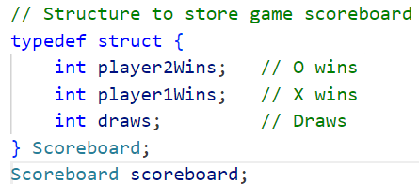
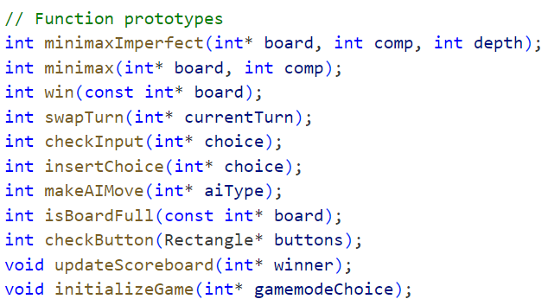
Jiang Weimin (2301083)
Slide 4 - Structure & Pointers
Objective:
Improve code structure and memory efficiency
Contributions:
Code Refactoring:
Restricted code using structures and pointers.
Reduced redundancy for streamlined code.
Memory Efficiency:
Utilized pointers for optimal memory usage.
Enhanced resource management.
Benefits:
Code Modularity:
Simplifies maintenance with modular structures.
Resource Optimization
Adaptability:
Prepared for future expansions or modifications.

Slide 11
Felix Chang (2301105)
Contributions
Splitting of Codes to utilise a header file
Split based on usage
Two-Player Mode
Manual/Offline Two-Player Mode
2 Players taking turns
Check for winning combinations after each turn
Graphical User Interface (GUI)
Plotting using gnuplot
Migrated to RayLib
Interactive/Clickable Board works with game logic

Slide 12
Felix Chang (2301105)
Utilising a header file
tictactoe.h
tictactoeMain.c, tictactoeLogic.c, tictactoeGUI.c
Two-Player Mode
Player 1 (‘X’) and Player 2 (‘O’)
Take turns to input onto grid
Manual/Offline taking turns
Each input will be checked for validity
Whether grid choice already has an input
Winning combinations are checked after each input
Row, Column and Diagonal combinations
Game ends when winner is declared

Slide 13
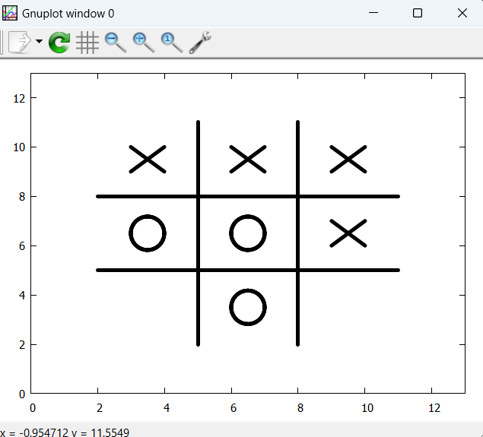
Felix Chang (2301105)
Graphical User Interface (GUI)
Initial use of gnuplot
Placed the player’s input into a csv file
Use gnuplot to plot the Grid, Xs and Os
Using the csv datafile
Not a great GUI solution
Not interactive/clickable, have to replot on every move, additional file
Switch to RayLib GUI
Create an actual game program with GUI
Players can click on the grid
Displays moves, grid and messages
Player input sent to inner game logic

Slide 14
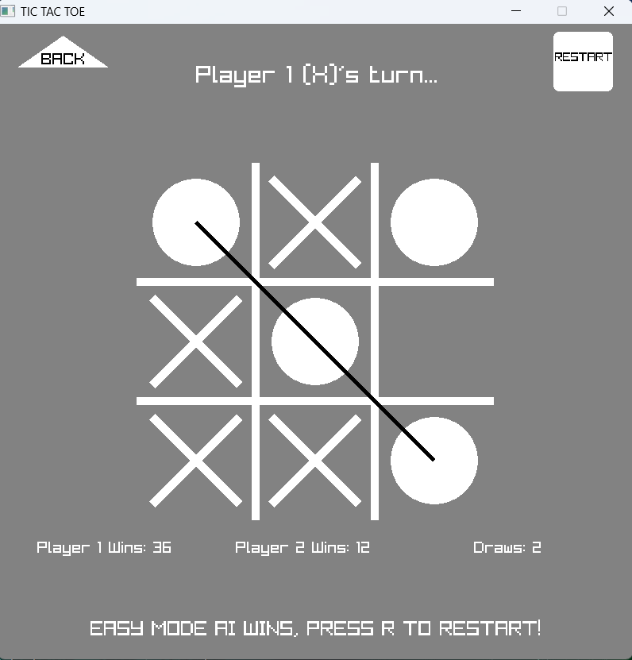
Felix Chang (2301105)
Graphical User Interface (GUI)
Using RayLib functions
Draw Lines for game grid
Draw Circle and ‘X’ for player moves
Draw Text to display messages
Whose turn it is
Who Wins
Draw buttons for user navigation
Menu Buttons
Back and Restart Buttons
Keyboard Button Input
Press “R” to Restart, “Esc” to Quit

Slide 15
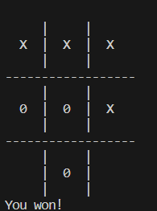
Lim Jing Chuan Jonathan (2300923)
GNU Plotting(before)
Contributions:
Plotting out the output result in GNUPlot.
https://youtu.be/cFCO1AV1B-I
Pros:
Provides better visual representation compare to terminal GUI.
Limitation:
Non-interactive, input still has to be done in terminal.

Slide 16
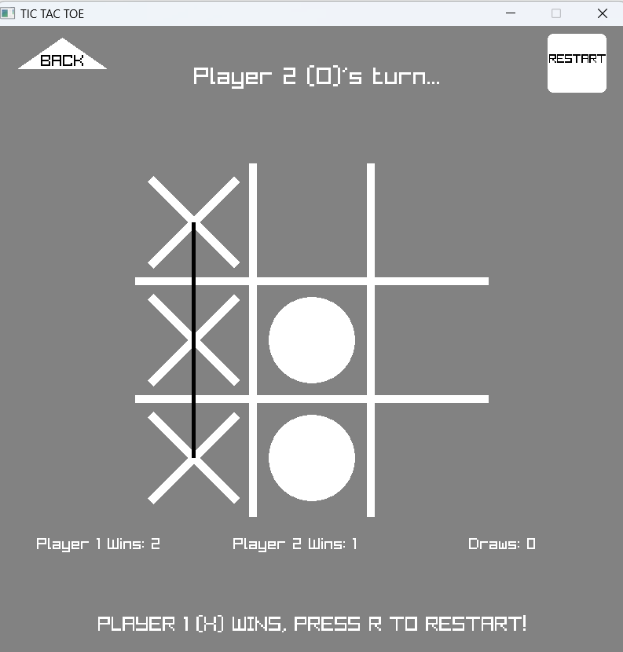
Lim Jing Chuan Jonathan (2300923)
RayLib(After)
Pros:
Provides interactive GUI.
Contributions:
Strikethrough effect for winning combination.
Sound effect for restart button and click selection.
Overall outlook of GUI.
https://www.youtube.com/watch?v=tJXzzxpCqGA

Slide 17
Ryan Oh Tian Guan (2300916)
Contributions Overview:
Extraction and Splitting of Tic Tac Toe Dataset for ML
Naive Bayes ML classifier training
Designing the Naive Bayes AI based on predicted probability

Slide 18
Ryan Oh Tian Guan (2300916)
Extracting and Splitting of Tic Tac Toe Dataset for ML
Extracting Dataset from file
Conditional statements for error handling
Assign allocated memory for the data which is stored in structure
Splitting of commas to ensure relevant data is stored
Splitting of Dataset to training and testing sets
Shuffle the dataset randomly
Split the dataset into 80% and 20%
Allocate memories for both training and testing sets to be stored in structure

Slide 19
Ryan Oh Tian Guan (2300916)
Naive Bayes ML classifier training
Training the model to calculate total counts
For each feature/move in each grid, calculate the number of features that correspond to positive or negative outcome
Illustration:
{x,o,x,o,b,x,o,o,x,p}
{o,b,x,x,o,o,b,o,x,n}
{b,x,b,b,x,b,x,b,b,p}
Grid 1: Grid 2:
Feature x, outcome p: 1 Feature x, outcome p: 1
Feature x, outcome n: 0 Feature x, outcome n: 0
Feature o, outcome p: 0 Feature o, outcome p: 1
Feature o, outcome n: 1 Feature o, outcome n: 0
Feature b, outcome p: 1 Feature b, outcome p: 0
Feature b, outcome n: 0 Feature b, outcome n: 1 …..

Slide 20
Ryan Oh Tian Guan (2300916)
Naive Bayes ML classifier training
Calculating probability of each grid’s feature given the outcome
Calculation: Total count of each grid’s feature and their corresponding outcome / total corresponding outcome number
Earlier Illustration:
{x,o,x,o,b,x,o,o,x,p}
{o,b,x,x,o,o,b,o,x,n}
{b,x,b,b,x,b,x,b,b,p}
Grid 1: Grid 2: Total counts of p: 800
Feature x, outcome p: 1 Feature x, outcome p: 1 Total counts of n: 158
Feature x, outcome n: 0 Feature x, outcome n: 0
Feature o, outcome p: 0 Feature o, outcome p: 1
Feature o, outcome n: 1 Feature o, outcome n: 0
Feature b, outcome p: 1 Feature b, outcome p: 0
Feature b, outcome n: 0 Feature b, outcome n: 1 …..

Slide 21
Ryan Oh Tian Guan (2300916)
Designing the Naive Bayes AI based on predicted probability
Prediction logic
With the probability statistics of each feature in each grid, given the outcome, we can compare an example dataset to calculate the outcome of the game.
Illustration:
{x,o,x,o,b,x,o,o,x,p} - Example dataset
Probabilities:
Grid 1: Grid 2: Positive outcome = Probability of p * 0.6 * 0.3 * ….
Feature x, outcome p: 0.6 Feature x, outcome p: 0.1 Negative outcome = Probability of n * 0.3 * 0.2 * ….
Feature x, outcome n: 0.3 Feature x, outcome n: 0.5
Feature o, outcome p: 0.2 Feature o, outcome p: 0.3
Feature o, outcome n: 0.8 Feature o, outcome n: 0.2
Feature b, outcome p: 0.2 Feature b, outcome p: 0.9
Feature b, outcome n: 0.1 Feature b, outcome n: 0.2 ….. If probability of p > n, returns p. If not, returns n

Slide 22
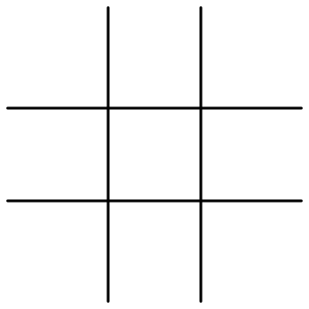
Ryan Oh Tian Guan (2300916)
Designing the Naive Bayes AI based on predicted probability
Prediction logic for AI’s move
Based on each move made by player, the AI will loop through all empty grids and capture each scenarios to compute the probability of p and n.
When posterior probability of p > n, AI will find a move that produces a conditional probability of n that is higher than the rest. It will choose that move.
When posterior probability of p < n, AI will choose a random move

Slide 23

Closing slide – You can add contact details, a call to action or a simple thank you
Thank You!

