Slide 1
Software Lifespan Models
Stages through which software goes, from conception to death!
Stages may be very different
Software = product
  Stages are similar to the lifespan of other products

Slide 2
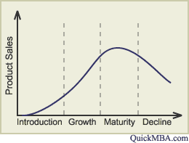
Product lifespan

Slide 3
Software lifespan
When software is a product
  Sales go through the same lifespan
Unique proprietary software
  Value follows the same curve
Different names of stages

Slide 4
Staged model
Initial development
first running version
evolution changes
Evolution
code
decay
servicing patches
Servicing
servicing discontinued
Phase-out
Switch-off
Close-down

Slide 5
Initial development
Requirements
Design
Implementation
  Similar to waterfall
Fundamental commitments
  Technology
    programming language, coding conventions, libraries,…
  Architecture
    components, interactions
  Program domain knowledge
    the knowledge is required for evolution

Slide 6
Evolution
adapts the application to the ever-changing user and operating environment
adds new features
corrects mistakes and misunderstandings
responds to both developer and user learning
program grows during evolution
both software architecture and software team knowledge make evolution possible

Slide 7
Code decay
positive feedback between
  the loss of software architecture coherence
  the loss of the software knowledge
    less coherent architecture requires more extensive knowledge
    if the knowledge is lost, the changes will lead to a faster deterioration
loss of key personnel = loss of knowledge
challenge: eliminate or slow code decay

Slide 8
Servicing
the program is no longer evolvable
  it either decays or managers decide not to support evolution
changes are limited to patches and wrappers
  less costly, but they cause further deterioration
process is very different from evolution
  no need for senior engineers
  programmer is assigned only part of the software to support
  the process is stable
    well suited to process measurement

Slide 9
Challenges in servicing
making the change without unexpected additional effects
program comprehension
documentation management
delivery of service patches
  upgrading software without the need to halt it

Slide 10
Reversal from servicing to evolution
very expensive, very rare
not simply a technical problem
  the knowledge of the software team must also be addressed
for all practical reasons, the transition from evolution to servicing is irreversible

Slide 11
Reengineering
Initial development
first running version
software changes
Evolution
reengineering
code decay
servicing patches
Servicing
servicing discontinued
Phase-out
switch-off
Close-down

Slide 12
Phase-out
no more servicing is being undertaken
  but the system still may be in production
the users must work around known deficiencies

Slide 13
Close-down
the software use is disconnected
  current life of successful software:
  about 10 to 20 years
the users are directed towards a replacement.
‘exit strategy’ is needed.
    changing to another system is expensive
    what to do with long-lived data?

Slide 14
Versioned staged model
Used by software with many users
Evolution is the backbone of the process
  Evolution produces versions
  Versions are serviced, phased-out, closed down

Slide 15
Versioned staged model
Initial development
first running version
evolution changes
Evolution Version 1
servicing patches
Servicing Version 1
evolution of new version
evolution changes
Phase-out Version 1
Evolution Version 2
servicing patches
Close-down Version 1
Servicing Version 2
evolution of new version
Phase-out Version 2
Evolution Version . . .
Close-down Version 2

Slide 16
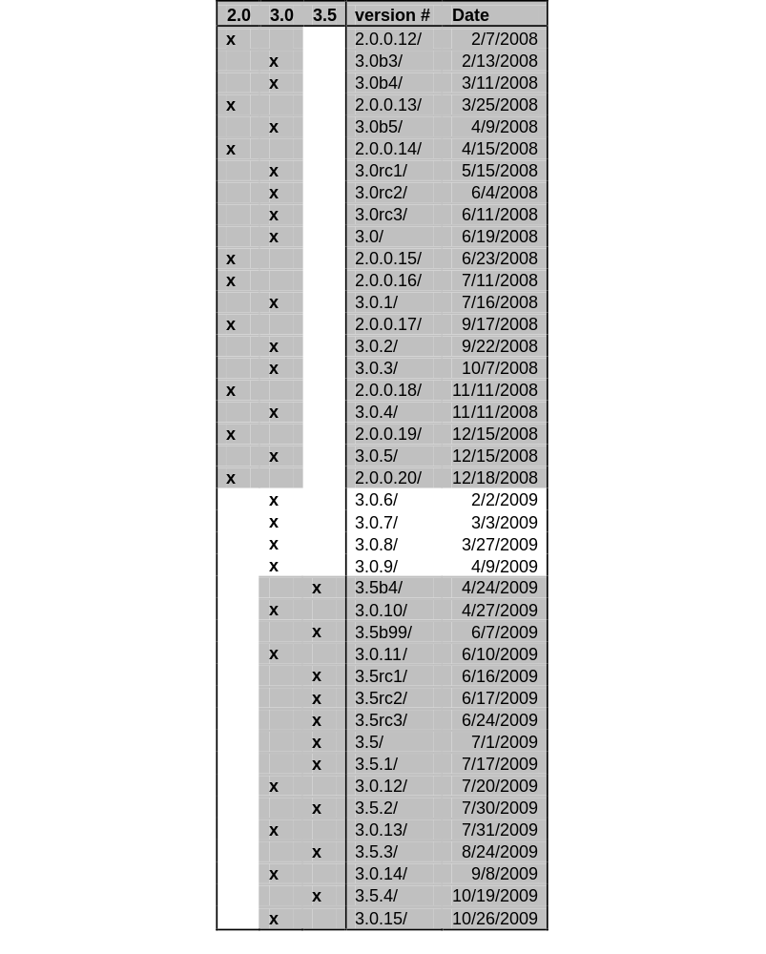
Mozilla Firefox releases
2008 – 2009
Versions 2.0 and 3.0
  serviced in parallel
Version 3.5 introduced 4/2009
  while version 3.0 still serviced
  while version 2.0 in phaseout

Slide 17
Incomplete lifespans
Discontinued projects
  Stopped during initial development
Stable domain
  No need for evolution

Slide 18
lifespan vs. Lifespan model
lifespan
  Common terminology
  Incorrect: There is no cycle
    Some software discontinued without a replacement
Lifespan model
  Better terminology
  Less commonly used

Slide 19
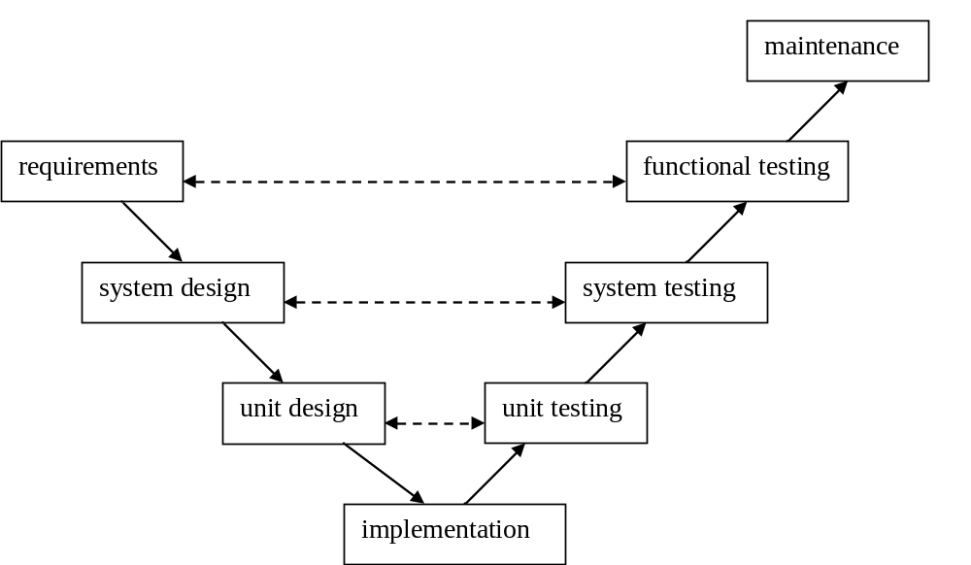
V-Model

Slide 20
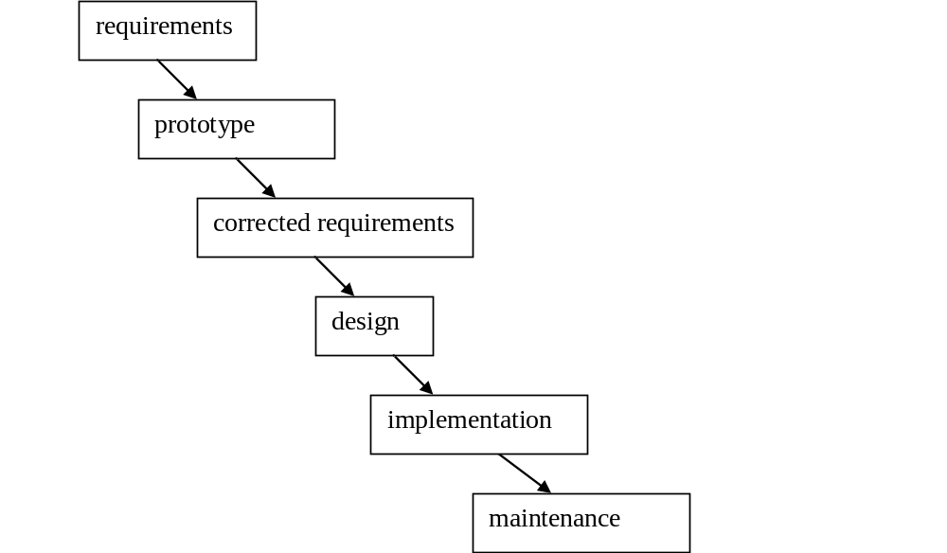
Prototyping model

