Slide 1




Robotic positioner
Presented by group 5: Thomas hu, Jordan smith, Jason wong

Slide 2

Overview
Problem Description
Requirements Analysis
System Design
Detailed Design and Testing
Demonstration
Design Discussion

Slide 3
Problem description

Slide 4
Problem Statement
“There exists a need for a low-cost system that can electrically rotate a load for welding applications to increase efficiency and safety.”

Slide 5
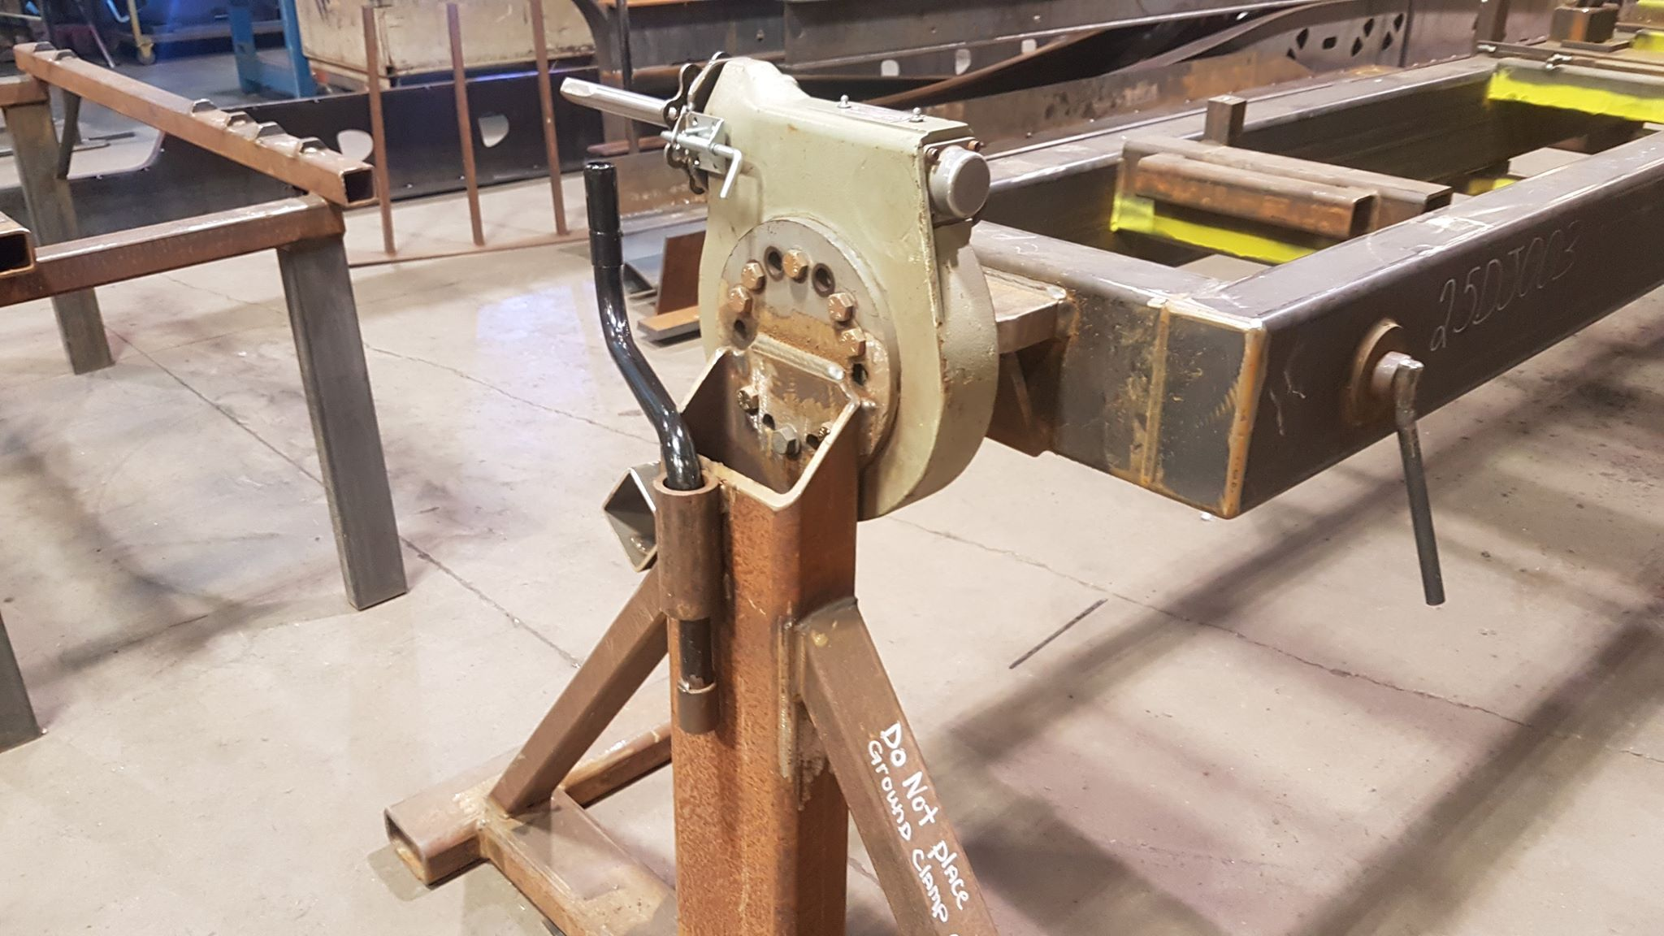
Why is this important?
Currently only uses mechanical rotators.
Advancing mechanical machines forward with electronics.
Provide a safer environment for the users.
Improves efficiency.

Slide 6
Requirements analysis

Slide 7
Design constraints/requirements
The System Must:
The System Shall:
Retrofit Doepker’s existing support frames.
Use an electric motor.
Not exceed $10,000 Canadian Dollars to build.
Be controlled using physical buttons on a control panel.
Have a rotation speed between 1-5 rpm.
Recall and rotate to a preset angular position.
Require a safety button to be depressed to operate the system.
Be operated from a control panel separated from the rotating portion of the system
Support up to max load of 500 kilograms.
Rotate a load 360˚ around the horizontal axis.

Slide 8
System design

Slide 9
Detailed design & testing

Slide 10
Demonstration

Slide 11
Design discussion

Slide 12
Tech Requirements
Network
Satellite
Link

Slide 13

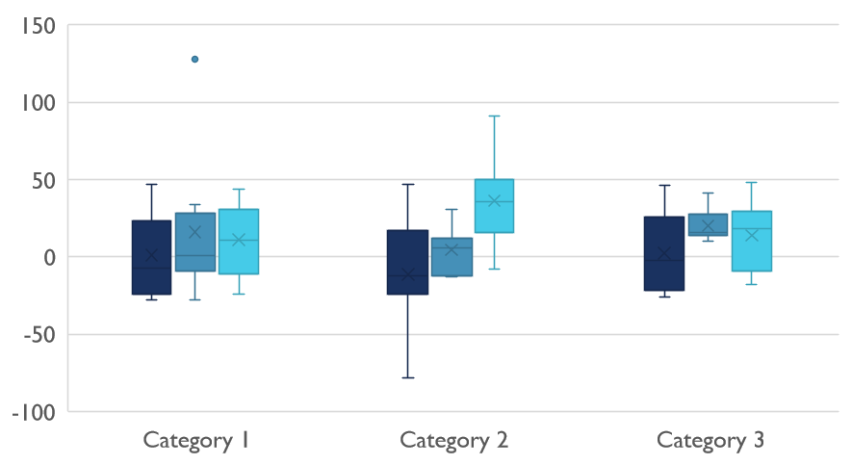
Competitive Landscape

Slide 14

Thank You
someone@example.com

