Slide 1




Robotic positioner
Presented by group 5: Thomas hu, Jordan smith, Jason wong

Slide 2

Overview
Problem Description
Requirements Analysis
System Design
Detailed Design and Testing
Demonstration
Design Discussion

Slide 3
Problem description

Slide 4
Problem Statement
“There exists a need for a low-cost system that can electrically rotate a load for welding applications to increase efficiency and safety.”

Slide 5
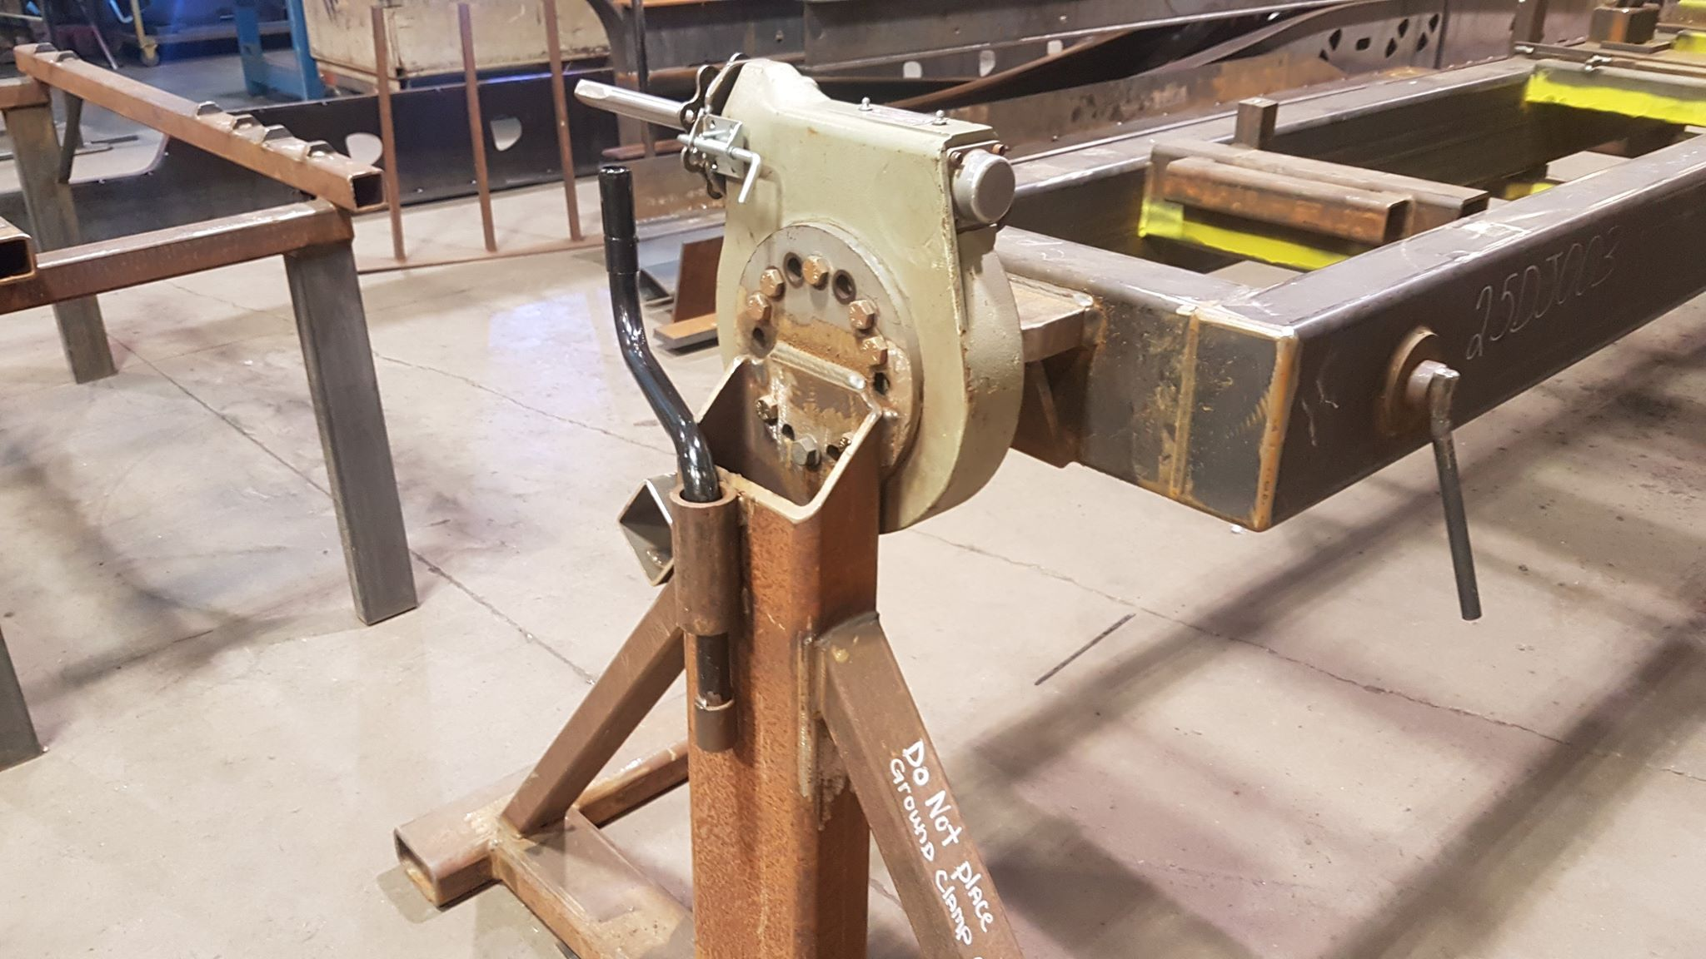
Why is this important?
Currently only uses mechanical rotators.
Advancing mechanical machines forward with electronics.
Provide a safer environment for the users.
Improves efficiency.

Slide 6
Requirements analysis

Slide 7
Design constraints/requirements
The System Must:
The System Shall:
Retrofit Doepker’s existing support frames.
Use an electric motor.
Not exceed $10,000 Canadian Dollars to build.
Be controlled using physical buttons on a control panel.
Have a rotation speed between 1-5 rpm.
Recall and rotate to a preset angular position.
Require a safety button to be depressed to operate the system.
Be operated from a control panel separated from the rotating portion of the system
Support up to max load of 500 kilograms.
Rotate a load 360˚ around the horizontal axis.

Slide 8
System design

Slide 9
System diagram – hardware systems
230 VAC
MOTOR
CONTROL SIGNAL
E-STOP
CONTROL SIGNAL
230 VAC
POWER
DISTRIBUTION
PANEL
230 VAC
12 VDC
REMOTE CONTROL

Slide 10
System diagram – software diagram

Slide 11
Detailed design & testing

Slide 12
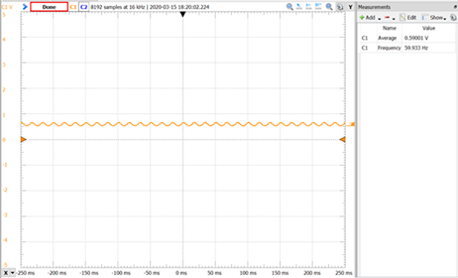
noise – pre-capacitor

Slide 13
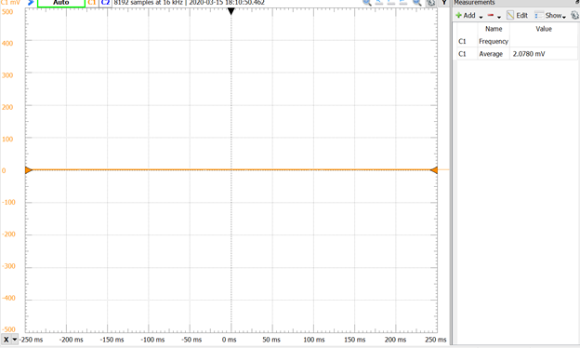
Noise - post-capacitor

Slide 14
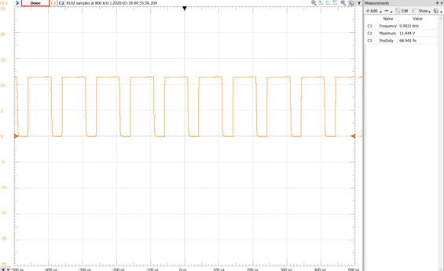
Fill in here

Slide 15
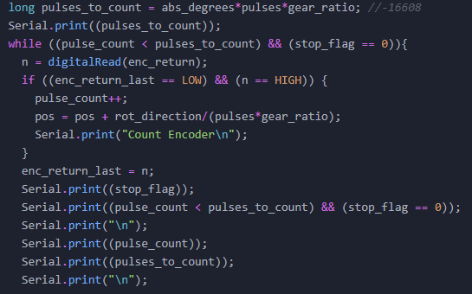
Software - code

Slide 16
Proof of concept testing
Incremental Subsystem Testing
Complete System Testing
Tested each subsystem as they were built.
Verified that each subsystem performed as expected.
Verified individual software functions:
Buttons
Rotations
E-stop/stand by states
Moved hardware from breadboard to proto-board.
Connected each subsystem as outlined in system diagram.
Testing torque.
Tested outline functionalities:
Each type of rotation
Button presses
Speed of rotation
Correct rotation angles

Slide 17
Demonstration

Slide 18
Design discussion
Limitations and future work

Slide 19
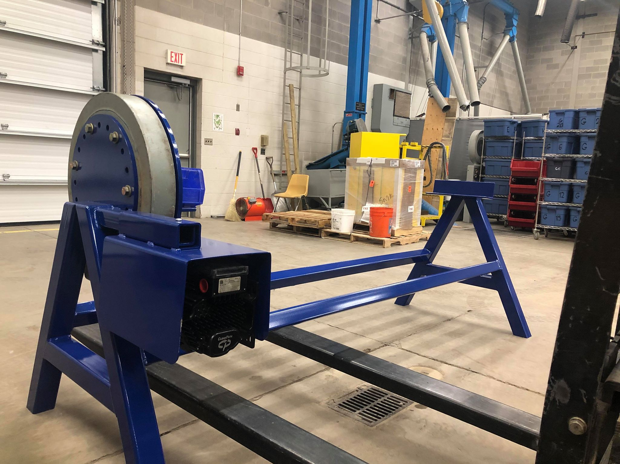
Challenges faced
Hardware/Software interfacing.
Gearing down the speed of rotations.
Shaft was binding on the collar of the adapter from the reducer.

Slide 20
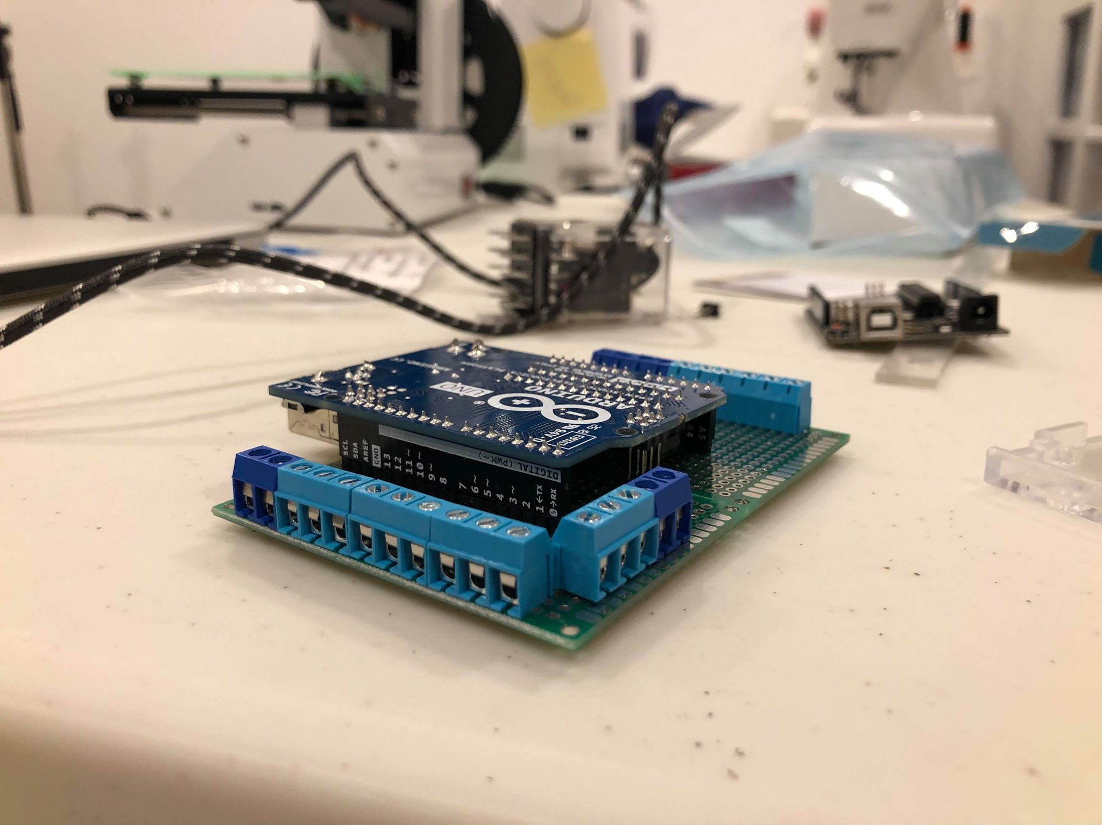
Current system limitations
Limited rotation settings.
Hard design to a proof of concept.
Handling load all on one side.

Slide 21
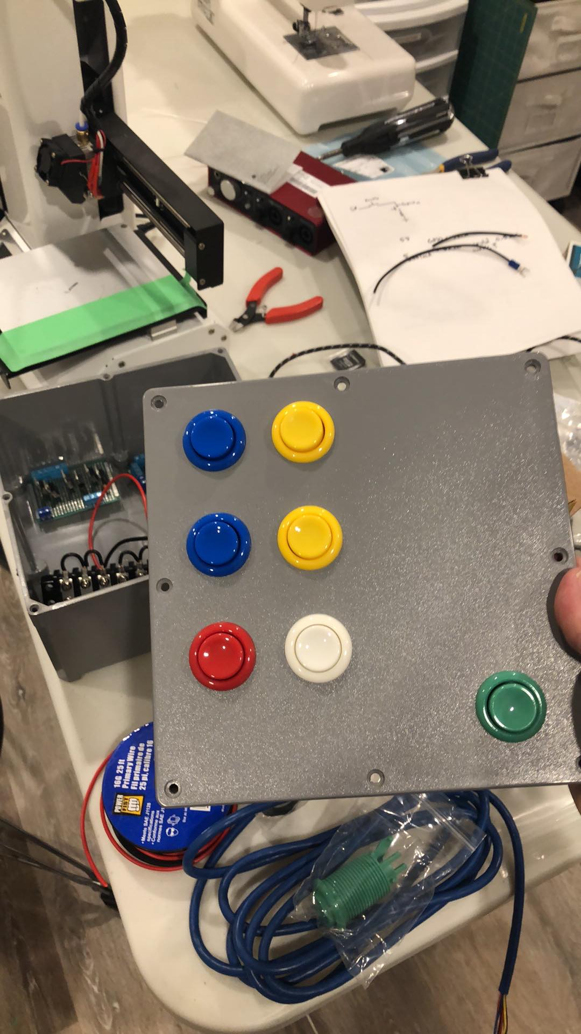
Future Design work
Design a proper PCB for the controller.
A speed setting for how fast/slow the positioner rotates.
Continuous rotation.
Sensor when the E-stop triggers.
Currently no check for the relay that it is flipped off.

Slide 22

Thank You! Questions?
Jordan smith
Thomas hu
Jason wong

