Slide 1




Robotic positioner
Presented by group 5: Thomas hu, Jordan smith, Jason wong

Slide 2

Overview
Problem Description
Requirements Analysis
System Design
Detailed Design and Testing
Demonstration
Design Discussion

Slide 3
Problem description

Slide 4
Problem Statement
“There exists a need for a low-cost system that can electrically rotate a load for welding applications to increase efficiency and safety.”

Slide 5
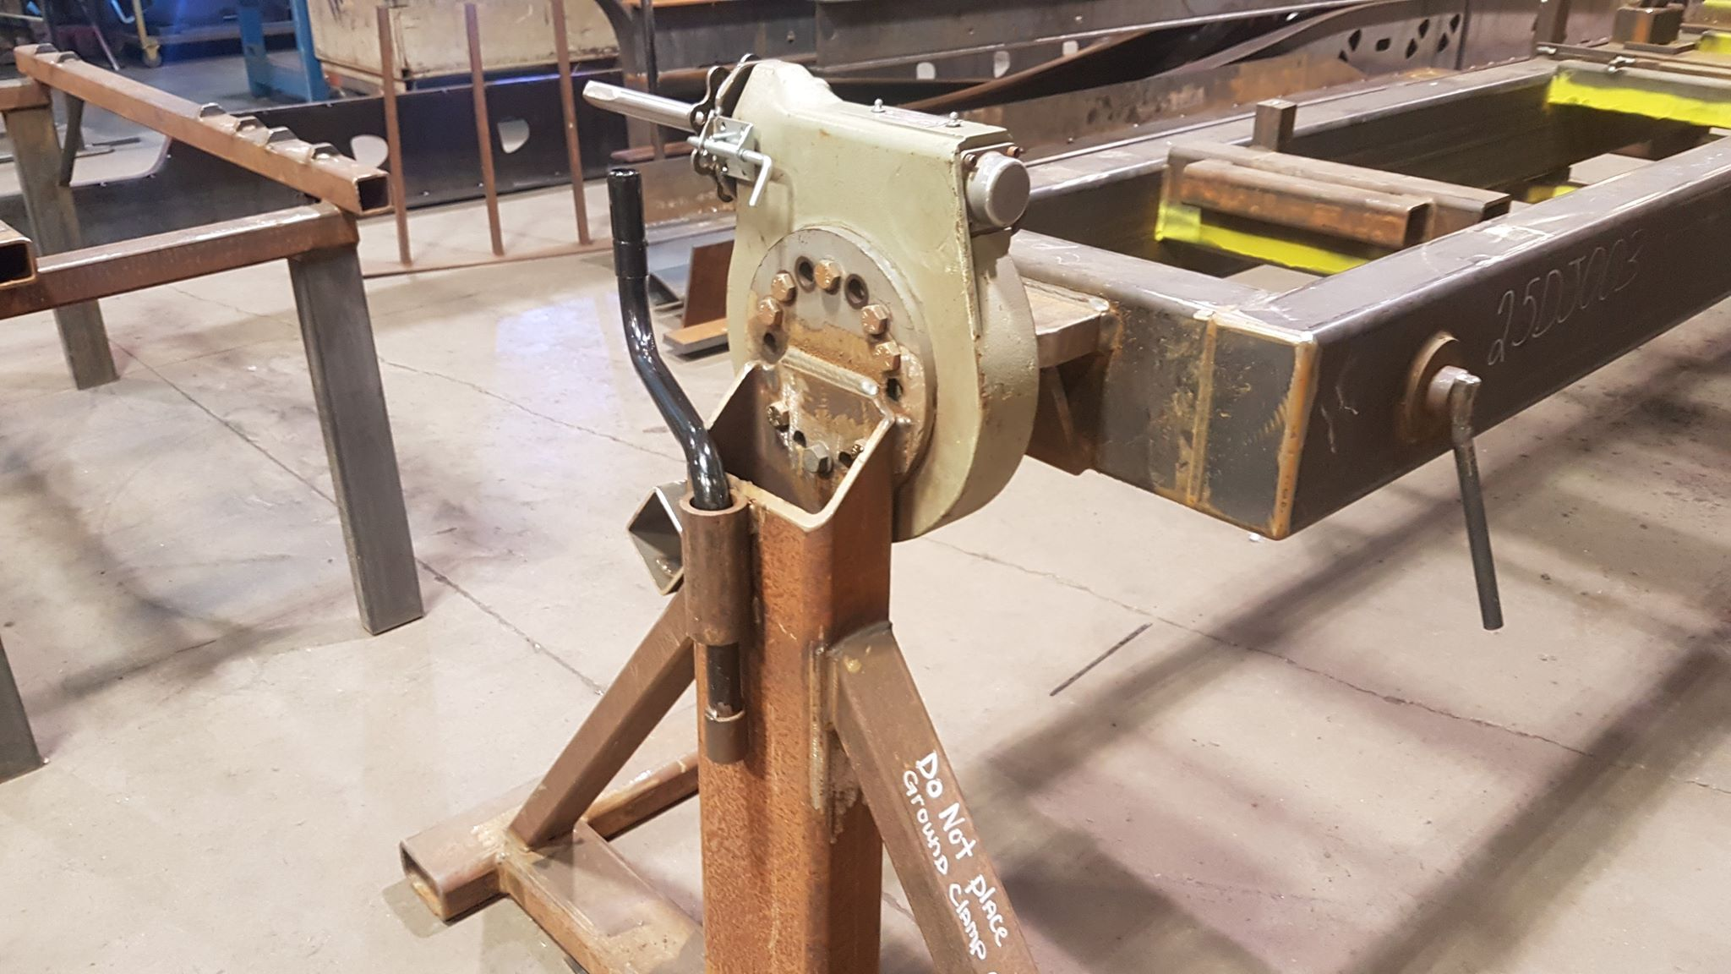
Why is this important?
Currently only uses mechanical rotators.
Advancing mechanical machines forward with electronics.
Provide a safer environment for the users.
Improves efficiency.

Slide 6
Requirements analysis

Slide 7
Design constraints/requirements
The System Must:
The System Shall:
Retrofit Doepker’s existing support frames.
Use an electric motor.
Not exceed $10,000 Canadian Dollars to build.
Be controlled using physical buttons on a control panel.
Have a rotation speed between 1-5 rpm.
Recall and rotate to a preset angular position.
Require a safety button to be depressed to operate the system.
Be operated from a control panel separated from the rotating portion of the system
Support up to max load of 500 kilograms.
Rotate a load 360˚ around the horizontal axis.

Slide 8
System design

Slide 9
System diagram – hardware systems
230 VAC
MOTOR
CONTROL SIGNAL
E-STOP
CONTROL SIGNAL
230 VAC
230 VAC
POWER
DISTRIBUTION
PANEL
12 VDC
REMOTE CONTROL

Slide 10
System diagram – software diagram

Slide 11
Detailed design & testing

Slide 12
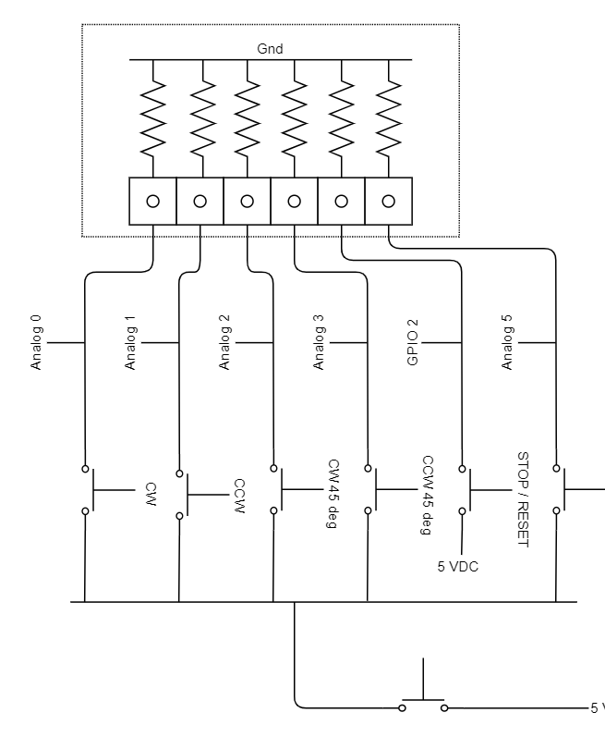
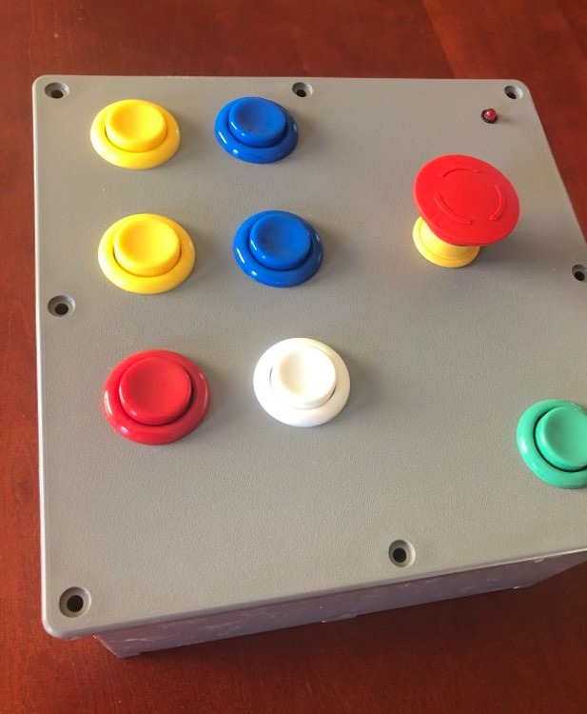
Remote
Button press to trigger events:
Enable(hardwired to control voltage for button commands)
Clockwise rotation
Counter clockwise rotation
CW and CCW 45 degree advance
Home(returns to zero)/set home
Stop/Reset
Emergency stop

Slide 13
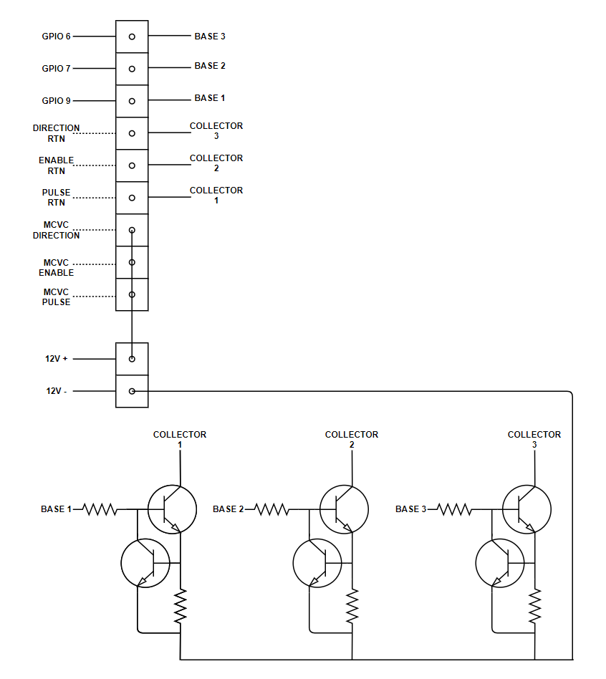
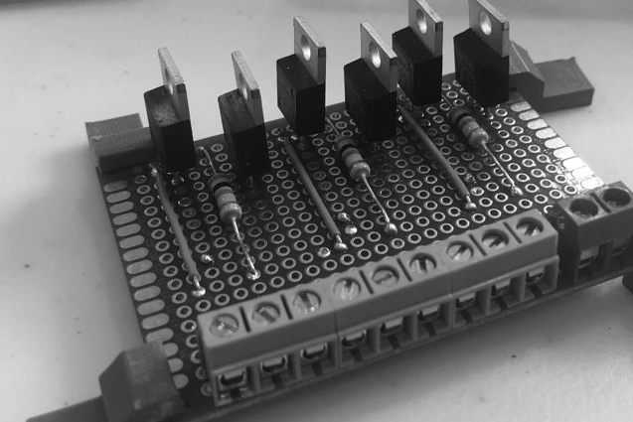
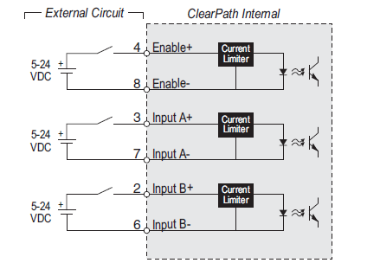
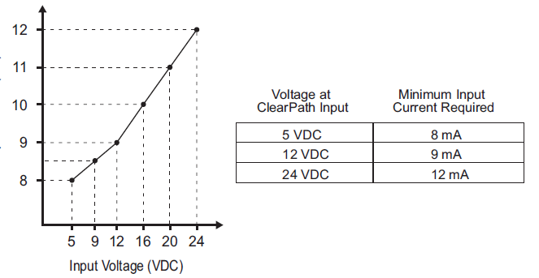
Motor control
Microcontroller was used to control a 12VDC signal via transistor
Base current limiter used to protect the circuit even in the case of a short circuit

Slide 14
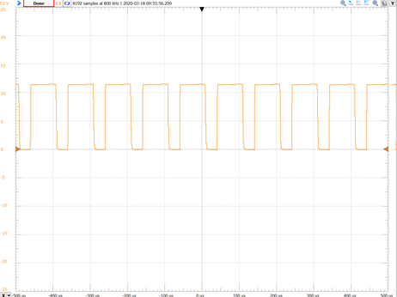
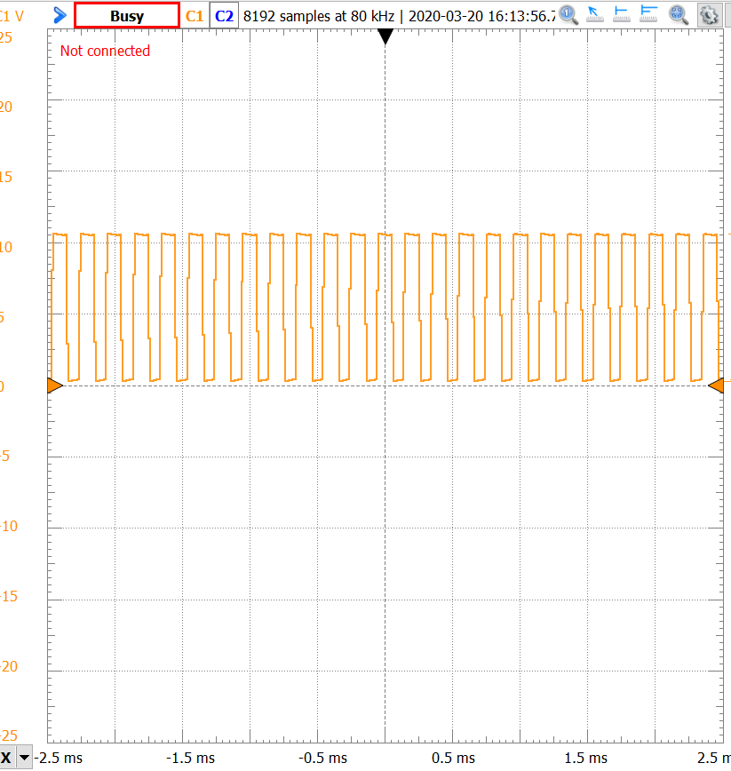
Motor Control
Frequency controlled operation
Originally used a 10kHz pulse
Firing circuit too slow
Caused duty cycle to be nearly 70%
Decided to use a 5kHz pule
Achieved a duty cycle of 55%

Slide 15
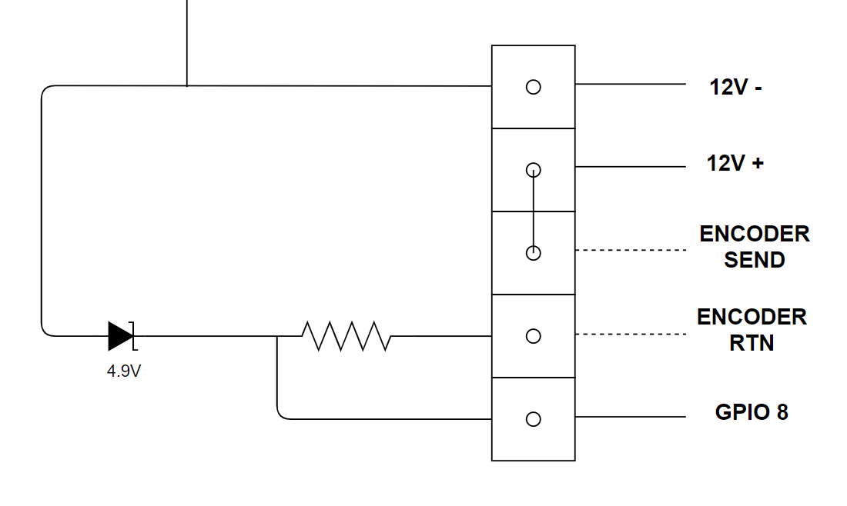
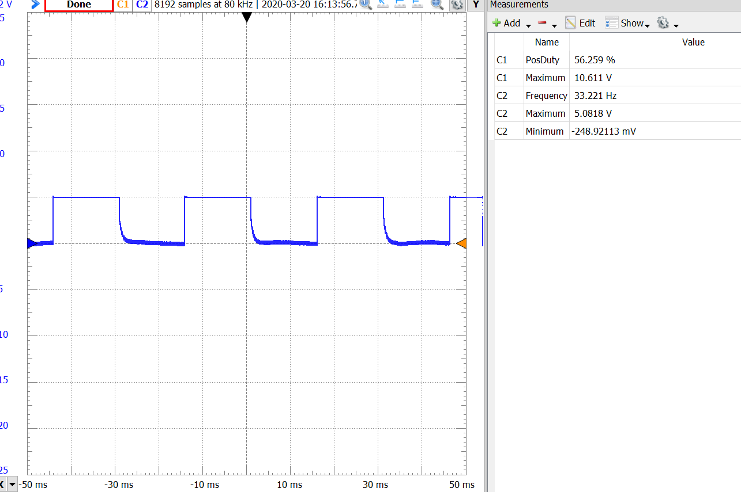
Motor Positioning
Motor encoder
4 pulses per revolution(PPR)
Motor operating at 500rpm to achieve 1rpm on robotic positioner
Arduino receives pulses at a frequency of 33.3Hz

Slide 16
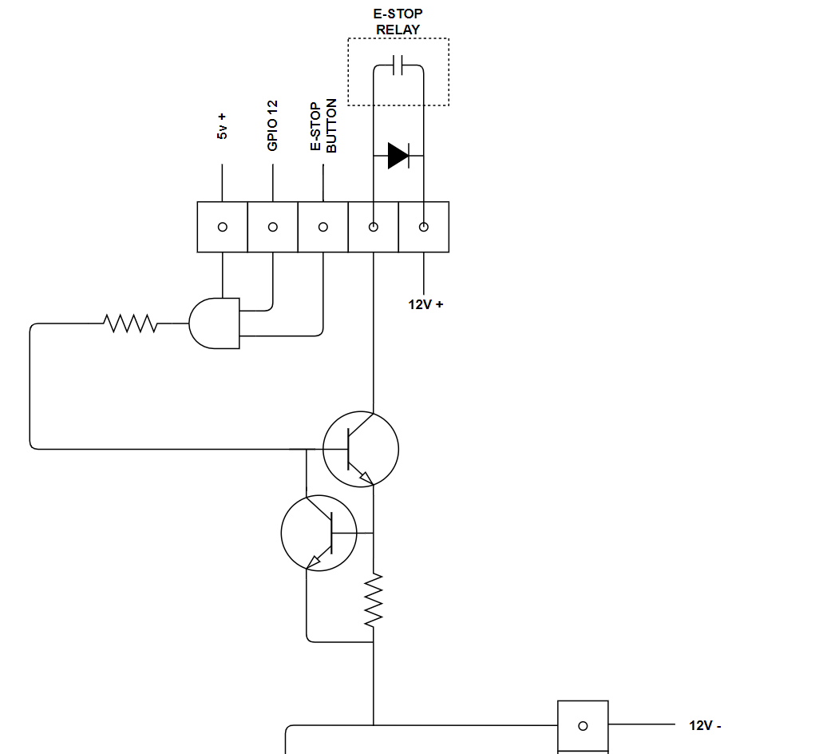
Emergency stop
Both the digital signal and hardwired E-Stop button must be logic high
Base current limiter incorporated for short circuit protection
Fly-back diode used to protect the circuit from change in inductive load

Slide 17
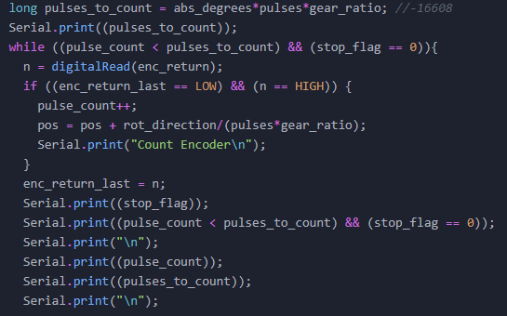
Software - code
Calculates the amount of degrees it needs to rotate.
Reading for changes for the pins
Once a pulse is read it adds to the pulse count and increments the position.
Multiple functions to handle each task.
Wait for rotations to finish
Rotate function
Stop rotating function
Everything else for the code was straight forward with the use of TimerOne and encoder library.

Slide 18
Proof of concept testing
Incremental Subsystem Testing
Complete System Testing
Tested each subsystem as they were built.
Verified that each subsystem performed as expected.
Verified individual software functions:
Buttons
Rotations
E-stop/stand by states
Moved hardware from breadboard to proto-board.
Connected each subsystem as outlined in system diagram.
Tested outline functionalities:
Each type of rotation
Button presses
Speed of rotation
Correct rotation angles

Slide 19
Demonstration

Slide 20
Design discussion
Limitations and future work

Slide 21
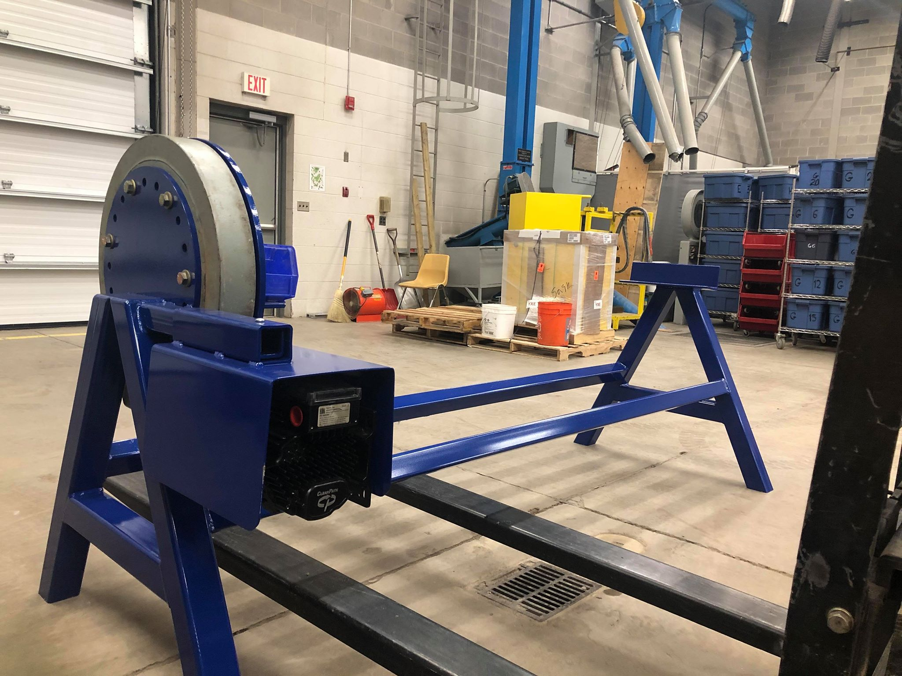
Challenges faced
Hardware/Software interfacing.
Hard design to a proof of concept.
Mechanical Binding
Noise
Avoidable mistakes
Covid-19

Slide 22
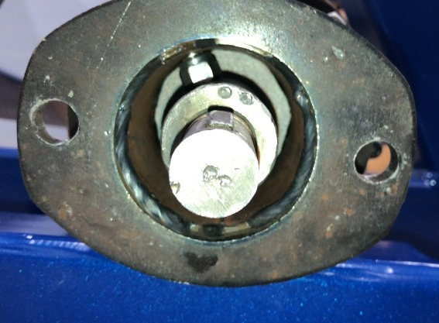
Mechanical binding
A welding seam was contacting a nut on the adapter collar
Dismantled the reducer and ground down the nut

Slide 23
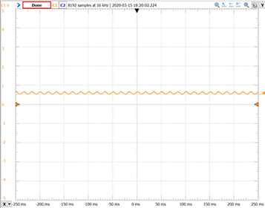
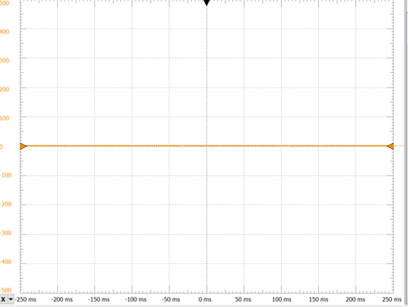
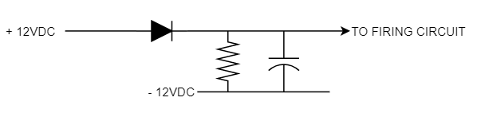
noise
Arduino is susceptible to noise
Electrolytic capacitor added to filter the DC voltage

Slide 24

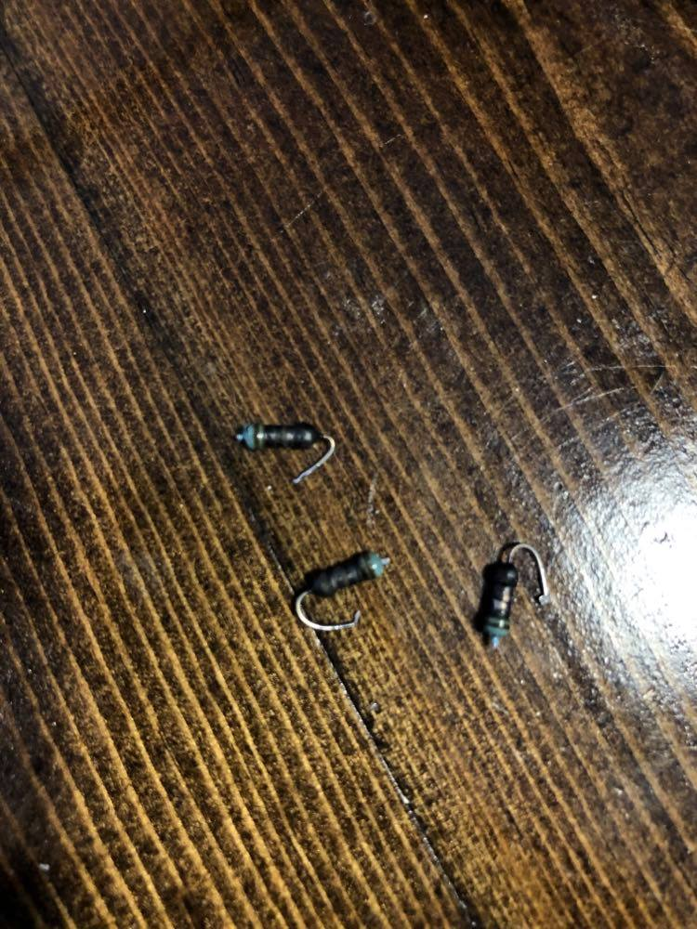
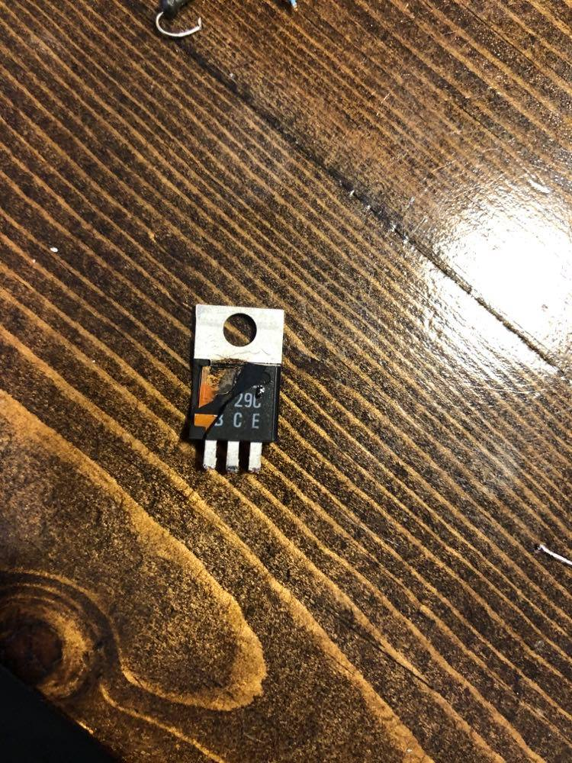
Avoidable mistakes
Accidentally contacted two terminals when testing the circuit causing a short circuit
Replacement parts are on order
https://scifi.stackexchange.com/questions/7511/why-do-consoles-explode-in-star-trek/95241

Slide 25

Covid-19
Unable to test the fully integrated system with the motor
Unable to test the torque at Doepker Industries

Slide 26
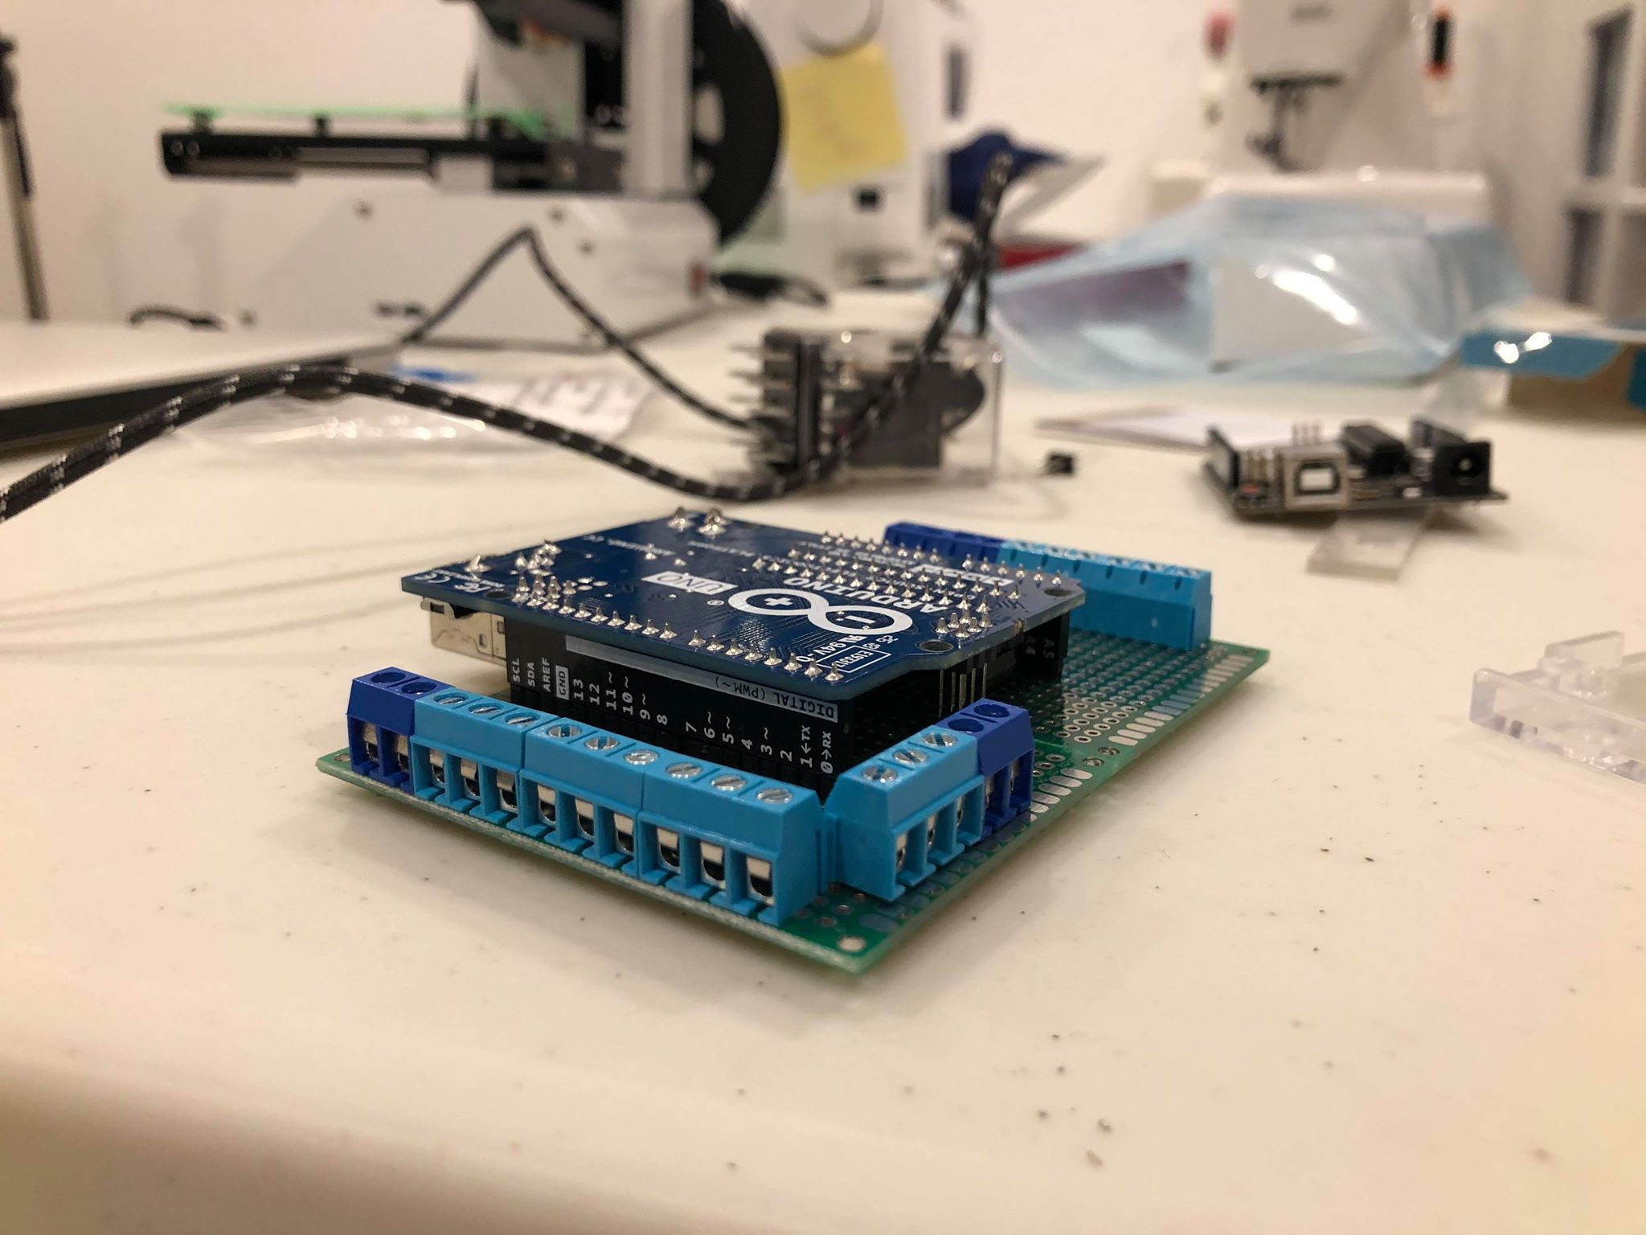
Current system limitations
Can only change speed of rotation in the code.
Handling load all on one side.

Slide 27
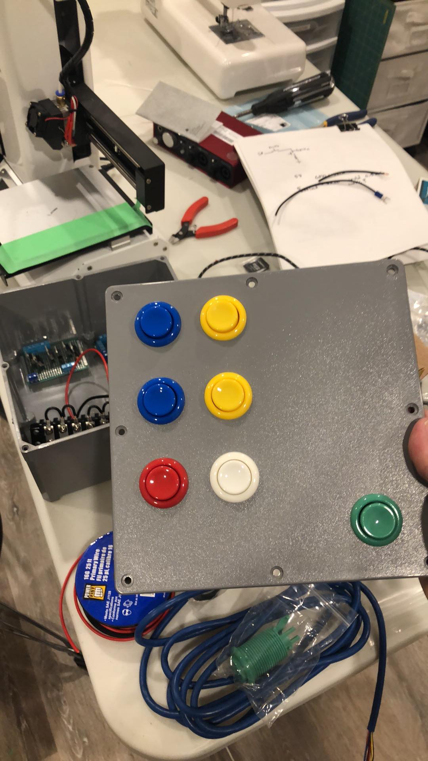
Future Design work
Design a proper PCB for the controller or use a PLC.
A speed setting for how fast/slow the positioner rotates.
Additional IO to verify events
External sensor to check if E-Stop triggers
External sensor on enable

Slide 28

Thank You! Questions?
Jordan smith
Thomas hu
Jason wong

