Slide 1
Deploy & verify a smart contract on cronos testnet
Using hardhat

Slide 2
Setting up the working directory
To create a boilerplate directly. In the project folder using the command below and select the type of project you would like to create.
Npx hardhat init
Installing the following dependencies
Npm install ethers dotenv @openzeppelin/contracts
Npm install --save-dev @nomiclabs/hardhat-verify
Npm install --save-dev @cronos-lab/hardhat-cronoscan
Npm install --save-dev solidity-coverage
Npm install --save-dev hardhat-gas-reporter
Remove the files that you are not going to use and replace them with the actual contract.
Update your hardhat.config.ts file.

Slide 3
Environment variables
Create the .env file, then populate it with the important data and save.
touch .env
The environment variables are:
MY_PRIVATE_KEY: this is the private key of a wallet address on Cronos Testnet, funded with TCRO, which will deploy the smart contract and be its owner. Ensure the wallet is funded with TRO, you can visit cronos.org/faucet to get some TRO.
CRONOS_EXPLORER_TESTNET_API_KEY: you can get the API key from explorer.cronos.org/testnet. This used by hardhat to connect to the cronos explorer in order to verify your smart contract.
COINMARKETCAP_API: you can get this API key from coinmarketcap.com. This is used by hardhat-gas-reporter to convert the deployment cost of the smart contract.

Slide 4
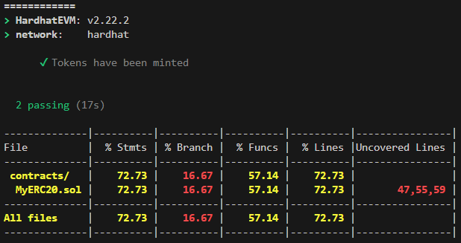
Test your code
It is important to achieve 100% unit test coverage with smart contracts. You can measure your test coverage by using the solidity-coverage tool we installed earlier.
Npx hardhat coverage
The next step would be to complete the test script in order to cover more cases.

Slide 5
Deploy on cronos testnet
The deployment to Cronos Testnet is fairly simple using the DeployMyERC20.script.ts file.
Npx hardhat run ignition/modules/DeployMyERC20.script.ts --network cronosTestnet

Slide 6
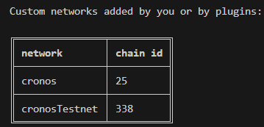
Verify the smart contract
Smart contract verification involves submitting the source code of your smart contract to ensure that the deployed bytecode on the blockchain matches the code provided.
The verification of the smart contract consists of uploading the smart contract code to the cronos explorer.
Npx hardhat verify --list-networks
The syntax to verify on the testnet
Npx hardhat verify --network cronosTestnet DEPLOYED_CONTRACT_ADDRESS “constructor argument 1” “constructor argument 2”
If you head over to the URL returned by the verify command, you should see the same deployed smart contract as earlier.
Users can now read your smart contract or send transactions directly.

