Slide 1

My Data My Story
Name
Reg. No.-12322566
Roll No-17
Section-DE328
Submitted for the Mini Project #3 of CAP776

Slide 2
Context Setting
Intuition
Analyzing daily physical activity data can reveal meaningful insights into a person’s lifestyle, fitness level, and health trends.
Objective
The goal is to understand the variation in daily step counts, detect trends or patterns, and provide insights for potential health and fitness improvements.
Challenges
Missing Data, Outliers, External Factors.
Submitted for the Mini Project #3 of CAP776
Name:Jay Dev Reg. No. 12322566 Section: DE328

Slide 3
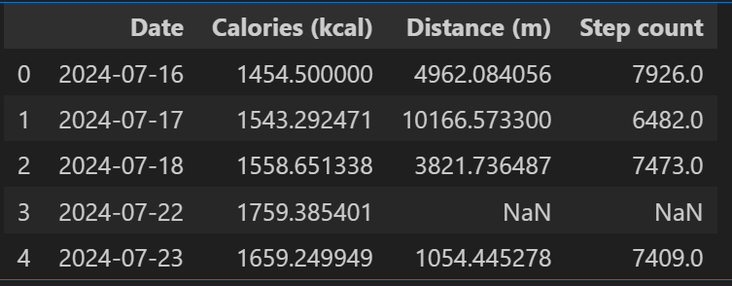
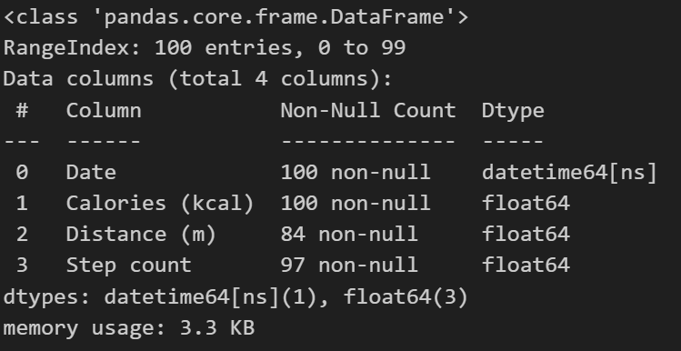
The data captured
Data description
Describe your data using df.head() and df.info()
Submitted for the Mini Project #3 of CAP776
Name: Jay Dev Reg. No. 12322566 Section: DE328

Slide 4
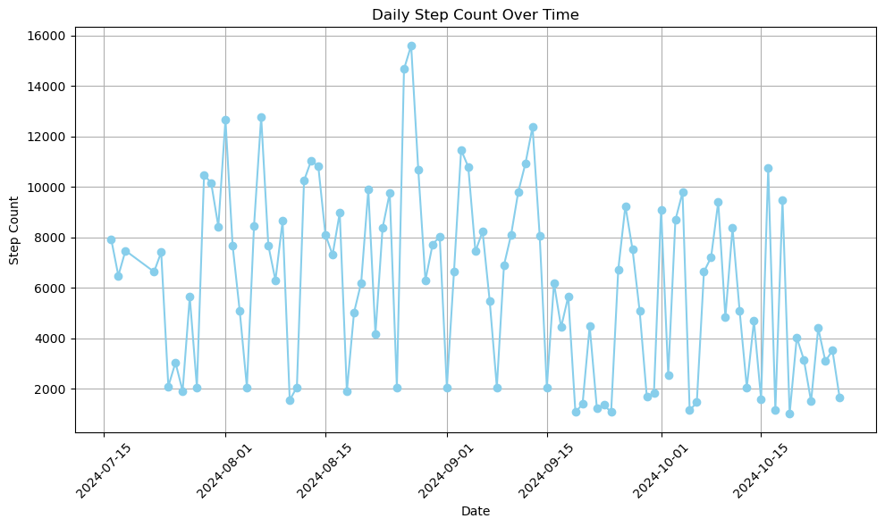
Story board #1
Graphical representation of data
Submitted for the Mini Project #3 of CAP776
Name: Jay Dev Reg. No. 12322566 Section: DE328

Slide 5
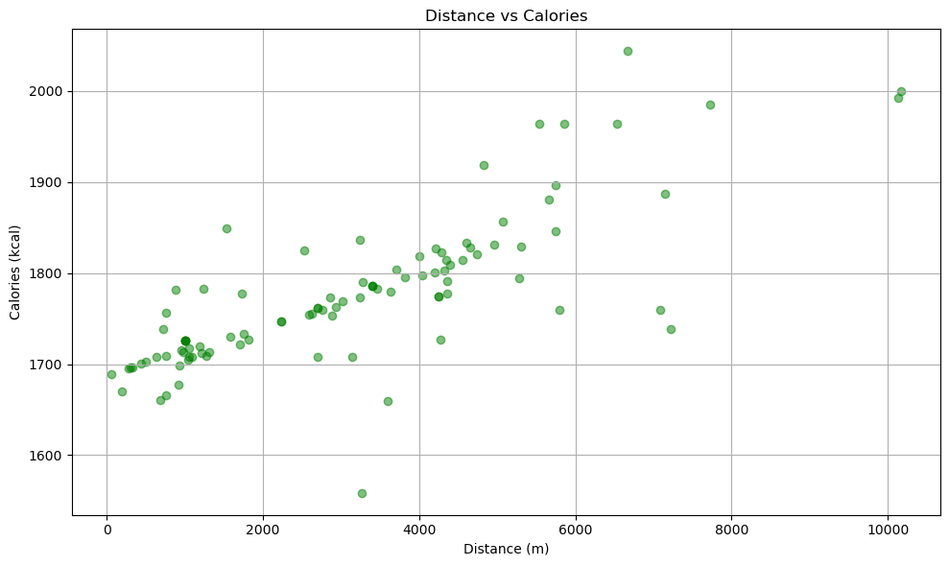
Story board #2
Graphical representation of data
Submitted for the Mini Project #3 of CAP776
Name: Jay Dev Reg. No. 12322566 Section: DE328

Slide 6
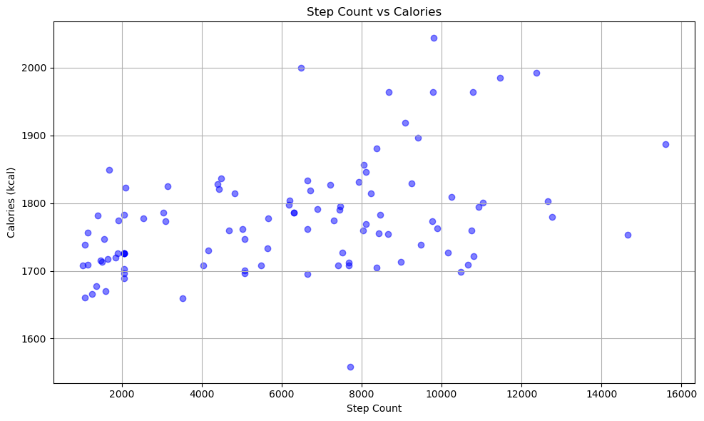
Story board #3
Graphical representation of data
Submitted for the Mini Project #3 of CAP776
Name: Jay Dev Reg. No. 12322566 Section: DE328

Slide 7
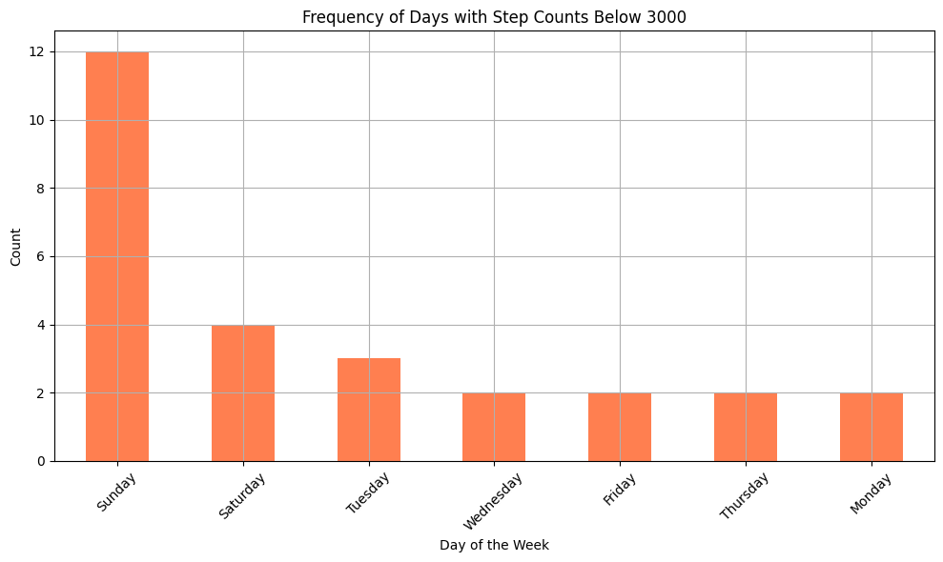
Story board #4
Graphical representaton of data
Submitted for the Mini Project #3 of CAP776
Name: Jay Dev Reg. No. 12322566 Section: DE328

Slide 8
Inferences drawn
Step Count Goal: The average step count (~6,000 steps) falls below the often recommended daily target of 10,000 steps. There’s room for improvement if increasing daily activity is a goal.
Weekly Patterns: Binning by weeks shows if there's any consistent rise or drop in activity. If weekends or specific weekdays consistently have lower step counts, that could indicate lifestyle or schedule-related inactivity.
Outliers and Rest Days: Days with step counts as low as 1000 steps likely represent days of inactivity or potential errors in data collection. These should be excluded from some forms of analysis to prevent skewed results.
Submitted for the Mini Project #3 of CAP776
Name: Jay Dev Reg. No. 12322566 Section:DE328

Slide 9
Future scope [Optional]
Personalized Recommendations: Generate customized fitness or dietary recommendations aligned with activity patterns to support health and wellness goals.
Time-Series Analysis: Perform time-series analysis to identify activity trends over time and assist in setting personal fitness goals.
Predictive Modeling: Develop predictive models to forecast calories burned and activity levels based on historical data.
Activity Classification: Classify days as either sedentary or active based on metrics like step count, heart rate, and speed, enabling better activity tracking.
Submitted for the Mini Project #3 of CAP776
Name: Jay Dev Reg. No. 12322566 Section: DE328

Slide 10
Thank You!
Submitted for the Mini Project #3 of CAP776
Name: Jay Dev Reg. No. 12322566 Section: DE328

