Slide 1
Introduction to CUDA and Computational Patterns
6 Hours
16-03-2023
1

Slide 2
Topics covered:
Introduction
Data Parallelism
CUDA Program Structure
A Vector Addition Kernel
Device Global Memory and Data Transfer
Error handling in CUDA
Kernel Functions and Threading
16-03-2023
2

Slide 3
Topics covered:
CUDA Thread Organization
Mapping Threads to Multidimensional Data
Matrix-Matrix Multiplication—A More Complex Kernel
Calculations of global threadID
Synchronization and Transparent Scalability
Assigning Resources to Blocks
Querying Device Properties
16-03-2023
3

Slide 4
Introduction
CUDA stands for Compute Unified Device Architecture
CUDA C is an extension to the popular C programming language used for writing massively parallel programs in a heterogeneous computing system.
To a CUDA programmer, the computing system consists of a host that is a traditional CPU, and one or more devices (GPUs) that are processors with a massive number of arithmetic units.
Software applications often have sections that exhibit a rich amount of data parallelism, a phenomenon that allows arithmetic operations to be safely performed on different parts of the data structures in parallel.
CUDA devices accelerate the execution of software applications by applying their massive number of arithmetic units to the data-parallel program sections.
16-03-2023
4

Slide 5
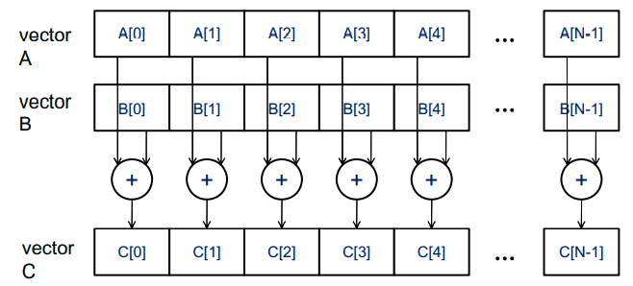
Data Parallelism
Modern software applications often process a large amount of data and incur long execution time on sequential computers.
Parallel programming uses both Task parallelism and Data parallelism.
Task Parallelism Vs Data parallelism
Task parallelism exists if the two tasks can be done independently. For example, a simple application may need to do a vector addition and a matrix-vector multiplication. Each of these would be a task.
Data parallelism refers to the program property whereby many arithmetic operations can be safely performed on the data structures in a simultaneous manner. For example, in vector addition, we use data parallelism.
16-03-2023
5

Slide 6
CUDA Program Structure
The structure of a CUDA program reflects the coexistence of a host (CPU) and one or more devices (GPUs) in the computer.
Each CUDA source file can have a mixture of both host and device code.
By default, any traditional C program is a CUDA program that contains only host code. One can add device functions and data declarations into any C source file by marking them with special CUDA keywords.
The NVIDIA C Compiler (NVCC) separates the host code and the device code during compilation process.
The host code is compiled with the host’s standard C compilers and runs as an ordinary CPU process.
The device code(kernels) is compiled by the NVCC and executed on a GPU device.
16-03-2023
6

Slide 7
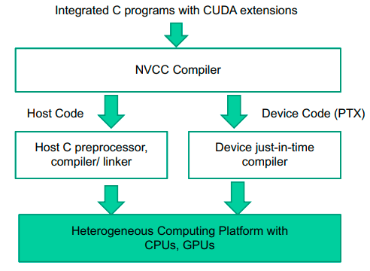
CUDA Program Structure
An Overview of the compilation process of a CUDA program
16-03-2023
7

Slide 8
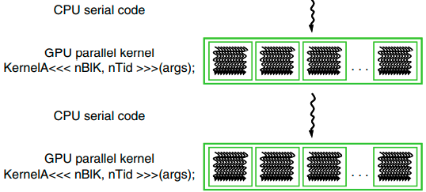
CUDA Program Structure
The execution of a CUDA program starts with host (CPU) execution.
When a kernel function is called (launched), it is executed by a large number of threads on a device.
All the threads that are generated by a kernel launch are collectively called a grid.
When all threads of a kernel complete their execution, the corresponding grid terminates, and the execution continues on the host until another kernel is launched.
CUDA threads take very few cycles to generate and schedule due to efficient hardware support.
CPU threads typically require thousands of clock cycles to generate and schedule
16-03-2023
8

Slide 9
A Vector Addition Kernel
A traditional vector addition C code example:.
// Compute vector sum h_C = h_A+h_B
void vecAdd(float* h_A, float* h_B, float* h_C, int n)
{
for (i = 0; i < n; i++)
h_C[i] = h_A[i] + h_B[i];
}
int main()
{
// Memory allocation for h_A, h_B, and h_C
// I/O to read h_A and h_B, N elements each …
vecAdd(h_A, h_B, h_C, N);
}
16-03-2023
9

Slide 10
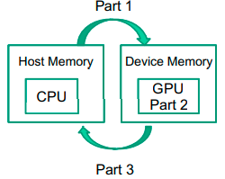
A Vector Addition Kernel
A modified vecAdd() function for execution on a CUDA device:.
#include <cuda.h>
void vecAdd(float* A, float*B, float* C, int n)
{
float *d_A, *d_B, *d_C;
int size = n* sizeof(float);
Part-1. // Allocate device memory for A, B, and C
// Copy A and B to device memory
Part-2. // Kernel launch code – to have the device
// to perform the actual vector addition
Part-3. // Copy C from the device memory
// Free device vectors
}
16-03-2023
10

Slide 11
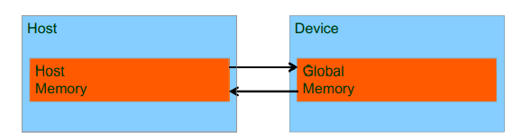
Device Global Memory and Data transfer
In CUDA, the host and devices have separate memory spaces. Devices are typically hardware cards that come with their own Dynamic Random Access Memory (DRAM) which is also called as Global memory.
The CUDA runtime system provides Application Programming Interface (API) functions to perform the following activities on behalf of the programmer:
To execute a kernel on a device, the programmer needs to allocate global memory on the device and transfer pertinent data from the host memory to the allocated device memory (Part-1).
Similarly, after device execution, the programmer needs to transfer result data from the device memory back to the host memory and free up the device memory that is no longer needed (Part-3).
CUDA host memory and device memory model for programmers
16-03-2023
11

Slide 12
Device Global Memory and Data transfer
The CUDA runtime system provides API functions for managing data in the device memory.
Function cudaMalloc() can be called from the host code to allocate a piece of device global memory for an object. It takes two parameters:
The first parameter to the cudaMalloc() function is the address of a pointer variable that will be set to point to the allocated object. The address of the pointer variable should be cast to (void ) because the function expects a generic pointer.
The second parameter to the cudaMalloc() function gives the size of the data to be allocated, in terms of bytes.
Function cudaFree() is called to free the storage space allocated for an object from the device global memory.
16-03-2023
12

Slide 13
Device Global Memory and Data transfer
#include <cuda.h>
void vecAdd(float* A, float*B, float* C, int n)
{
float *d_A, *d_B, *d_C;
int size = n* sizeof(float);
Part-1. // Allocate device memory for A, B, and C
// Copy A and B to device memory
Part-2. // Kernel launch code – to have the device
// to perform the actual vector addition
Part-3. // Copy C from the device memory
// Free device vectors
}
#include <cuda.h>
void vecAdd(float* A, float*B, float* C, int n)
{
float *d_A, *d_B, *d_C;
int size = n* sizeof(float);
Part-1. cudaMalloc((void**)&d_A, size);
cudaMalloc((void**)&d_B, size);
cudaMalloc((void**)&d_C, size);
// Copy A and B to device memory
Part-2. // Kernel launch code – to have the device
// to perform the actual vector addition
Part-3. // Copy C from the device memory
cudaFree(d_A);
cudaFree(d_B);
cudaFree(d_C);
}
The addresses in d_A, d_B, and d_C are addresses in the device memory. These addresses should not be dereferenced in the host code. They should be mostly used in calling API functions and kernel functions. Dereferencing a device memory pointer in the host code can cause exceptions or other types of runtime errors during runtime.
16-03-2023
13

Slide 14
Device Global Memory and Data transfer
Once the host code has allocated device memory for the data objects, it calls cudaMemcpy() to transfer the data from host to device.
The cudaMemcpy() function takes four parameters:
The first parameter is a pointer to the destination location for the data object to be copied.
The second parameter points to the source location.
The third parameter specifies the number of bytes to be copied.
The fourth parameter indicates the types of memory involved in the copy:
from host memory to host memory
from host memory to device memory
from device memory to host memory
from device memory to device memory
cudaMemcpy() cannot be used to copy between different GPUs in multi-GPU systems
16-03-2023
14

Slide 15
Device Global Memory and Data transfer
#include <cuda.h>
void vecAdd(float* A, float*B, float* C, int n)
{
float *d_A, *d_B, *d_C;
int size = n* sizeof(float);
Part-1. // Allocate device memory for A, B, and C
// Copy A and B to device memory
Part-2. // Kernel launch code – to have the device
// to perform the actual vector addition
Part-3. // Copy C from the device memory
// Free device vectors
}
#include <cuda.h>
void vecAdd(float* A, float*B, float* C, int n)
{
float *d_A, *d_B, *d_C;
int size = n* sizeof(float);
// Part-1
cudaMalloc((void **)&d_A, size);
cudaMalloc((void**)&d_B, size);
cudaMalloc((void**)&d_C, size);
cudaMemcpy(d_A, A, size, cudaMemcpyHostToDevice);
cudaMemcpy(d_B, B, size, cudaMemcpyHostToDevice);
// Part-2
// Kernel launch code – to have the device to perform the
//actual vector addition
// Part-3
cudaMemcpy(C, d_C, size, cudaMemcpyDeviceToHost);
cudaFree(d_A); cudaFree(d_B); cudaFree(d_C);
}
16-03-2023
15

Slide 16
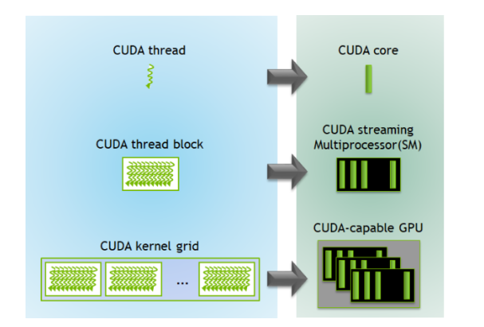

Slide 17
Error Handling in CUDA
CUDA API functions return flags that indicate whether an error has occurred when they served the request.
Most errors are due to inappropriate argument values used in the API call.
In practice, we should surround the API call with code that tests for error conditions and prints out error messages so that the user can be aware of the fact that an error has occurred.
// if the system is out of device memory, the user will be informed about the situation.
cudaError_t err = cudaMalloc((void** ) &d_A, size);
if (err ! = cudaSuccess)
{
printf(“%s in %s at line %d\n”, cudaGetErrorString (err), __FILE__, __LINE__);
exit(EXIT_FAILURE);
}
16-03-2023
17

Slide 18
Kernel Functions and Threading
In CUDA, a kernel function specifies the code to be executed by all threads during a parallel phase.
Since all the threads execute the same code, CUDA programming is an instance of the well-known SPMD (single program, multiple data) parallel programming style.
SPMD Vs SIMD
SPMD is not the same as SIMD (single instruction, multiple data).
In an SPMD system, the parallel processing units execute the same program on multiple parts of the data.
In a SIMD system, all processing units are executing the same instruction at any instant.
16-03-2023
18

Slide 19
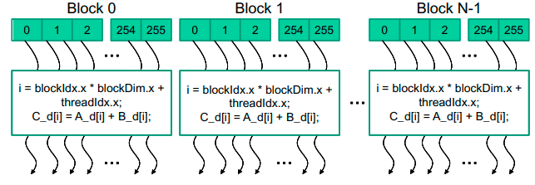
Kernel Functions and Threading
When a host code launches a kernel, the CUDA runtime system generates a grid of threads that are organized in a two-level hierarchy.
Each grid is organized into an array of thread blocks.
All blocks of a grid are of the same size; each block can contain up to 1,024 threads.
The number of threads in each thread block is specified by the host code when a kernel is launched.
The same kernel can be launched with different numbers of threads at different parts of the host code.
For a given grid of threads, the number of threads in a block is available in the blockDim variable.
The value of blockDim.x variable is 256. In general, the dimensions of thread blocks should be multiples of 32 due to hardware efficiency reasons.
16-03-2023
19

Slide 20
Kernel Functions and Threading
Each thread in a block has a unique threadIdx value (0, 1, . . 255).
This allows each thread to combine its threadIdx and blockIdx values to create a unique global index for itself with the entire grid.
A data index i is calculated as:
i = blockIdx.x * blockDim.x + threadIdx.x.
By launching the kernel with a larger number of blocks, one can process larger vectors. By launching a kernel with n or more threads, one can process vectors of length n.
Since blockDim is 256 in our example, the i values of threads in block 0 ranges from 0 to 255. The i values of threads in block 1 range from 256 to 511. The i values of threads in block 2 range from 512 to 767.
Since each thread uses i to access d_A, d_B, and d_C, these threads cover the first 768 vector elements for the addition.
16-03-2023
20

Slide 21
Kernel Functions and Threading
Kernel function for a vector addition
The keyword __global__ indicates that the function is a kernel and that it can be called from a host function to generate a grid of threads on a device.
The condition if(i < n) will only execute the required threads and prevents the execution of unnecessary threads.
// Compute vector sum C = A+B
// Each thread performs one pair-wise addition
_ _global_ _ void vecAddKernel(float* A, float* B, float* C, int n) {
int i = threadIdx.x + blockDim.x * blockIdx.x;
if(i < n)
C[i] = A[i] + B[i];
}
For example, if the vector length is 100, the smallest efficient thread block dimension is 32. we need to launch four thread blocks to process all the 100 vector elements which will create 128 threads.
By setting condition if(i < n) , we disable the last 28 threads in thread block 3 from doing work.
16-03-2023
21

Slide 22
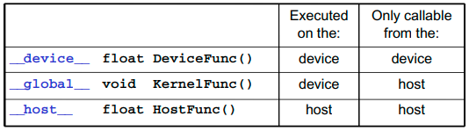
Kernel Functions and Threading
CUDA extends C language with three qualifier keywords in function declarations:
The __global__ keyword indicates that the function being declared is a CUDA kernel function. A __global__ function is to be executed on the device and can only be called from the host code.
The __device__ keyword indicates that the function being declared is a CUDA device function. A device function executes on a CUDA device and can only be called from a kernel function or another device function. Device functions can have neither recursive function calls nor indirect function calls through pointers in them.
The __host__ keyword indicates that the function being declared is a CUDA host function. A host function is simply a traditional C function that executes on the host and can only be called from another host function.
16-03-2023
22

Slide 23
Kernel Functions and Threading
By default, all functions in a CUDA program are host functions if they do not have any of the CUDA keywords in their declaration.
One can use both __host__ and __device__ in a function declaration. This combination tells the compilation system to generate two versions of object files for the same function:
One is executed on the host and can only be called from a host function.
The other is executed on the device and can only be called from a device or kernel function.
When the host code launches a kernel, it sets the grid and thread block dimensions via execution configuration parameters:
The configuration parameters are given between the <<< and >>> before the traditional C function arguments.
The first configuration parameter gives the number of thread blocks in the grid.
The second configuration parameter specifies the number of threads in each thread block.
vecAddKernel<<< ceil(n/256.0), 256 >>> (d_A, d_B, d_C, n);
16-03-2023
23

Slide 24
Complete CUDA program for vecADD()
#include <cuda.h>
void vecAdd(float* A, float*B, float* C, int n)
{
float *d_A, *d_B, *d_C;
int size = n* sizeof(float);
// Part-1
cudaMalloc((void **)&d_A, size);
cudaMalloc((void**)&d_B, size);
cudaMalloc((void**)&d_C, size);
cudaMemcpy(d_A, A, size, cudaMemcpyHostToDevice);
cudaMemcpy(d_B, B, size, cudaMemcpyHostToDevice);
// Part-2
vecAddKernel<<< ceil(n/256.0), 256 >>>(d_A, d_B, d_C, n);
// Part-3
cudaMemcpy(C, d_C, size, cudaMemcpyDeviceToHost);
cudaFree(d_A); cudaFree(d_B); cudaFree(d_C);
}
// Kernel for computing vector sum C = A+B
_ _global_ _ void vecAddKernel(float* A, float* B, float* C, int n) {
int i = threadIdx.x + blockDim.x * blockIdx.x;
if(i < n)
C[i] = A[i] + B[i];
}
16-03-2023
24

Slide 25
CUDA Thread Organization
All CUDA threads in a grid execute the same kernel function and they rely on coordinates to distinguish themselves from each other and to identify the appropriate portion of the data to process.
CUDA threads are organized into a two-level hierarchy:
A grid consists of one or more blocks
Each block in turn consists of one or more threads.
All threads in a block share the same block index, which can be accessed as the blockIdx variable in a kernel.
Each thread also has a thread index, which can be accessed as the threadIdx variable in a kernel.
When a thread executes a kernel function, references to the blockIdx and threadIdx variables return the coordinates of the thread.
The execution configuration parameters in a kernel launch statement specify the dimensions of the grid and the dimensions of each block:
vecAddKernel<<< ceil(n/256.0), 256 >>>(d_A, d_B, d_C, n);
16-03-2023
25

Slide 26
CUDA Thread Organization
In general, a grid is a 3D array of blocks, and each block is a 3D array of threads.
The programmer can choose to use fewer dimensions by setting the unused dimensions to 1.
The exact organization of a grid is determined by the execution configuration parameters (within <<< and >>> ) of the kernel launch statement. The first execution configuration parameter specifies the dimensions of the grid in number of blocks. The second specifies the dimensions of each block in number of threads.
Each such parameter is of dim3 type, which is a C structure with three unsigned integer fields, x, y, and z. These three fields correspond to the three dimensions:
dim3 dimGrid(128, 1, 1);
dim3 dimBlock(32, 1, 1);
vecAddKernel <<< dimGrid, dimBlock >>> (...);
16-03-2023
26

Slide 27
CUDA Thread Organization
The grid and block dimensions can also be calculated from other variables. In the following example, the value of variable n at kernel launch time will determine the dimension of the grid:
For convenience, CUDA C provides a special shortcut for launching a kernel with 1D grids and blocks. Instead of using dim3 variables, one can use arithmetic expressions to specify the configuration of 1D grids and blocks. In this case, the CUDA C compiler simply takes the arithmetic expression as the x dimensions and assumes that the y and z dimensions are 1.
For a given grid of threads, the dimension of grid is available in gridDim variable, and the dimension of each block is available in the blockDim variable.
dim3 dimGrid (ceil(n/256.0), 1, 1);
dim3 dimBlock(32, 1, 1);
vecAddKernel <<< dimGrid, dimBlock >>> (...); // n is the number of data elements
vecAddKernel <<< ceil(n/256.0), 32 >>> (...); // n is the number of data elements
16-03-2023
27

Slide 28
CUDA Thread Organization
In CUDA C, the allowed values of gridDim.x, gridDim.y, and gridDim.z range from 1 to 65,536.
All threads in a block share the same blockIdx.x, blockIdx.y, and blockIdx.z values.
Among all blocks, the blockIdx.x value ranges between 0 and gridDim.x-1, the blockIdx.y value between 0 and gridDim.y-1, and the blockIdx.z value between 0 and gridDim.z-1.
All blocks in a grid have the same dimensions.
The total size of a block is limited to 1,024 threads, with flexibility in distributing these elements into the three dimensions as long as the total number of threads does not exceed 1,024.
For example, (512, 1, 1), (8, 16, 4), and (32, 16, 2) are all allowable blockDim values, but (32, 32, 2) is not allowable since the total number of threads would exceed 1,024.
dim3 dimGrid(128, 1, 1); // gridDim.x = 128, gridDim.y = 1, gridDim.z = 1
dim3 dimBlock(32, 1, 1); // blockDim.x = 32, blockDim.y = 1, blockDim.z = 1
vecAddKernel <<< dimGrid, dimBlock >>> (...);
16-03-2023
28

Slide 29
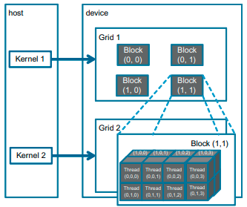
CUDA Thread Organization
Example of a 2D (2, 2, 1) grid that consists of 3D (4, 2, 2) blocks. The grid can be generated with the following host code:
dim3 dimGrid(2, 2, 1);
dim3 dimBlock(4, 2, 2);
vecAddKernel <<< dimGrid, dimBlock >>> (...);
Each block in Figure is labeled with (blockIdx.y, blockIdx.x).
For example, block(1,0) has blockIdx.y=1 and blockIdx.x=0.
Note that the ordering of the labels is such that the highest dimension comes first. This is reverse of the ordering used in the configuration parameters where the lowest dimension comes first.
This reversed ordering for labeling threads works better for mapping of thread coordinates into data indexes in accessing multidimensional arrays.
16-03-2023
29

Slide 30
CUDA Thread Organization ( z,y,x notation used)
Each threadIdx also consists of three fields: the x coordinate threadId.x, the y coordinate threadIdx.y, and the z coordinate threadIdx.z.
In the following example, each block is organized into 4 x 2 x 2 arrays of threads. The Figure expands block(1,1) to show its 16 threads. For example, thread(1,0,2) has threadIdx.z=1, threadIdx.y=0, and threadIdx.x=2. In this example, we have four blocks of 16 threads each, with a grand total of 64 threads in the grid.
16-03-2023
30

Slide 31
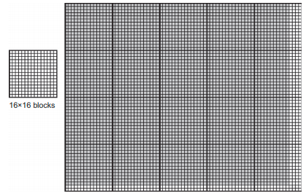
Mapping Threads to Multidimensional Data
The choice of 1D, 2D, or 3D thread organizations is usually based on the nature of the data.
For example, pictures are a 2D array of pixels. It is often convenient to use a 2D grid that consists of 2D blocks to process the pixels in a picture.
In this picture example, we have four extra threads in the x-direction and two extra threads in the y-direction. That is, we will generate 80x64 threads to process 76x62 pixels.
The picture processing kernel function will have if statements to test whether the thread indices threadIdx.x and threadIdx.y fall within the valid range of pixels.
It is a 76x62 picture.
Assume that we decided to use a 16x16 block, with 16 threads in the x-direction and 16 threads in the y-direction.
We will need five blocks in the x-direction and four blocks in the y-direction, which results in 5x4=20 block.
16-03-2023
31

Slide 32
Mapping Threads to Multidimensional Data
→ n (blockDim.x) = 76
Within the kernel function, references to built-in variables gridDim.x, gridDim.y, blockDim.x, and blockDim.y will result in 5, 4, 16, and 16, respectively.
Assume that the host code uses an integer variable n to track the number of pixels in the x-direction, and another integer variable m to track the number of pixels in the y-direction.
Assume that the input picture data has been copied to the device memory and can be accessed through a pointer variable d_Pin. The output picture has been allocated in the device memory and can be accessed through a pointer variable d_Pout.
→ m (blockDim.y) = 62
dim3 dimGrid (ceil(n/16.0), ceil(m/16.0), 1);
dim3 dimBlock(16, 16, 1);
vecAddKernel <<< dimGrid, dimBlock >>> (d_Pin, d_Pout, n, m);
16-03-2023
32

Slide 33
Mapping Threads to Multidimensional Data - Flattening a 2D-array
Ideally, we would like to access d_Pin as a 2D array where an element at row j and column i can be accessed as d_Pin[j][i].
However, the ANSI C standard based on which CUDA C was developed requires that the number of columns in d_Pin be known at compile time.
Unfortunately, this information is not known at compiler time for dynamically allocated arrays.
As a result, programmers need to explicitly linearize, or “flatten,” a dynamically allocated 2D array into an equivalent 1D array in the current CUDA C.
In reality, all multidimensional arrays in C are linearized.
There are at least two ways one can linearize a 2D array:
row-major layout
column-major layout
16-03-2023
33

Slide 34
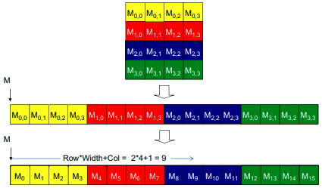

Mapping Threads to Multidimensional Data - Flattening a 2D-array
row-major layout
Here we place all elements of the same row into consecutive locations. The rows are then placed one after another into the memory space.
M_{j,i} denote an M element at the j^{th} row and the i^{th} column.
The 1D equivalent index for the M element in row j and column i is j x 4 + i. The j x 4 term skips over all elements of the rows before row j. The i term then selects the right element within the section for row j.
16-03-2023
34

Slide 35
Mapping Threads to Multidimensional Data - Flattening a 2D-array
column-major layout
Here we place all elements of the same column into consecutive locations. The columns are then placed one after another into the memory space.
This is used by FORTRAN compilers.
The column-major layout of a 2D array is equivalent to the row-major layout of its transposed form.
16-03-2023
35

Slide 36
Mapping Threads to Multidimensional Data – the pictureKernel()
__global__ void pictureKernell(float* d_Pin, float* d_Pout, int n, int m)
{ // Calculate the row # of the d_Pin and d_Pout element to process
int Row = blockIdx.y*blockDim.y + threadIdx.y;
// Calculate the column # of the d_Pin and d_Pout element to process
int Col = blockIdx.x*blockDim.x + threadIdx.x;
// each thread computes one element of d_Pout if in range
if ((Row < m) && (Col < n))
{
d_Pout[Row*n+Col] = 2*d_Pin[Row*n+Col];
}
}
→ n (blockDim.x) = 80
This kernel will scale every pixel value in the picture by a factor of 2.0.
There are a total of blockDim.x(16) * gridDim.x(5) threads in the horizontal direction and blockDim.y(16) * gridDim.y(4) threads in the vertical direction.
m=64 n=80 gridDim.x=5 blocks, gridDim.y=4 blocks blockDim.x=16 threads, blockDim.y =16 threads
The expression Col=blockIdx.x*blockDim.x+threadIdx.x generates every integer value from 0 to blockDim.x*gridDim.x-1.(0-79)
The condition (Col < n) && (Row < m) make sure that only the threads in proper range are executed.
0,0
1,0
2,0
3,0
4,0
0,1
1,1
2.1
3,1
4,1
→ m (blockDim.y) = 64
0,2
1,2
2.2
3,2
4,2
0,3
1,3
2.3
3,3
4,3
dim3 dimGrid (ceil(n/16.0), ceil(m/16.0), 1);
dim3 dimBlock(16, 16, 1);
vecAddKernel <<< dimGrid, dimBlock >>> (d_Pin, d_Pout, n, m);
16-03-2023
36

Slide 37
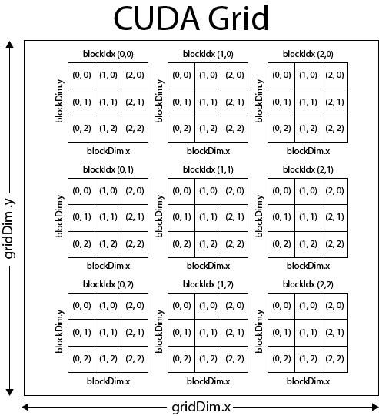
Calculations of global threadID
Note: (x,y) is followed

Slide 38
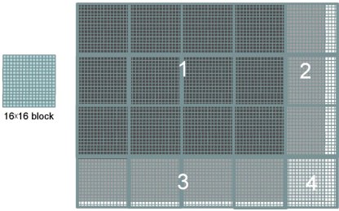
Mapping Threads to Multidimensional Data – the pictureKernel()
→ n (blockDim.x) = 80
During the execution, the execution behaviour of blocks will fill into one of four different cases:
The first area, marked as 1 consists of the threads that belong to the 12 blocks covering the majority of pixels in the picture. Both Col and Row values of these threads are within range (76).
The second area, marked as 2 contains the threads that belong to the 3 blocks covering the upper-right pixels of the picture. Although the Row values of these threads are always within range, the Col values of some of them exceed the n value.
The third area, marked as 3 contains the threads that belong to the 4 blocks covering the lower-left pixels of the picture. Although the Col values of these threads are always within range, the Row values of some of them exceed the m value (62).
The forth area, marked as 4 contains the threads that belong to 1 block covering the lower-right pixels of the picture. Both Col and Row values exceed the n and m values.
→ m (blockDim.y) = 64
16-03-2023
38

Slide 39
Matrix-Matrix Multiplication – A More Complex Kernel
We can map every valid data element in a 2D array to a unique thread using threadIdx, blockIdx, blockDim, and gridDim variables:
// Calculate the row #
int Row = blockIdx.y*blockDim.y + threadIdx.y;
// Calculate the column #
int Col = blockIdx.x*blockDim.x + threadIdx.x;
Matrix-Matrix multiplication between an I x J matrix d_M and a J x K matrix d_N produces an I x K matrix d_P.
16-03-2023
39

Slide 40
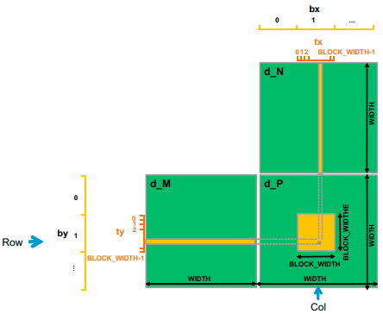
Matrix-Matrix Multiplication – A More Complex Kernel
When performing a matrix-matrix multiplication, each element of the product matrix d_P is an inner product of a row of d_M and a column of d_N. The inner product between two vectors is the sum of products of corresponding elements. That is, d_P _{Row,Col} =Σd_M_{Row,k} * d_N_{k,Col}, for k = 0, 1, ... Width-1.
We design a kernel where each thread is responsible for calculating one d_P element.
The d_P element calculated by a thread is in row blockIdx.y * blockDim.y + threadIdx.y and
in column blockIdx.x * blockDim.x + threadIdx.x.
16-03-2023
40

Slide 41
Matrix-Matrix Multiplication– Kernel for thread-to-data mapping
In the following kernel, we assume square matrices having dimension Width*Width.
Throughout the source code, instead of using a numerical value 16 for the block-width, the programmer can use the name BLOCK_WIDTH by defining it. It helps in autotuning.
__global__ void MatrixMulKernel(float* d_M, float* d_N, float* d_P, int Width)
{
// Calculate the row index of the d_Pelement and d_M
int Row = blockIdx.y*blockDim.y+threadIdx.y;
// Calculate the column index of d_P and d_N
int Col = blockIdx.x*blockDim.x+threadIdx.x;
if ((Row < Width) && (Col < Width))
{
float Pvalue = 0;
// each thread computes one element of the block sub-matrix
for (int k = 0; k < Width; ++k)
Pvalue += d_M[Row*Width+k]*d_N[k*Width+Col];
d_P[Row*Width+Col] = Pvalue;
}
}
#define BLOCK_WIDTH 16
// Setup the execution configuration
int NumBlocks = Width/BLOCK_WIDTH;
if (Width % BLOCK_WIDTH)
NumBlocks++;
dim3 dimGrid(NumBlocks, NumbBlocks);
dim3 dimBlock(BLOCK_WIDTH, BLOCK_WIDTH);
// Launch the device computation threads
matrixMulKernel<<dimGrid, dimBlock>>(M, N, P, Width);
Host code
Kernel code
16-03-2023
41

Slide 42
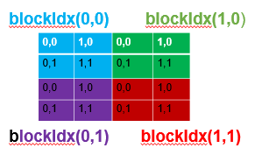
A(4X4) X B(4X4) = C(4X4) block_width X block_height=2X2 That is, each block has 2 threads in x direction and 2 threads in y direction
block_height
block_width
One block

Slide 43

Calculation of Row and Col for m[1][2]
int Row = blockIdx.y X blockDim.y + threadIdx.y;
= 0 X 2 + 1
= 1
int Col = blockIdx.x X blockDim.x + threadIdx.x;
=1 X 2 + 0
= 2
m[Row][Col]= m[ Row X Width+ Col]= m[1 X 4+ 2]=m[6]

Slide 44
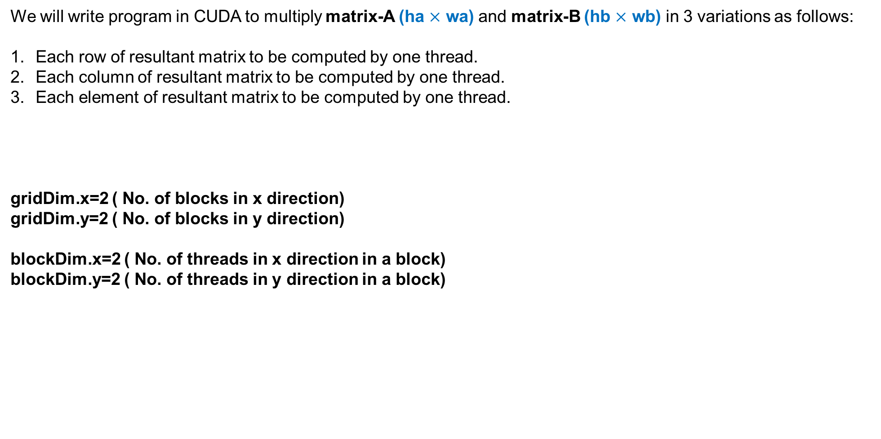
Matrix-Matrix Multiplication – three variants
We will write program in CUDA to multiply matrix-A (ha $×$ wa) and matrix-B (hb $×$ wb) in 3 variations as follows:
Each row of resultant matrix to be computed by one thread.
Each column of resultant matrix to be computed by one thread.
Each element of resultant matrix to be computed by one thread.
gridDim.x=2 ( No. of blocks in x direction)
gridDim.y=2 ( No. of blocks in y direction)
blockDim.x=2 ( No. of threads in x direction in a block)
blockDim.y=2 ( No. of threads in y direction in a block)
16-03-2023
44

Slide 45
Accessing Row & Col of a matrix
_{Accessing Col}
_{Accessing Row}
M₀ | M₁ | M₂ | M₃ | M₄ | M₅ | M₆ | M₇ | M₈ | M₉ | M₁₀ | M₁₁
M₀
M₄
M₈
M₁
M₅
M₉
M₂
M₆
M₁₀
M₃
M₇
M₁₁
The beginning element of the Col column is the Col element of the 0 row, which is M[Col].
Accessing each additional element in the Col column requires skipping over entire rows. This is because the next element of the same column is actually the same element in the next row.
Therefore, the k element of the Col column is M[k * Width + Col].
Col₀
Row₀
Row₁
Row₂
Recall that a matrix M is linearized into an equivalent 1D array where the rows of M are placed one after another in the memory space, starting with the 0 row.
For example, the beginning element of the 1 row is M[1 * Width] because we need to account for all elements of the 0 row.
In general, the beginning element of the Row row is M[Row * Width].
Since all elements of a row are placed in consecutive locations, the k element of the Row row is at M[Row * Width + k].
Col₁
Col₂
Col₃
_{Matrix M}
M₀ | M₁ | M₂ | M₃
M₄ | M₅ | M₆ | M₇
M₈ | M₉ | M₁₀ | M₁₁
16-03-2023
45

Slide 46
1. Each row of resultant matrix to be computed by one thread
multiplyKernel_rowwise<<<1,ha>>>(d_a, d_b, d_c, wa, wb);
__global__ void multiplyKernel_rowwise(int * a, int * b, int * c, int wa, int wb)
{
int ridA = threadIdx.x;
int sum;
for(int cidB = 0; cidB < wb; cidB++)
{
sum= 0;
for(k = 0; k< wa; k++)
{
sum += (a[ridA * wa + k] * b[k * wb + cidB]);
}
c[ridA * wb+ cidB] = sum;
}
}
16-03-2023
46

Slide 47
2. Each column of resultant matrix to be computed by one thread
multiplyKernel_colwise<<<1, wb>>>(d_a, d_b, d_c, ha,wa);
__global__ void multiplyKernel_colwise(int * a, int * b, int * c, int ha, int wa)
{
int cidB = threadIdx.x;
int wb = blockDim.x;
int sum, k;
for(ridA = 0; ridA < ha; ridA++)
{
sum = 0;
for( k=0; k< wa; k++)
{
sum += (a[ridA * wa + k] * b[k * wb + cidB]);
}
c[ridA * wb + cidB] =sum;
}
}
16-03-2023
47

Slide 48
3. Each element of resultant matrix to be computed by one thread
multiplyKernel_elementwise<<<(1, 1), (wb,ha)>>>(d_a, d_b, d_c, wa);
__global__ void multiplyKernel_elementwise(int * a, int * b, int * c, int wa)
{
int ridA = threadIdx.y;
int cidB= threadIdx.x;
int wb = blockDim.x;
int sum=0, k;
for( k = 0; k < wa; k++)
{
sum += (a[ridA * wa + k] * b[k * wb + cidB]);
}
c[ridA * wb + cidB] =sum;
}
16-03-2023
48

Slide 49
Calculations of global threadID
Note: (x,y) is followed

Slide 50
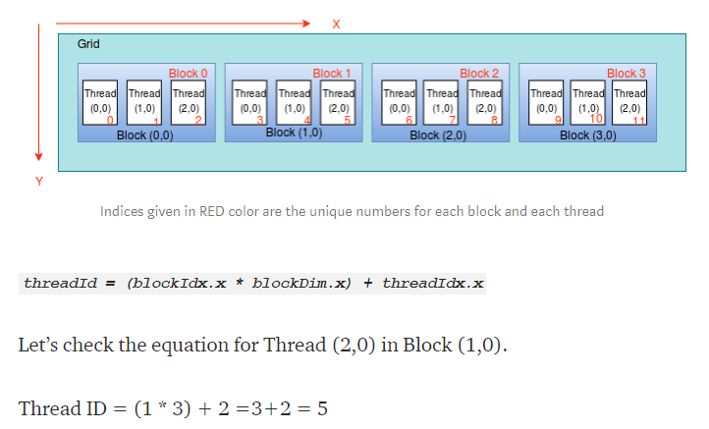
Calculations of global threadID – ID Grid/1D Block
<<< 4, 3 >>>

Slide 51
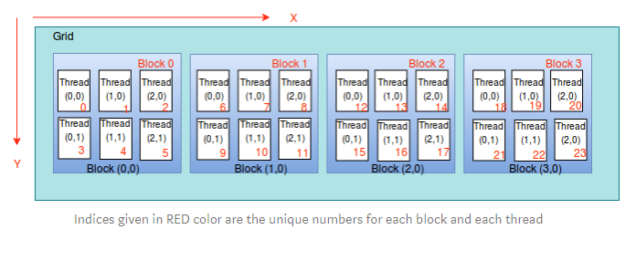
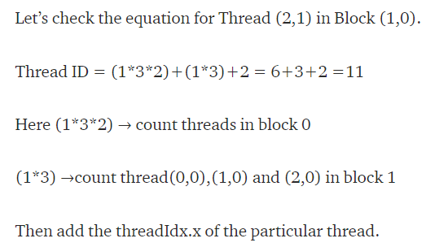
Calculations of global threadID – ID Grid/2D Block
<<< 4, (3,2) >>>

Slide 52
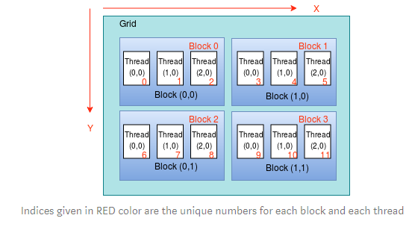
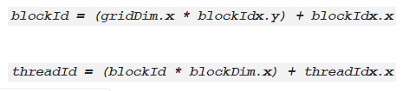
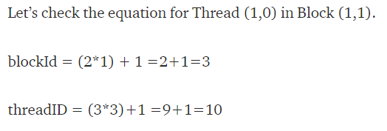
Calculations of global threadID – 2D Grid/1D Block
<<< (2,2), 3 >>>

Slide 53
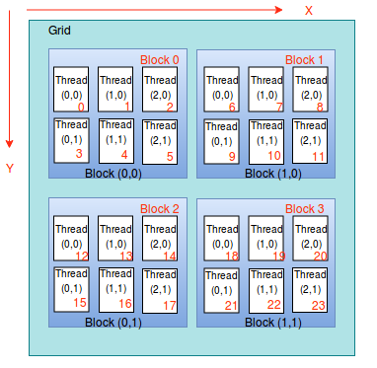
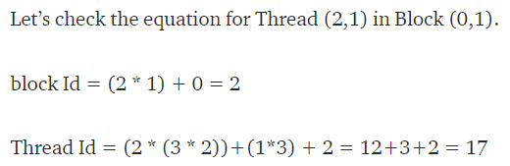
Calculations of global threadID – 2D Grid/2D Block
<<< (2,2), (2,3) >>>
blockId = (gridDim.x * blockIdx.y) + blockIdx.x
threadId = (blockId * (blockDim.x * blockDim.y))
+
(threadIdx.y * blockDim.x) + threadIdx.x

Slide 54
Calculations of global threadID
1D grid of 1D blocks:
__device__int getGlobalID_1D_1D(){
return blockIdx.x *blockDim.x + threadIdx.x;
}
1D grid of 2D blocks:
__device__ int getGlobalID_1D_2D(){
return blockIdx.x * blockDim.x * blockDim.y + threadIdx.y * blockDim.x + threadIdx.x;
}
1D grid of 3D blocks:
__device__ int getGlobalID_1D_3D(){
return blockIdx.x * blockDim.x * blockDim.y * blockDim.z + threadIdx.z * blockDim.y * blockDim.x +
threadIdx.y * blockDim.x + threadIdx.x;
}
16-03-2023
54

Slide 55
Calculations of global threadID
2D grid of 1D blocks:
__device__ int getGlobalID_2D_1D(){
int blockId = blockIdx.y * gridDim.x + blockIdx.x;
int threadId = blockId * blockDim.x + threadIdx.x;
return threadId;
}
2D grid of 2D blocks:
__device__ int getGlobalID_2D_2D(){
int blockId = blockIdx.x + blockIdx.y * gridDim.x;
int threadId = blockId * (blockDim.x * blockDim.y) + (threadIdx.y * blockDim.x) + threadIdx.x;
return threadId;
}
2D grid of 3D blocks:
__device__ int getGlobalID_2D_3D(){
int blockId = blockIdx.x + blockIdx.y * gridDim.x;
int threadId = blockId * (blockDim.x * blockDim.y * blockDim.z) + (threadIdx.z * (blockDim.x *
blockDim.y)) + (threadIdx.y * blockDim.x) + threadIdx.x;
return threadId;
}
16-03-2023
55

Slide 56
Calculations of global threadID
3D grid of 1D blocks:
__device__int getGlobalID_3D_1D(){
int blockId = blockIdx.x + blockIdx.y * gridDim.x + gridDim.x * gridDim.y * blockIdx.z;
int threadId = blockId * blockDim.x + threadIdx.x;
return threadId;
}
3D grid of 2D blocks:
__device__int getGlobalID_3D_2D(){
int blockId = blockIdx.x + blockIdx.y * gridDim.x + gridDim.x * gridDim.y * blockIdx.z;
int threadId = blockId * (blockDim.x * blockDim.y) + (threadIdx.y * blockDim.x) + threadIdx.x;
return threadId;
}
3D grid of 3D blocks:
__device__int getGlobalID_3D_3D(){
int blockId = blockIdx.x + blockIdx.y * gridDim.x + gridDim.x * gridDim.y * blockIdx.z;
int threadId = blockId * (blockDim.x * blockDim.y * blockDim.z) + (threadIdx.z * (blockDim.x *
blockDim.y)) + (threadIdx.y * blockDim.x) + threadIdx.x;
return threadId;
}
16-03-2023
56

Slide 57
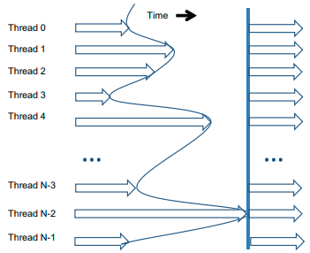
Synchronization and Transparent Scalability
CUDA allows threads in the same block to coordinate their activities using a barrier synchronization function __syncthreads().
When a kernel function calls __syncthreads(), all threads in a block will be held at the calling location until every thread in the block reaches the location.
This ensures that all threads in a block have completed a phase of their execution of the kernel before any of them can move on to the next phase.
In CUDA, a __syncthreads() statement, if present, must be executed by all threads in a block.
16-03-2023
57

Slide 58
Synchronization and Transparent Scalability
When a __syncthread() statement is placed in an if-statement, either all threads in a block execute the path that includes the __syncthreads() or none of them does.
For an if-then-else statement, if each path has a __syncthreads() statement, either all threads in a block execute the __syncthreads() on the then path or all of them execute the else path.
The two __syncthreads() are different barrier synchronization points. If a thread in a block executes the then path and another executes the else path, they would be waiting at different barrier synchronization points. They would end up waiting for each other forever.
It is the responsibility of the programmers to write their code so that these requirements are satisfied.
The ability to synchronize also imposes execution constraints on threads within a block. These threads should execute in close time proximity with each other to avoid excessively long waiting times.
16-03-2023
58

Slide 59
Synchronization and Transparent Scalability
In fact, one needs to make sure that all threads involved in the barrier synchronization have access to the necessary resources to eventually arrive at the barrier. Otherwise, a thread that never arrived at the barrier synchronization point can cause everyone else to wait forever.
CUDA runtime systems satisfy this constraint by assigning execution resources to all threads in a block as a unit. A block can begin execution only when the runtime system has secured all the resources needed for all threads in the block to complete execution.
When a thread of a block is assigned to an execution resource, all other threads in the same block are also assigned to the same resource. This ensures the time proximity of all threads in a block and prevents excessive or indefinite waiting time during barrier synchronization
By not allowing threads in different blocks to perform barrier synchronization with each other, the CUDA runtime system can execute blocks in any order relative to each other since none of them need to wait for each other.
16-03-2023
59

Slide 60
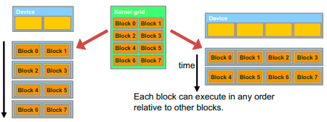
Synchronization and Transparent Scalability
In a low-cost system with only a few execution resources, one can execute a small number of blocks at the same time. In a high-end implementation with more execution resources, one can execute a large number of blocks at the same time.
The ability to execute the same application code on hardware with a different number of execution resources is referred to as transparent scalability, which reduces the burden on application developers and improves the usability of applications.
16-03-2023
60

Slide 61
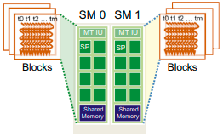
Assigning Resources to Blocks
Once a kernel is launched, the CUDA runtime system generates the corresponding grid of threads. These threads are assigned to execution resources on a block-by-block basis.
In the current generation of hardware, the execution resources are organized into streaming multiprocessors (SMs).
Multiple thread blocks can be assigned to each SM.
Each device has a limit on the number of blocks that can be assigned to each SM. For example, a CUDA device may allow up to eight blocks to be assigned to each SM.
16-03-2023
61

Slide 62
Assigning Resources to Blocks
In situations where there is an insufficient amount of any one or more types of resources needed for the simultaneous execution of eight blocks, the CUDA runtime automatically reduces the number of blocks assigned to each SM until their combined resource usage falls under the limit.
With a limited numbers of SMs and a limited number of blocks that can be assigned to each SM, there is a limit on the number of blocks that can be actively executing in a CUDA device.
Most grids contain many more blocks than this number. The runtime system maintains a list of blocks that need to execute and assigns new blocks to SMs as they complete executing the blocks previously assigned to them.
One of the SM resource limitations is the number of threads that can be simultaneously tracked and scheduled.
It takes hardware resources for SMs to maintain the thread and block indices and track their execution status.
In more recent CUDA device designs, up to 1,536 threads can be assigned to each SM. This could be in the form of 6 blocks of 256 threads each, 3 blocks of 512 threads each, etc.
16-03-2023
62

Slide 63
Querying Device Properties
When a CUDA application executes on a system, how can it find out the number of SMs in a device and the number of threads that can be assigned to each SM?
The CUDA runtime system has an API function cudaGetDeviceCount() that returns the number of available CUDA devices in the system:
The CUDA runtime system numbers all the available devices in the system from 0 to dev_count-1. It provides an API function cudaGetDeviceProperties() that returns the properties of the device of which the number is given as an argument:
The built-in type cudaDeviceProp is a C structure with fields that represent the properties of a CUDA device
int dev_count;
cudaGetDeviceCount( &dev_count);
cudaDeviceProp dev_prop;
for (i=0; i<dev_count; i++) {
cudaGetDeviceProperties( &dev_prop, i);
// decide if device has sufficient resources and capabilities
}
16-03-2023
63

Slide 64
Querying Device Properties
The built-in type cudaDeviceProp is a C structure with fields that represent the properties of a CUDA device
The maximal number of threads allowed in a block in the queried device is given by the field dev_prop.maxThreadsPerBlock.
The number of SMs in the device is given in dev_prop. multiProcessorCount.
The clock frequency of the device is in dev_prop. clockRate.
The host code can find the maximal number of threads allowed along each dimension of a block in dev_prop.maxThreadsDim[0] (for the x dimension), dev_prop.maxThreadsDim[1] (for the y dimension), and dev_prop.maxThreadsDim[2] (for the z dimension).
The host code can find the maximal number of blocks allowed along each dimension of a grid in dev_prop.maxGridSize[0] (for the x dimension), dev_prop.maxGridSize[1] (for the y dimension), and dev_prop.maxGridSize[2] (for the z dimension).
16-03-2023
64

