Slide 1


PANIMALAR ENGINEERING COLLEGE
Department of Computer Science and Engineering
CS8811 PROJECT WORK
A SECURE ESCROW PLATFORM FOR DECENTRALIZED TRANSACTIONS BETWEEN UNTRUSTED PARTIES
Mr.M.MOHAN,B.E.,M.Tech.,(Ph.D.), SUPERVISOR ASSISTANT PROFESSOR GRADE I
SRICHARAN .S [211419104265] SRI SANJAY .S [211419104274] VIJAY .P.K [211419104308]
Batch Number: C11

Slide 2
INTRODUCTION
A decentralized escrow protocol makes it easy for people who don't trust each other to make safe payments. The Eskro protocol is used. Before a transaction can be made, tokens are sent to an escrow, which is a third-party smart contract. The escrow holds the tokens until the conditions for payment are met. Both the agreed-upon product or service and the agreed-upon payment must be made by all parties involved in the transaction. One party shouldn't be able to back out of a deal at the other party's expense. If the payment terms depend on outside information, like when a product is shipped, the oracle pattern can be used to give the escrow the information it needs. As soon as the smart contract code is put on the blockchain, it can't be changed. This makes sure that the escrow functionality is safe. This gives everyone involved in the trade the peace of mind that they won't be taken advantage of.

Slide 3
LITERATURE SURVEY
TITLE | DESCRIPTION | AUTHOR1 | YEAR
1.Blockchain based physical deliveryof proof system | The survey was a very good process to find out a good solution. Reviewing all the concepts related to it is really good practice. Withthewidespread e-commerce, the need for a trusted systemto ensurethedelivery of traded items is crucial. | Haya r sahib, Khaled Saleh | 2018
2.Auditable Protocols for Fair Payment and Physical Asset Delivery Based on Smart Contracts | The survey before the result is a very good step to find out a better output. With the rapid development of electronic information technology, onlinetransaction will gradually surpass traditional market transaction, amongwhich online payment and asset delivery become the focus of attention. | Shingling Wang, Ixia Yang, Yawling Jahan | 2019
3.Decentralized Applications: The Blockchain-Empowered SoftwareSystem | Blockchain technology has attracted tremendous attention inbothacademia and capital market. However, overwhelming speculations onthousands of available cryptocurrencies and numerous initial coinoffering scams have also brought notorious debates on this emergingtechnology | W. Cai, Z. Wang, J. B. Ernst, Z. Hong, C. Feng and V. C. M. Leung | 2018
4.Security and PrivacyinDecentralized Energy Trading Through Multi-Signatures, BlockchainandAnonymous Messaging Streams | Smart grids equipped with bi-directional communication flowareexpected to provide more sophisticated consumption monitoringandenergy trading. | N. Z. Aitzaz and D. Voinovich | 2018
5.Blockchain smart contracts: Applications, challenges, and future trends | In recent years, the rapid development of blockchain technologyandcryptocurrencies has influenced the financial industry by creatinganewcrypto-economy. | Nasheed khan, Faiza lousily | 2021

Slide 4
PROBLEM STATEMENT
A decentralized escrow protocol that facilitates secure P2P payments between trustless parties
There is an inherent risk of fraud in the majority of transactions, both online and offline, where a buyer and a seller exchange goods or services for money. What should be sent out first, the goods or the money is another constant debate.
These transactions could involve anything from purchasing products from peer-to-peer marketplaces like eBay to receiving payment from a customer for freelancing work. Each year, these transactions reach up to $100 trillion worldwide.

Slide 5
TECHNOLOGY STACK
HARDWARE REQUIREMENTS
A server or a network of servers to run the platform.
Adequate storagefor storing transaction records and smart contracts.
Security hardware such as firewalls, intrusion detection and prevention systems, and other security appliances.
Encryption hardware to encrypt and decrypt sensitive information.
SOFTWARE REQUIREMENTS
Operating system: The platform can run on any operating systemsuchas Linux, Windows, or macOS.
Web server: The platform may require a web server such as Apacheor Nginx to serve web pages and APIs.
Programming languages: The platform may require programminglanguages such as Solidity for writing smart contracts,
Client-side programming: JavaScript
Server-side programming: Python
Database: The platform may require a database to store transactionrecords and smart contracts. Popular options include MySQL, MongoDB, and PostgreSQL.
Blockchain platform: The platform may be built on a blockchainplatform such as Polygon, which allows for the creation of decentralized applications and smart contracts

Slide 6
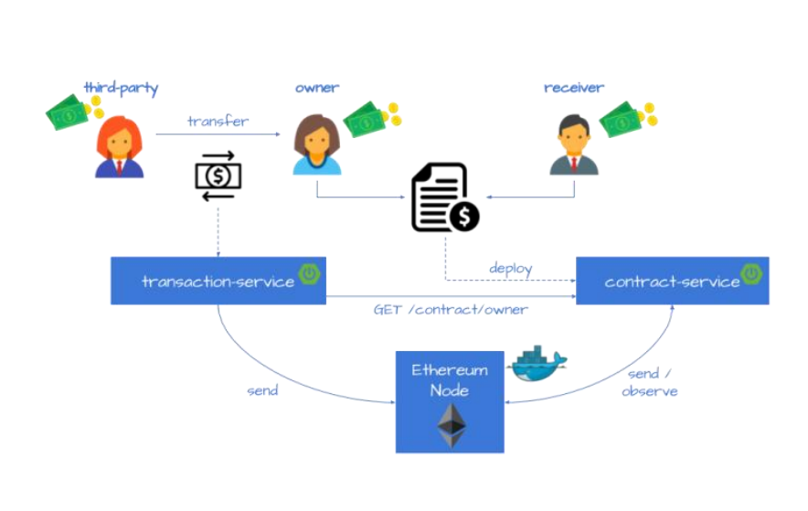
SYSTEM ARCHITECTURE

Slide 7
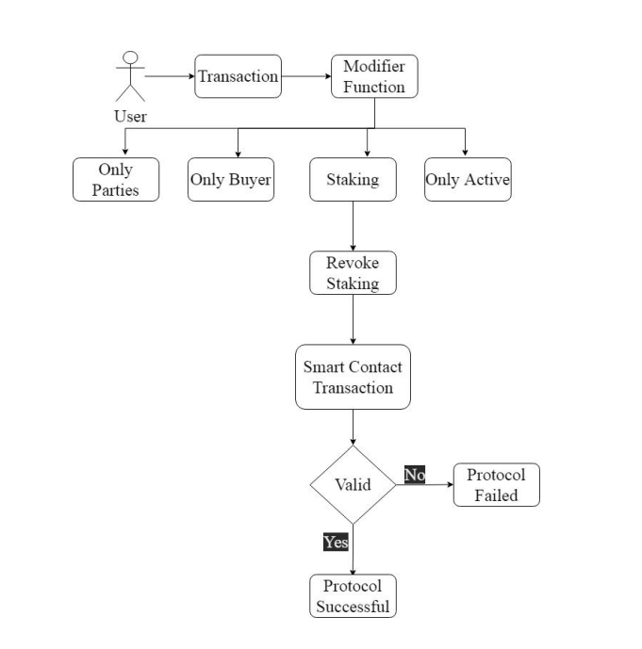
SYSTEM DESIGN
DATAFLOW DIAGRAM

Slide 8
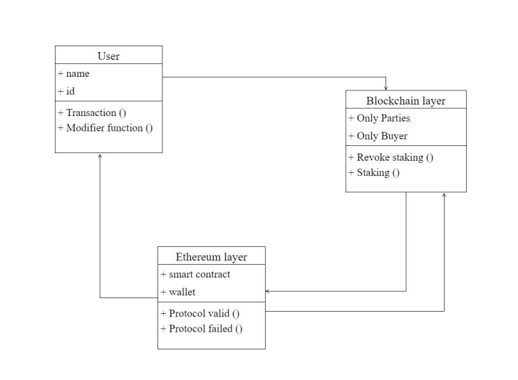
CLASS DIAGRAM

Slide 9
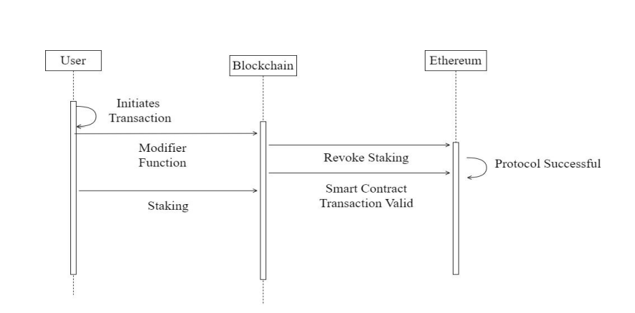
ACTIVITY DIAGRAM

Slide 10
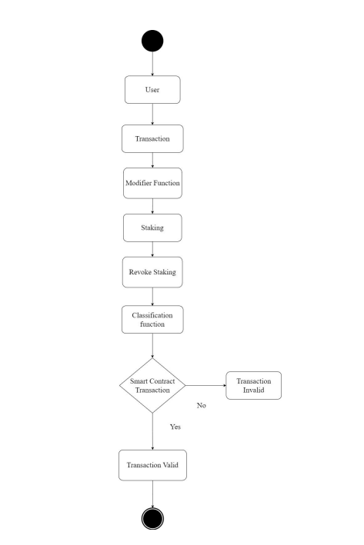
ER DIAGRAM

Slide 11
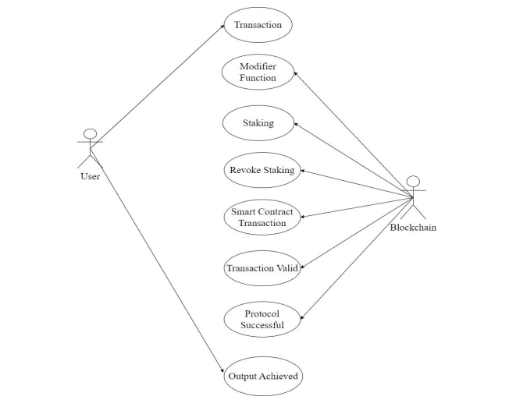
USECASE DIAGRAM

Slide 12
MODULE DESCRIPTION
Module Names
The Escrow Contract Implementation (to FacilitateTransaction)
Escrow Contract creating Smart-Contract Implementation
Front-End

Slide 13
The Escrow Contract Implementation (to FacilitateTransaction)
The Eskro.sol contract is used to facilitate the transaction betweentwotrustless parties.
● SafeMath.sol
SafeMath.sol from OpenZeppelin is imported here.(It validatesif
an arithmetic operation will result in integer overflow/underflow).
● Modifiers- onlyParties() ,onlyBuyer(),onlyActive() modifiers are definedtomake sure that the associated function can be called by onlycertainpeople or can be called under only certain circumstances.
● stake() - This Function is used for the parties to stake some amount of ETHthat they can’t withdraw until both parties reach a consensus andagree to either cancel or proceed with their trade.
● revokeStake()- This allows parties to withdraw their staked fund if the contract hasnot been locked yet.
● cancel()- This function is used to cancel transactions. This can be revokedbythe revokeCancellation() function.

Slide 14
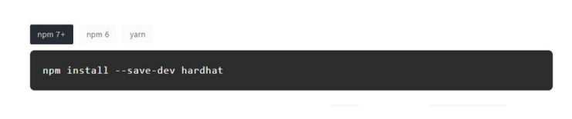
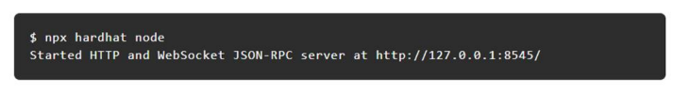
The Escrow Contract Implementation (to FacilitateTransaction)
● confirm()- This functions confirms that seller has confirmed & honored the transaction. After hitting this function the contract is set to an inactive state and a state change event is emitted.

Slide 15
Escrow Contract creating Smart-Contract Implementation
The Escrow contract to facilitate the transaction between two trustlessparties are created is created by a contract called EsKroFactory.sol
● createContract() -
It takes buyer’s address,seller’s address,price as parameters.Createscontract and emits ContractCreated() event after successful
creation of Escrow contract.
● getContractsByIndex()-
It returns index of the contract that is created
● getContractsByAddress()-
It returns address of the contract
● getContracts()-
It returns all the contracts

Slide 16
Front-End
The ABI & address of the deployed contract is used along with thehelpof Ethers.js library to connect the frontend with the smart-contract.
Components- The code is divided into various components to keeptheproject clean and maintainable
● Wallet.js-
This is used as the connect button which helps users to connect their Metamask wallet with the web-app.
● Contract.js-
stake(),withdrawStake(),cancel(),revokeCancel(),confirm() functions are implemented in this component.The buttons for staking related all activities are handled by this component.
● ContractCreation.js-
Creation of the contract is handled in this component.

Slide 17
TESTS AND REPORTS
Module 1: The Escrow Contract (to Facilitate Transaction)
Test Case ID | Test Case Description | Input Data | Expected Output | Actual Output | Pass/Fail | Remarks
T1 | User initiates an escrow transaction and funds are successfully deposited into the contract | User A initiates an escrow transaction with User B Transaction amount: $100 User A has $120 in their account balance | Contract should hold $100 in escrow until the terms of the transaction are fulfilled | Contract holding $100 in escrow until the terms of the transaction are fulfilled | Pass | Efficient
T2 | User attempts to initiate an escrow transaction with insufficient funds | User A initiates an escrow transaction with User B Transaction amount: $100 User A has $50 in their account balance | Contract should not allow the transaction to proceed and User A should be notified of insufficient funds | Contract didn’t allow the transaction to proceed and User A is notified of insufficient funds | Pass | Efficient

Slide 18
TESTS AND REPORTS
Module 2: Escrow Contract Creating Smart-Contract
Test Case ID | Test Case Description | Input Data | Expected Output | Actual Output | Pass/Fail | Remarks
T1 | User creates a smart contract for an escrow transaction | User A creates a smart contract for an escrow transaction with User B Transaction amount: $500 Escrow period: 30 days | Smart contract should be created and stored on the blockchain, and contract address should be returned to User A | Smart contract created and stored on the blockchain, and contract address is returned to User A | Pass | Efficient
T2 | User attempts to create a smart contract for an escrow transaction with invalid input parameters | User A attempts to create a smart contract for an escrow transaction with User B Transaction amount: -$100 Escrow period: -10 days | Smart contract creation should fail and User A should be notified of the invalid input parameters | Smart contract creation failed and User A is notified of the invalid input parameters | Pass | Efficient

Slide 19
TESTS AND REPORTS
Module 3: Front-End
Test Case ID | Test Case Description | Input Data | Expected Output | Actual Output | Pass/Fail | Remarks
T1 | User logs in to the escrow platform and is redirected to their account dashboard | User A enters their login credentials (username and password) | User A should be able to view their account information and any ongoing escrow transactions | User A can view their account information and any ongoing escrow transactions | Pass | Efficient
T2 | User attempts to access a page without logging in | User A attempts to access the escrow transaction page without logging in | User A should be redirected to the login page before being allowed to access the desired page. | User A is redirected to the login page before being allowed to access the desired page. | Pass | Efficient

Slide 20
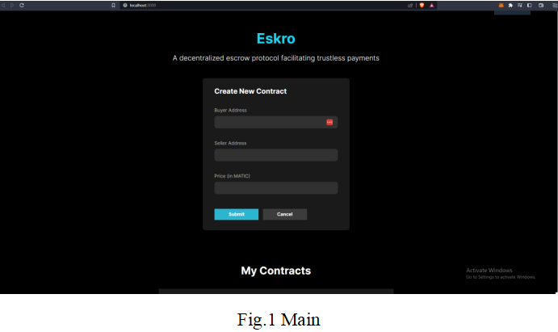
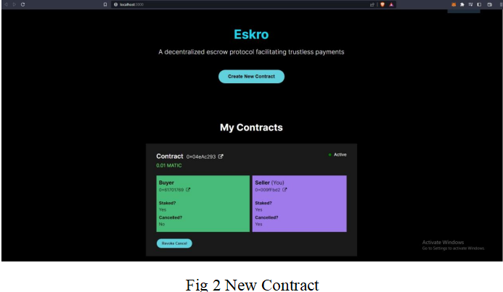
SCREENSHOTS :

Slide 21
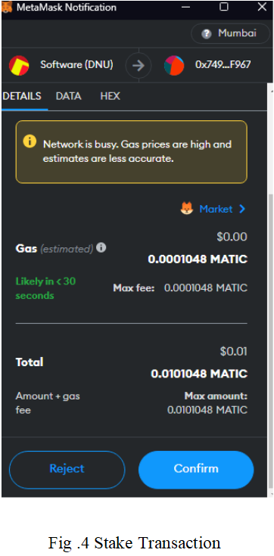
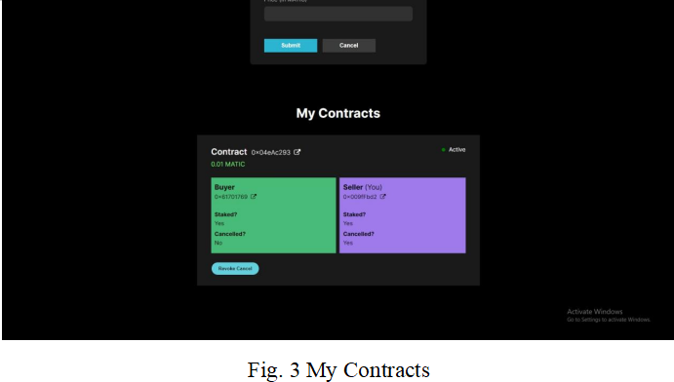

Slide 22
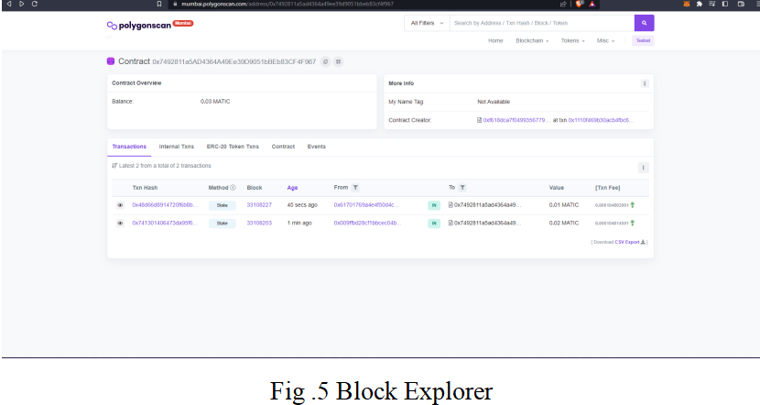
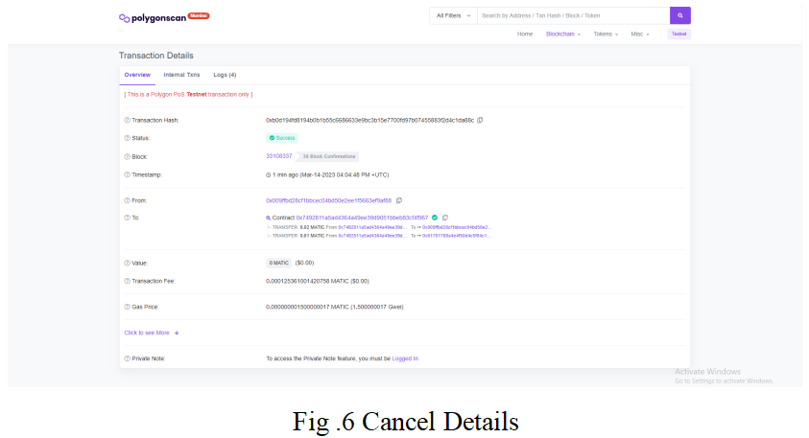

Slide 23
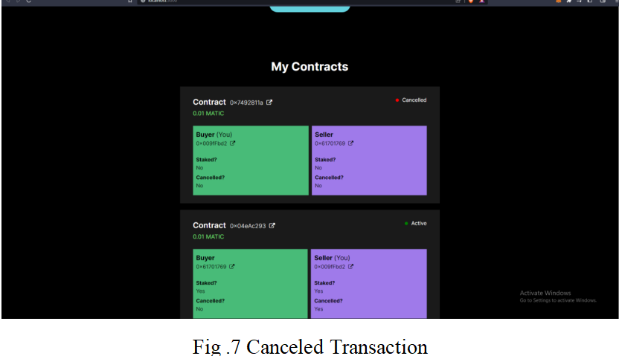
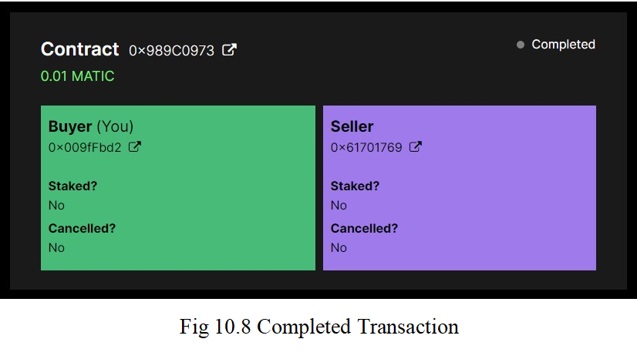

Slide 24
CONCLUSION
The escrow systems that we suggest are completely orthogonal tothemethod in which the files are shared and distributed among peers. Theescrow service and the verification of the content can be done bythepeer-to-peer service, or by a separate non-affiliated service. We hope that our study can stimulate more future research endeavors on this crucial problem in the blockchain.

Slide 25
REFERENCES
[1] Haya r sahib, Khaled Saleh, “Blockchain based physical delivery of proof system", Khalifa university conference and electronicsdepartment,2018
[2] shingling wang, ixia yang, yawling Jahan, “Auditable Protocols for Fair Payment and Physical Asset Delivery Based on Smart Contracts”, Xi’an university of technology conference in science,2019
[3] W. Cai, Z. Wang, J. B. Ernst, Z. Hong, C. Feng and V. C. M. Leung, "Decentralized Applications: The Blockchain-Empowered SoftwareSystem," in IEEE Access,2018
[4] N. Z. Aitzaz and D. Voinovich, "Security and PrivacyinDecentralized Energy Trading Through Multi-Signatures, BlockchainandAnonymous Messaging Streams," in IEEE Transactions on Dependableand Secure Computing, 2018
[5] Nasheed khan, Faiza lousily, “Blockchain smart contracts: Applications, challenges, and future trends”, Peer-to-peer networkingapplications , 2021
[6] Enes Erden, Momin kibbe, kernel akala, “A Bitcoin payment networkwith reduced transaction fees and confirmation times”, Computer networks and technology conference,2021
[7] Reza Trapdoor, Peja ghazi, “Block by block: A blockchain-basedpeer-to-peer business transaction for international trade”, Technological forecast and social change conferences, 2022
[8] Steven Goldfaden, Joseph Bonneau, Rosario Gennaro &ArvindNarayanan , “Escrow Protocols for Cryptocurrencies: HowtoBuyPhysical Goods Using Bitcoin”, International Conference on Financial Cryptography and Data Security, 2017
[9] Z. Hong, Z. Wang, W. Cai and V. C. M. Leung, "Connectivity-aware task outsourcing and scheduling in D2Dnetworks", Proc. 26th Int. Conf. Compute. Common. Newt. (ICCCN),2017
[10] M. Wuhrer and U. Zdun, "Smart contracts: Security patterns intheEthereum ecosystem and solidity", Proc. Int. Workshop BlockchainOriented Soft. Eng. (IWBOSE), 2018.

