Slide 1

Dataset Analysis for Hybrid Indoor Localization
WiFi + Magnetic Sensor Fingerprinting
SURA Research Project
under Dr.Neel Kanth Kandu
Jayendra - 2024CS10891
Sindhush - 2024CS10303

Slide 2

The Indoor Localization Challenge
Global Positioning System (GPS) technology, while revolutionary for outdoor navigation, faces significant limitations when deployed indoors. The satellite signals required for GPS triangulation are severely attenuated by building materials such as concrete, steel, and glass, resulting in unreliable or completely unavailable positioning information within indoor environments.
This fundamental limitation has driven extensive research into alternative localization methodologies that leverage signals of opportunity already present in indoor spaces. The emergence of ubiquitous wireless infrastructure and sophisticated smartphone sensors has created new possibilities for accurate indoor positioning systems.
WiFi Received Signal Strength
Magnetic Field Disturbances
Inertial Measurement Unit (IMU)
Radio signal measurements from wireless access points throughout the building
Unique magnetic signatures created by indoor metal structures and building materials
Accelerometer, gyroscope, and orientation sensors tracking device movement
These complementary sensing modalities can be fused together to create robust indoor localization systems that overcome the individual limitations of each signal type. The integration of multiple sensor streams provides redundancy, improves accuracy, and enables continuous positioning even when individual signal sources become temporarily unavailable.

Slide 3

Research Objective and Dataset
WiFi Received Signal Strength (RSS)
Magnetometer Readings
Project Goal
Three-axis magnetic field measurements capturing spatial variations in magnetic signatures
Develop a high-accuracy indoor localization system leveraging hybrid sensor data fusion from WiFi, magnetic field, and inertial sensors
Signal measurements from detected wireless access points with timestamps and coordinates
This research employs the MagWi Benchmark Dataset, a comprehensive collection of smartphone sensor data gathered from indoor environments across multiple buildings. The dataset represents one of the most extensive collections of its kind, specifically designed for benchmarking indoor localization algorithms and sensor fusion techniques.
Accelerometer Data
Gyroscope Measurements
Three-axis acceleration measurements for motion detection and activity recognition
Angular velocity data for orientation tracking and movement characterization
The dataset was collected using multiple smartphone models operated by different users, ensuring diversity in hardware characteristics and usage patterns. This multi-user, multi-device approach enhances the generalizability of any localization models developed from this data.
Pressure Sensor
Orientation Sensors
Atmospheric pressure readings for floor-level detection in multi-story buildings
Device orientation and heading information derived from sensor fusion algorithms

Slide 4
Dataset Composition and Structure
Data File Overview
Temporal Characteristics
The dataset comprises two primary categories of sensor recordings, each serving a distinct purpose in the localization framework. The organization follows a timestamp-based structure where each file represents sensor readings at a specific point in time and physical location.
The sampling frequency differs significantly between WiFi scanning and inertial/magnetic sensors, reflecting their distinct physical properties and power consumption characteristics.
2831
4261
50-200
1-2
WiFi Scan Files
Magnetic/IMU Recordings
IMU Sampling Rate (Hz)
WiFi Scan Rate (Hz)
Individual fingerprint locations with associated access point detections
High-frequency sensor measurements synchronized with WiFi scans
Continuous high-frequency measurements of inertial and magnetic signals
Periodic wireless network discovery operations balancing accuracy with power consumption
The disparity in sampling rates between WiFi and IMU sensors is intentional and reflects practical constraints. WiFi scanning consumes significant power and generates radio frequency emissions, limiting how frequently smartphones can perform network discovery operations. Conversely, inertial and magnetic sensors can sample continuously with minimal power overhead, providing rich temporal information about device movement and environmental characteristics.

Slide 5

WiFi Data Format and Organization
Column Name
Description
Each WiFi fingerprint file follows a structured format that combines location metadata with wireless network observations. The file structure employs a hierarchical organization where the first row establishes the spatial reference point, and subsequent rows enumerate detected access points at that location.
Time
Timestamp of the WiFi scan measurement in Unix epoch format with millisecond precision
X-pos
Cartesian X-coordinate representing the physical location where the scan was taken (in meters)
This file organization has important implications for data preprocessing and feature engineering. When constructing training datasets for machine learning models, all rows from a single file must be aggregated to create a comprehensive fingerprint representation for that location. The aggregation process typically involves creating a feature vector where each element represents the signal strength from a specific access point, with missing values handled through imputation or zero-padding strategies.
Y-pos
Cartesian Y-coordinate representing the physical location where the scan was taken (in meters)
SSID
Service Set Identifier - the human-readable name of the wireless network broadcast by the access point
BSSID
Basic Service Set Identifier - the unique MAC address (hardware identifier) of the wireless router or access point
Critical Data Structure Insight
Only the first row in each file contains valid X and Y coordinate values. All subsequent rows represent additional access points detected during the same scan at the identical physical location. Therefore, each file corresponds to exactly one fingerprint location, but may contain multiple access point detections.
RSS
Received Signal Strength - power level of the WiFi signal measured in decibels relative to one milliwatt (dBm)

Slide 6
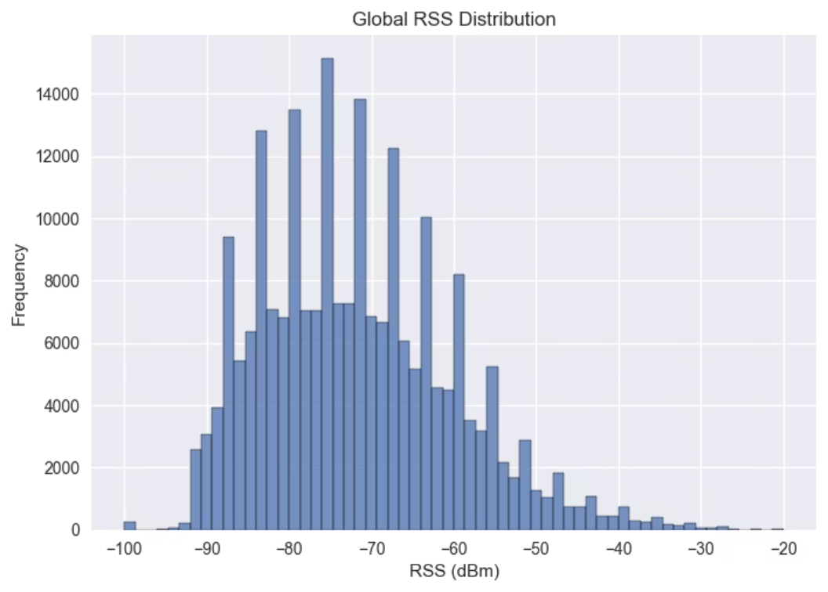

Received Signal Strength (RSS) Distribution Analysis
-72
-95
-20
11.5
Mean RSS (dBm)
Minimum RSS (dBm)
Maximum RSS (dBm)
Standard Deviation
The histogram of RSS values reveals a distribution centered around -72 dBm with a standard deviation of approximately 11.5 dBm, indicating substantial signal variability across the measurement locations. The minimum observed value of -95 dBm represents the practical detection threshold where signals become indistinguishable from background noise, while the maximum of -20 dBm indicates proximity to powerful access points with direct line-of-sight propagation paths.
The signal distribution falls within expected indoor ranges, validating the dataset quality. Very few missing values (<0.1%) suggest reliable WiFi scanning hardware and stable wireless infrastructure during data collection.

Slide 7
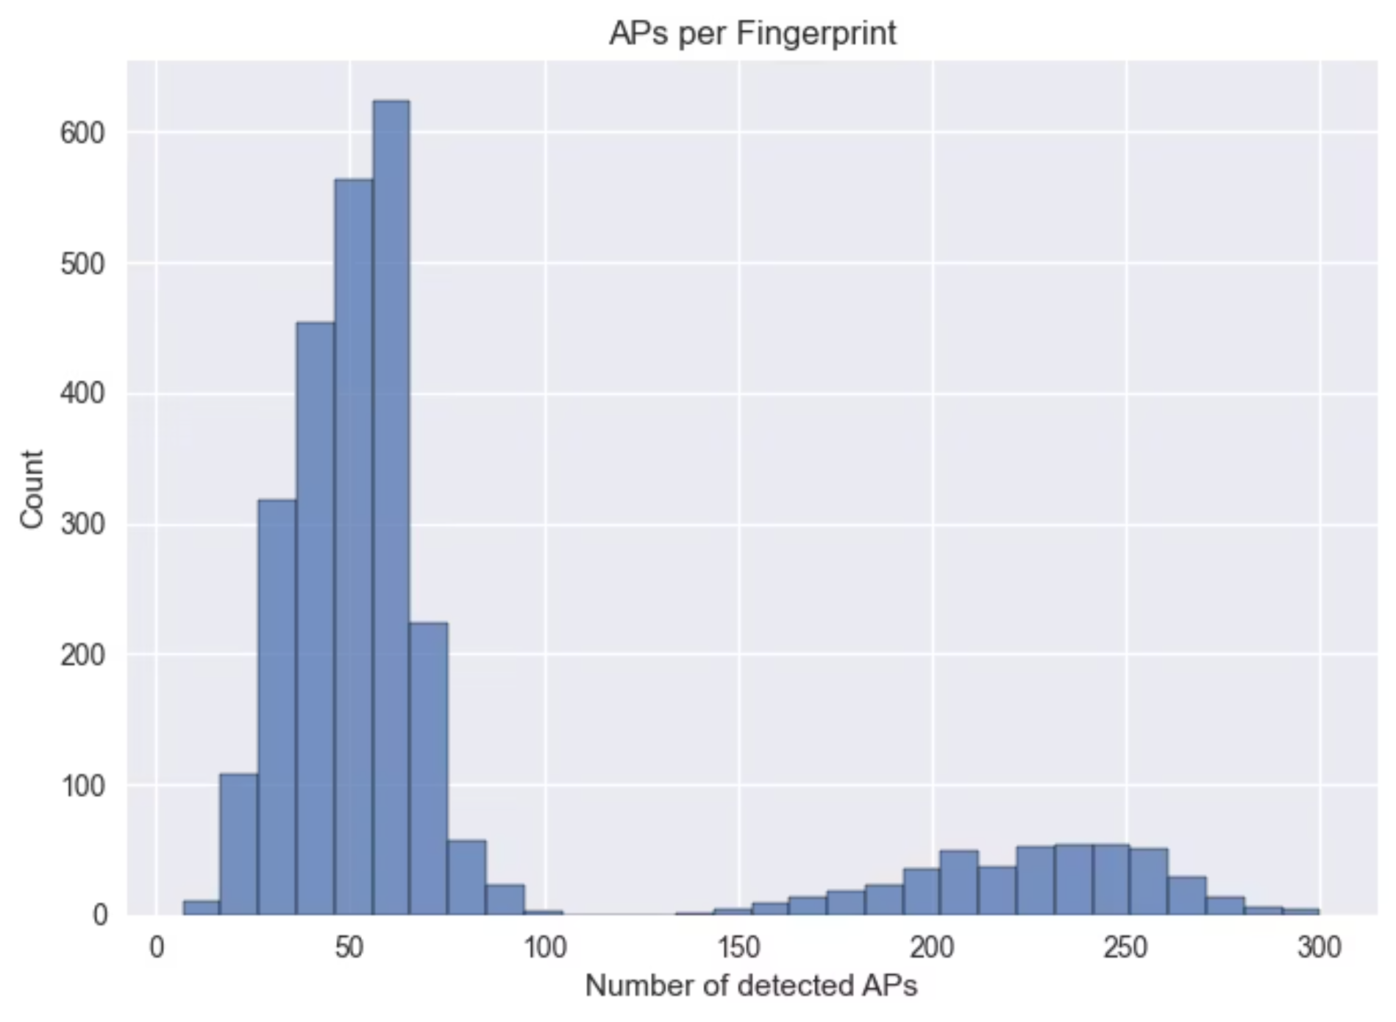
Access Point Density and Distribution
78
300
Average APs per Scan
Maximum APs
7
Minimum APs
Access point density varies significantly (7-300 APs per location) due to building layout and infrastructure differences. Higher density improves localization accuracy by providing more spatial features, but excessive density adds computational overhead. Of 1425 unique routers detected, some appear 1400+ times (stable features), while many appear rarely (potential noise). Feature selection can identify discriminative access points and filter unreliable routers

Slide 8
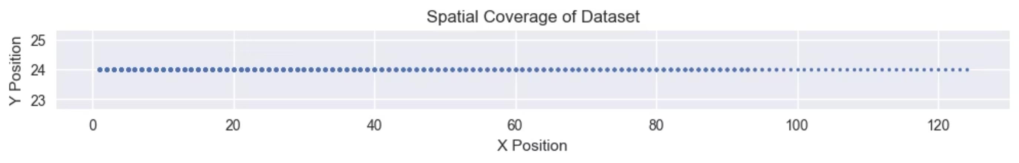
Spatial Distribution and Trajectory Patterns
Scatter plot visualization of the fingerprint locations reveals 2381 labeled fingerprints collected along a continuous trajectory through the indoor environment. The spatial distribution exhibits a distinctive pattern where the Y-coordinate remains nearly constant while the X-coordinate varies significantly, suggesting data collection along a corridor or hallway path.
Continuous Trajectory
Corridor Path Pattern
Sequential Dependencies
2381 labeled fingerprint locations arranged along a path, indicating systematic data collection rather than random sampling
Y-coordinate remains almost constant while X varies, suggesting linear hallway or corridor collection route
Temporal ordering of measurements enables sequential modeling approaches using LSTM or GRU architectures
The trajectory nature of the data collection has important implications for model selection and evaluation. Traditional classification or regression models treat each fingerprint as an independent observation, ignoring the temporal dependencies between consecutive measurements. However, sequential models such as Long Short-Term Memory (LSTM) networks and Gated Recurrent Units (GRU) can exploit the temporal structure, using previous locations and movements to inform current position estimates.
This sequential pattern also suggests opportunities for trajectory smoothing and dead reckoning integration, where inertial sensor data between WiFi scans can be used to interpolate positions and improve temporal resolution. The combination of fingerprint matching with inertial dead reckoning represents a common sensor fusion approach in indoor localization systems.

Slide 9
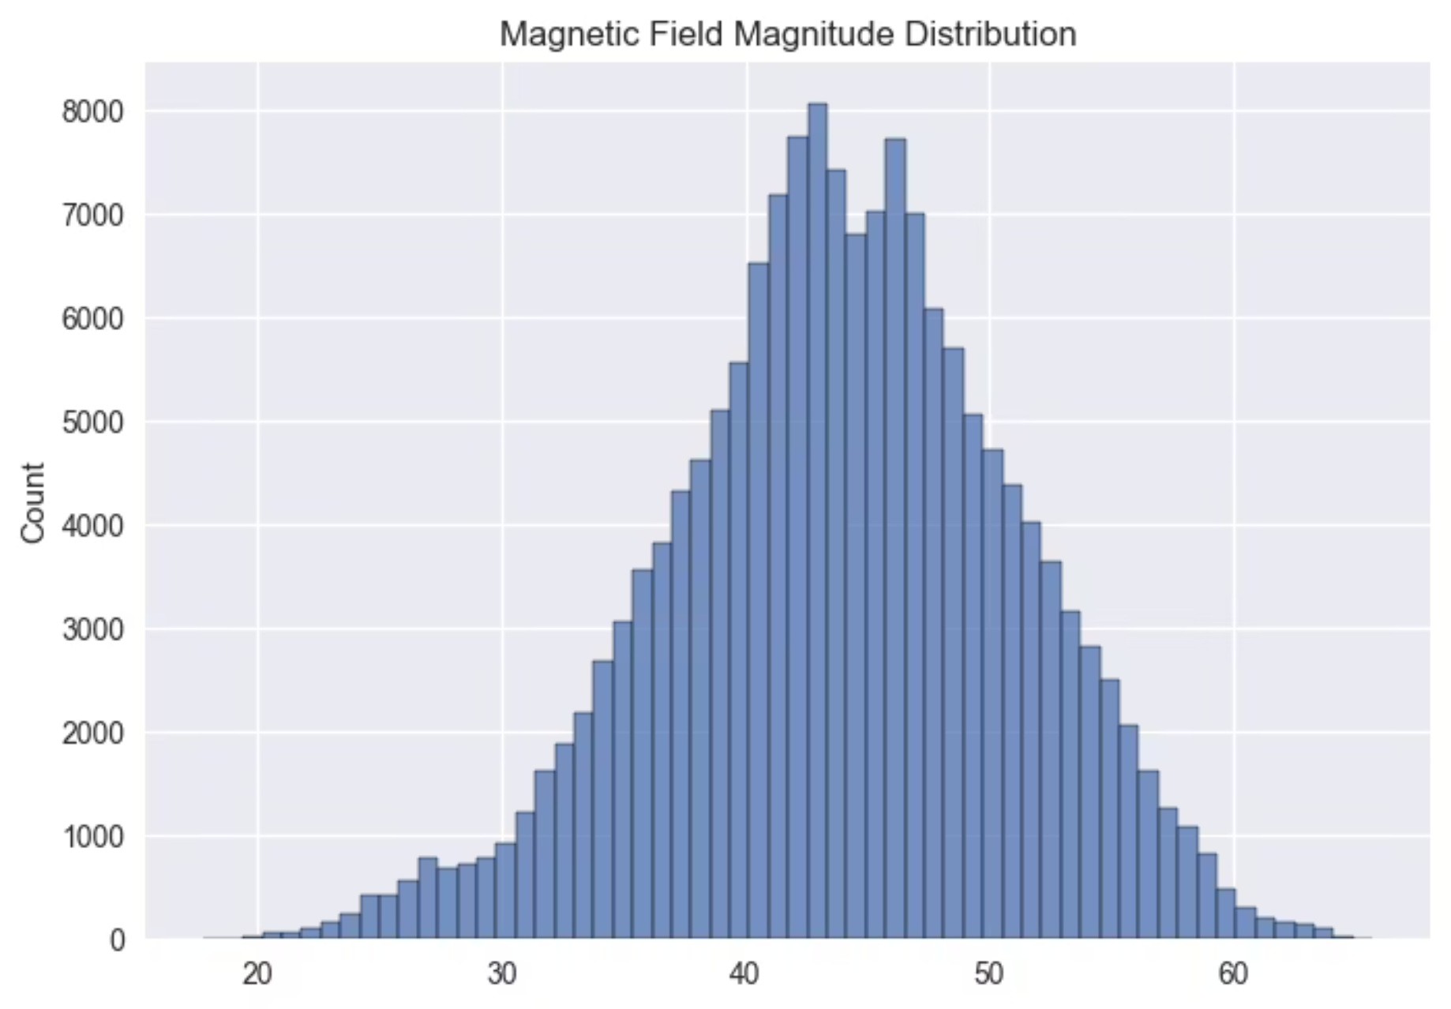
Magnetic Field Characteristics
44
The magnetometer data reveals stable signal distributions with mean magnetic field magnitude of approximately 43.9 microtesla (µT) and standard deviation of 7.1 µT, spanning a range from 18 to 66 µT. These values align with typical indoor magnetic field characteristics, where the Earth's natural magnetic field (approximately 25-65 µT) is distorted by building materials, metal structures, and electrical installations.
Mean Magnitude (µT)
7.1
Standard Deviation (µT)
18
Minimum (µT)
66
Maximum (µT)

Slide 10
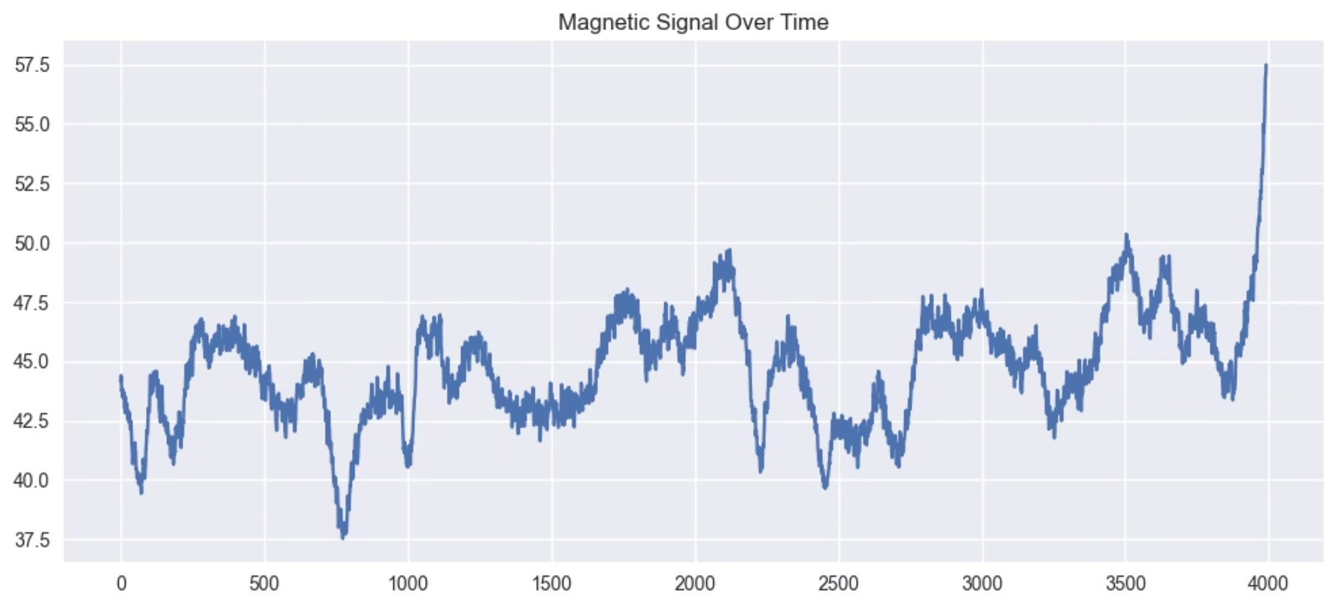
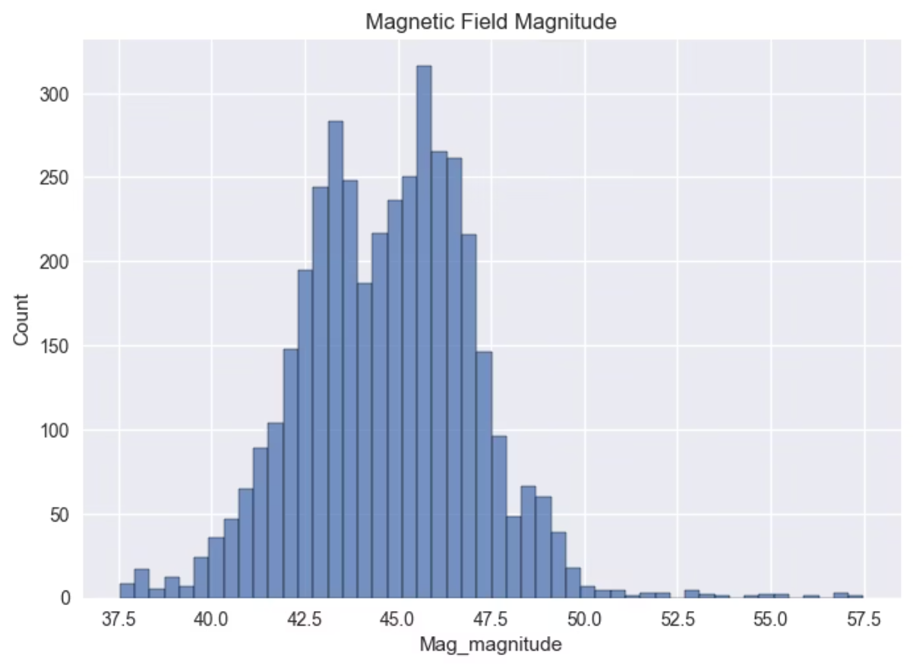
Magnetic Field Singular File
The localized magnetic distortions created by indoor metal structures serve as distinctive location fingerprints. Unlike WiFi signals that can be affected by network configuration changes, magnetic field distortions are largely determined by permanent building characteristics, making them stable over time. This temporal stability represents a significant advantage for long-term localization deployments where WiFi infrastructure may be reconfigured or replaced.
Three-axis magnetometer readings can be combined to compute magnetic field magnitude or decomposed into directional components, each providing different information for localization. The magnitude captures the overall strength of distortion at a location, while directional components reveal the spatial orientation of metal structures. Both approaches have demonstrated effectiveness in magnetic fingerprinting literature.

Slide 11

Summary and Next Research Steps
Dataset Quality Assessment
Key Findings
The MagWi Benchmark Dataset represents a high-quality, large-scale collection suitable for developing and evaluating hybrid indoor localization systems. The dataset exhibits realistic indoor signal characteristics, high access point density, and complementary sensor modalities.
Statistical analysis confirms expected signal distributions, minimal missing data, and systematic spatial coverage along continuous trajectories.
WiFi Characteristics
Magnetic Signatures
2831 fingerprints with coordinates
1425 unique routers detected
~78 APs per location on average
RSS centered at -72 dBm
<0.1% missing values
Stable signal distribution
Mean magnitude ~44 µT
Range 18-66 µT
Useful for fingerprinting
Time-invariant features
Expected Benefits of Hybrid Sensor Fusion
The combination of WiFi fingerprinting with magnetic field measurements and inertial sensors is expected to improve localization accuracy compared to single-sensor approaches. WiFi provides spatial discrimination through access point visibility patterns, magnetic fields offer time-invariant location signatures, and IMU sensors enable continuous tracking between fingerprint updates.

Slide 12
Next Phase: Model Development and Evaluation
Feature Vector Construction
1
Convert raw WiFi fingerprints into structured feature vectors with consistent dimensionality, handling missing values and access point variability
2
Sensor Fusion Architecture
Design integration framework combining WiFi RSS, magnetic magnitude, and IMU-derived features into unified representation
Training Dataset Preparation
3
Construct labeled training dataset with cross-validation folds, ensuring temporal independence between training and test sets
4
Model Implementation
Implement and tune machine learning models including Random Forest, Gradient Boosting, k-Nearest Neighbors, and deep learning architectures
Performance Benchmarking
5
Compare localization accuracy against state-of-the-art methods using standard metrics and statistical significance testing

