Slide 1

SURA : Indoor Localization Using Wi-Fi and Magnetic Fields in GPS Denied Scenarios
Team Members:
Utkarsh Agrawal (2024CS10076)
Jayendra Birhade (2024CS10891)
Mentor:
Dr. Neel Kanth Kundu ( CARE )

Slide 2
Problem with GPS and Current Solutions
GPS Limitation: GPS signals degrade heavily indoors due to Line-of-Sight blockage (walls, roofs) and thus the reliability on GPS decreases exponentially.
Need: Accurate indoor navigation is critical for complex environments (hospitals, malls, airports, warehouses) and emergency response.
Flaws with Wi-Fi: Wi-Fi positioning is currently used in some niche commercial cases, but it is highly unreliable on its own due to:
Signal Instability: Multipath fading and dynamic environments (e.g., moving crowds, opening doors).
Device Heterogeneity: Different smartphone antennas record vastly different signal strengths (RSS).
Pervasive Signals: Modern smartphones are already equipped with Wi-Fi receivers, Magnetometers, and IMUs (Accelerometers/Gyroscopes).
The Goal: Intelligently fuse these existing signals to create a seamless, robust "Indoor GPS" without requiring new, expensive infrastructure (like BLE beacons or RFID)

Slide 3
Literature Review and Research Gap
Single-Signal Limitations: Wi-Fi Only: Vulnerable to dynamic environments (people moving, doors closing etc.).[1] Magnetic Only: Low distinctiveness in large, symmetrical open areas.[3]
Data Bottleneck: Many fusion papers rely on private datasets, hindering reproducibility.
Impractical Datasets: Previous works train and test under highly controlled, unrealistic conditions such as single device, single user, fixed orientation etc.[4]
Previous Models Used: The models used by previous models do not utilize the IMU sensor data and thus have a huge improvement potential. [3] [4]
In the real world, people keep phones in their pockets, swing them while walking, or hold them to their ear, causing current models to completely fail.

Slide 4
Objectives
Problem Statement: To develop a highly accurate, hybrid indoor localization system (fusing Wi-Fi, Magnetic, and IMU data) that is inherently robust against real-world complexities: device, user, and orientation heterogeneity.
Key Objectives:
Establish Baselines: Reproduce existing K-Nearest Neighbor (KNN) and Extended Kalman Filter (EKF) pipelines to set a performance benchmark and to create a proof of concept.
Advanced Sensor Fusion: Design a novel Deep Learning architecture (CNN + LSTM) to capture spatial signal patterns and temporal user movement.
Real-World Robustness: Implement scaling and normalization techniques so the model maintains high accuracy regardless of the smartphone model, the user's stride, or how the phone is carried (pocket, swinging, calling).
Computational Optimization: Ensure the final model is lightweight enough for edge devices (smartphones), with future exploration into Quantum ML concepts.

Slide 5
Dataset Analysis
The Foundation: Utilizing a comprehensive, publicly available dataset designed specifically for real-world robustness.
Multi-Modal Data: Synchronized Wi-Fi (RSS), Magnetic Field (X, Y, Z), and IMU (Accelerometer, Gyroscope) readings.
Real-World Variability Captured:
Heterogeneous Devices: Samsung Galaxy S8, S9+, A8, LG G7, etc.
User Diversity: Multiple participants with varying heights and walking strides.
Realistic Orientations: Navigation, Swinging in hand, In Pocket, Calling (at ear).
Spatial Diversity: Data spans multiple different buildings, each containing 2 to 3 distinct walking routes.
The Ultimate Real-World Test: Allows us to change the phone, the user, and the route while keeping the environment constant—proving the model learns the building, not the hardware or user habits.

Slide 6
Project Timeline
Phase 1: Academic Research & Literature Review (Completed) - Identified gaps in single-signal and homogeneous device models found across multiple research papers.
Phase 2: Dataset Exploration & Analysis (Completed) - Compared Multiple Publicly available datasets. Preprocessed data, handled missing values, and analyzed signal distributions.
Phase 3: Proof of Concept & Baselines (Completed) - Reproduced traditional models to set performance benchmarks.
Phase 4: Deep Learning - Developing CNN+LSTM based advanced models in order to exploit the complexity of the Magnetic and Wifi (AP) data.
Phase 5: Computational Optimization – Using Quantum Machine Learning to improve the performance of the ML model.

Slide 7
Proof of Concept – Single Signal Baselines
Methodology:
Environment: BE Building.
Rigorous Split: Trained on A8, G7, and S8; Tested on unseen S9+.
Algorithm: K-Nearest Neighbours (K=5).
Pure Magnetic Model:
Benchmark: 34.29m | Our Error: 15.38m [2]
Pure Wi-Fi Model:
Benchmark: 12.86m | Our Error: 5.93m [2]
Features: 127 unique BSSIDs.
Preprocessing: Cross-normalization (row-wise) & zero-filling unavailable signals.
Why difference in the result? The Research Paper does not elaborate upon the exact data preprocessing and the test-train split of the dataset, so we took the liberty and did in a way that inclines with our problem statement.
The results show that if treated properly both the signals have predictive power.

Slide 8
Proof of Concept – Hybrid KNN Fusion
Hybrid Feature KNN (Wi-Fi + Magnetic):
Benchmark: 4.89m | Our Error: 5.72m [2]
Environment: BE Building.
Rigorous Split: Trained on A8, G7, and S8; Tested on unseen S9+.
Algorithm: K-Nearest Neighbours (K=7).
The Feature Imbalance Challenge:
Wi-Fi Features: 127 variables.
Magnetic Features: 3 variables (X, Y, Z).
Why such a small improvement between the Wi-Fi and the Hybrid model: Naive KNN struggles to balance 127 Wi-Fi signals against 3 magnetic vectors, allowing Wi-Fi to dominate the feature space. More over the difference between the errors is due to the same reasons.
Despite the small improvement the hybrid model performed better proving the scope of improvement using hybrid methods.

Slide 9
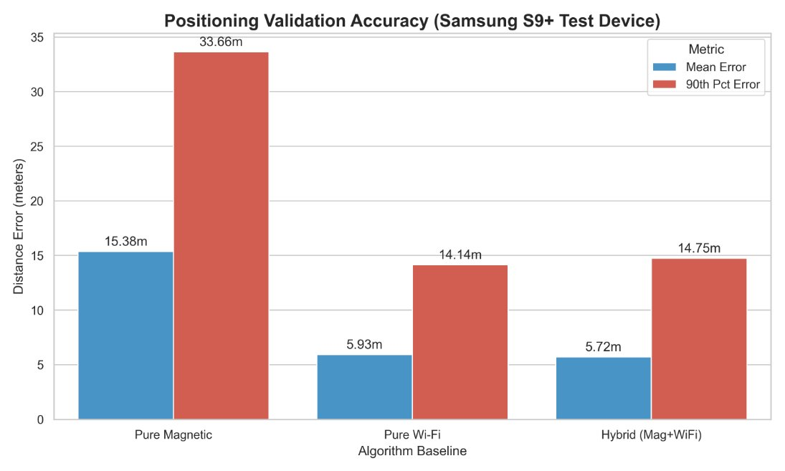

Slide 10
The Extended Kalman Filter Pipeline
EKF Pipeline Results:
Benchmark: 4.31m | Our Error: 4.29m
The MagWi paper [2] ellaborates clearly on how the have build there EMF pipeline so we tried to keep the same architecture.
The 4-Step Architecture:
Dead Reckoning: Calculate baseline trajectory using IMU step data.
Global Wi-Fi Search: Use the Wi-Fi KNN to identify a coarse "bounding circle" of the user's location.
Local Magnetic Search: Use the Magnetic KNN to pinpoint the exact location within that Wi-Fi circle.
Kalman Fusion: Mathematically fuse the IMU trajectory with the Wi-Fi/Mag location to eliminate sensor drift.

Slide 11
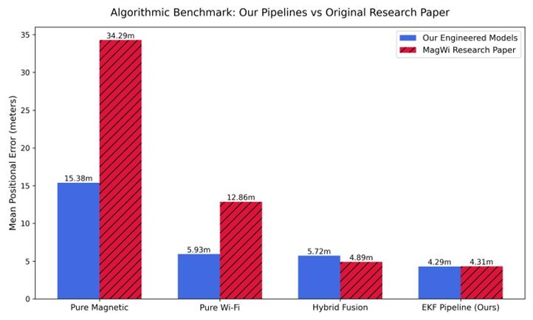

Slide 12
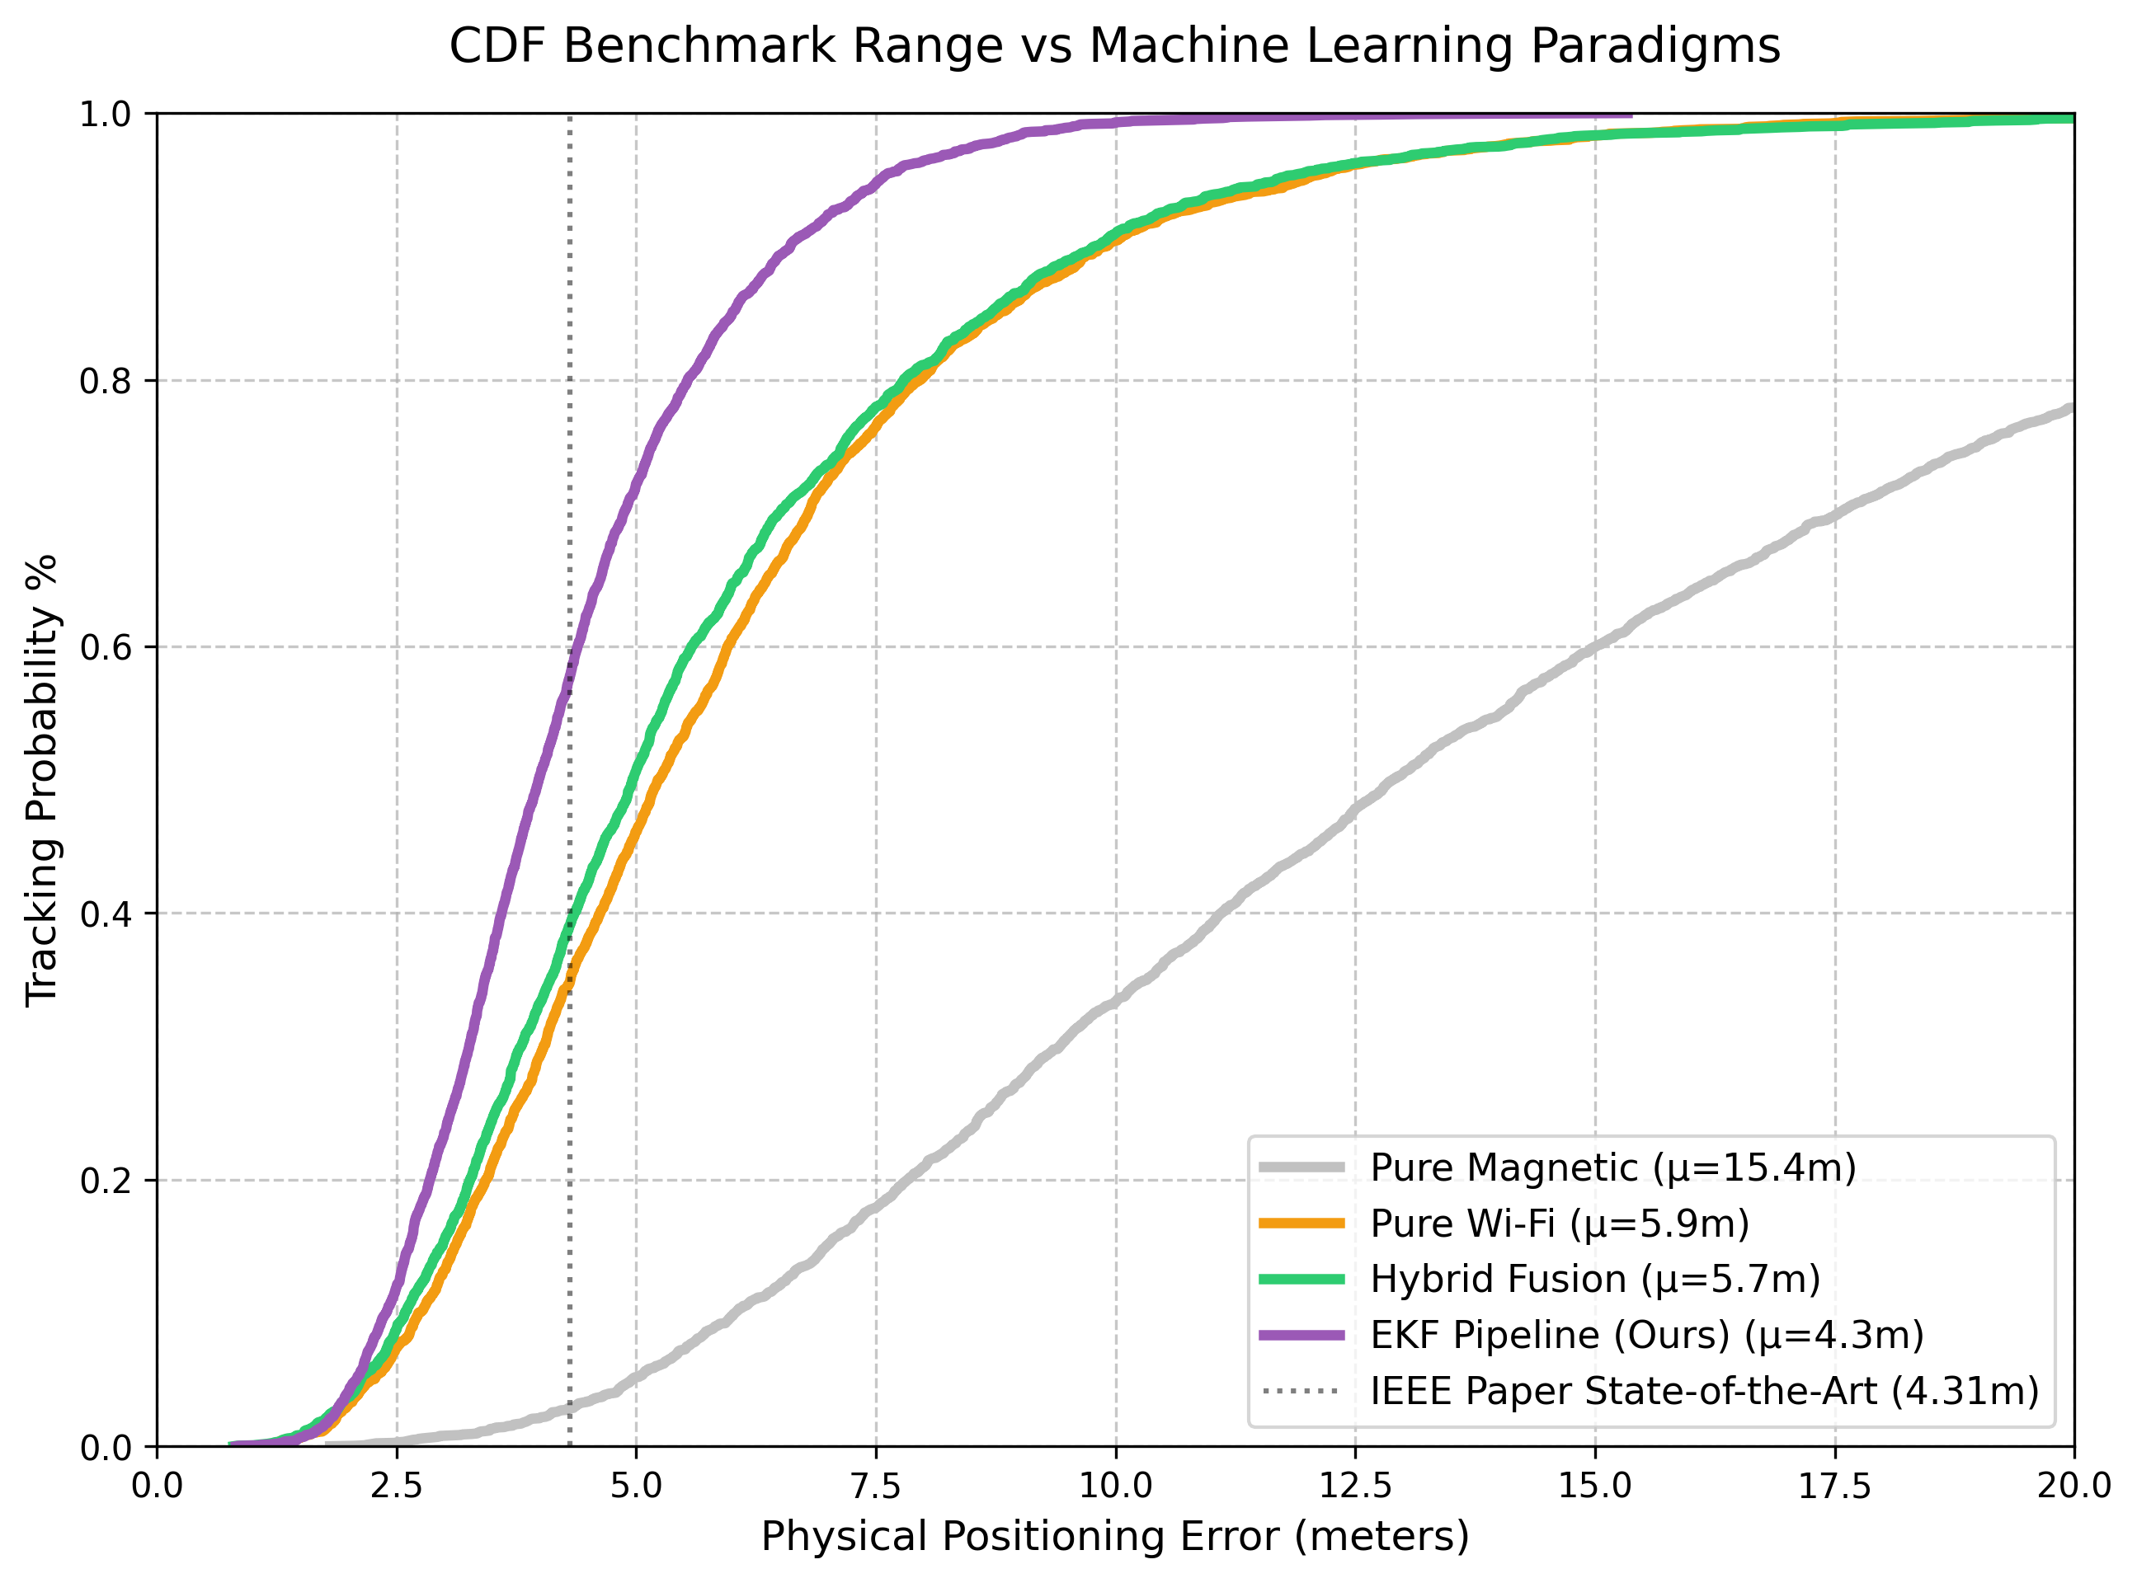

Slide 13
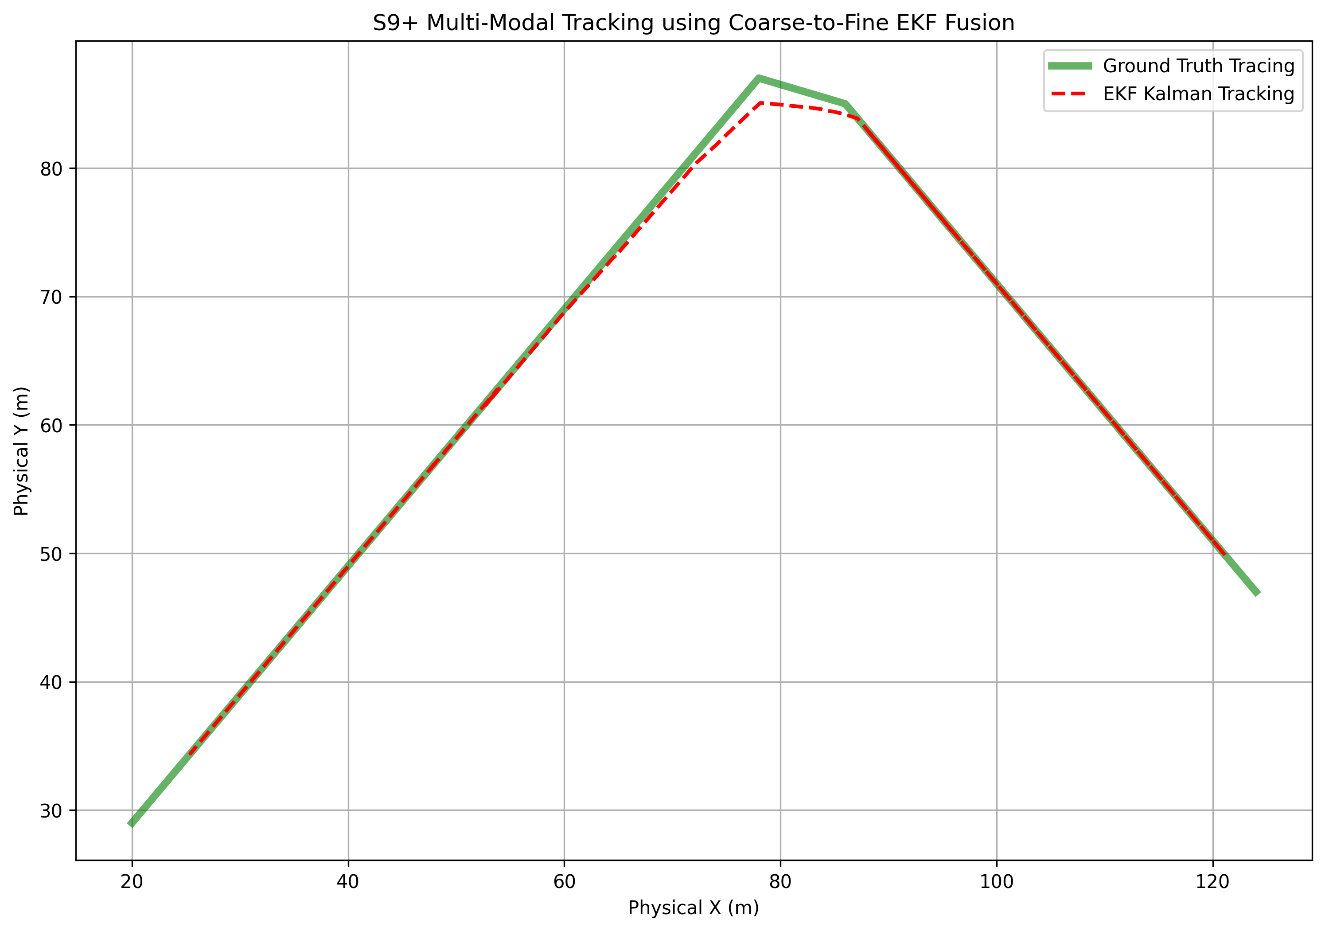
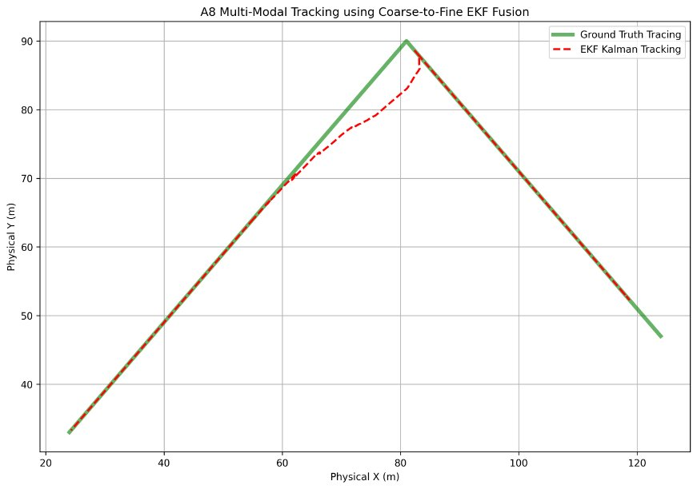
Tested on the S9+ model
Tested on the A8 model

Slide 14
Proposed Architecture
The Limitation of Traditional Models (KNN/EKF):
Feature Imbalance: 127 Wi-Fi signals mathematically overpower 3 Magnetic vectors in simple distance metrics.
Independent Point Predictions: KNN treats every location as a disconnected snapshot, ignoring the continuous physics of human movement.
The Deep Learning Pipeline:
Input: Preprocessed, normalized matrix of 130 features (Wi-Fi RSS + Magnetic X, Y, Z).
CNN Layer (Spatial Extraction): Acts as a feature extractor. Treats the 130 inputs like a 1D or 2D image, learning complex, non-linear relationships and automatically balancing the importance of Wi-Fi vs. Magnetic data.
LSTM Layer (Temporal Tracking): Receives the spatial features from the CNN. Uses its "memory" cells to track the sequence of the user's steps over time, naturally filtering out erratic jumps and predicting smooth trajectories.

Slide 15
Why CNN + LSTM? A Theoretical Fit
The Signals are Complementary:
Wi-Fi RSS Fingerprinting: High spatial uniqueness (distinguishes rooms/wings). Limitation: High temporal instability (multipath fading, moving crowds, device heterogeneity).
Magnetic Field Fingerprinting: Highly stable, infrastructure-free distortions caused by a building's steel reinforcements. Limitation: Low spatial discriminability (long, symmetrical corridors look identical).
The Perfect Mathematical Fit:
CNN handles the Wi-Fi Noise: Convolutional filters are exceptionally robust against local noise and missing data (dropped packets), extracting the true spatial "fingerprint map" across the building.
LSTM handles the Magnetic Ambiguity: By tracking the sequence of magnetic distortions over time, the LSTM learns which specific corridor the user is walking down, breaking the symmetrical ambiguity.

Slide 16
Future Goals and Innovations
Phase 4.1: Deep Fusion Network Development (Current/Next)
Fully implement, train, and tune the CNN + LSTM architectures against our established KNN/EKF baselines.
Phase 4.2: Edge-Computing Optimization
The Goal: A model is useless if it drains a smartphone battery in minutes.
The Method: Prune and quantize the deep networks to ensure lightweight, on-device inference without cloud latency.
Phase 5: Quantum Machine Learning (QML) - Innovative Stretch Goal
Investigate integrating quantum circuits (e.g., Quantum Neural Networks or QSVMs) to radically optimize complex feature mapping and reduce classical computational costs.
Potential Improvements: - Reduction in Number of parameters and weights.[5] - Faster convergence so the training time reduces significantly. [6] - Reduction in time complexities. - Has inherent compatibility for non-linear data. - Requires less amount of training data.[7]

Slide 17
Budget
Budget Estimate
₹10,000 allocated for HPC usage, covering compute costs for GPU training, large-scale experiments, and model evaluation.
₹20,000 allocated for miscellaneous contingency expenses such as books, conference registration, external storage drives, and other research-related materials.

Slide 18
References
[1] Saeed, Mohamedalfateh TM, Mosab AA Yousif, and Ibrahim Ozturk. "Mitigating Device Heterogeneity for Enhanced Indoor Positioning System Performance Using Deep Feature Learning." IEEE Access (2025).
[2] Ashraf, Imran, et al. "MagWi: Benchmark dataset for long term magnetic field and Wi-Fi data involving heterogeneous smartphones, multiple orientations, spatial diversity and multi-floor buildings." IEEE Access 9 (2021): 77976-77996.
[3] Klipp, Konstantin, et al. "Comparing CNN and LSTM Networks for Magnetic Localization of IoT Devices and Pedestrian Tracking." 2025 11th International Conference on Computing and Artificial Intelligence (ICCAI). IEEE, 2025.
[4] Zhang, Wei, et al. "DeepPositioning: Intelligent fusion of pervasive magnetic field and WiFi fingerprinting for smartphone indoor localization via deep learning." 2017 16th IEEE International Conference on Machine Learning and Applications (ICMLA). IEEE, 2017.
[5] Mittal, Sparsh, et al. "Hybrid quantum machine learning based human speech emotion recognition." 2025 IEEE International Conference on Acoustics, Speech, and Signal Processing Workshops (ICASSPW). IEEE, 2025.
[6] Qu, Zhiguo, et al. "QFSM: a novel quantum federated learning algorithm for speech emotion recognition with minimal gated unit in 5G IoV." IEEE Transactions on Intelligent Vehicles (2024).
[7] Hybrid classical–quantum Convolutional Neural Network for stenosis detection in X-ray coronary angiography

