Slide 1
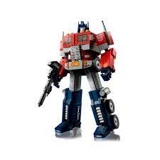
AI/ML Accelerator
Session 4 - Week 2
Natural Language Processing
Ayyanar Jeyakrishnan
WellsFargo
Notes:
48

Slide 2
POS Tagging, Grammar, Syntax, and Parsing
Technique | Details | Use Case | When to Use
Parts of Speech (POS) Tagging | Identifies and assigns parts of speech (noun, verb, adjective, etc.) to each word in a sentence. It helps in understanding sentence structure. | Text classification, information extraction, sentiment analysis, and speech recognition. | Use when needing to understand the role of each word in context.
Grammar | Refers to the rules governing the structure of sentences (syntax, morphology, etc.). Helps identify correct sentence structure. | Grammar checking, text correction, and text generation tasks. | Use when building systems that require language understanding and generation.
Syntax | Describes the arrangement of words and phrases to create well-formed sentences. It includes dependencies and phrase structures. | Language translation, dialogue systems, question answering, and summarization. | Use in syntactic analysis tasks like parsing or language generation.
Parsing | The process of analyzing a sentence's structure according to grammar rules (e.g., constituency parsing, dependency parsing). | Sentence parsing, dependency parsing for syntactic analysis, machine translation. | Use when you need to understand the syntactic structure of a sentence.
Notes:
48

Slide 3
Usecase and Example
Sentence Parsing: Helps break down the sentence structure for syntactic analysis.
Named Entity Recognition (NER): Identifying names, organizations, locations, etc., which often depend on POS tags.
Machine Translation: Mapping POS tags helps in translating sentence structures from one language to another.
Sentiment Analysis: Adjectives, verbs, and nouns help determine the sentiment of a sentence (positive, negative, neutral).
Sentence: "Apple Inc. was founded by Steve Jobs in Cupertino in 1976."
Word | POS Tag | Entity
Apple | Noun (NNP) | Organization
Inc. | Noun (NNP) | Organization
was | Verb (VBD) | -
founded | Verb (VBD) | -
by | Preposition (IN) | -
Steve | Noun (NNP) | Person
Jobs | Noun (NNP) | Person
in | Preposition (IN) | -
Cupertino | Noun (NNP) | Location
in | Preposition (IN) | -
1976 | Noun (CD) | Date
Notes:
48

Slide 4
Quick Demo -1
POS Tagging
Notes:
48

Slide 5
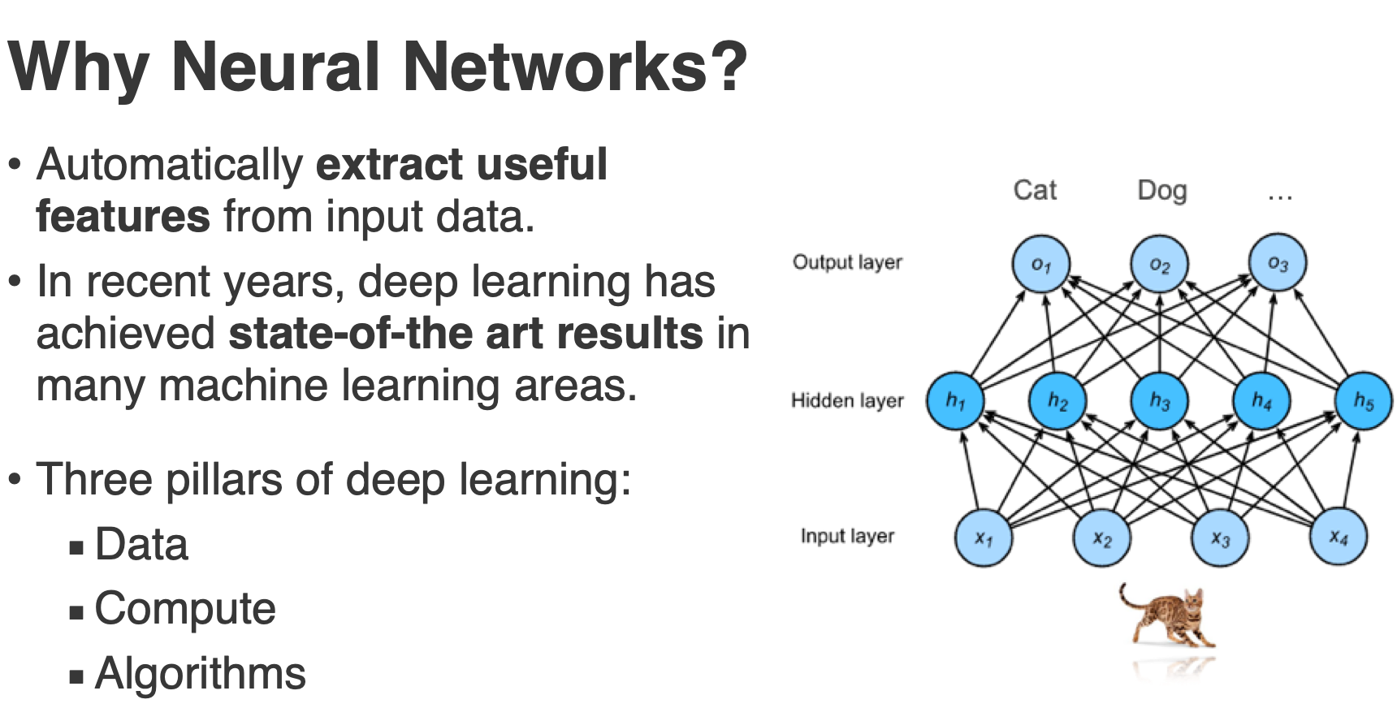
Neural Network
Notes:
48

Slide 6
Neural Network
Notes:
Welcome to Machine Learning Accelerator – the TABular Data course
Day 3
1

Slide 7
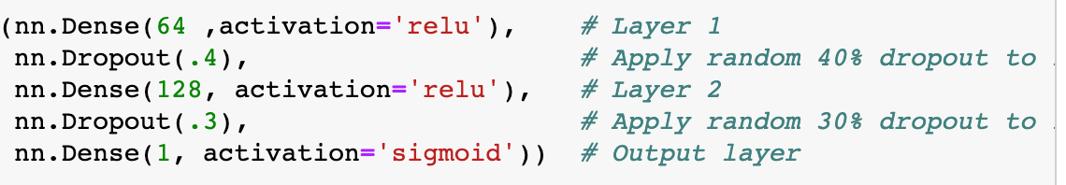
Build and Train Neural Network
How to build and use these ML models?
Can it be this simple?
What is Activation, Dense ?
Notes:
48

Slide 8
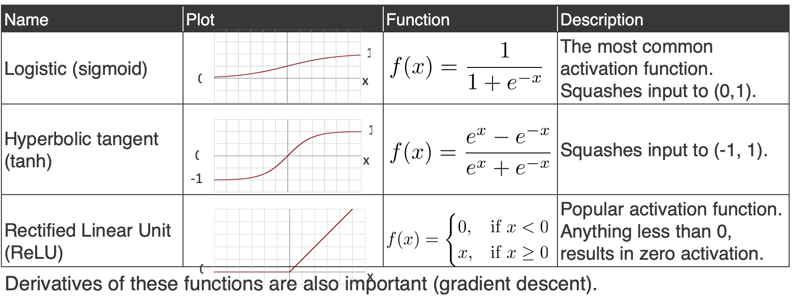
Activation Function
Notes:
48

Slide 9
Output Activations / Cost Functions
Problem | Decription | Name | Cost Functions
Binary classification | Output probability for each class, in (0,1) Logistic regression of output of last layer | Sigmoid | Cross Entropy for Logistic
Multi-class classification | Output probability for each class, in (0,1) Sum of outputs to be 1 (probability distribution) Training drives target class values up, others down | Softmax | Cross Entropy for SoftMax
Regression |  | Linear/ ReLU | Mean Squared Error
Notes:
48

Slide 10
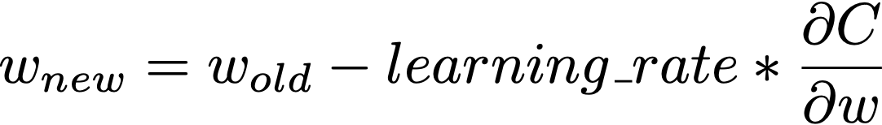


Training Neural Networks
Cost function is selected according to problem: Binary, Multi-class Classification or Regression.
Update network weights by applying the gradient descent method and backpropagation. More details
Weight update formula:
: Cost
Gradient with respect to
Notes:
48

Slide 11
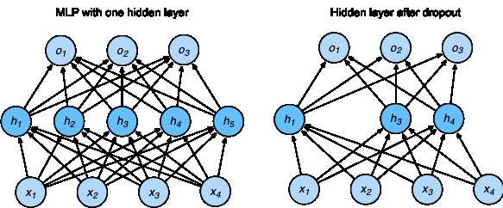
DropOut
Regularization technique to prevent overfitting.
Randomly removes some nodes with a fixed probability during the training.
Notes:
48

Slide 12
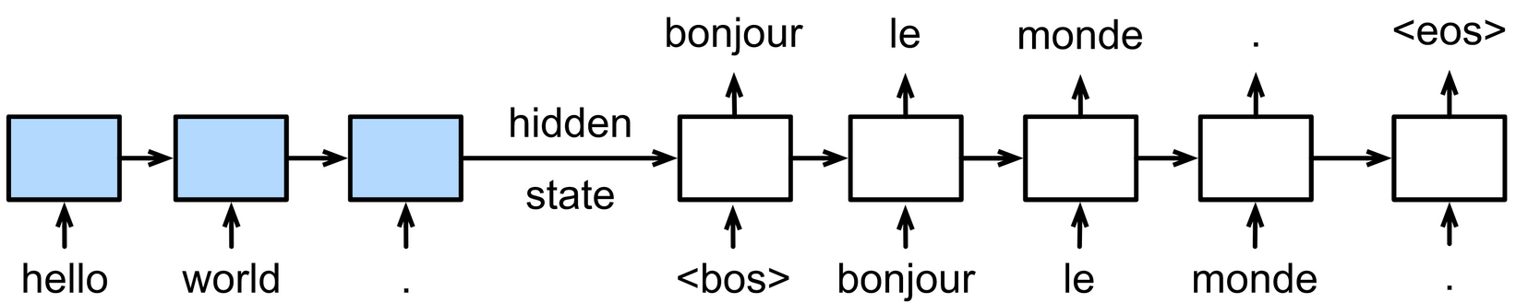
Neural Network for Sequential Data ?
Text data has sequential information of words.
Other sequential inputs (time series, music notes, video, etc.)
Example: Language translation
Notes:
48

Slide 13
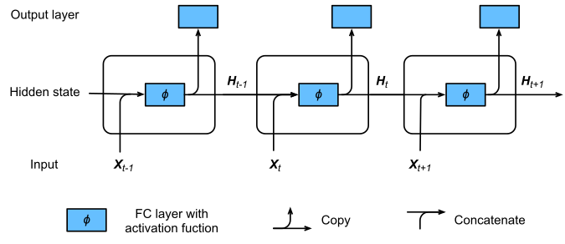
Recurrent Neural Networks (RNN)
RNN uses an internal state to preserve the sequential information between input elements.
X: Input
H: Hidden state
t: Timestep
Notes:
48

Slide 14
Recurrent Neural Networks (RNN)
RNN uses an internal state to preserve the sequential information between input elements.
X: Input
H: Hidden state
t: Timestep
Notes:
48

Slide 15
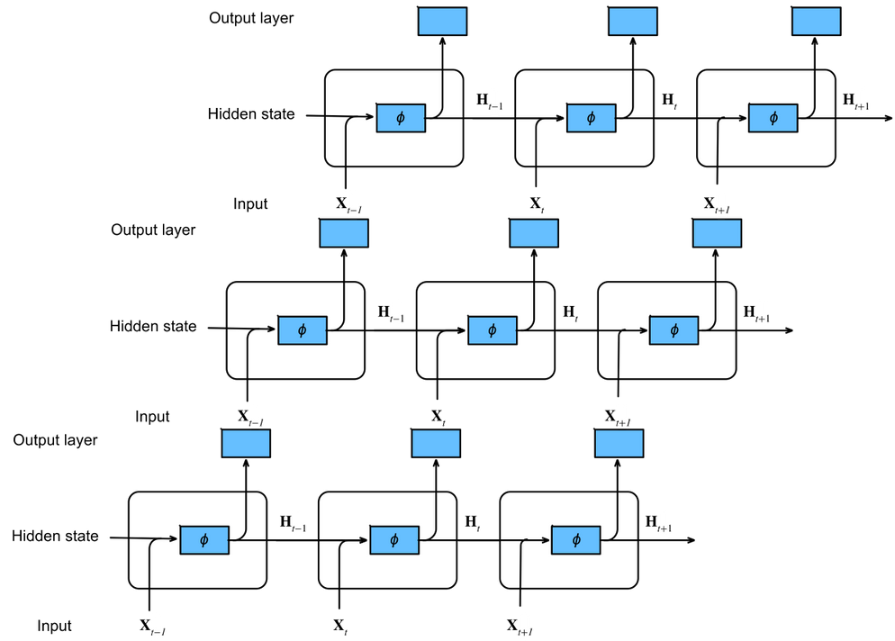
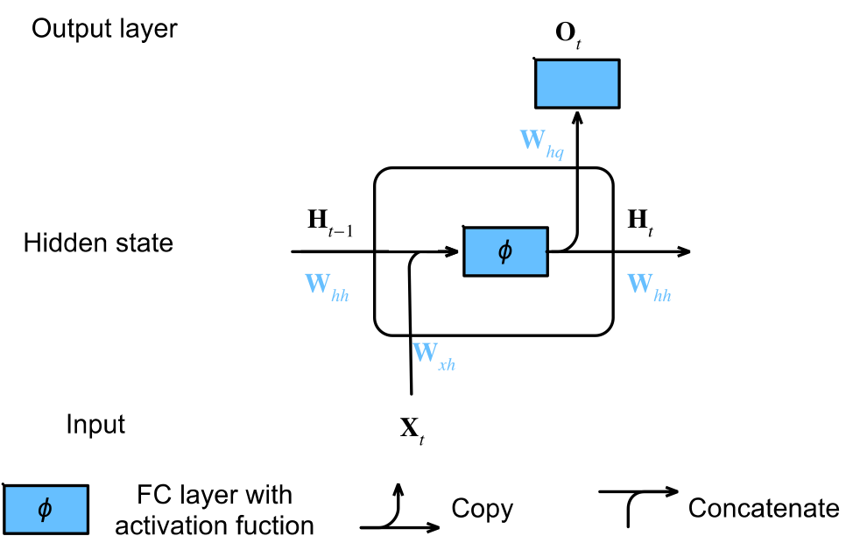
RNN
Stacked RNN
Notes:
48

Slide 16
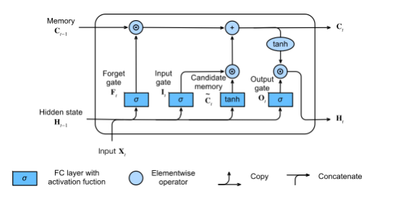
Long Short-term Memory Networks (LSTM)
Long Short-Term Memory (LSTM) networks are special RNNs, with different gates and memory cells:
Gates:
Input gate
Forget gate
Output gate
Memory cells:
Candidate memory cell
Memory cell
Hidden state
Notes:
48

Slide 17
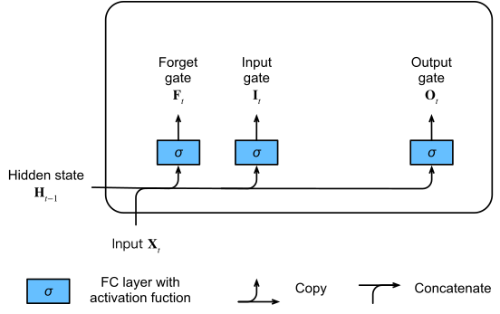
Input, Forget and Output Gates
Input is (number of examples: 𝑛, number of inputs: 𝑑 )
Hidden state of last timestep (number of hidden states: ℎ).
All gates use sigmoid activation function.
Notes:
48

Slide 18
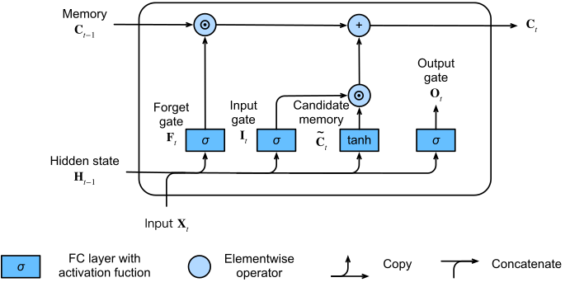
Memory Cell
How much of the old memory will stay and : How much new data will be added
Notes:
48

Slide 19
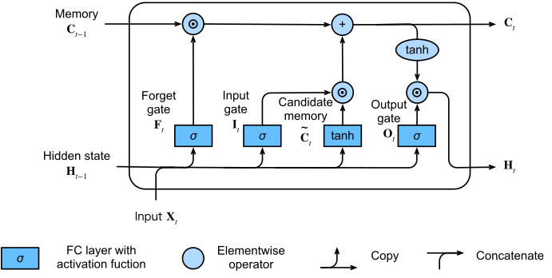
LSTM Architecture
Notes:
48

Slide 20
LSTM vs RNN
Feature | RNN | LSTM
Architecture | Simple looping units | Complex units with memory cells and gates
Memory Capability | Limited short-term memory | Long-term memory through cell state
Gates | None | Forget, Input, and Output gates
Vanishing Gradient Problem | Prone to vanishing gradient | Mitigates vanishing gradient through gated structure
Ideal Use Cases | Short sequences, limited dependency tasks | Long sequences, tasks with long-term dependencie
Notes:
48

Slide 21
Transformer
Notes:
Welcome to Machine Learning Accelerator – the TABular Data course
Day 3
1

Slide 22
Transformer - Why We needed
RNNs are naturally sequential -> Cannot be trained in parallel
RNNs (or LSTMs) still need “attention” mechanism to deal with long range dependencies between states
If attention gives us access to any state, can we simply utilize the attention and ignore the RNN?
Notes:
48

Slide 23
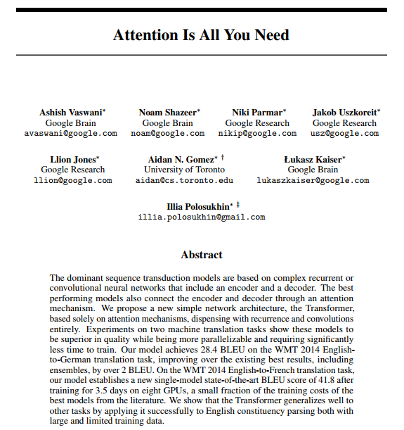
Attention Matters
Attention is a mechanism that forces the model to focus on specific parts of the input sequence.
Can process sequential data parallelly.
Notes:
48

Slide 24
Lingustics Need Context
Recurrent Neural networks process one token at a time
In linguistics, people believe that instead sentences are best understood by combining into higher level concepts
I
kicked
the
ball
S
VP
S: Sentence
VP: Verb Phrase
NP: Noun Phrase
NP
NP
I
kicked
the
ball
Can we make a model that mirrors this philosophy?
Notes:
48

Slide 25
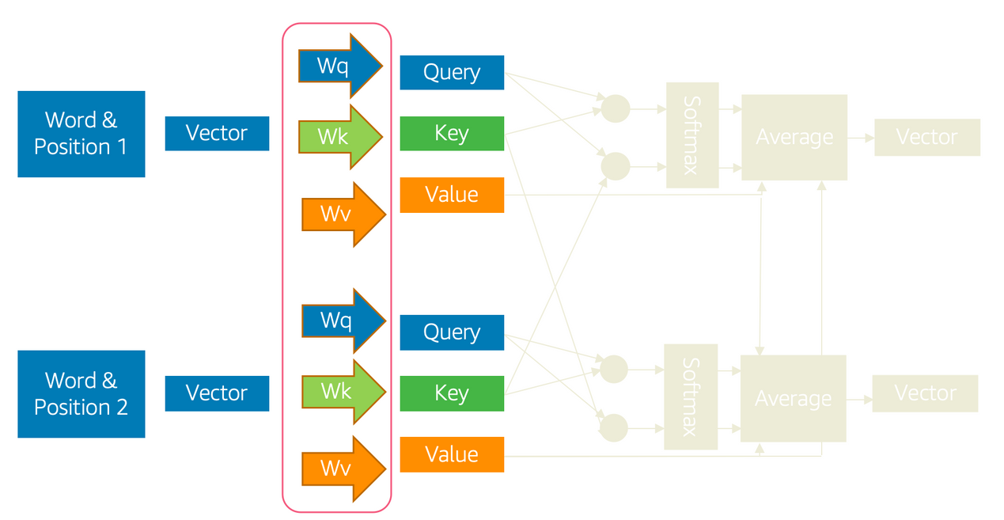
Single Headed Attention
The key, query, and value will all be vectors of numbers.
Notes:
48

Slide 26
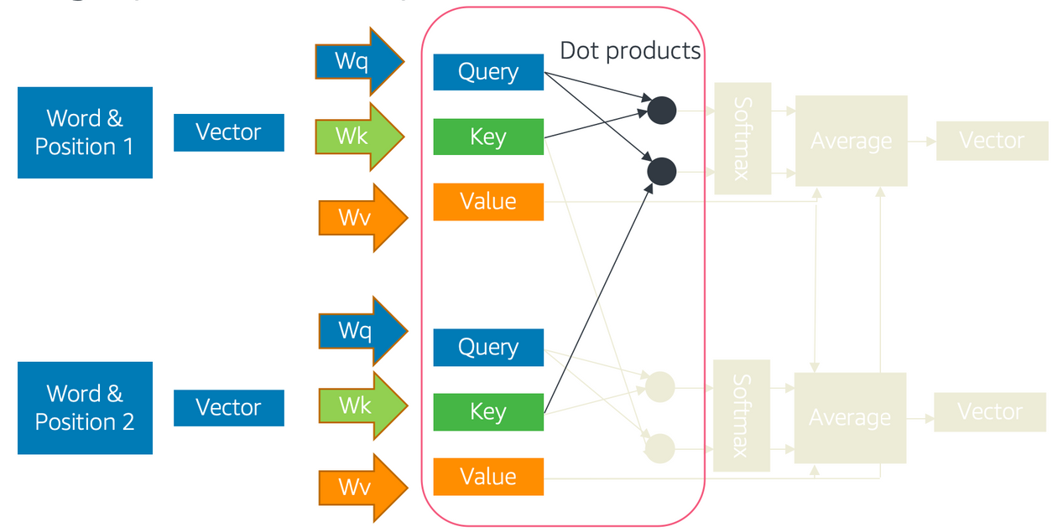
Single Headed Attention
Similarity is commonly given by the dot product .
Large positive dot products are similar.
Notes:
48

Slide 27
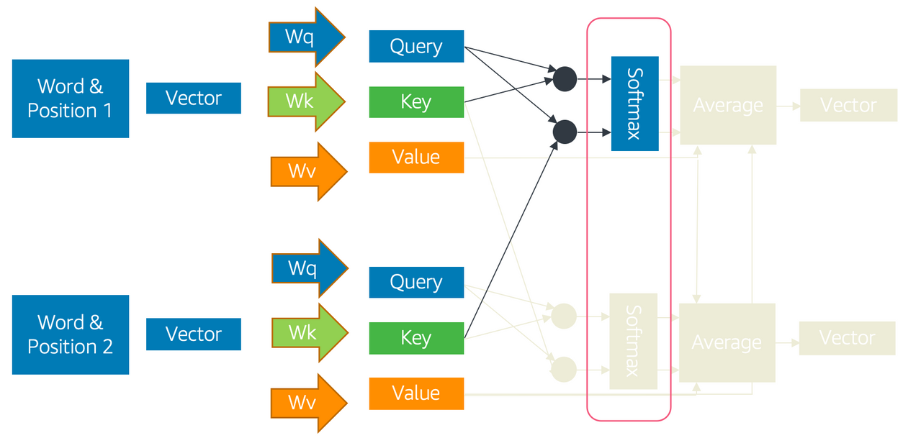
Single Headed Attention
At each token, compute the softmax of the dot products to get a collection of weights that sum to one
The larger are corresponding to the larger dot products.
Notes:
48

Slide 28
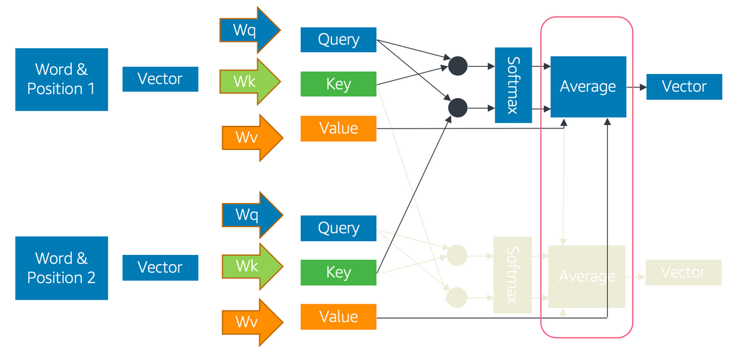
Single Headed Attention
The final lookup is obtained by weighted averaging the values:
Notes:
48

Slide 29
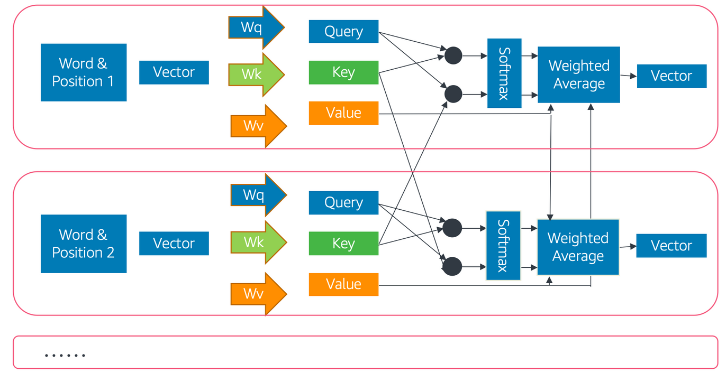
Single Headed Attention
This process is repeated for every token in the network.
Notes:
48

Slide 30
Single Headed Attention
At each token:
The key, query, and value are represented by vectors of numbers.
The query and (other token’s) key similarity is commonly given by the dot product . Large positive dot products are similar.
The query and all (other token’s) key similarities are normalized by the softmax of the dot products to get the weights
The output value of the query is the weighted average of the (other token’s) values:
Notes:
48

Slide 31
Single Headed Attention - Challenges
verb: to fasten or attach
“I tied the bag closed.”
verb: to establish in relationship
“We tied the criminal to the scene of the crime.”
noun: railway supports
“She hammered the rail to the tie.”
noun: equality in a contest
“The game ended in a tie.”
noun: sustained tone in music:
“The tie holds the note into the next measure.”
noun: Something knotted when worn
“He put on his favorite tie for the job interview
Issue of Polysemy
Consider some of the meanings of the word ”tie”
Notes:
48

Slide 32
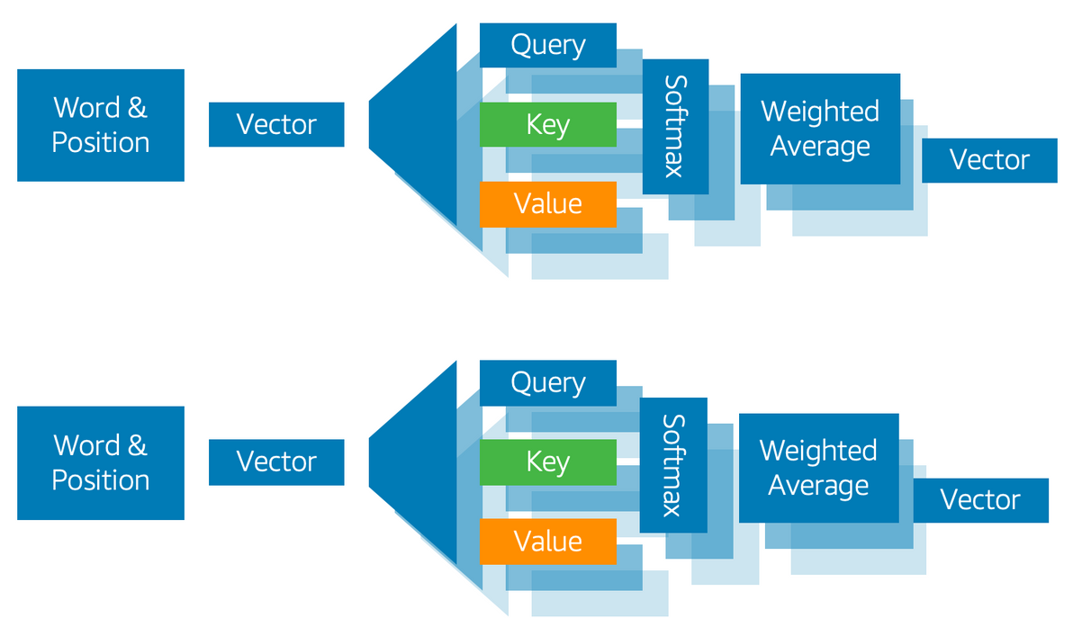
Multi Headed Attention
To solve the issue of polysemy, every token (and every subsequent layer) will emit multiple keys, multiple values, and multiple queries! This is called multi-headed attention.
Notes:
48

Slide 33
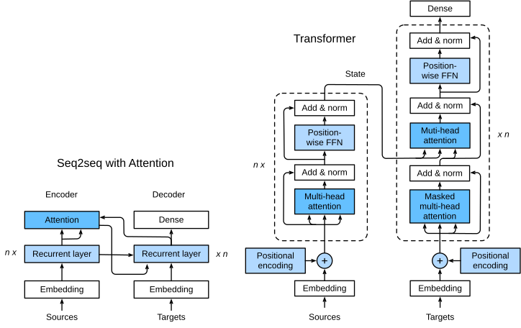
Transformers
The full architecture contains:
Transformer block
Add and norm
Position encoding
More details of transformer.
Notes:
48

Slide 34
Using Pre-trained Model
Transformers take a long time to train
GPT (240 GPU days)
BERT (256 TPU days)
GPT-2 (2048 TPU days)
Directly use pre-trained models
The Hugging Face contains a large number of pretrained transformer models (BERT, RoBERTa, BioBERT, ClinicalBERT, etc., LLAMA) on a varied of corpus.
Notes:
48

Slide 35
Using Pre-Trained Models
There are multiple ways to use these pre-trained models:
Use it as a fixed embedding (no training cost). We investigate this in a notebook example.
The model can be fine-tuned end-to-end as a classifier.
The model can be fine-tuned as a language model on your specific dataset, then used as an encoder or fine-tuned on the classification task.
The model can be trained from scratch. This is very intensive, and should only be done with 50GB+ of text.
INCREASING COST
Notes:
48

Slide 36
Demo 3 - BERT Model
Notes:
48

Slide 37
Office Hours Week2
Discussion - Exercise - Day 2
https://www.kaggle.com/datasets/pawankumargunjan/imdb-review
https://www.kaggle.com/datasets/prakharrathi25/google-play-store-reviews
Notes:
48

