Slide 1
Agenda
Kubernetes 101 - Highlevel Overview
OpenShift 101 - Highlevel Overview
Deployment on OCP (OpenShift Container Platform)
Wells Internal Sizing, RACI, Cluster Details
OECM on OCP
Target Product Status
Current Status (WIP)

Slide 2
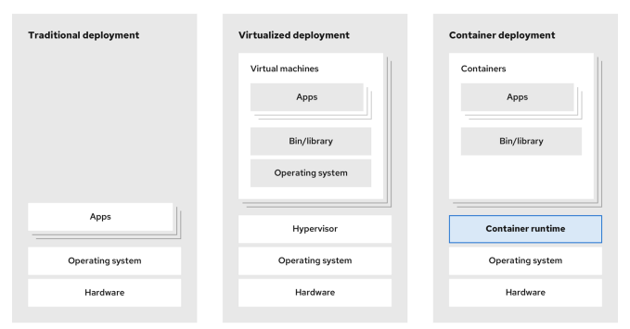
Evolution of Container Technology

Slide 3
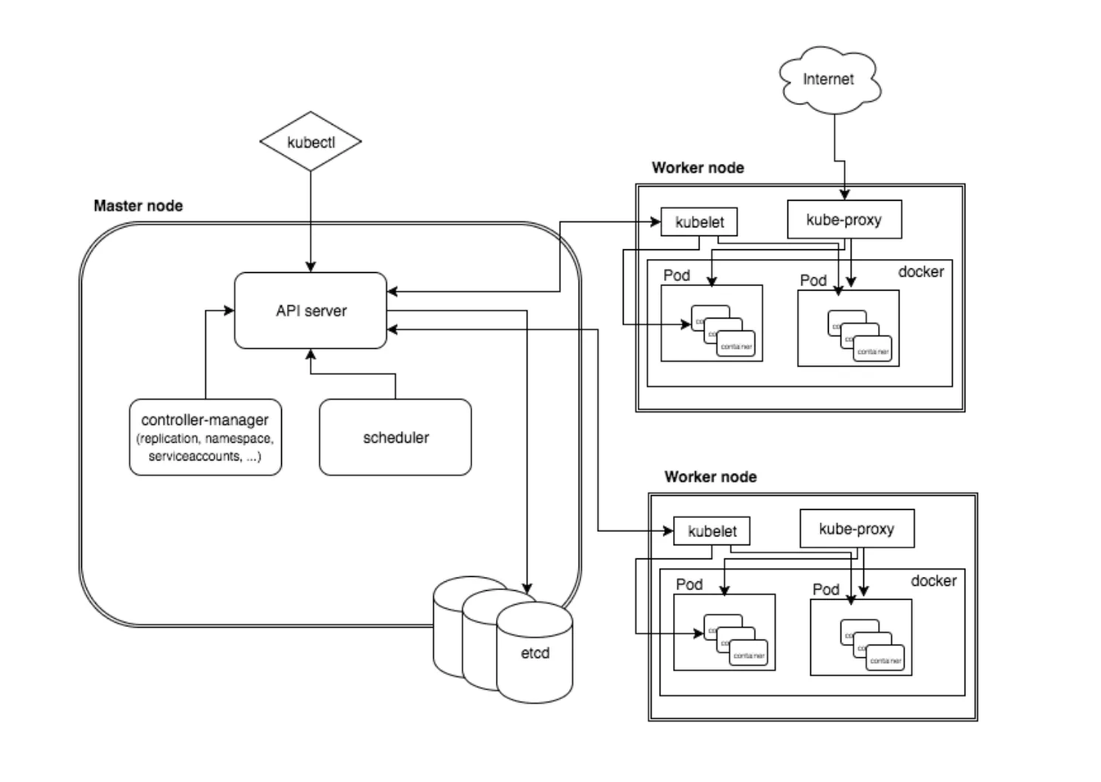
Kubernetees 101 - Highlevel Overview
Orchestration of Containers: Kubernetes automates the deployment, scaling, and management of containerized applications, making it easier to handle complex applications spread across multiple environments.
Master Nodes
API Server
ETC
Scheduler
Control Manager
Worker Node
Kubelet
Kubeproxy
Pod
Client: kubectl

Slide 4
Kubernetees 101 - Pod
apiVersion: v1
kind: Pod
metadata:
name: multi-container-pod-example # Name of the Pod
spec:
containers:
# Container 1: Apache HTTP Server (httpd)
- name: apache-container # Name of the first container
image: httpd:latest # Image for the Apache HTTP server
ports:
- containerPort: 80 # Port exposed by the Apache server
# No custom command is needed; defaults to running httpd service
# Container 2: Alpine Linux Shell
- name: alpine-container # Name of the second container
image: alpine:latest # Image for Alpine Linux
command: ["/bin/sh"] # Command to run when the container starts
args: ["-c", "while true; do echo 'Hello, Kubernetes from Alpine!'; sleep 5; done"]
# The command runs a shell that outputs a message every 5 seconds
Atomic unit or smallest “unit of work” of Kubernetes.
Pods are one or MORE containers that share volumes, a network namespace, and are a part of a single context.
They are also ephemeral

Slide 5
Kubernetees 101 - Storage
Pods are useful but often need data sharing between containers or data persistence. To enable this, Kubernetes offers:
Volumes: Shared, temporary storage tied to a Pod’s lifecycle, persisting across container restarts but deleted with the Pod.
PersistentVolumes (PVs): Cluster-wide storage that retains data beyond the Pod’s lifecycle.
PersistentVolumeClaims (PVCs): Requests for storage used by Pods to access PersistentVolumes.
StorageClasses: Define and manage different storage types, enabling dynamic provisioning of PersistentVolumes.

Slide 6
Kubernetees 101 - Volume
apiVersion: v1
kind: Pod
metadata:
name: multi-container-volume-example # Name of the Pod
spec:
containers:
# Container 1: Apache HTTP Server (httpd)
- name: apache-container # Name of the first container
image: httpd:latest # Image for the Apache HTTP server
volumeMounts:
- name: shared-data # Referencing the Pod volume by name
mountPath: /usr/local/apache2/htdocs # Path inside the container where the volume is mounted
# Container 2: Alpine container for writing data to the shared volume
- name: alpine-writer-container # Name of the second container
image: alpine:latest # Image for Alpine Linux
command: ["/bin/sh", "-c"] # Command to run when the container starts
args:
- while true; do echo "Hello from Alpine at $(date)" >> /data/index.html; sleep 5; done
# Command writes a timestamped message to the shared file every 5 seconds
volumeMounts:
- name: shared-data # Referencing the same Pod volume by name
mountPath: /data # Path inside the container where the volume is mounted
volumes:
- name: shared-data # Defining the volume used by both containers
emptyDir: {} # Type of volume that is created as an empty directory
Storage linked to the Pod's lifecycle.
A Pod can have multiple types of volumes.
Usable by any container within the Pod.
Survives Pod restarts; durability depends on the volume type.

Slide 7
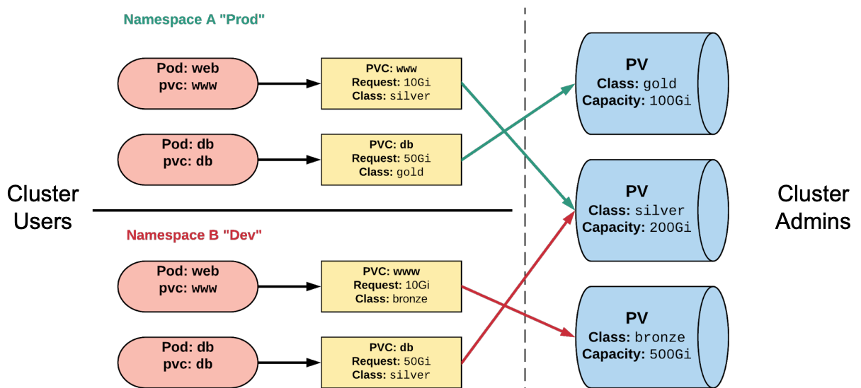
Kubernetees 101 - Persistent Volume
PersistentVolumeClaims (PVCs):
Namespaced requests for storage within a Kubernetes cluster.
Specify requirements rather than directly mapping to a specific storage resource.
Ensure portability of storage claims, allowing applications to access storage across various backends or providers.
Persistent Volumes (PVs):
Represent a storage resource within a Kubernetes cluster.
Linked to a backing storage provider such as NFS, GCEPersistentDisk, or RBD.
Typically provisioned by an administrator.
Managed independently from Pod lifecycles.
Cannot be attached directly to a Pod and must be accessed via a PersistentVolumeClaim (PVC).

Slide 8
Kubernetees 101 - PV/PVC Spec File
# PersistentVolumeClaim (PVC) Specification
apiVersion: v1
kind: PersistentVolumeClaim
metadata:
name: pvc-sc-example # Name of the PersistentVolumeClaim
spec:
accessModes:
- ReadWriteOnce # Access mode requested by the PVC
resources:
requests:
storage: 1Gi # Storage size requested by the PVC
storageClassName: silver # References the storage class defined in the PV
# PersistentVolume (PV) Specification
apiVersion: v1
kind: PersistentVolume
metadata:
name: nfsserver # Name of the PersistentVolume
spec:
capacity:
storage: 50Gi # Total available storage capacity
volumeMode: Filesystem # Type of volume (Filesystem or Block)
accessModes:
- ReadWriteOnce
- ReadWriteMany
persistentVolumeReclaimPolicy: Delete # Behavior when PVC is deleted (Delete or Retain)
storageClassName: silver # Storage class name for PVCs to reference
mountOptions:
- hard # Ensures hard mount for stability
- nfsvers=4.1 # Specifies NFS version
nfs:
path: /exports # Path on the NFS server
server: 172.22.0.42 # NFS server IP address

Slide 9
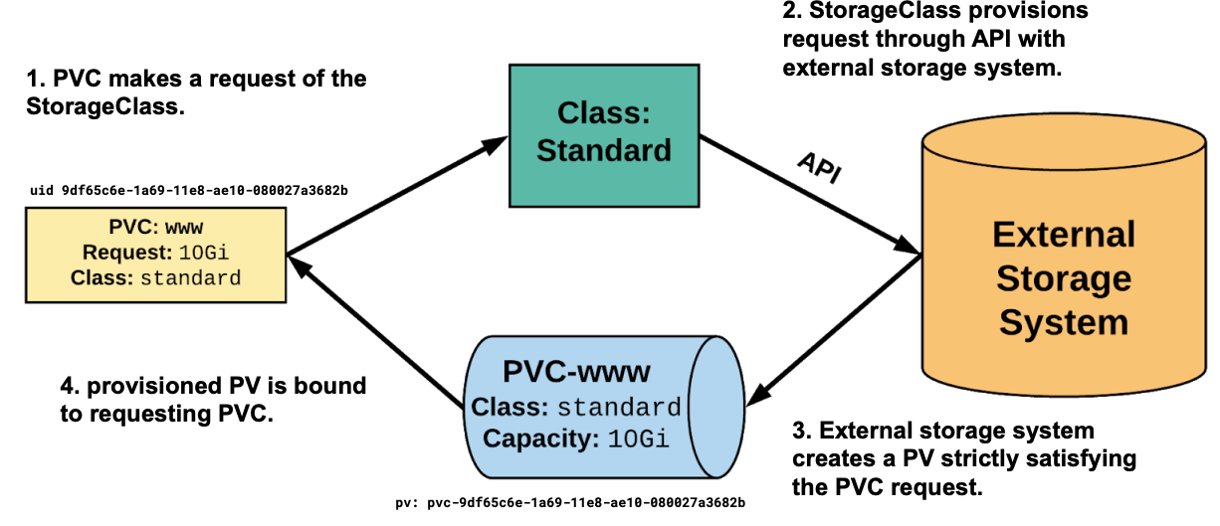
Kubernetees 101 - Storage Classes
kind: StorageClass
apiVersion: storage.k8s.io/v1
metadata:
name: standard # Name of the storage class
provisioner: kubernetes.io/gce-pd # The driver used for external storage provisioning
parameters:
type: pd-standard # Type of persistent disk (e.g., pd-standard, pd-ssd)
zones: us-central1-a, us-central1-b # Availability zones for the storage
reclaimPolicy: Delete # Policy for reclaiming the storage asset after PVC deletion

Slide 10
Kubernetees 101 - Wells Reference
kind: StorageClass
apiVersion: storage.k8s.io/v1
metadata:
name: netapp-trident-block # Name of the StorageClass for block storage
provisioner: netapp.io/trident # Provisioner specific to NetApp Trident
parameters:
backendType: ontap-san # Backend type for block storage (e.g., ontap-san)
spaceReserve: thin # Optional: Thin or thick provisioning
encryption: true # Optional: Enable encryption for the volume
fsType: ext4 # Filesystem type for block storage (e.g., ext4, xfs)
protocols: iscsi # Protocol used for block storage (e.g., iscsi, fc)
snapshotPolicy: default # Optional: Snapshot policy to use
igroup: default # Optional: Specifies the initiator group for access
reclaimPolicy: Retain # Policy for reclaiming storage after PVC deletion
volumeBindingMode: Immediate # When the volume should be provisioned (Immediate or WaitForFirstConsumer)

Slide 11
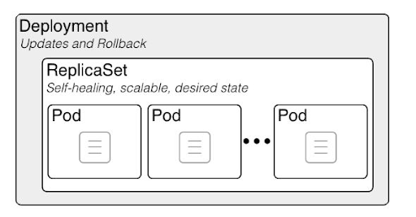
Kubernetees 101 - Deployment / Replicaset

Slide 12
Kubernetees 101 - Deployment / Replicaset - Spec
apiVersion: apps/v1
kind: Deployment
metadata:
name: deploy-example # Name of the deployment
spec:
replicas: 3 # Number of Pod replicas
revisionHistoryLimit: 3 # Number of old ReplicaSets to retain
selector:
matchLabels:
app: nginx # Label to match for Pod selection
env: prod # Additional label for environment
strategy:
type: RollingUpdate # Deployment strategy type
rollingUpdate:
maxSurge: 1 # Maximum number of Pods that can be created above the desired number during update
maxUnavailable: 0 # Maximum number of Pods that can be unavailable during the update
template: # Pod template definition
<pod definition>

Slide 13
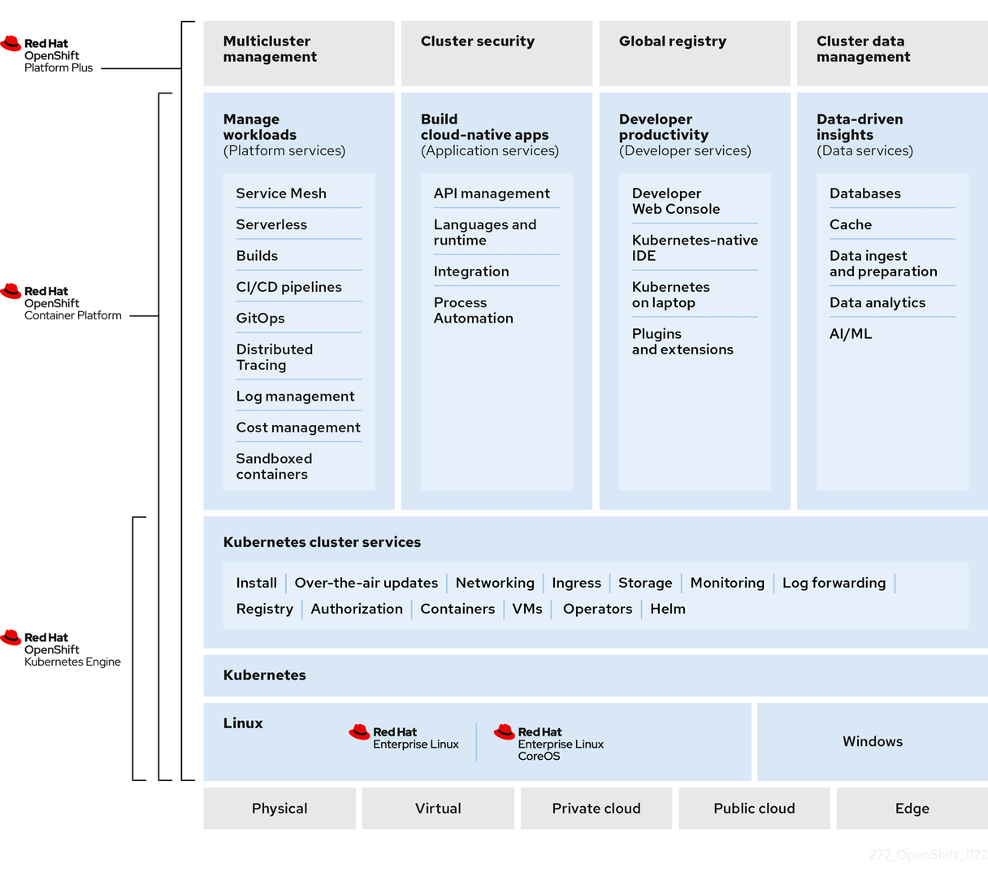
Openshift 101

Slide 14
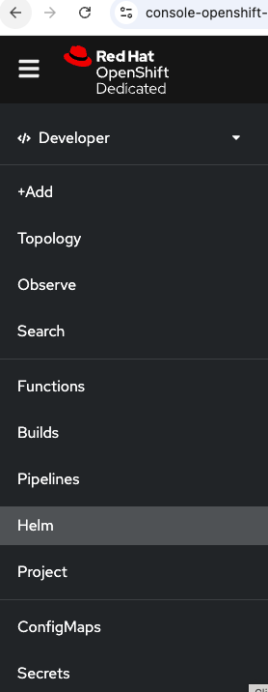
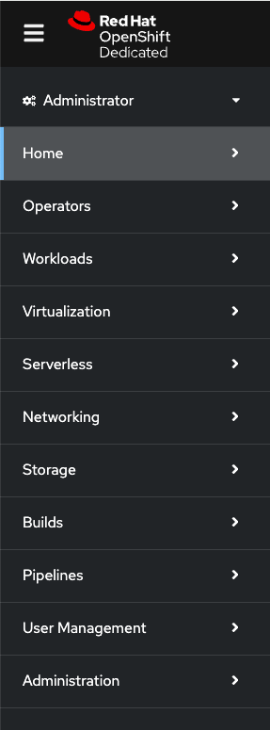
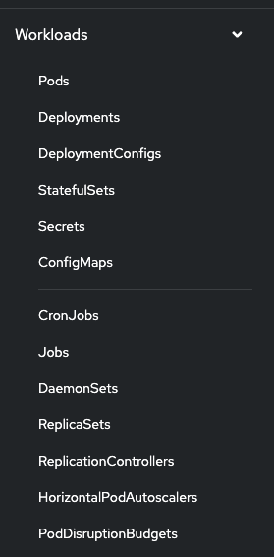
WellsFargo - Openshift Cluster

Slide 15
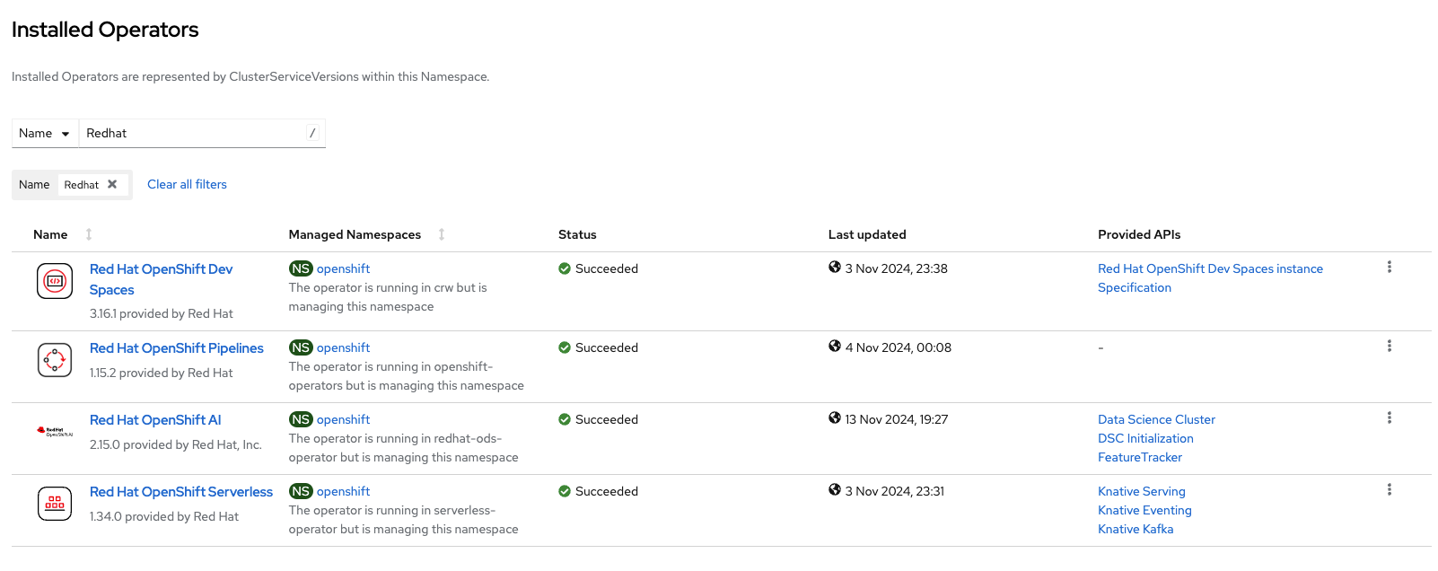
WellsFargo - Openshift Cluster - Operator

Slide 16
WellsFargo - Openshift Cluster - Wells RACI

Slide 17
WellsFargo - Openshift Cluster - TCOO

Slide 18
WellsFargo - Openshift Cluster - DTI Architecture

Slide 19
WellsFargo - OECM Architecture in Openshift

Slide 20
WellsFargo - Helm Chart - OECM Completed

Slide 21
WellsFargo - Helm Chart - OECM Ongoing Activity

Slide 22
WellsFargo - Helm Chart - OECM Apps Ready (Draft)

Slide 23
WellsFargo - Helm Chart

Slide 24


THANK YOU

