Slide 1
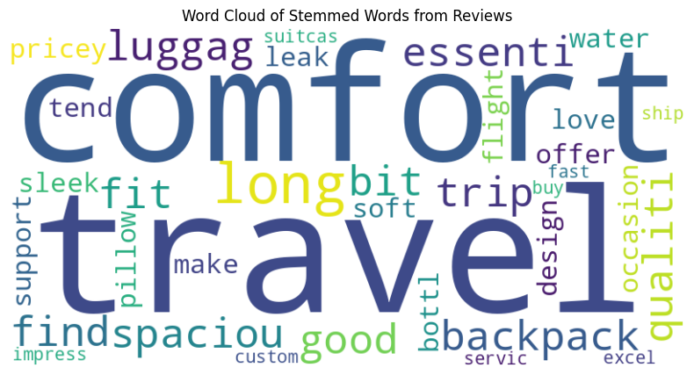
AI/ML Accelerator
Session 4 - Week 1
Natural Language Processing
Ayyanar Jeyakrishnan
WellsFargo
Notes:
Welcome to Machine Learning Accelerator – the TABular Data course
Day 3
1

Slide 2

Learning Outcomes
Practical knowledge of natural language processing (NLP) specific model training and applications
Be comfortable talking with NLP Terminology
Notes:
This course provides a fundamental understanding of Machine Learning, in particular working with Tabular Data
You will gain familiarity with standard Machine Learning tools and data preprocessing libraries
to benefit future work in Machine Learning, such as
Identifying and exploring Machine Learning opportunities
Start your own Machine Learning projects or work with scientist to build Machine Learning solutions for business
2

Slide 3
Use Case Summary
For this course, we’ll apply sentiment analysis to product reviews from a travel accessories retailer, Oceanwave15 Retails. By analyzing customer reviews, we aim to identify patterns in customer satisfaction, highlight popular products, and detect potential issues with product quality or usability. This analysis can guide strategic decisions in marketing, product improvement, and customer support.
Review | Sentiment
1. "This water bottle keeps drinks cold for hours and is perfect for long hikes." | Positive
2. "The suitcase is a bit heavy and not very easy to carry, especially when full." | Negative
3. "The seat cushion was comfortable but didn't offer much back support over long trips." | Neutral
Notes:
This course provides a fundamental understanding of Machine Learning, in particular working with Tabular Data
You will gain familiarity with standard Machine Learning tools and data preprocessing libraries
to benefit future work in Machine Learning, such as
Identifying and exploring Machine Learning opportunities
Start your own Machine Learning projects or work with scientist to build Machine Learning solutions for business
2

Slide 4
Question 1
How to Solve this Problem in Least Effort in Scalable of Million Review Records in Secured Environment - Cost Efficiently - Accuracy doesn’t matter a lot
Open AI 4o ChatGPT
Open AI 3.5 ChatGPT
a
c
Gemini
Simple NLP Technique
b
d

Slide 5
NLP Sessions Overview - Week 1
Day 1 - BootCamp
Day 2 - Office Hours
Introduction to NLP and Applications Text Preprocessing (Stemming, Stop Words)
Basic Text Representations (BoW, TF-IDF)
N-Gram Language Modeling and Probabilities
Hands-On Demo: Building Bigram/Trigram Model
Tokenization and Embedding
Recap and Discussion of NLP Basics & N-Gram Modeling
Review Kaggle Exercises
Notes:
The course is split in three parts.
Let’s have a quick overview & see what to expect from each:
we first introduce key ML concepts,
train our first ML model on a classification task (on some toy dataset) use the model to make predictions on new data
question how good of a model we just built and discuss metrics to evaluate model performance,
While touching upon the trickiest/most common problem in ML Overffiting
we discuss a few steps to explore larger real-life datasets – how much data is there, what type of data, how to deal with missing values or outliers,
and we ‘put it all together’ building a KNN model on this dataset
best way to learn is by doing it, so aside from in-class practice, we open an ML competition
use all ML techniques of the day, to win this competition over the next three days
we next dig deeper into real-life datasets, discussing more ML techniques to handle numerical, categorical, and text features
We also introduce more advanced ML models, tree-based models like: decision trees and random forests
as ML models get more sophisticated, there are more architectural decisions to be made, and we discuss tuning ML models for best performance
To speed up building, training and deploying ML models we introduce you to a few AWS AI/ML services,
Getting you experimenting with ML on AWS beyond Jupiter notebooks
and again, use all these new techniques, to improve your scores and win our ML competition
we walk further down the path of ML models stepping into the DL territory
by looking at ML models that learn by some version of gradient descent optimization
regression models (so called linear models), and neural networks
we close the course learning about ML technique that’s gaining more traction lately AutoML and how it works on AWS
and again, encouraging you to apply all learning to improve performance in the final project competition
3

Slide 6
Good
[77,111,114,110,105,110,103,32,69,118,101,114,121,111,110,101]
Notes:
48

Slide 7
Good Morning Everyone
Notes:
48

Slide 8
Machine Learning with Text Data
ML models need well-defined numerical data.
Text data
Text preprocessing
(Cleaning and formatting)
Vectorization
(Convert to numbers)
Train ML Model using numerical data
Stop words removal,
Stemming, Lemmatization
Bag of Words
K Nearest Neighbors (KNN),
Neural Network, etc.
Notes:
48

Slide 9
Stop Words Removal
Why Do We Need Stop Words Removal?
Reduces Dimensionality: By filtering out common words, the model processes a smaller, more relevant set of words.
Enhances Model Performance: Focusing on significant words can lead to better results in tasks like text classification.
Speeds Up Processing: Fewer words mean quicker analysis and computation.
Customizable: Stop words can be tailored for specific tasks to include or exclude certain words based on the context.
What is Stop Words Removal in NLP?
Stop words are common words in a language (e.g., "and," "the," "is") that:
Appear frequently in text but add little meaning.
Contribute minimal value to NLP tasks like classification or topic modeling.
Are removed to reduce noise and improve processing efficiency.
Notes:
48

Slide 10
Quick Demo -1
Stop Word Removal
Notes:
48

Slide 11
Stemming
Use Cases:
Search Engines: Stemming helps match queries with relevant documents by matching different forms of a word.
Text Classification: It reduces vocabulary size and helps algorithms identify related terms as the same.
Sentiment Analysis: Ensures consistency when analyzing words like "happy," "happily," and "happiest."
What is Stop Words Removal in NLP?
Stemming is the process of reducing words to their base or root form by removing suffixes and prefixes. The root form obtained may not always be a valid word but serves as a representation of the original word group.
Original: ["cats", "running", "jumping", "happily"]
Stemmed: ["cat", "run", "jump", "happi"]
Challenges
Over-Stemming: This occurs when words are reduced too much, resulting in unrelated terms being matched (e.g., "universe" and "university" could be reduced to "univers").
Under-Stemming: This happens when words are not sufficiently reduced, and similar words remain separate.
Notes:
48

Slide 12
Quick Demo -2
Stemming
Notes:
48

Slide 13
Bag of Words (BoW)
Simple example using word counts:
 | a | cat | dog | is | it | my | not | old | wolf
“It is a dog.” | 1 | 0 | 1 | 1 | 1 | 0 | 0 | 0 | 0
“my cat is old” | 0 | 1 | 0 | 1 | 0 | 1 | 0 | 1 | 0
“It is not a dog, it a is wolf.” | 2 | 0 | 1 | 2 | 2 | 0 | 1 | 0 | 1
Notes:
48

Slide 14
Term Frequency (TF)
Term frequency (TF): Increases the weight for common words in a document.
 | a | cat | dog | is | it | my | not | old | wolf
“It is a dog.” | 0.25 | 0 | 0.25 | 0.25 | 0.25 | 0 | 0 | 0 | 0
“my cat is old” | 0 | 0.25 | 0 | 0.25 | 0 | 0.25 | 0 | 0.25 | 0
“It is not a dog, it a is wolf.” | 0.22 | 0 | 0.11 | 0.22 | 0.22 | 0 | 0.11 | 0 | 0.11
Notes:
48

Slide 15
Inverse Document Frequency (IDF)
term | idf
a | log(3/3)+1=1
cat | log(3/2)+1=1.18
dog | log(3/3)+1=1
is | log(3/4)+1=0.87
it | log(3/3)+1=1
my | log(3/2)+1=1.18
not | log(3/2)+1=1.18
old | log(3/2)+1=1.18
wolf | log(3/2)+1=1.18
Inverse document frequency (IDF): Decreases the weights for commonly used words and increases weights for rare words in the vocabulary.
Notes:
48

Slide 16
Term Freq.-Inverse Doc. Freq (TF-IDF)
Term Freq. Inverse Doc. Freq (TF-IDF): Combines term frequency and inverse document frequency.
 | a | cat | dog | is | it | my | not | old | wolf
“It is a dog.” | 0.25 | 0 | 0.25 | 0.22 | 0.25 | 0 | 0 | 0 | 0
“my cat is old” | 0 | 0.3 | 0 | 0.22 | 0 | 0.3 | 0 | 0.3 | 0
“It is not a dog, it a is wolf.” | 0.22 | 0 | 0.11 | 0.19 | 0.22 | 0 | 0.13 | 0 | 0.13
Notes:
48

Slide 17
N-gram
An n-gram is a sequence of n tokens from a given sample of text or speech.
We can include n-grams in our term frequencies too.
Sentence | 1-gram (uni-gram): | 2-gram (bi-gram):
It is not a dog, it is a wolf | “it”, “is”, “not”, “a”, “dog”, “it”, “is”, “a”, “wolf” | “it is”, “is not”, “not a”, “a dog”, “dog it”, “it is”, “is a”, “a wolf”
Notes:
48

Slide 18
Bag-of-Words (BoW) and Term Freq.-Inverse Doc. Freq (TF-IDF)
 | Bag of Words (BoW) | TF-IDF (Term Frequency-Inverse Document Frequency)
Definition | Counts occurrences of each word in a document, creating a sparse matrix. | Weighs words based on frequency in a document and uniqueness across documents.
Purpose | Captures word presence and frequency, useful for basic text representation. | Emphasizes unique words, reducing the impact of commonly used ones.
Use Case | Sentiment Analysis: Determines positivity/negativity by word frequency. Topic Modeling: Finds common themes by identifying frequent words. | Document Similarity: Measures similarity between documents based on unique terms. Information Retrieval: Helps match queries with relevant documents based on term importance.
Calculation | Counts number of times each word appears (frequency). | Calculates TF-IDF weight as TF (Term Frequency) x IDF (Inverse Document Frequency).
Notes:
48

Slide 19
Bag-of-Words (BoW) and Term Freq.-Inverse Doc. Freq (TF-IDF)
 | Bag of Words (BoW) | TF-IDF (Term Frequency-Inverse Document Frequency)
Handling Common Words | Cannot differentiate importance of common vs. unique words; frequent words dominate. | Reduces weight of common words, giving unique terms greater importance.
Challenges | Leads to high-dimensional, sparse matrix with many zeros. High memory usage, especially for large datasets. Often overemphasizes common words without distinguishing relevance. | Can ignore context by isolating term importance per document. Sensitive to dataset size; rare words may be underweighted. High computational cost for calculating IDF on large corpora.
Benefits | Simple and easy to implement. Effective for tasks where high frequency signals importance. | Provides a balanced representation by highlighting unique terms. Improves accuracy in tasks requiring term specificity.
Notes:
48

Slide 20
Some NLP Terms
Corpus: Large collection of words or phrases - can come from different sources: documents, web sources, database
Common Crawl Corpus: web crawl data composed of over 5 billion web pages (541 TB)
Reddit Submission Corpus: publicly available Reddit submissions (42 GB)
Wikipedia XML Data: complete copy of all Wikimedia wikis, in the form of wikitext source and metadata embedded in XML. (500 GB)
en_core_web_md is a medium-sized pre-trained NLP model provided by spaCy, offering robust word vectors, tokenization, and linguistic features for tasks such as named entity recognition, part-of-speech tagging, and word embeddings.
Notes:
45

Slide 21
Quick Demo - 3
Bag of Words
TF-IDF
Notes:
48

Slide 22
Tokenization
What
Tokenization is the process of breaking down a larger body of text into smaller units called tokens. These tokens can be words, subwords, or sentences, serving as the basic building blocks for further text analysis
Types of Tokenization:
Word Tokenization:Breaks down text into individual words.
Example: “The travel backpack is spacious.” → ['The', 'travel', 'backpack', 'is', 'spacious']
Sentence Tokenization: Splits text into sentences.
Example: “The travel backpack is spacious. It fits all my essentials.” → ['The travel backpack is spacious.', 'It fits all my essentials.']
Purpose
Text Processing: Simplifies and structures raw text to make it analyzable for NLP tasks.
Feature Extraction: Enables feature creation for models by isolating words or phrases.
Understanding Language: Helps capture the distribution and sequence of words.
Challenges
Handling Punctuation: Deciding whether punctuation should be retained as separate tokens.
Compound Words: Maintaining words like “New York” as a single token.
Language Complexity: Adapting tokenization rules for languages without spaces (e.g., Chinese).
Notes:
48

Slide 23
Quick Demo - 4
Word Embedding
Sentence Embedding
Notes:
48

Slide 24
K-Nearest Neighbors (KNN)
K-Nearest Neighbors (KNN) is a simple, non-parametric, and supervised learning algorithm used for both classification and regression tasks. KNN classifies new data points based on the "distance" from other points in the dataset.
Applications of KNN
Sentiment Analysis: Classifying text data (e.g., reviews) into positive or negative sentiment.
Recommender Systems: Finding similar items or users for personalized recommendations.
Anomaly Detection: Identifying unusual patterns in data, such as fraud detection.
How KNN Works
Distance Calculation: Measures the similarity between data points using distance metrics (e.g., Euclidean, Cosine).
Neighbor Selection: Selects the 'k' nearest neighbors of the data point.
Classification/Prediction:
Classification: The class with the majority among the k-neighbors is assigned to the data point.
Regression: Takes the average (or weighted average) of neighbors’ values to predict.
Notes:
48

Slide 25
Quick Demo - 5 - KNN
Notes:
48

Slide 26

Recap of the Day
Text data
Text preprocessing
(Cleaning and formatting)
Vectorization
(Convert to numbers)
Train ML Model using numerical data
Stop words removal,
Stemming, Lemmatization
Bag of Words
K Nearest Neighbors (KNN),
Neural Network, etc.
Notes:
48

Slide 27
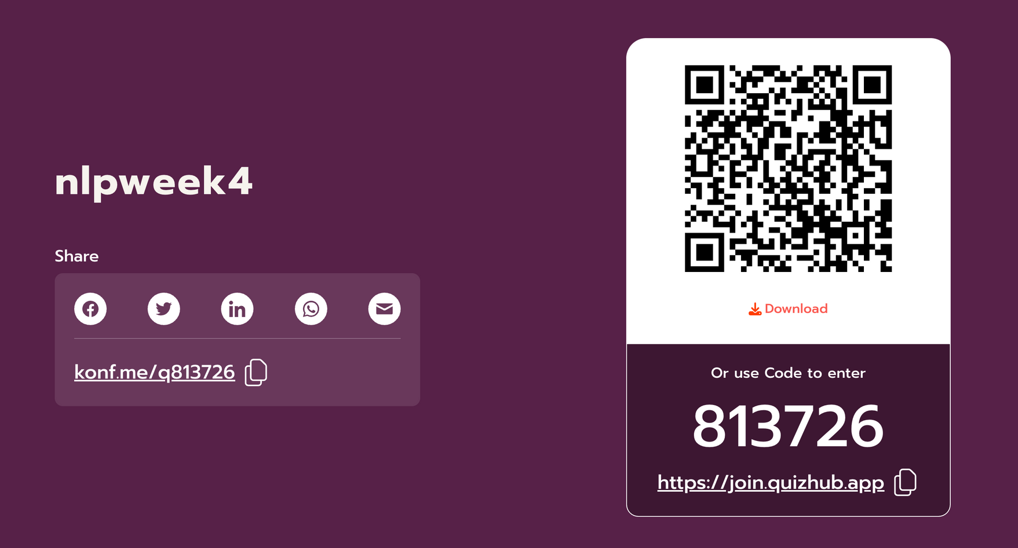
Quiz Time
Notes:
48

Slide 28
Office Hours Week 1
Discussion - Exercise - Day 2
https://www.kaggle.com/datasets/mansithummar67/171k-product-review-with-sentiment-dataset?
https://www.kaggle.com/datasets/shivrajguvi/e-commerce-dataset-for-practice
Notes:
48

Slide 29
NLP Sessions Overview - Week 2
Session 2
Office Hours 2
Parts of Speech (POS) Tagging and Demo
Grammar, Syntax, and Parsing Techniques
Parsing Demo: Dependency Parsing with Spacy
Introduction to Encoder-Decoder Models
Short Coming of Transformer Architecture
Hands-On: Building a Simple Encoder-Decoder
Recap and Discussion on Parsing and Encoder-Decoder Models
Review Exercises (Hugging Face, Kaggle)
Notes:
The course is split in three parts.
Let’s have a quick overview & see what to expect from each:
we first introduce key ML concepts,
train our first ML model on a classification task (on some toy dataset) use the model to make predictions on new data
question how good of a model we just built and discuss metrics to evaluate model performance,
While touching upon the trickiest/most common problem in ML Overffiting
we discuss a few steps to explore larger real-life datasets – how much data is there, what type of data, how to deal with missing values or outliers,
and we ‘put it all together’ building a KNN model on this dataset
best way to learn is by doing it, so aside from in-class practice, we open an ML competition
use all ML techniques of the day, to win this competition over the next three days
we next dig deeper into real-life datasets, discussing more ML techniques to handle numerical, categorical, and text features
We also introduce more advanced ML models, tree-based models like: decision trees and random forests
as ML models get more sophisticated, there are more architectural decisions to be made, and we discuss tuning ML models for best performance
To speed up building, training and deploying ML models we introduce you to a few AWS AI/ML services,
Getting you experimenting with ML on AWS beyond Jupiter notebooks
and again, use all these new techniques, to improve your scores and win our ML competition
we walk further down the path of ML models stepping into the DL territory
by looking at ML models that learn by some version of gradient descent optimization
regression models (so called linear models), and neural networks
we close the course learning about ML technique that’s gaining more traction lately AutoML and how it works on AWS
and again, encouraging you to apply all learning to improve performance in the final project competition
3

