Slide 1
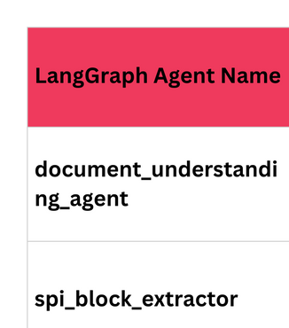
1
Invoice Received (API or Manual Upload)
Document Understanding Agent
2
SPI Block Extractor
3
SPI Lookup Agent
4
VECTOR DB
Auto Prompt Generation Agent
5
Extraction Agent
5
Response Agent
6

