Slide 1
1
Invoice Received (API or Manual Upload)
Document Understanding Agent
2
SPI Block Extractor
3
SPI Lookup Agent
4
VECTOR DB
Auto Prompt Generation Agent
5
Extraction Agent
5
Response Agent
6

Slide 2
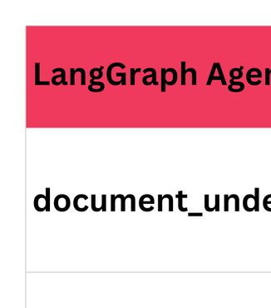

Slide 3













CORE Fax QA Agentic Workflow
LLM Call
Start
API Call /
MCP
Orchestrator
End
Data
Aggregator
Answering
Agent
Reasoning
Agent
End
Aggregator
Agent
ICMP
SAS DB
Core2

Slide 4
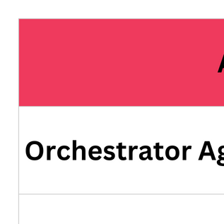
CORE Fax QA Agentic Workflow

